Slide 1
Highlights from Minnesota HIV Surveillance Report, 2021
HIV/AIDS Surveillance System
June 2022
Notes:
.

Slide 2
Land Acknowledgement
Every community owes its existence and vitality to generations from around the world who contributed their hopes, dreams, and energy to making the history that led to this moment. Some were brought here against their will, some were drawn to leave their distant homes in hope of a better life, and some have lived on this land for more generations than can be counted. Truth and acknowledgment are critical to building mutual respect and connection across all barriers of heritage and difference.
We begin this effort to acknowledge what has been buried by honoring the truth. We are standing on the ancestral lands of the Dakota people. We want to acknowledge the Dakota, the Ojibwe, the Ho Chunk, and the other nations of people who also called this place home. We pay respects to their elders past and present. Please take a moment to consider the treaties made by the Tribal nations that entitle non-Native people to live and work on traditional Native lands. Consider the many legacies of violence, displacement, migration, and settlement that bring us together here today. Please join us in uncovering such truths at any and all public events.*
*This is the acknowledgment given in the USDAC Honor Native Land Guide – edited to reflect this space by Shannon Geshick, MTAG, Executive Director Minnesota Indian Affairs Council
Notes:
Before we begin our webinar, we take a moment to acknowledge that Minnesota stands on ancestral land of tribal nations… including the Dakota, Ojibwe, Ho Chunk, and other nations. Please take a moment to consider the treaties made by the Tribal nations that entitle non-native people to live and work on traditional Native lands.

Slide 3
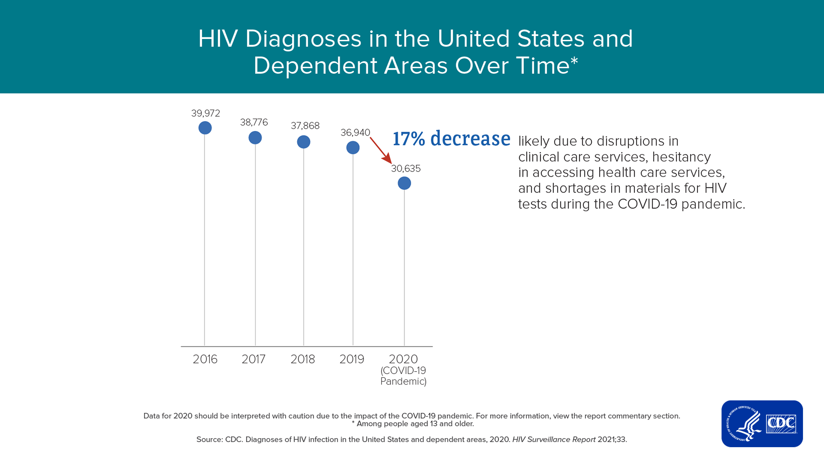
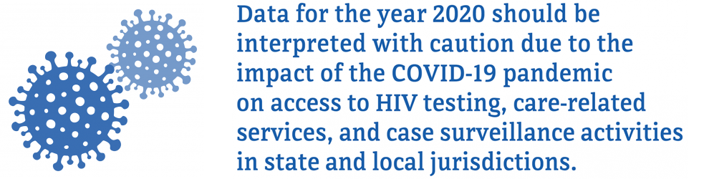
COVID-19 Pandemic Impact on HIV Diagnoses in United States, 2020
Notes:
The COVID-19 pandemic in the United States led to disruptions in HIV testing services and access to clinical services throughout 2020. This disruption resulted in a steep single-year decline in HIV diagnoses. The number of HIV diagnosis in the United States in 2020 (30,403) was 17% lower than in 2019. This decrease is predominantly attributed to declines in testing caused by less frequent visits to health centers, reduced outreach services, and shifting of public health staff to COVID-19 response activities. Strategies implemented by state and local health departments for HIV-related testing and care services, such as self-testing and telehealth, did not make up for declines in laboratory-based HIV testing. Given these disruptions, HIV was likely underdiagnosed in 2020, and data for 2020 should be interpreted with caution.
Underreporting of laboratory test results to state and local HIV surveillance programs was not a major contributor to declines in diagnoses, as all jurisdictions reported to CDC all laboratory results received.
Since the COVID-19 pandemic is still ongoing, more time and data are needed to accurately assess COVID-19’s affect on HIV in the United States. Assessments of trends in HIV diagnoses that include the year 2020 are discouraged.

Slide 4
New HIV Diagnoses in Minnesota, 2021

Slide 5
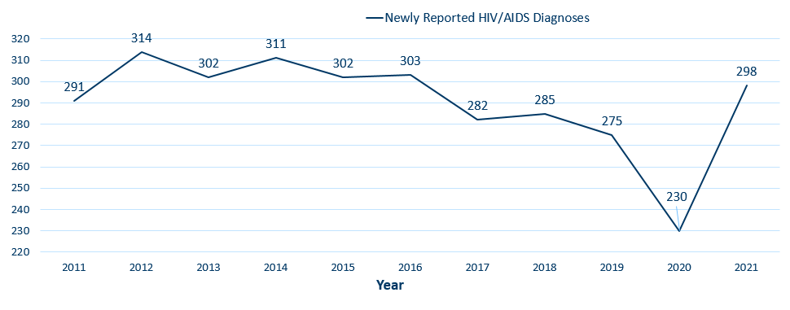
New HIV Disease Diagnoses*
HIV/AIDS Cases by Year, 2011-2021
*Includes all new cases of HIV infection (both HIV (non-AIDS) and AIDS at first diagnosis) diagnosed within a given calendar year.
Notes:
In this report, the term “new HIV diagnoses” refers to Minnesota residents living with HIV who were diagnosed in a particular calendar year and reported to MDH. This includes people whose first diagnosis of HIV infection is AIDS (AIDS at first diagnosis). HIV diagnosis data are displayed by earliest known date of HIV diagnosis.
In 2021 there were 298 newly diagnosed cases, compared to 230 cases in 2020. 2020 was an outlier year, however, with a 16% decrease in HIV diagnoses from the previous year, likely attributable to the same factors driving the national decrease in diagnoses in 2020 due to the impact of COVID-19 pandemic. 298 diagnoses in 2021, while a 30% increase over 2020, is an 8% increase from 2019, and is average compared to the number of diagnoses per year in the prior decade, excluding 2020. More time and data will be required to determine whether this is a true increase in HIV infection rates or if part of the increase is due to a rebound in diagnoses after disruptions in 2020.

Slide 6
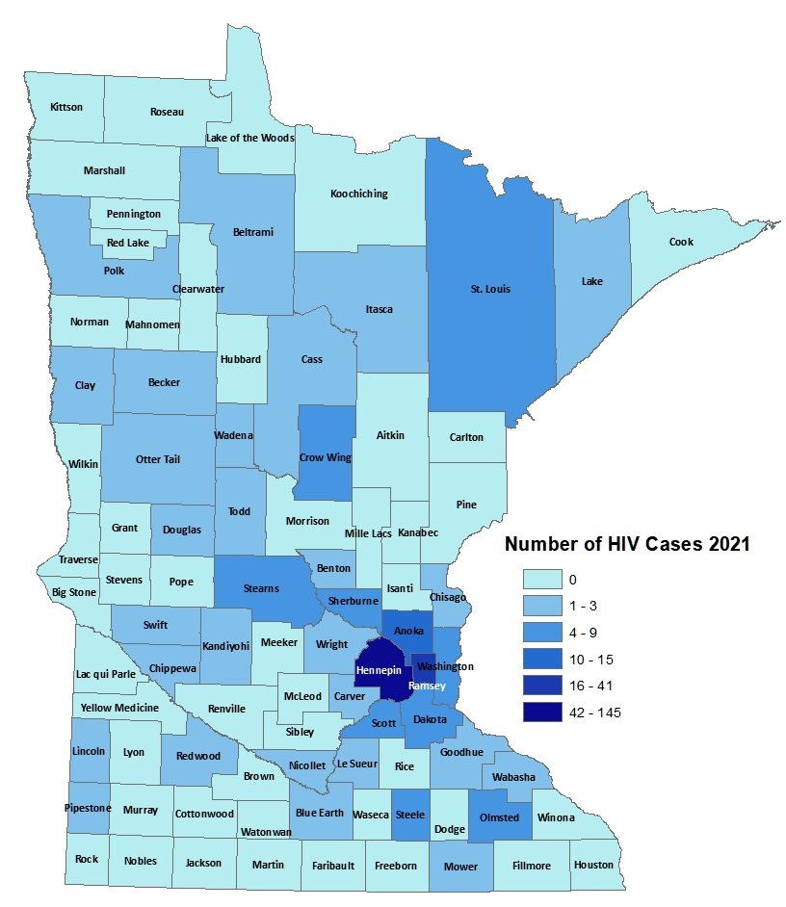
HIV Diagnoses# by County of Residence at Diagnosis, 2021
City of Minneapolis
City of St. Paul
Suburban*
Greater Minnesota
Total
93 cases (31%)
34 cases (11%)
95 cases (32%)
76 cases (26%)
298 cases
#HIV or AIDS at first diagnosis
*7-county metro area, excluding the cities of Minneapolis and St. Paul
Notes:
Historically, about 80% of new HIV infections diagnosed in Minnesota have occurred in Minneapolis, St. Paul and the surrounding seven-county metropolitan area.
In 2021, of 298 total HIV diagnoses, 74% of the cases were in the seven-county Twin Cities metro region with 31% in Minneapolis, 11% in St. Paul, and 32% in the remaining suburban area (excluding Minneapolis/St. Paul). In greater Minnesota, there were 76 newly diagnosed HIV cases across 39 counties.

Slide 7
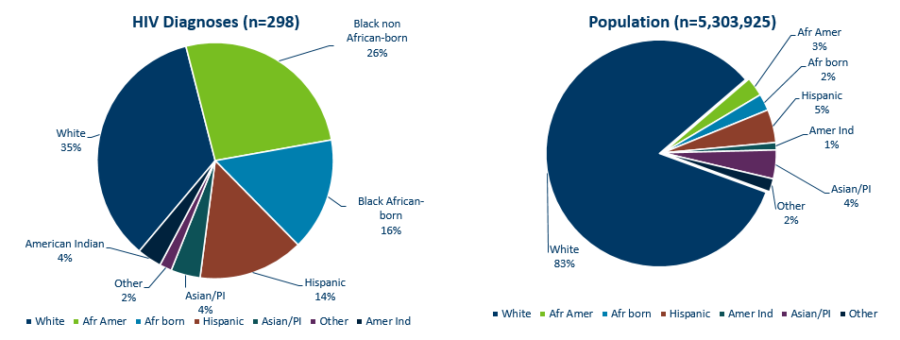
HIV Diagnoses* in Year 2021 and General Population in Minnesota by Race/Ethnicity
* HIV or AIDS at first diagnosis † Population estimates based on 2010 U.S. Census data. (n = Number of people
Notes:
Comparing the racial/ethnic distribution of new HIV diagnoses [LEFT] to the general population of Minnesota [RIGHT], it is apparent that disparities continue to exist. Non-Hispanic African-American and Black African-born Minnesotans jointly make up about 5% of the population in Minnesota, yet accounted for 42% of the newly diagnosed cases of HIV in 2021. Similarly, Hispanics of any race account for approximately 5% of the population, but account for 14% of the newly diagnosed cases.

Slide 8
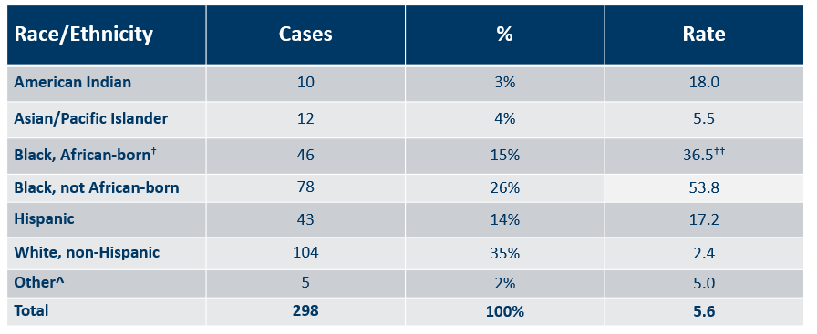
Number of Cases and Rates (per 100,000 people) of HIV Diagnoses* by Race/Ethnicity† Minnesota, 2021
* HIV or AIDS at first diagnosis; 2010 U.S. Census Data used for rate calculations.
† “Black African-born” refers to Black people who reported an African country of birth; “Black not African-born” refers to all other Black people.
†† Estimate of 125,939 Source: 2019 American Community Survey.
^ Other = Multi-racial people or people with unknown or missing race
# Unable to calculate rate, unknown denominator
Notes:
Each year we calculate the rate of diagnosis for each racial/ethnic group represented in the surveillance system to assess the impact of HIV within each community. The rate takes into account the size of the population of each group.
Non-Hispanic Black communities had the highest rate of diagnoses in 2021 with 36.5 HIV diagnoses per 100,000 population among Black African-born people and 53.8 HIV diagnoses per 100,000 population among Black, not African-born people. For African-Americans who are not African-born, this represents a rate that is 22 times the rate in the white non-Hispanic population in Minnesota. The rate among the African-born population is 15 times that of the white non-Hispanic population.
Hispanic people of any race have the next highest rate of newly diagnosed HIV cases in Minnesota at 17.2 per 100,000 people; this is a rate 7 times that of white, non-Hispanic people.
American Indians have a rate of people newly diagnosed with HIV of 18 per 100,000 people, 7.5 times the rate of white, non-Hispanic people.

Slide 9
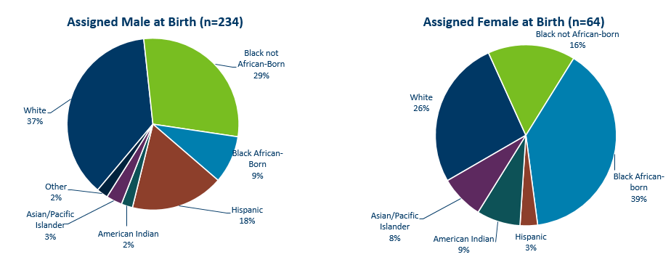
HIV Diagnoses* Diagnosed in Year 2021 by Sex Assigned at Birth and Race/Ethnicity†
*HIV or AIDS at first diagnosis (n = Number of people)
†“Black African-born” refers to Black people who reported an African country of birth; “Black not African-born” refers to all other Black people. Cases with unknown race are excluded.
Notes:
There are differences in the racial/ethnic distribution by sex assigned at birth. Left to right are data for people assigned Male and Female at birth.
On the LEFT, among 234 people assigned the sex of male at birth, 37% of the 2021 cases diagnosed in Minnesota are Non-Hispanic white [seen in dark BLUE]. Non-Hispanic Black non-African born [In light GREEN] and Black, African-born males [light BLUE] made up 38% of cases and Hispanic males of any race accounted for 18% of cases.
ON the RIGHT, among the 64 people assigned the sex of female at birth, the disparities of new HIV diagnoses are even more apparent among people of color. They represent 74% of new HIV cases assigned female at birth vs 63% of new HIV cases assigned male at birth. Greater than half of female infections, or 55% combined, are Black, African-born and non-African born.

Slide 10
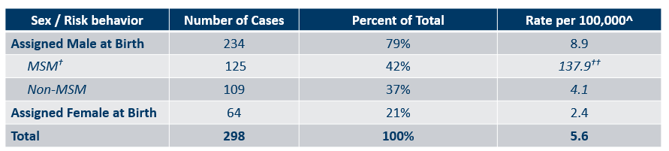
Number of Cases and Rates (per 100,000 people) of Adults and Adolescents* Diagnosed with HIV/AIDS by Sex Assigned at Birth and Risk† in Minnesota, 2021
*HIV or AIDS at first diagnosis ages 13 and older.
^2010 United States Census Data used for rate calculations, except where otherwise specified.
†MSM refers to both MSM and MSM/IDU risk identified at time of reported HIV diagnosis. It includes all PLWH assigned the sex of male at birth who report a male sexual partner. Therefore, some Trans Women are included in both the total number of cases and the population estimate.
††Estimate of 90,663 Source: http://www.emorycamp.org/item.php?i=92
Notes:
Here we look at cases and rates of the 298 new HIV infections by sex assigned at birth and reported sexual behavior.
By sex assigned at birth….
The number of cases among people assigned male at birth have remained stable, accounting for 234 of 298 new HIV cases. The 64 cases among people assigned female at birth, while an increase from the 37 diagnosed in 2020, still represents a decrease from the 76 diagnoses in 2019. The reason for this decrease is currently unknown.
As a result, people assigned male at birth represent 79% of all new HIV diagnoses- which is an increase from previous years.
Looking further at data by risk behavior….
Men who have Sex with Men, or MSM, have the highest rate of HIV diagnosis. In 2021, the estimated rate of HIV diagnosis among MSM was 137.9 per 100,000 population. This is nearly 38 times higher than the rate among non-MSM men.
It’s important to note that MSM contains cases from all racial/ethnic categories and therefore, cannot be directly compared to the rates on the previous slide. For more information on how this rate was estimated, see the HIV Surveillance Technical Notes which are available on our website.

Slide 11
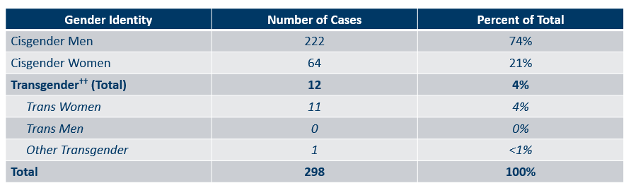
Number of Cases of Adults and Adolescents* Diagnosed with HIV/AIDS by Gender Identity in Minnesota, 2021
*HIV or AIDS at first diagnosis ages 13 and older.
††Current gender was not reportable until 2009, so may be incomplete for HIV infections reported before that time. Because current gender is incomplete for a large number of cases, there may be misclassification of transgender Minnesotans in either of the cisgender groups.
Notes:
This slide shows the number of people living with HIV/AIDS by gender identity. In 2021, there were 12 transgender HIV cases diagnosed in Minnesota (11 Trans women, and 1 other Transgender identity). This represents 4% of new cases reported in the state.

Slide 12
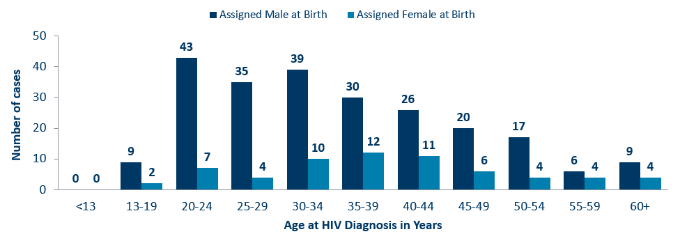
Age at HIV Diagnosis* by Sex Assigned at Birth, Minnesota, 2021
*HIV or AIDS at first diagnosis
Notes:
In 2021, there were 100 cases diagnosed under the age of 30, accounting for 34% of all cases. 87 (85%) of these were in people assigned to the male sex at birth. Age groups 20-24 and 30-34 had the largest number of new cases in 2021.

Slide 13
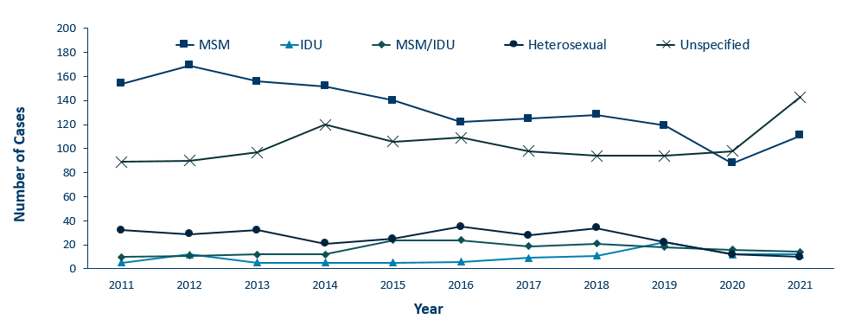
HIV Diagnoses* by Mode of Exposure and Year, 2011 – 2021
*HIV or AIDS at first diagnosis
MSM = Men who have sex with men IDU = Injection drug use Heterosexual = Heterosexual contact Unspecified = No mode of exposure ascertained
Notes:
This slide depicts risk for all people diagnosed with HIV in Minnesota during the past decade. In 2021, mode of exposure was unknown or undisclosed in a plurality (48%) of cases. Of cases where mode of transmission was reported, men having sex with men was the most common, accounting for 42% of all diagnoses but over 80% of diagnoses with known modes of transmission.
The number of cases among people who inject drugs (IDU only) was 20 cases in 2021, down from 2019 (n=22) yet an increase from 2018 (n=11) and 2020 (n=12). However, Minnesota has declared an ongoing outbreak among people who inject drugs in St. Louis County, with cases dating back to 2019. Hennepin-Ramsey counties are also experiencing an ongoing outbreak among people who inject drugs, with some cases dating back to 2018. More details on these outbreaks later in this slide presentation.

Slide 14
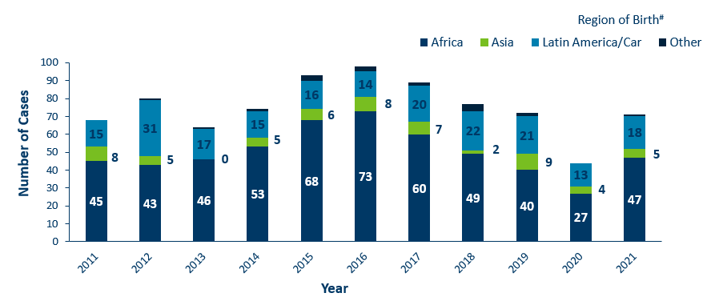
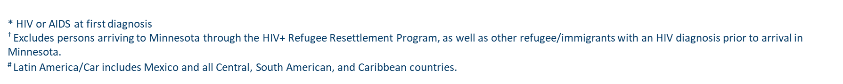
HIV Diagnoses* among Foreign-Born People† in Minnesota by Year and Region of Birth
2011 - 2021
Notes:
This slide describes HIV diagnoses by global region of birth among foreign-born people. In general, the number of new HIV infections diagnosed among foreign-born people in Minnesota has steadily increased from 20 cases in 1990 to an average of 83 cases over the last decade. This increase has been largely driven by the increase of cases among African-born people, as well as people from Mexico, Central and South America and the Caribbean.
In 2021, there were 71 cases of newly reported HIV among foreign-born people. This is about one out of four of all new cases (24%) The majority of foreign-born cases in 2021 were from Africa, followed by Latin America and the Caribbean.

Slide 15
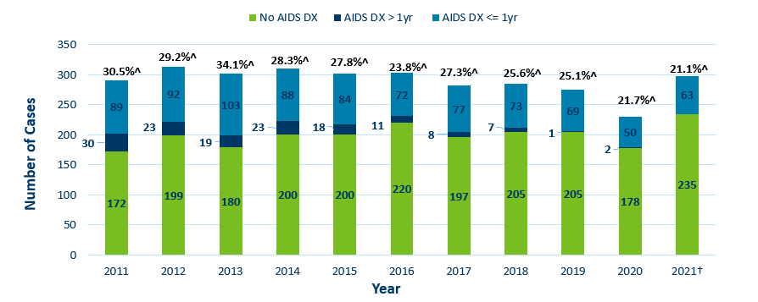
Time of Progression to AIDS for HIV Diagnoses in Minnesota*
2011 - 2021†
*Numbers include AIDS at 1st report but exclude people arriving to Minnesota through the HIV+ Refugee Resettlement Program, as well as other refugee/immigrants with an HIV diagnosis prior to arrival in Minnesota.
^ Percent of cases progressing to AIDS within one year of initial diagnosis with HIV
† Numbers/Percent for cases diagnosed in 2021 only represents cases progressing to AIDS through April 2022
Notes:
Late testers are defined as anyone with an AIDS diagnosis within one year of their initial HIV diagnosis. They represent missed opportunities for early intervention.
In 2020, 21.7% of new cases were late testers. This proportion of cases has remained relatively similar over the past 10 years, ranging between 22-34%. Most late testers, about 85%, are diagnosed with AIDS at the same time they are initially diagnosed with HIV infection. As with other characteristics of the HIV epidemic in Minnesota, the proportion of late testers varies by demographic characteristics.
For 2021, 21.1% (63) of new HIV cases were “late testers” to date, which represents only a partial follow-up year through April 2022. Please note that cases diagnosed in 2021 may not encompass all cases diagnosed – since a full year of observation is required to capture progress to AIDS within a year (which would end later this year in December 2022).

Slide 16
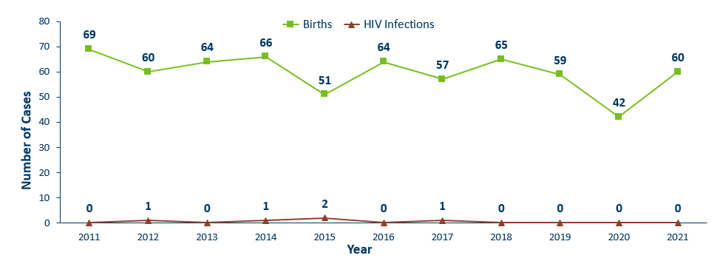
Births to Pregnant People Living with HIV and Number of Perinatal Acquired HIV Infections* by Year of Birth, 2011- 2021
* HIV or AIDS at first diagnosis for a child exposed to HIV during pregnant person’s pregnancy, at birth, and/or during breastfeeding.
Notes:
The ability to interrupt the transmission of HIV from mother to child via antiretroviral therapy and appropriate perinatal care is an important accomplishment in the history of the HIV/AIDS epidemic. Without antiretroviral therapy, newborn HIV infection rates range from 25-30%, but decrease to 1-2% with appropriate medical intervention. The rate of transmission has decreased from 15% between 1994 and 1996 to 0.0% in the past three years (2019-2021). The last transmission was in 2017.
For the past decade, the number of births to pregnant parents living with HIV has ranged between 42-69 births (2011-2021).
For 2021, there was an increase to 60 births to pregnant parents living with HIV with no perinatal HIV cases baby born to a HIV-positive pregnant person in Minnesota in 2021.

Slide 17
People Living with HIV/AIDS in Minnesota

Slide 18
Estimated Number of People Living with HIV/AIDS in Minnesota
As of December 31, 2021 9,697* people are assumed alive and living in Minnesota with HIV/AIDS. This includes:
  5,476 (56%) living with HIV infection (non-AIDS)
  4,221 (44%) living with AIDS
This number includes 2,644 people who were first reported with HIV or AIDS elsewhere and subsequently moved to Minnesota
This number excludes 1,662 people who were first reported with HIV or AIDS in Minnesota and subsequently moved out of state
*This number includes persons with Minnesota reported as their current state of residence, regardless of residence at time of diagnosis. It also includes state prisoners and refugees arriving through the HIV+ Refugee Resettlement Program, as well as HIV+ refugees/immigrants arriving through other programs.
Notes:
As of December 31, 2021, there were estimated to be 9,697 people alive and living with HIV/AIDS in Minnesota. This number included 5,476 (56%) living with an HIV infection that had not progressed to an AIDS diagnosis and 4,221 (44%) living with AIDS. This number also included 2,644 people who were first reported with HIV or AIDS elsewhere and now live in Minnesota and excluded 1,662 persons first reported with HIV or AIDS in Minnesota who now live out of state.

Slide 19
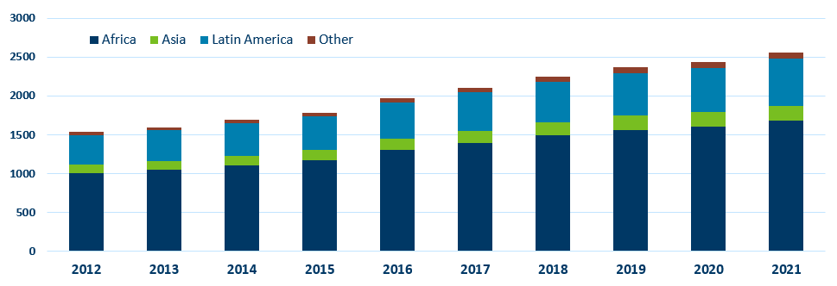
Foreign Born People Living with HIV/AIDS in Minnesota* by Region of Birth, 2012-2021
*This number includes persons who reported Minnesota as their current state of residence, regardless of residence at time of diagnosis. It also includes state prisoners and refugees arriving through the HIV+ Refugee Resettlement Program, as well as HIV+ refugees/immigrants arriving through other programs.
Notes:
One particular population of interest in Minnesota that sets us apart from other states is our larger foreign-born HIV-positive population. Between 1990 and 2021, the number of foreign-born people living with HIV/AIDS in Minnesota increased substantially, especially among the African-born population. In 1990, 50 foreign-born people were reported to be living with HIV/AIDS in Minnesota, and by 2007 this number had increased to 1,126 people. In 2021, the total number of foreign-born people living with HIV/AIDS in Minnesota was 2,553, a 5% increase from 2020. The majority of these people immigrated to the United States from Africa and Latin America. This trend illustrates the growing diversity of the HIV-positive population in Minnesota and the need for culturally appropriate HIV care and prevention efforts.

Slide 20
Additional Topics

Slide 21
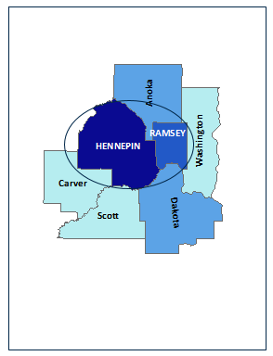
HIV Outbreak in Hennepin/Ramsey Counties
Hennepin/Ramsey Counties HIV Outbreak
In February 2020, MDH Health Alert Network declared an outbreak among people who inject drugs (PWID)
Current Case Count: 101 cases
Inclusion Criteria:
51 encampment-related
40 MSM/IDU
10 IDU
People at high-risk in the current outbreak:
People who use injection drugs (PWID) or share needles/works
People experiencing homelessness or unstable housing
People who exchange sex for income or other items they need
Notes:
Minnesota has seen an increase of HIV among certain populations in Hennepin and Ramsey Counties. An outbreak was declared in Hennepin and Ramsey counties among people who inject drugs (PWID) in 2020 with cases dating back to December 2018.
Minnesota's outbreak-associated cases have risk factors consistent with the national outbreaks.
People at high risk in the current outbreaks include:
People who use injection drugs or share needles/works.
People experiencing homelessness or unstable housing.
People who exchange sex for income and other items they need.
For more information, please see our updated HIV statistics website, described at the end of the presentation.

Slide 22
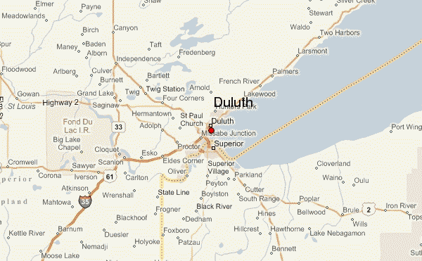
HIV Outbreak in Duluth Region
People at high-risk in the current outbreak:
  People who use injection drugs (PWID) or share needles/works
  People experiencing homelessness or unstable housing
  People who exchange sex for income or other items they need
  Men who have sex with men
Duluth Region HIV Outbreak
In March 2021, MDH Health Alert Network declared an outbreak in the Duluth Region (30-mile area) among newly diagnosed HIV cases
Current Case Count: 23 cases
Notes:
Minnesota has seen an increase of HIV in the Duluth area (30-mile radius) . Duluth area declared an outbreak in 2021 with cases dating back to 2019. The Duluth area outbreak includes all newly diagnosed HIV cases and linked cases within the region. Typically, there are 1-5 cases of HIV per year in St. Louis County, beginning in the fall of 2019 there was a significant increase of newly diagnosed HIV cases in the area.
People at high risk in the current outbreaks include:
People who use injection drugs or share needles/works.
People experiencing homelessness or unstable housing.
People who exchange sex for income and other items they need.
Men who have sex with men.
For more information, please see our updated HIV statistics website, described at the end of the presentation.

Slide 23
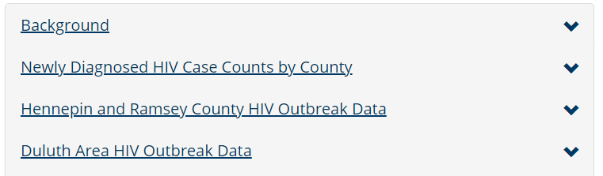
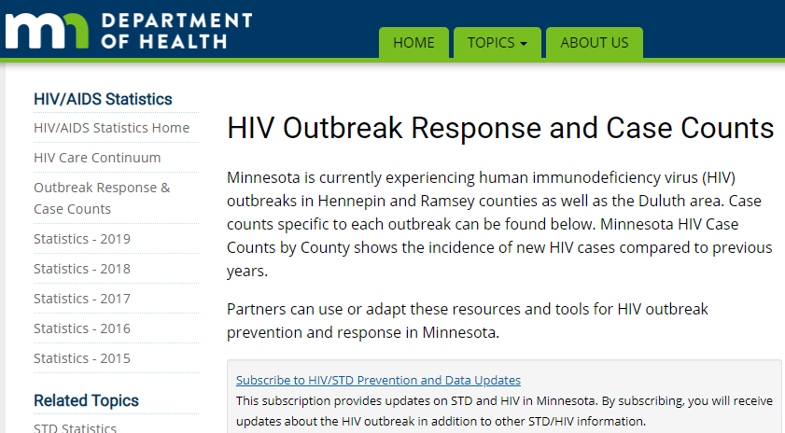
Updated webpage: Outbreak Data e-Resources
HIV Outbreak Response and Case Counts
https://www.health.state.mn.us/diseases /hiv/stats/hiv.html
Subscribe to receive our HIV/STD prevention and data e-mail updates.
Notes:
In addition to newly diagnosed HIV case counts by county, we update our statistics web page to include information on outbreak data.
Please visit the Minnesota Department of Health HIV pages at www.health.state.mn for additional details.
While you’re here, you can subscribe to our listserv to receive HIV/STD prevention updates to your email.

Slide 24
Thank you.
HIV Surveillance Team
Health.HIV.Surveillance@state.mn.us
651-201-4040

