Slide 1

Vectorborne Disease
2018
HEALTH AND CLIMATE CHANGE TRAINING MODULE SERIES
Minnesota Climate & Health Program | Environmental Impacts Analysis Unit
Notes:
Welcome to today’s webinar on the Vectorborne Disease module produced by the Minnesota Department of Health.
I am Micaela Resh, a Health Educator and Communications Specialist with the Climate and Health Program at the Minnesota Department of Health.

Slide 2
MN CLIMATE & HEALTH PROGRAM
1
2
Research & improve data for research
3
Design & evaluate adaptation interventions
4
5
Develop tools & products
Provide technical assistance
Educating & increase awareness
Notes:
The Minnesota Climate and Health Program is part of a nation-wide effort to anticipate, prepare for, and respond to the health impacts of climate change. The program follows five overarching goals that guide its work:
Educate and increase awareness of the health impacts of climate change.
Research and improve data for research to ensure that our work is based on the best science available.
Design and evaluate adaption interventions.
Develop tools and products for public health practitioners and others to use to prepare for climate change.
Provide technical assistance to communities for mapping vulnerable populations and planning for climate changes.

Slide 3
CLIMATE & HEALTH WEBINAR SERIES
Climate & Health 101: July 26, 2017
Extreme Heat Events: August 16, 2017
Agriculture & Food Security: September 20, 2017
Air Quality: November 22, 2017
Wellbeing: December 13, 2017
Water Quality & Quantity: January 24, 2018
Vectorborne Disease: March 14, 2018
Notes:
This training module is one of seven training modules that address the health effects of climate changes in Minnesota. The other six training modules cover the topics of:
Climate and Health 101
Extreme Heat Events
Agriculture & Food Security
Air Quality
Wellbeing
Water Quality and Quantity
These modules have been designed for public health professionals, as well as others concerned about climate change, to provide a basic level of information about the observed climate changes in Minnesota and their health impacts. Each module is a set of slides scripted with slide notes, so you can present them to your own audiences. These training modules are funded, in part, by a grant from the Centers for Disease Control and Prevention.
Following each webinar, we will post the training module on the Minnesota Department of Health website, so anyone can access it for future use.
Today’s webinar will be interactive. We will be asking four polling questions throughout the session that you can respond to, using the polling bar that will appear on the right side of your screen. If you have any questions throughout the session, please submit them using the chat function, located in the drop down on the top of your screen. We will be saving 15 minutes to answer questions at the end.

Slide 4
OUTLINE
Overview of vectorborne disease
Climate changes in Minnesota
Ecology and epidemiology of vectorborne disease in Minnesota
Changes in vectorborne disease risk
Meaningful action steps
Notes:
Here is the outline for today’s webinar.
We will be covering:
An overview of vectorborne disease
Climate changes in Minnesota
Ecology and epidemiology of vectorborne disease in Minnesota
Changes in vectorborne disease risk
Meaningful action steps to protect yourself from vectorborne disease

Slide 5

PRESENTER BIO
Molly Peterson
Vectorborne Disease Epidemiologist
Division of Infectious Disease Epidemiology, Prevention, and Control
Minnesota Department of Health
Notes:
I would now like to introduce our presenter for today’s webinar, Molly Peterson. Molly is a vectorborne disease epidemiologist at the Minnesota Department of Health. She earned her Master of Public Health degree from Cleveland State University and also has a background in veterinary services and community-based participatory research. As an epidemiologist, her current work involves human disease surveillance as well as field and research studies on topics such as vector distribution, infection prevalence, and vectorborne disease impacts.”
Welcome, Molly.

Slide 6

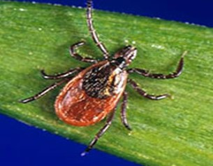
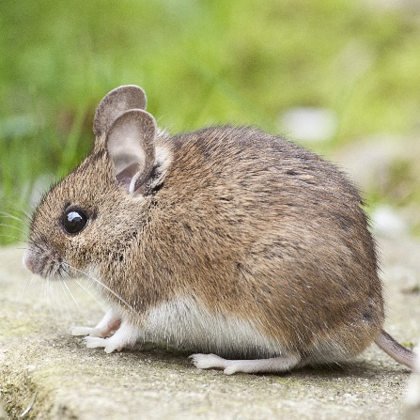
VECTORBORNE DISEASE TERMS
Disease agent: disease causing bacteria, viruses, parasites
Vector: arthropods that transmit disease agents
Host: animal or human fed on by a vector
Reservoir: source from which a vector acquires disease agent while feeding
Notes:
Thank you, Micaela for the introduction, and thank you to those joining us on today’s webinar. I’m happy to be here to discuss vectorborne diseases of Minnesota and the potential impacts of climate change on future disease risk. I’d like to start off by covering a few vectorborne disease terms that will come up in today’s module
First is disease agent, which refers to disease causing bacteria, viruses, parasites.
Second, is a vector, which are arthropods that transmit disease agents (in Minnesota, primarily ticks and mosquitoes)
Host: animal or human fed on by a vector
Reservoir: source from which a vector acquires disease agent while feeding (maintain the disease agent in nature)

Slide 7
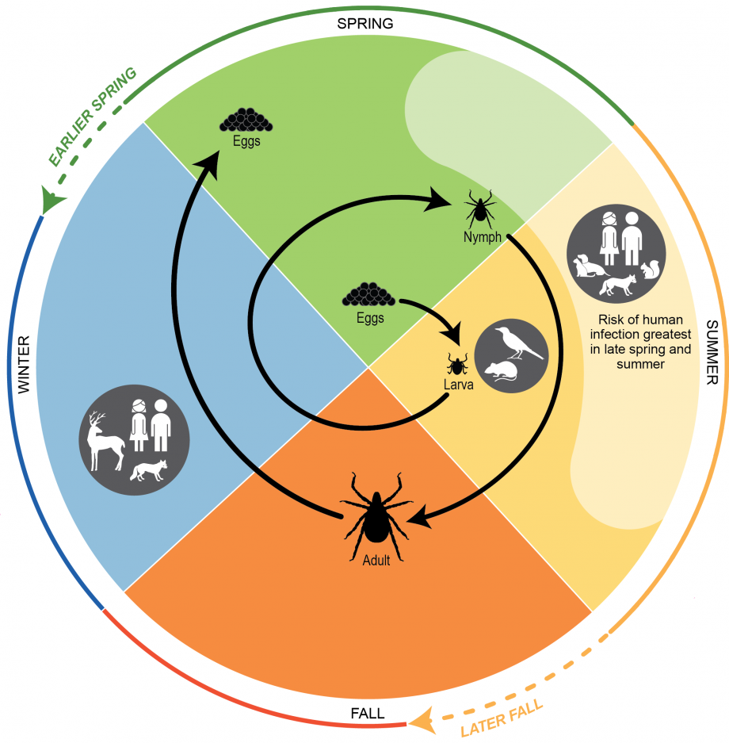
WHAT IS VECTORBORNE DISEASE?
Naturally cycle between arthropod vectors and animal reservoir hosts
  Mainly mammals and birds
This cycle maintains the disease agents
Humans acquire vectorborne diseases incidentally
Notes:
What are vectorborne diseases?
Vectorborne diseases are caused by disease agents transmitted by arthropod vectors. These diseases naturally cycle back and forth between the arthropod vectors and animal reservoir hosts, typically mammals and birds. This cycle maintains the disease agents, such as bacteria, viruses, or protozoa, in the environment. Humans can acquire vectorborne diseases when they are incidentally bitten by arthropod vectors. For example, the graphic on the right shows the life cycle of a tick, which will be explained further on in this webinar. Ticks feed on multiple hosts with a blood meal at each stage of their life cycle. They typically feed on birds and small mammals but may feed on humans that they come into contact with. In this case, disease agents are maintained through natural reservoir hosts and the ticks that feed on them.

Slide 8
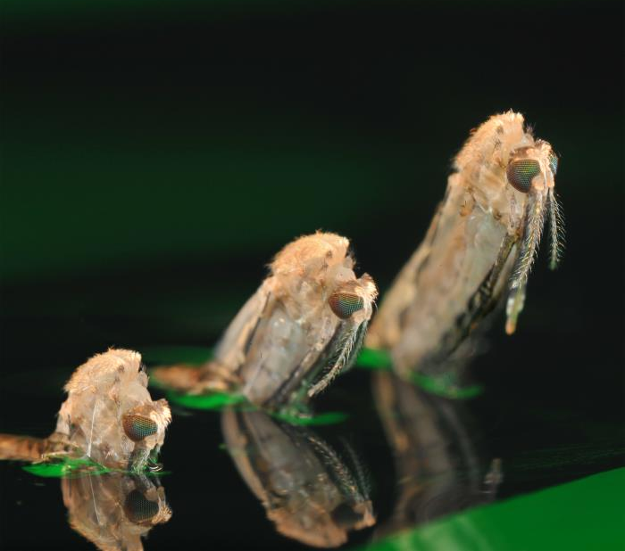
WHAT IS VECTORBORNE DISEASE?
Vectorborne diseases are:
Complex and dynamic
Difficult to predict
Constantly evolving
Notes:
Vectorborne diseases are dynamic as they combine elements of human health, animal health and biology, and our shared environment. The complex nature of these diseases makes prevention and control complex as well. It also makes predicting risk a challenge, as even in small areas, vectorborne disease risk may not be evenly distributed.
Both vectors and their hosts are constantly evolving, so knowledge of vector biology is critical to understanding and preventing these diseases.

Slide 9
FACTORS IMPACTING VECTORBORNE DISEASE RISK
Environment
Host
Vector
Pathogen
Human Host
Demographic
Socioeconomic
Cultural
Behavioral factors
Reservoir Host
Behavior
Species
Ability to maintain and spread pathogens
Disease Agent
Virulence
Type of disease
Risk
Arthopod Vector
Species
Life stage
Host preferences
Behavior
Notes:
Vectorborne disease risk is dependent on a large number of factors that may relate directly or indirectly to the disease agent, arthropod vector, reservoir host, and human host. Climate change and the environment may affect any or all of these factors as vectors and their hosts are sensitive and responsive to environmental conditions. The impact that climate and the environment has on vectors and their hosts, in turn, has an impact on disease transmission and risk by affecting the abundance of vectors and reservoir hosts, the number of vectors infected with a disease agent, the abundance of suitable habitat, and human behaviors that can lead to exposure to infected vectors.

Slide 10
OUTLINE
Overview of vectorborne disease
Climate changes in Minnesota
Ecology and epidemiology of vectorborne disease in Minnesota
Changes in vectorborne disease risk
Meaningful action steps
Notes:
This next section will provide a basic overview of the climate changes occurring in Minnesota.

Slide 11
WEATHER VERSUS CLIMATE
Weather:
conditions of the atmosphere over a short period of time
Climate:
conditions of the atmosphere over long periods of time
Notes:
Before we get started with the observed climate changes in Minnesota, let’s cover a few definitions. Although related, the terms weather and climate are definitely different. Weather generally refers to conditions of the atmosphere over a short period of time, like days or weeks, while climate refers to conditions of the atmosphere over long periods of time, like 20-30 years.
So when we talk about climate change, we’re referring to any significant change in the measures of climate lasting for an extended period of several decades.
Weather has always fascinated Minnesotans, perhaps because we have all kinds of it, but recently climate change has also become a leading topic of concern.

Slide 12

DEFINITIONS
Climate adaptation:
efforts to anticipate and prepare for the effects of climate change, and thereby to reduce the associated health burden
Climate mitigation:
efforts to slow, stabilize, or reverse climate change by reducing greenhouse gas emissions
Notes:
And, here are definitions for climate adaptation and climate mitigation. Actions to prevent the negative health effects of climate change can be described as one or the other.
For climate adaptation, this means to anticipate and prepare for the effects of climate change in order to reduce the associated health burdens.
Climate mitigation refers to efforts that slow, stabilize, or reverse climate change by reducing greenhouse gas emissions.

Slide 13
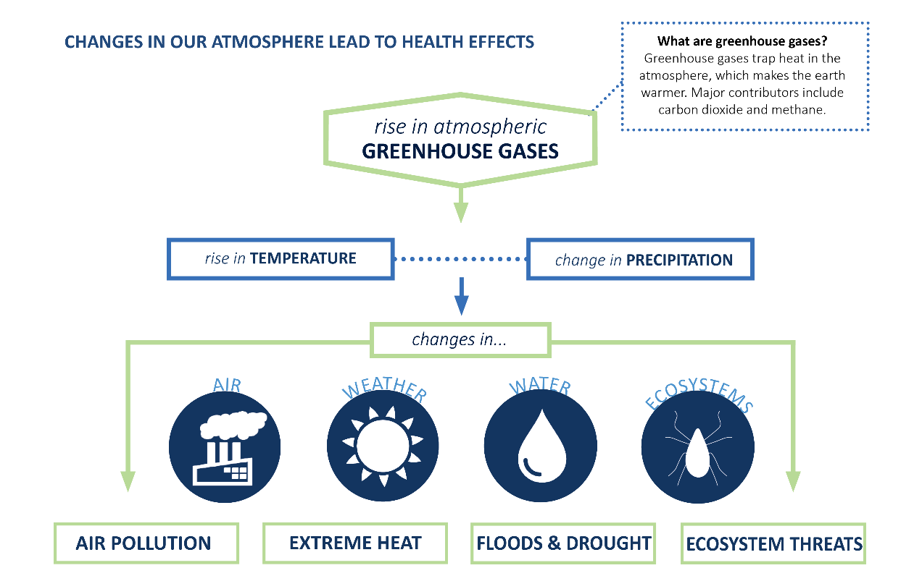
CLIMATE AND HEALTH ARE LINKED
Notes:
The Minnesota Department of Health is dedicated to understanding the links between climate changes and negative health impacts, and identifying strategies for addressing these health impacts in Minnesota communities.
Most climate scientists attribute our changing climate to the burning of fossil fuels, like coal and oil, to produce energy for everyday use. This burning adds heat-trapping gases into the air, like carbon dioxide, methane, and nitrous oxide. These heat-trapping gases are commonly known as greenhouse gases.
As this graphic shows, the rise in greenhouse gases is leading to increases in temperature and changes in precipitation. These changes are disrupting our air quality, weather patterns, water quality and quantity, and ecosystems, which in turn, are leading to more air pollution, extreme heat, floods & drought, and ecosystem threats.
Many of these changes have impacts on the health of people, and these impacts will likely increase.

Slide 14
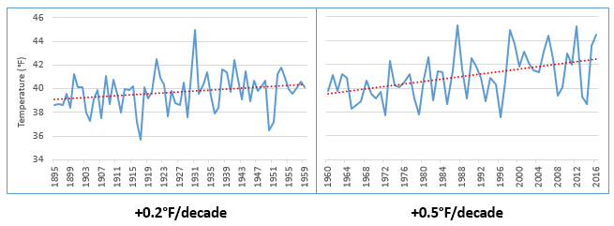
RISING TEMPERATURES
Minnesota Average Annual Temperature, 1895 -2016
Source: NOAA, 2017
Notes:
One of the main effects of Minnesota’s changing climate is that temperatures are rising. Minnesota has gotten noticeably warmer, especially over the last few decades. This slide shows a shift in the rate of change of Minnesota’s annual average temperatures. The time frame is from 1895 to 2016, which is approximately the last 120 years.
The left side of the graph shows Minnesota temperatures for roughly the first 60 years, from 1895 to 1959, where temperatures increased by about two-tenths of a degree Fahrenheit per decade. The graph on the right side of the slide shows roughly the next 60 years, from 1960 to 2016, where Minnesota’s average temperature has accelerated to a rate of over a half of a degree Fahrenheit per decade. This would amount to an increase of 5 degrees Fahrenheit that we would experience by the end of this century – a significant accelerated rate.

Slide 15

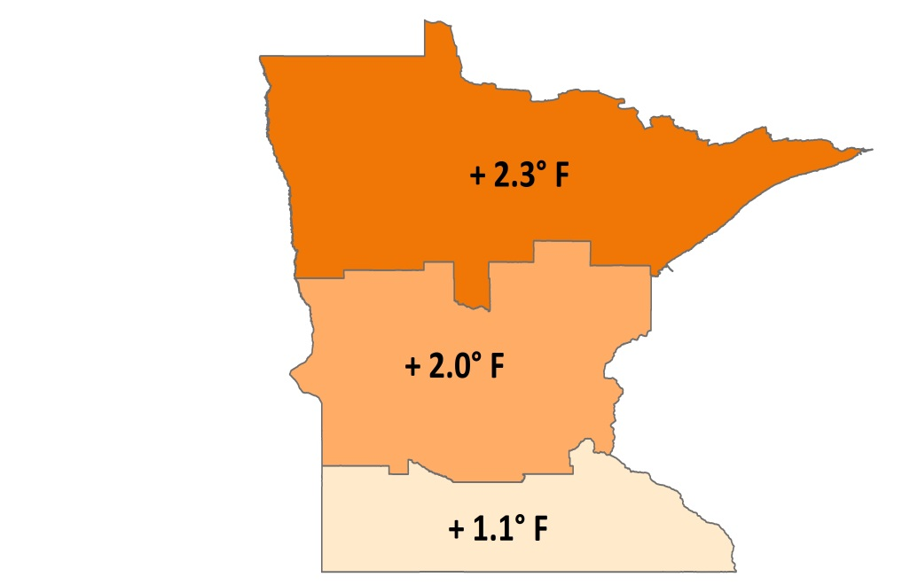
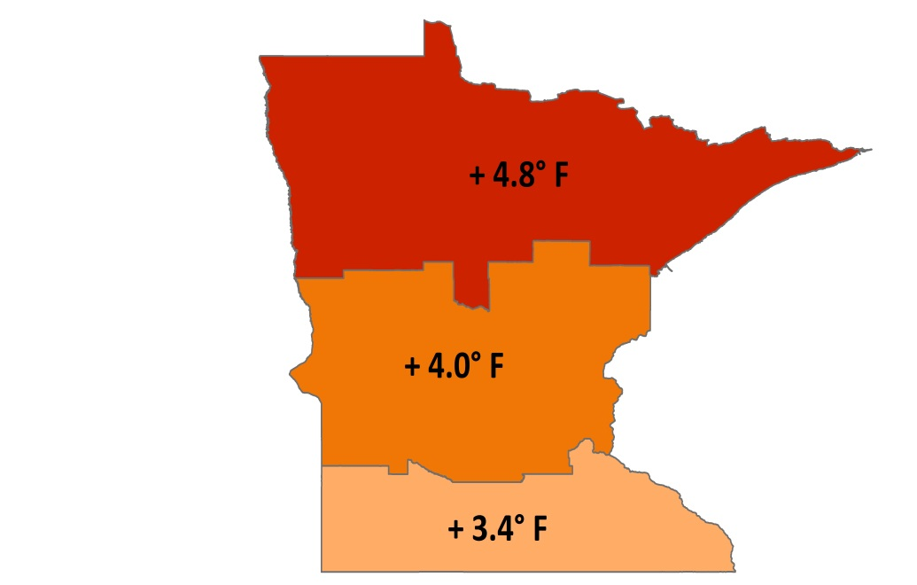
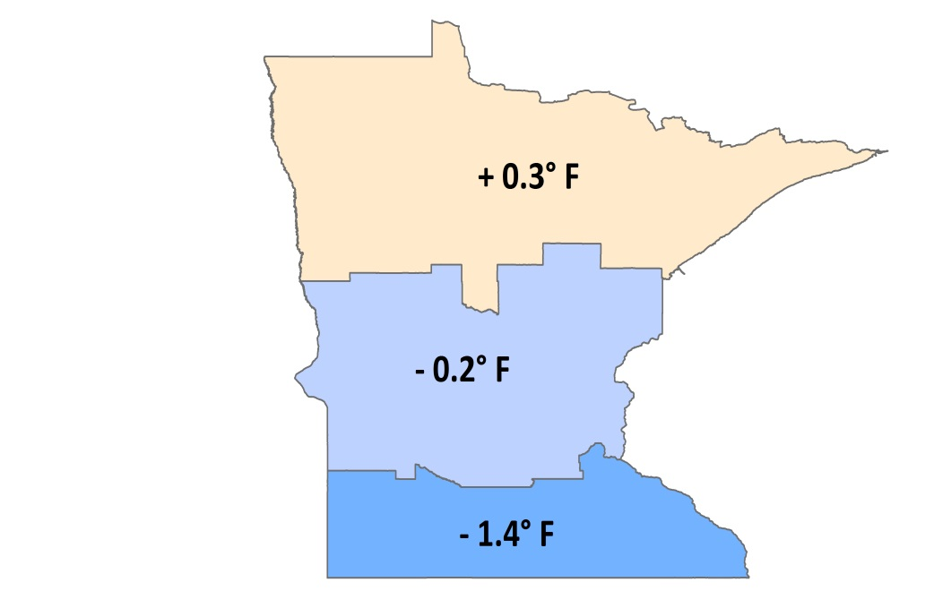
CHANGING TEMPERATURES BY GEOGRAPHY AND SEASON
Total Temperature Change, 1895-2015
Annual Average Winter Lows Summer Highs
Notes:
These maps show temperature changes since the beginning of the record for different parts of the state, and for annual average, winter low, and summer high temperatures.
As seen on the previous slide, annual average temperatures are increasing; however, winter low temperatures are rising much faster than the annual average temperatures. In fact, much of the observed warming we are experiencing in Minnesota can be explained by the warming of our winter low temperatures. In general, we are now having warmer winters, less snow and more winter rain.
Summer high temperatures have risen slightly in the north, but have fallen in the middle and southern part of the state.
And finally, the northern part of the state is warming faster than the southern part of the state. This is consistent with patterns seen across the Northern Hemisphere, where climate changes are occurring more rapidly at higher latitudes.

Slide 16
ENVIRONMENTAL CHANGES
Changing Plant Hardiness Zones
After USDA Plant Hardiness Zone Map, USDA Miscellaneous Publication No. 1475, Issued January 1990.
Arbor Day Foundation Plant Hardness Zone Map published in 2015.
Notes:
Rising temperatures are already causing substantial shifts in the environment. Maps of the plant hardiness zones from the US Department of Agriculture show what types of plants will survive well and where. Zones are based on the average annual minimum winter temperature over a 30-year period and each zone represents a 10-degree Fahrenheit increment of minimum temperatures.
The maps on this slide compare two points in recent times. The map on the left is from 1990 and the map on the right is from 2015. Look closely at the changes in Minnesota over this 25-year period. In 1990, Minnesota was predominantly zone 3 in the northern half of the state and zone 4 in the southern half of the state. By 2015, these zones shifted north substantially, and in fact, zones historically associated with areas like southern Iowa have now arrived in southern Minnesota. Minnesota is now predominantly zone 4 across the majority of the state, AND zone 5 has now emerged in the far southern part of the state.

Slide 17
PRECIPITATION INCREASES
Minnesota Average Annual Precipitation, 1895-2016
-0.2”/decade
+0.5”/decade
Notes:
The other change that we are observing in Minnesota is a change in our precipitation patterns. With warmer temperatures, more evaporation occurs, and warmer air can hold more water vapor than cooler air.
This slide shows Minnesota's average annual precipitation. The time frame is the same as the temperature slides showing the past 120 years, from 1895 to 2016. The graph on the left highlights the trend from 1895-1959, and the graph on the right highlights the trend from 1960-2016. For the first 60 years, the trend in precipitation was actually slightly downward, at a loss of two-tenths of an inch per decade. This downward trend was influenced by the Dust Bowl years of the 1930s. The rate of precipitation in the recent 60 years, however, has increased by nearly one half of an inch per decade.

Slide 18




PRECIPITATION – MORE EXTREME EVENTS
1860s
1870s
1880s
1900s
1910s
1920s
1930s
1940s
1950s
1960s
1970s
1980s
1990s
2000s
2010s
2020s
1890s
1
1
1
2
3
3
4
7 OF THE 15
MINNESOTA MEGA-RAIN EVENTS HAVE
OCCURRED SINCE 2002
Notes:
Along with the increase in annual average precipitation, the character of precipitation is changing in Minnesota.
The overall increase in our average annual precipitation is being driven by heavy rain events. The graphic on this slide points out that there have been 15 historic mega-rain events in Minnesota since 1858, which is when weather record-keeping began, about 160 years ago. A mega-rain event represents a huge amount of rain over a very large geographic area. This is categorized by six inches of rainfall covering more than 1,000 square miles with the core of the rainfall being at least 8 inches. To help visualize the size of this large geographic area, 1,000 square miles is the combined size of all of Hennepin, Ramsey, and Washington Counties, in east central Minnesota.
Over this 160-year period, seven of these 15 mega-rain events have occurred since 2002 – just in the last 15 years. And, for the first time, we had two mega-rain events in the same year – one in July 2016 and one in August 2016.

Slide 19
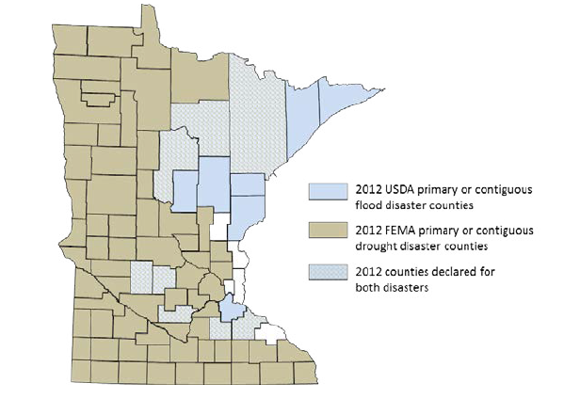
PRECIPITATION CHANGES
Blue counties were declared disaster areas due to flooding.
Brown counties were declared disaster areas due to drought.
Light blue, cross-hatched counties received both designations.
Notes:
Even though there is more moisture in the atmosphere, that doesn’t necessarily mean a consistent rise in rain and snow. The changing character of precipitation in Minnesota brings the potential for both extreme wet and extreme dry spells. Increases in heavy rain events have the potential to cause both increased flooding and drought. Based on the localized nature of heavy rain events and their intensity, this can leave some areas of the state drenched and other areas without any precipitation.
An example was the Year 2012. In that year, 75 of Minnesota’s 87 counties were declared disaster areas for drought, shown as the brown-shaded counties on this map. In that same year, 15 counties were declared disaster areas for flooding. These are the blue-shaded counties on this map. For those 15 counties that were declared disasters for flooding, eight were also declared disasters for drought within the same year. These are the light-blue, cross-hatched counties on the map. This underscores the intensification of precipitation extremes in both directions.

Slide 20
OUTLINE
Overview of vectorborne disease
Climate changes in Minnesota
Ecology and epidemiology of vectorborne disease in Minnesota
Changes in vectorborne disease risk
Meaningful action steps
Notes:
In this next section, Molly will cover the ecology and epidemiology of vectorborne disease in Minnesota.

Slide 21
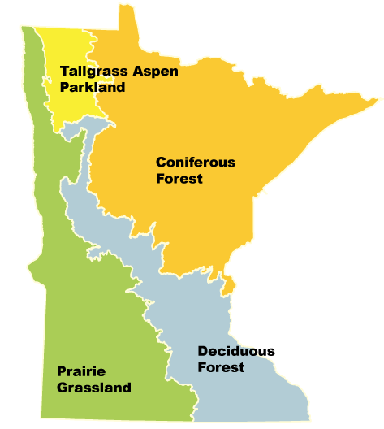
MINNESOTA BIOMES
Coniferous Forest
Deciduous Forest
Prairie Grassland
Tallgrass Aspen Parkland
Notes:
Before we begin talking about vector distribution and habitat, it’s important to understand Minnesota’s unique geography. Minnesota is truly an east meets west state, which manifests in a convergence of several biomes and habitats. These habitats have an impact on where vectors can live and thrive, which in turn has an impact on disease risk. Beginning in the northeast corner of the state where many travel to enjoy the north country, we see mixed coniferous forest. These are forests comprised of many deciduous trees such as maple, birch, and aspen with some cone-bearing evergreens in most areas such as spruce, fir and tamarack. In the southeast corner of the state cutting through the metro area and north central part of the state, we see a dominant deciduous forest. These forests made up trees that lose their leaves at the end of the growing season such as oak, maple, and basswood trees, with sapling and herb layers. In the southwest corner and western border of the state expansive grassland that previously existed has almost entirely been developed for agriculture purposes. Finally, in the upper northwest corner lies Minnesota’s smallest biome- tallgrass aspen parkland. This biome is home to prairie grasses and wetlands with groves of aspen trees. Harsh winds and dry conditions affect this area and its inhabitants.

Slide 22
POLLING QUESTION
Which of the following tick species poses the greatest threat to public health in Minnesota?
Blacklegged (Deer) Tick
American Dog (Wood) Tick
Lone Star Tick
Notes:
Before we begin talking about ticks, we will take a break for our first polling question.
Which of the following tick species poses the greatest threat to public health in Minnesota.
Blacklegged (Deer) Tick
American Dog (Wood) Tick
Lone Star Tick
You will now have 30 seconds to submit your answer.
Thank you for answering, the correct answer is “a” Blacklegged (Deer) Tick. Let’s learn more about the ticks of public health concern in Minnesota.

Slide 23
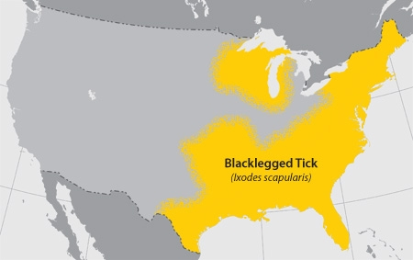
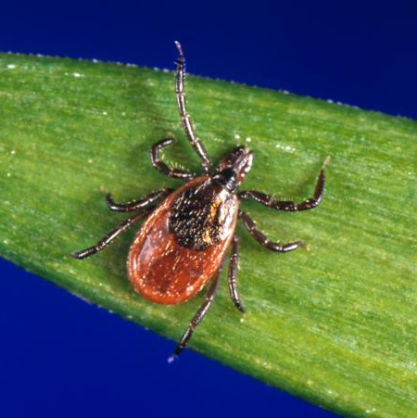
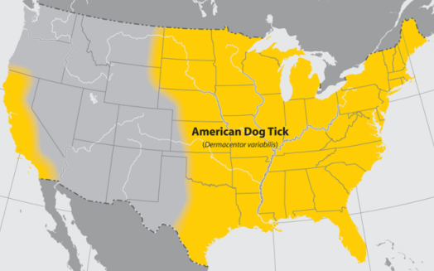
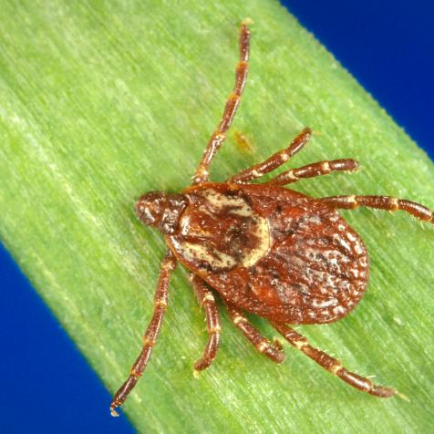
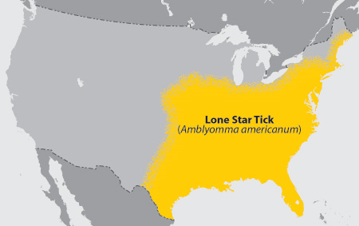
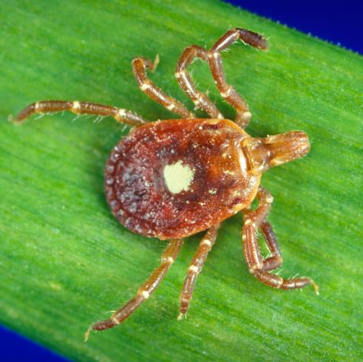
3 TICKS OF PUBLIC HEALTH CONCERN IN MINNESOTA
Blacklegged (Deer) Tick
Lyme disease
Anaplasmosis
Babesiosis
Ehrlichiosis
Powassan virus
American Dog (Wood) Tick
Rocky Mountain Spotted Fever
Tularemia
Lone Star Tick
Ehrlichiosis
Tularemia
Notes:
In Minnesota, there are roughly about 12 species of hard ticks found here. These are ticks that have a hard dorsal plate and mouthparts that are visible from above. However, not all of them spread disease and only a few of these tick species are a primary public health concern: the blacklegged tick (formerly called the deer tick), the American dog tick (also known as the wood tick), and the lone star tick. The map to the left of each tick illustrates the geographic distribution of each tick throughout the US. These maps are based on reports of and systematic searches for each tick species, so these are approximate ranges. Notice, the Lone Star tick just reaches the southern border of Iowa. This tick is rarely found in MN, however we do receive sporadic reports and even submissions of this tick collected in MN. Given the increasing number of reports, it’s likely that it’s range has expanded to southern MN, illustrating developments in tick ranges since these maps were first created. The American dog tick, commonly referred to as the wood tick, is widely abundant throughout the state. Although this tick is often encountered by Minnesotans, it rarely transmits disease, though it is possible.

Slide 24
3 TICKS OF PUBLIC HEALTH CONCERN IN MINNESOTA
Blacklegged (Deer) Tick
Lyme disease
Anaplasmosis
Babesiosis
Ehrlichiosis
Powassan virus
American Dog (Wood) Tick
Rocky Mountain Spotted Fever
Tularemia
Lone Star Tick
Ehrlichiosis
Tularemia
Notes:
The blacklegged tick is responsible for transmitting all five of Minnesota’s endemic tickborne diseases, making it the main tick of public health concern in the state.
These include: Lyme disease, Anaplasmosis, and Babesiosis, the three most commonly reported tickborne diseases in Minnesota
There are also several other emerging tickborne diseases that may or may not be spread by the blacklegged tick. Note the approximate distribution of the blacklegged tick throughout Minnesota is not as widespread as the American dog tick, but its range has expanded greatly in the past 15 years or so, which we will discuss later on in this webinar.
The following slides on ticks will be referring specifically to blacklegged ticks.

Slide 25
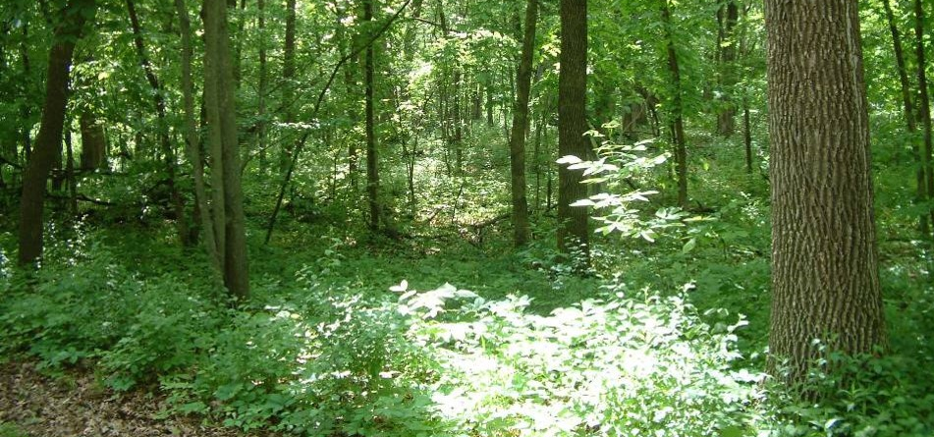
BLACKLEGGED TICK HABITAT
Canopy cover
Low-growing vegetation and shrubs
Leaf litter
Notes:
Understanding Minnesota’s unique biomes allows us to know where we are likely to come into contact with blacklegged ticks. This picture shows a great example of blacklegged tick habitat. While American dog ticks are found in open, grassy areas and woods, blacklegged ticks are more sensitive creatures prone to desiccation, or drying out, if they don’t have ideal conditions.
Take note of the canopy cover, the understory and herb layer, with lots of brush and leaf litter on the forest floor. These conditions provide an ideal home for the blacklegged tick and its animal hosts. The habitat is warm and moist creating a humid environment where the blacklegged tick will do well.
They spend most of their lifetime on the forest floor conserving energy under the leaf litter and herb layer, only coming out to seek a host. Since most people are not walking through the thick of these wooded areas, exposure to blacklegged ticks may be greatest along trails and the fringe area between the woods and borders of yards, parks, and other open areas.
Blacklegged ticks may also rarely be found in open areas (such as yards or tall grasses) that are near wooded habitat so it is important to be on the lookout for ticks when in or near wooded areas.

Slide 26
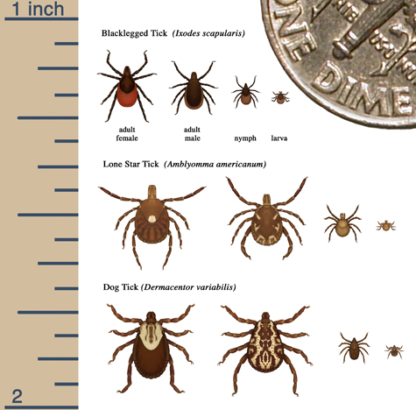
TICK LIFE STAGES
Four Life Stages
Egg
Larva
Nymph
Adult
Notes:
Hard ticks have four life stages: egg (not pictured), larva, nymph, and adult. All ticks take a blood meal at the larval and nymph stages, but only females will take a blood meal at the adult stage. Adult males will attach to hosts the way female adults do, but they do not take a blood meal, which means they are much less likely to spread disease and, therefore, less of a public health concern.
How long is the typical lifespan of a blacklegged tick? You may be surprised to learn they can live 2-3 years, depending on their success at finding hosts and mates as well as environmental factors such as temperature. Most of their life is spent in their environment instead of on a host as during their lifetime they will only have up to three blood meals.
The life cycle begins when an adult female ticks lays hundred to a few thousand eggs in the springtime. The eggs will hatch into larvae that summer. The larvae will take the first blood meal and prefer to feed on smaller animals, like mice and birds, so they do not usually feed on humans. After this feeding, the larvae molt into nymphs and rest until the following spring. During this first meal, the larvae may pick up a disease agent (such as Borrelia burgdorferi- the agent that causes Lyme disease) while feeding on a small mammal, such as the white-footed mouse. Not all larvae will pick up a disease agent during this feeding but may have a second opportunity during the nymph stage.
In the late spring and summer of the second year, nymphs will take a second blood meal. Hosts can range from small to large. Those who take a blood meal will molt into an adult male or female tick that fall. Adults prefer to feed on mainly large mammals, such as deer or humans. Adult females will feed on a host, mate with an adult male tick, lay hundreds of eggs, and then die. The males attach to a host to find a female mate and then die. Some adults who do not find a host and mate may survive through the winter and have a second chance the following spring. Blacklegged ticks can usually survive Minnesota winters if there is good snow cover.

Slide 27
POLLING QUESTION
When looking for a host, blacklegged ticks do which of the following?
See
Jump
Climb on near ground level
Fall from trees
Notes:
We will now be having our next polling question.
When looking for a host, blacklegged ticks do which of the following?
See
Jump
Climb on near ground level
Fall from trees
You will now have 30 seconds to submit your answer.
Thank you for answering, the correct answer is “c” climb on near ground level. Let’s learn more about the tick questing process.

Slide 28
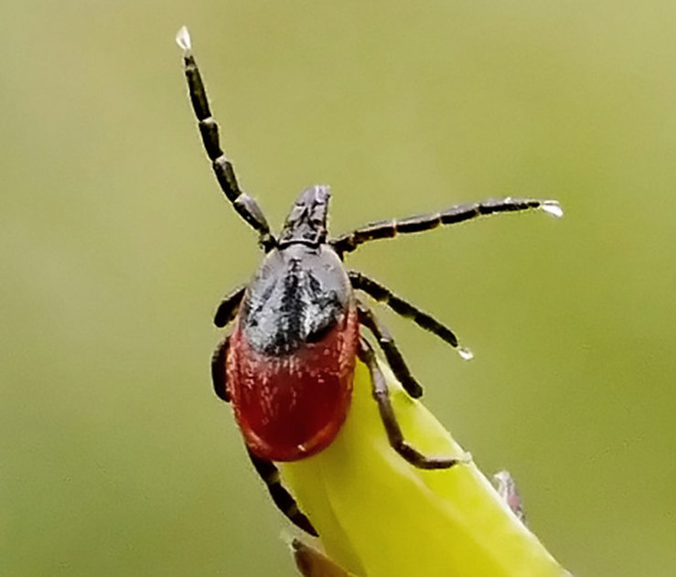
BLACKLEGGED TICK QUESTING
To find a host, blacklegged ticks:
  Search from the tips of low-growing vegetation
  Sense biochemical cues from potential hosts
  Climb onto a host near ground level as they walk by
Blacklegged ticks do not see, jump, fly, or fall from trees
Impacted by weather and environmental conditions
Notes:
When looking for a host, ticks perform a behavior called questing. This is when they emerge from the leaf litter and crawl to the tips of grass, leaves, branches. They use their back two sets of legs to hold onto the tip of the vegetation and reach their front two sets of legs out to grab onto a host that may pass by. Ticks do not see, but sense these hosts through biological cues such as body heat, CO2, or vibrations. When a tick senses a host passing by, they grab on. From there they do not jump, but crawl. Some ticks will attach by biting a host relatively quickly, while others crawl around for awhile finding areas such as the ears or the base of the scalp. Because many people find ticks along the scalp or higher up on their body, it’s commonly thought that ticks jump, fly, or fall from trees, but ticks do not do any of these behaviors. They have just crawled without us noticing.
Questing behavior is very dependent on weather and environmental conditions as ticks require humidity to climb out the leaf litter and quest. Without these conditions, ticks stay in the leaf litter in order to conserve moisture. Good questing conditions can change throughout the span of a day as temperature and humidity levels change. Increased wind can also affect questing as it can contribute to drier conditions.

Slide 29
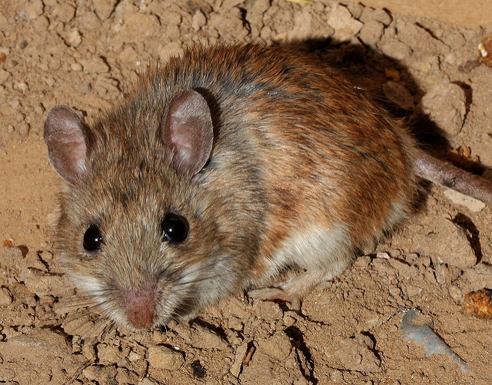
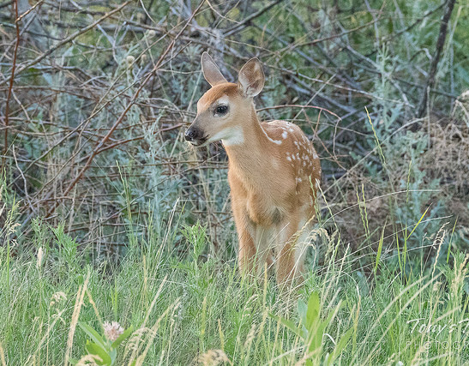
BLACKLEGGED TICK HOSTS
Main Reservoir Host: White-Footed Mouse
Main Reproductive Host: White-Tailed Deer
Notes:
Although blacklegged ticks may have many different hosts, they have two main hosts: the white-footed mouse and the white-tailed deer.
The white-footed mouse in the main reservoir host for the blacklegged tick. Immature stages such as larvae and nymphs can become infected while feeding on these mice that may be carrying disease agents that cause Lyme disease or other diseases. If the mouse is infected with the bacteria that causes Lyme disease, the larva that feeds on it will become infected and can transmit the bacteria during its second feeding. This is only the case when the tick feeds on an infected animal; not all animals are infected.
Deer get a bit of a bad rap when it comes to ticks as people often associate the two. Deer can support large numbers of ticks as they are the main reproductive host for adult ticks seeking to mate. Adult male and female ticks will mate on a deer after a female has taken a blood meal. The female will then fall off and lay eggs before dying. Deer do not play a role in the disease transmission cycle, and even if a tick were to get infected from a deer, that adult tick will not go on to feed again and cannot pass infections onto their offspring. Deer may serve as a mode of tick distribution, carrying ticks to new areas. However, the new habitat must still be suitable for ticks to survive and thrive in that new area.

Slide 30
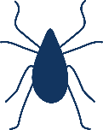
TICKBORNE DISEASE TRANSMISSION TO HUMANS
Ticks infected with bacteria causing Lyme Disease
Time of attachment needed to transmit disease agents:
  Lyme disease: 24 – 48 hours
  Anaplasmosis: 12 – 24 hours
  Babesiosis: >24 hours
1 in 3 adult ticks
1 in 5 nymph ticks
Notes:
When ticks attach to human hosts, there are a few factors that impact disease transmission.
First, ticks must already be infected with a pathogen to transmit the disease to humans. In the case of Lyme disease, approximately 1 in 3 adult ticks and 1 in 5 of nymph ticks are infected with bacteria that cause Lyme disease.
Second, ticks must be attached for a certain period of time before they are able to transmit disease agents, such as those listed here.
Overall, nymphs and adult female ticks are the greatest risk for disease transmission to humans. Remembering that adult males are less of a public health risk as they will attach to a host but do not take a blood meal.
The three diseases listed are the three most commonly reported tickborne diseases in Minnesota with Lyme disease being the most commonly reported.

Slide 31
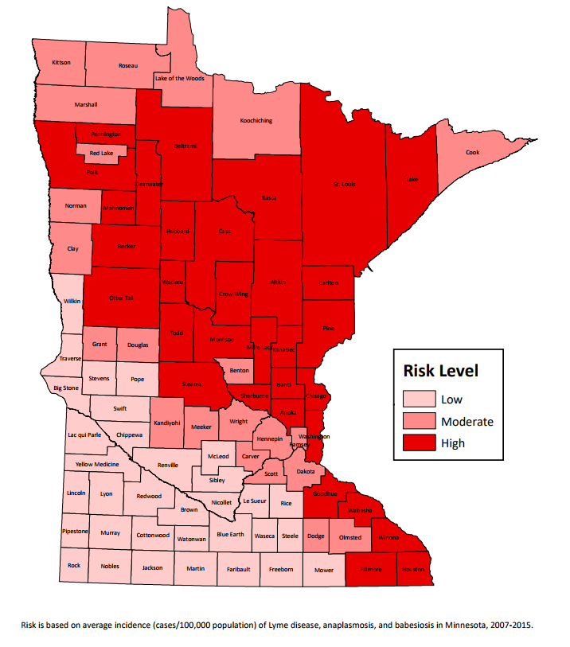
TICKBORNE DISEASE RISK IN MINNESOTA
Tickborne Disease Risk in Minnesota
Lowest risk: western border and southwest corner
Highest risk: wooded habitats of north central and northeast regions
Notes:
Tickborne disease risk is not evenly distributed in Minnesota.
This map depicts risk of tickborne disease in Minnesota based on average incidence of Lyme disease, anaplasmosis and babesiosis from 2007-2015. In Minnesota, tickborne disease risk is highest in wooded or brushy areas where ticks live and thrive. The areas of highest risk (dark red counties) correspond with where we find wooded habitat in Minnesota. A limitation of this map is that cases are reported by county of residence and not where someone may have been exposed to a tick. This means that not all areas of risk are reflected by this map, including the Minnesota River valley region where MDH staff have confirmed blacklegged tick presence as far south as New Ulm in Brown County.

Slide 32
REPORTED TICKBORNE DISEASE CASES IN MINNESOTA (1996-2016)
Notes:
Trends in reported cases of tickborne diseases in MN are generally increasing over time. This can be due to any of several reasons: distribution of the blacklegged tick into new areas exposing new members of the population, human behaviors such as an increase in outdoor recreation behaviors or time spent in new high risk areas leading to increased exposures, increasing awareness of these diseases leading to more patients considering tickborne diseases as a cause for their acute illness and more doctors testing for these diseases, improved reporting to the health department among other factors such as environmental conditions.
In Minnesota, vectorborne diseases have a strong seasonal component due to vector activity, which is apparent in annual cases reported to MDH. From 1996-2015, 70% of all confirmed Lyme disease cases reported to MDH had illness onset during the months of June, July, or August. And from 2002-2015, 97% of all West Nile Virus disease cases reported to MDH had illness onset during the months of July, August, or September. Therefore, in early summer we think about ticks and tickborne disease risk, and in the late summer, mosquitoes and mosquitoborne disease risk.

Slide 33
POLLING QUESTION
How many known species of mosquitoes are present in Minnesota?
~11
~51
~150
Notes:
It’s now time for our next polling question.
Up next, we will be discussing mosquitoes and mosquitoborne disease in Minnesota.
How many known species of mosquitoes are present in Minnesota?
11
51
150
Thank you for answering, the correct answer is “b” 51. Let’s learn more about mosquitoes in Minnesota.

Slide 34
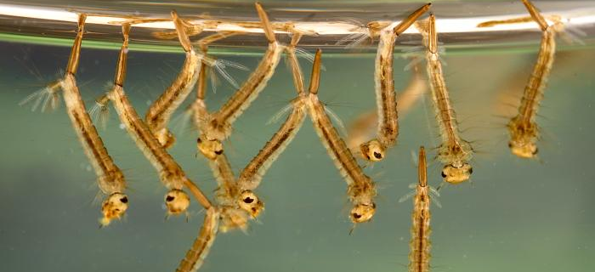
MOSQUITOES
51 species of mosquitoes in MN
Endemic arboviruses of MN include:
West Nile Virus, Western Equine Encephalitis, La Crosse Encephalitis, Jamestown Canyon Virus, Eastern Equine Encephalitis
Notes:
Mosquitoes are a type of fly that can act as vectors of human disease; Minnesota is home to 51 species. The diseases they can transmit are referred to as mosquitoborne diseases or arboviruses. Different species of mosquitoes transmit different disease agents similar to ticks. Many disease agents require a reservoir to amplify the virus in order to allow for transmission to humans.
Mosquitoborne diseases exist naturally in cycles between the mosquitoes and susceptible reservoir hosts such as mammals and birds. Virus amplification occurs as a result of increased circulation of the virus between an increasing number of mosquito vectors and the reservoir hosts. These diseases may spillover when humans incidentally enter into the ongoing disease transmission cycle or when amplification cycles occur in close proximity to humans. Weather conditions and climate can impact the amplification periods.
Endemic arboviruses of MN include West Nile Virus, La Crosse Encephalitis, Jamestown Canyon Virus, Western Equine Encephalitis, and Eastern Equine Encephalitis. All of these diseases can cause mild febrile illness with some illnesses progressing to encephalitis, or brain swelling.

Slide 35
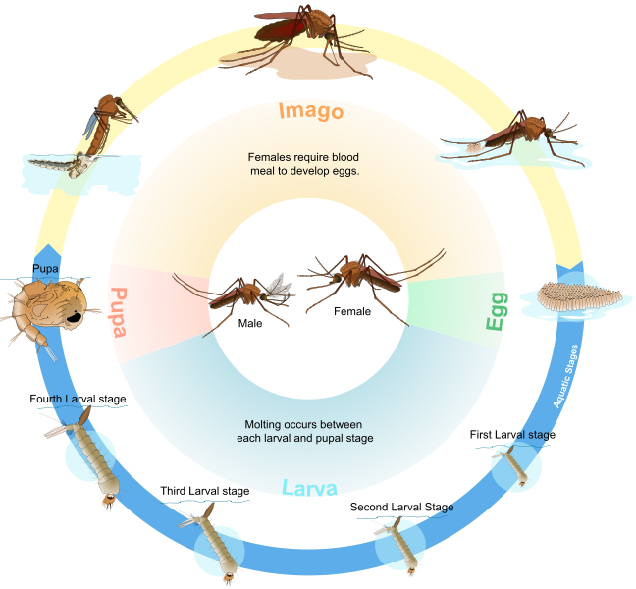
MOSQUITO LIFE CYCLE
Four life stages
  Egg
  Larva
  Pupa
  Adult
Water is a necessary part of mosquito habitat
  Varying habitats and egg-laying behaviors
To find a host, adult mosquitoes see and detect movement, body warmth, chemical cues
Only adult females take blood meals
Notes:
Mosquitoes have a four stage life cycle. After a blood meal, an adult female will lay her eggs directly on or near water or in places that may flood with water such as damp soil or containers. The eggs can survive months of dry conditions; some can survive for years. Once an egg hatches in water a larva will emerge. As the larva matures, it will grow larger as it undergoes four molts. The larva will live and feed in the water, coming to the surface to breathe, as it eventually develops into a pupa. In the pupal stage, the mosquito rests and tumbles, but no feeding occurs. Finally, an adult mosquito will emerge from the pupal case and rest of the surface of the water. After the body and wings have dried, the mosquito will leave the water.
This whole process can take anywhere from one week to one month and depends on many factors such as water temperature, species characteristics, and other conditions like food availability. Climate can affect many parts of the life cycle, such as the temperature of the water where eggs hatch and larvae develop. Warm water temperatures can speed up the process of development, leading to quicker emergence of adults from pupal cases.
As adults, only females will bite and take a blood meal while males typically feed on nectar or water. Mosquitoes have host preferences and do not typically prefer humans.

Slide 36
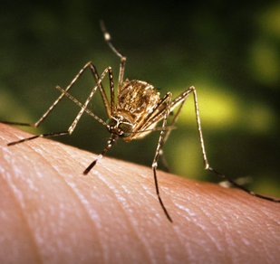
WEST NILE VIRUS
Transmitted by Culex tarsalis
Widely abundant west of the Mississippi River
Moderate fliers that can fly miles from breeding site
Overwinter as adult mosquitoes
Prefer birds as hosts
Feed at dusk and dawn
Primarily affects the elderly
Notes:
West Nile Virus is Minnesota’s most commonly reported arbovirus. Symptoms of this disease are most severe in the elderly population who are, therefore, considered high-risk. The virus circulates naturally between the Culex tarsalis mosquito and birds allowing for virus amplification. Humans and horses may incidentally become infected when exposed and serve as “dead-end hosts”. Many birds serve as a reservoir for the disease before rapidly dying from infection. Other birds may become chronically infected as they do not die as often. Chronically infected birds that migrate may serve as a mode of disease spread to new areas.

Slide 37
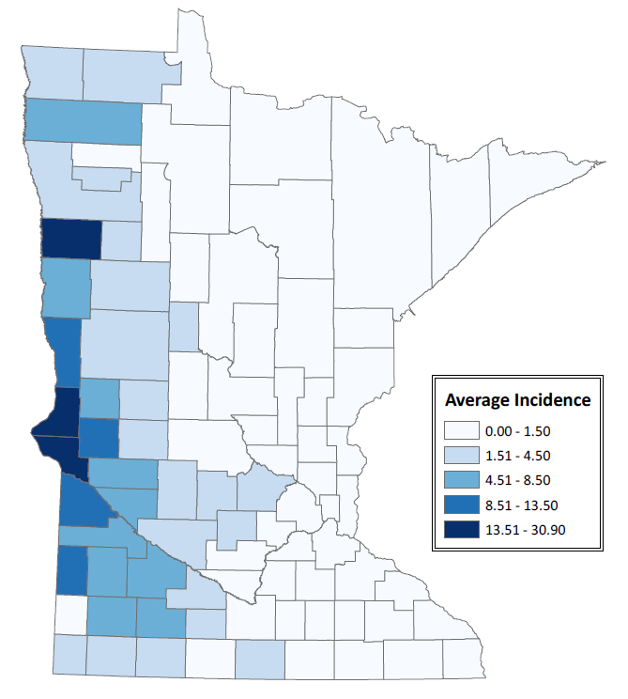
CULEX TARSALIS HABITAT
West Nile Virus Disease Risk (2002-2016)
Stagnant wetlands
Open agriculture habitat
Rest in wooded areas
Notes:
Culex tarsalis mosquitoes are found to be widely abundant west of the Mississippi River in Minnesota as its habitat includes semi-permanent wetlands and drainage ditches such as those found on agricultural lands. In dry conditions, water in drainage ditches can stop flowing and become stagnant, which can then be used by mosquitoes as a breeding site. These wetlands produce mosquito populations, but mosquitoes will fly and rest in wooded/brushy areas nearby to conserve moisture. In open agricultural land, these areas are often around the homes of farming families or farm buildings, bringing mosquitoes into areas where human hosts are.
This map depicts risk for West Nile Virus based on average incidence from 2002-2016. Note the higher incidence of disease cases and risk in Western MN where Culex tarsalis is abundant. A low number of cases also regularly occur in the Twin Cities metro area.

Slide 38
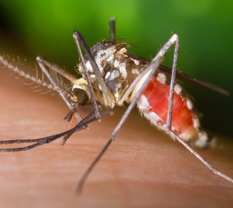
LA CROSSE ENCEPHALITIS
Transmitted by Aedes triseriatus (Eastern tree-hole mosquito)
Forest-dwelling mosquito
Fly up to 200 yards from breeding site
Virus overwinters in eggs
Virus amplifies in summer (squirrels and chipmunk)
Feed during the daytime
Primarily affects children
Notes:
La Crosse Encephalitis was first reported in the 1960’s in a Houston County, MN child. She died in a hospital in La Crosse, Wisconsin, which the disease was then named after. Spread by the tree-hole mosquito, Aedes triseriatus, this disease primarily affects children. The tree-hole mosquito is a forest-dwelling species that will not fly far from where they were bred, only about 200 yards, so risk is often localized.

Slide 39
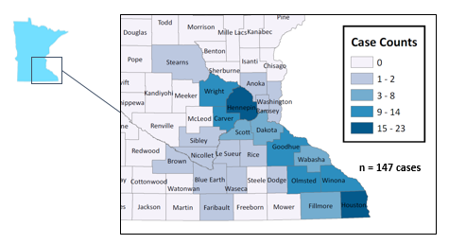
AEDES TRISERIATUS HABITAT
Cases of La Crosse Encephalitis by County of Residence (1985-2016)
Tree-holes
Man-made containers
Wooded or shaded areas of Southeast Minnesota considered high-risk
Notes:
The tree-hole mosquito breeds in water-holding habitat in wooded or shaded areas such as man-made containers and tree holes formed naturally in trees and in trees with multiple trunks forming pockets that can hold water. These habitats are often found near areas with reported La Cross Encephalitis. Children under the age of 16 are considered high-risk for La Crosse Encephalitis. Residents of wooded or shaded areas in the southern 2/3 of Minnesota are also high-risk.
This map depicts reported cases of La Cross Encephalitis by county of residence from 1985-2016. Note that all cases occurred in the southern 2/3 of Minnesota.

Slide 40
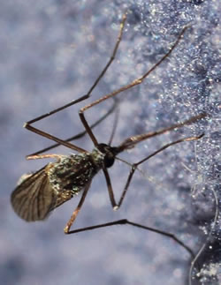
JAMESTOWN CANYON VIRUS
First reported in the US in 2004
May be transmitted by several spring Aedes species
  Other mosquitoes that bite people
Referred to as “snow-melt species”
  Develop in snow melt pools
  One generation per year
  Longer transmission season
Notes:
Jamestown Canyon Virus was first reported in the US in 2004. Although widely distributed in North America, JCV is rarely reported in the US. It can be transmitted by any of several spring Aedes mosquitoes as well as other mosquito species that commonly bite people. From 2001-2013 only 31 cases were reported across the US. To date in 2017, 67 cases of JCV have been reported in the US, with the Upper Midwest reporting the majority of these cases. Aedes species mosquitoes are referred to as snow-melt mosquitoes as they develop in snow melt pools. They emerge after the melt occurs, which leads to a longer transmission season (spring to fall) compared to some other mosquito species.

Slide 41
POLLING QUESTION
Which mosquitoborne disease had the highest number of reported cases in Minnesota from 2002 – 2016?
West Nile Virus
La Crosse Encephalitis
Jamestown Canyon Virus
Notes:
Which mosquitoborne disease had the highest number of reported cases in Minnesota from 2002 – 2016?
West Nile Virus
La Crosse Encephalitis
Jamestown Canyon Virus
Thank you for answering, the correct answer is “a” West Nile Virus.

Slide 42
REPORTED MOSQUITOBORNE DISEASE CASES IN MINNESOTA (2002-2016)
Notes:
Mosquitoborne disease trends appear very different than tickborne disease trends. This is likely due to dependency on weather conditions during vector activity season as weather conditions can impact breeding and virus amplification. For example, in 2003, Minnesota experienced a hot, dry summer and the largest number of reported West Nile Virus cases. Stagnant pools of water, increased water temperature that can lead to quicker mosquito development, and increased amplification of the virus all as a result of hot and dry weather conditions could have possibly led to an increase in cases.

Slide 43
OUTLINE
Overview of vectorborne disease
Climate changes in Minnesota
Ecology and epidemiology of vectorborne disease in Minnesota
Changes in vectorborne disease risk
Meaningful action steps
Notes:
Next up, we will be discussing changes in vectorborne disease risk.

Slide 44
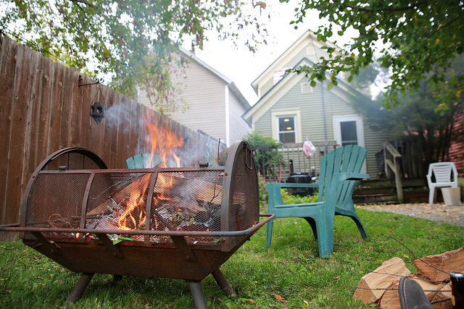
VECTORBORNE DISEASE TRANSMISSION IN MINNESOTA
Trends
Increase in some vector distribution over time
Increase in case numbers of some diseases
Appearance of new disease agents
Similar to other areas in the United States.
Notes:
The story of vectorborne disease trends in Minnesota is not unlike that of the rest of the world. It has seen an increase of cases of some diseases and appearance of new diseases as well as the geographic expansion of some vector distribution over time. The appearance of new disease agents may be due to “looking harder” for them through systematic studies, but may also be due to introductions of new disease agents in the state. Similarly, increased expansion in the range of some vectors may be partly due to systematic field searches for them in new areas.

Slide 45

ARTHOPOD VECTORS AND CLIMATE
Vectors are sensitive to weather factors such as:
Temperature
Relative humidity
Precipitation
Wind
Climate plays a role in vector:
Life cycle
Activity
Geographic distribution
Notes:
Environmental conditions play an important role in arthropod vector biology. Vectors are sensitive to weather factors such as temperature, relative humidity, precipitation, and wind, which can have an impact on their life cycle and host-seeking and breeding activities. Their geographic distribution can be impacted by climate as favorable environmental conditions are critical to a vector’s ability to thrive in an area.

Slide 46

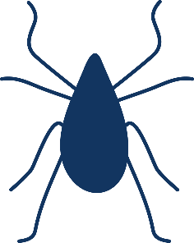
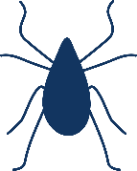
CLIMATE CHANGE AND TICKBORNE DISEASE RISK
Increased temperature
Increased precipitation and humidity
Longer tick growing/feeding season
Lower mortality in winter
New tick species
New disease agents
Increased blacklegged tick survival in warm season
Increased time available for tick feeding each day
Notes:
Regarding tickborne diseases specifically, climate change is likely to impact risk. For example, with increased temperatures it is likely that ticks will become active sooner and stay active longer allowing for more time to develop and feed on hosts. There may also be a decrease in tick die off over the winter months as well. An increase in temperature can also lead to new tick species in areas where they weren’t before with the ability to survive and establish a population, which can also lead to the introduction of new disease agents in these areas.
Increased precipitation and humid conditions may allow for increased rates of tick survival and extended favorable feeding time each day.

Slide 47
CLIMATE CHANGE AND TICKBORNE DISEASE RISK
Increased habitable forest
Increased host populations
More habitat for blacklegged ticks
More habitat for tick hosts
Land use and development must also be considered
Higher tick populations
Easier establishment of ticks into new areas
Notes:
An increase in suitable habitat for blacklegged ticks and their hosts could lead to their expansion into new areas and allow ticks in these new areas to establish populations easier with the potential for larger populations.
How land is used and developed is also an important consideration when thinking about future risk.
Homes developed in an area where habitable forest once was may create new exposure opportunities
Deforestation can also lead to a decrease in tick habitat

Slide 48

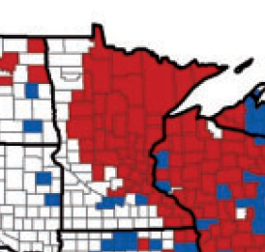
IXODES SCAPULARIS DISTRIBUTION BY COUNTY
1996
2015
Red = Established*
Blue = Reported
White = No Records
*≥ 6 ticks or two life stages recorded within a single calendar year
Eisen, R. J., Eisen, L., and C. B. Beard. County-Scale Distribution of Ixodes scapularis and Ixodes pacificus (Acari: Ixodidae) in the Continental United States. 2016. J Med Ent 0:0 (1-38). doi: 10.1093/jme/tjv237
Notes:
Tickborne disease risk is constantly evolving and will continue to do so as vector distribution changes. These distribution maps show the expanding geographic distribution of the blacklegged tick from 1996-2015 based on counties of recorded presence. Some of this expansion is also due to systematic searches for the ticks and documenting new established populations.

Slide 49
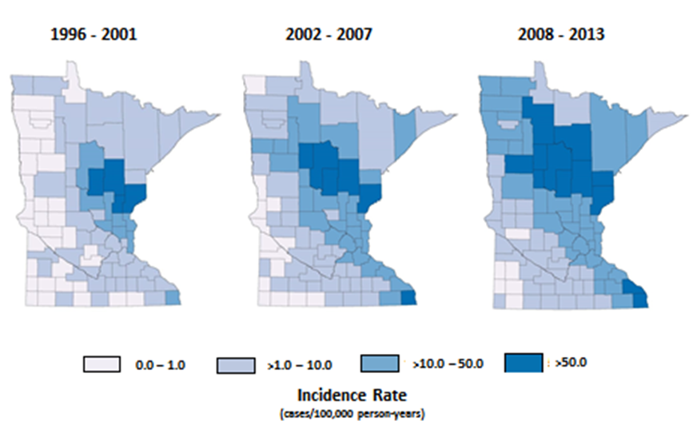
DISTRIBUTION OF LYME DISEASE CASES IN MINNESOTA
Notes:
Expanding tick ranges will change tickborne disease risk in new areas. Seen in the previous slide, between 1996 and 2015, blacklegged ticks became more established in north and northwest Minnesota and the risk for tickborne diseases followed. These maps show the distribution of Lyme disease cases increased from 1996-2013. Again, cases are recorded by county of residence, but we can note similarities in expansion of disease incidence and vector distribution within Minnesota.

Slide 50
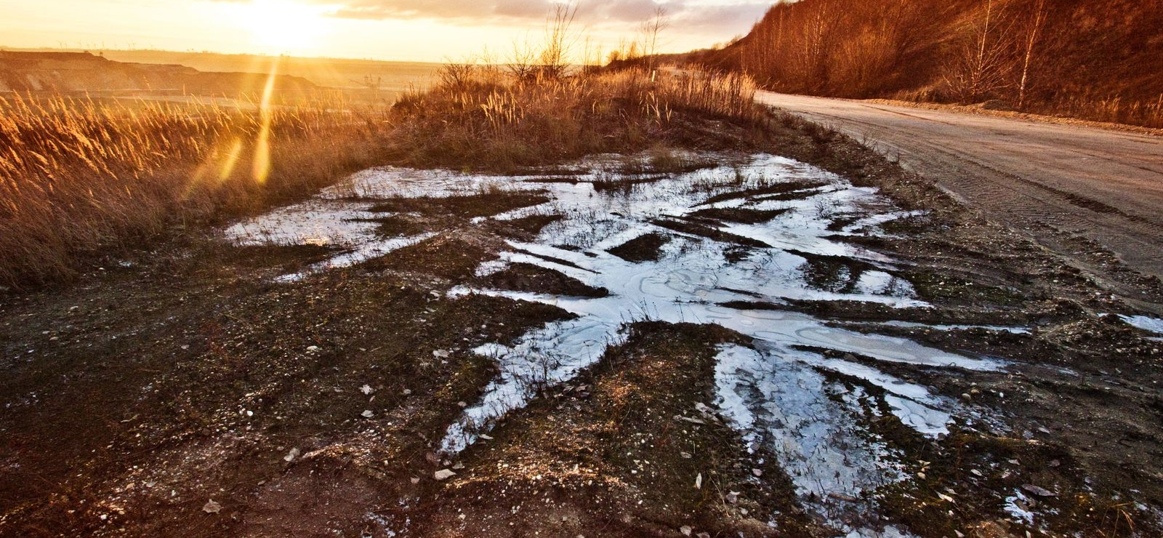
CLIMATE CHANGE AND MOSQUITOBORNE DISEASE RISK
1. Warmer and drier conditions
  Increased West Nile Virus risk
2. Warmer and wetter conditions
  Increased La Crosse Encephalitis risk
3. Changes in forest and agricultural land
  Changes in suitable habitat for mosquitoes and hosts
Notes:
Regarding mosquitoes, potential impacts of climate change may include:
Warmer and drier conditions can lead to increased West Nile Virus risk during the mosquito season due to the enhanced virus amplification and greater vector production.
Warmer and wetter conditions are favorable for La Crosse Encephalitis transmission due to longer virus amplification season and more wet breeding habitat locations. This could lead to increased La Crosse Encephalitis risk.
Changes in proportion of forest to agriculture land cover may lead to changes in suitable habitat for vectors, hosts and disease agents leading to changes in human disease risk.

Slide 51
CLIMATE CHANGE AND MOSQUITOBORNE DISEASE RISK
4. Potential emergence or re-emergence of exotic mosquitoborne diseases
5. Potential increased survival of exotic mosquito species of public health importance
Notes:
Climate change may also lead to an emergence or re-emergence of exotic mosquito-borne diseases such as: Malaria, Chikungunya, and Rift Valley Fever.
Climate change may also increase the survival of exotic mosquito species such as Aedes albopictus (Asian tiger mosquito) and Aedes japonicus (Japanese rock pool mosquito), which is already surviving and becoming widely established in Minnesota.

Slide 52
OUTLINE
Overview of vectorborne disease
Climate changes in Minnesota
Ecology and epidemiology of vectorborne disease in Minnesota
Changes in vectorborne disease risk
Meaningful action steps
Notes:
In this next section, we will provide steps to take to prevent yourself and your families from vectorborne diseases.

Slide 53

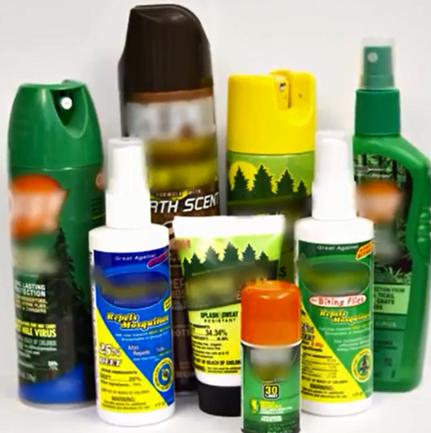
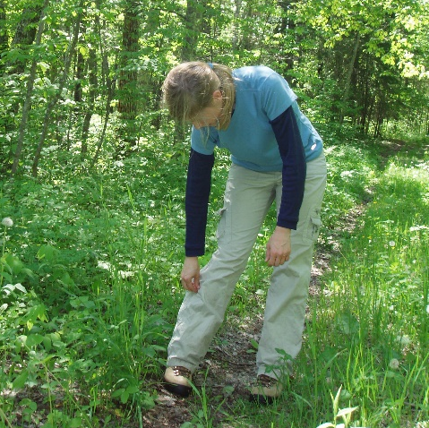
PROTECT YOURSELF FROM TICKBORNE DISEASES
Know when and where you are at risk
Wear repellent
Check yourself for ticks
Notes:
The best thing we can do to prevent tickborne disease is to practice disease prevention methods.
1. Know when and where ticks may be living so that you know when and where you may be at risk for exposure. The blacklegged tick, which spreads the most common tickborne diseases in MN, prefers wooded and brushy habitat, and although most people tend to stick to trails while in the woods, the fringe areas and sides of trails can present good exposure opportunities. The American dog tick, which is commonly found throughout MN prefers wooded or open, grassy areas. Ticks live close to the ground and when seeking a host, take advantage of those who brush/walk past them. While in the woods it’s important to be aware of this and look down often as you may be able to spot and remove a tick that has recently crawled onto you before it has an opportunity to climb upward.
Though you may come across a tick during any of the warm months of the year, nymphs are most active in MN from mid-May through mid- July. Adult ticks come out when the snow melts in early spring and are most active through June when they fade back before coming out to be active again in the fall.
2. Wearing repellent is a great prevention measure that people should take to prevent tick bites. Repellents that contain 20-30% DEET are effective at deterring ticks that may bite you. DEET is safe to apply directly on exposed skin or clothing for adults and children, but should not be used on infants under 2 months of age. Permethrin products are used directly on clothing and are great for people who spend extended periods of time in possible tick habitat. Permethrin is not safe to use directly on skin, but can treat clothing and gear and lasts through multiple washes. You can also buy gear that is already treated with permethrin. Other effective ingredients are available but use of products registered by the EPA is highly recommended. Always be sure to follow the instructions on the label. Shower and wash yourself after coming indoors in order to wash off remaining repellent from your skin.
Other tips: Dress to keep out ticks! Wear long- sleeved shirts and long pants. Tuck your pants into your socks to create a barrier and prevent ticks from going up your pant leg. Wearing light colored clothing makes it easier to spot ticks that may be on you. Also, after undressing when coming indoors, ticks may be on clothes and gear. Since we don’t want them in the home, it’s a good idea to throw clothing in the dryer on high for at least 6 minutes when dry and 60 minutes when wet. This will kill any ticks that may be on the clothing.
3. The most important thing you can do to prevent tickborne diseases is to check yourself carefully for ticks after being outside in or near wooded areas. For some people, this may mean making tick checks part of their daily routine. After coming indoors, you should remove all clothing, closely check your entire body, and shower. Ticks may bite any part of your body, but tend to find hidden spots to attach such as the waist band area and pelvis, belly button, the backs of the knees, armpits and scalp. Ticks, especially nymphs, can look like a fleck of dirt on your skin so it’s important to do a good job of checking closely. If you are to find a tick, it’s important to remove the tick as soon as possible. A video on proper tick removal is available on our website at http://www.health.state.mn.us/divs/idepc/dtopics/tickborne/prevention.html.

Slide 54
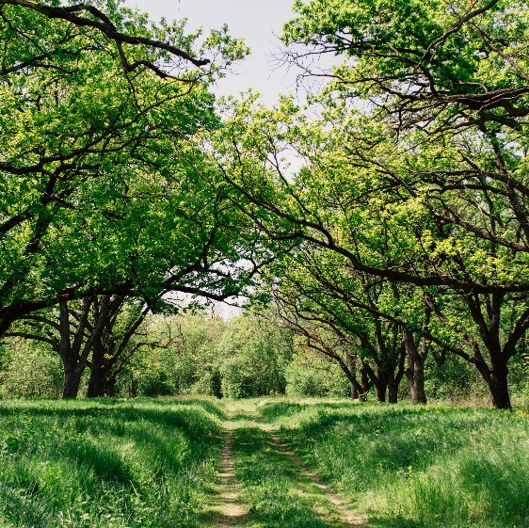


REDUCE EXPOSURE TO TICKBORNE DISEASE
Keep trails mowed short
Remove leaf litter and brush
Talk with your vet about tick preventatives for your pet
Notes:
Other good ways to prevent tick exposures include habitat management on your home property. Keep trails mowed short and wide. Remove leaf litter and brush around the house or on the property. Create tick safe zones in areas where you spend time such as near a swing set or picnic table and place these in dry areas of the yard. Create a barrier between your yard and the woods by creating a landscape barrier (such as a three foot wide border of wood chips or gravel).
Pets can be a good way to bring ticks into the house and may be an indicator of potential tick exposures for their owners. There is a Lyme vaccine available for dogs, but this will not stop your dog from bringing them into the house. Always check your pets for ticks (best if you do this before they come inside), and remove any you may find. If you are finding ticks on your pets after being in or near wooded or brushy areas, this can be a good reminder to check yourself. Talk with your vet about tick preventatives and follow instructions of the vet and product label.

Slide 55

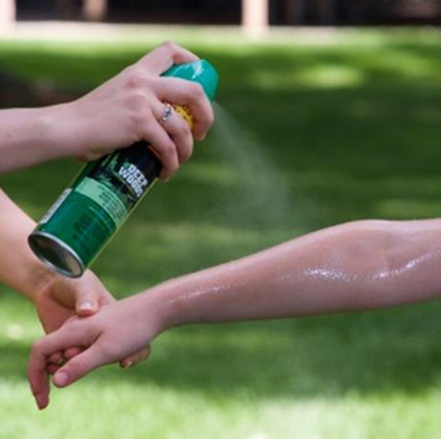

PROTECT YOURSELF FROM MOSQUITOBORNE DISEASE
Create physical barriers
Wear repellent
Remove mosquito breeding habitat
Notes:
Protecting yourself from mosquitoborne disease means bite prevention, and bite prevention is disease prevention.
You can do this by creating physical barriers such as wearing long sleeve and pants, staying indoors when disease carrying mosquitoes are active, and ensuring that windows and screens are intact.
Also make sure to wear repellent and follow the label instructions. Use repellents that have 20-30% DEET, pricaridin, or oil of lemon eucalyptus.
Lastly, remove mosquito breeding habitats. You can do this by dumping water holding containers weekly (i.e., kiddie pools, bird baths, buckets, fountains, flower pots, etc), cover wood tightly with tarps so that water cannot pool, checking and cleaning out gutters.
Another important prevention method is to remove any man-made containers such as tires from your property. If you cannot, move them to a sunny spot on the property.

Slide 56
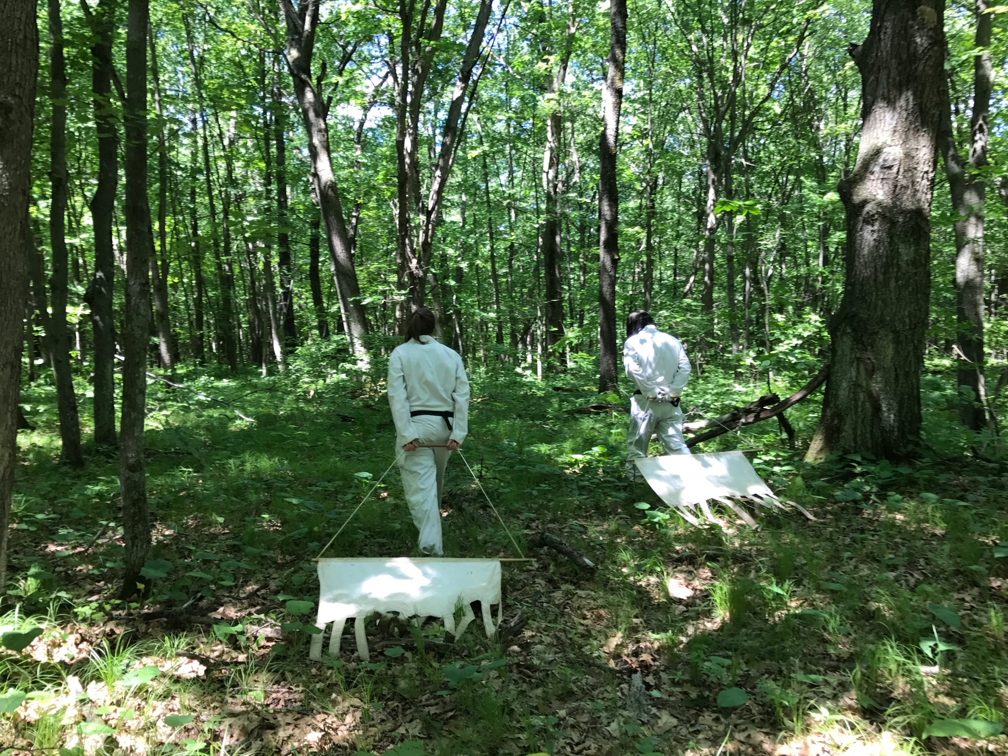
SUMMARY
Climate change likely to impact vectorborne disease risk
Challenging to quantify and predict
Complex epidemiology
Dedicated infrastructure for disease and vector surveillance is critical
Notes:
Predicting the future of vectorborne disease risk in Minnesota in light of climate change is challenging. Geographic distribution and incidence of these diseases is likely to change due to climate change, however, to what extent is still unclear. It is likely that the risk of illness will increase in some areas while decreasing in others. The vectorborne disease staff at MDH are dedicated to maintaining long-term public health infrastructure that allows us to track vectorborne diseases over space and time here in MN. Through ongoing disease surveillance we interview cases to determine exposure locations and activities, in addition to systematic field studies that allow us to document expanding tick distribution and infection prevalence. We also partner with local, regional, and federal partners to stay up-to-date on vectorborne disease research and information.
In the frame of climate change, the main concern is long-term changes that may affect vectorborne disease risk in the future instead of temporary natural disasters or events that can affect vectorborne disease risk temporarily. What will the climate in Minnesota look like in 200 years? How will this change the plants and animals found across the state? How will this affect how humans use and develop land? Will people move into or out of Minnesota? Will immigration to Minnesota put pressure on the land and its resources? Will outdoor behaviors stay the same or change based on these questions?

Slide 57
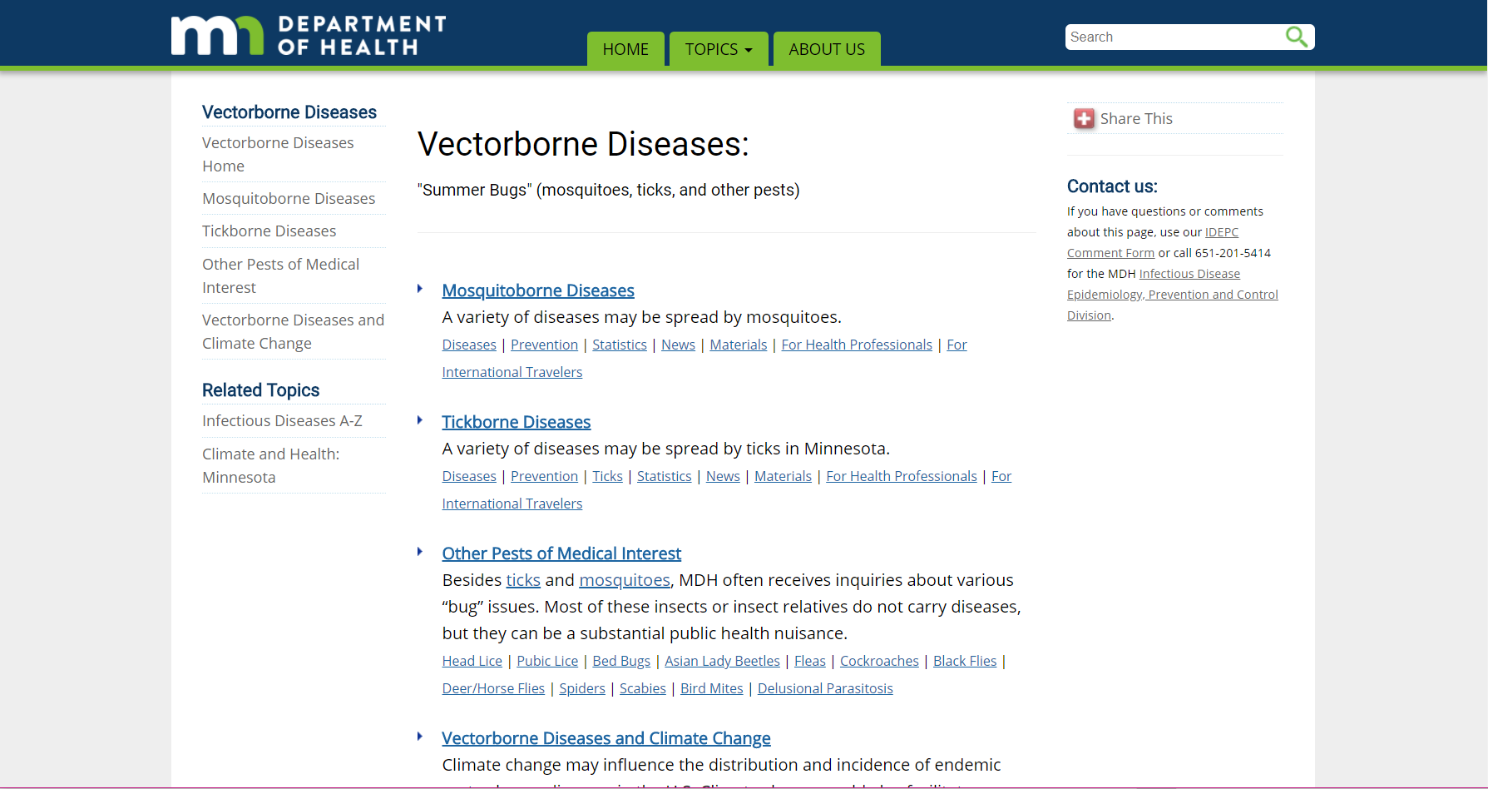
MDH
Vectorborne Disease Unit
http://www.health.state.mn.us/ticks
Notes:
To learn more about vectorborne disease in Minnesota, the MDH Vectorborne Disease Unit offers information and resources about diseases, prevention, statistics, news, and information for international travelers.
To find out more about the MDH Vectorborne Disease Unit, you can visit the link shown at the bottom of this slide or search for “vectorborne disease” through the MDH agency website.

Slide 58
ACKNOWLEDGEMENTS
Thank you
to the following people for guiding the creation of this training module:
Molly Peterson, Minnesota Department of Health, Vectorborne Disease Unit
David Neitzel, Minnesota Department of Health, Vectorborne Disease Unit
Jenna Bjork, Minnesota Department of Health, Vectorborne Disease Unit
Notes:
In closing, I’d like to thank the following people who contributed their time and insights to create this training module. [Read names.] They each brought perspectives and expertise to the table over the course of several months to shape what you saw today and it’s a great example of professionals working outside of their traditional scope to advance public health, so my thanks to this group.

Slide 59
Questions?
Contact Minnesota Climate and Health Program
health.climatechange@state.mn.us
651-201-4898

