Slide 1
Developmental and Social-Emotional Screening and
Communication Best Practices about Referrals

Slide 2
Tribal-state relations statement
The State of Minnesota is home to 11 federally recognized Indian Tribes with elected Tribal government officials. The State of Minnesota acknowledges and supports the unique political status of Tribal Nations across Minnesota and their absolute right to existence, self-governance, and self-determination. This unique relationship with federally recognized Indian Tribes is cemented by the Constitution of the United States, treaties, statutes, case law, and agreements. The State of Minnesota and Tribal governments across Minnesota significantly benefit from working together, learning from one another, and partnering where possible.
The Minnesota Department of Health recognizes, values, and celebrates the vibrant and unique relationships between the 11 Tribal Nations and the State of Minnesota. Partnerships formed through government-to-government relationships with these Tribes will effectively address health disparities and lead to better health outcomes for all of Minnesota.
Notes:
Please insert your own agency or program statement (if desired).
This slide depicts the MDH Tribal-State Relations Statement – MDH staff should use this statement as per guidance from MDH’s Office of American Indian Health. Please read guidance for including the Land Acknowledgement and/or Tribal State Relations Statement, audience size, audience demographics, and recommendations for who should read the statement.

Slide 3
Objectives
Identify ways to provide family-centered, equitable, culturally responsive, and high-quality screening services.​
Identify recommended, standardized screening instruments for their program.​
Explain next steps for referrals for developmental and social emotional concerns.
Identify local partners to coordinate with to help support healthy child development and family wellbeing.​
Notes:
[Programs may want to revise the objectives to meet their needs.]

Slide 4
Promoting healthy child development

Slide 5
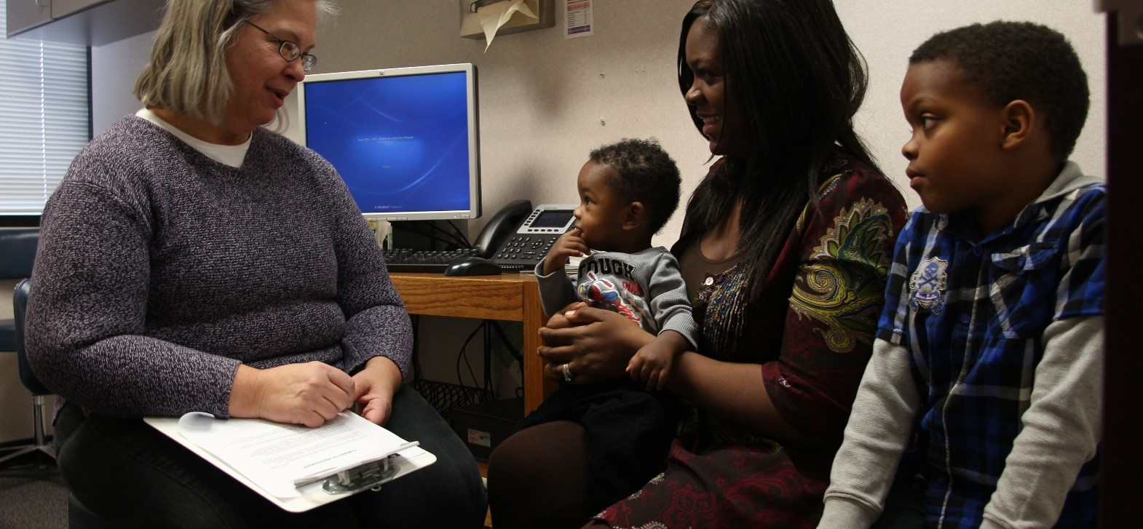
Promoting healthy development
Notes:
Even though we’re a program that works hard to identify concerns and make sure families get referrals and services their child needs, we’re not just focused on problems. We’re in a good position to promote healthy development.
There are some ways that you can do this even during your short visit with the family:
[Use examples of ages or situations appropriate for your screening program setting.]
Use the screening instrument as a tool to have a conversation about typical child developmental milestones at this age, and what the parent can expect over the next few months as the child continues to develop.
Model how interacting face-to-face with the infant or child helps wire their brain for healthy social and emotional development: Talk to the baby as you check him or her over: look in their eyes, talk back when they coo. Encourage the parent to keep talking, reading and playing with their baby face to face every day.
During the visit, reinforce healthy parent-child interactions by noticing and commenting on the positive ways the parent interacts with their child: “I noticed that when ____ looked anxious, you smiled at him and hugged him a little closer. That seemed to really make him feel secure.”
Share resources and ideas with the parent about how they can support healthy social-emotional development. You may have some favorite take-home materials to share with parents; others will prefer to go to the web for more information. Some key resources and links are listed at the end of this module.

Slide 6

Early Childhood Indicators of Progress (ECIPs)
Resources and information for parents including activities which promote healthy development
Aligned with Minnesota kindergarten through 12 grade standards
Minnesota ECIPs
Notes:
Minnesota’s ECIPs were last updated in 2025 and can be found at the link shown on this slide.
Quotes from the ECIP document:
“Early childhood specialists have developed what is known as ‘early learning guidelines’ that describe what young children can know and do as they grow and develop; that is, they outline the knowledge and skills that all young children should be provided opportunities to learn.In Minnesota, these shared expectations are called the Early Childhood Indicators of Progress: Minnesota’s Early Learning Standards (ECIPs)” (p. 4)
“The ECIPs are also intended to support caregivers of young children. Communication with families and caregivers should include discussions of the ECIPs, so they have the information they need to support children’s learning and development” (p. 12)

Slide 7
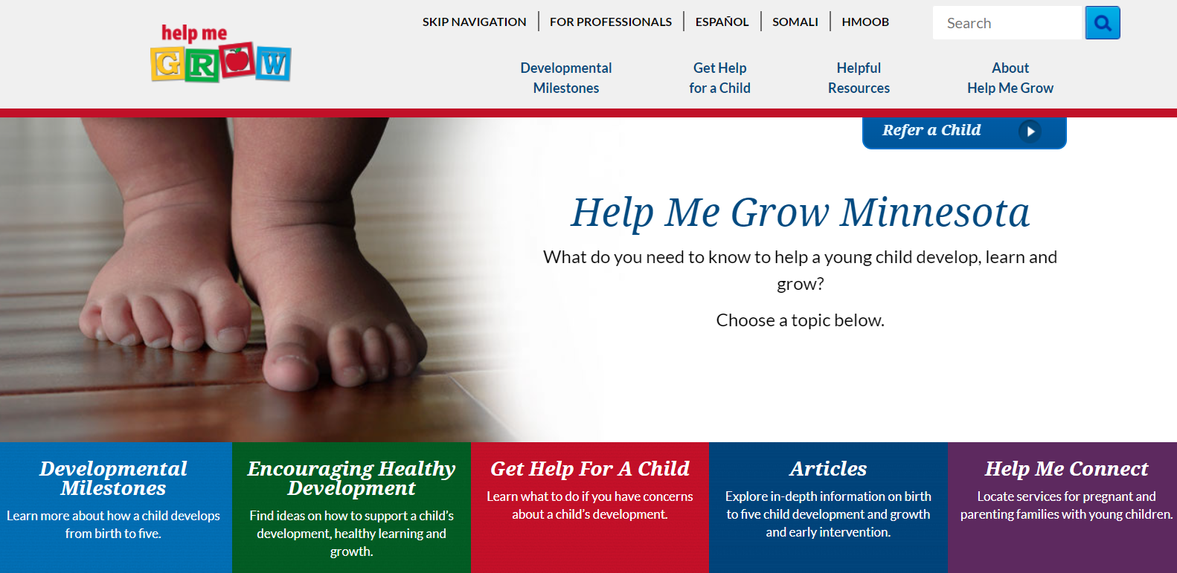
Help Me Grow
Help Me Grow MN
Notes:
Help Me Grow Minnesota offers a wealth of information for families and providers about early childhood development birth to age 8.
Parents can watch videos that show developmental milestones for different ages and learn what they can do to encourage their child’s healthy development.
I’d like to emphasize the nice Social Emotional milestones that are available on HMG
This website is also a point of referral for early intervention and preschool special education services in Minnesota. However, district usually refer directly to their special ed departments from screening.
Social & Emotional Milestones | Help Me Grow MN

Slide 8
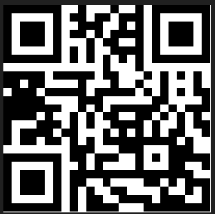
Help Me Grow Minnesota
Help Me Grow Minnesota is the referral connection for families when they or someone they know have worries about their baby's, toddler's, or young child's growing and learning (development)
Connection to supports and services through the family's local school district or cooperative
  FREE for every child who is eligible and their family
Resources on the website about many topics including what we might expect at different ages of growing and learning for ages birth to 5

Slide 9
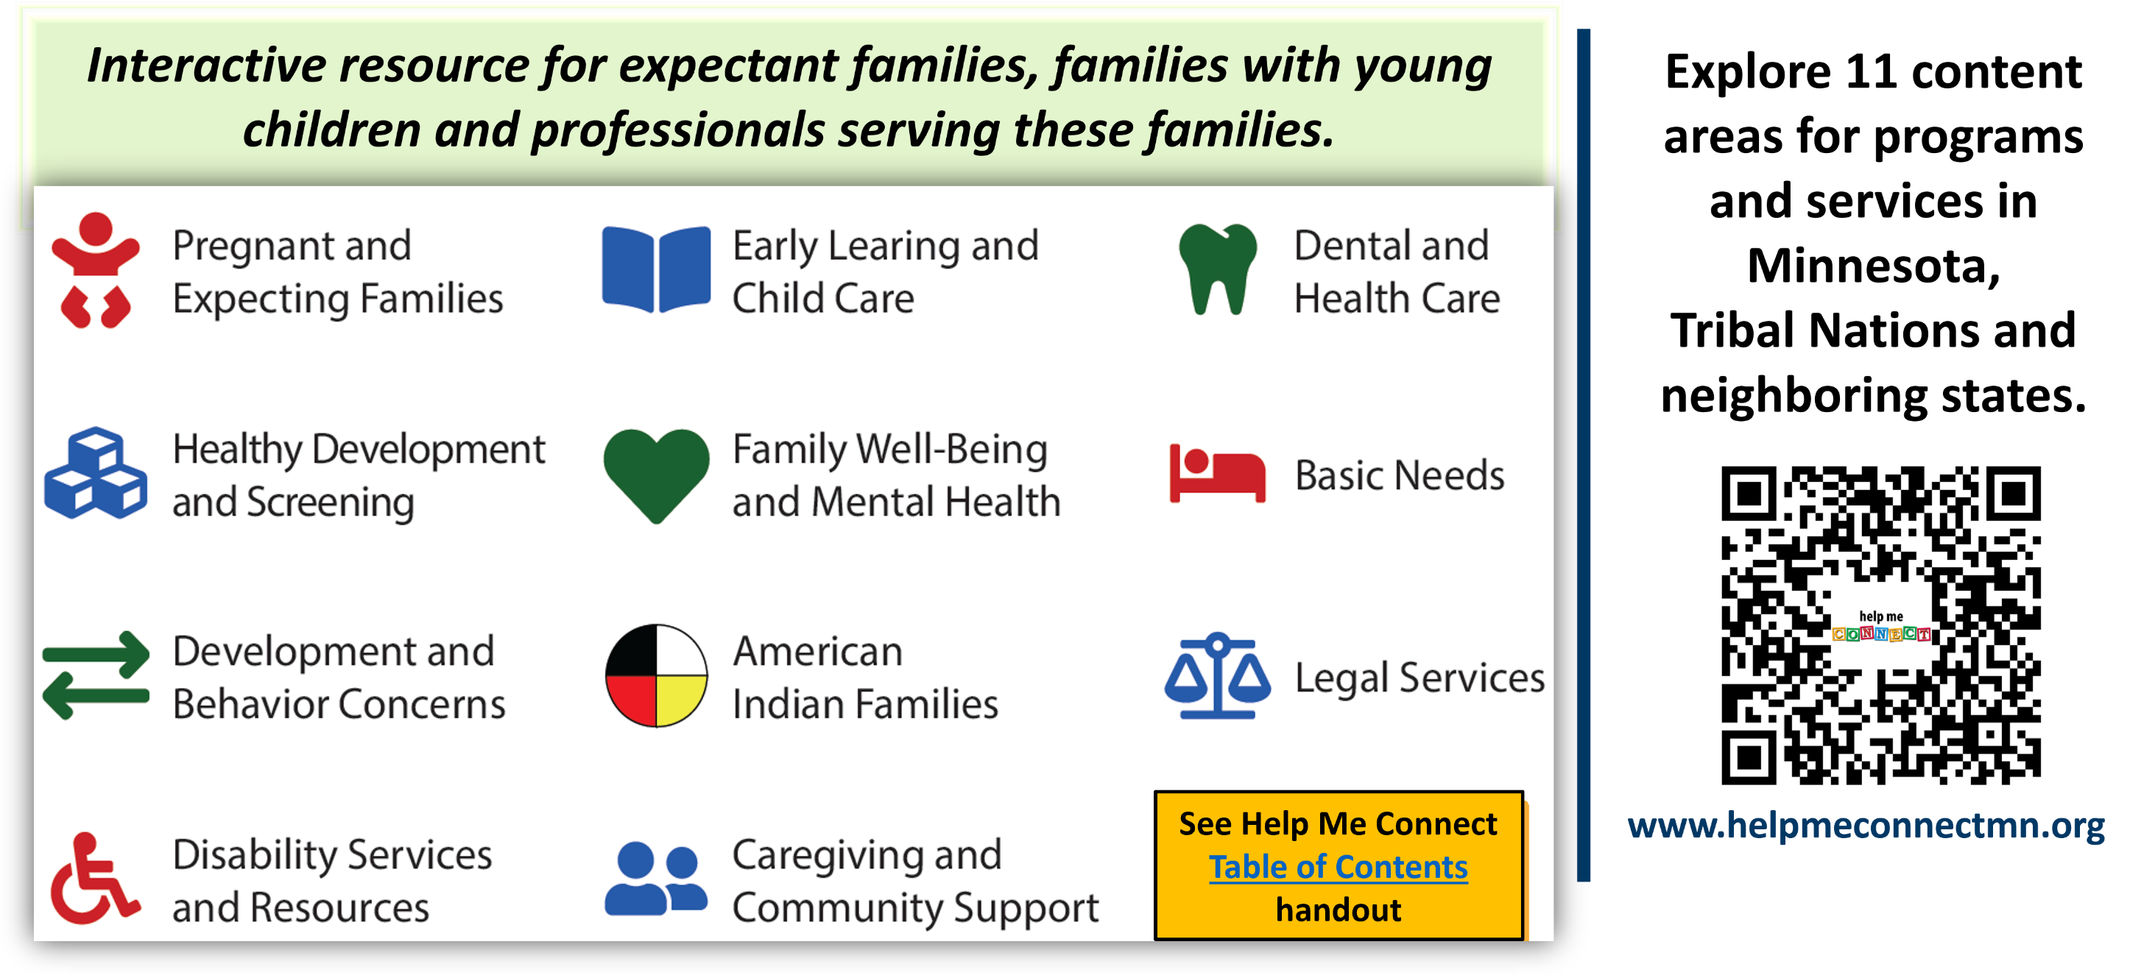
  Helping families thrive with Help Me Connect

Slide 10
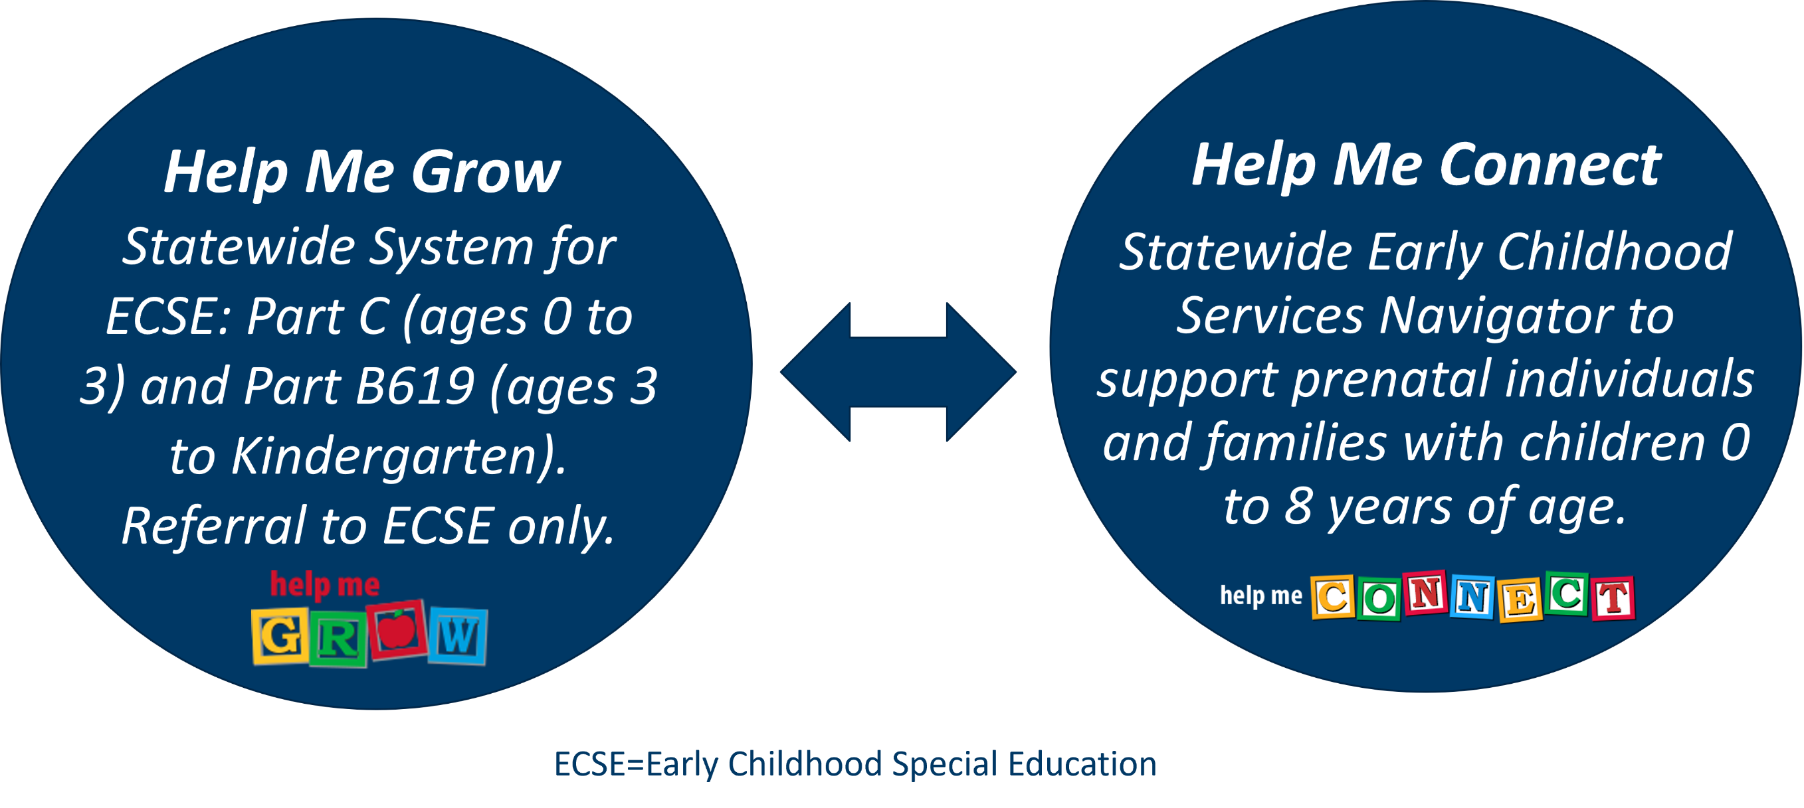
Help Me Grow and Help Me Connect

Slide 11
Difference between Help Me Connect and Help Me Grow
Help Me Grow
Resources and videos about early childhood development, typical development milestones, when to be concerned, and what to do.
Referral portal to early childhood special education staff at the school district.
Information about next steps after a referral is made and what to expect.
Connect with regional Interagency Early Intervention Committees (IEICs).
Help Me Connect
Online directory that helps professionals and families find all types of programs in their local communities (16,000+ listings).
Works in partnership with Help Me Grow to connect families to other helpful resources outside of the ECSE specialty and capacity.
No wrong door approach – connects to the existing Help Me Grow referral system.
Referral portal for professionals to connect families to other needed services.

Slide 12
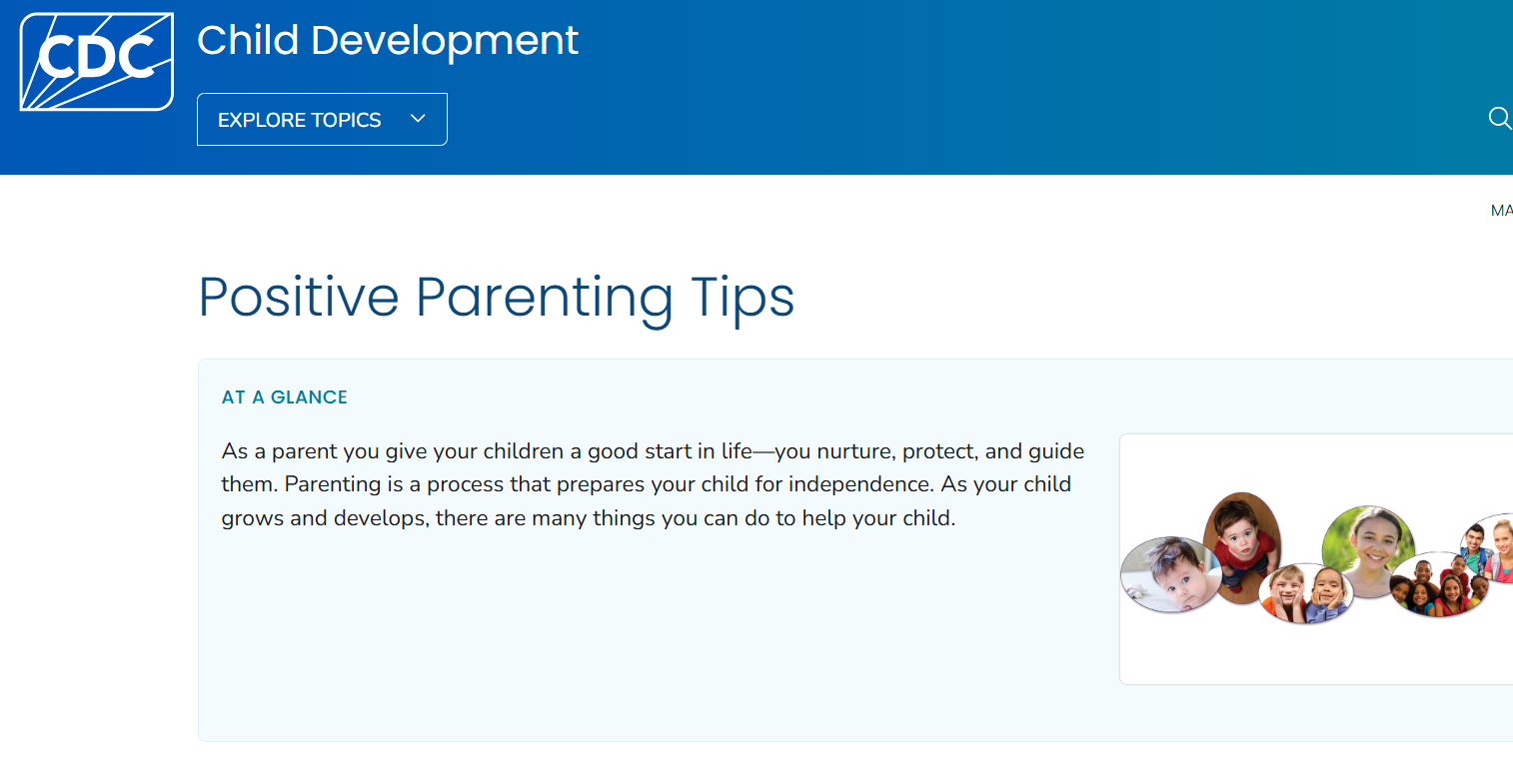
CDC Positive Parenting Tips
CDC Positive Parenting Tips
Notes:
The CDC also offers downloadable handouts on positive parent tips, for children age birth through 17 years.

Slide 13
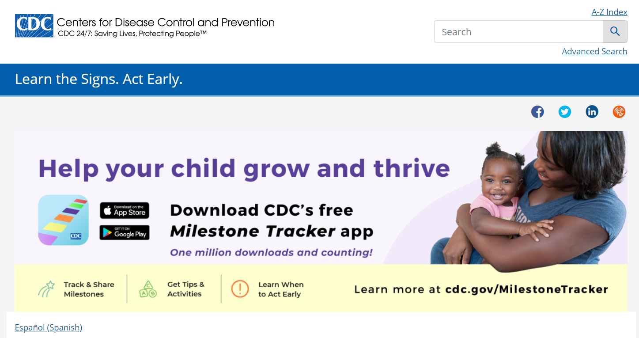
CDC Learn the Signs. Act Early.
CDC Learn the Signs. Act Early.
Notes:
The Centers for Disease Control and Prevention, better known as the CDC, offers both website resources and free downloadable developmental information for families and professionals.
This includes milestones, free materials, a Watch Me! Training for early care and education providers, what to do if you’re concerned about your child’s development, multimedia tools, and an autism case training. For

Slide 14
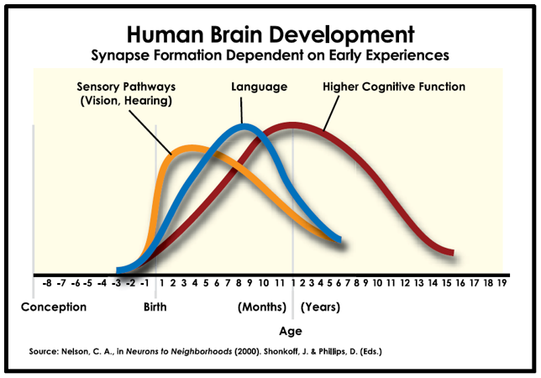
Early Childhood Brain Development​
Notes:
The time during pregnancy and the child’s first 3 years of life is perhaps the most crucial time of development. This graph shows how skills begin to build before we can see them evidenced by the child, and how each developmental skill builds on previous skills. Brain development begins in the womb and continues rapidly in the first few months of life. It’s easy to see here how early intervention is so important for vision and hearing problems – if we don’t catch these issues early, they impact later development in a way that we can’t “take back”. Even though it may be harder to physically see, the impact of early social-emotional development is equally important. As staff in one of Minnesota’s screening programs, your role is so important to help support families in their child’s development, and to identify any concerns early so that they can get evaluated and treated.
More information on the science of early child brain development is available from the Harvard Center on the Developing Child

Slide 15




Child development
Fine and gross motor
How children move their bodies and use their hands
Communication and language
How children understand and communicate with others
Cognitive
How children explore, learn, think, and figure out how to solve problems
Social-emotional
How children feel, behave, and relate to others
Notes:
WHAT IS DEVELOPment? What exactly are we looking for when we provide developmental screening? When you talk with parents about why you are screening, here are some ways you can explain what we are looking for – both skills that the child is already doing, and things that they might not be doing yet. It helps us figure out whether we should take a closer look at a certain area, provide some extra resources, and what we can do to support things that are going well.
The Help Me Grow website has more information and videos for parents about developmental milestones.
For Clinics only: To be reimbursed for developmental screening – use one of the recommended tools.
ASQ-3: 0-5 years
PEDS-R: 0-7 Years
SWYC: 0-5 years

Slide 16

Social-emotional development
(or infant and early childhood mental health)
All in the context of family, community and culture:
  Relationships
  Emotional regulation
  Security and exploration
Zero to Three
Notes:
Social-emotional development is a very important part of a young child’s development and requires a separate screening instrument. Social-emotional development is also known as infant and early childhood mental health. It’s “the developing capacity of the young child to experience, regulate, and express emotions, form close and secure interpersonal relationships, and explore the environment and learn, in the context of a caregiving environment that includes family, community, and cultural expectations for young children.” Zero to Three is the leading national organization for infant and early childhood mental health. More information for both parents and professionals is available on their website.
Both parents and professionals tend to know more about and feel more comfortable with general developmental concepts like brain development, speech, and motor milestones. However, social-emotional development is the basis for a child’s later relationships, behavior, and mental health.
[Interactive activity: What do you notice about the children in this picture? When you are with a child at work, what are signs of emotional regulation? (Examples: crying and going to the parent for safety, thumb-sucking to calm themselves, saying “I’m scared”…]

Slide 17

Family-centered screening process
Notes:
Development happens in the context of relationships. The child’s parent (or other primary caregiver – maybe a grandparent or foster parent) is their main partner in healthy development. The child’s relationship and interaction with that parent literally help wire healthy brain development. One of our most important jobs is to partner with parents to support them, as they support their child’s development. In a minute, we’ll take a quick look at resources for parents.
You can help support parents by doing the following as you work with them:
Recognize them as the expert on their child
Explain in plain (but not condescending) language what you would like to do and why
Always ask about parent concerns and usually ask more than once. Parent concerns are very telling, and sometimes it takes a while for them to feel comfortable enough to share with you what they may be worried about.
After the screening process is finished, have a conversation with the parent about the results, and offer resources and referrals. Find out what fits best with the child’s and family’s needs and priorities.
When you take this approach, it helps validate the parent’s role and concerns and helps build the trust that is needed to move to the next step if a concern is identified.

Slide 18
What can interrupt healthy development?
Biological reasons
Exposure to environmental toxins
Disruptions in relationships with primary care givers
Exposure to trauma
Social/environmental stressors, racism, poverty
Notes:
Biological reasons
Prenatal alcohol or drug use
Exposure to lead/mercury/arsenic/poor air quality (helpful resource: Toxic Free Kids Act Educational Materials - MN Dept. of Health)
Loss of a parent or primary care giver for any reason: death, abandonment, or inconsistent availability perhaps due to mental illness or substance use
Exposure to trauma (domestic violence, neighborhood violence, abuse or neglect)
Social or environment stressors on the child and family - like poverty, homelessness, racism, decreased access to quality child care or education or medical services
Systemic racism
All of these can negatively affect brain development and long-term health outcomes, especially if the child doesn’t have consistent, nurturing care or environment.
Hyperlinks:
Neurons to Neighborhoods – https://nap.nationalacademies.org/catalog/13119/from-neurons-to-neighborhoods-an-update-workshop-summary
ACE Study - https://www.cdc.gov/violenceprevention/aces/index.html

Slide 19
How do we identify social emotional concerns in young children?
Listening to parents- parents know their children best.
  Using parent informed screenings that identify early childhood mental health issues.
  Having systems that families feel comfortable with assist in screening.
  Make sure parents know their options for referral and are given choices.
  Integrating mental health services in systems where families feel comfortable receiving care.

Slide 20
Long-term effects of adverse childhood experiences (ACEs)
Notes:
[OPTIONAL SECTION]

Slide 21
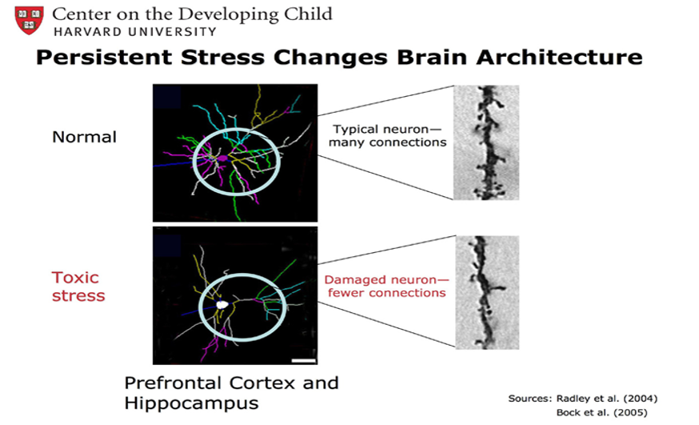
The Effects of Trauma and Adversity on the Brain

Slide 22
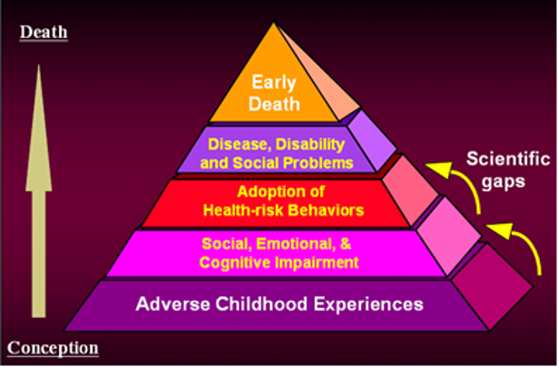
Adverse childhood experiences (ACEs)
Notes:
Research over the past decade research on the long-term health consequences of adverse childhood experiences (ACEs) helps us understand how crucial it is to pay attention to the experiences of our youngest children.

Slide 23
Ten ACEs studied
Childhood abuse
  Emotional
  Physical
  Sexual
Neglect
  Emotional
  Physical
Household dysfunction
  Witnessing domestic violence
  Alcohol or other substance abuse
  Mentally ill or suicidal household members
  Parental marital discord
  Crime in the home/imprisonment
Notes:
Studies on ACEs – both nationally and in Minnesota – asked adults to look back on experiences they had during childhood, including exposure to verbal, physical or sexual abuse; drinking problems, drug use, or mental illness in the household; incarceration of a member of the household; parent separation or divorce; and witnessing domestic violence.

Slide 24
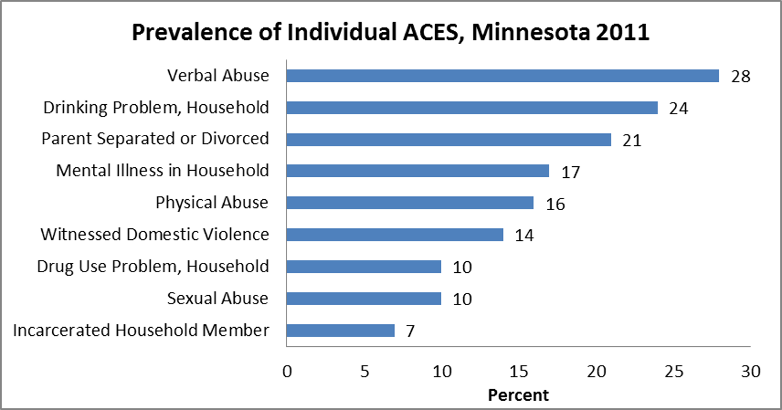
ACEs in Minnesota (BRFSS 2011)
Notes:
Data in Minnesota was similar to national data: almost a third of respondents reported exposure to at least one ACE.
These adverse childhood experiences can and do impact development. Developmental screening and referral are so important in helping children and families receive the supports they need to thrive.

Slide 25
Standardized screening

Slide 26
What is screening?
Quick and simple check of child health and development – for all children
  Uses standardized tools
  Identifies child strengths and skills
  Identifies more subtle concerns
Not a diagnosis!
  Not the same thing as assessment or evaluation
Answers the question, “Does this child need more comprehensive evaluation?”
Notes:
The goal of screening is to identify as early in a child’s life as possible any developmental or social-emotional concerns, and to help the family connect to meaningful services and supports that help the child do better in their health, education, and social interactions.
Standardized screening is designed to help us identify developmental or social-emotional concerns – especially more mild concerns that might not be obvious even to professionals.
Standardized screening instruments have been tested on thousands of children to make sure they are accurate in identifying real concerns, and reliable in different situations.
Screening is universal: all children should be screened, not just ones that we’re concerned about.
The purpose of screening is both to show child’s developmental progress, AND to pick up on hints that a child may need a closer look with more comprehensive evaluation. Screening does not diagnose.

Slide 27
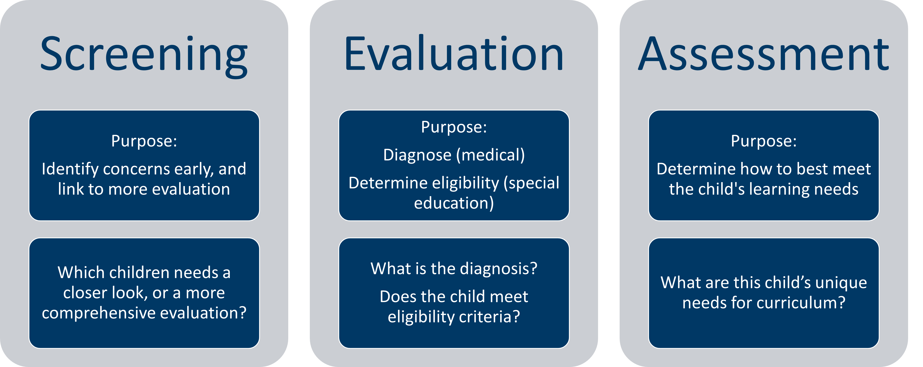
How is screening different from evaluation and assessment?
Notes:
[OPTIONAL: Programs should be clear about definitions that are pertinent in their setting.]
Screening, evaluation and assessment mean different things. Screening is a BRIEF, standardized approach that is designed to identify developmental concerns early. It is used for a whole program population (NOT just those with concerns), at routine age intervals, as children get older. It answers the question, “Which children need a more comprehensive evaluation?”
Evaluation is a more in-depth, comprehensive look at a child when concerns are raised during screening. In the medical setting, it answers the question, “What is the diagnosis?” In the educational setting, it is used to determine if a child is eligible for early intervention or preschool special education services.
Assessment is different still. It is an ongoing or recurring process to decide what an individual child’s learning or curriculum needs are.

Slide 28

Talking to parents about screening
Normalize screening: just like hearing, vision, height and weight
Do call it a tool or a “snapshot in time” to check in how the child is growing and developing
Don’t use words like test, fail, or any diagnosis words
It is a 'check in' where we ask parent about their concerns and to give their best, honest answers
Notes:
If we explain screening well ahead of time, parents have an easier time with it, and we get more helpful information. Some parents may be nervous about screening – like it’s a test, or that we will be judging how good of a parent they are. These tips can help calm these worries, and help parents understand how important their role is, as “expert” on their child.

Slide 29
Required components of early childhood screening
Vision/hearing
Height/weight
Immunization review
Health care provider/coverage
Review of risk factors which may impact learning
Developmental/social emotional
Parent summary interview
MDE ECS Program lists a Standards form (under “program resources”)
Notes:
[Optional slide for ECS]

Slide 30
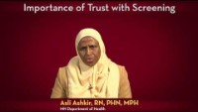
Presenting Screening to Refugee or Immigrant Families
Notes:
For families who are less familiar with preventive health and developmental screenings, trust is a huge factor, along with explaining the purpose of screening.
In this video, Asli talks about this, in relation to the Somali population. [CLICK ON PHOTO TO LINK TO THE YOUTUBE VIDEO: https://www.youtube.com/watch?v=bBvwOmG72Hs&list=PLqPfFYYbtBZjkeFkeVwUKz-iciPB8HpPi&index=9 ]
[DISCUSSION: Some potential questions for group discussion:
What are ways we can establish a trusting relationship with families in our setting/program?
Besides trust, what are other issues that Asli raises for us to pay attention to in our approach with families?]

Slide 31
Successful screening for culturally and linguistically diverse families
Learn more about the cultures and languages in the community you serve
Hire staff who are representative of the families being served
Use professional interpreters, with a little extra training
Provide additional support for access, screening process, and follow-up as needed
Notes:
[QUESTIONS TO CONSIDER DISCUSSING: How do we address these challenges?] Presenter pick 2 questions to talk about.
What cultural or ethnic groups do we serve? How do our screening rates or ages screened differ by race?
How easy is it for a parent to request an appointment or ask a question if English is not their preferred language?
How closely does our staff match the population we serve?
If it’s not a close match, what could we do to address that? (examples: paraprofessional staff, volunteers, community/cultural liaisons, interpreters, other ways?)
When using professional interpreters, be sure to check with the family if they have a gender or any other preferences for their interpreter.
Are we using the best screening instrument(s) for the population we serve? Are there particular questions or items that are problematic?
What are ways that you’ve been successful in trusting and effective screening relationships, even across cultures and languages?

Slide 32
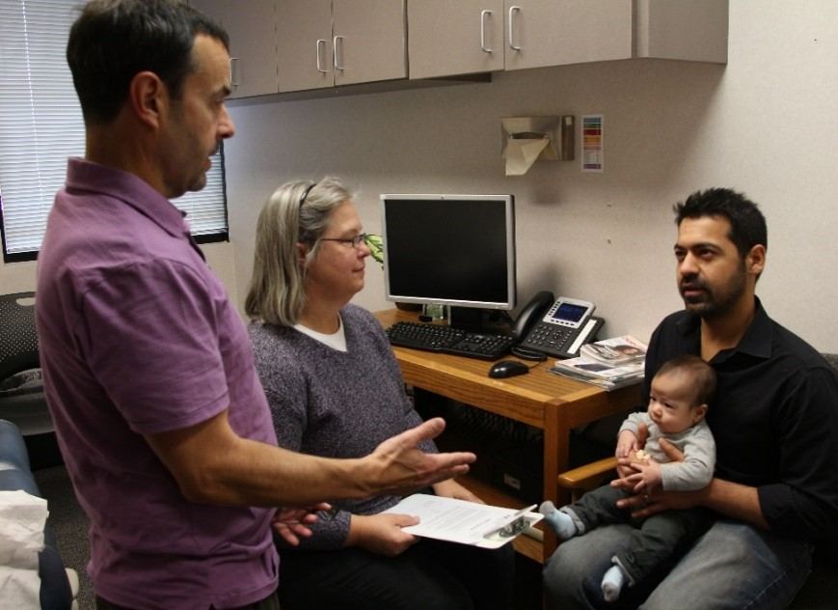
Working with interpreters
Effectively determine if an interpreter is needed
Provide a professional interpreter whenever possible
Educate the interpreter
It’s okay to explain or re-frame questions
Notes:
Provide a professional interpreter; do not try to screen without or use family members (children or adults).
How do you decide if an interpreter is needed?
Less effective: Do you need an interpreter?
More effective: In what language are you most comfortable talking about your child’s health and development? (This is closer to the level of language they will need to use to talk with you about their child’s development.)
Confirm dialect/regional language and culture with interpreter for a good match with the caregiver
Take a few minutes ahead of time to explain the tools you are using; ask them not to provide answers for the parent; request direct translation; and give them permission to raise concerns (like if something isn’t culturally appropriate, or something else they notice).
[If desired: Refer to Minneapolis Public Schools interpreter handout as an example – handout and next slide.]

Slide 33
Minnesota Department of Education (MDE):
Guide for interpreters
Early Childhood Screening Guidelines for Interpreters under program resources
Training Video: Early Childhood Screening and Interpreters under professional learning
Ask parent: In what language are you most comfortable discussing your child’s health?
If child speaks or is in a home with a language other than English offer to screen in both languages for the most accurate results
Notes:
[Note although these were created for ECS any screening program could benefit from looking at these and adapting them to their program]
Hyperlinks:
Early Childhood Screening Guidelines for Interpreters - https://education.mn.gov/mdeprod/groups/educ/documents/basic/bwrl/mdg3/~edisp/mde087018.pdf
Training Video: Early Childhood Screening and Interpreters –
https://education.mn.gov/MDE/VideoNew/?group=Communications&id=mde033429 This 20 minute video was made with input from the Taskforce, MDE specialists in Equity, Community Engagement, Multi Language Learners and educational interpreters in Minnesota.

Slide 34
Screening instruments

Slide 35
Recommended screening instruments
Minnesota has a list of recommended instruments that have been reviewed for validity, reliability, and practicality
Different screening programs have different requirements for which instrument to use
Programs are responsible for making sure that they are using the most current, recommended instrument(s) for their program
Notes:
All public screening programs in Minnesota should refer the website of the Minnesota Interagency Developmental Screening Task Force for information about recommended screening instruments. Many other resources are also available on this website.
[REVIEW WHAT INSTRUMENTS ARE USED IN YOUR PROGRAM. For example:
For Early Childhood Screening, state statute requires an observational developmental screening instrument, but also a parent report instrument – different ECS programs use different developmental tools, but most programs use the Ages and Stages Questionnaires: Social-Emotional (ASQ:SE-2) to meet that 2nd requirement.
Follow Along Program uses ASQ-3 and ASQ:SE (or ASQ:SE-2).
MIECHV family home visiting programs report on ASQ-3 and ASQ:SE screening.
Clinics that provide Child and Teen Checkups usually use the ASQ-3 or PEDS or SWYC parent report developmental screening instruments, for practical reasons.]
Hyperlinks:
Recommended Instruments – https://www.health.state.mn.us/people/childrenyouth/ctc/devscreen/instruments.html
Recommended instruments for c&tc clinic settings - Instruments at a Glance for CTC Clinics (state.mn.us)
Screening Programs - https://www.health.state.mn.us/people/childrenyouth/ctc/devscreen/programs.html

Slide 36
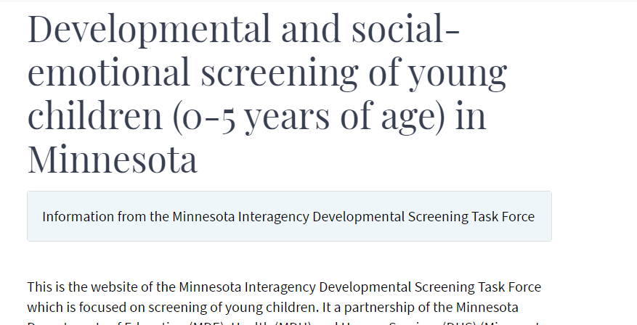
Developmental and social-emotional screening of young children in Minnesota
Developmental and Social-Emotional Screening for Young Children (0-5 Years) Minnesota
Notes:
The link on this page takes you to the “Developmental and social-emotional screening of young children (0-5 years of age)” webpage, this page is presented by the Minnesota Interagency Dev Screening Task Force. Included on the page are recommended instruments and other information for public screening programs for ages birth through 5 years.
The Resources page (screenshot shown here) has links to help you find local programs that support healthy early childhood development, as well as links to state and national resources. Note the left navigation panel: point out “Recommended Instruments”, “Referral”, and “Resources”.
from the website where the Minnesota Interagency Developmental Screening Task Force posts [Direct link to webpage, if you would like to explore it with your training group: https://www.health.state.mn.us/people/childrenyouth/ctc/devscreen/index.html]

Slide 37
Choosing a screening tool
What type of screening is required or allowed for your program?
What staff qualifications does the tool require?
What instrument best meets your population’s needs?
Refer to Choosing an Instrument on the developmental screening website
Notes:
What type of screening is required or allowed for your program?
Developmental and social-emotional screening require separate instruments.
Parent report (answered by a parent or primary caregiver) vs. observational instruments (administered by a staff person or professional)
What staff qualifications does the tool require?
Refer to the screening instrument manual.
What instrument best meets your population’s needs?
Age range
Validated for a diverse population
Is it translated into needed language(s)? Is it validated in those languages? Are there different cut-off scores?
Hyperlinks:
Choosing an Instrument - https://www.health.state.mn.us/people/childrenyouth/ctc/devscreen/selection.html

Slide 38
What makes a good, standardized screening instrument? (Review criteria)
Instrument purpose
Developmental domains
Sensitivity/specificity, validity
Reliability
Recent standardization
Additional considerations:
  Practicality
  Population and age span targeted by the instrument
  Cultural, ethnic, and linguistic sensitivity
  Minimum expertise of screeners
  Cost
Notes:
This is good for audience to know why the instruments were chosen.[OPTIONAL: Even if your program’s tool is pre-determined, staff may like to know that the MN Interagency Developmental Screening Task Force uses certain criteria to select high quality instruments recommended for public screening programs.]
Instrument purpose: Does the tool accurately screen for conditions we are trying to address?
Developmental domains: Instruments for Minnesota’s screening programs should at least cover the following areas:
Gross motor
Fine motor
Language/communication
Cognitive
Social-emotional (separate instrument)
Sensitivity/specificity, validity: Is the tool ACCURATE? (it actually finds what we are looking for)
Reliability: Is the tool RELIABLE, from one time to the next, or from one administrator to the next?
Recent standardization: Was the tool developed and tested within the last 10-15 years?
Additional considerations:
Practicality: How long does it take to complete?
Population and age span targeted by the instrument: Has it been validated on a diverse population, at the ages that matter for our programs?
Cultural, ethnic, and linguistic sensitivity: Has the tool been translated into other languages? If so, was that translation validated in that population? (Note: this is a big challenge – some tools have been validated in Spanish, but very few in other languages.)
Minimum expertise of screeners: What kind of staff person can administer and interpret the tool?
Cost

Slide 39
Screenings by program
Program | Developmental | Social-Emotional
Child and Teen Checkups (C&TC) | Recommended Parent report or observational | Recommended Parent report
Head Start & Early Head Start | Required Parent report or observational | Required Parent report
Early Childhood Screening (ECS) | Required Observational* | Required Parent report
Child Protection | N/A | Required Parent report
Family Home Visiting | Required Parent report or observational | Recommended Parent report
Follow Along Program | Required Parent report | Required Parent report
* Observational requirement is waived for parents requesting virtual screening due to health concerns.
Notes:
[optional slide – to compare requirements across programs]
There are many public screening programs in Minnesota: Child and Teen Checkups, Head Start and Early Head Start, Early Childhood Screening, Child Protection, Family Home Visiting, and the Follow Along Program. Each of these programs has specific screening recommendations or requirements.
This is helpful to know in order to choose an instrument, but also means there may be more opportunities for children to be screened, and opportunities for different programs to coordinate to decrease duplication of services.
* Note for ECS, during COVID-19, a parent report tool of cognitive, speech/language, fine and gross motor development may be used for distance screening. Observational tool is used during in-person or hybrid learning model.

Slide 40
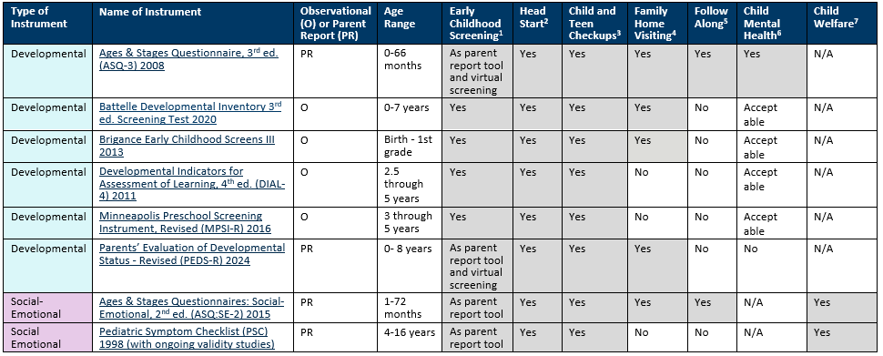
All Instruments at a Glance
Notes:
DHS-7990-ENG (Pediatric Symptom Checklist Parent and Youth Screening Tool Q38) (state.mn.us)
[OPTIONAL – Shows currently recommended instruments.]
Light blue are developmental screening tools.
Purple are social-emotional screening tools.
The columns show whether these recommended tools are appropriate for different age groups and different programs in Minnesota.

Slide 41
Where do I order screening tools or forms?
Connect with publisher links within the All Instruments at a Glance document on MDH Recommended Instruments.

Slide 42
Observational developmental screening instruments
Require a child to perform certain developmental tasks, observed by a professional
Allow for direct observation of development that may not be recognized by parent/caregiver (such as a speech concern)
May be particularly useful if the parent/caregiver has limited ability give a report of development
Are currently required for Early Childhood Screening programs (except if parent requests virtual screening for health reasons)

Slide 43
Parent-report developmental screening instruments
Perform as well or better than observational tools
Help focus visits on issues important to families
Create teachable moments
Respect parents as experts
Capture milestones even if child cannot “perform” them at the screening visit
References:
  Minnesota Child Improvement Partnership. Healthy Development through Primary Care Project, 2008.
  Developmental Surveillance and Screening Policy Implementation Project, AAP, June 2006.
Notes:
[OPTIONAL: Some screening providers question the validity of parent-report instruments; this is to address that concern.]
Many professionals wonder if we can we rely on parent-completed instruments. Research shows that parent report instruments perform as well or better than tools that rely on professionals making real-time observations of skills at a specific time and location. Parents or caregivers spend the most time with their child and can most often capture many more subtle behaviors in their children. Other benefits of using a parent-report instrument:
You can identify both how the child is doing with development, and what the parent’s concerns are.
You can more quickly focus your visit on what concerns the parent (and what they are most motivated to act on.)
Parents feel respected as the expert on their child.
Parents have the chance to learn about child development during the screening process – use the screening instrument as a teaching tool, and a tool to start a conversation about concerns.
Regardless of what instrument you use, an essential part of screening is asking parents about any concerns they have about their child, and following up on those concerns.

Slide 44

What’s in the ASQ-3?
(Ages and Stages Questionnaires: 3)
If possible, give to parents ahead of time
A tool to check the child's development
Covers: Communication, gross motor, fine motor, problem solving, personal-social
Response options: Yes, sometimes, not yet
Written at the 4-6th grade level
Unscored section- open ended questions
Parent concerns are very predictive- any concerns require follow-up
Notes:
[OPTIONAL: There is often confusion about the ASQ-3 versus the ASQ:SE. ]
Both are parent-report instruments.
The ASQ-3 covers general development, including the areas listed here.
The ASQ:SE covers specific areas of social-emotional development.
The 2nd edition just came out in fall of 2015, and is called the ASQ:SE-2. Programs who use the ASQ:SE should transition to the 2nd edition no later than July 1, 2017.

Slide 45

What’s in the ASQ:SE-2?
(Ages and Stages Questionnaires: Social-Emotional, 2nd edition)
Data and cut-off scores based on sample size of more than 14,000 diverse children
Age range: 1 to 72 months of age
Has a monitoring zone (similar to ASQ-3)
Scoring and interpretation is similar to ASQ:SE
Screening Items specific to autism
Refined Spanish translation
Notes:
[OPTIONAL – for programs that use the ASQ:SE, this slide outlines the main changes in the 2nd edition (ASQ:SE-2). According to the publishers, people who are familiar with using the original ASQ:SE should not need special training to use the ASQ:SE-2.]

Slide 46
Small group discussion
What instruments is your program currently using?
What are the benefits of using the instrument?
What are some of the challenges?
Do you have any success stories to share?
Notes:
[Optional]

Slide 47
Communication and relationship practice objectives
Identify importance of relationships in referral process.
Identify referrals and follow up for developmental and social emotional concerns.
Apply new knowledge in communication, referral, and follow up processes with small group case study.
Identify communication best practices for discussing referrals.
Notes:
[Programs may want to revise the objectives to meet their needs.]
These practices apply to communication between families and providers/screeners, and between providers and partner agencies where referrals are being made or received. Communication is not just about transferring information — it is about building trust, cultivating belonging, and creating shared understanding. These practices reflect what families and partners have told us makes referral conversations meaningful and effective.”
1. Build trust as the foundation – Center relationships in every referral conversation, honoring families’ strengths, voices, and lived experiences.
2. Communicate with care and collaboration – Use relational approaches (listening, validating, co-creating) when discussing referrals and follow-up for developmental and social-emotional concerns.
3. Practice and apply together – Strengthen communication and referral processes through shared case studies, reflection, and collaboration across families, providers, and partners.

Slide 48
Making meaning out of screening

Slide 49
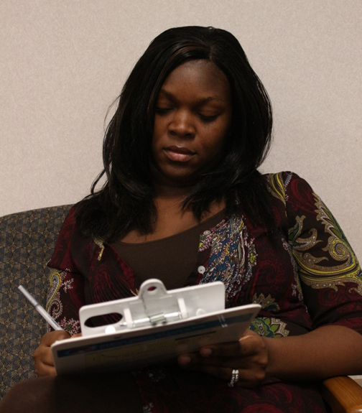
Interpreting screening results
Clarify any missing or concerning responses
Interpret results in context
Consider:
  Opportunity
  Health or developmental factors
  Family and cultural factors
No screening tool is perfect
Notes:
Even though using a standardized screening tool is much more effective than not, no screening instrument is 100% accurate. Any concerning result requires action
Ask parent/caregiver for clarification about missed or concerning answers
Screening must be interpreted in the context of the child and family’s experience, culture, and everything else you know about the child.
Consider the following:
Opportunity – give the child an opportunity to try a new skill if it hasn’t been offered before.
Health and developmental factors, such as recent illness or hospitalization; history of vision, hearing or other factors that could affect development. Screen again when those issues have been addressed.
Family and cultural factors – including family or cultural expectations around parenting, discipline

Slide 50
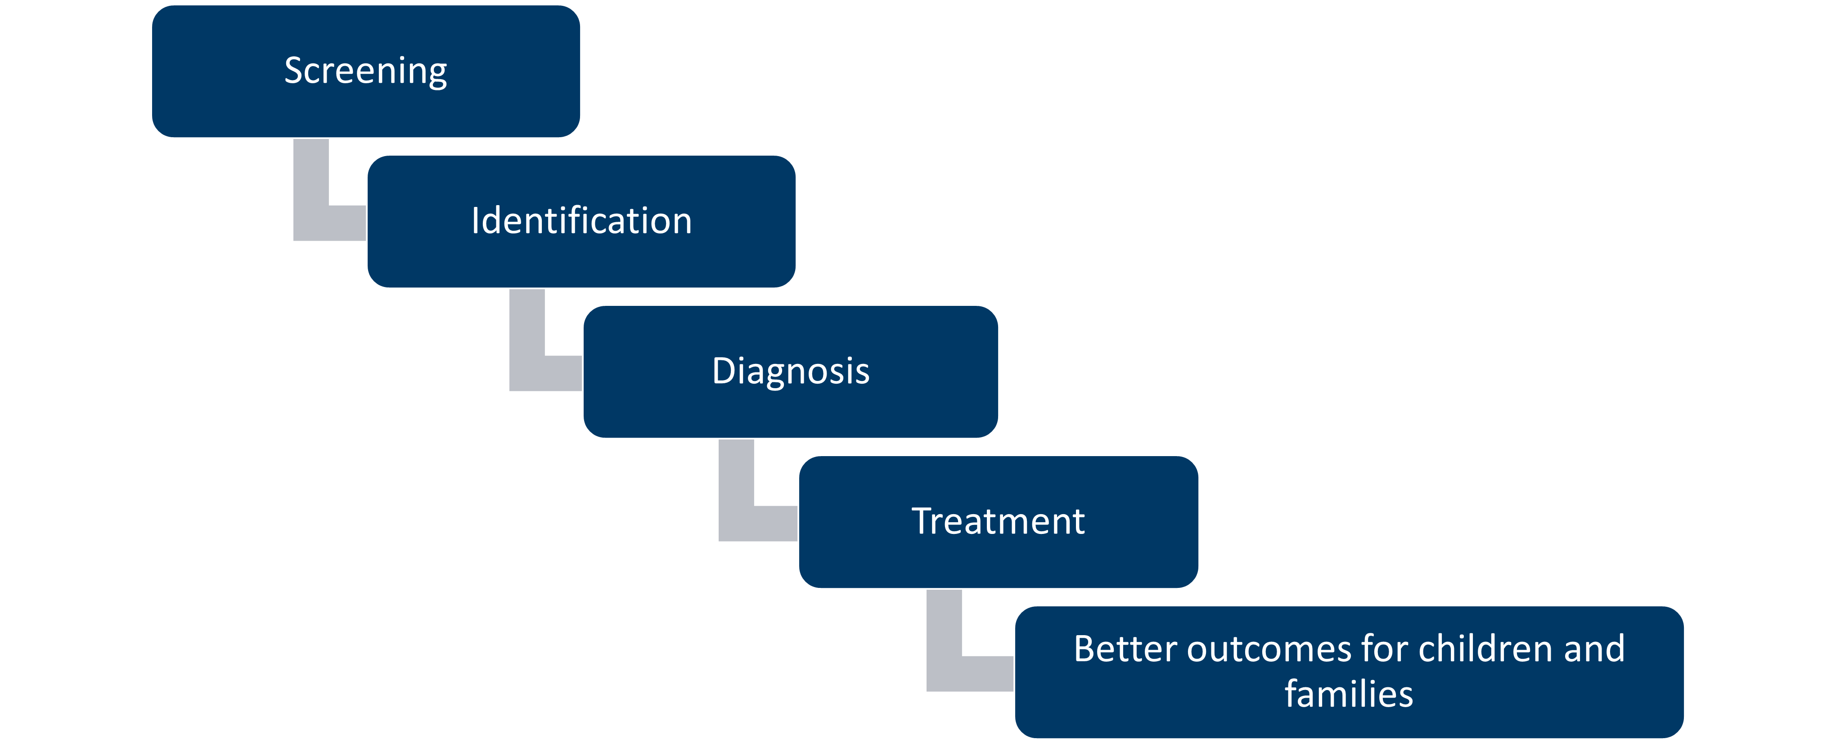
Typical process following screening
Notes:
This is an example, but not all concerning screening results lead to referrals to clinics to diagnose or evaluations for special education.

Slide 51
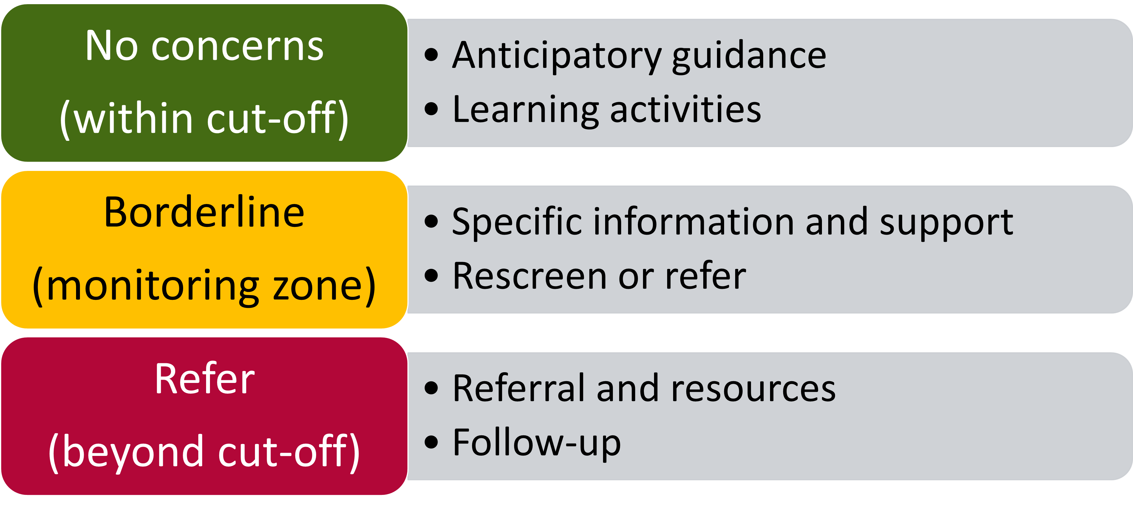
Results and action
Notes:
If screening results are within cut-off range (“pass” or typical development), this is our opportunity to provide education about what to expect next in the child’s development, and give ideas about how the parent or caregiver can support healthy development at home.
**anticipatory guidance and learning activities should be included/provided no matter what the results are!
If screening results are borderline or in the monitoring zone, more information is needed. Talk more with the family to see if there are programs or other things that could support the child’s healthy development, and follow up sooner rather than later with the family to re-screen the child.
If the child’s screening results are beyond cut-off (concerning), more information is needed. Discuss the concerns with the family and develop a plan together for next steps. We’ll talk in a minute about what those next steps might be.
Remember, even if screening results are “normal”, if either the parent or you have a concern about the child’s development, they may still need a referral for a more comprehensive evaluation or supportive services.

Slide 52
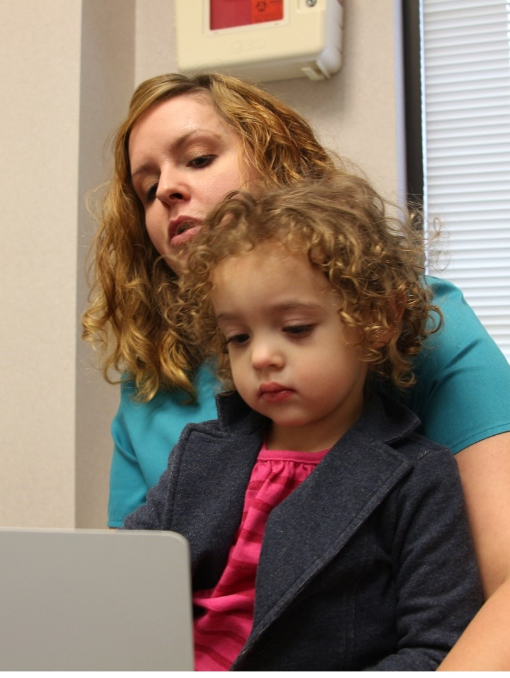
Talking about screening results: What not to say
She failed her screening.
I’m worried she might have autism.
Let’s just wait and see if she grows out of it.
Here’s the number for Help Me Grow. You should call to see if she can get special education.
Notes:
There are some ways NOT to approach screening results with parents.
Do not use the word “fail”: Screening is not a test. Screening helps us both see what is going well for a child, and it helps us find areas where we might want to take a closer look.
Don’t use any diagnosis words: Screening is not a diagnosis. If there is an area of concern, more information is needed.
Take the “wait and see” approach

Slide 53
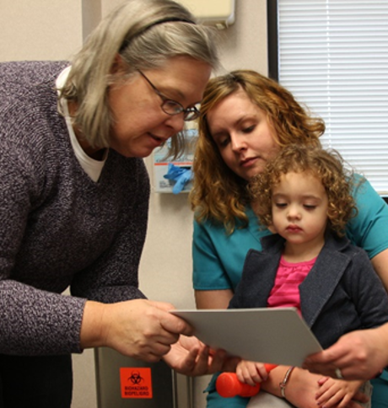
Talking about screening results: A better way
The screening showed that she’s doing ____ very well. However, it looks like she isn’t doing ____ yet like most other children her age.
What have you noticed about this?
The screening is just a quick check. We can take a closer look at what might be going on and find some helpful resources.
Would it be okay if I shared some ideas with you?
Notes:
DO use screening as a tool to start conversation. Give specific examples of the child’s strengths, and any areas of concern.
The screening showed that she’s doing ____ very well. However, it looks like she isn’t doing ____ yet like most other children her age.
DO address parent concerns and learn more about what they think.
What do you think? What have you noticed about this?
DO offer to provide recommendations for next steps. Use family-centered decision making principles to develop a plan together.

Slide 54
Effective communication strategies
Developing a partnership with families is critical for early and accurate identification
Include recommendations for ways families can help support healthy development
Video resource for effective communication on referral and follow up
  Communicating with Families During the Screening Process (11-minute video)
  While the video takes place in a clinic setting, any screening program staff may find it a helpful
Notes:
[Preview video for your program and select content that best aligns]
This is a short video with a focus on effective communication practices with families about screening recommendations for referral and follow up, links to screening and intervention resources. While the video takes place in a clinic setting, any screening program staff may find it a helpful resource in building partnerships with families during screening.
Video depicts effective communication strategies for primary care providers, pediatricians and care coordinators to utilize with families throughout the screening process. Developing a partnership with families during routine well-child visits is critical to ensure early and accurate identification for further assessment. There are also suggestions for ways the family can help to support their child’s healthy development between screenings. Recommendations for referral and follow up are also included.

Slide 55
Referrals: When concerns are identified

Slide 56
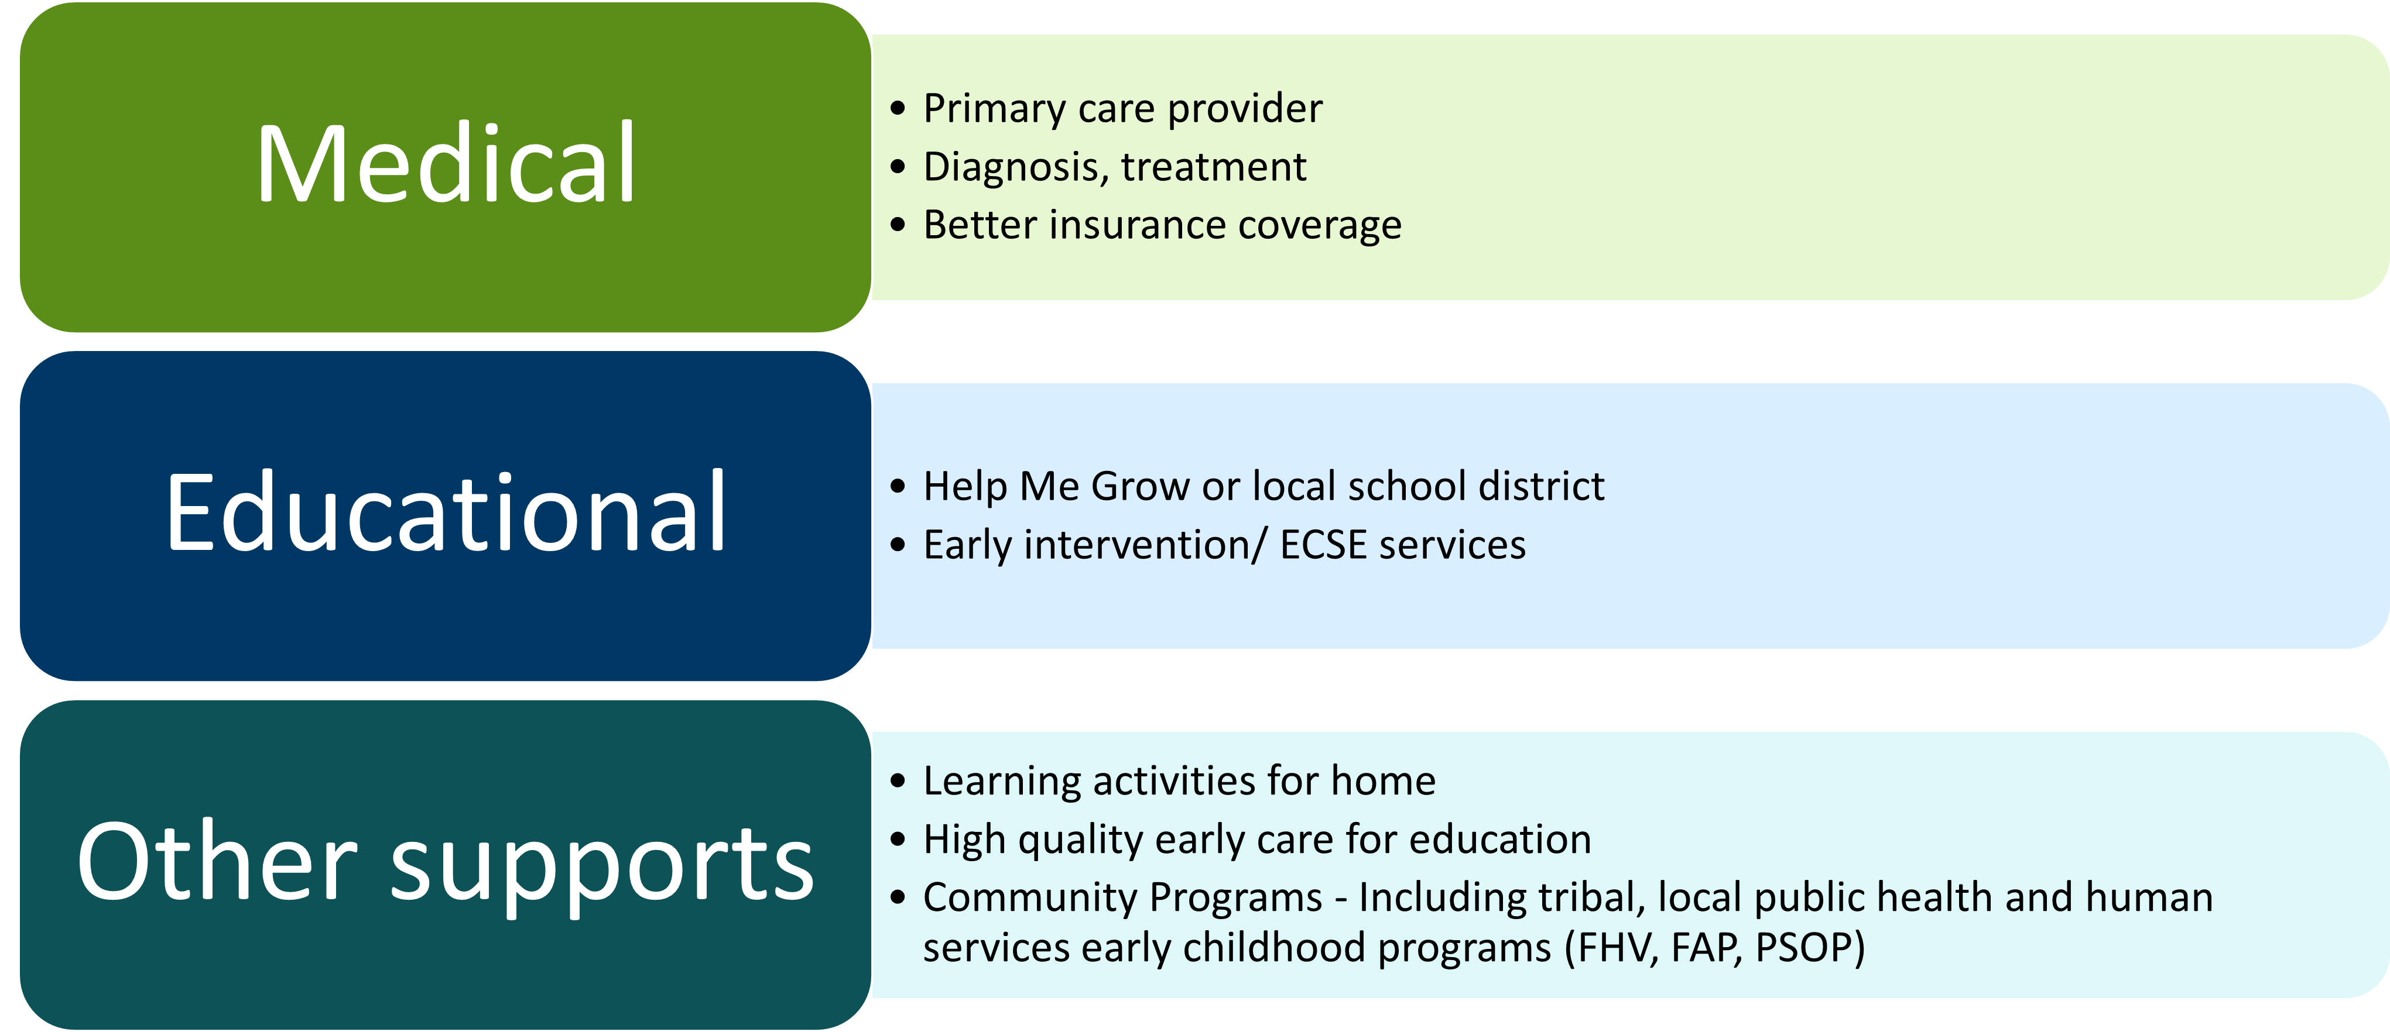
Developmental concerns: DUAL referral
(motor, cognitive, communication concerns)
Notes:
Whenever general developmental concerns are identified, the family should be offered a DUAL referral (to both, simultaneously):
To the child’s primary care clinic for MEDICAL evaluation to determine possible cause and treatment. This can also result in better health insurance for the child.
To the child’s local school district for EDUCATIONAL evaluation to see whether the child is eligible for early intervention services that are free to the family.
We’ll talk more in a minute about why both of these referrals are important.
In every community, there are programs that may help support the child’s healthy development and the family’s well-being. This might include things like high quality child care or Head Start, Early Childhood Family Education (ECFE), evidence-based family home visiting, or other supportive services.

Slide 57
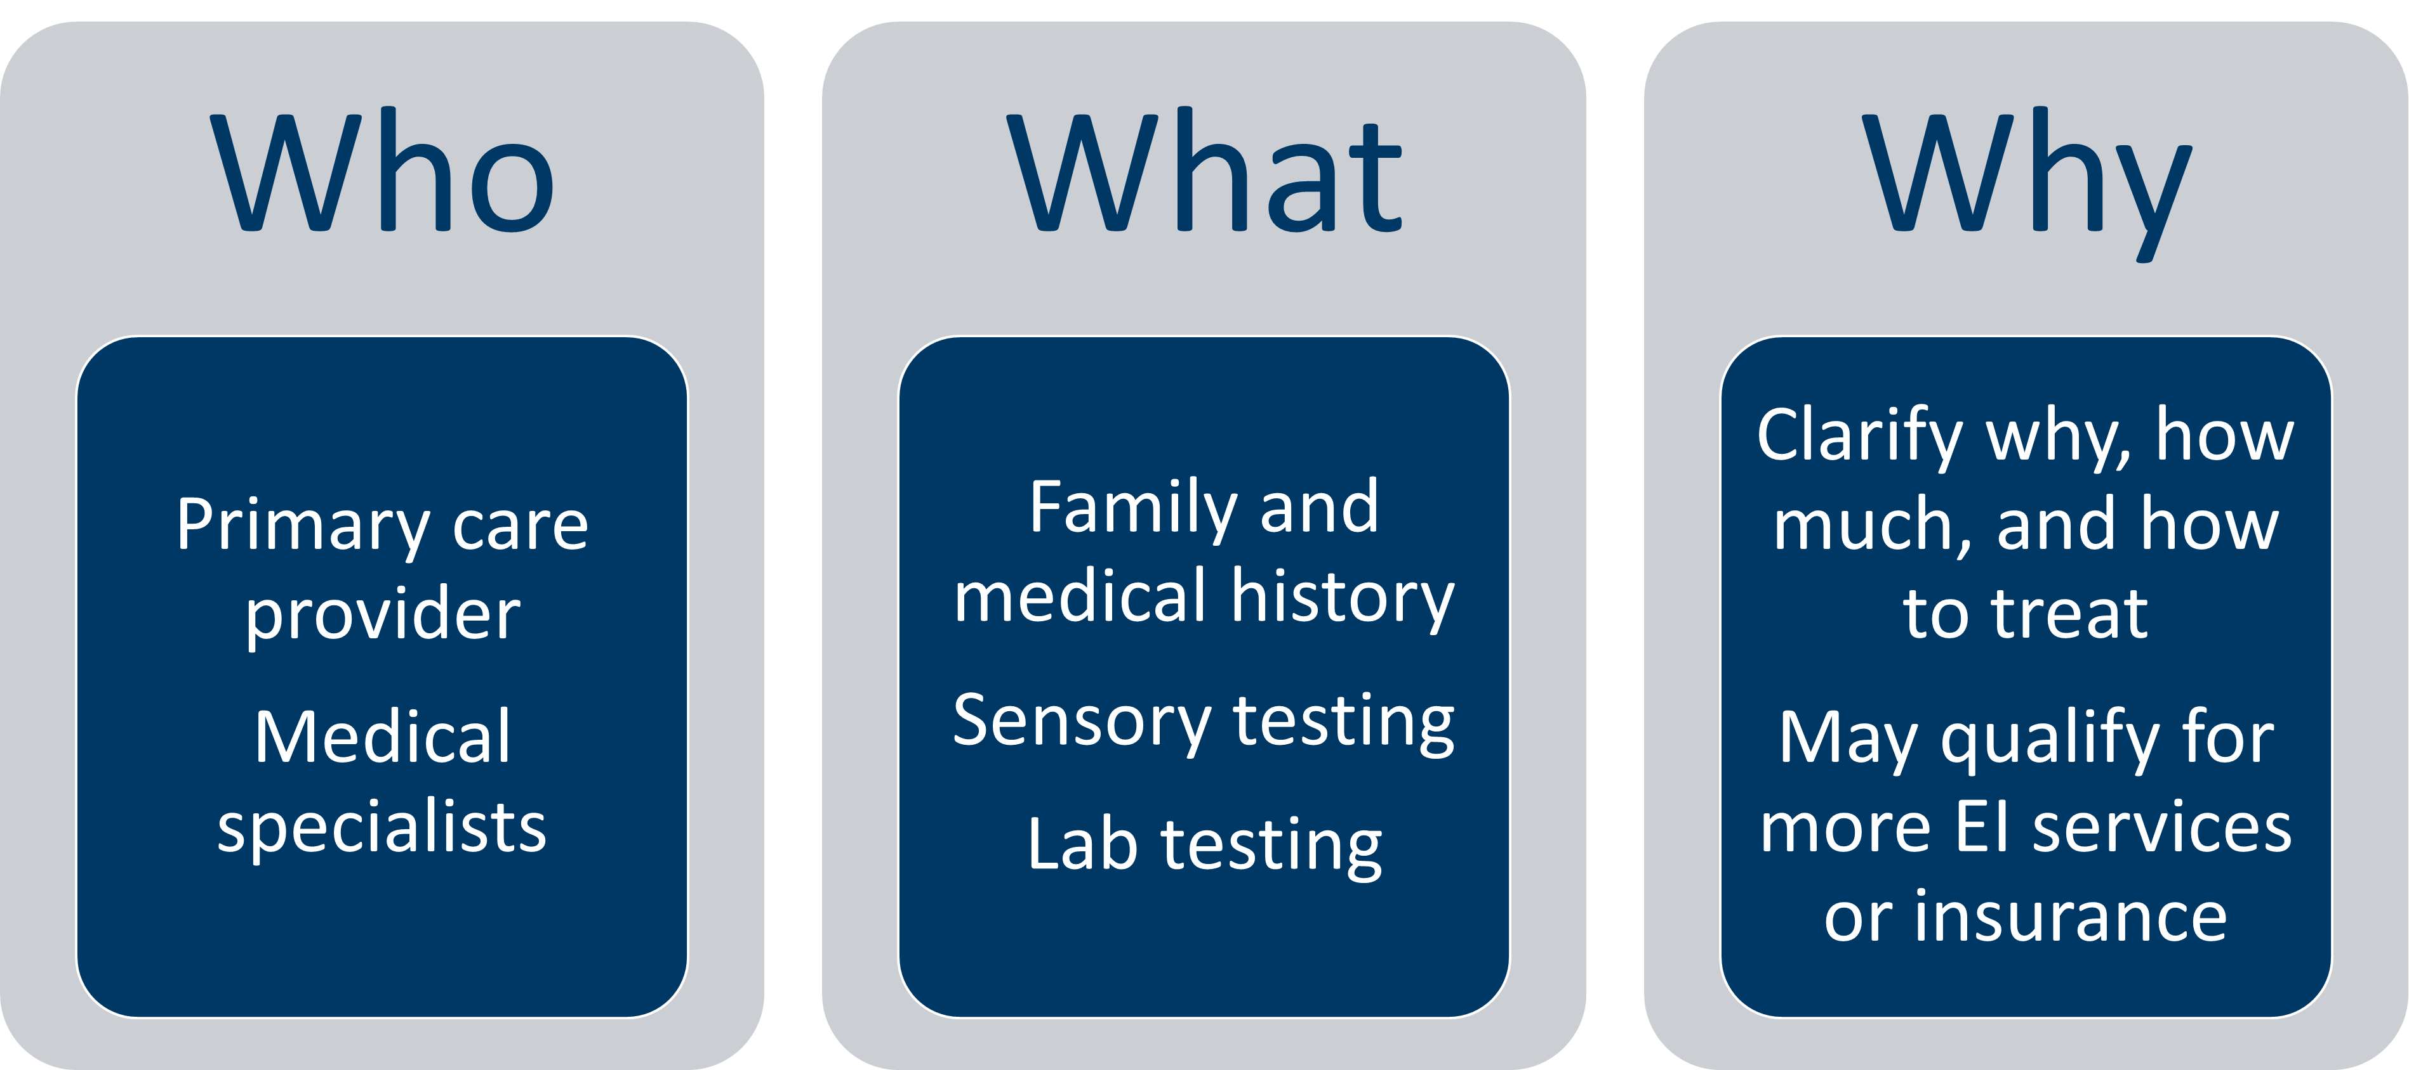
Medical evaluation
Notes:
A child with developmental concerns should always be referred for more evaluation by their primary health care provider or helped to connect to a clinic if they don’t have one.
The health care clinician will provide a comprehensive medical evaluation to help see if there really is a delay, and if so, how much of a delay. They can help see why the delay may be happening. Medical evaluation will include a careful health and family history and physical exam, and may include testing for hearing, vision, lead exposure, thyroid problems or other conditions. Untreated chronic health conditions like asthma, allergies, or under-nutrition can result in developmental or behavioral problems. The primary care provider may decide to refer the child to medical specialists such as an audiologist, ophthalmologist, developmental pediatrician, geneticist for more evaluation.
A medical diagnosis may mean that the child qualifies for more early childhood special education services and may help the child qualify for better health insurance or social services.

Slide 58
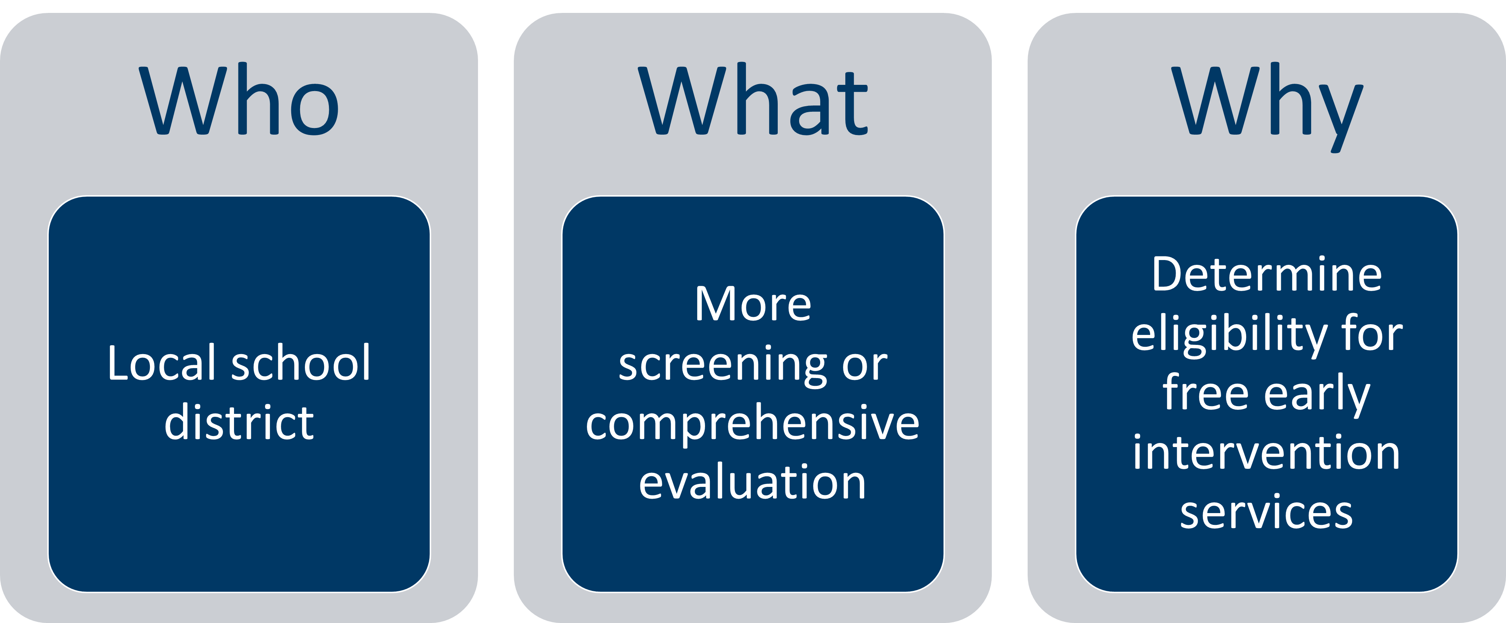
Educational evaluation
Notes:
While the primary care provider is responsible for medical diagnosis and treatment, it’s essential to ALSO refer the child right away for an educational evaluation. In Minnesota, the local school districts provide Infant and Toddler Intervention and Preschool Special Education Services. The school district will contact the family and offer more screening or comprehensive evaluation to see if the child is eligible for free early intervention services.

Slide 59
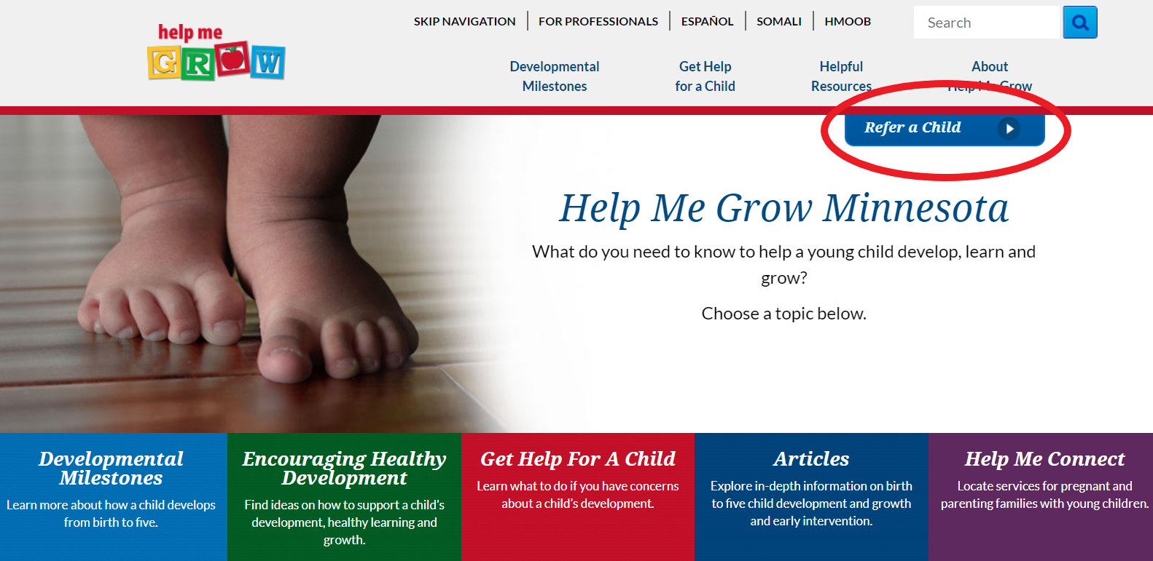
How to make a referral for educational evaluation in Minnesota
Call the school district directly, or
1-866-693-GROW (4769) or Help Me Grow MN
Notes:
We talked about HMG earlier-about the resources they have for families about healthy development-videos etc. Now we will talk about how HMG is also a place to refer to the school district. To referral a child to for an educational evaluation to see if they are eligible for services, you can either refer them directly to the local school district by phone, fax or secure electronic means,
Or refer them via the statewide Help Me Grow website or toll-free phone number.
Click on the “Refer a Child” button to make the referral. [Optional: brief website demo]

Slide 60
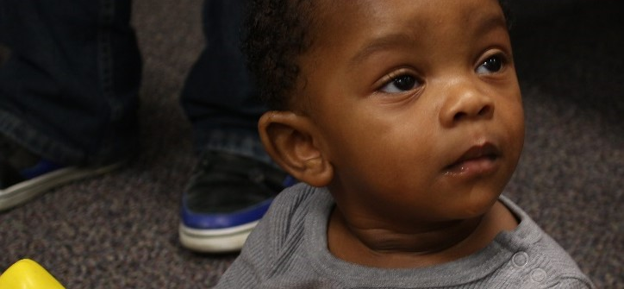
Benefits of EARLY referrals for educational evaluation
Referrals before 3 years of age:
  Earlier intervention is more effective
  Easier to qualify for services
  Services offered year-round
  Services provided in child’s “natural environment”
Referrals beginning at age 3:
  Must demonstrate an educational need
  Services provided in early childhood classroom or center-based setting
Notes:
Referral to Help Me Grow is important, at any age before kindergarten – the sooner, the better! This gives the child more time to benefit from early childhood special education services, if they qualify. Earlier intervention is more effective and can reduce family stressor
There are some differences between Infant and Toddler Intervention services for 0-2 years and Preschool Special Education for 3-5 years.
Good reasons to refer before 3 years of age (when possible):
Earlier intervention is more effective, as we’ve talked about
Easier to qualify for ECSE services – the threshold to qualify for services under 3 years of age is lower
Services are year-round – this is a federal requirement, may not be met by all districts
Services provided in child’s “natural environment” – meaning in the child’s home or daycare
While referral at any age is important, there are some important changes once the child turns 3 years old. Beginning at age 3, :
The child must show an educational need, not just a developmental delay or concern. It is harder to qualify for early childhood special education services.
Services are usually provided in integrated preschool setting, rather than at home or daycare.

Slide 61
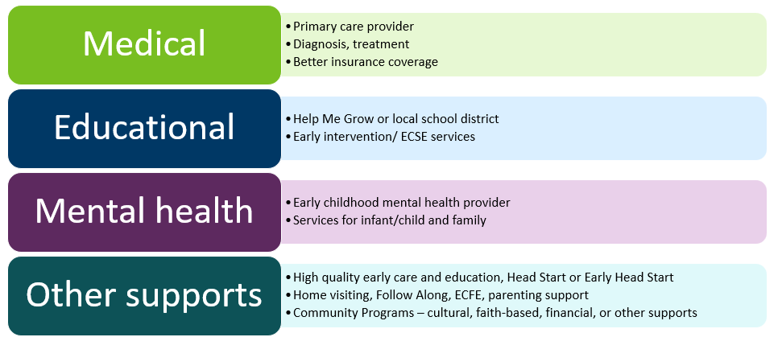
Social-emotional concerns: TRIPLE referral
Notes:
Just like with developmental concerns, social-emotional concerns are most easy and effective to treat when we identify and act early.
For this reason, a child with social-emotional concerns should be also referred for medical and educational evaluation.
An additional important referral to make is to a local mental health provider that has special skills and training in working with the youngest children (birth to 5 years) and their families.

Slide 62
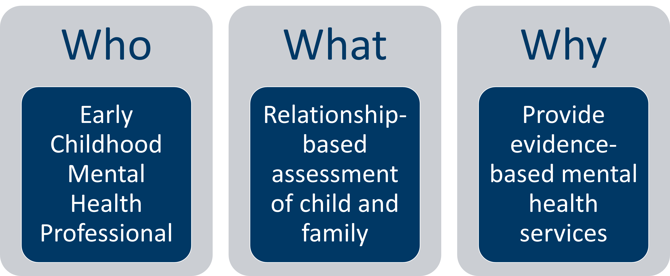
Mental health evaluation
Notes:
Early Childhood Mental Health professionals are specially trained to work with parents and caregivers when an infant, toddler, or young child shows behavioral or other social-emotional delays or concerns. They also recognize and support the mental health of the parent. These professionals have specialized training in evidence-based assessment and treatment of a broad range of social-emotional concerns. Their work supports the relationship between the parents and infant or young child, and their services support positive parenting. As with any developmental concern, it’s best to refer for mental health services sooner, rather than waiting until behaviors or relationships are at a point of crisis.

Slide 63
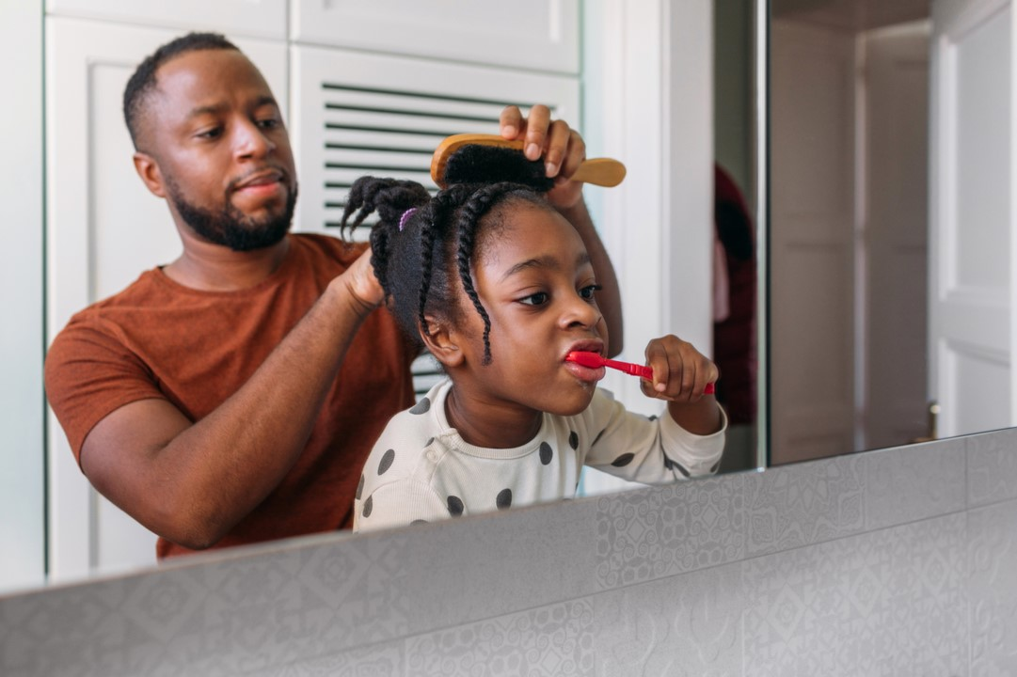
Early childhood mental health services case story
Case example shared by one district
Early childhood mental health referral for sleeping difficulties and frequent tantrums
Referral completed yet family engaged for only 3 months before choosing to end services due to family stressors
Second referral for continued concerns 2 years later with more collaborative process and ongoing connections and support from ECFE staff
Family successfully engaged with services for child and credited progress to their connections with ECFE and community supports provided with referral
Notes:
[Consider creating own case story or use this one]
One district reports example of the importance of referrals for social emotional concerns and early childhood mental health services positive impact:
Child referred for sleeping difficulties and struggles with frequent tantrums and met weekly with early childhood mental health services. Family system stressed and they chose to end services after 3 months as child making progress.
Two years later a second referral was made and services restarted. This time more of a collaborative process with parent and ongoing communication support with district ECFE staff, who were involved with family, made a difference in getting several supports in place in the community who they can lean on in difficult times. Child and family are now doing well. Local community support as reported by parent was a key part of resolving the issue.

Slide 64
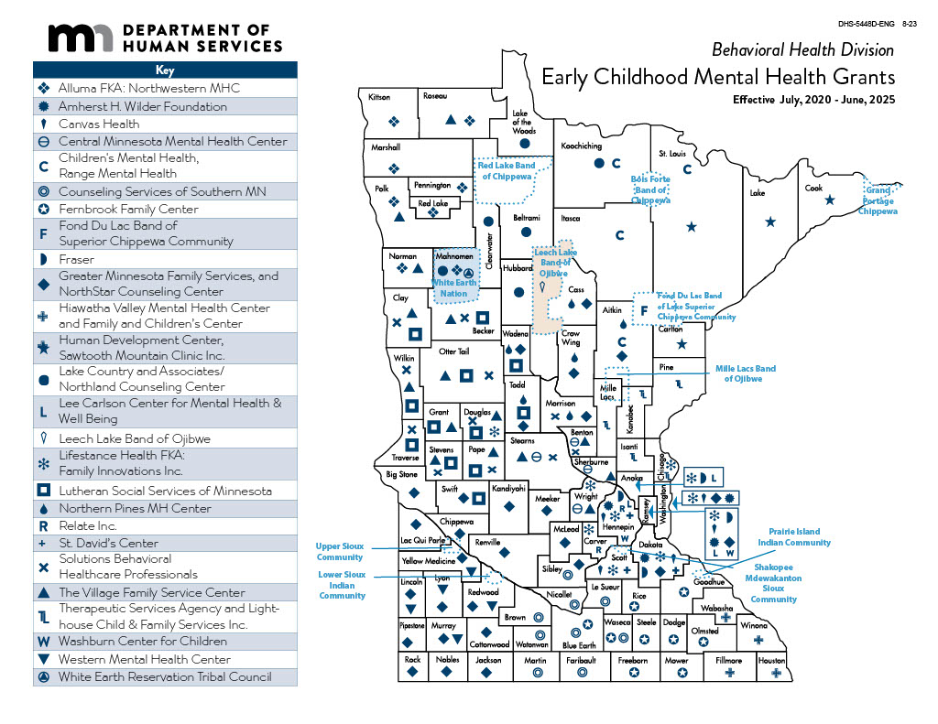
Early childhood mental health services in Minnesota
Early Childhood Mental Health System of Care
Notes:
Minnesota is fortunate to have mental health professionals that specialize working with families of infants, toddlers and young children. These professionals have special training to provide evidence-based mental health services that work with parents and caregivers to support parenting and healthy development. Also talk about Help Me Connect
[HANDOUT: map and contact information for early childhood mental health providers/grantees.]
The Minnesota Department of Human Services supports early childhood mental health grantees in all counties and some tribes. Other local agencies may be available as well in your area – get to know your local resources.
Hyperlink:
https://mn.gov/dhs/partners-and-providers/policies-procedures/childrens-mental-health/early-childhood-mh-system-care/

Slide 65

Access an early childhood mental health clinician
Take time to identify local resources and plan to contact them to collaborate and provide a “warm handoff” for families
Partner with community-based organizations or Community Hubs that serve diverse members and who may help provide culturally and linguistically relevant support
Help Me Connect Results: Early Childhood Mental Health Providers
Notes:
Website: https://helpmeconnect.web.health.state.mn.us/HelpMeConnect
Type in: Mental Health

Slide 66
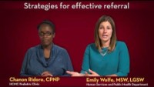
Effective referrals
Offer options
Develop plan together
Prioritize based on family’s needs
Active referral: get the process started together
Warm handoff: help make initial connection, let families know what to expect, introduce them if possible
Notes:
[optional video: 2:16 minutes. CLICK ON PHOTO TO OPEN LINK TO YOUTUBE VIDEO. Direct link: https://www.youtube.com/watch?v=SZNgyfCGRsw&list=PLqPfFYYbtBZgdBhtKrxFAgsQPQgSIntNz&index=5]
Emily Wolfe is a social worker. She describes the family-centered approach she takes to talking about referrals. In this case, she is talking about referral for social-emotional concerns, but the same principles may apply to other types of referrals as well.
[LEARNING STRATEGY: Delete text from slide. Watch video together and ask participants to identify strategies for effective referral.]

Slide 67
Facilitating a referral for mental health services
Head Start/Early Head Start created a helpful guide in supporting children and families called Facilitating a referral for Mental Health Services
Families may be hesitant to move forward with a referral for various reasons
Strategies to help with the referral process should include:
  Clear conversation: Come to agreement with family about the reason for referral:
  Economic considerations: How will they pay for services?
  Logistics: How will they get to the service/transportation?
  Cultural barriers: Beliefs and/or language differences from providers
Strategies to Ask Potential Health Services Providers in your area
Notes:
Website: https://eclkc.ohs.acf.hhs.gov/mental-health/article/facilitating-referral-mental-health-services-children-their-families-within-early-head-start-head

Slide 68
Questions to ask mental health providers in your area
What types of services do you offer?
Do you have bilingual and diverse providers? Do you provide interpreters?
Who is the person I should contact about referrals?
Do you provide home visits?
What hours are you available to provide services?
Can your location be easily accessed by public transportation?
Notes:
Website: https://eclkc.ohs.acf.hhs.gov/mental-health/article/facilitating-referral-mental-health-services-children-their-families-within-early-head-start-head

Slide 69
Why are effective referrals for mental health important?
Overall, we are not seeing as many referrals based on social-emotional concerns as we would expect given recent historic events
Remember anxiety may impact a child’s ability to communicate
Honestly addressing parents’ questions and concerns can help them take the next step
Early intervention is key, and a screening doesn’t give all the information needed
  Further evaluation may be needed
Referrals empower parents in making informed decisions about the supports that are available for their child and/or family

Slide 70
How do you talk with parents about elevated scores?
When parents indicate high scores on ASQ:SE-2 - Take it seriously!
You can say: “I see that you have some concerns about your child from how you filled out the screening questionnaire. I am wondering if you would like me to help you get some support?”
“Let’s call my colleague at ___ agency, they can help figure out what to do next.”
“Is it ok if I call you in a couple weeks to see if you have questions or have other concerns?”

Slide 71
Screener's role in referral
Screeners are required by statute to refer potentially eligible children under age 5 to ECSE
This is true even if the parent is not interested in the referral (send contact info only)
It is the role of the ECSE program to review all information, including the screening, with parents and propose any potential next steps
Parents may decline further evaluation or services after evaluation
  Nothing will happen without their informed consent

Slide 72
Pediatric Symptom Checklist trauma question
“Has your child ever experienced anything scary or stressful in the past year?”
  Consider these follow-up questions:
    Did you get any support?
    Would you like some support? I can connect you with a colleague (friend) who can support both you and your child around this stressor.
Pediatric Symptom Checklist Parent and Youth Screening Tool Q38
Notes:
The Pediatric Symptom Checklist starting at age 4 years includes the question about has anything scary happened to your child. Our dev. Screen task force is working to imbed these questions into the ASQ
We have these in word format in Spanish, Somali, Hmong upon request to the MDH dev screening task force? Or does it make more sense to ask if DHS will post since they already have English version posted.

Slide 73
Effective referrals
Offer options
Develop plan together
  Consider any other health concerns if known
  Consider other cultural, communication style, environment, parenting practices, opportunities that impact screening results
Prioritize based on family’s needs
Active referral: get the process started together
Warm handoff: help make initial connection, let families know what to expect, introduce them if possible
Notes:
Read slide
(skip video)
[optional video: 2:16 minutes. CLICK ON PHOTO TO OPEN LINK TO YOUTUBE VIDEO. Direct link: https://www.youtube.com/watch?v=SZNgyfCGRsw&list=PLqPfFYYbtBZgdBhtKrxFAgsQPQgSIntNz&index=5]
These details are from ASQ training manual and are helpful as you develop possible referral plan together:
-Did parent have opportunity to try items on screening with the child?
-Some cultural groups value quietness, silence. Some are louder, more talkative. Children in bilingual homes may take a bit longer to speak
-Some parent practices may have different expectations for independence/dependence in feeding, dressing, toilet training, sleeping, holding, etc
-some may spend a lot of time with screens and others no screens so more opportunity for physical development

Slide 74
Parent communication preferences
Wilder Study 2019
  14 group discussions with 89 parents across the state
Prefer two-way conversation: face-to-face.
Prefer time to build trust: “goal is to empower, not a bunch of paper.”
Prefer “in-reach” instead of outreach. Relationship building focus.
Technology- keep it mobile friendly, but some lack internet access…

Slide 75
Follow through
Family-centered decision-making:
  What is highest priority for the family?
  What works for them?
  Teach back
Follow through
  Families often do not follow through the first time – more than half of the time!
  Follow up by phone, mail, text or with a future visit
  Engage other professionals that have a trusted relationship with the family, with their permission
  Tips: care coordinator, tickler file, Excel spread sheet…
Notes:
[Training recommendation: Group discussion]
How do we put families at the center of how our screening and referral process works? How could we improve? [This can also be a good time to recognize that “family” means different things to different people – talk about how you learn from the child’s caregiver about the important people in that child’s life – who help with decisions, child care, and daily logistics like getting to appointments.]
Once we’ve developed a follow-up plan with the family, we can use the “teach back” method to ensure understanding and unearth any remaining questions or concerns. Ask the parent/caregiver to explain in their own words what they understand to be the next step. This is the same information they can share at home with other important adults in the child’s life.
What are expectations for follow-up in our program, when concerns are identified and a referral is made? How can we do a better job of making sure families are supported to get to the next step?

Slide 76
Resource:
Hard Conversations in early childhood
Hard Conversations panel discussion
Intended to support practitioners working with families of young children to feel more confident when discussing important but sensitive topics
Available with a Hard Conversations companion guide to facilitate team conversation on the Early Childhood Special Education (ECSE) Part C and Part B Resources webpage
Notes:
[Good video for discussion, preview first and find best clip for your program needs]

Slide 77
Hard conversations discussion
Discussion questions: Tricia talked about benefits of intentional reflection and processing that her team engages in to answer questions like, “Why is this[conversation/topic] making me feel a certain kind of way?”
She also discussed the benefits of practicing how you are going to talk about a topic that makes you uncomfortable with a family.
Is this something your team or program currently supports? If not, how could this process be built into your collaborative work?
Notes:
Hard Conversations panel discussion Watch from: 17:11 to 22:30. (VideoNew)
Above questions/prompts are from the companion guide linked on slide immediately preceding this one

Slide 78
Implicit bias awareness and resources
MDE Early Learning webinars by Dr. Rosemarie Allen
Overview of Implicit Bias through the Lens of Suspensions and Expulsions
Examine the issues of inequities in early childhood specifically around suspensions and expulsions.
Culturally-Responsive Leadership
Assess awareness of your own hidden biases and develop skills in culturally responsive leadership.
Using Trauma-Informed Practices to Promote Resilience
Investigate the impacts of trauma at children’s developmental stages and how to respond with trauma informed practices.
Connecting with Hard-to-Reach Families
Learn how to connect with families who are hard-to-reach (underrepresented, invisible/overlooked, and service avoidant).
Microaggressions and Cultural Humility
Examine three types of macroaggressions and how they show up in the work place. Practice cultural humility.
Notes:
[These were developed for prekindgarten staff audience but may be helpful for any program.]

Slide 79
Small group discussion
5-10 minutes
Case example
What is your process for discussing screening results with the family?
What is your district process for referral for developmental and social emotional concerns?
What is your district process for follow through for developmental and social emotional referrals?
Learning from each other
Do you have a success or a challenge story? Please share
Notes:
Case Example:
Family of 3 year old only speaks Somali.
Interpreter present for family.
Both Development and Social Emotional screener showed concerns indicating possible need for referrals.
Other areas of screening showed no concerns.
Family has no insurance coverage.

Slide 80
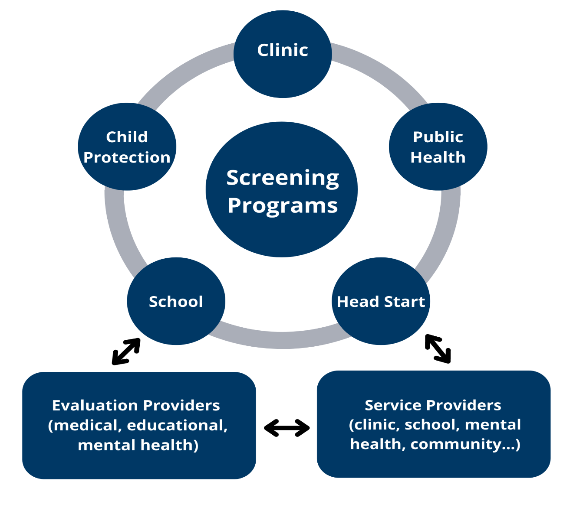
Closing the loop
Family needs
Parent consent
Who needs to know
What information
Notes:
[Point out the child and family in the middle of a complex system]
The child will have better outcomes, and the family will have a smoother and less frustrating process, if we coordinate with other programs who are serving or will be working with the family.
Questions:
Where else does the child receive screening, besides our program? How can we best coordinate with them?
What information do other providers need after referral to do their job well, and meet the needs of the family?
Note: explain to the family why sharing information is helpful to decrease duplication (repeated screening) and improve the services their child can get; make sure to follow federal and state privacy laws and obtain signed consent when it’s required. [an example of when consent is needed is provided on the next slide]
Screening results: clinics, schools and mental health providers can use screening results to inform their evaluation (and they don’t have to duplicate screening)
Other information about the child and family that may help inform the evaluation (e.g. homelessness, pertinent health or social history)

Slide 81
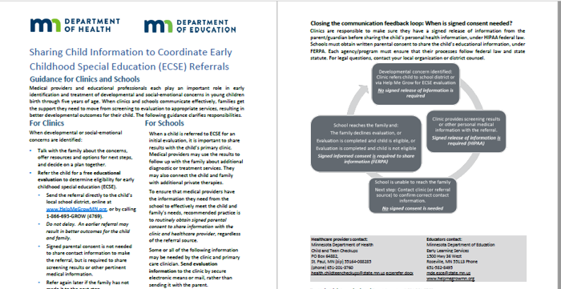
Example of why and how to share information
Fact sheet for clinics and schools: Sharing Child Information to Coordinate ECSE Referrals
Notes:
This fact sheet was developed by MDH and MDE to clarify the importance of sharing information and coordinating care between clinics and early childhood special education programs when it comes to early childhood screening and evaluation. It clarifies HIPAA and FERPA requirements for sharing information.
This can serve as an example for other programs as well. Contact information is available on the back side of the fact sheet, for questions.
Hyperlinks:
Sharing Child Information to Coordinate ECSE Referrals - https://www.health.state.mn.us/docs/people/childrenyouth/ctc/devscreen/ecserefer.pdf

Slide 82
Support for parents in your community
Early Childhood Family Education (ECFE)
Head Start and Early Head Start
Cultural, faith-based and other community-based parenting groups
For children with developmental concerns or special health needs:
  Parent-to-parent networks such as Family Voices (Parent-to-Parent of Minnesota), PACER, Hands and Voices
  Other condition-specific groups and organizations
Notes:
[Include other parent supports and resources that are available in your community.]
Hyperlinks:
Family Voices - https://familyvoicesofminnesota.org/
PACER - https://www.pacer.org/
Hands and Voices - https://www.mnhandsandvoices.org/

Slide 83
Support for parents in your community cont.
Family Home Visiting
Follow Along Program
Primary care/health care provider
Parent Support Outreach Program (PSOP)
Early Childhood Mental Health providers
If families are in need of mental health services and there is a long wait time, then refer to primary health care provider and local public health home visiting
Notes:
Hyperlinks:
Family Home Visiting – https://www.health.state.mn.us/communities/fhv/index.html
Follow Along Program – https://www.health.state.mn.us/people/childrenyouth/fap/index.html
Primary care/health car provider - https://mn.gov/dhs/people-we-serve/children-and-families/health-care/health-care-programs/programs-and-services/ctc.jsp
Parent Support Outreach Program (PSOP) - https://www.thefamilypartnership.org/programsservices/education/parent-development-and-support/parent-support-outreach-program-psop/
Early Childhood Mental Health providers - https://mn.gov/dhs/people-we-serve/people-with-disabilities/health-care/childrens-mental-health/programs-services/other-dhs-programs.jsp

Slide 84
Developmental and social-emotional resources
Developmental and social-emotional screening resources has information on these programs:
  Help Me Connect
  Child and Teen Checkups
  WIC
  Early Childhood Screening
  Help Me Grow
  Learn the Signs. Act Early.
  Positive Parenting Tips
Notes:
Hyperlinks:
Resources - https://www.health.state.mn.us/people/childrenyouth/devscreen/resources.html

Slide 85
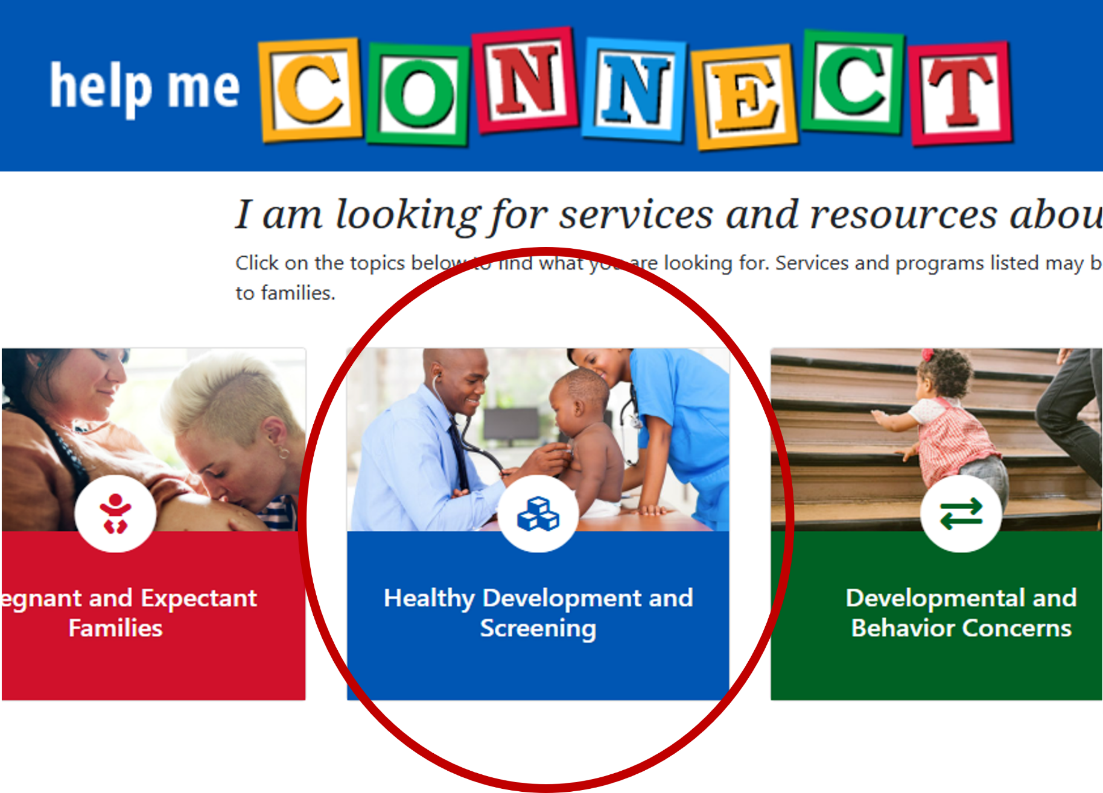
Help Me Connect
Brief descriptions and links to public screening programs offered for children birth to Kindergarten entrance.
www.helpmeconnectmn.org
Notes:
We mentioned this site/resource earlier in the presentation but doesn’t hurt to revisit/remind you of it again!

Slide 86

CDC developmental screening app for parents
CDC Developmental Milestone Tracker
Phone app for parents with children between ages 2 and 5 years.
Links to videos and resources and sends updates about child development.
Available in English or Spanish
Notes:
This, too, is a repeat of an earlier mentioned resource to parents to support their child’s development and to anticipate, track, and act early on child’s development

Slide 87
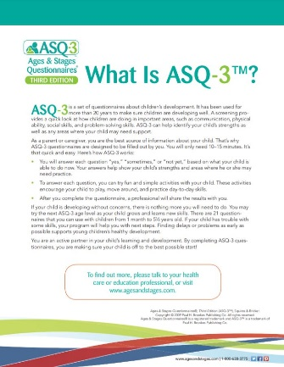
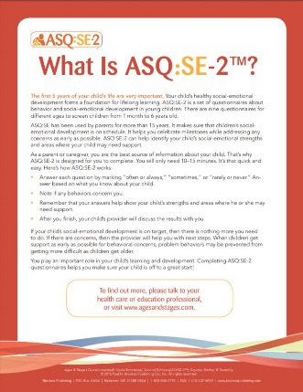
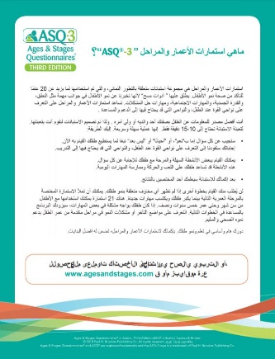
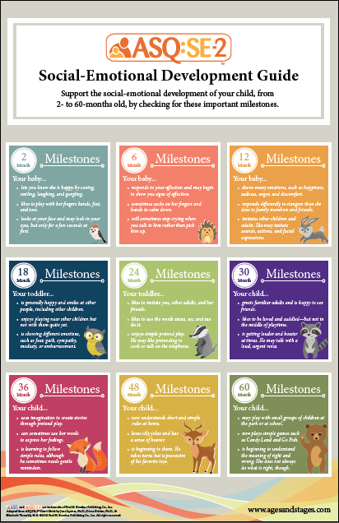
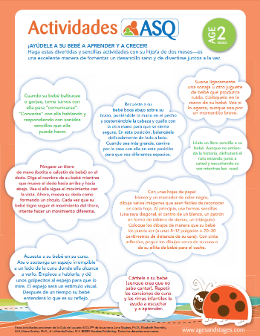
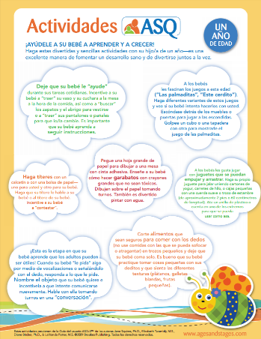
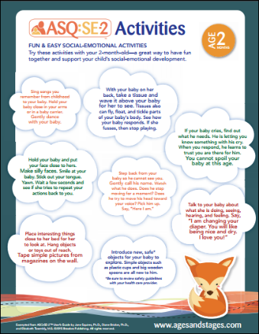
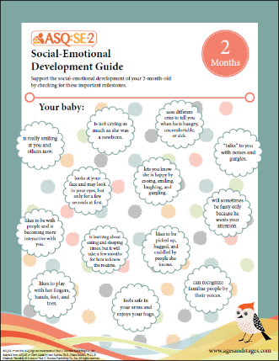
Ages and Stages resources
Parent resources: About ASQ For Parents
Sign up for ASQ Newsletter!
Notes:
ASQ®-3 and ASQ®:SE-2 Training Materials by J Squires, J Farrell, J Clifford, S Yockelson, E Twombly, and L Potter Copyright © 2021 Brookes Publishing Co. All rights reserved. www.agesandstages.com

Slide 88
Create program referral resources
Create your program specific contact list of:
  Medical evaluation and treatment
  Educational evaluation and services
  Mental health evaluation and services
  Other local programs that support healthy development
  Materials and resources for families
  Methods to follow-up with families
Notes:
[This slide is to describe what districts can do. Optional discussion: Review your program’s resources and process for referral for the following:]
Medical evaluation and treatment – if a child is not already connected to a primary healthcare provider, what are some local clinics that provide high quality pediatric care?
Educational evaluation and services – how do we make the referral for ECSE evaluation? [for example, Help Me Grow online, directly to ECSE staff in our building, other…]
Mental health evaluation and services – who are the local early childhood mental health agencies and professionals? Have we met them? Can we set up a time to meet, and develop a referral process?
Other local programs that support healthy development – especially if a child doesn’t qualify for ECSE services, what are other programs we can recommend? [e.g. quality child care, Head Start/Early Head Start, Follow Along Program, Family Home Visiting, local parenting support groups…]
Materials and resources for families – What resources do we offer to parents to support healthy development at home?
Methods to follow-up with families – How do we/can we ensure that families make it to the next step when concerns are identified?

Slide 89
Supporting program staff in trauma informed (healing centered) screening practices

Slide 90
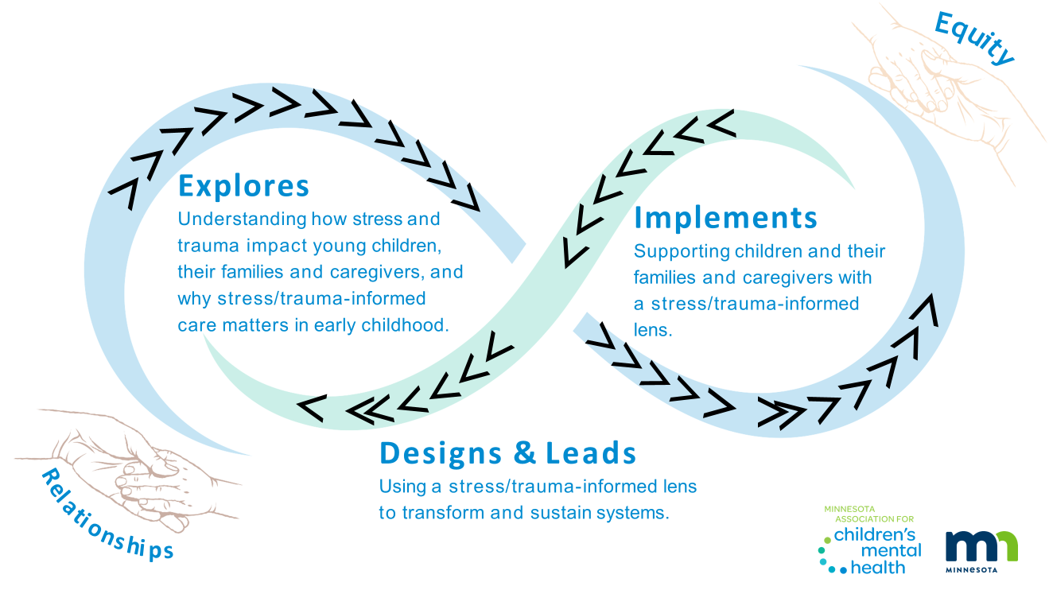
Roadmap for healing-centered practice
Notes:
This infographic reminds up that social emotional health and trauma informed care is “healing Centered practice” and you are a part of it as you are developing relationships with parents. Your social emotional health is important too and helps to support families as well. There are resources for you as a provider as well as educators.

Slide 91
Resources to support your work
Minnesota Toolkit for Healing-Centered Practice
Provides Early Childhood professionals with access to stress and trauma informed resources for working with young children and families
Grounded in equity and relationships
Develop approved (professional development system)
Mirrors the Knowledge and Competency Framework

Slide 92
Healing centered (trauma informed) screening facilitators guide
Healing Centered (Trauma Informed) Screening Facilitators Guide
The discussion guide has been created for early childhood screening teams around the state of Minnesota and Tribal Nations to promote healing centered, culturally responsive, and trauma-informed screening through a lens of early childhood mental health.
The guide may be used for training screening staff and each section has a rhythm of learning, practice and application.

Slide 93
Optional small group healing centered activity
Responding to experiences of stress and trauma. Healing Centered Facilitators Guide, pages 38-40.
Example of small group activity
Imagine you are doing a screening with a 2-year-old and their caregiver. Before the screening, the caregiver discloses to you over the phone that something traumatic has happened to the child and they get overstimulated when they leave the house. Take 10 minutes to consider questions and reflect on:
  How would you create a safe screening space for the child and caregiver?
  What might be your next steps in getting the family the support they need?
Notes:
[OPTIONAL] Activity
This is an example of an optional activity/application from the Stress Trauma section.

Slide 94
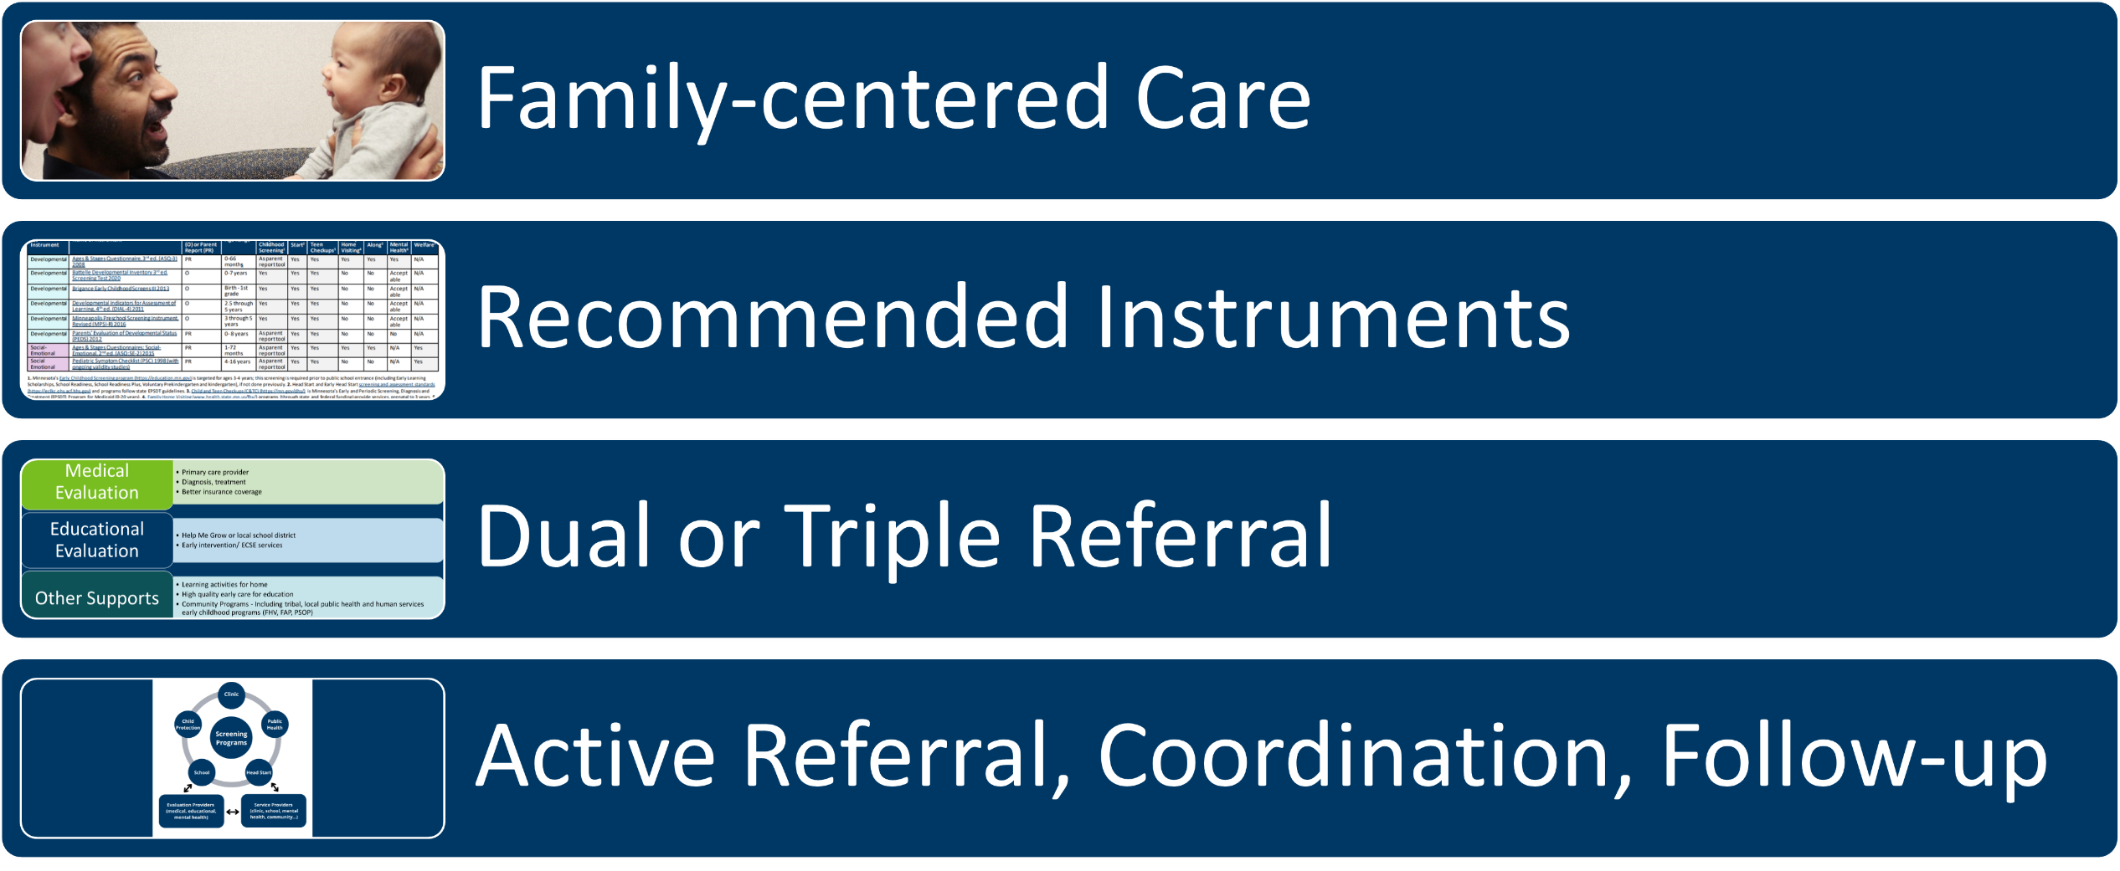
Take-home points
Notes:
Summarize the most important points of the training. [Discussion suggestion: ask attendees to elaborate on each of these.]
Family-centered care means recognizing parents/caregivers as children’s most important partner in healthy development; building our services and processes around what works for families; listening first to parent/family concerns; and partnering with families to develop a plan when concerns are identified. (This includes Trauma informed or healing centered screening).
Minnesota recommends specific developmental and social-emotional screening instruments that are sensitive, specific, valid, reliable, and practical. Recommended instruments should be used in all of Minnesota’s public screening programs. These instruments are listed online, along with more detailed information.
When developmental concerns are identified, make a dual referral (refer the child for both medical and educational evaluation). When social-emotional concerns are identified, make a triple referral (for medical, educational, and mental health evaluation). [Review referral resources and processes for your specific program.]
Make an active referral by sending referral and related information directly rather than asking the parent to call or bring the information. Coordinate and communicate with the program to which the child is being referred, with appropriate parent/guardian permission. Follow-up to make sure the family was able to make it to the next step.

Slide 95
Thank you!
Notes:
Communication Best Practices about Screening and Referrals evaluation: https://forms.office.com/g/8vGk3Ubztt

Slide 96
Promoting healthy child development​ links
Minnesota ECIP’s (https://dcyf.mn.gov/partners-and-providers/child-care-and-early-learning/professional-development)
Help Me Grow MN (https://helpmegrowmn.org/HMG/index.html)
Encouraging Healthy Development (https://www.helpmegrowmn.org/HMG/HelpfulRes/EncourageHealthDev/index.html)
Help Me Connect​ (http://www.helpmeconnectmn.org/)
CDC Positive Parenting Tips (https://www.cdc.gov/child-development/positive-parenting-tips/)
CDC’s Learn the Signs, Act Early (https://www.cdc.gov/ncbddd/actearly/)
Center on the Developing Child, Harvard University (http://developingchild.harvard.edu/)
Zero to Three (www.zerotothree.org)

Slide 97
Standardized screening​ links
MDE ECS Program (https://education.mn.gov/MDE/dse/early/elprog/scr/)
Early Childhood Screening Guidelines for Interpreters (https://dcyf.mn.gov/partners-and-providers/child-care-and-early-learning/districts-schools-and-head-start/screening)
Training Video: Early Childhood Screening and Interpreters (https://dcyf.mn.gov/partners-and-providers/child-care-and-early-learning/districts-schools-and-head-start/screening)

Slide 98
Screening instruments links
MDH Recommended instruments (https://www.health.state.mn.us/people/childrenyouth/devscreen/instruments.html)
Screening programs in Minnesota (https://www.health.state.mn.us/people/childrenyouth/devscreen/programs.html)
Developmental and Social-Emotional Screening for Young Children (0-5 Years) in Minnesota (https://www.health.state.mn.us/people/childrenyouth/devscreen/index.html)
Choosing an Instrument (https://www.health.state.mn.us/people/childrenyouth/devscreen/selection.html)
Video: Communicating with Families During the Screening Process (https://www.youtube.com/watch?v=VoAN3605IGY)

Slide 99
Referral links
Early Childhood Mental Health System of Care (https://mn.gov/dhs/partners-and-providers/policies-procedures/childrens-mental-health/early-childhood-mh-system-care/)
Early Childhood Mental Health Providers (https://helpmeconnect.web.health.state.mn.us/HelpMeConnect/Search/FamilyWell-BeingandMentalHealth/MentalHealthorSubstanceUseDisorder/EarlyChildhoodMentalHealthProviders?loc=&geo=)
Facilitating a referral for Mental Health Services (https://eclkc.ohs.acf.hhs.gov/mental-health/article/facilitating-referral-mental-health-services-children-their-families)
Pediatric Symptom Checklist Parent and Youth Screening Tool Q38 (https://edocs.dhs.state.mn.us/lfserver/Public/DHS-7990-ENG)
Wilder Study 2019 (https://www.wilder.org/sites/default/files/imports/ChildCareAware_MarketingPlan_8-19.pdf)​
Hard Conversations panel discussion (https://education.mn.gov/MDE/VideoNew/?group=Communications&id=PROD081159)
Hard Conversations companion guide (https://education.mn.gov/mdeprod/idcplg?IdcService=GET_FILE&dDocName=PROD081160&RevisionSelectionMethod=latestReleased&Rendition=primary)
Part C and Part B Resources (https://education.mn.gov/MDE/dse/early/spec/ecse/)
Sharing Child Information to Coordinate ECSE Referrals (https://www.health.state.mn.us/docs/people/childrenyouth/ctc/devscreen/ecserefer.pdf)

Slide 100
Implicit bias awareness links
MDE Early Learning (https://education.mn.gov/mde/dse/early/)
Overview of Implicit Bias through the Lens of Suspensions and Expulsions (https://education.mn.gov/MDE/VideoNew/?group=Communications&id=MDE031534)​​
Culturally-Responsive Leadership (https://education.mn.gov/MDE/VideoNew/?group=Communications&id=MDE031533)​
Using Trauma-Informed Practices to Promote Resilience (https://education.mn.gov/MDE/VideoNew/?group=Communications&id=MDE031532)​
Connecting with Hard-to-Reach Families (https://education.mn.gov/MDE/VideoNew/?group=Communications&id=MDE031531)​
Microaggressions and Cultural Humility (https://education.mn.gov/MDE/VideoNew/?group=Communications&id=MDE031530)

Slide 101
Support for parents links
Early Childhood Family Education (https://dcyf.mn.gov/programs-directory/early-childhood-family-education-ecfe)
Head Start and Early Head Start (https://dcyf.mn.gov/programs-directory/head-start-and-early-head-start)​
Cultural, faith-based and other community-based parenting groups (https://helpmeconnect.web.health.state.mn.us/HelpMeConnect/Search/FamilyWell-BeingandMentalHealth/VariedSupportsthroughCommunityOrganizations/ParentingSupport?loc=&geo=)​
Family Voices (Parent-to-Parent of Minnesota) (https://familyvoicesofminnesota.org/)
PACER (https://www.pacer.org/)
Hands and Voices (https://www.mnhandsandvoices.org/)​
Other condition-specific groups and organizations (https://helpmeconnect.web.health.state.mn.us/HelpMeConnect/Search/FamilyWell-BeingandMentalHealth/ParentingSupportProgramsForSpecificPopulations/Parentswhohavechildrenwithspecialhealthneeds?loc=&geo=)
Family Home Visiting (https://www.health.state.mn.us/communities/fhv/index.html)​
Follow Along Program (https://www.health.state.mn.us/people/childrenyouth/fap/index.html)​
Primary care/health care provider (https://mn.gov/dhs/people-we-serve/children-and-families/health-care/health-care-programs/programs-and-services/ctc.jsp)​
Parent Support Outreach Program (PSOP) (https://mn.gov/dhs/people-we-serve/children-and-families/services/child-protection/programs-services/parent-support-outreach.jsp)​
Early Childhood Mental Health providers (https://mn.gov/dhs/people-we-serve/people-with-disabilities/health-care/childrens-mental-health/programs-services/other-dhs-programs.jsp)

Slide 102
Developmental links
Developmental and social-emotional screening resources (https://www.health.state.mn.us/people/childrenyouth/devscreen/resources.html)
CDC Developmental Milestone Tracker (https://www.cdc.gov/ncbddd/actearly/milestones-app.html)
About ASQ For Parents (https://agesandstages.com/about-asq/for-parents/)
Sign up for ASQ Newsletter (https://agesandstages.com/free-resources/newsletter/)

Slide 103
Healing centered screening links
Minnesota Toolkit for Healing-Centered Practice (https://macmh.org/publications/resources-for-healing-centered-practice/)
Develop (https://dcyf.mn.gov/programs-directory/develop)
Knowledge and Competency Framework (https://education.mn.gov/MDE/dse/early/highqualel/know/)
Healing Centered Facilitators Guide (https://education.mn.gov/mdeprod/idcplg?IdcService=GET_FILE&dDocName=PROD085417&RevisionSelectionMethod=latestReleased&Rendition=primary)

