Slide 1
Social Media Toolkit
Social media post ideas for water testing laboratories to use to promote private well testing.

Slide 2
Minnesota Department of Health
Created June 2019 by:
Well Management Section 625 North Robert Street, P.O. Box 64975 St. Paul, Minnesota 55164-0975 651-201-4600 or 800-383-9808 health.wells@state.mn.us www.health.state.mn.us/wells

Slide 3
How to use These Slides for Social Media
Find a slide you would like to post on social media.
Save the slide as an image. (See next slide for instructions.)
Upload the image to a social media platform.
Use the text in the notes of the slide to help develop a message to accompany the image on social media.
Note: These messages were designed with Minnesota testing recommendations in mind.

Slide 4
How to Save a Slide as an Image
Click on the slide you want to save as an image.
Click on “File → Save As.”
Select where you would like to save the image.
Name the image and select from the drop down menu JPEG or PNG.
Click Save.
Select whether you want to save all slides as images or just the slide you are on.

Slide 5
We are accredited and ready to help you get your well water tested.
Notes:
Check out our accreditation at www.health.state.mn.us/labsearch. We follow testing standards to make sure you get accurate information so you can make informed decisions about your drinking water. Contact (your laboratory name) today to order a well water test.

Slide 6
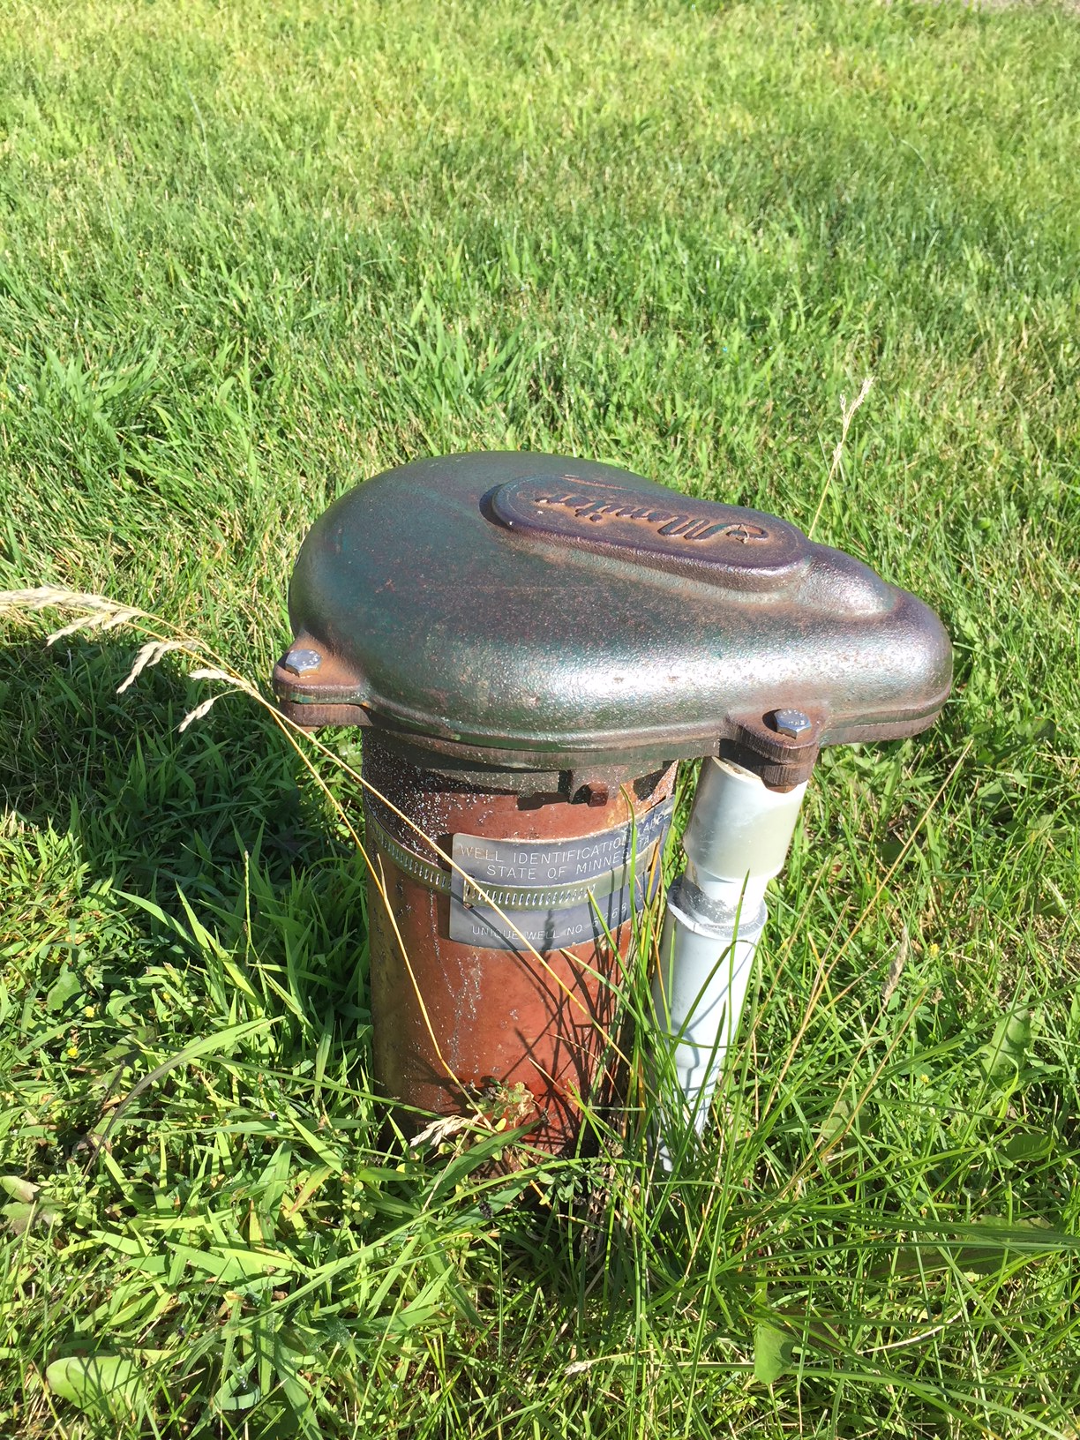
You are responsible for testing your private well water.
You are responsible for testing your private well water.
We can help.
Notes:
If you get your drinking water from a private well, you are responsible for regularly testing your water to make sure it is safe to drink. No one else is doing this for you. Contact (your laboratory name) to find out how to get your water tested.

Slide 7
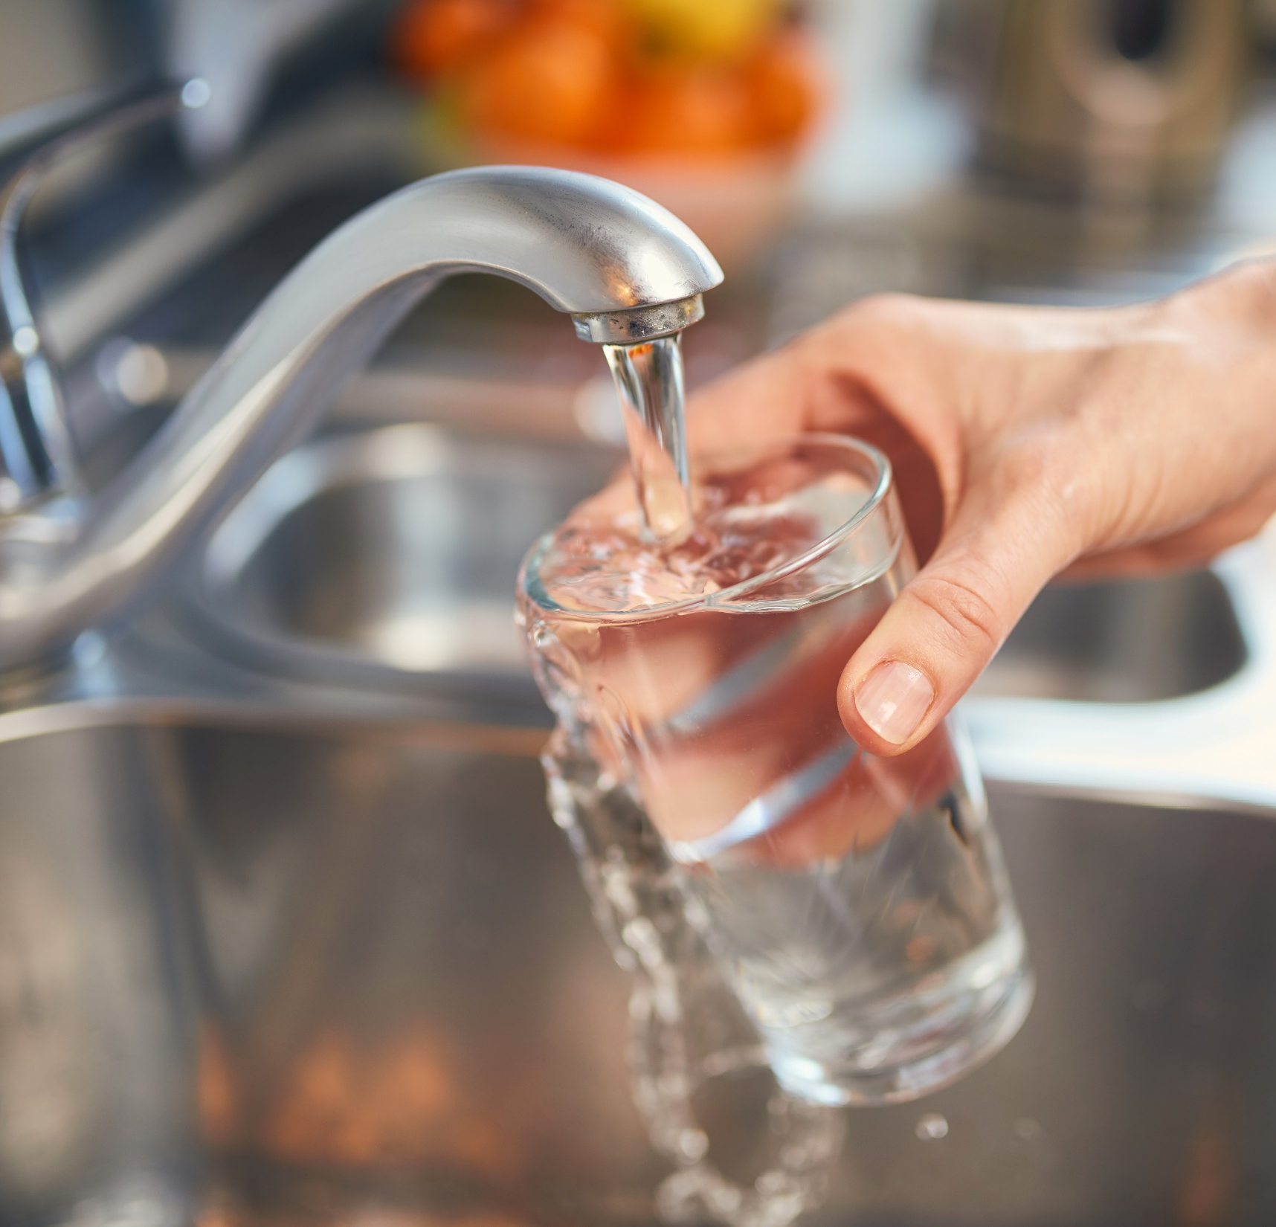
Have you tested your drinking water from your private well this year?
Have you tested your drinking water from your private well this year?
Notes:
While most groundwater is of good quality, there can be contaminants in groundwater that can cause short- and long-term health effects. The quality of your drinking water can change over time and the only way to know is to test your well. Contact (your laboratory name) to get your water tested to make sure it is safe for everyone in your home.

Slide 8
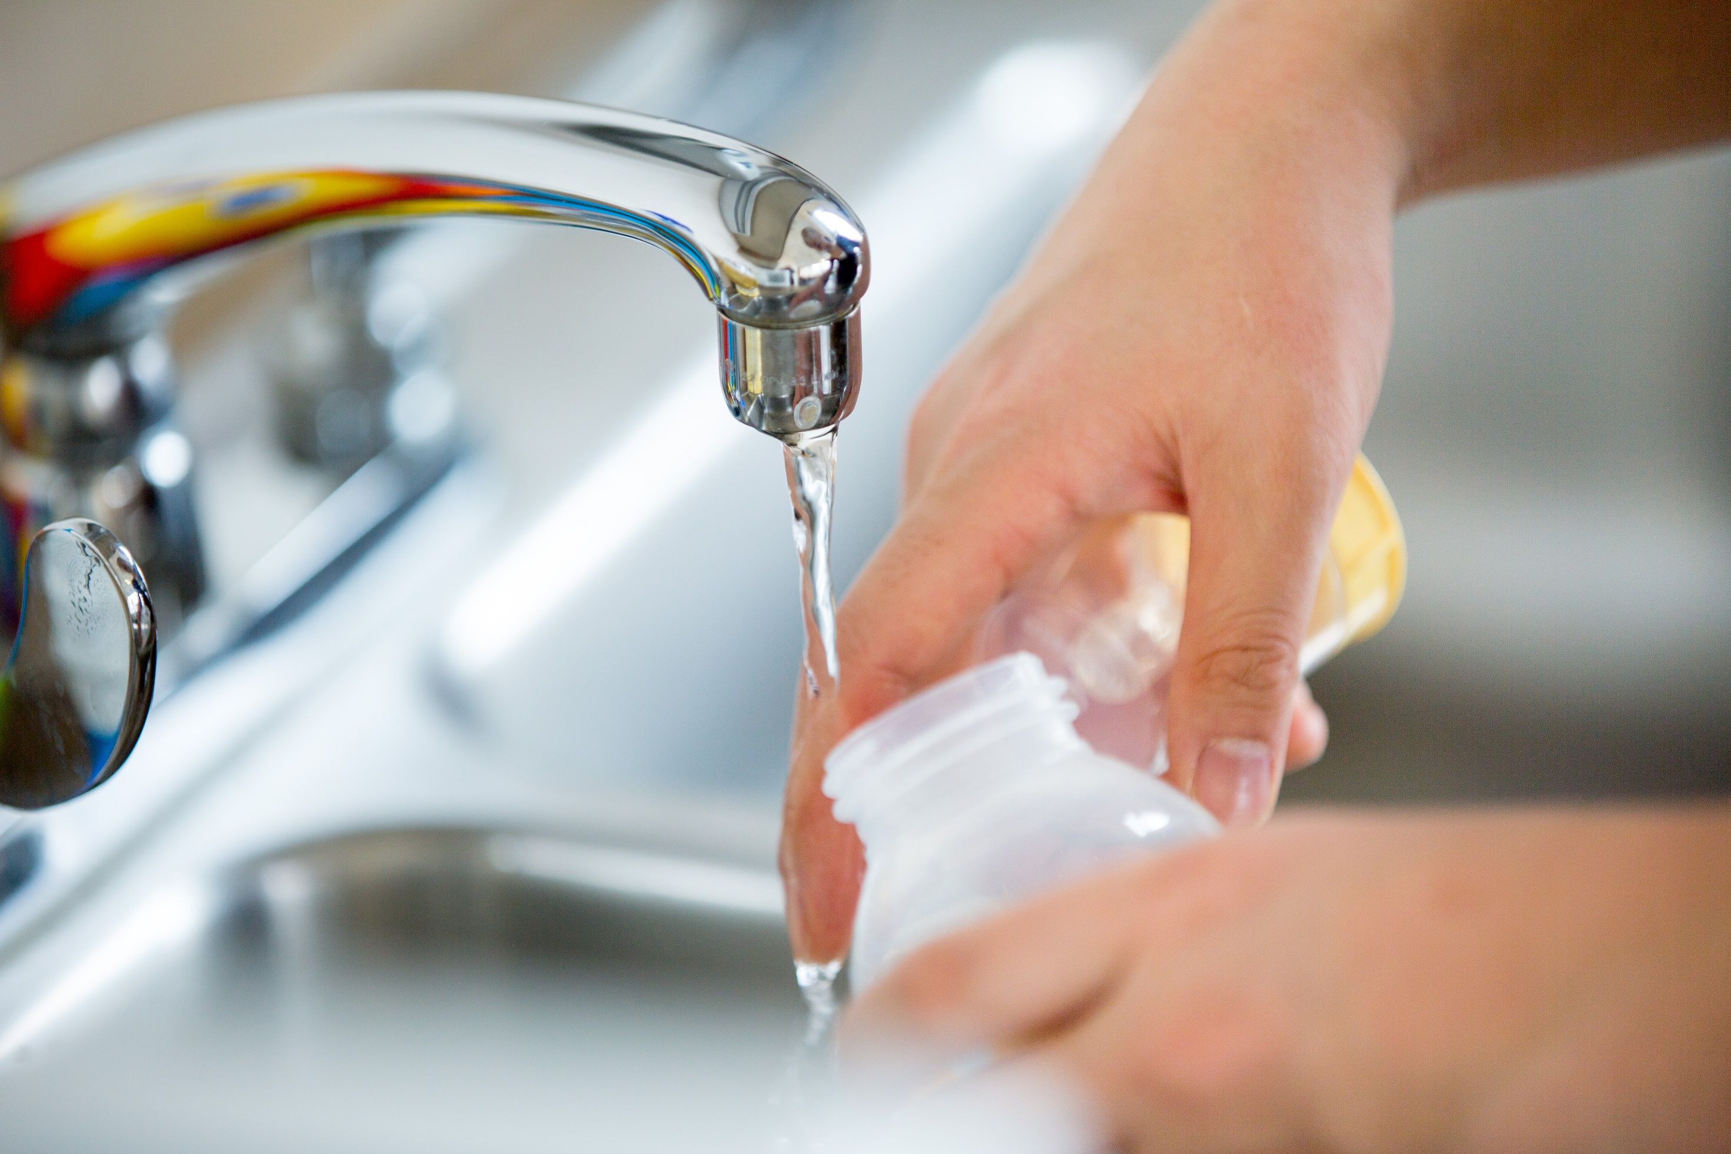
Testing your well water is often the only way to know if your water is contaminated.
Testing your well water is often the only way to know if your water is contaminated.
Notes:
You cannot taste, see, or smell most groundwater contaminants. Testing your private well is the only way to know if your drinking water might have high levels of unsafe contaminants. Contact (your laboratory name) to find out how to get your water tested.

Slide 9
Some groundwater contaminants can make you sick.
Some groundwater contaminants can make you sick.
Notes:
Some common contaminants in Minnesota groundwater can make you sick right away (like bacteria) or increase your risk of heart disease or cancer (like arsenic). Test your private well water to make sure your water is safe for everyone in your home. Contact (your laboratory name) for more information. There are ways to address these contaminants if your water has an unsafe level.

Slide 10
Nitrate in drinking water can affect how blood carries oxygen.
Nitrate in drinking water can affect how blood carries oxygen. Babies are at the highest risk.
Test your well water today.
Notes:
Minnesota Department of Health recommends testing for nitrate every other year. Nitrate levels can change over time. Contact (your laboratory name) for information on how to test for nitrate. There are ways to address nitrate if your water has an unsafe level.

Slide 11
Arsenic in drinking water can increase the risk of lung and other cancers
Arsenic in drinking water can increase the risk of lung and other cancers.
Test your well water today.
Notes:
Minnesota Department of Health recommends testing for arsenic at least once. Arsenic levels are unlikely to change a lot over the lifetime of your well. Contact (your laboratory name) for information on how to test for arsenic. There are ways to address arsenic if your water has an unsafe level.

Slide 12
Bacteria in drinking water can cause stomach problems.
Bacteria in drinking water can cause stomach problems.
Test your well water today.
Notes:
Minnesota Department of Health recommends testing for coliform bacteria every year. The coliform bacteria test can help you identify if other harmful bacteria may be in your well water. Contact (your laboratory name) for information on how to test for coliform bacteria. There are ways to address coliform bacteria in your drinking water.

Slide 13
Lead in drinking water can slow development of children.
Lead in drinking water can slow development of children.
Test your well water today.
Notes:
Minnesota Department of Health recommends testing for lead at least once. Lead levels are unlikely to change a lot over the lifetime of your well. Contact (your laboratory name) for information on how to test for lead. There are ways to address lead if you find out you have an unsafe level in your drinking water.

Slide 14
Manganese in drinking water can cause problems with memory, attention, and motor skills.
Manganese in drinking water can cause problems with memory, attention, and motor skills.
Test your well water today.
Notes:
Minnesota Department of Health recommends testing for manganese before a baby drinks the well water or drinks juice or formula made with well water. Manganese levels are unlikely to change a lot over the lifetime of your well. Contact (your laboratory name) for information on how to test for manganese. There are ways to address manganese if you find out you have an unsafe level in your drinking water.

Slide 15
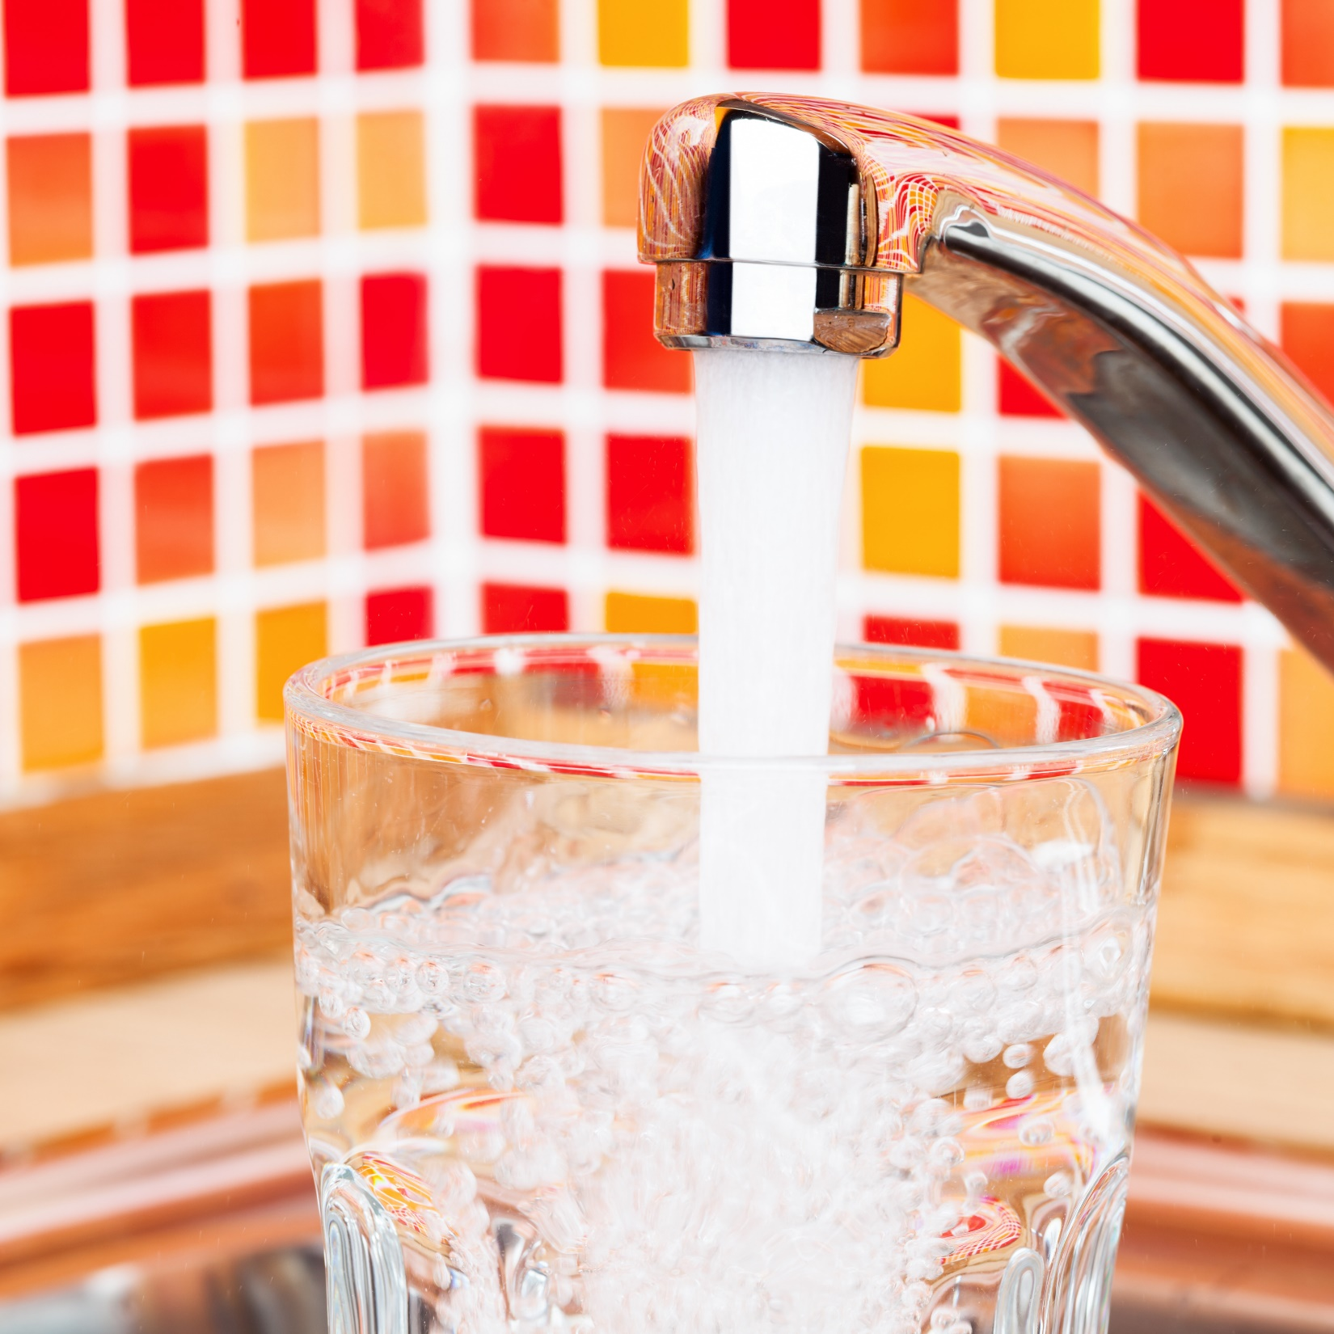
Water quality can change over time.
Water quality can change over time.
Test your well water regularly.
Notes:
Did you know your water quality can change over time? The best way to make sure your private well water is still safe to drink is to have it tested. Contact (your laboratory name) to find out how to get your well water tested.

Slide 16
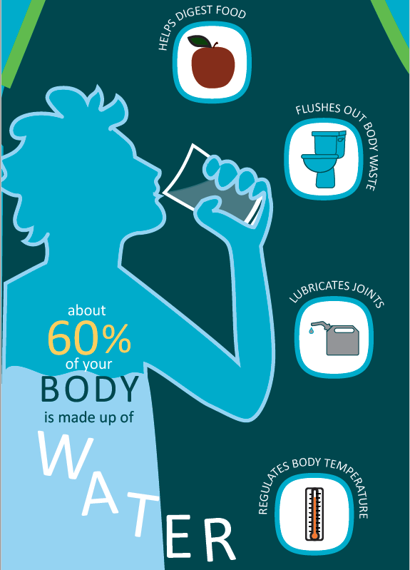
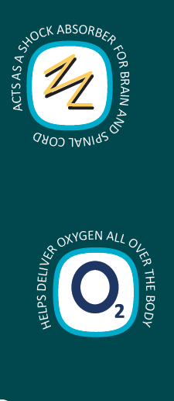
Your body needs quality drinking water.
Your body needs quality drinking water.
Test your well water regularly.
Notes:
Testing your well water is an easy way to make sure your water is safe. Contact (your laboratory name) to get your well water tested.

Slide 17
You cannot always taste, smell, or see changes in your water quality.
You cannot always taste, smell, or see changes in your water quality.
Notes:
Testing your well water is often the only way to know if your water quality changed. You cannot taste, smell, or see most water quality changes. Contact (your laboratory name) to learn how to test your well water.

Slide 18
Which water is from a well with a current water test?
Notes:
Testing your well water is often the only way to know if your water quality changed. You cannot taste, smell, or see most water quality changes. Contact (your laboratory name) to learn how to test your well water.

Slide 19
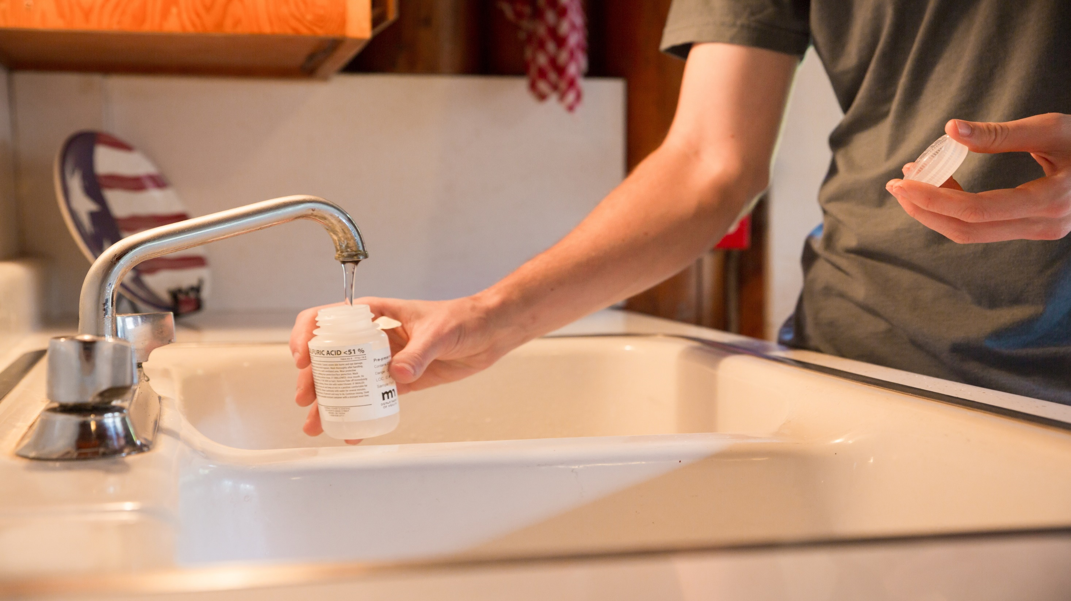
Testing your private well water is easy!
Testing your private well water is easy!
Notes:
Testing your private well water is an easy way to make sure your water is safe from contaminants that can cause stomach problems or increase cancer risks. Contact (your laboratory name) to find out how to get your water tested.

Slide 20
How to Test Your Well Water
Get a Test Kit
Collect and Return Your Sample
Receive Your Results
Contact Us
Notes:
Testing your well water is easy. Contact us at (insert contact information), tell us what you want to test for. We will explain how to take a sample and then send you results once we have tested your water.

Slide 21
Keep you and your family healthy by testing your well water regularly.
Keep you and your family healthy by testing your well water regularly.
Notes:
Testing your well water is an easy and important step to keep you and your family healthy. Contact (your laboratory name) to test your well water.

