Slide 1

Psychological First Aid
A Minnesota Community Support Model
Community

Slide 2
Psychological First Aid (PFA)
Principles and techniques of PFA meet four basic standards.
Consistent with research evidence on risk and resilience following trauma
Applicable and practical in field settings
Appropriate to developmental level across the lifespan.
Culturally informed
Notes:
To the Trainer: The Minnesota model of Psychological First Aid meets competencies recommended by the NIMH panel such as being consistent with the research evidence on risk and resilience following trauma, applicable and practical in all field setting, appropriate across developmental levels, and culturally informed.

Slide 3
Psychological First Aid Model
A model that:
  Integrates public health, community health, and individual psychology
  Includes preparedness for communities, work places, healthcare systems, schools, faith communities, and families
  Does not rely on direct services by mental health professionals
  Uses skills you probably already have…
Source: Gerald Jacobs, U.DMHI, 2005
Notes:
3
To the Trainer: Psychological First Aid Integrates - In times of disaster or traumatic events that have an impact on the community, public health and community psychology are called upon to respond.
Does not rely - but behavioral health professionals are available for support.
Builds individual resilience and community resilience through understanding normal stress reactions allowing you to be prepared for what you might experience and shows you how you can help yourself and others through skills you probably already have.

Slide 4
What is Stress?
The International Federation of the Red Cross defines stress as “A very broad term referring to the effect of anything in life to which people must adjust.”
  For instance, anything we consider challenging causes stress, even if it is something we willingly choose to do
  The key is that stress requires us to adjust our attention and behavior and makes demands upon our energy.
Notes:
4
To the Trainer: Stress is part of daily living but in disaster the increased danger elevates all the processes to a survival level in intensity and pervasiveness. You will see individual and community differences in stress definitions and reactions.

Slide 5
Psychosocial Stress Response
Fear and Distress
Response
Impact of Event
Behavior
Change
Psychiatric
Illness
Adapted from: Source: Butler AS, Panzer AM, Goldfrank LR, Institute of Medicine Committee on
Responding to the Psychological Consequences of Terrorism Board of on Neuroscience
and Behavioral Health. Preparing for the psychological consequences of terrorism:
A public health approach. Washington, D.C.: National Academies Press, 2003.
Notes:
To the Trainer: It is important to realize that the largest number of reactions are “common” in an UNCOMMON situation”. With the appropriate support and assisting techniques you will be able to assist a large number of survivors. A smaller number of reactions are going to be chronic and pathological and will need further professional help.

Slide 6

Common Physical Reactions Adults
  Sleep difficulties
  Gastrointestinal problems (Diarrhea, cramps)
  Stomach upset, nausea
  Elevated heart rate, blood pressure and blood sugar
  With extended stress, suppression of immune system functioning
Notes:
To the Trainer: There will be differences in the number of symptoms that will be manifested by survivors-some more; some less; Some mild; some severe; some of short duration and others chronic. Often the physical symptoms become less evident with time, but extended physical stress reactions can result in suppression of immune system functioning. It is common for disaster relief workers to experience cold and flu like symptoms a couple of weeks after they finish a deployment. You probably have an experience in your life in which you experienced extreme stress and then after the situation was resolved you came down with a cold, some other physical ailment.
With severe symptoms always refer to a medical professional to determine if there is a underlying medical condition.

Slide 7

Common Physical Reactions Children / Youth
  Headaches
  Stomachaches
  Nausea
  Eating Problems
  Speech Difficulties
  Skin Eruptions
Notes:
To the Trainer: Similar to adults, children and youth may experience loss of bladder control or constipation; speech difficulties, upset stomach, loss or increase in appetite, headaches, skin eruptions; etc. Often younger children’s reactions are longer lasting than adults. As with adults, with severe symptoms always refer to a medical professional to determine if there is a underlying medical condition.

Slide 8
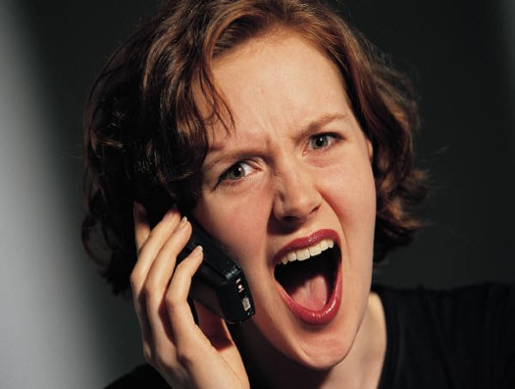
Common Emotional Reactions Adults
  Fear and Anxiety
  Sadness and Depression
  Anger and Irritability
  Numb, withdrawn, or disconnected
  Lack of involvement or enjoyment in favorite activities
  Sense of emptiness or hopelessness
Notes:
To the Trainer: There will be differences in the number of symptoms that will be manifested by survivors-some more; some less; Some mild; some severe; some of short duration and others chronic. Often the physical symptoms become less evident with time, but extended physical stress reactions can result in suppression of immune system functioning. It is common for disaster relief workers to experience cold and flu like symptoms a couple of weeks after they finish a deployment. You probably have an experience in your life in which you experienced extreme stress and then after the situation was resolved you came down with a cold, some other physical ailment.
With severe symptoms always refer to a medical professional to determine if there is a underlying medical condition.

Slide 9

Common Emotional Reactions Children / Youth
  Anxiety & Vulnerability
  Fear of reoccurrence
  Fear of being left alone
    Particularly if separated from family
  Loss of “Sense of Safety”
  Depression
  Anger
  Guilt
Notes:
To the Trainer: Children may have many of the same reactions as adults, and may show them by withdrawing from their peers, engaging in risk taking actions, clinging to parents and having fears of abandonment; younger children may be unable to comprehend danger or to decide what to do. They may feel that they are responsible for what happened (like children of divorced parents) – if only they had been ….(better, smarter, listened to their parents) then …..would not have happened. It is important to listen to kids to discover what they think happened, and to clarify facts in a manner that is age appropriate. As with adults, if symptoms persist after several months you should refer to a Behavioral Health Professional.

Slide 10

Common Behavioral Reactions Adults
  Family difficulties
  Substance abuse
  Being overprotective of family
  Keeping excessively busy
  Isolating oneself from others
  Being very alert at times, startling easily
  Avoiding places, activities, or people that bring back memories
Notes:
To the Trainer: Help people understand that some coping behaviors can lead to increased risk: alcohol & drug use/abuse, risky behaviors, Hyper alertness (especially in returning soldiers), Denial or avoidance of disaster impact, and misplaced anger at loved ones. If you are a mandated reporter, and you discover an danger to self or others situation (suicidal thoughts, abuse to a child or a vulnerable adult, or an expression of homicidal intentions) you must immediately refer to a behavioral health professional and/or law enforcement.
If symptoms persist after several months you should refer to a Behavioral Health Professional.

Slide 11

Common Behavioral Reactions Children / Youth
  Childish” or regressive behavior
    May not be deliberate acting out
  Bedtime problems
    Sleep onset insomnia
    Mid-night awakening
    Fear of dark
    Fear of event reoccurrence during night
Notes:
To the Trainer: Children and youth of all ages are highly influenced by the emotional state of their caretakers. A child’s reaction is based upon age, developmental level, proximity to family members, losses that occur during and immediately after a disaster and the secondary effects on the family and community. Younger children may regress developmentally. They may develop increased fears, and display behaviors of a younger stage of development. Example: A 5 year child starts wetting the bed after staying dry at night for last several years.
Even infants may have increased startle reactions. Teenagers may become more compliant or may begin risk taking behaviors. Example: Sometimes teens who had plans to go to college suddenly change their plans because they want to stay close to their families. WHAT CAN HELP
Keep family structure – routines, bed times, meal times, etc… Talk to the child at their age level. Monitor exposure – shut off the T.V.
Give them a little extra attention –listen to their fears, but don’t push them to talk (drawing, writing stories, and play can all be outlets for a child to express fears.

Slide 12
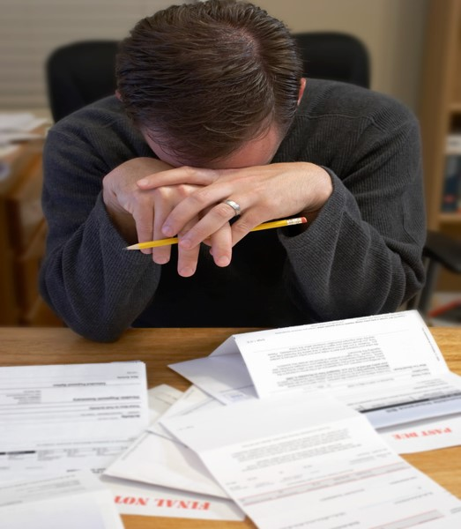
Common Cognitive Reactions Adults
  Difficulty concentrating
  Difficulty with memory
  Intrusive Memories
  Recurring dreams or nightmares
  Flashbacks
  Difficulty communicating
  Difficulty following complicated instructions
Notes:
To the Trainer: Flashbacks are normal and differ from psychosis in that the individual is briefly re-experiencing an actual past traumatic event triggered by a new sensory exposure. – we will discuss sensory reactions in a latter slide. Due to difficulty with concentration, the worker should expect hesitation, silence, fragmented sentences and tangential associations in the conversation with survivors during the first week. At times you may be inpatient when the survivor is slow in establishing a relationship or answering your questions because you are aware of the time it is taking, but you need to be aware that the survivor is doing the best they can to oblige you.
To help people when they are experiencing cognitive reactions, and you need to impart medical information –
Ask them if they would like to have someone else present while you explain things, but remember that person may also be experiencing disaster reactions.
Provide the information in very simple language.
Repeat if you feel it is necessary.
Give the information to them to them in writing at a 6th. Grade language or less.
If symptoms persist after several months you should refer to a Behavioral Health Professional.

Slide 13

Common Cognitive Reactions Children / Youth
  Confusion, memory loss, and disorientation
  Difficulty in concentrating
    May appear as behavioral problems in classroom
  School may be where child functions best
    Continuing Structure, sense of control
    Social group
Notes:
To the Trainer: Again children can react cognitively just like adults. Shortened attention span, can’t concentrate, worry, memory loss, can’t problem solve, numb, unwanted memories .They may have trouble completing school work, have dreams and night terrors, or be preoccupied with the disaster. An example of this is when a young child play acts the disaster over and over again. Returning to school with its formal structure and opportunity for social interaction and support will assist the child in recovery.
As with adults, if symptoms persist after several months you should refer to a Behavioral Health Professional.

Slide 14

Common Faith & Spiritual Reactions
Adults & Children
  Reliance upon faith
  Questioning values and beliefs
  Loss of meaning
  Directing anger toward God
  Cynicism
Notes:
To the Trainer: Turning to spirituality and religion increases the coping abilities of survivors who have relied in the past in this comforting behavior. Many survivors who previously were not active in religious activities turn more active post-disaster. Others may question why God would allow such a thing to occur and express loss of faith.

Slide 15

Common Sensory Reactions
Adults & Children
  Sight
  Sound
  Smell
  Taste
  Touch
Notes:
To the Trainer: Senses have the power to diminish or intensify stress responses.
Under stress, sensory responses are compromised, and can be imprinted with sensory memories of the event.
New sensory experiences can trigger these memories. Responders from 911 report that the smell of fuel and smoke brings back strong memories of the disaster. Certain songs remind us of key time frames in our life.
Many people that have gotten food poisoning or gotten sick after eating a meal (even if that meal was not in any way connected to their illness) feel physically ill at the thought or even the sight of that food. Certain textures elicit comfort – teddy bear therapy.

Slide 16
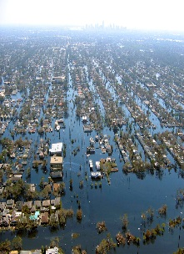
An Event is More Stressful or
Traumatic When …
  Event is unexpected
  Many people die, especially children
  Event lasts a long time
  The cause is unknown
  The event is poignant or meaningful
  Event impacts a large area
Notes:
To the Trainer: Stress increases when the precipitating event is traumatic. Give examples you are familiar with: 911 fits many of these criteria, Oklahoma bombing, Katrina, Alabama tornado, Fires, Operation OIF and OEF, etc.

Slide 17
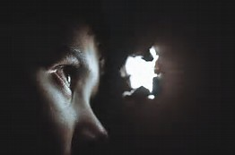
What Assists our Emotional Re-Adjustment?
  Acceptance of the event and our losses.
  Identification, labeling, and expression of our emotions.
  Regaining a sense of mastery and control over our life.
Notes:
To the Trainer: Disasters and major life crisis's leave a lasting impression. Things are never the same after a disaster. Our attitudes, and beliefs, as well as our environment and how we live our life our day to day life may be changed in small or dramatic ways. As we adapt to these changes they become our New Normal condition. Example: After years of having to deal with the threat of flooding, t is normal for those living along the Red River to sandbag every year. The September 11th terrorist attack in New York City made everyone in the USA aware that we can be attacked and harmed on our own soil leading to a New Normal of increased security and disaster preparedness.
People adjust to the changes that are forced upon them by finding ways to understand and accept our losses, understand our emotional reactions, and regain a sense of mastery and control of the situation.
Healthy adjustment can result in healthier behavior, increased functioning and self-confidence.
Unhealthy adjustment increases your risk of developing physical illness, a dependence on unhealthy coping mechanisms (addictive behaviors), and in some cases Clinical Depression or Post Traumatic Stress Disorder.
HOW CAN WE HELP? (transition to next slide)

Slide 18
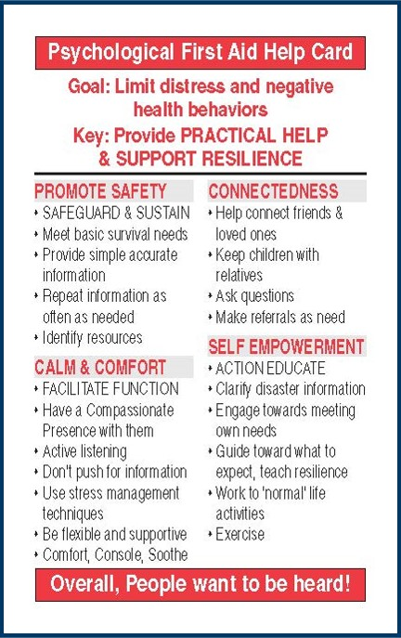
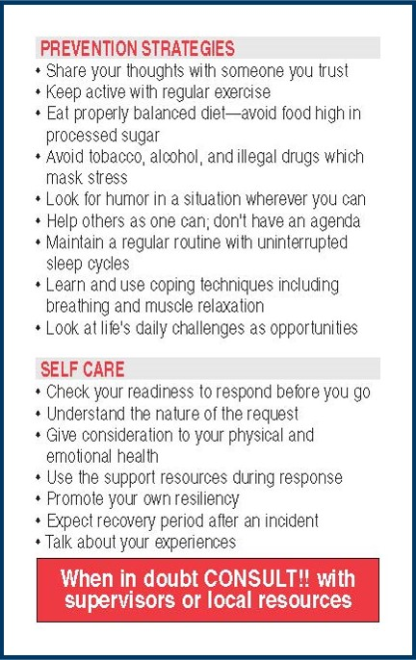
MN PFA Card

Slide 19
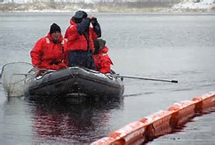
Promote Safety
  Remove from immediate danger area as soon as possible
  Meet basic survival needs
Notes:
To the Trainer: In all responses, SAFETY FIRST! Why is this important to psychological first aid?
Because the first psychological need people have is to be fed, clothed, warm and to know where they will be getting basic needs met. At these times it is not helpful to talk about common reactions to stress. People simply have too much noise in their heads to process the information. Initial responses involve helping people access their basic needs, or understand how to access them.

Slide 20

Calm & Comfort
  Most often, people just need someone to talk to about their experience
  Someone to care
  Someone to really listen
  Someone to lean on or cry with
  Someone to BE PRESENT TO THEM!
Source: Gerald Jacobs, U.DMHI, 2005
Notes:
To the Trainer: What people most need is a caring presence – someone to really listen and be with them in the moment

Slide 21

Active Listening
  Make it clear that you are listening by displaying:
  Compassionate Presence
  Body Language
    Eye contact
    Facial expression
    Tone of voice
Notes:
You provide comfort by active listening.
ACTIVE LISTENING:
Make it clear that you are listening
Provide Vocal/Verbal Support
- Tone of voice (Not too loud)
- Encouraging prompts/head movement
- eye contact (if speaking to someone from another culture check to see if direct eye contact is appropriate)

Slide 22

Active Understanding
  Try not to interrupt until story ended
  Ask questions to clarify
  Establish sequence of events
  Avoid “Why?” and “Why not?” Don’t judge
  Avoid evaluation of their experience and their reactions
  Silence is O.K.
Source: Gerald Jacobs, U.DMHI, 2005
Notes:
To the Trainer: Active listening involves focusing your attention on the speaker in a caring empathic manner. This means showing respect and not interrupting them and asking questions for your own curiosity, or sharing your personal experiences. It is ok to ask clarifying questions so that you can ensure that you understand what you are being told, but it is also ok to just be a silent listening presence. It is also ok to just sit with a survivor and make no communication because your presence alone can provide comfort.

Slide 23

Agitation
  Sometimes, despite our best attempts, some people may become agitated
  Refusal to follow directions
  Loss of control, becoming verbally agitated
  Becoming threatening
  It is usually not personal
  This is their reaction to an UNCOMMON situation, and it has nothing to do with you
Notes:
To the Trainer: Denial defenses are primary in all catastrophic situations. Sometimes an innocent word expressed by you may produce an unexpected violent reaction. You have to be sensitive to the fact that most survivors need to defend themselves FOR A TIME from the reality of their situation. *Carefully support them into accepting reality and help them process the sense of loss by using comforting skills.
Emotional/Behavioral Escalation:
Answer their questions
Repeat your request in a neutral tone of voice
Elements of De-escalation:
1) Introduce yourself if they do not know you
2) Ask the person what they would like to be called
3) Don't shorten their name or use their first name without their permission
With some cultures, it is important to always address them as "Mr." or "Mrs.", especially if they are older than you
4) Use concrete questions to help the person focus
5) Use closed ended questions (If the person is not too agitated, briefly explain why you are asking the question)
For example: I'd like to get some basic information from you so that I can help you better. Where do you live?
6) Come to an agreement on something. Establishing a point of agreement will help solidify your relationship and help gain their trust Positive language has more influence than negative language. Active listening will assist you in finding a point of agreement

Slide 24

Be Kind, Calm, and Compassionate
  Express patience and compassion, even if people are being difficult.
  Speak in a calm voice.
  Remain courteous and respectful of people – even if the other person does not!
Source: Psychological First Aid: Helping Others in Times of Stress
Notes:
To the Trainer: Active listening and active understanding requires you to express patience and compassion even if those you are trying to assist are being difficult.
Speak to the person with respect even if they are not showing you respect. This is communicated by the use of words like please and thank you. Don't make global statements about the person's character; Do use “I” statements; and remember that Lavish praise is not believable. As stated earlier: Positive language has more influence than negative language. Active listening will assist you in finding a point of agreement.

Slide 25

Psychological First Aid Don’ts
  Avoid asking for in-depth description of traumatic experiences.
  Follow the lead of the individual in discussing what happened during the event.
  Individuals should not be pressed to disclose details of any trauma or loss.
Source: Center for the Study of Traumatic Stress
Notes:
To the Trainer: Psychological First Aid is not therapy, and interventions such as Critical Incident Stress Debriefing (CISM) which encouraged the sharing of emotions and experiences has shown to be ineffective and may even re-traumatize survivors so avoid asking for in-depth descriptions of the event. Let the survivor lead the conversation.
Factual information is important to the survivor – it builds trust and provides a sense of control over the situation so never promise something that you can not deliver and never criticize other service providers in front of those that require that service.

Slide 26

It is Not OK to suggest that…
  Let’s talk about something else
  You should work toward getting over this
  You are strong enough to deal with this
  I know how you feel
  You’ll feel better soon
  You did everything you could
  You are lucky to be alive
  You need to relax
  It’s good that you are alive
Notes:
To the Trainer: Don’t tell people what to do. Don’t act like you understand what they are going through. Don’t say you did everything that you could –you don’t know what they feel that they should have done. Studies have shown that no 2 people interpret a situation in exactly the same way. Just be PRESENT and listen to their thoughts and feelings without any judgment or comment.

Slide 27

It is OK to…
  Recommend substitute solutions that are:
    more useful
    less burdensome or
    less likely to backfire
  If you don’t know an answer, say “I don’t know but I might be able to help you find out.”
  Or, “I’m not sure what to do, but I will be happy to help you find someone who does.”
Notes:
To the Trainer: If someone doesn’t know what’s happening (this is a natural response to stress), it’s ok to tell them very simply and calmly “you arrived here a few minutes ago to tell me xyz, and I am finding out how to solve the problem or who to contact that can help you.”

Slide 28
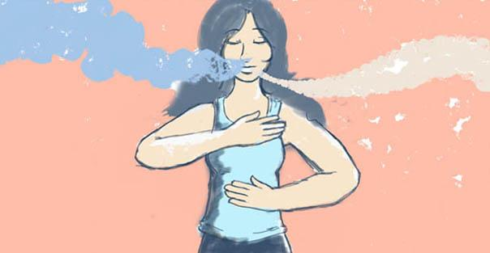
Provide Information on Coping
  Provide basic information about common stress reactions
  Provide basic information on ways of coping
    First Aid Card
  Teach simple relaxation techniques
    Deep Breathing
    Muscle relaxation
Notes:
To the Trainer: get into a comfortable position with your feet flat on the floor and your back straight. Start by slowly releasing the air from your lungs by breathing it out through your mouth. Next, slowly breath in air through your nose or your mouth. In your mind, picture your lungs and your entire body filling up with clear clean white air. Hold that air in your lungs for a while. Feel its calming nature. Then slowing release the air through either your mouth or your nose. Picture in your mind that the air that is being released is gray or black because it contains your fears and worries. Repeat 3 times or more until your feel more relaxed. As you are practicing your deep breathing you can also relax tight muscles by focusing on warm comfortable heat slowly traveling up your body starting at your feet then moving to up your legs, your hips, your back, arms, shoulder , and up your neck and finally up your face and head.

Slide 29

Maladaptive Coping Strategies
Excessive withdrawal, retreat, avoidance
High use of fantasy; poor reality testing
Impulsive behavior
Venting on weaker individuals
Over-dependent behavior
Lack of empathy for others
Notes:
To the Trainer: Maladaptive coping strategies are those behaviors that do not provide lasting stress reduction, in fact cause increased stress if practiced over an extended period of time. Maladaptive coping behaviors can also be a sign of acute or chronic stress, or in some cases ac clinical diagnosis.

Slide 30

Positive Coping Strategies
Actively seeking assistance
Reacting constructively to environmental challenges and recognizing potential for growth
Use of non-destructive defenses such as humor, exercise, good eating habits, time management, relaxation exercises
Notes:
To the Trainer: Positive coping strategies not only assist in the recovery process and reduce stress reactions, build resilience to future events. Practice healthy behaviors in mind, body, and spirit.

Slide 31

Connectedness
  Help connect with friends & loved ones
  Help connect with pets
  Connect with disaster resources and support services
  Connect with community resources and support services
Notes:
To the Trainer: Assisting survivors in organizing and getting to those disasters related services, resources and opportunities that will help them achieve pre-disaster levels of functioning and equilibrium.
Restoring the individual bonds to the human supportive systems as one of the essential needs of survivors to regain the sense of being part of a community. Connecting children with their parents lessen their fears and stress.
Continually inform the survivor of changes in the community or emergency programs--diminishing uncertainty and increasing knowledge will reinforce coping capacity.
Reuniting family members is particularly important when someone has been injured or even killed. It is important also to remember that reuniting family members who were not directly involved is important too and a tragedy can increase anxiety for individuals not immediately involved. For children especially, it is important to help them find family to assist with calming and soothing.

Slide 32

Look for…
  Unresponsiveness to verbal questions or commands
  Glassy eyed and vacant stare – unable to find direction
  Disorientation (aimless disorganized behavior)
  Strong emotional responses
    uncontrollable crying, hyperventilating, rocking
Notes:
To the Trainer: Notice if the survivor is showing signs of unresponsiveness to questions, or displays a glassy eyed vacant stare – these are signs that they individual should be referred to a mental health professional for assessment. Additional, notice strong emotional responses such as uncontrolled crying or any aimless, disorganized behavior such as frantic pacing because these too are signs of a need for a referral to a mental health professional.

Slide 33

Alarm Bells/When to Refer
  Harm to self
    Saying they want to:
    “End it all”
    “Go to sleep and never wake up again”
  Preoccupation with death
  Giving away possessions
  Excessive use of substances
    Driving under influence
    In some cases working under influence
Notes:
To the Trainer: Notice if the survivor is showing signs of unresponsiveness to questions, or displays a glassy eyed vacant stare – these are signs that they individual should be referred to a mental health professional for assessment. Additional, notice strong emotional responses such as uncontrolled crying or any aimless, disorganized behavior such as frantic pacing because these too are signs of a need for a referral to a mental health professional.

Slide 34
Alarm Bells/When to Refer
  Harm to others
    Child abuse
    Spouse abuse
  Loss of control
  Significant withdrawal (as change in behavior)
  Unable to care for self (cannot eat, bathe etc. - Vulnerable)
Notes:
To the Trainer: Notice if the survivor is showing signs of unresponsiveness to questions, or displays a glassy eyed vacant stare – these are signs that they individual should be referred to a mental health professional for assessment. Additional, notice strong emotional responses such as uncontrolled crying or any aimless, disorganized behavior such as frantic pacing because these too are signs of a need for a referral to a mental health professional.

Slide 35

Self Empowerment
  Provide disaster and responder reintegration information
  Engage towards meeting own needs-practical problem solving
  Work to “normal life” activities
  Promote Resilience
    Everyone who experiences a traumatic event is touched by it
    We have the ability to “bounce forward” to a “New Normal”
Notes:
To the Trainer: Primary goal is to support and comfort and then refer to community resources. Saying - I am here and will help you to the best of my ability” is a powerful resource to support and enhance coping. Give credible information about the incident at the level of the child’s understanding. Clarify any rumors or misinformation. Inform about resources that are available at school and in the community to assist the child and their family. What are the local support systems to assist the survivor based on your knowledge of distress signs, cultural and religious traditions and the resources at your disposal?
Give people the facts of the disaster situation. It can be helpful to point out an easier way to do things if the person is receptive to your input. Assist people to address their most pressing needs and help them to set an action plan of how to address that need. Help people to get involved in the recovery process – their own and their communities.

Slide 36
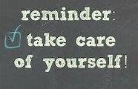
Develop a Personal Resiliency Plan
  Focus beyond the short term – DO IT NOW!
  Get to understand what triggers stress for you
  Know your personal unique stressors and Red Flags for further assistance
  Select from your own menu of positive coping responses
  Practice stress reduction and self care daily
Notes:
To the Trainer: Understand how you react to stress. Do you feel it as: Shoulder pain, Headaches, Stomach problems? Learn to recognize when you reach your stress limit. Remember what are the common reactions to stress. Use healthy coping skills – what has worked for you in the past? Assisting others in physical or emotional pain may start to affect you so you should be constantly aware of your own reactions. Emotional pain and anxiety are “contagious” and will affect you so continue to monitor yourself for stress reactions.

Slide 37
MN PFA User Resources
Minnesota Department of Health, Behavioral Health Web page http://www.health.state.mn.us/oep/responsesystems/behavioral.html
Just-in-Time PFA Training video
  11 minute video based on the MDH PFA First Aid Card
https://www.youtube.com/watch?v=sa7WiL1xwQg
University of Minnesota PFA Phone Apps
http://www.sph.umn.edu/academics/ce/tools/
  Psychological First Aid
  Responder Self-Care

Slide 38

Psychological First Aid Online Training
  Free 45 minute 6 module course
  Includes a pre & post test and module quizzes
  Walks you through the development of your own self-care plan
  Printable Handouts, PFA card, & certificate
  .75 CEUs from the University of MN

Slide 39

For More Information
  Nancy Carlson
  Behavioral Health Preparedness Coordinator
  Minnesota Department of Health
  Office of Emergency Preparedness
  Phone 651-201-5707
  Cell: 651-247-7398
  Nancy.J.Carlson@state.mn.us
  MDH Behavioral Health Web Sites:
  www.health.state.mn.us/oep/planning/mhimpact.html

