Slide 1

Using ICS in a Public Health Response
Spring 2018

Slide 2
Training Objectives
Review Incident Command System (ICS) positions and responsibilities and assume a role in a simulated response.
Develop SMART incident response objectives, identify strategies and tactics, and finally hold an incident briefing.
Review the Planning P phases and the ICS forms used in each phase and develop an Incident Action Plan.
Identify next steps for applying the ICS process and tools for planned and emergency incident responses within their agencies.
Notes:
Welcome everyone. We’re happy you could join us for this training.
This training resulted from a discussion with the SCHSAC PHEP Oversight Work Group about unused local health department funds from last year. Their request was to develop a hands on training for local health departments on how to use ICS in more of a workshop format that would also allow agencies to work as a team. Every region has a representative on the PHEP Oversight Work Group. (Ask if the representative from that region is present and if she/he would like to add anything).
We hope you will find it beneficial in helping you apply the incident command system to public health responses. Through this training, you will have the opportunity to prepare and execute a response strategy to a simulated public health incident by reviewing and then applying the following incident command system principles and tools: (Read Objectives on Slide)

Slide 3

Introductions
Name
Agency/ Role at agency
ICS Experience & ICS Role (exercises or real life responses)
Notes:
Let’s start with Introductions:
Introduction facilitators
Each person introduce:
Self
Agency
ICS roles served in exercises and responses
Now let’s take the pre-test.

Slide 4
Workshop Agenda
Day 1
Welcome and Introductions
ICS Roles and Responsibilities: Fundamentals
Planning P and ICS Forms Practice
Wrap-Up
Day 2
Recap and Day 2 Overview
Incident Briefing 201 Activity
Tactics Meeting & Shift Change Briefing
Lunch
Planning Meeting & Incident Action Plan
Operational Period Briefing
Hotwash & Next Steps
Notes:
Here is the agenda for the next day and a half. We’ll spend the next 4 hours discussing how to apply the Incident command system roles and responsibilities. We’ll also walk through the Planning P process and work with the incident command forms that are used in each section of the planning p. Day 2 is a full day “coached” exercise with opportunities to apply all the steps of the Planning P using the ICS forms in a Hepatitis A scenario. This is a workshop – no AAR-IP will be produced. This does not count toward any grant exercise requirement.
Let’s review the content of your folders. On the right side of the folder are the documents we’ll refer to over the next few hours (they’re printed on green paper). You have a full color Planning P. And the Planning P meeting agendas are printed on white paper and stapled together. Tomorrow’s exercise materials are printed on purple paper on the right hand side. Your course evaluation is the last piece of paper printed in purple.
All ICS forms are printed on white paper and are on the left side of the folder. These are the ICS forms you downloaded from SharePoint. You can use the paper version or the electronic version--whichever you prefer during this class and you’ve got them for reference going forward.

Slide 5

Day 1: ICS Responsibilities and Fundamentals
Every incident or event requires that certain management functions be performed.
Notes:
Now we’re going to start the first section of the workshop. There is a system that responders are required to use.

Slide 6

Day 1: ICS Responsibilities and Fundamentals
ICS Structure for Local Public Health
  Quick Review of Core Positions and Responsibilities
  Review ICS Positions Handout
Staffing Activity
Debrief
  Challenges
  Take-aways
Notes:
In this section we are going to start with an overview of the ICS structure for local public health to include a quick review of core positions and responsibilities followed by a staffing activity. At the end of this section, you will have the opportunity to identify ICS staffing challenges within your agency and some next steps – “key take-aways” for follow-up after this workshop.

Slide 7
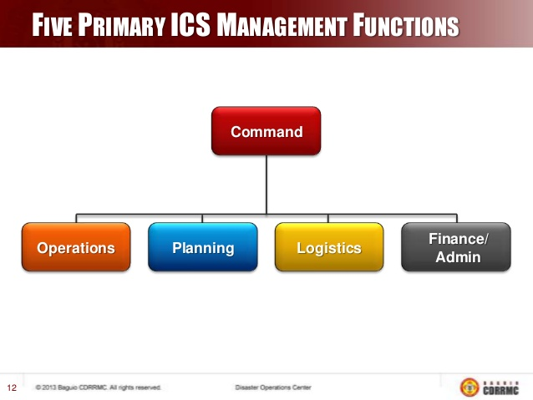
ICS Positions and Responsibilities
Notes:
Every incident or event requires that certain management functions be performed. The problem must be identified and assessed, a plan to deal with it developed and implemented, and the necessary resources procured and paid for.
Even if an incident is very small, and only one or two people are involved, these management functions still will apply to some degree. Please refer to the ICS Positions List handout as we review the key functions over the next few slides.
There are five major management functions that are the foundation upon which the ICS organization develops. These functions apply whether you are handling a routine emergency, organizing for a major nonemergency event, or managing a response to a major disaster.
The five major management functions are:
• Incident Command/Manager
• Operations
• Planning
• Logistics
• Finance/Administration
Let’s now briefly review each of these ICS functions:
• Command: Sets incident objectives and priorities and has overall responsibility at the incident or event.
• Operations: Conducts tactical operations to carry out the plan. Develops the tactical assignments and organization, and directs all tactical resources.
• Planning: Prepares and documents the Incident Action Plan to accomplish the incident objectives, collects and evaluates information, maintains resource status, and maintains documentation for incident records.
• Logistics: Provides support, resources, and all other services needed to meet the incident objectives.
• Finance/Administration: Monitors costs related to the incident. Provides accounting, procurement, time recording, and cost analyses.
Each of these sections support operations.

Slide 8
ICS Positions and Responsibilities Activity
Management Function | Vacation Activity
Incident Command | Establish a budget and select the destination.
Operations | Select the method of travel, determine the route to the destination, and operate the vehicle.
Planning | Find the most expedient route to the destination, determine whether there are any current road construction or other obstacles, and determine how many miles will be traveled.
Logistics | Arrange for vehicle, fuel, lodging, and food.
Finance/Administration | Pay for the trip.
Notes:
Apply ICS model for planning a vacation.
Ask audience what each role’s primary responsibility for taking a vacation. Wait for response.
Answers fly in.

Slide 9
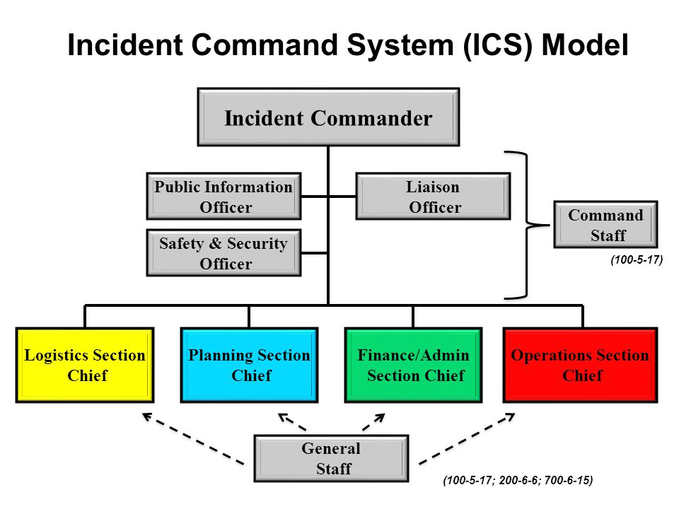
ICS Positions and Responsibilities
Notes:
Expanding the Organization
As incidents grow, the Incident Commander may delegate authority for performance of certain activities to the Command Staff and the General Staff.
• Command Staff: The Command Staff provide information, safety, and liaison services for the entire organization.
• General Staff: The General Staff are assigned functional authority for Operations, Planning,
Logistics, and Finance/Administration.
Command Staff: Depending upon the size and type of incident or event, it may be necessary for the Incident Commander to designate personnel to provide information, safety, and liaison services for the entire organization.
In ICS, these personnel make up the Command Staff and consist of the:
Public Information Officer, who serves as the conduit for information to internal and external stakeholders, including the media or other organizations seeking information directly from the incident or event.
Safety Officer, who monitors safety conditions and develops measures for assuring the safety of all assigned personnel.
Liaison Officer, who serves as the primary contact for supporting agencies assigned to an incident.

Slide 10
ICS Positions Activity 1 (Part 1)
  Exercise Part 1: 10 minutes
  Scenario: You receive a call that there is a confirmed case of measles at a local daycare center that provides care for 75 children, ages 6 weeks through 8 years.
  Task: Establish incident command structure.
    You are charged with setting up the initial ICS structure for this response. This is happening NOW and you must fill the roles from your current roster of staff.
    All required positions on the worksheet must be assigned.
Notes:
Handout ICS 207 form Incident Organization Structure
Review exercise directions for Part 1.
Read the scenario.
Read the task.
The required positions are those with an asterisk, although you are welcome to assign staff to all the roles.
If there is more than 1 person attending from your agency, you can work together to identify staff.
Any questions?
Monitor time – give a 5 minute warning and then a 1 minute warning.
Monitor table groups – if participants finish early, move on to Part 2.

Slide 11
ICS Positions Activity 1 (Part 2)
  Exercise Part 2: 10 minutes
  In your table groups, discuss the following questions. Choose a recorder and reporter.
  Discuss your decision-making process for assigning the ICS positions - what was your rationale for the assignments?
  What were your challenges in filling these positions?
  What are potential solutions to address the identified challenges?
Report out to large group
Notes:
Review exercise directions for Part 2.
Ask if any questions.
Monitor time.
Monitor table groups – if participants finish early, move on to Part 2.
Facilitate large group discussion. If not doing next 2 slides (repeat exercise with different scenario), then ask What are your key take-aways from this activity?
Solicit answer to each question from 1 table group and then ask other tables to share additional answers.
After discussing all the questions, transition to second scenario (next slide), OR
Ask the group to identify key take-aways from this activity.
MDH might say the what, but local public health figures out the how. So MDH may be providing direction on what needs to happen, but LHDs need to stand up their local response structures because of the local relationships, partnerships, information, etc. that you have. You’ll be working with MDH on how to get things done.

Slide 12
ICS Positions Activity 2 (Part 1)
  Exercise Part 1: 5 minutes
  Scenario: A major storm has impacted your community with 10+ inches of rain and very strong winds. You receive a call that residents of a mobile home park are being evacuated to a local school and the nursing home is planning to evacuate as well.
  Task: Establish incident command structure.
    You are charged with setting up the initial ICS structure for this response. This is happening NOW and you must fill the roles from your current roster of staff.
    All required positions on the worksheet must be assigned.
Notes:
If time allows, do a second exercise. (optional) Same task as just done—but using a different scenario to see if ICS structure changes.
Review exercise directions for Part 1.
Read the scenario.
Read the task.
For this second scenario, review your assignments from the measles incident and identify any changes to your assigned staff.
You have 5 minutes.
Ask if any questions.
Monitor time – give a 2 minute warning.
Monitor table groups – if participants finish early, move on to Part 2.
Hold on to those for later activities.
Review exercise directions for Part 1.

Slide 13
ICS Positions Activity 2 (Part 2)
  Exercise Part 2: 10 minutes
  In your table groups, discuss the following questions. Choose a recorder and reporter.
  What if any staffing changes did you make based on the new scenario? Discuss any changes in your decision-making process for assigning the ICS positions?
  What are your challenges for establishing an ICS structure in your agency?
  What are your key take-aways from this activity?
  Report out to large group.
Notes:
Review exercise directions for Part 2 from the slide.
Ask if any questions.
Monitor time.
Monitor table groups – if participants finish early, move on to Part 2.
Facilitate large group discussion.
Solicit answer to the first 2 questions from 1 table group and then ask other tables to share additional answers.
Ask each table group to share answers to question 3 – what are your key take-aways from this activity?
NOTE: Can also choose to facilitate large group discussion for all questions to save time.
Remind participants to keep their ICS 207 Organizational Chart for later use.

Slide 14
Day 1: Planning P and ICS Forms
ICS has specific tools and processes that can help move your team through a response in an organized way.
Notes:
Read slide

Slide 15
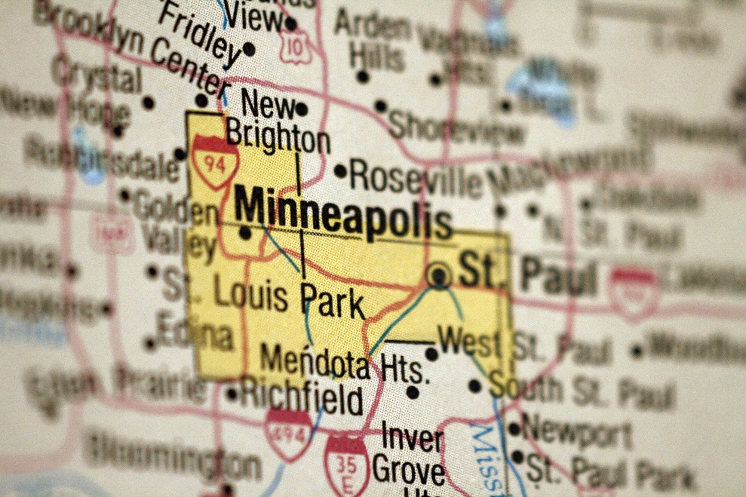
Planning P
The Planning P is a powerful tool … if you use it.
Roadmap to what should happen when and with whom.
2 parts
  Stem
  Circle (circular sequence)
Notes:
Incident objectives, strategies, and tactics do not just appear out of thin air; there must be a planning process for developing and modifying them based on the incident.
The Planning P is an important tool and guide to the incident planning steps and processes.
The process outlined in the Planning P has proved useful for both simple and complex incidents.
Let’s take a look at what the Planning P looks like and we’ll examine the 2 parts, which are referred to as the Stem and the Circle.
You can follow along on the slide or bring up the handout.

Slide 16
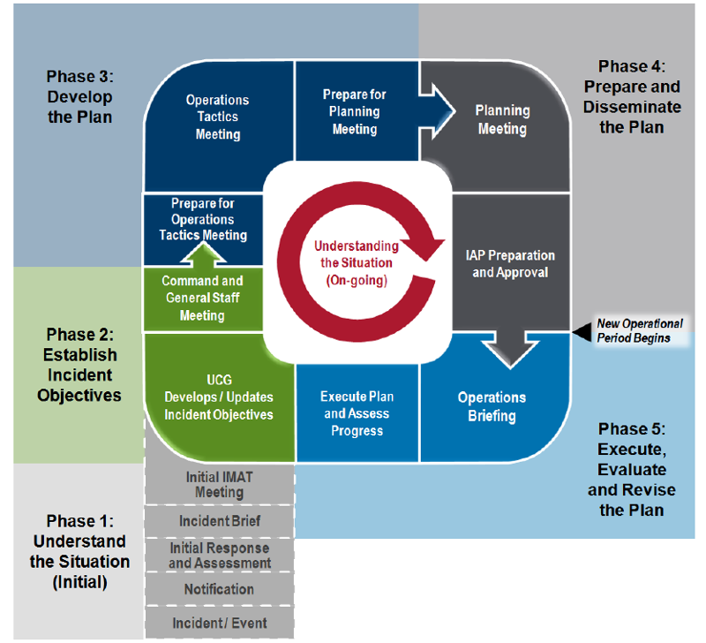
Day 1: ICS Responsibilities and Fundamentals Review
Notes:
The bottom leg, or stem, of the Planning P describes the initial response period, where understanding the situation occurs. The top, circular part describes the planning cycle that occurs in each operational period. Information gathering and sharing is happening continuously throughout this process. We’ll look closer at each of the sections in a few minutes.
We’re assuming that you are all have some familiarity with the Planning P. However, our research and evaluations have indicated that Incident Commanders are not always fully comfortable with applying the steps of the Planning P. The more familiar we all are with the process, the smoother an incident will likely run.
If the Incident Commander has a good grasp of the Planning P process, they are able to lead their team more effectively in a response. It is also important that each member of the ICS team understands the Planning P so that they too can effectively respond to incidents.

Slide 17
Planning P Stem
Initial IMAT Meeting or IC/UC Meeting
Incident Brief
Phase 1: Understand the Situation (Initial)
Initial Response and Assessment
Notification
Incident/Event
Notes:
This slide takes a closer look at the activities that make up the stem of the P.
Here it describes the IC actions/activities that are part of the “stem” of the Planning P where understanding the situation occurs. These sections will often occur in a short time-frame and may overlap. Some sections may not apply in situations when there is not a Unified Command. (e.g., the section at top of the leg– “Initial IMAT Meeting or IC/UC Meeting”)
Notification/Initial Response and Assessment: The Incident Commander is notified of the incident, assesses the situation, and sizes up the incident. A thorough size up provides information needed to make initial incident management decisions. (Next slide to address “Size Up”)
Initial IMAT Meeting or Initial IC/UC meeting: An IMAT is Incident Management Assistance Team- a rostered group of ICS –qualified personnel deployed to support on scene personnel or the affected jurisdiction.

Slide 18
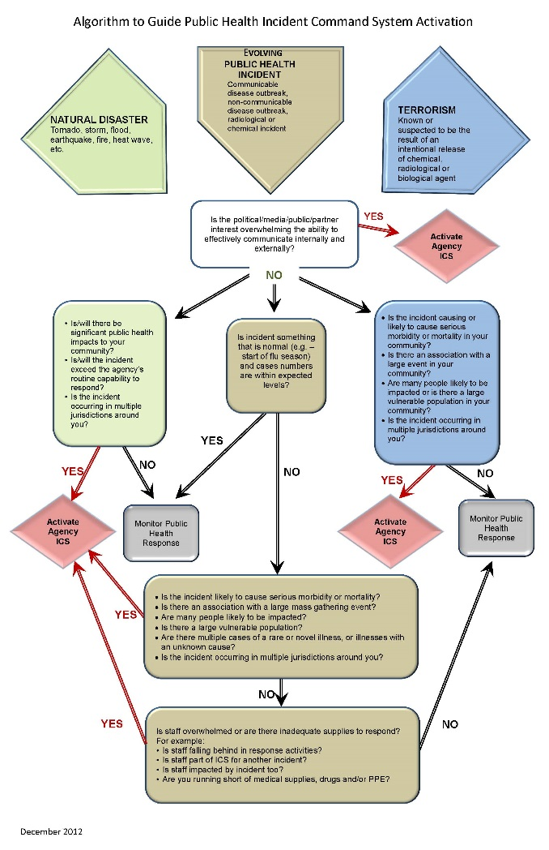
Size Up - Activate ICS or Not?
Notes:
A few words on “Size Up”. This algorithm is a tool that can help public health agencies determine whether or when to activate an ICS structure. Just follow the algorithm from top to bottom. This is one of the documents you downloaded for this workshop if you want to pull it up on your computer.
Some questions (or triggers) that help with making a size up:
Is there political, media, public, or partner interest that might overwhelm your ability to effectively communicate?
Is this something that is occurring in multiple jurisdictions?
Is this something out of the norm? (e.g., flu cases in summer)
Will this have significant public health impact?
Is this associated with a large event in your community?
Are vulnerable populations impacted?
Based on your answers to these kinds of questions, this tool can help you determine if the incident will warrant a larger public health response and the need to activate an ICS structure.
Algorithm was created from a group project as part of the Harvard University, National Preparedness Leadership Initiative.

Slide 19
Planning P Stem Contd.
Initial IMAT Meeting or IC/UC Meeting
Incident Brief
Phase 1: Understand the Situation (Initial)
Initial Response and Assessment
Notification
Incident/Event
Notes:
So back to Initial Response and Assessment:
At MDH we have created the Checklist for Initial Response to help the IC perform the “size up.” (handout and review Initial Checklist for Response form.) This document is to be used to characterize the nature of an incident, determine the scope of the impact, and ensure designated staff and partners are notified and involved in decision making. If a response structure is activated, this document is to be used by the Incident Commander/Manager in completing the ICS Form 201 Incident Briefing.
Group Review: So look at page one of this document. Under the Notification section, that’s our list of who MDH would notify, but who would you list here from your agency or jurisdiction to notify if you’ve determined there needs to be a larger public health response?
Activity: Have each person list who they would initially notify upon receiving a call that an incident has occurred, such as a measles outbreak or nursing home evacuation. Allow 2 minutes.
After 2 minutes, remind participants that their emergency response plan should list key staff and processes for notification and activation.
Incident Brief: If your size up indicates needing to activate an incident response team, the IC continues notifications and sets up an ICS structure which will lead to the Initial Incident Briefing. This leads to the creation of the ICS-201 Incident Briefing form. (Go to next slide for Incident Briefing Activity: review scenarios and fill out ICS 201 form)
Initial IMAT Meeting or Initial IC/UC meeting: The IC finalizes and clarifies the IC/UC structure, roles and responsibilities, identifies the operational period, overall response organization and support facilities, selects the Operations Chief, and makes key decisions. An IMAT is Incident Management Assistance Team- a rostered group of ICS –qualified personnel deployed to support on scene personnel or the affected jurisdiction.

Slide 20
Incident Briefing 201 Activity
Activity:
  Step 1: Review assigned scenario
  Step 2: Complete ICS 201 Initial Incident Briefing form using information from assigned scenario.
  15 minutes to complete ICS 201
  Step 3: Provide a briefing on your incident
Discussion or Questions?
Notes:
Distribute/Open the ICS 201 Initial Incident Briefing form. Review ICS 201 briefly. (not all sections of the ICS 201 will have information to plug in to it.) So once you’ve determined there needs to be an ICS structure activated, and you notify your ICS team, you’ll need to brief them on what’s going on. This form helps capture that information and is distributed and reviewed with your ICS team at the Initial Incident Briefing.
Group Activity – Divide room into 2 groups (may need to divide into 4 groups if large number of students in class)…Distribute the 2 scenarios among the groups (Winter Weather Scenario & Storm Damage to Hospital Water Supply). Groups should review their scenario and begin to fill out ICS 201 Incident Briefing based on the limited information they have.
(each person at the table will review a scenario and begin to fill out an ICS 201 Incident Briefing.)
Hold a Briefing
So now we want to hold the Initial Incident Briefing. Everyone has a copy of the Holding an Incident Briefing Handout (located in P_Meeting_Agendas folder) so follow along on this checklist and track what the IM is saying, then you will be using this checklist as you hold your Initial Incident Briefing. Our Incident Managers at MDH use this checklist to help them walk through holding the initial incident briefing. So we’ll have the instructors demonstrate how we normally hold the Initial Incident Briefing. Then we’ll have table 1 hold their initial incident briefing and then table 2 can hold their initial incident briefing.
Instructors should role play holding an incident briefing- using an MDH ICS 201 Briefing form already filled out.
We are going to demonstrate an Incident Briefing. We are doing this as we do it at MDH in the department operations center (DOC) because we recognize that each local health department will do things slightly differently. So we will model this for you, and you should be able to adapt this to your individual agency practices.
Then have one group brief the other using their 2 different scenarios. (Winter Weather Scenario & Storm Damage to Hospital Water Supply)

Slide 21
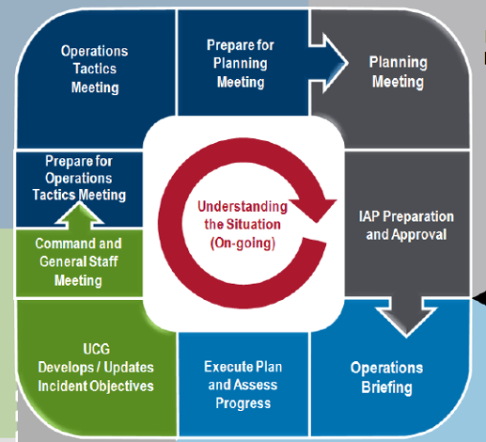
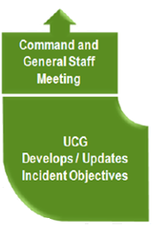
Planning P – Circle of Fun
Phase 2: Establish Incident Objectives
Notes:
ANIMATION ON THIS SLIDE – CLICK WILL ENLARGE GREEN SECTION OF CHART AND MAKE THE CIRCLE DISAPPEAR
There are several IC responsibilities that are part of each operational period. Let’s look at each a bit closer.
Develops/Updates Incident Objectives: Here, the IC establishes priorities and limitations, develops incident objectives, identifies relevant Standard Operating Procedures (SOPs), policies, and procedures, and determines staff assignments and workload division. The IC may reach out to their Command and General Staff for help in developing the objectives.
Command and General Staff Meeting: In this meeting, the Incident Commander meets and briefs command and general staff on direction, objectives, and priorities, assigns work tasks, and resolves problems and clarifies roles.
At MDH, these meetings just flow right into one big meeting where we develop objectives and the Command and General staff freely contribute.
These pieces are the second phase of the Planning P.

Slide 22
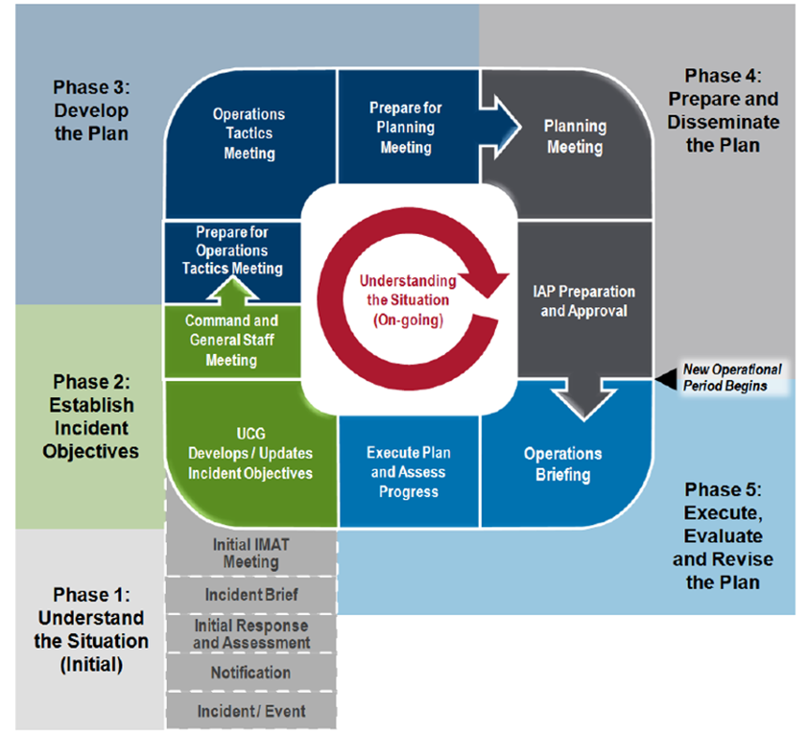

Planning P
The Start of
Each
Planning Cycle
Notes:
-Now that we’ve practiced assessing the initial situation, let’s work on establishing incident objectives
-Planning for each operational period begins with the Incident Manager developing or updating incident objectives
-Objectives are based on continued assessment of the situation and progress made
As part of completing your ICS 201 Incident Briefing, you developed some “initial” objectives that are often more general or global in nature. The incident objectives we are working on now should be more specific or SMART.

Slide 23
Writing “SMART” Objectives
Specific – Is the wording precise and unambiguous?
Measurable – How will achievements be measured?
Action oriented – Is an action verb used to describe expected accomplishments?
Realistic – Is the outcome achievable with available resources?
Time sensitive – What is the timeframe?
Notes:
In order for incident objectives to be operational and establish the framework for operations, they must follow the SMART model or a similar approach.
Ask yourself, are the objectives:
Specific – Is the wording precise and unambiguous? What is the specific task? What exactly are we going to do, with whom and for whom?
Measurable – How will achievements be measured? What are the standards or parameters?
Action-oriented – Is an action verb used to describe expected accomplishments? What are the performance expectations?
Realistic – Is the outcome achievable with given available resources and can it be accomplished as proposed?
Time-sensitive – What is the timeframe? When will we accomplish this objective? Note: Not all objectives are time sensitive. Don’t force a time frame if you don’t need it.
You know that you have SMART objectives when everyone on the team knows what needs to be done without questions or debate.
In addition to being SMART, incident objectives should be clear, concise statements for managing the response. Ideally, these objectives will be listed in priority order.

Slide 24
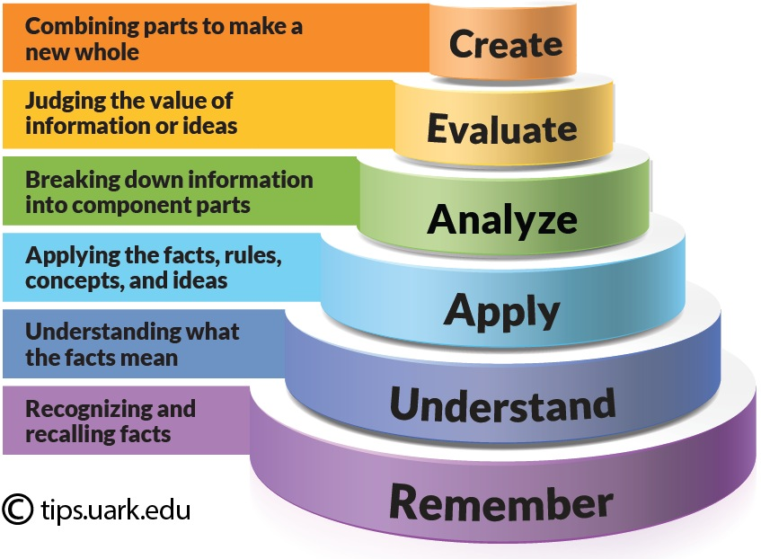
Bloom’s Taxonomy
Bloom’s Taxonomy is a framework for establishing organized objectives
Why is it important to have organized objectives?
  To plan and deliver appropriate instruction to staff
  To design strategies and tactics that are directly aligned with the incident objectives
Notes:
Writing SMART objectives can be challenging. Bloom’s Taxonomy is a resource for writing measureable objectives to help you know that you are making progress toward the incident and operational objectives.
-People often struggle with finding the right verbs to use in an objective.
-Bloom’s Taxonomy provides you with a list of action-oriented verbs in six categories, which gives you the ability to choose the right level of action that you want to occur.
-Using stronger verbs provides more specific direction and common understanding of what needs to be accomplished. -Using vague verbs means people can put their own interpretation on what they think is supposed to occur, which may or may not be correct, so you end up with team members going in different directions.
To help you with writing objectives for this workshop, we have provided a handout of action-oriented verbs based on Bloom’s Taxonomy.

Slide 25
Examples: SMART Objectives
  Examples:
Environmental health staff will complete inspections within 3 days for Springfield’s 45 licensed restaurants and grocery delis to allow them to reopen after a 24-hour power failure.
Healthcare Surge group supervisor will establish a briefing schedule with the MDH Health Regulation Division to maintain situational awareness before the next operational period.
County Public Health employees will begin dispensing medication to the affected population at the open POD at County High School within 12 hours.
Notes:
What makes these objectives SMART?
Answers:
They provide a timeframe for completion.
They use precise wording.
They have clear and measurable outcomes.

Slide 26
Activity: SMART Objectives 1
Situation: Hurricane XYZ has caused significant flooding in your community, forcing several hospitals and nursing homes to evacuate.
Incident Objective: As needed, provide assistance to facilities that are evacuating.
Is this objective SMART?
Notes:
Have a participant read the situation and incident objective out loud.
Is this objective SMART? No, it does not meet any of the criteria of specific, measurable, action-oriented, realistic or time-sensitive. How can we make it better?
Possible Answer: Hold daily conference calls at 10 am with healthcare facilities to assess evacuation needs for the remainder of the week or until further notice.

Slide 27
Activity: SMART Objectives 2
Situation: Poultry Farm ABC’s chickens begin falling ill. Avian Influenza is suspected and several farm workers have reported flu like symptoms.
Incident Objective: Work with the Public Health Lab to confirm Avian Influenza
How would you improve this objective?
Notes:
Again, have a participant read the situation and incident objective out loud.
Is this objective SMART? No, it does not meet any of the criteria of specific, measurable, action-oriented, realistic or time-sensitive. How can we make it better?
Example: Obtain lab results from Public Health Lab to Confirm/rule out Avian Influenza in chickens at Poultry Farm ABC within 12 hours.

Slide 28
SMART Objectives Activity
Activity
Step 1: Using your scenarios from the Incident Briefing 201 Activity, define what you need to do in the next operational period by writing SMART objectives
Step 2: Each group will write 3 SMART objectives for their scenario
10 minutes to write 3 SMART objectives
Large group discussion
Notes:
Write objectives based on scenarios from Planning P activity – slide 20 (Winter weather and flooded hospital causing evacuation scenarios)
Hand out- use the ICS 202 Incident Objectives form
Directions for the facilitator…
Scenarios from Stem of Planning P activity
Determine what activities need to happen (objectives) – what do you need to do
Give the groups ten minutes to write 3 SMART objectives
Facilitate a group discussion

Slide 29
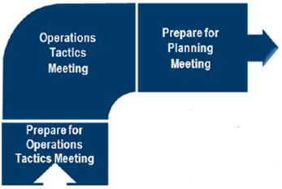
Planning P – The Circle of Fun
Phase 3: Develop the Plan
Notes:
ANIMATION ON THIS SLIDE – CLICK WILL ENLARGE DARK BLUE SECTION OF CHART AND MAKE THE CIRCLE DISAPPEAR
The third phase in the Planning P is developing the plan, which consists of these three meetings. Preparing for the tactics meeting, having the tactics meeting and preparing for the planning meeting.
Prepare for the Operations Tactics Meeting: At this time, the IC receives the operations briefing and meets one-on-one with Incident Management Team members to follow up on assignments and provide further guidance as needed.
Operations Tactics Meeting: The Tactics Meeting is led by the Operations Chief to develop the tactics and complete ICS forms 215 Operational Planning Worksheet (completed by Operations Chief) and 215A Incident Action Safety Plan Analysis (completed by Safety Officer). The Incident Commander does not attend, but should check-in with Command and General staff after the Tactics Meeting.
Again, tactics are the short-term, site-specific actions (based in strategy) that are completed to accomplish the objectives. They are the specific actions of “how” something will get done.
The final step in this section is the Preparation for the Planning Meeting. Here, the Incident Commander receives the operations briefing, and reviews assignments, objectives, and decisions.
But before we go there, let‘s take a look at the Tactics meeting.

Slide 30
Planning P Objectives
Objectives
State what will be accomplished
Strategies
Establish the general plan or direction for accomplishing the incident objectives
Tactics
Specify how the strategies will be executed (action steps assigned to someone)
Notes:
Once you have established SMART and operational incident objectives, how do you accomplish them?
While objectives establish the framework for incident operations, strategies and tactics are the tools needed to translate objectives into actions that get the necessary work done.
Take a minute to review the information on the slide.
Now let’s take a look at another analogy applying strategies and tactics:
Dinner Party Analogy
Objective:
Host a 3-course meal for 10 people on Friday evening at 8:00
Strategies:
Cater
Potluck
Prepare yourself
Tactics:
Choose cater - Order from Keys to deliver appetizer, salad and main dish of tater-tot hotdish to us at 123 Main Street at 7:30 pm
OR
Choose potluck – Assign each friend to bring a dish in one of the categories (appetizer, salad or main dish) to 123 main street at 7:30 pm.

Slide 31
Strategies
Strategies establish the general plan or direction for accomplishing the incident objectives.
Select a strategy that:
  Is within acceptable safety norms
  Is feasible, practical, and sustainable
  Is cost effective
  Is consistent with sound environmental practices
  Meets political considerations
Notes:
So let’s look more in depth at strategies. Strategies are the methods by which objectives are accomplished
When choosing a strategy, brainstorm several and pick the one that makes the most sense logistically and financially.
Choosing a clear strategy will help you develop clearly defined tactics during your tactics meetings.

Slide 32
Example Strategies
Objective: Begin dispensing medications to affected populations within 12 hours.
Strategy:
Open Closed PODs
Activate agency Points of Dispensing plan.
Existing clinics dispense medication
Notes:
Using a sample objective from earlier, brainstorm strategies
What are some strategies to begin dispensing medications to affected populations within 12 hours?
1. Activate the agency Point of Dispensing Plan
2. Open closed PODs
3. Existing clinics dispense medication
As you can see we brainstormed 3 strategies. In a real life situation, we would choose the one(s) that fits best with the current situation.

Slide 33
Tactics & Tactics Meeting
Tactics specify how the strategies will be executed
Tactics Meeting goals are to establish tactics, assign resources, and monitor performance
Use the Operational Planning Worksheet, ICS Form 215
Notes:
Now that we’ve chosen our strategies, let’s move on to discussing Tactics.
Tactics are the short-term, site-specific actions (based in strategy) that are completed to accomplish the objectives. The Operation’s Chief develops tactics. Tactics are generated from the Tactics meeting and are documented in the ICS 215 Operational Planning Worksheet.
Developing objectives, strategies, and tactics has implications for current and future staffing and resources.

Slide 34
Sample Tactics
Objective: Begin dispensing medications to affected populations within 12 hours.
Strategy: Activate agency Points of Dispensing plan.
Tactics: notify and activate staff, open pre-identified POD, receive medication, administer just-in-time training to staff, push out public messaging on who should come to the POD.
Notes:
Tactics are the steps you take to accomplish the strategies. So if you were going to activate your POD plans, what steps or actions would you need to do to make this happen?
Wait for the group to generate some examples. Then bring up the pre-identified samples.
As you can see, you can have many tactics to accomplish one strategy.

Slide 35

Tactics Meeting
Purpose
Preparation
Who Attends
Who Leads
Notes:
Before we move into developing strategies and tactics for your objectives, let’s take a more in-depth look at what the tactics meeting is all about.
-purpose of the tactics meeting is to assess current incident objectives
-some things to consider include:
-Is the incident increasing in size and/or complexity?
-Are your current objectives effective? Are they addressing the issues at hand?
-What is the current status of your resources? Are they sufficient to meet your objectives?
-meeting is attended by the logistics chief, planning section chief, operations chief, and safety officer
-the Operations chief leads the meetings

Slide 36
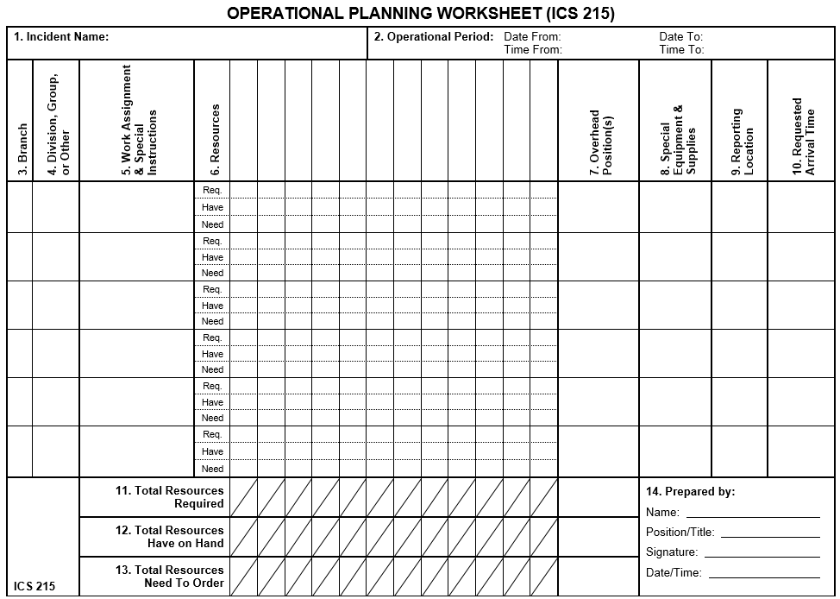
Operational Planning Worksheet (215)
Notes:
This is the FEMA form ICS-215 Operational Period Worksheet, which is used for Operational Planning.
The FEMA Independent Study class IS 201: Forms Used For the Development of an Incident Action Plan provides detailed instruction on how to use this form. You should become familiar with this form, because it is the form that your jurisdiction will use.
MDH has adapted this form to better suit the purpose of holding the tactics meeting and putting focus on specific roles and groups responsible for each tactic. For the purpose of this training, we’ll be using the ICS 215 form MDH recently developed to help us work through the tactics meeting.

Slide 37
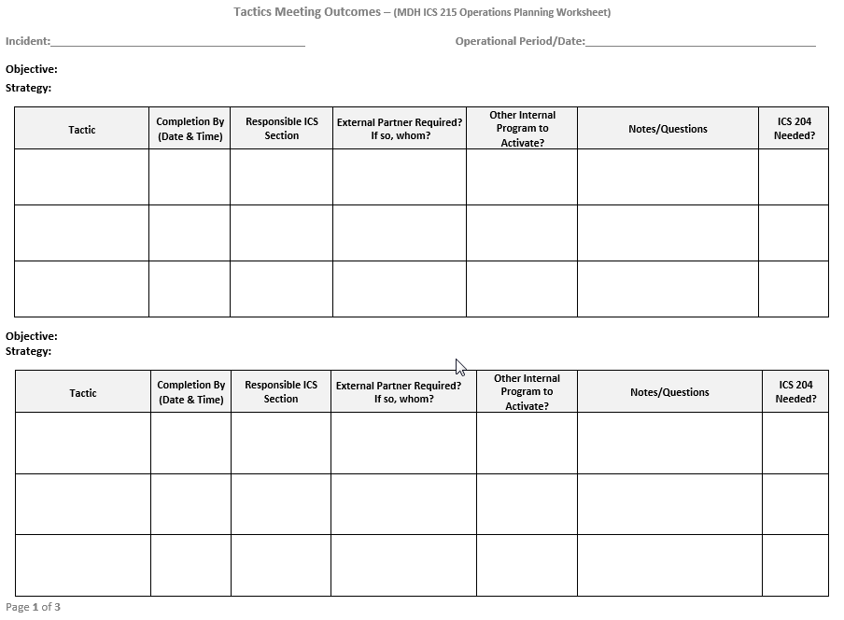
MDH 215 Tactics Meeting Outcomes Form
Notes:
As I just noted, we found from our exercises that the FEMA 215 didn’t meet our needs. We revised it and have tested it in MDH exercises and found that staff were better able to develop tactics.
This form is only used internally at MDH / for public health led incidents. MDH does not use this in multi-agency / non-public health incidents. It is not recommended for non-public health types of incidents.
First we start using this form by adding one objective and the strategy to each table in the form. Then at the Tactics meeting, the Operations Chief facilitates the completion of the form. If there is an objective that requires logistical support, the Logistics Chief can help fill out some of the columns. You list the tactic, determine the completion date or time. Identify who is responsible for the tactic and if they are required to work with any additional partners to complete this objective. Or if you need to activate any additional MDH programs areas. This is how we use it– it’s a Word form– you can feel free to use it or modify it or not use it.
The final column needs a yes or no answer to the question, Will an ICS form 204 Assignment List be needed for the IAP? The ICS 204 is often required for staff that are deployed to the field, such as a Disaster Recovery Center or a Point of Dispensing Site.
Next, let’s look at this form using some of the strategies and tactics identified from the previous slides.

Slide 38
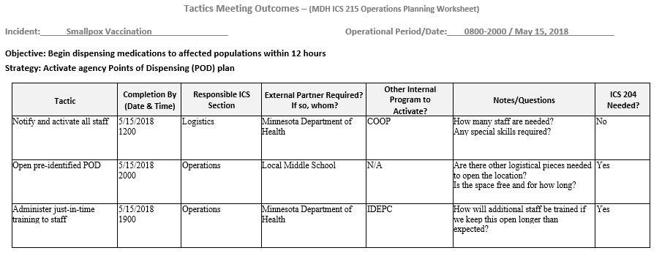
MDH 215 Tactics Meeting Outcomes Form Example
Notes:
Take a minute to review the slide and let us know if you have questions.
So you can see on this form, we have an objective and a strategy listed above each table. And the rest of the columns filled in with who is responsible for doing what and if additional partners are needed, and so on…
While this is occurring and being recorded in the Tactics Meeting, the Safety Officer is listening and taking notes on the ICS Form 215A Incident Action Safety Plan Analysis form. They are recording any safety hazards the staff need to be aware of and also identifying what mitigations are necessary to keep staff safe from these hazards as the staff are carrying out the operations to achieve the incident objectives.

Slide 39
Tactics & Tactics Meeting Activity
Activity
  Step 1: Identify tactics for the scenario you’ve been using
  Step 2: Write tactics for the objectives you created
  Step 3: Fill out MDH 215 Tactics Meeting Outcomes
10 minutes
Large Group Report Out
Notes:
Write tactics based on objectives you’ve written for the two scenarios we have been working on.
You can use either the MDH Tactics Meeting Outcome Form in your folders or you can use the downloaded copy on your computer.
Directions for the facilitator…
Each group should have 3 objectives written for which they’ll be writing tactics
Give the group 10 minutes to write 1-2 tactics for each of their objectives
Facilitate a group discussion for 10 minutes
Address the strategy and tactic discussion by letting group know that they should focus on the tactics and if the strategy is easily identified, go ahead and use it. Otherwise, it’s optional.

Slide 40
Preparing for the Planning Meeting
Incident Commander and Planning Chief decide which ICS forms are needed in the Incident Action Plan
Preparation includes:
  Requests for additional staff and/or stuff
  Preparing ICS form for Incident Action Plan
  Assessment of current plans and resources
  Gathering of pertinent information to support/revise incident management decisions
Notes:
Preparing for the Planning Meeting. The processes in the Planning P – circle of fun are essentially the same for all phases of the operations.
During the initial stages of the incident, the incident manager with the command and general staff must develop a simple plan that can be communicated through concise verbal briefings. Frequently, this plan must be developed very quickly and with incomplete situation information.
As the incident evolves, additional lead time, staff, information systems, and technologies enable more detailed planning and cataloging of events and “lessons learned.”
Preparing for the Planning Meeting
Following the Tactics Meeting, preparations are made for the Planning Meeting, to include the following actions coordinated by the Planning Section:
Review the ICS Form 215 Operational Planning Worksheet that was developed in the Tactics Meeting.
Review the ICS Form 215A, Incident Safety Analysis (prepared by the Safety Officer), based on the information in the ICS Form 215.
Assess effectiveness of current operations and resource efficiency.
Gather information to support incident management decisions.

Slide 41
Incident Action Plan Forms
Incident Action Plans usually have
  202 Incident Objectives –Planning Chief
  207 Incident Organization Chart – Planning Chief
  208 Safety Message – Safety Officer
  204 Assignment List (if deploying staff) – Planning Chief- Operations Chief helps
Notes:
(Add questions as you move through these i.e. “have you used this form?”)
Why don’t you pull up the ICS Forms List by Position that you downloaded.
Incident Action Plans are commonly made up of the following forms: (You don’t have to use every form in an IAP--)
For a written IAP, you will always have at least the ICS 202 Incident Objectives. As noted earlier,
the Purpose of the ICS 202 is to describe and document the incident strategy, incident objectives, command emphasis/priorities, and the safety considerations. This form is completed by the Planning Chief.
The ICS 207- Incident Organization form depicts the ICS organization position assignments– who is filling which role. This can be displayed in your Department / Emergency Operations Center on the wall, or printed and included in your IAP to show who is working in which ICS position. The Planning section completes this form- (specifically the Resources Unit, if they are not activated then the Planning Chief completes it.) Again, this is one of the forms completed earlier today.
The ICS 208 is the Safety Message- The Safety Officer completes this form by using what they filled out on the ICS 215A- Incident Action Plan Safety Analysis where they analyzed hazards and what mitigations should be taken to remain safe. The ICS 208 Safety Message is an optional form for the IAP, but we use it in every exercise to make it a habit to think about the safety of our staff. Especially if you have staff that will be deployed to a location as part of the incident response, you need to document what activities staff should be aware of to remain safe. For example, depending on the incident staff may need to consider road closures if traveling, personal protective equipment, etc. An abbreviated safety message should also be included on the ICS 204 – Assignment List.
ICS 204 Assignment List – tells your operations staff where they are going and what they will be doing. We use this form in exercises where we have people deployed to a location, such as to a Disaster Recovery Center, or if we have staff that are assigned to work at or inspect a shelter. The Planning section completes this form (specifically the Resources Unit– if they are not activated, then the Planning Chief completes it).

Slide 42
Other ICS Forms
211p Personnel Check-in List
214 Activity Log - Everyone
  Financial reimbursement
  Legal
  Documentation for shift changes and historical reasons
Notes:
Other ICS forms you will need, but are not specifically referred to in the planning p are the ICS 211p - Personnel Check-In List– this form helps you track who worked which shift/operational period. (This is an old FEMA form- they’ve changed it and made it less useful to public health, so we stick with the old form.)
Tomorrow you’ll sign in on the 211p when you come in.
The ICS 214 Activity Log is the other ICS form all of you will use to document significant activities that you worked on during your shift. You have an ICS 214 Activity Log in your folder and a completed example downloaded.
You should use this form tomorrow during the exercise.
You should document significant things like:
Decisions made
Resources requested (what was requested, by whom, when the resource is to be delivered)
Assignments delegated or received (to/from whom, document when to be completed by)
Actions taken
Changes in the plan
Tasks completed
The ICS 214 can also be used for legal documentation and can help with FEMA reimbursement

Slide 43
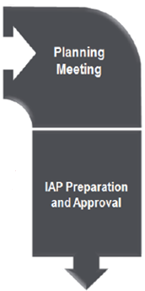
Planning P – Circle of Fun Contd.
Phase 4: Prepare and Disseminate the Plan
Notes:
ANIMATION ON THIS SLIDE – CLICK WILL ENLARGE GRAY SECTION OF CHART AND MAKE THE CIRCLE DISAPPEAR
As we move into the fourth phase of the Planning P, we move directly into the Planning Meeting. During the meeting, the proposed response plan is reviewed and approved. Following this meeting the Incident Action Plan documents, also known as the IAP, are completed.
IAP Preparation and Approval comes next. At this time, the Incident Commander reviews the IAP for completion, makes changes as necessary, and approves the plan.

Slide 44
Planning Meeting
Facilitated by Planning Chief
Objectives:
  Develop strategic and tactical plan for next shift
  Assess resource needs/surplus
  Share information needed by others
  Identify and discuss critical action items
Meeting length: no longer than 30 minutes
Validating the Planning – the ‘thumbs up’
Notes:
The Planning Meeting is facilitated by the Planning Chief. This meeting, attended by Command and General staff, should last no longer than 30 minutes. The
Objectives for this meeting include:
1. Reviewing strategic and tactical plans for next shift
2. Assessing resource needs/surplus
3. Sharing information needed by others, and
4. Discussing critical action items.
The overall purpose of this meeting is to validate the planning – give a “thumbs up”.

Slide 45
Incident Action Plan (IAP)
Getting it all down in writing
Common forms used in an IAP
  However, don’t need all of them every time
Planning chief pulls all the pieces together, makes sure they are complete, assembles them into a package
Presents to the Incident Commander for approval
Once approval is obtained, IAP is copied and distributed
Notes:
Following the Planning Meeting, the IAP is prepared. Read notes on slide.
You always need an Incident Action Plan, especially in complex incidents or incidents that occur over a long period of time or across multiple jurisdictions. You especially want an IAP (whether paper or electronic) to share with staff who might be working off site at an open POD, for example, so you are all on the same page and know what the plan is.

Slide 46
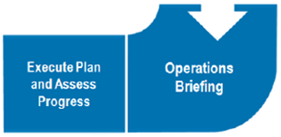
The Planning P – Circle of Fun
Phase 5: Execute, Evaluate and Revise the Plan
Notes:
ANIMATION ON THIS SLIDE – CLICK WILL ENLARGE LIGHT BLUE SECTION OF CHART AND MAKE THE CIRCLE DISAPPEAR
Finally comes Phase 5.
First is the Operations Briefing attended by both Command and General staff and the Operations Section lead staff. Here, the Incident Commander provides overall guidance and clarification, leadership presence, motivation, and emphasizes the response priorities.
As we finalize the ongoing circle, we Execute the Plan and Assess Progress. At this point the IAP is executed and progress is assessed. The ICS team monitors on-going operations, reviews progress of work and assigned tasks, receives situation briefings, identifies operational changes to be made, and prepares for the Update Objectives meeting (the start of the new operational period). Ask yourself:
Are we actually doing the work we said we were going to do?
Are we actually accomplishing the objectives/goals we set at the beginning?
Based on new information, are there any changes that we need to make?

Slide 47
Wrap-up
Summary
Day 2 Logistics
  Continental Breakfast
  Agenda overview
Questions
Notes:
Summary – review objectives for today:
Review Incident Command System (ICS) positions and responsibilities.
Develop SMART incident response objectives, identify strategies and tactics, and finally hold an incident briefing.
Review the Planning P phases and the ICS forms used in each phase.
Identify next steps for applying the ICS process and tools for planned and emergency incident responses within their agencies.
Please take out your Action Plan and for the next 2-3 minutes jot down some key take-aways and identify action steps/to-do’s.
Review agenda for tomorrow:
Tomorrow you will be participating in a day-long public health-focused exercise workshop responding to an “Hepatitis A” incident. You will apply what you learned today during the exercise.
We need you to report here by 8:30 a.m. When you get here, you will select your role for the exercise, review your role’s responsibilities, and identify the forms that your role is responsible to complete. We will start the exercise promptly at 9:00 a.m.
Continental breakfast and lunch will be provided.
Again, we are starting the exercise promptly at 9:00 a.m. and need you to report at 8:30 a.m. to decide on your roles and review the work associated with that role.
Anybody have any questions about tomorrow or anything that we covered today?

Slide 48

Welcome
Please help yourself to Breakfast
At your assigned table, decide on your ICS Role
Review the handout about ICS Roles
Review what ICS Forms are used by Role (Forms List by Position)
Notes:
Good morning everyone. Welcome back. We have a full day with hard work, so please help yourself to some breakfast.
At your assigned table, decide what ICS roles everyone will have. (Indicate if they have to fill every role or decide which roles they will fill and how to decide).
When you have your ICS role, take the time to review the position description so you know what you are responsible to do.
Also review what forms your role typically completes, when the form is used, and how.

Slide 49
Start Day 2
Agenda for Day 2:
  Hepatitis A Exercise
  Hotwash
  Next Steps
Notes:
8:45/8:50 a.m. – Announce that we are starting in 10 - 15 minutes.
Before we get started, are there any questions regarding yesterday’s content?
Our agenda today is a public health-focused exercise workshop.
After the exercise, we will do a hotwash
We are starting going to start the exercise at 9 a.m.

Slide 50
Recap Day 1
Roles and Responsibilities
  Completed 207
Reviewed the Planning P
  Size up
  Initial checklist
  201
  Providing a briefing
Developing objectives, strategies, and tactics
Completing the operational planning worksheets (215)
Preparing for the Planning meeting
  Reviewing IAP forms
Notes:
Before we start the exercise, let’s do a quick recap of our Day 1 learning.
Quiz questions:
1. Which are the command staff positions? (officers: PIO, Safety, and Liaison)
2. Which are the general staff positions? (Planning, Operations, Logistics, and Finance/Administration)
3. What is the one position you have to have for any incident? (incident commander)
4. What are IAPs? (Incident Action Plans)
5. What forms are commonly used in IAPs? (202, 204, 207)
6. Who gets staff and stuff? (Logistics Chief)
6. Who are the doers? (Operations)
7. Who makes sure the IAP gets done? (Planning Chief)
8. Who fills out the 214? (and why do you do it?) (You all do, because it document key decisions and actions that will be useful for the ongoing team, FEMA reimbursement, and legal challenges.)

Slide 51
Simulation Cell
Simulation Cell (SimCell)
  Helps provide a more realistic exercise experience
  Not feasible for everyone to play in every exercise
  A SimCell imitates actions, activities, or conversations of everyone not in the room
  Asking questions/requesting information/contacting different outside people, organizations, partners, etc. helps you practice what you would actually do during a response.
Notes:
Simulation Cell:
A Simulation Cell (SIMCELL), or facilitator are used to imitate the actions, activities, and conversations of an individual, agency, or organization that is not participating in the exercise but that would likely be actively involved during a real event
SimCell Demonstration Examples:
Logistics chief needs to acquire supplies for a POD.
You need to indicate who you are (what is your role) and tell the ‘SimCell’ who you are trying to contact. Hi, I’m calling the MDH District Epidemiologist. Or Hi, I’m calling the local hospital infection preventionist.
Make your request.
The SimCell will respond as that person or agency. Please note that the person in the SimCell cannot know everything about every agency/organization, so they will provide you with as realistic an answer as possible and to keep the exercise moving forward. This may or may not be the actual response / method that would be used. We call this an artificiality of an exercise.
The exercise activities today will stay in this room. We won’t make actual calls to anybody, but we can pretend to make the calls/talk to people we would in an actual response. That’s the purpose of the SimCell.

Slide 52
Planning P Reminder
Notes:
Before we begin the exercise, let’s quickly review the planning P. We will walk through the steps of the planning P and we will take a look at where we are in the process a few times through the day. Remember to use the Planning P handout to remind yourself where we’re at as we’re moving through the day.

Slide 53
STARTEX
Start the Exercise!
Scenario Overview
Purpose
Description
Expectations
Timeframe
Notes:
Ok, Now we’ll begin today’s session– THE EXERCISE!!!! (dun dun DUUUNNNN!)
Exercise notes:
Use the Forms List by Position to guide you in identifying which forms you should use based on the position you’ll be playing during the exercise.
Instructors read the Day 2_Exercise Overview handout as participants follow along.

Slide 54
Notification & Activation
Notes:
You have all been notified of a hepatitis A outbreak in your community. Your agency has decided to use ICS to manage this response and you have been activated as a member of the command and general staff team.
Read your scenario. (Instructor asks if there are any questions)
There are 2 options; a community outbreak or a restaurant outbreak. You can choose which scenario your group wants to work on.
We will give you 5 minutes to review the scenarios. Make sure to take the time to thoroughly read the scenario. You should also take time to periodically review the scenario to determine if you have missed any actions.
Instructors: At the 5 minute mark: Okay – let’s stop and see if anyone has any questions.
Now, during the next 20 minutes, take the information you just read in the scenario and complete the 201. The ICS 201 Incident Briefing form is in your folders and you also downloaded it. Complete either version.
In a real incident, one person in your agency would likely have received notification of the incident. The designated Incident Manager would be completing the ICS 201 incident briefing in preparation for the Initial Incident Briefing. However, today, for practice, we are requesting all of you to fill out the 201 Initial Incident Briefing form.
Instructor: At 10 minutes, ask if there are any questions and how people are doing with completing the form.
5 minutes left - Each instructor should go to each group and assessing where people are at and letting them know they have 5 minutes left.
Monitor groups and move on.

Slide 55
Initial Incident Briefing
Notes:
In your table groups, the incident manager should use the “Holding an Incident Briefing” checklist and their completed ICS 201 to provide the initial Incident Briefing (meeting).
You have 10 minutes to complete this.
Facilitator notes:
Hold Incident Briefing Each IC needs to brief their team. The IC should stand up, with the checklist and the 201, and brief his/her team. Make it a little more formal than sitting.
Brief in small groups at their table– Instructors float around.
Remind them to use the Holding a Briefing Checklist to help them move forward to the next step in the P process.
Was the checklist helpful?
Is there anything not on the checklist that you felt would be important to add?
Any other comments?
Next, we’ll move into developing the incident objectives and the command and general staff meeting.

Slide 56
The Planning P
Notes:
We’ve made it through the Stem already. We’ve done our size up, our notifications and held an incident briefing. Let ‘s move into Phase 2.
You might find your team needs to start reaching out to others now. Remember to use the SimCell. Are there any questions regarding the SimCell?

Slide 57
Develop Incident Objectives/Command and General Staff Meeting
Notes:
On the Planning P, we have now completed the stem of the P and we now entering the circle of fun. Keep in mind that developing the incident objectives are often part of the Command and General Staff meetings. Everyone contributes to these meetings.
You have completed your incident briefing, after the briefing you move into developing the incident objectives and the Command and General Staff meeting. This is where you set the operational period and develop operational incident objectives.
In your groups, pull out and complete your ICS 202 Incident Objectives form. (wait until all have the form in front of them).
But first, let’s talk about Operational Periods. What is an operational period? It is a defined set of time where you will execute your plan (the IAP) and work on the response. It can be 8 hours, a week, or a month depending on the type of incident. They tend to be shorter during the beginning of the incident and as the incident evolves, the operational period often gets longer.
Now you are going to start working on:
Setting your operational period
Developing SMART objectives
Make sure you create at least 3 objectives
If you get stuck, remember to review your scenario to see what is recommended
You have 30 minutes to complete the ICS 202 Incident Objectives form. At the end of the 30 minutes, we’ll ask you to share your objectives with the whole group.
After sharing their objectives, discuss the Command & General staff meeting by reviewing the agenda and explaining the timing of the operational period.
It is a more structured meeting to kick off a multi-day incident response to make sure all staff know what they are supposed to be working on.
Now, it’s time for a break.

Slide 58
BREAK!
Notes:
15 minutes

Slide 59
Planning P, Again
Notes:
Phase 2 is already complete. We’ve developed the incident objectives and held our Command and General staff meeting. Let’s move into development of the plan.

Slide 60
Tactics Meeting
Notes:
Are there any questions from the morning portion of the break? Anybody stuck on anything?
So far this morning, we have been notified, activated, completed the 201, and had an initial incident command briefing. We then developed incident objectives and operational time period.
Now we are going to prepare for the Tactics Meeting by adding your objectives to the ICS 215 or MDH 215 Tactics Meeting Outcome form.) You have 5 minutes to do this.
Next we are going to do a Tactics Meeting.
The Purpose of Tactics Meeting is to develop the strategy and tactics. In this meeting, you will:
Determine strategy & tactics
Assign Resources
Monitor performance (You wouldn’t do this in the first tactics meeting, but would monitor performance at subsequent tactics meetings.)
You downloaded an agenda for the tactics meeting. It is an informal meeting. Here is who attends and their responsibilities:
Operations Chief- review Objectives, determine strategy & tactics, assign resources. (ICS 215 or MDH 215)
Safety Officer- determine hazards and mitigations for those hazards (ICS 215 A)
Logistics Chief- locate needed resources
Finance Chief- make sure finances can support operational needs
Planning Chief- Identify alternate plans or strategies to support objectives
Group Activity-
Conduct tactics meeting:
- Determine strategies and tactics for each objective
Record information on the ICS 215 or MDH 215
The Incident Commander can stay with the group, but should not participate and definitely should not lead the meeting. Instructors should redirect any IC who is directing the Tactics meeting.
Instructor note: if room space allows, have participants go to a different area to hold the tactics meeting.
One group should demo the tactics meeting as well.
Time allotted: 30 minutes

Slide 61
Prepare for the Planning Meeting
Notes:
Now that you completed the tactics meeting, it’s time to prepare for the Planning Meeting.
Preparing for the Planning Meeting: All ICS personnel have work to do during this part of the Planning P.
This is a very active part of the Planning P. You will probably need to reach out to the Simulation Cell (SimCell) to ask questions of people who are not part of the exercise (people, organizations, etc.)
IC- Stay out of the weeds! Give direction. Manage your team.
Safety: Complete form ICS 215A- Safety Analysis- draft up mitigations to hazards. Develop Safety Message ICS 208.
Liaison- Makes contact with assisting agencies. Collect contact information. Identifies any special agency needs/restrictions.
PIO- Develops public messages. Monitors social media and provides rumor control.
Operations- Continues to collect information. Works with Safety and Planning to ensure complete ICS 215, 215A, work assignments (ICS 204)
Planning- Develops maps, displays, situation reports, acquires info, develops ICS forms, and collects them for IAP.
Logistics- Locates and orders resources, (staff and equipment), ground transportation, radio or phone communication, creates medical plan if needed.
Finance- Calculates costs, works on rental agreements and contracts, tracks staff time.
This is what you all will be working on now, in order to be ready for the Planning Meeting, that will be right after lunch. When you are working on these things, you need to document your actions and decisions. You should use the ICS 214. This comes in handy when there is shift change or for updating leadership (county boards, etc.)
Any questions before you get started? You’ve got 45 minutes to work on everything. Remember to use the SimCell.
Instructors float around room to assist with completing forms, answering questions.
- determine forms to include in the IAP?
-order resources and reserve location for clinics?
-prepare public messaging?
-prepare ICS 204 assignment lists if needed (based on ICS 215/MDH 215)
Instructors: have an assignment ready for each position if they did not get one out of the tactics meeting.
Time allotted: 45 minutes

Slide 62
Lunch
Notes:
Lunch: 30 minutes

Slide 63
Remember!
Notes:
We’ve made it through Step 3, which was development of the plan. We developed the strategies and the tactics. We also put together what we needed for the planning meeting. Now it’s time to hold the planning meeting.

Slide 64
Planning Meeting
Notes:
The Purpose of the Planning Meeting is to review and validate the Plan. The whole ICS team attends. The Planning Chief leads the meeting.
Agenda: (remind them they have an agenda in their downloads)
Planning Chief- Opens meeting by Reviewing objectives
Operations Chief- Provides update on situation. Identify groups that are activated and what they will work on.
Safety Officer- Highlights areas of concern and identify safety practices that should be observed.
Logistics Chief- Gives status of the resources that have been ordered (what you are working on)
Finance Chief: Provides update on any purchasing or contracts you are working on for the response.
Liaison Officer –partner status outline any issues related to partners working the response.
PIO- Reviews public messaging needs and provides update on what you are working on.
Planning Chief/Incident Commander- Asks for formal approval of plan- (all should say “YES”). Give deadline for having all ICS forms completed and in to Planning Chief. End of meeting.
-Group Activity-
Instruct each group to walk through Planning Meeting in their group, then have 1 group demonstrate it for the larger group.
Time allotted: 45 minutes

Slide 65
IAP Preparation and Approval
Notes:
After the Planning Meeting, you’ll work on finalizing the IAP.
During this part of the Planning P, all staff are working on completing the forms they are assigned.
Once your form is completed, dated, and signed, you send it to the Planning Chief who will collate the IAP and present it to the Incident Commander who will review the forms and sign the IAP indicating approval. Then the Planning Chief copies the IAP for the Operational Period Briefing.
Do you all know which form you are working on for the IAP?
- Group Activity -
*If everyone got forms completed before lunch: you have 10 minutes to review your forms and make any final changes and get them to the Planning Chief.
Reminder:
ICS forms:
202
204
207
208
Questions for the instructor to ask:
- Who has worked with these forms, either an exercise or a real response?
- how they will actually do this back in their agency? Paper copies? Email out to C & G staff?
Time allotted: 15 minutes

Slide 66
Check-in!
Notes:
Phase 4 of the planning P is now complete. The IAP should be ready to go, which will guide the direction of the next operational period. This might be all of you working the next shift or it might be a completely new team. Let’s move into Phase 5 and get the next operational period kicked off.

Slide 67
Operational Period Briefing
Notes:
Operational Period Briefing is conducted at the beginning of each operational period. This is a wider-ranging meeting that includes division directors, group supervisors, operational staff. The purpose is to review what has occurred and what the plan is going forward, job assignments, etc.
Purpose: It’s a formal meeting and it’s BRIEF. No discussions. Review of the IAP. Planning Chief runs it.
Agenda:
Planning Chief- Open meeting, review objectives
Operations Chief- Review incident status and operational focus for today/this operational period. Review each ICS 204-Assignment List (just high-level review– “Here’s who is working where. Any questions, ask your group leader.”)
Logistics Chief- Review Radio/Communications Plan, Medical Plan, Transportation Plan- (if any) or just review resources provided to Ops staff.
Safety Officer- Review safety Message, emphasize safety!
Incident Commander- Closing remarks--Thank you and release staff.
Group Activity -
Directions: You know have 5 minute to prepare for the Ops briefing.
Then have one group give Ops Period Briefing to whole group (can have two groups give briefing if time allows)

Slide 68
Break
Notes:
10 minute break

Slide 69
Shift Change Briefing
Notes:
What is a Shift Change Briefing?
One ICS team will be leaving and a new one will be coming in to work the next operational period.
Here’s what usually happens:
-What occurred? (Where are we at now? What’s been decided?)
-What needs following up? (any unfinished business that needs attending to?)
-What’s the plan for the next operational period?
Directions:
5 minutes: prepare a brief list of points that you will share with the person coming in to your position for the next shift.
At the end of five minutes, ask an Incident Commander from one table to come up and ask an Incident Commander from another table to brief the incoming person.
Ask another role (Planning chief) from table 3 to come up and a table 4 planning chief
And so forth….
Each person has about 3 minutes to do their briefing.
Instructor select a position from each table to do the briefing. After each individual briefing, ask the group if they understand what their responsibilities are.

Slide 70
End Exercise

Slide 71
Final Thoughts
Key Takeaways to follow up on
Notes:
Some key roles we didn’t have
Documentation Unit Leader- maintain records for historical and financial reimbursement purposes.
Key learning takeaways. Provide 5 minutes for completion.

Slide 72
Hotwash/Evaluation
Notes:
-What went well?
-What can be improved?
Time allotted: 15 minutes
We are going to take 10 minutes to talk about what went well with this workshop. If we could go back in time, what you like to see done differently.
Now we are going to go around the room and ask each of you to share one item from your ICS LPH Action Plan.

Slide 73
Thank you!
Center for Emergency Preparedness & Response
Health.epr@state.mn.us
651-201-5700
Notes:
Thank you for your participation.
We just want to remind you that the answers you received from the SimCell were provided to the best of our knowledge but may not reflect what will actually happen during an actual incident.
Please fill out the evaluation and your LPH Action Plan.

