Slide 1


Public Health
Incident Leadership
Module 5: Managing the team
August 2015

Slide 2
Objectives
Describe the difference between management objectives and incident objectives
Describe how to link objectives with response activities
Describe the process of leading the Incident Management Team through the Planning P
Identify the forms necessary to complete the Planning P
Notes:
The objectives for this module are focused on three management tools you will use to guide the response: objectives, the Planning P, and ICS forms. The objectives are:
Describe the difference between management objectives and incident objectives.
Describe how to link objectives with response activities.
Describe the process of leading the Incident Management Team through the Planning P.
Identify the forms necessary to complete the Planning P.

Slide 3
Management Tool 1
Objectives
Notes:
The first management tool we’ll focus on is objectives.

Slide 4
What is an Objective?
Merriam-Webster defines an objective as “the aim, target, or purpose”.
Objectives describe what you want to accomplish.
Objectives establish the direction of the incident management effort.
Notes:
First, what is an objective? An objective is “something that one’s actions are intended to attain or accomplish:” the “the aim, target, or purpose.”
Objectives are necessary for establishing the direction of the incident response.
We’ll now focus on two types of objectives: management objectives and incident objectives.

Slide 5
Management Objectives
More general and over-arching.
Seldom change during an incident.
Examples:
  Protect the health and safety of the public.
  Protect employees and assets from harm during response and recovery.
  Maintain the department’s critical priority services.
  Provide assets to local public health departments and health care providers to ensure community access to public health and healthcare services.
Notes:
Management objectives are the overall focus of a health department or Incident Management Team in a response. These objectives are usually general, over-arching, and can even apply to everyday work as well as response to incidents.
Management objectives may be developed before an incident happens; they are designed to be broad enough to apply to any scenario and seldom change during an incident.
Instructor Note: Share the examples of the response management objectives listed on the slide.
Ask: Can you think of any other examples specific to your health department?

Slide 6
Incident Objectives
Operational
Establish the framework for incident operations
Change depending on strategies and tactics
Use the SMART model
Examples:
  By noon tomorrow, set-up ten hotline phones and schedule staff for 12 hour shifts, 7 days a week for 2 weeks.
  By Friday, complete testing of private wells and the city water supply in the flooded community.
Notes:
Incident objectives should reflect overall management objectives, but are specific to the operational period and the duration of the incident response.
They are operational and establish the framework for incident operations.
These objectives are re-evaluated each operational period, and updated as necessary based on new situation information and changes in strategies and tactics.
Accomplishing these short-term, specific incident objectives moves the health department or Incident Management Team towards achieving the longer-term management objectives.
Instructor Note: Share the examples of the incident objectives listed on the slide.
Ask: Can you think of any other examples specific to your health department?

Slide 7
SMART Objectives
S
Specific
M
Measurable
A
Action-oriented
R
Realistic
T
Time sensitive
Notes:
In order for incident objectives to be operational and establish the framework for operations, they must follow the SMART model or a similar approach. We know you’ve heard this before, but this is critical to an effective response and is easy to forget in the stress of an incident.
Ask yourself, are the objectives:
Specific – Is the wording precise and unambiguous? What is the specific task? What exactly are we going to do, with whom and for whom?
Measurable – How will achievements be measured? What are the standards or parameters?
Action-oriented – Is an action verb used to describe expected accomplishments? What are the performance expectations?
Realistic – Is the outcome achievable with given available resources and can it be accomplished at proposed?
Time-sensitive – What is the timeframe? When will we accomplish this objective? Note: Not all objectives are time sensitive. Don’t force a time frame if you don’t need it.
In addition to being SMART, incident objectives should be clear, concise statements for managing the response. Ideally, these objectives will be listed in priority order.
These descriptions are also included on the SMART handout in your training materials.

Slide 8
SMART or Not?
By 3:00 p.m. today, the Public Information Officer will have communicated information to the public on the availability of safe drinking water in the affected area.
Notes:
We will now look at some examples of incident objectives in the next few slides. Can you identify which objectives are SMART?
Answer: SMART. The objective is specific, measureable, action-oriented, realistic, and time-sensitive.

Slide 9
SMART or Not?
We will let people know whether or not they can drink the water.
Notes:
Answer: Not SMART. The objective does not fully meet any of the SMART criteria as it is not specific, measureable, action-oriented, realistic, or time sensitive.

Slide 10
SMART or Not?
Coordinate with faith-based community leaders to assess the availability of health information for their community with language barriers.
Notes:
Answer: Not SMART. The objective is action-oriented and realistic, but not specific, measureable, or time-sensitive.

Slide 11
SMART or Not?
Environmental health staff will complete inspections within 3 days for Springfield’s 45 licensed restaurants and grocery delis to allow them to reopen after a 24-hour power failure.
Notes:
Answer: SMART. The objective is specific, measureable, action-oriented, realistic, and time-sensitive.

Slide 12
Objectives - Strategies - Tactics
Objectives establish the framework for incident operations.
Strategies and tactics translate objectives into the actions that get the work done.
Notes:
Once you have established SMART and operational incident objectives, how do you accomplish them?
While objectives establish the framework for incident operations, strategies and tactics are the tools needed to translate objectives into actions that get the necessary work done.
Strategies are the methods by which objectives are accomplished.
Tactics are the short-term, site-specific actions (based in strategy) that are completed to accomplish the objectives. The Incident Commander does not develop tactics. This is the Operations Chief’s responsibility. Tactics are generated from the Tactics meeting and are documented in the Incident Action Plan. Even though tactics are not developed by Incident Commanders, they should be familiar with the process and what good strategies and tactics look like.
Developing objectives, strategies, and tactics has implications for current and future staffing and resources.
Many people struggle with understanding the difference between objectives, strategies, and tactics, or why we need to develop all three. One way to think about it is in terms of child’s questions. Children are known for continually asking “why.” They might ask a question, and when a parent gives an answer, they ask “but why?” several more times before they get the true answer.
For example:
Child: Why can’t I play outside?
Parent: Because it’s raining.
Child: But why?
Parent: Because you’ll get all wet and dirty.
Child: But why?
Parent: Because you won’t have time to change out of wet clothes before you go to basketball practice.
In an incident response, we want to be asking not why? why? why?, but how? how? how?. Each time you ask “how,” you are getting a more specific answer about what you need to do and how you will do it. The objectives, strategies, and tactics each get to a more specific level of “how.” They allow us to move from a framework for how the issues will be addressed, to a method for how solutions will be accomplished, to the specific actions for how it’ll get done.
For example:
Responder 1: How will we address the issues?
Responder 2: By identifying and working towards these goals. (objectives)
Responder 1: How will accomplish those goals/solutions?
Responder 2: By using these methods. (strategies)
Responder 1: How will we get it done with those methods?
Responder 2: By taking these specific actions. (tactics)

Slide 13
Example: Pandemic Influenza
Objective: By Tuesday, Human Resources will implement the social distancing policy from the department’s All-Hazards Plan to ensure health of staff.
Strategy: Activate procedures for social distancing to maintain employee health.
Tactics:
  Cancel all meetings and non-essential travel.
  Implement work-from-home strategies.
Notes:
Let’s take a look at a specific example of an objective, strategy, and tactics relating to pandemic influenza.
Objective: By Tuesday, Human Resources will implement the social distancing policy from the department’s All-Hazards Plan to ensure health of staff.
Strategy: Activate procedures for social distancing to maintain employee health.
Tactics: Cancel all meetings and non-essential travel.
Implement work-from-home strategies.
As you can see, the objective establishes a specific purpose, the strategy provides a method, and the tactics offer strategy-based actions to meet the objective.
Instructor Note: Divide the participants into small groups and hand out the Objectives, Strategies, Tactics Exercise Handout, giving one objective to each group. Have each group identify a strategy(s) and tactics for the objective provided, and share out with the larger group.

Slide 14
Management Tool 2
Planning P
Notes:
Our first management tool focused on developing SMART objectives to guide the operation and provide direction to the team.
We are now going to move into the second management tool, the Planning P.

Slide 15
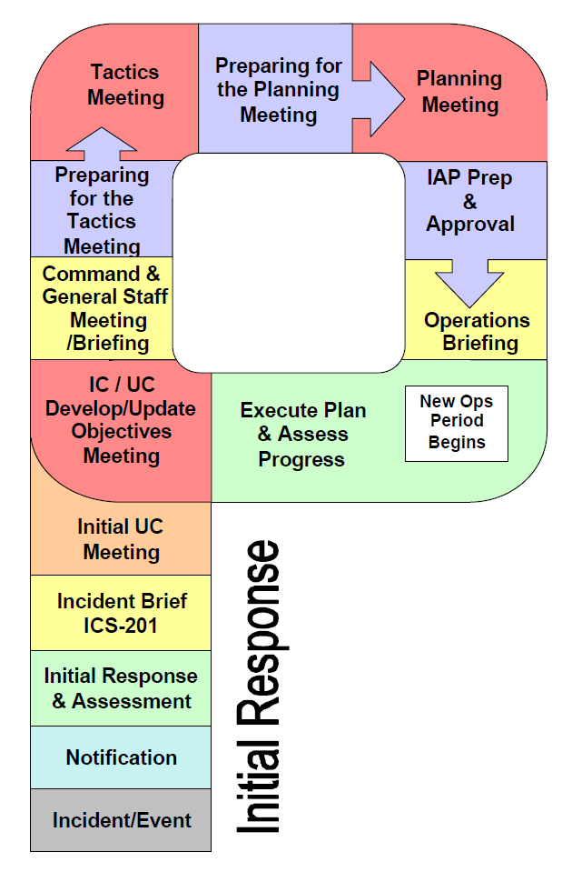
The Planning P
Notes:
Incident objectives, strategies, and tactics do not just appear out of thin air; there must be a planning process for developing and modifying them based on the incident.
The Planning P is in important tool and guide to the incident planning steps and processes.
The process outlined in the Planning P has proved useful for both simple and complex incidents.
The bottom leg of the P describes the initial response period, while the top circular part describes each operational planning period cycle.
We’re assuming that you all are familiar with the Planning P. However, our research and evaluations have indicated that Incident Commanders are not fully comfortable with applying the steps of the Planning P.
If the Incident Commander has a good grasp of the Planning P process, they are able to lead their team more effectively in a response.

Slide 16
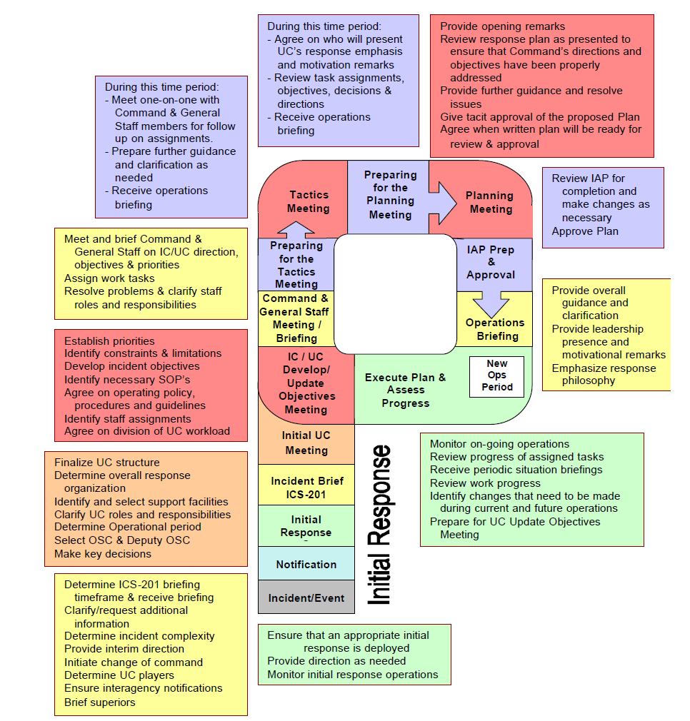
Incident Command Activities
Notes:
As a supplement to the general Planning P, the U.S. Coast Guard developed role-specific Planning P’s, which describes the tasks completed by each position for each step of the Planning P.
In your handouts, there is a copy of the “Operational Planning ‘P’ for Command Activities.”
This handout outlines the role of the Incident Commander at each step of the Planning P. We will now work our way around the Planning P, highlighting your role as Incident Commander.
You will notice that the color-coded boxes correspond with the Planning P step of the same color.
Note: This handout often uses the acronym “UC” for Unified Command, instead of IC for Incident Commander. You may have either based on your health department structure and the nature of the response.

Slide 17
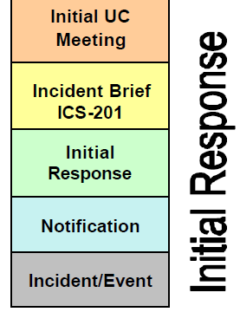
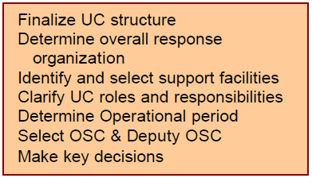
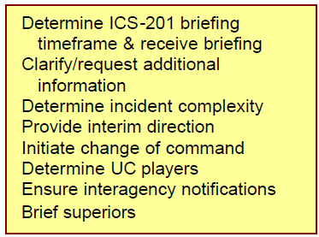
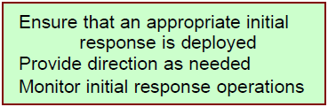
Initial Response
Notes:
Instructor Note: In the next few slides, walk through the role of the IC for each section of the Planning P as described in the boxes.
This slide describes the IC actions that are part of the initial response “leg” of the Planning P. These sections will often occur in a short time-frame and may overlap. Some roles of the IC may not apply in situations when there is not a Unified Command.
Initial Response: The IC is notified of the incident and ensures the initial response is deployed. They provide direction and monitor initial response operations as needed.
Incident Brief ICS-201: The Incident Commander receives the initial briefing. During this time, they clarify information, determine complexity, provide interim direction, initiate change of command, determine players, ensure interagency notifications, and brief supervisors.
Initial IC/ UC meeting: The IC finalizes and clarifies the IC/ UC structure, roles, and responsibilities, identifies the operational period, overall response organization and support facilities, selects the Operations Chief, and makes key decisions.

Slide 18
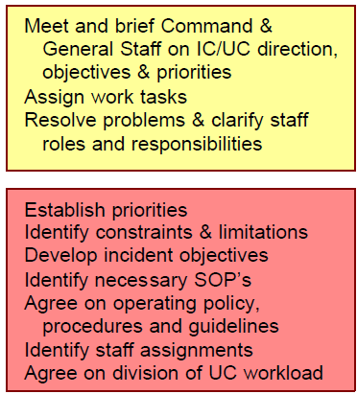
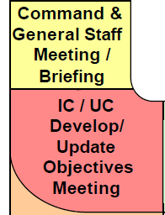
Objectives and ICS Briefing
Notes:
These next few slides describe the IC responsibilities that are part of each operational period, the “circular” part of the Planning P.
IC/ UC Develop/ Update Objectives Meeting: Here, the IC establishes priorities and limitations, develops incident objectives, identifies relevant Standard Operating Procedures (SOP’s), policies, and procedures, and determines staff assignments and UC workload division.
Command and General Staff Meeting/ Briefing: In this meeting, the Incident Commander meets and briefs command and general staff on direction, objectives, and priorities, assigns work tasks, and resolves problems and clarifies roles.

Slide 19
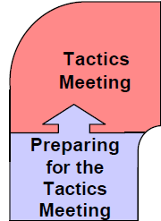
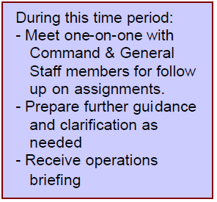
Tactics Meeting
Led by Operations Chief
- IC does not attend
Notes:
Next in the Planning P comes the Tactics Meeting.
Preparing for the Tactics Meeting: At this time, the IC receives the operations briefing and meets one-on-one with Incident Management Team members to follow up on assignments and provide further guidance as needed.
Tactics Meeting: The Tactics Meeting is led by the Operations Chief to develop the tactics and complete ICS forms 215 and 215A. The IC does not attend, but should check-in with Command and General staff after the Tactics Meeting.
Again, tactics are the short-term, site-specific actions (based in strategy) that are completed to accomplish the objectives. They are the specific actions “how” something will get done.

Slide 20
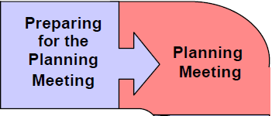
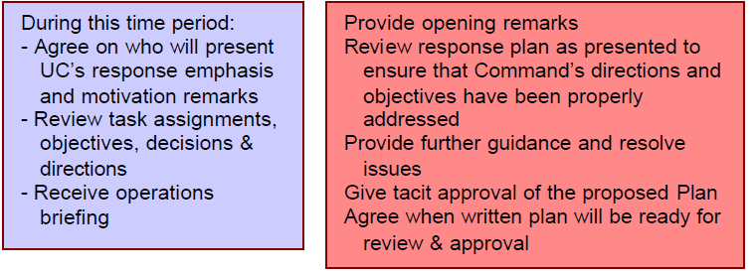
Planning Meeting
Notes:
The Planning Meeting follows the Tactics Meeting in the Planning P.
Preparing for the Planning Meeting: The Incident Commander receives the operations briefing, and reviews assignments, objectives, and decisions. If there is a Unified Command, the IC will also coordinate who within the UC will present remarks.
Planning Meeting: Here, the IC provides the opening remarks, provides guidance, resolves issues, reviews and approves the proposed response plan, and determines the timeline for review and approval of the written Incident Action Plan.

Slide 21
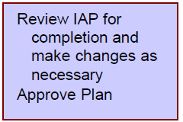
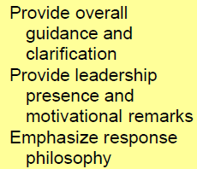
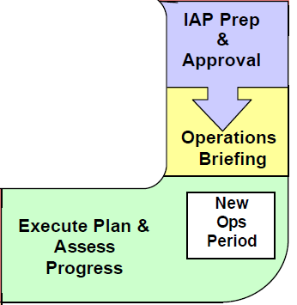
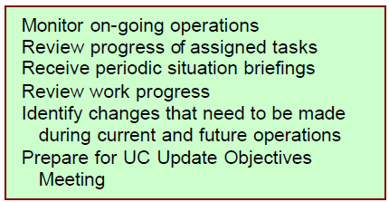
IAP and Operations
Notes:
This last area of Planning P involves the Incident Action Plan (IAP) and Operations.
IAP Prep & Approval: The IC reviews the IAP for completion, makes changes as necessary, and approves the plan.
Operations Briefing: Here the Incident Commander provides overall guidance and clarification, leadership presence, motivation, and emphasizes the response priorities.
Execute Plan and Assess Progress (New Ops Period): Here, the IAP is executed and progress is assessed. The IC monitors on-going operations, reviews progress of work and assigned tasks, receives situation briefings, identifies operational changes to be made, and prepares for the IC/ UC Update Objectives meeting (the start of the new operational period). Ask yourself:
Are we actually doing the work we said we were going to do?
Are we actually accomplishing the objectives/goals we set at the beginning?
Based on new information are there any changes that we need to make?

Slide 22
Management Tool 3
ICS Forms
Notes:
So to quickly review, we started out discussing how to develop SMART objectives to guide the operation and provide direction to the team.
We just finished looking at the Planning P and how it can be used to plan for your incident response.
The third and last management tool we’ll review is the ICS forms.

Slide 23
Fun with Forms
215
204
202
203
214
201
215A
208
206
205A
207
211p
221
221A
231
230
201.10
213-RR
205
213
HELP?!?!
Notes:
Command and General Staff, including Incident Commanders, commonly feel confused and overwhelmed by the ICS forms, especially because they are not used on a daily basis.
Sometimes an Incident Commander during a response will direct others to complete the forms for the Incident Action Plan (IAP) without having a clear idea of what forms should be included. Forms are necessary for planning, documentation, and continuity of the response.
This documentation is not only relevant and necessary to guide the response, but meets other needs. For example, if the health department is going to apply for FEMA reimbursement, this usually requires submission of the completed IAP(s). Another potential use could be used to respond to legal challenges after the incident.
In addition to being familiar with the Planning P process and the IC role responsibilities for each step, it is also critical for the IC to have a basic understanding of the ICS forms.
The handout, “Incident Command System (ICS) Forms List,” identifies:
commonly used forms,
who uses the forms, and
when the forms are used.
The next few slides will now focus on commonly used forms for an IAP and the overall response.
Instructor Note: Hand out “Incident Command System (ICS) Forms List” from the end of this module.
Activity: If you wish, you could hand out the bingo “FORMS” cards at the end of this module. Participants can play bingo by x-ing out the ICS form numbers as they hear them described.

Slide 24
ICS Forms
ICS 201: Incident Briefing
Provides basic information regarding incident situation and allocated resources
Initial action worksheet and documentation
Shared during briefing of command & general staff
ICS 214: Activity Log
Completed by ALL ICS positions involved in the response
Documents details of notable activities: resources, events, communications, progress
Notes:
There are only 2 forms that the Incident Commander is directly responsible for: the ICS 201 Incident Briefing and the ICS 214 Activity Log. All other forms are completed by members of the Command and General Staff and approved by the IC.
The ICS 201 provides the ICS team with basic information regarding the incident situation and allocated resources. It is used for the initial briefing of the command and general staff, and the documentation of the initial response to the incident. This form is critical in the identification and documentation of incident objectives. The IC should have an active role in developing and/or updating the 201, but may involve other staff in filling out the actual form.
The ICS 214 Activity Log should be completed by all ICS positions involved in the response, including the Incident Commander. The 214 documents notable activities and progress, resources, events, and communications. The 214 should be completed for every operational period.
All completed ICS forms should be submitted to the Documentation Unit.

Slide 25
Incident Action Plan (IAP) Forms
Forms commonly included in IAP:
ICS 202: Incident Objectives
ICS 203: Organization Assignment List
ICS 204: Assignment List
ICS 205: Radio Communications Plan
Notes:
Incident Management Teams are often unclear about which forms should be included in the Incident Action Plan (IAP), a written plan defining incident objectives and identifying the tactics to manage an incident during an operational period.
There is no definitive list about what should or should not be included in the IAP; it will depend on the size and type of the incident and the response. However, there are some forms that are commonly included in Incident Action Plans.
The forms listed here are based on exercises and responses within the Minnesota Department of Health. Your health department may routinely include a different list of forms.
Instructor Note: Talk through the forms listed here, identifying the number and title, who is responsible for filling them out (who uses the forms), and when the form is used. These forms are also listed in the “Incident Command System (ICS) Forms List” handout.
Forms commonly included in IAP:
ICS 202: Incident Objectives
Who uses this form: Planning Chief
When is this form used: Command/ General Staff Meeting
Why use this form: Describes the basic strategy and objectives for each operational period
ICS 203: Organization Assignment List
Who uses this form: Planning-Resources Unit
When is this form used: After the Planning Meeting
Why use this form: Provides information on the response organization and staffing
ICS 204: Assignment List
Who uses this form: Planning-Resources Unit:
When is this form used: After the Planning Meeting
Why use this form: Identifies personnel, contact information, and assignments
ICS 205: Radio Communications Plan
Who uses this form: Logistics-Tactical Communications Unit
When is this form used: After the Planning Meeting
Why use this form: Provides information on radios, frequencies, and talkgroups
Only included in IAP if radio communication is used

Slide 26
Incident Action Plan (IAP) Forms
ICS 205A: Communications List
ICS 206: Medical Plan
ICS 207: Incident Organization Chart
ICS 208: Safety Message Plan
Notes:
Instructor Note: Talk through the forms listed here, identifying the number and title, who is responsible for filling them out (who uses the forms), and when the form is used. These forms are also listed in the “Incident Command System (ICS) Forms List” handout.
More forms commonly included in IAP:
ICS 205A: Communications List
Who uses this form: Logistics Chief
When is this form used: Ongoing
Why is this form used: Records all contact information for all responding personnel
ICS 206: Medical Plan
Who uses this form: Medical Unit & Safety Officer
When is this form used: After the Planning Meeting
Why is this form used: Provides information on health care and medical emergency procedures for responders
ICS 207: Incident Organization Chart
Who uses this form: Planning-Resources Unit
When is this form used: Ongoing
Why is this form used: Provides a visual chart depicting what ICS positions are activated and the personnel staffing each position
(Oftentimes, either the ICS 203 or the ICS 207 may be used, rather than both forms)
ICS 208: Safety Message Plan
Who uses this form: Safety Officer
When is this form used: After the Tactics Meeting
Why is this form used: Identifies any messages for responders regarding safety/site saftey

Slide 27
ICS Forms
Other Commonly Used Forms:
ICS 215: Operational Planning Worksheet
ICS 215A: Incident Action Plan Safety Analysis
ICS 211p: Incident Personnel Check-In List
Notes:
Instructor Note: Talk through the forms listed here, identifying the number and title, who is responsible for filling them out (who uses the forms), and when the form is used. These forms are also listed in the “Incident Command System (ICS) Forms List” handout.
Other Commonly Used Forms, not usually found in the IAP:
ICS 215: Operational Planning Worksheet
Who uses this form: Operations Chief
When is this form used: Tactics Meeting
Why is this form used: Documents decisions made concerning resource needs for the next operational period
ICS 215A: Incident Action Plan Safety Analysis
Who uses this form: Safety Officer
When is this form used: Tactics Meeting
Why is this form used: Communicates safety and health concerns regarding the operational objectives
ICS 211p: Incident Personnel Check-In List
Who uses this form: Planning- Resources Unit Leader
Everyone uses this form to sign in, the IC reminds everyone to sign in, and Documentation gets the form
When is this form used: Immediately/Ongoing
Why is this form used: Personnel-check in and out
There are other common ICS forms, including:
ICS 201.10 Resources Tracking Form
ICS 213: General Message
ICS 213-RR: Resource Request
ICS 221 & 221 Attachment A: Demobilization Check-Out
ICS 230: Daily Meeting Schedule
ICS 231 General Meeting Summary
You may use these and/ or other ICS forms depending on your health department and the specific incident. It is important for the Incident Commander to have an understanding of the most common forms, know where to locate the forms, and who to go to if a form needs to be completed.

Slide 28
Framework for Public Health Incident Leadership
Skills
Behaviors “Do”
Performance Skills
Leadership
Knowledge
Cognitions “Think”
Communication
Situation Monitoring
Mutual Support
Attitudes
Affect “Feel”
Incident Command Team
Knowledge
Attitudes
Notes:
In the first module, we presented some foundational knowledge around leadership and applying everyday leadership skills to response situations.
The second module focused on communication skills; and the third module reviewed the roles, responsibilities and expectations of the Incident Commander and the Incident Management Team.
The fourth and fifth modules discussed how the Incident Commander can form and manage the team.
Now we’ll conclude highlighting the key messages from each module.

