Slide 1
Primary Refugee Arrival Health Screening Data
Refugee and International Health Program
2018

Slide 2
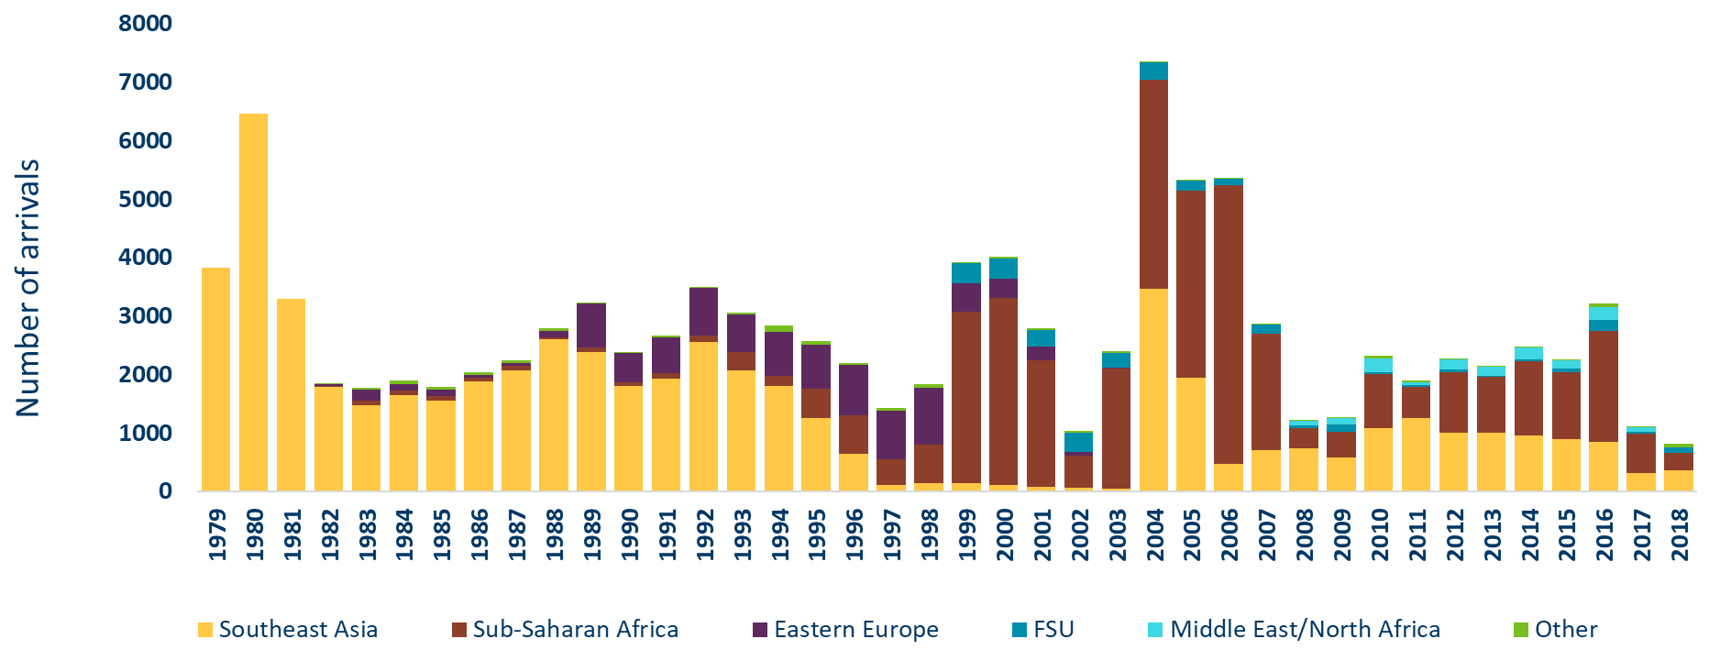
Primary* Refugee Arrivals to Minnesota by Region of World
1979-2018
*first resettled in Minnesota
Category | 1979 | 1980 | 1981 | 1982 | 1983 | 1984 | 1985 | 1986 | 1987 | 1988 | 1989 | 1990 | 1991 | 1992 | 1993 | 1994 | 1995 | 1996 | 1997 | 1998 | 1999 | 2000 | 2001 | 2002 | 2003 | 2004 | 2005 | 2006 | 2007 | 2008 | 2009 | 2010 | 2011 | 2012 | 2013 | 2014 | 2015 | 2016 | 2017 | 2018
Southeast Asia | 3817 | 6457 | 3296 | 1783 | 1477 | 1644 | 1551 | 1872 | 2066 | 2600 | 2384 | 1792 | 1923 | 2549 | 2070 | 1797 | 1249 | 638 | 109 | 136 | 137 | 111 | 73 | 57 | 44 | 3458 | 1933 | 469 | 705 | 726 | 583 | 1082 | 1243 | 995 | 1005 | 947 | 884 | 836 | 304 | 359
Sub-Saharan Africa | 0 | 0 | 0 | 17 | 64 | 70 | 73 | 66 | 76 | 30 | 68 | 65 | 91 | 115 | 312 | 176 | 496 | 663 | 427 | 664 | 2930 | 3198 | 2159 | 556 | 2046 | 3589 | 3203 | 4764 | 1981 | 350 | 424 | 921 | 533 | 1036 | 953 | 1269 | 1150 | 1911 | 678 | 293
Eastern Europe | 0 | 0 | 0 | 37 | 203 | 117 | 105 | 55 | 45 | 110 | 756 | 511 | 622 | 810 | 644 | 750 | 764 | 851 | 841 | 970 | 485 | 330 | 235 | 59 | 15 | 0 | 0 | 0 | 0 | 0 | 0 | 0 | 0 | 0 | 0 | 0 | 0 | 0 | 0 | 0
Former Soviet Union | 0 | 0 | 0 | 0 | 0 | 0 | 0 | 0 | 0 | 0 | 0 | 0 | 0 | 0 | 0 | 0 | 0 | 0 | 0 | 0 | 354 | 335 | 292 | 331 | 251 | 294 | 178 | 112 | 167 | 45 | 126 | 39 | 41 | 44 | 8 | 45 | 58 | 177 | 32 | 88
Middle East/North Africa | 0 | 0 | 0 | 0 | 0 | 0 | 0 | 0 | 0 | 0 | 0 | 0 | 0 | 0 | 0 | 0 | 0 | 0 | 0 | 0 | 0 | 0 | 0 | 0 | 0 | 0 | 0 | 0 | 0 | 76 | 119 | 235 | 48 | 175 | 162 | 200 | 149 | 229 | 76 | 12
Other | 0 | 0 | 0 | 9 | 22 | 64 | 55 | 41 | 46 | 42 | 26 | 7 | 20 | 20 | 23 | 106 | 57 | 37 | 47 | 63 | 18 | 40 | 35 | 30 | 46 | 12 | 6 | 11 | 14 | 7 | 14 | 43 | 26 | 9 | 13 | 12 | 6 | 51 | 13 | 66
Notes:
This graph describes the region of origin among people who arrived with humanitarian visa statuses to Minnesota from 1979 through 2018. This includes persons with refugee, asylee, parolee, certified victim of trafficking, and Amerasian visas. Subsequent slides will refer to these collectively as “people with refugee status”. Note that all data are reported by calendar year.

Slide 3
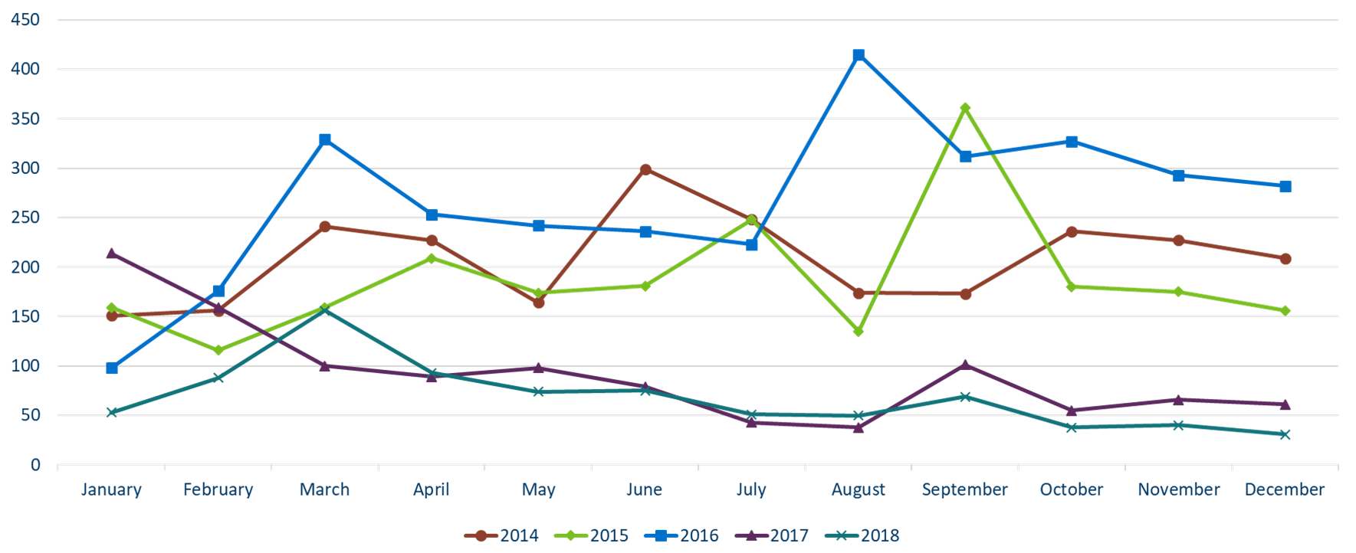
Primary Refugee Arrivals to Minnesota by Month
2014-2018
Category | 2014 | 2015 | 2016 | 2017 | 2018
January | 151 | 159 | 98 | 214 | 53
February | 165 | 116 | 176 | 159 | 88
March | 241 | 159 | 329 | 100 | 156
April | 227 | 209 | 253 | 89 | 93
May | 164 | 174 | 242 | 98 | 74
June | 299 | 181 | 236 | 79 | 75
July | 248 | 248 | 223 | 43 | 51
August | 174 | 135 | 415 | 38 | 50
September | 173 | 361 | 312 | 101 | 69
October | 236 | 180 | 327 | 55 | 38
November | 227 | 175 | 293 | 66 | 40
December | 209 | 156 | 282 | 61 | 31
Notes:
This graph shows refugee arrival numbers to Minnesota by month from 2014-2018. At the beginning of October each year, the President of the United States sets an admissions ceiling for the number of refugee arrivals that can be admitted into the U.S. during the subsequent fiscal year. In 2018, like 2017, arrival numbers remained lower than those seen in previous years.

Slide 4
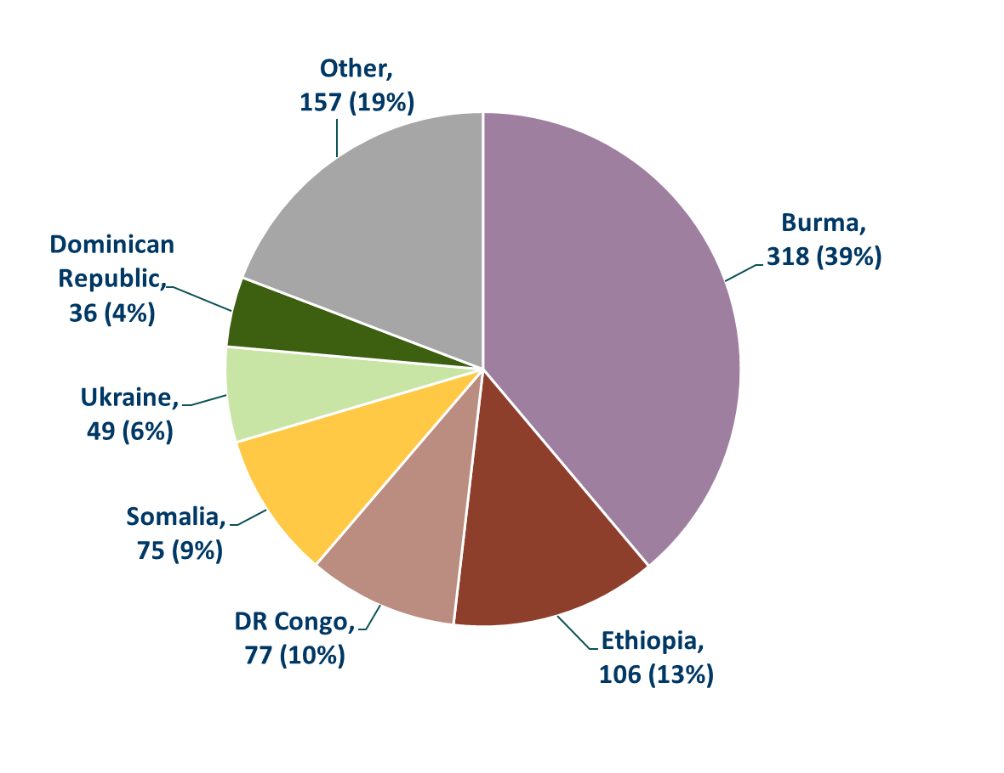
Primary Refugee Arrivals to Minnesota by Country of Origin
2018
N=818
“Other” includes Afghanistan, Bhutan, Cameroon, China, Cuba, El Salvador, Eritrea, Guatemala, India, Iran, Iraq, Kazakhstan, Kuwait, Mexico, Moldova, Philippines, Russia, Rwanda, Senegal, South Sudan, Sri Lanka, Syria, Thailand, Venezuela, and Yemen.
Notes:
This chart details the countries of origin of people with refugee status who arrived to Minnesota during 2018. This chart includes only primary arrivals, or those who resettled in Minnesota directly from overseas.

Slide 5
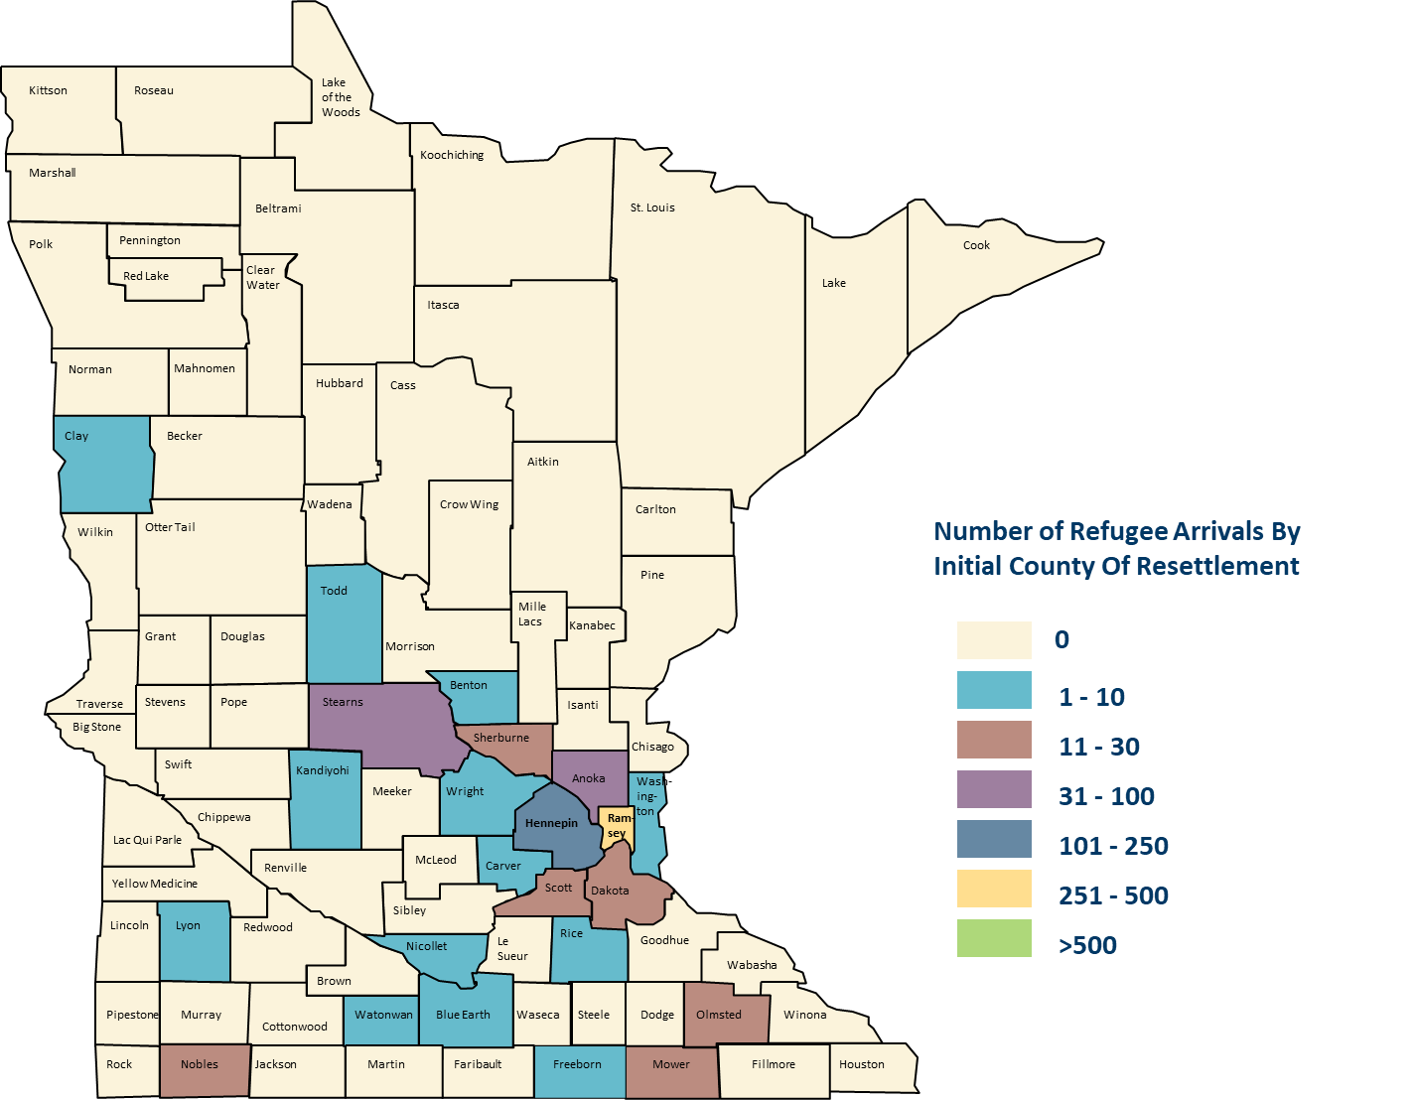
2018 Primary Refugee Arrivals to Minnesota by County (N=818)
Primary Refugee Arrivals to Minnesota by Initial County of Resettlement and Country of Origin, 2018 (PDF) (https://www.health.state.mn.us/communities/rih/stats/18yrsum.pdf)
Notes:
This map indicates which counties in Minnesota received people with refugee status in 2018. Ramsey County received the largest number of arrivals (432), followed by Hennepin (112), Stearns (47), and Anoka (40).

Slide 6
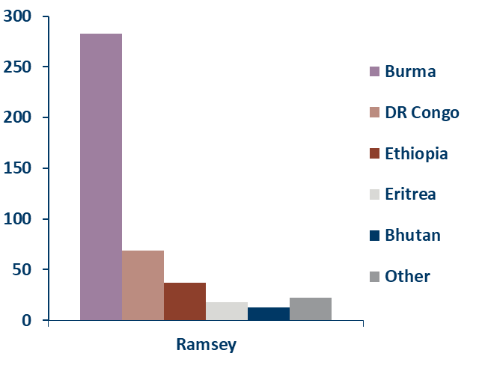
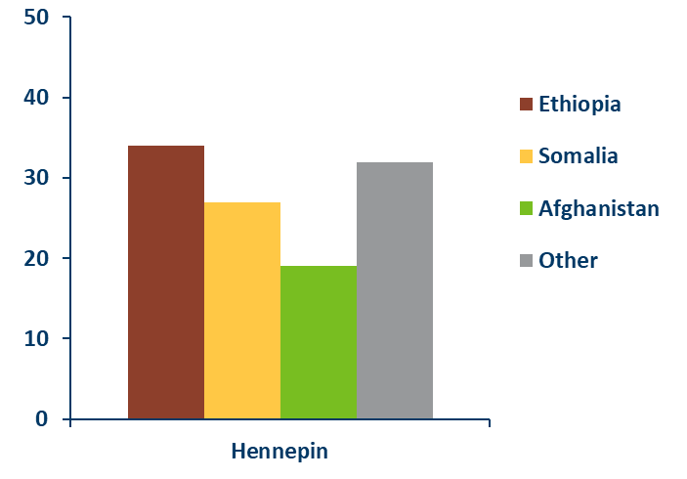
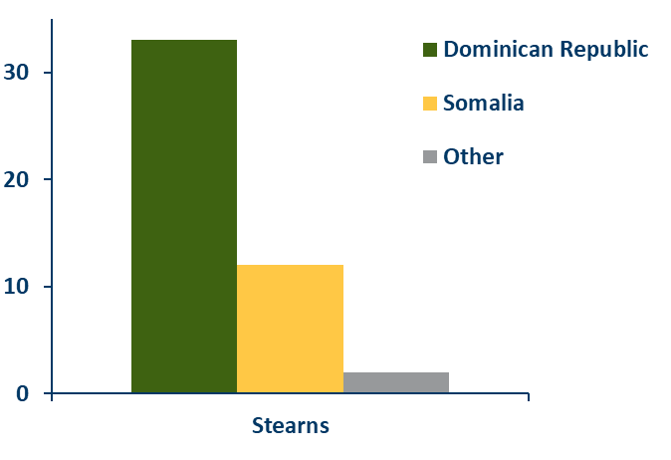
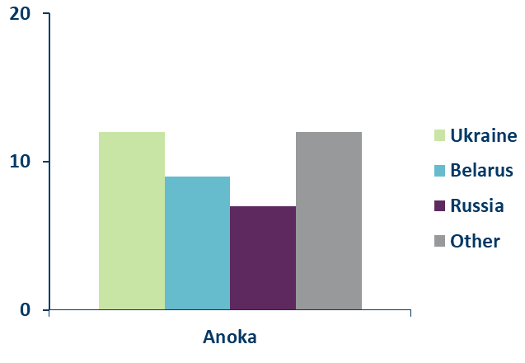
Arrivals by County of Resettlement and Country of Origin Minnesota, 2018
N=442
N=112
N=47
N=40
Notes:
These graphs are for the 4 counties with the largest number of arrivals in 2018. Each graph shows the distribution of people with refugee status by country of origin resettling in each county. Ramsey sees a high number of Burmese arrivals, indicated by the light purple bar, as well as arrivals from DR Congo, Ethiopia, Eritrea, and Bhutan. Most refugees who resettled in Hennepin County came from Ethiopia, Somalia, and Afghanistan. Stearns County refugees mainly arrived from the Dominican Republic and Somalia. Refugees resettling in Anoka County arrived from Ukraine, Belarus, and Russia.

Slide 7
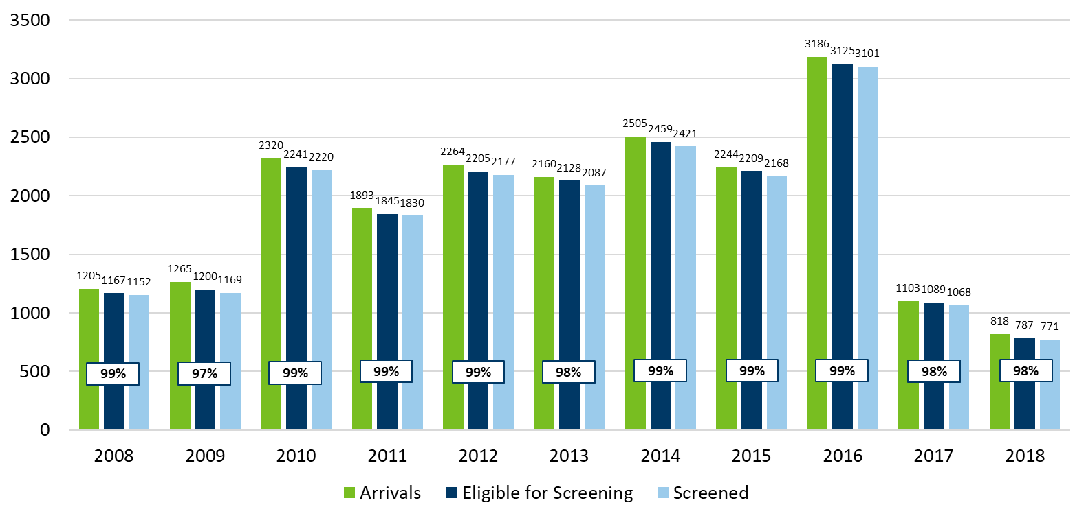
Primary Refugee Arrivals Screened in Minnesota
2008-2018
Category | 2008 | 2009 | 2010 | 2011 | 2012 | 2013 | 2014 | 2015 | 2016 | 2017 | 2018
Arrivals | 1205 | 1265 | 2320 | 1893 | 2264 | 2160 | 2505 | 2244 | 3186 | 1103 | 818
Eligible for screening | 1167 | 1200 | 2241 | 1884 | 2205 | 2128 | 2459 | 2209 | 3125 | 1089 | 787
Screened | 1152 | 1169 | 2220 | 1830 | 2177 | 2087 | 2421 | 2168 | 3101 | 1068 | 771
Percent of arrivals who completed screening | 99% | 97% | 99% | 99% | 99% | 98% | 99% | 99% | 99% | 98% | 98%
Ineligible if moved out of state or to an unknown destination, no insurance, unable to locate, or died before screening.
Notes:
In Minnesota, people with refugee status are offered a post-arrival health assessment, usually within 30-90 days of their arrival to the U.S. These assessments are done by public health clinics or private providers. The goal of the health assessment is to control communicable diseases among, and resulting from, the arrival of new refugees through screening, treatment, and referral. Since 2008 the proportion of new arrivals who complete a health assessment has remained ≥97%.

Slide 8
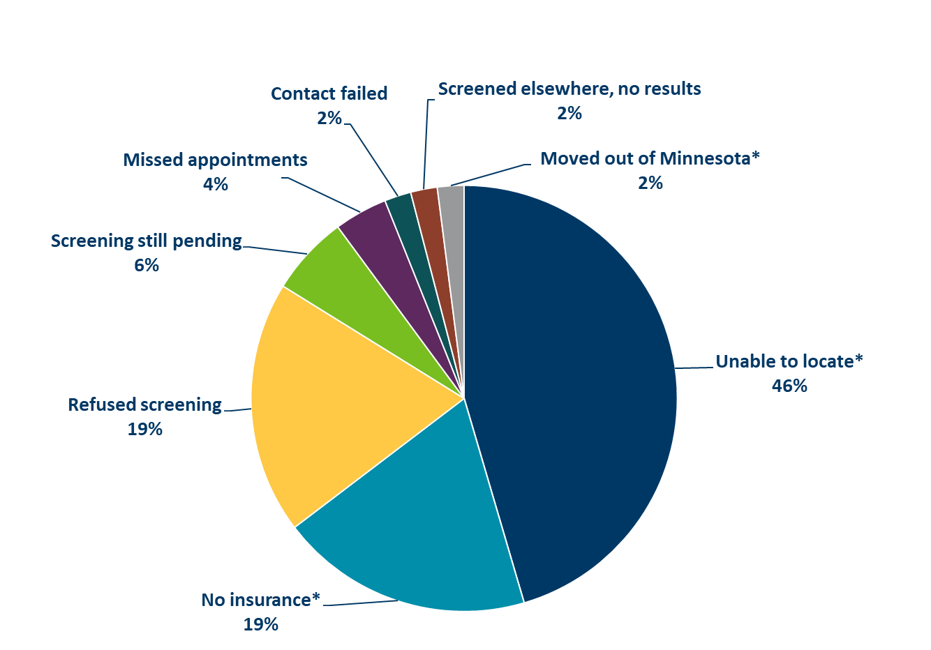
Primary Refugees’ Reasons for No Screening Minnesota, 2018
Category | Number of Arrivals | Percent of Total Arrivals
Unable to locate* | 21 | 45%
No insurance* | 9 | 19%
Refused screening | 9 | 19%
Screening still pending | 3 | 6%
Missed appointments | 2 | 4%
Contact failed | 1 | 2%
Screened elsewhere, no results | 1 | 2%
Moved out of Minnesota* | 1 | 2%
N=47
*Ineligible for the refugee health assessment
Notes:
In 2018, among the 47 people with refugee status who did not receive a post-arrival health assessment, 21 (46%) could not be located due to an incorrect address, 9 (19%) did not have insurance, 9 (19%) refused screening, screening for 3 (6%) are still pending, 2 (4%) missed their appointments, efforts to schedule appointments for 1 (2%) failed, 1 (2%) was screened, but no results were reported, and 1 (2%) moved out of Minnesota prior to screening.
Those who could not be located due to an incorrect address were considered ineligible for an assessment and are not included in the denominator when calculating the percent who received an assessment.

Slide 9
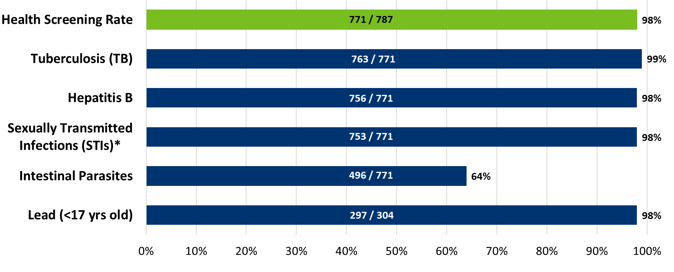
Refugee Screening Rates by Exam Type
Minnesota, 2018
Category | Number of Eligible Arrivals | Number of Arrivals Screened | Percent Screened
Health Screening | 787 | 771 | 98%
Tuberculosis (TB) | 771 | 763 | 99%
Hepatitis B | 771 | 756 | 98%
Sexually Transmitted Infections (STIs) | 771 | 753 | 98%
Intestinal Parasites | 771 | 496 | 64%
Lead (<17 yrs old) | 304 | 297 | 98%
*Screened for at least one type of STI
Notes:
People with refugee status are eligible for a health screening, usually initiated 30-90 days after U.S. arrival. The goal of this screening is to control communicable disease through health assessment, treatment, and referral.
This chart describes the overall percent of people with refugee status who received an assessment (among those eligible for an assessment), indicated by the green bar. The percent screened for various conditions as part of their assessment are indicated by the blue bars. For example, among those who received a health assessment, 99% were screened for tuberculosis. Screening for blood lead levels is only recommended for children younger than 17 years, so among refugee children younger than 17 who received a health assessment, 98% were screened for blood lead level. Only 64% of those who received a health assessment were screened for intestinal parasites because most refugees are treated for intestinal parasites presumptively prior to U.S. departure.

Slide 10
Health Status of New Refugees, Minnesota, 2018
Health status upon arrival | Number (%) of refugees screened* | Number (%) of refugees with infection
TB (latent or active)** | 763 (99%) | 137 (18%)
Hepatitis B infection*** | 756 (99%) | 30 (4%)
Parasitic infection**** | 496 (64%) | 91 (18%)
Sexually transmitted infections (STIs)***** | 753 (98%) | 10 (1%)
Lead****** | 297 (98%) | 33 (11%)
Hemoglobin | 763 (99%) | 118 (15%)
*Total screened: N=771 (98% of 787 eligible refugees)
** Persons with LTBI (≥10mm induration or IGRA+, normal CXR) or suspect/active TB disease
*** Positive for hepatitis B surface antigen (HBsAg)
**** Positive for at least one intestinal parasite infection
***** Positive for at least one STI (tested for syphilis, HIV, chlamydia, and/or gonorrhea)
****** Children <17 years old (N=304); lead level ≥5 µg/dL
Notes:
This table describes the number and percent of people with refugee status screened for specific conditions, among those screened (middle column of the table), and the number and percent testing positive among those screened for that condition (right-hand column of the table).
All refugees are screened for active, infectious tuberculosis (TB) before coming to the U.S. and no one who has infectious TB is allowed to travel to the U.S. The health screening in the U.S. includes a full TB evaluation, including screening for latent TB infection. Not everyone who carries the TB bacteria becomes sick. For most, the immune system responds to the bacteria and keeps it inactive. This is called latent TB infection, and cannot be spread to other people.
The health screening also includes screening for hepatitis B infection. The most common risk of transmission for refugees is mother-to-child, acquired at birth from an infected mother.
Most refugees receive anti-parasite treatment overseas to lower their risk of health complications. During their initial medical exam in the U.S., many refugees are also tested for parasites and treated, if needed.
Screening for sexually transmitted infections includes syphilis, HIV, chlamydia, and/or gonorrhea. All refugees 15 years and older are also screened for syphilis and gonorrhea before coming to the U.S.
Children under 17 are also tested for elevated blood lead levels. An elevated blood lead level is defined as ≥5 µg/mL.
The health screening also includes screening for hemoglobin deficiency (anemia). Hemoglobin deficiency is defined as <12 mg/dL.

Slide 11
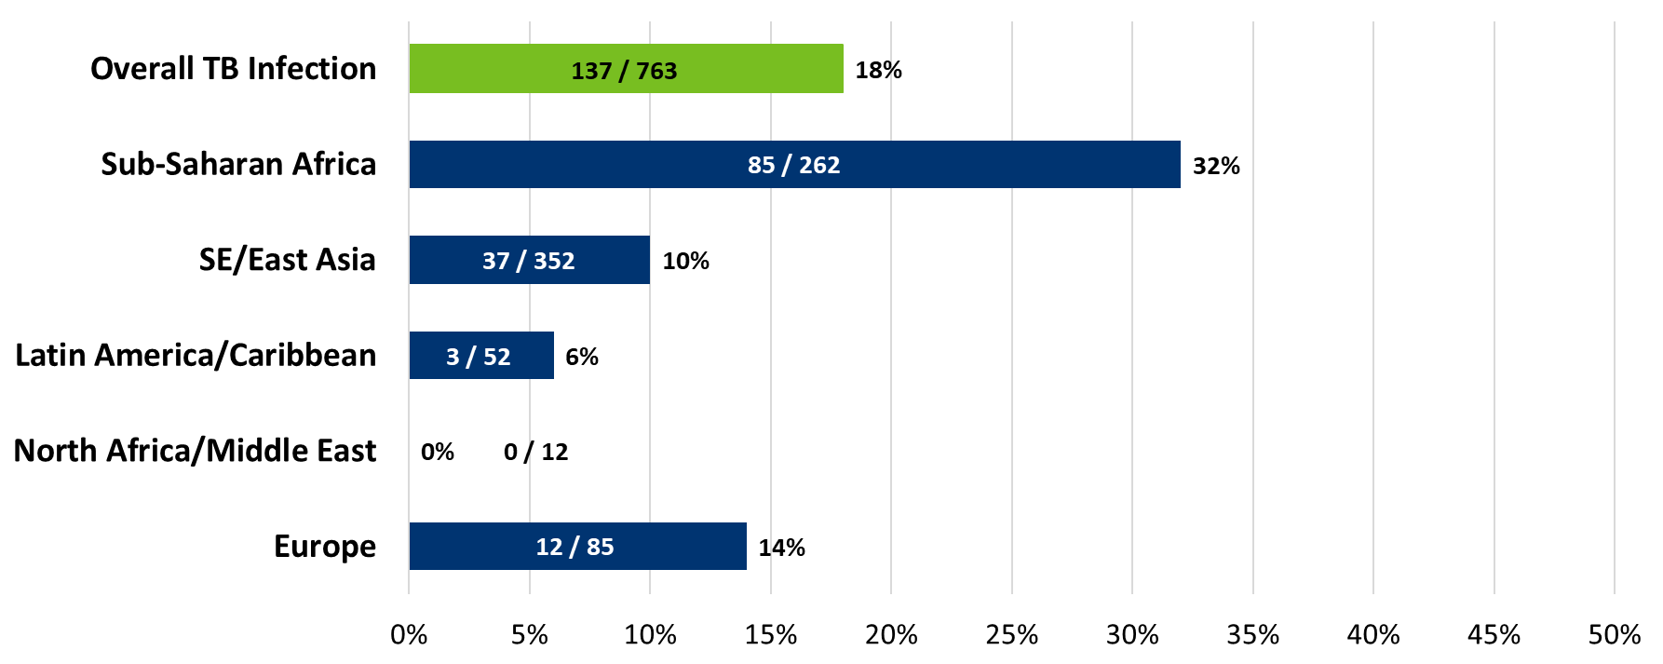
Latent or Active Tuberculosis (TB)* Among Refugees by Region of Origin, Minnesota, 2018
*Diagnosis of Latent TB infection (N=137) or Suspect/Active TB disease (N=0)
Total screened=763
Category | Number of Infections | Number of Arrivals Screened | Infection Rate (%)
Sub-Saharan Africa | 85 | 262 | 32%
Southeast/East Asia | 37 | 352 | 10%
Latin America/Caribbean | 3 | 52 | 6%
North Africa/Middle East | 0 | 12 | 0%
Europe | 12 | 85 | 14%
Overall TB Infection | 137 | 763 | 18%
Notes:
The overall prevalence of TB infection, either latent TB infection or suspect/active TB disease, was 18% among those screened for TB. All of these were diagnoses of latent TB infection, which is not infectious and cannot be spread to others. People with LTBI can be treated to get rid of the TB bacteria entirely. Minnesota has one of the highest rates of LTBI treatment completion in the country for newly arrived refugees. It is a sign of a successful and safe resettlement program here in Minnesota that we are able to treat conditions before they are infectious.
Arrivals from sub-Saharan Africa had the highest prevalence of TB infection, with 32% of sub-Saharan Africans screened for TB who tested positive.

Slide 12
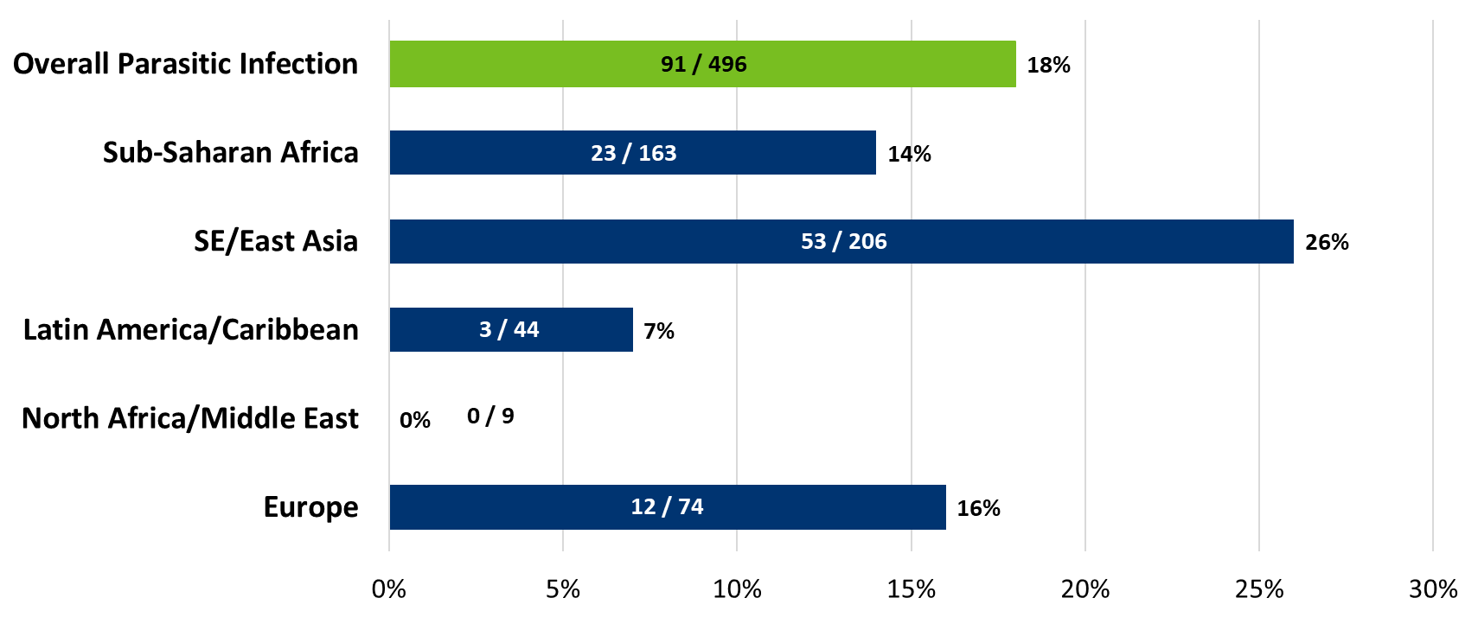
Intestinal Parasitic Infection* Among Refugees by Region of Origin, Minnesota, 2018
*At least 1 parasitic infection found via stool or serology (excluding nonpathogenic)
Total screened=496
Category | Number of Infections | Number of Arrivals Screened | Infection Rate (%)
Sub-Saharan Africa | 23 | 163 | 14%
Southeast/East Asia | 53 | 206 | 26%
Latin America/Caribbean | 3 | 44 | 7%
North Africa/Middle East | 0 | 9 | 0%
Europe | 12 | 74 | 16%
Overall Parasitic Infection | 91 | 496 | 18%
Notes:
The prevalence of parasitic infection (with at least one pathogenic parasite) among those screened for intestinal parasites was 21%. The most common parasites observed were Schistosoma species (47 infected) and Strongyloides stercoralis (40). Other less commonly identified parasites included Dientamoeba fragilis (6) and Giardia lamblia (5).
Most refugee arrivals receive presumptive treatment for intestinal parasites overseas, which has reduced the prevalence of certain parasitic infections, such as strongyloidiasis and schistosomiasis.

Slide 13
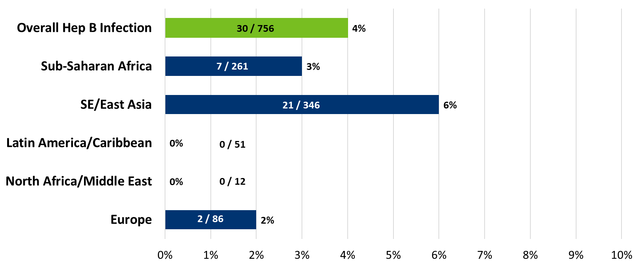
Hepatitis B Infection* Among Refugees by Region of Origin, Minnesota, 2018
*Positive hepatitis B surface antigen (HBsAg)
Total screened=756
Category | Number of Infections | Number of Arrivals Screened | Infection Rate (%)
Sub-Saharan Africa | 7 | 261 | 4%
Southeast/East Asia | 21 | 346 | 3%
Latin America/Caribbean | 0 | 51 | 6%
North Africa/Middle East | 0 | 12 | 0%
Europe | 2 | 86 | 0%
Overall Hep B Infection | 30 | 756 | 4%
Notes:
The overall prevalence of hepatitis B infection, either acute or chronic, was 4% among those who received a hepatitis B surface antigen test (HBsAg). Hepatitis B is preventable with vaccination and the majority of newly-arriving refugees receive the recommended vacation either overseas or domestically.

Slide 14
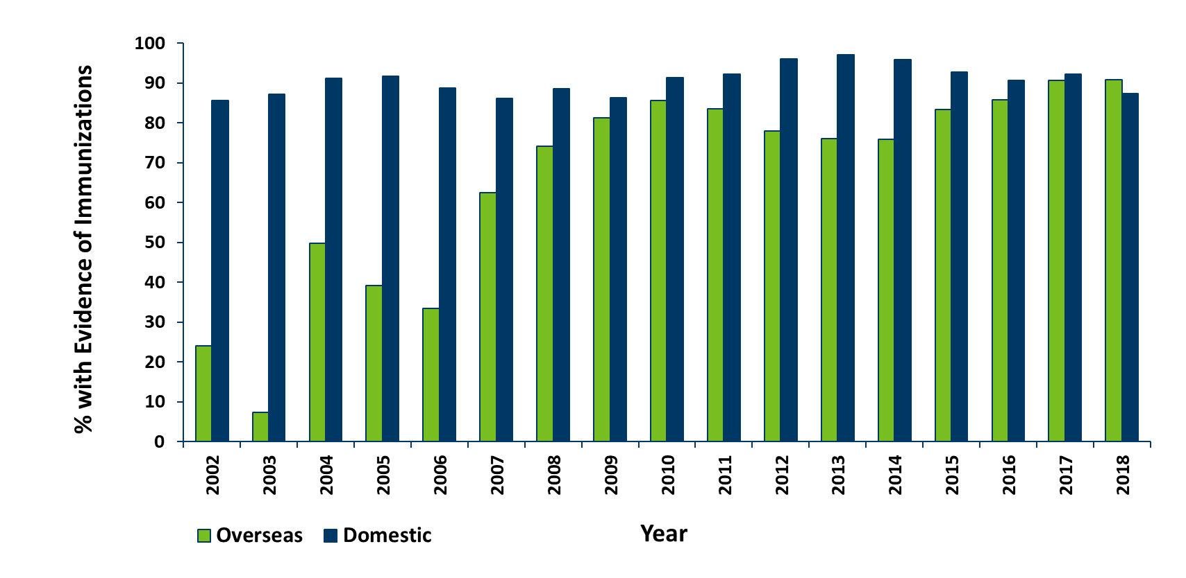
Immunization Status Among Refugees
Minnesota, 2002-2018
Category | 2002 | 2003 | 2004 | 2005 | 2006 | 2007 | 2008 | 2009 | 2010 | 2011 | 2012 | 2013 | 2014 | 2015 | 2016 | 2017 | 2018
Received at least one documented vaccine overseas | 24% | 7.4% | 49.7% | 39.2% | 33.5% | 62.4% | 74.2% | 81.2% | 85.6% | 83.5% | 78% | 76% | 75.9% | 83.4% | 85.8% | 90.6% | 90.8%
Received one or more vaccinations during domestic screening process | 85.6% | 87.2% | 91.1% | 91.7% | 88.8% | 86.1% | 88.6% | 86.3% | 91.3% | 92.2% | 96% | 97% | 95.8% | 92.8% | 90.6% | 92.2% | 87.3%
Notes:
This chart looks at immunization status in persons with refugee status. The green bars show those who came to the U.S. with at least one documented vaccine overseas. In the early 2000’s it was uncommon for people with refugee status to arrive with documentation of any vaccinations. However, in recent years >80% are arriving with at least some vaccine history.
The blue bars indicate those who received one or more vaccinations during the domestic screening process. The majority of newly arrived refugees either have a vaccine series started or continued after arrival. These vaccinations are important to prevent outbreaks such as polio, measles, and other infectious diseases. Additionally, people with refugee status apply for permanent residency at the end of one year, and they have to show proof of certain vaccinations at that time.

