Slide 1
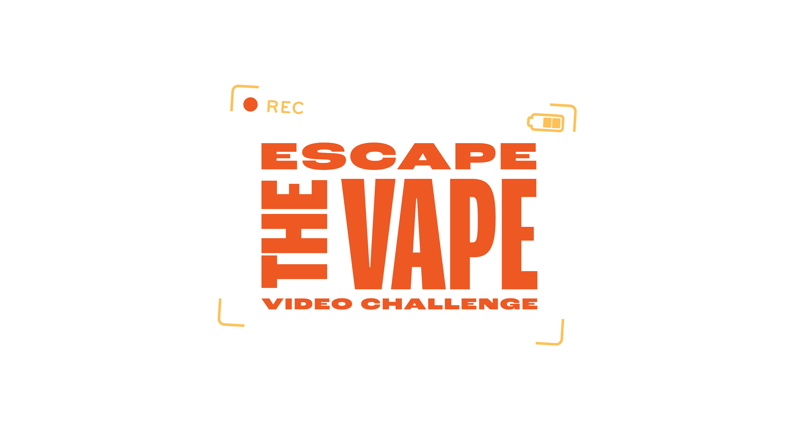
Escape the Vape Video Challenge
Health Education (Grade 6)
Michelle Padden

Slide 2
Escape the Vape Video Challenge
Day 1

Slide 3
What it is vaping?
Definition
E-cigarettes, also known as vapes, are battery-operated devices that heat a liquid and produce an aerosol. An aerosol is a mix of small particles released in the air.
Common terms
vapes, e-cigarettes, e-cigs, pods
Notes:
CDC. “About E-Cigarettes (Vapes).” Centers for Disease Control and Prevention. Last updated October 24, 2024. Accessed October 23, 2025. https://www.cdc.gov/tobacco/e-cigarettes/about.html

Slide 4
What is inside?
Vapes can contain harmful and potentially harmful substances, including:
Nicotine – highly addictive chemical that can harm the adolescent brain
Cancer-causing chemicals
Heavy metals such as nickel, tin, and lead
Tiny particles that can be inhaled deep in the lungs
Volatile organic compounds
Flavorings such as diacetyl, a chemical linked to a serious lung disease

Slide 5
Vaping myths vs. facts
Myth | Fact
Vaping is just water vapor, so it is harmless | The aerosol from e-cigarettes can also contain harmful and potentially harmful substances. These include cancer-causing chemicals and tiny particles that can be inhaled deep into lungs.
It helps me relax, like smoking. | Nicotine addiction or withdrawal can contribute to these feelings or make them worse. Youth may use tobacco products to relieve their symptoms, which can lead to a cycle of nicotine addiction.
It is safer than smoking cigarettes. | Most vapes contain nicotine, which is highly addictive. Using nicotine during adolescence can harm the parts of the brain that control attention, learning, mood, and impulse control
Notes:
CDC. “Health Effects of E-Cigarettes (Vapes).” Centers for Disease Control and Prevention. Last updated October 20, 2024. Accessed October 23, 2025. https://www.cdc.gov/tobacco/e-cigarettes/health-effects.html

Slide 6
How vaping affects your body
Brain – impacts attention, memory, mood; the developing brain is more vulnerable to the harmful effects of nicotine.​
Mental health – risk of addiction and poor mental health; nicotine dependence can worsen stress and anxiety.
Lungs – irritation, inflammation; risks of respiratory illnesses.​
Cardiovascular system – raising heart rate, possibly blood pressure; strain.​
Other – possible links to long-term diseases not yet fully known.

Slide 7
Why do teens vape?
Marketing and social influences
Flavors make it appealing
Peer pressure, wanting to fit in
Curiosity, boredom, wanting to experiment
To relieve stress
Notes:
CDC. “Why Youth Vape.” Centers for Disease Control and Prevention. Last updated October 17, 2024. Accessed October 23, 2025. https://www.cdc.gov/tobacco/e-cigarettes/why-youth-vape.html

Slide 8
What are the risks of vaping?
Addiction – once you start, hard to stop.​
Respiratory issues – cough, wheezing, asthma worsened, etc.​
Effects on physical performance – especially sports, stamina.​
Possible long-term unknowns – still being researched.​
Cost – financial cost, opportunity cost.

Slide 9
How to turn down a vape?
Refuse it
  “No thanks, I’m good.”
  “That’s not for me.”
  “I don’t want that.”​
Use humor, change the subject.​
Suggest alternatives
  “Let’s go do something else.”
Have a plan ahead of time.

Slide 10
What are some healthier choices?
Hobbies, sports, creative activities.​
Talking with someone trustworthy (coach, parent, counselor).​
Stress management: breathing exercises, mindfulness, journaling.​
Seeking help if someone is already using and wants to quit.

Slide 11
Wrap Up
Takeaways from today:
Vaping is not harmless, especially for young people
It entails risks that matter
You deserve to make healthy choices.
Think/Pair/Share:
What surprised you?
What would you tell a friend?

Slide 12
Please complete this exit ticket before you leave: ##add link to vaping quiz##

Slide 13
Escape the Vape Video Challenge
Day 2

Slide 14
Would you like to…
Earn some extra money? (Up to $500!)​
Make a difference in the lives of other teens?​
Have fun?​
Learn new technology skills?​
Be creative?
If so, you should join the Escape the Vape Video Challenge!

Slide 15
What is Escape the Vape?
The Escape the Vape Video Challenge is a PSA video contest where Minnesota 6th-12th graders can use their voices to raise awareness about the dangers of vaping and expose the shadowy commercial tobacco marketing tactics behind it.

Slide 16
How it works …
Create a 30-second PSA video.​
Must follow contest rules (e.g., no showing real vaping devices, adhere to safety).
Videos must include:
  ​At least one vaping fact about the dangers of vaping
  One call to action
Submit the video and complete permission form between December 1st, 2025, and January 31st, 2026.

Slide 17
How is it judged?
Videos are judged by youth and adult judges.​
Adults review the videos to be sure that they qualified – followed all the rules.
​Adults judge the first round, narrowing down to the top 25 in each age group.
Students from the Room to Breathe Youth Advisory Council narrow the videos down to the top finalists for each age group.
The public votes on the winner!

Slide 18
Tips for making a great video
Be creative and original.​
​Use accurate facts.​
Make the message clear (one or two strong messages).​
Visual appeal, sound quality, good editing.
Need some more inspiration? Take a look at the 2025 winners’ videos.

Slide 19
Brainstorming
What kind of messages do you think will really reach your peers?​
What creative approaches could work?​
What concerns might you have about making a video (logistic, safety, etc.)?

Slide 20
Resources
Escape the Vape Video Challenge webpage: Vaping Truths — Escape the Vape
Minnesota Department of Health Commercial Tobacco Use webpages: E-cigarettes and Vaping | Commercial Tobacco Use - MN Dept. of Health
Truth Initiative Youth Vaping webpages: Youth vaping, smoking & nicotine use
Centers for Disease Control Smoking and Tobacco Use webpages: E-Cigarettes (Vapes) | Smoking and Tobacco Use | CDC
American Lung Association E-Cigarettes and Vaping webpages: E-Cigarettes & Vaping | American Lung Association

