Slide 1
Medical Assistance for Breast or Cervical Cancer
Collaboration and coordination between Minnesota agencies to improve health outcomes

Slide 2
Outline
Breast and Cervical Cancer Prevention and Treatment Act of 2000
Eligibility for Medical Assistance-Breast and Cervical Cancer (MA-BC)
MA-BC Eligibility Determination/Enrollment
MA-BC Temporary eligibility
On-going MA-BC coverage

Slide 3
Breast & Cervical Cancer Prevention and Treatment Act of 2000
The Act created a new Minnesota Medical Assistance eligibility category in 2000 that expands coverage to previously uninsured low-income people screened through the Sage Screening Program
Full Medical Assistance benefits to people diagnosed through the Sage Screening program and needing treatment for a breast or cervical cancer or pre-cancer

Slide 4
Medical Assistance – “MA-BC”
Provides full Medical Assistance (MA) benefits for eligible people
Coverage begins where Sage coverage ends (once a diagnosis is made)
Coverage goes for 12 months, or as long as cancer treatment continues (renewal paperwork required)

Slide 5
Eligibility Criteria for MA-BC
To be eligible for MA-BC an individual must:
Have been screened under the Sage Screening Program and (Sage) program funds were used to pay (all or part) for the screening or diagnostic services
*Includes screening done in other state's programs that are a part of the CDC’s Breast and Cervical National Cancer Screening Programs
Need treatment, including staging services, to determine the extent and course of treatment for breast or cervical cancer, including pre-cancerous cervical lesions, and early-stage cancer
Be under age 65 and have no creditable insurance
*Creditable insurance includes:
*Medicare and
Group and individual health care coverage (unless the plan does not cover the needed treatment)
Not be otherwise eligible for MA (county can evaluate for other adequate assistance programs)

Slide 6
Eligibility Criteria for MA-BC continued…
To be eligible for MA/BC an individual must:
Be a Minnesota resident
Be a U.S citizen or have an immigration status that qualifies them for MA
Have a Social Security Number

Slide 7
Administration of MA-BC
Minnesota County Servicing Agencies administer MA-BC eligibility determination and enrollment
Each Minnesota county has one or two designated MA-BC contacts. Contacts can be found at the MA-BC County Contact List on the Sage website, or contact Sage Clinical Services Staff
MA-BC County Contact List (https://www.health.state.mn.us/diseases/cancer/sage/documents/ma-bc_contacts.pdf)

Slide 8
MA-BC Eligibility Determination/Enrollment
What forms are needed for MA-BC Eligibility Determination?
Sage Enrollment form (copy)
MA-BC Application/renewal Form
*Example of each form, the link to form follow:

Slide 9
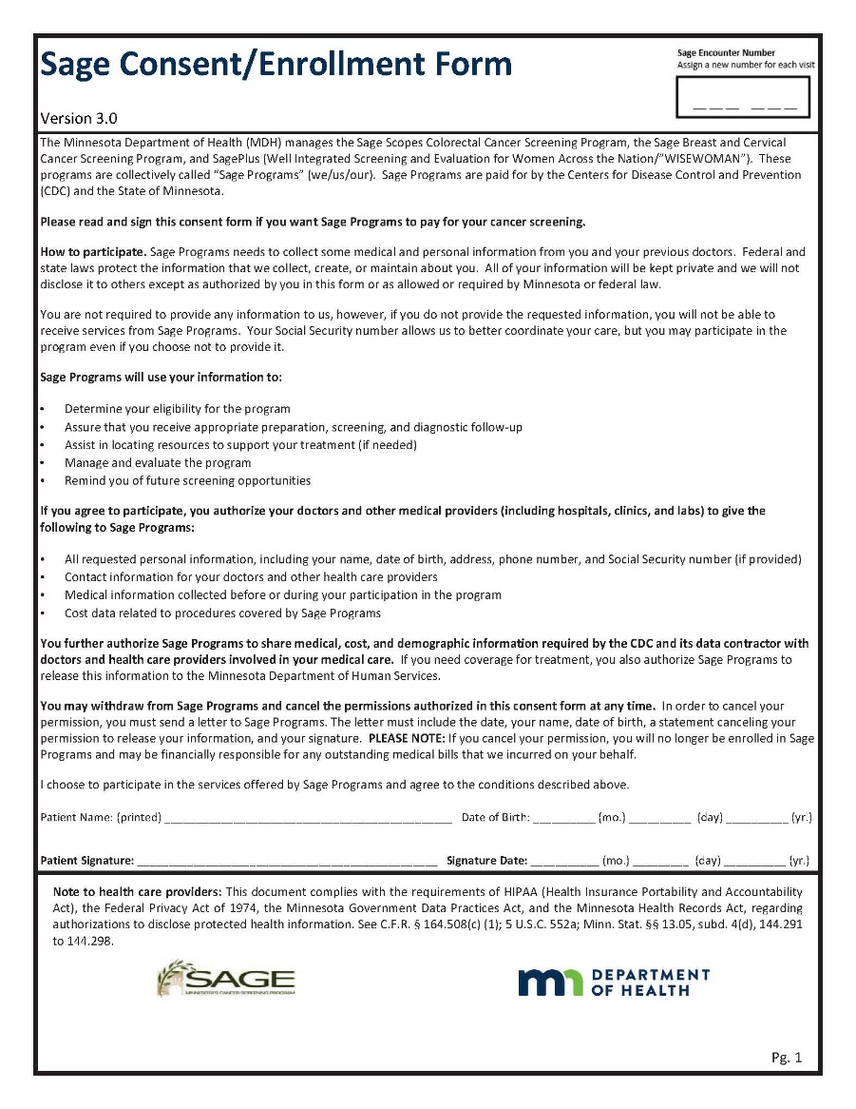
Sage Enrollment Form
Find Sage Enrollment Form at:
Sage Forms
https://www.health.state.mn.us/diseases/cancer/sage/providers/frmslbl.html

Slide 10
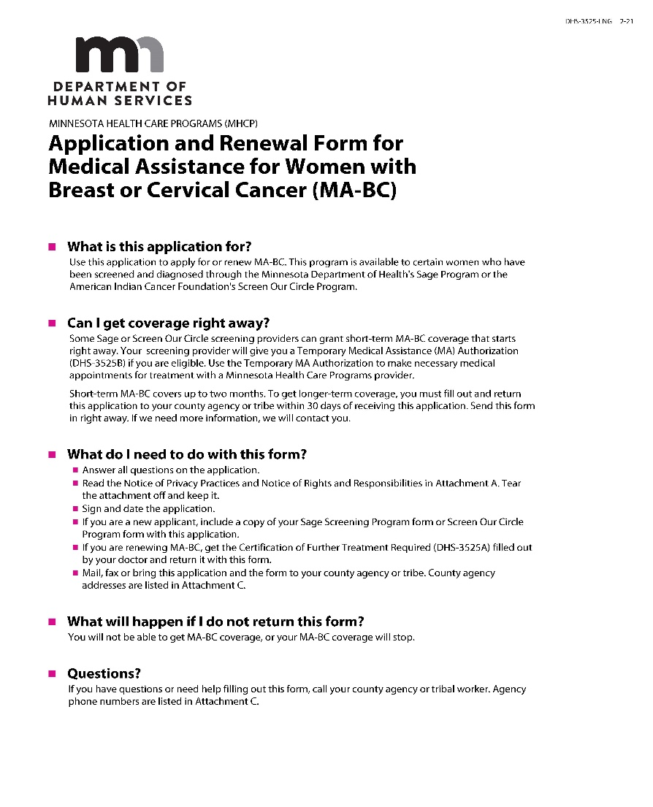
MA-BC Application/Renewal
Find Form DHS-3525 at:
Minnesota Health Care Programs Application
https://edocs.dhs.state.mn.us/lfserver/Public/DHS-3525-ENG

Slide 11
Temporary Medical Assistance/Presumptive Eligibility (PE)
Temporary Medical Assistance may be presumptively granted by a Minnesota Health Care program (MHCP) participating provider who has received MA-BC Presumptive Eligibility training (you have now been trained) and has signed the agreement with DHS to conduct presumptive eligibility for clients of the Sage screening Program. See the Sage Provider Manual for more details.
Temporary Medical Assistance provides immediate coverage for a temporary period to an individual who needs to begin cancer treatment or obtain services
*Presumptive Eligibility Coverage provides “full MA benefits” for the presumptive period

Slide 12
Temporary Medical Assistance/Presumptive Eligibility (PE) continued…
Temporary MA-BC coverage may be presumptively granted by the Minnesota Health Care Program (MHCP) PE provider or clinic to people who:
Were screened through the Sage Program
Need to begin cancer treatment or obtain services
Are under age 65
*Citizenship or immigration status is not a factor in determining presumptive eligibility for MA-BC – once Temporary Medical Assistance has been granted, it cannot be taken away.

Slide 13
Temporary Medical Assistance/Presumptive Eligibility (PE) continued…
To enroll a person on Temporary Medical Assistance, the PE provider must complete and submit the following forms to the county:
Sage Enrollment Form (Copy)
Copy of Temporary Medical Assistance Authorization (DHS-3525B)
* A copy of each form and link are on the following slides.

Slide 14
Sage Enrollment Form
Find Sage Enrollment Form at:
Sage Forms
https://www.health.state.mn.us/diseases/cancer/sage/providers/frmslbl.html

Slide 15
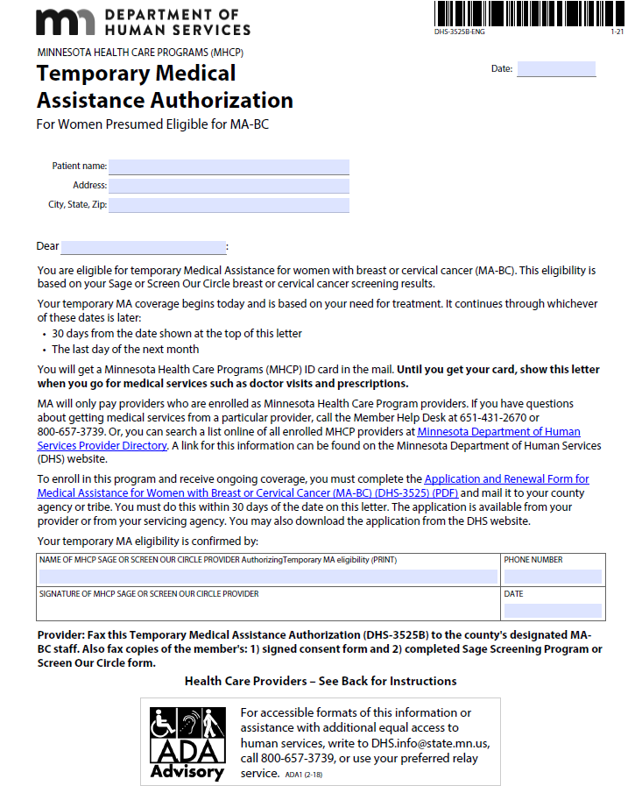
Temporary Medical Assistance/Presumptive Eligibility (PE) Form
Find Form DHS-3525B at:
https://edocs.dhs.state.mn.us/lfserver/Public/DHS-3525B-ENG

Slide 16
On-going MA-BC Coverage (after granting Temporary MA-BC)
Presumptive Eligibility is effective on the first day of the month PE is granted. This means services provided at any time that month may be covered by MA-BC.
Once Presumptive Eligibility has been granted, Temporary MA-BC remains in effect:
Through the end of the month following the month Temporary MA was granted*
An application for on-going coverage is processed and an eligibility determination is made
A person who is presumed eligible for MA-BC must apply for ongoing coverage within 30 days of the date Presumptive Eligibility is granted
For on-going MA-BC determination; a Sage Enrollment form and a Minnesota MA Application/Renewal Breast and Cervical Cancer (DHS-3525) form must be completed and submitted to the county.
*Temporary MA-BC follows Medical Assistance ‘month-based” eligibility policy as supported by DHS eligibility systems

Slide 17
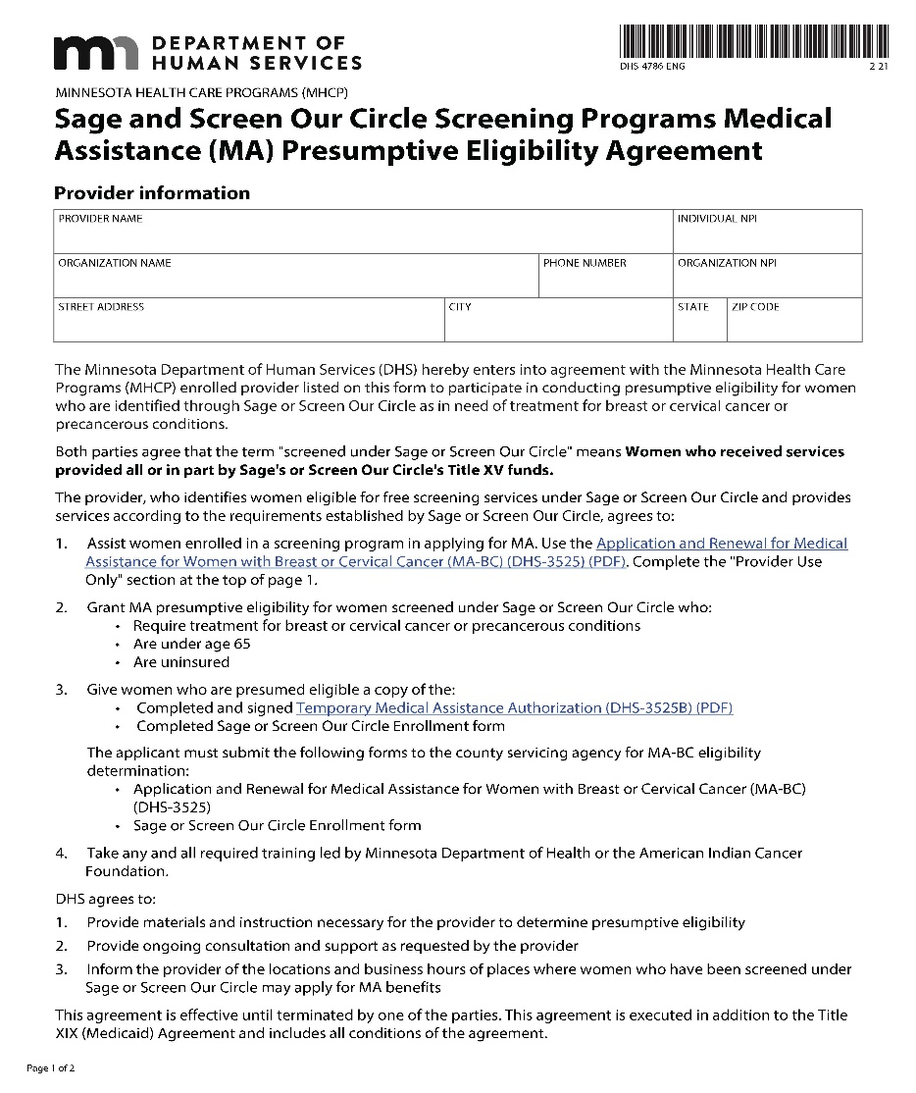
MA Presumptive Eligibility Grantor Agreement
Form must be completed and submitted to DHS before a MHCP participating provider can grant Temporary Medical Assistance
Medical Assistance Presumptive Eligibility Agreement
https://edocs.dhs.state.mn.us/lfserver/Public/DHS-4786-ENG

Slide 18
Questions or Comments? Contact your Sage Clinical Services Staff
Nikki Kuechenmeister, Follow-Up Coordinator
651-201-5904
Nikki.Kuechenmeister@state.mn.us
Haley Storms-Kruchten, Clinical Services Coordinator
651-201-4803
Haley.Storms-Kruchten@state.mn.us
Carlie Koberstine, Clinical Services Consultant
651-201-4969
Carlie.Koberstine@state.mn.us

