Slide 1
Acute Stroke Ready Hospital (ASRH) Designation Site Visit
Data and Performance Improvement Template
Use this template to build your presentation for the data portion of your stroke hospital designation site visit.
Use as many or as few of the slides as you like. The more you use, the better the reviewer will understand your program.
This is a discussion and a presentation. Please use ideas in this template to show off how much work you already do, and do not worry if you do not address everything. No two stroke programs are alike, highlight what YOU do!
Do not worry if you do not meet goals, show us that you are working on the process. Many large centers do not meet goals, but designation is about identifying where you can improve and actively addressing things as they arise, which you can only do through case review and PI.
Contact the stroke system designation coordinator with questions about your presentation.

Slide 2
Walk us through your average times over the last 3 years for each of the below that you track.
These are required metrics to track for ASRH Designation (Reference Page 17 in ASRH Designation Reference Guide):
Door to Stroke team activation*
Door to provider*
Door to telestroke activation*
Door to imaging initiated
Door to imaging read
Door to needle
Door in door out
Use one slide for each metric (see next slide as an example). Reviewers want to see the change, improvement in your performance, SINCE your last site visit! It is ok if it is not meeting goals!
*Starred door to metrics are currently unavailable in the Portal- Door to provider, Door to stroke team activation, door to telestroke activation.

Slide 3
Data trends – 1 slide per metric
EXAMPLE:
DTN/Door to Needle THEN (at time of your last site visit) and NOW (this site visit) *Review your previous site visit Data and PI powerpoint for your performance at that time.
What has been done to improve it?
  Show off great work (I.E. Direct to CT process reduced overall DTN time)
If your performance needs work:
  Tell us what contributed to decrease in performance
  What barriers you have identified
  Tell us what stroke team education and or PI projects you have planned in the future to address/improve this metric

Slide 4
Consider adding other items to your tracking
Do you track any of the following? Show us what you have found over time.
  Last Known Well time documented
  Last Known Well time given in Clock Time
  Dysphagia screen documented
  Reason for not giving alteplase in 0-4.5 hour window
  Consideration of endovascular treatment within 24 hour window
  Delays or problems in transport
  Telestroke issues

Slide 5
Stroke Committee
Departments represented on committee
How often do you meet
How do you implement case review within the committee (i.e. do you bring themes to the group or perform every case review within the group)
If you have telestroke, what role do they play in case review and PI?

Slide 6
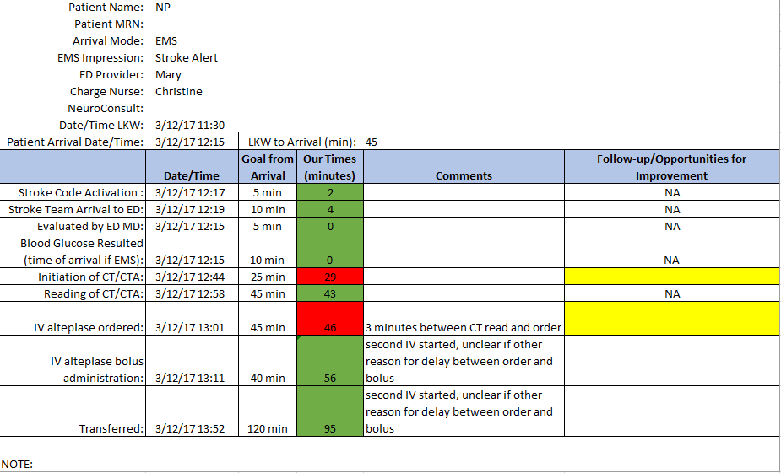
Individual Case Review
Show us what your case review elements (PI log) look like. An example :

Slide 7
Follow up on Individual Case Review (action steps)
Tell us what feedback (and the feedback process) looks like:
  to Acute Stroke Team members
  to EMS
  Do you have a feedback form: send emails, call, touch base in meetings (I.E. within the Stroke Committee to department leads. Do department leads share with their frontline staff?)

Slide 8
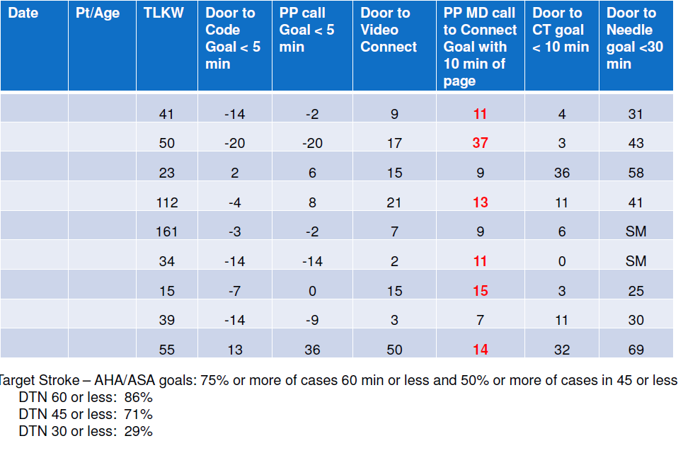
Aggregate Case Review
Compiling individual reviews.
Show us how you look at times for all your cases, to identify themes or delays (your PI log)

Slide 9
Follow up on Aggregate Case Review (action steps)
What do you do when you identify a theme, an issue or delay in performance, an opportunity to improve?
Do you bring it to committee? What happens from that point?

Slide 10
Turning Themes into Performance Improvement Projects
How do you create a plan for the identified issue?
Who is involved in creating the plan
How do you engage partners to get the plan implemented?
How do you measure it, and show what success is?
Present a PI plan you have done a project on, or plan to. If you haven’t identified one, show or talk through an example of how you might.

Slide 11
Additional info
Anything else you would like the review team to know?

