Slide 1


2018-2022 HIV Prevention Projects Grantee Training
Chryssie Jones | Prevention Unit Supervisor
February 14, 2018
Notes:
Welcome to the 2018-2022 HIV Prevention Projects Grantee Training. My name is Chryssie Jones and I am the Prevention Unit Supervisor. I am joined by the grant management team and other staff at MDH to go through key aspects of our HIV prevention programs and your role as a funded agency.

Slide 2

Training Agenda
Introduction of Grant Managers
Contract and Budget Highlights
Program Areas
Progress Reports
Reporting
U = U
Material Review
Notes:
Training Agenda
This training will cover the following topics:
Introduction of Grant Managers, contract and budget highlights, program areas, grantee progress reports, reporting HIV positive cases to MDH, the undetectable equals Untransmittable campaign, and requirements for materials review.
A few housekeeping things: After each topic we will do questions and answers before moving on to the next topic, and there will be a final time for questions at the end if you have more. Please use the chat box to ask questions during the webinar.

Slide 3
Grant Managers
Area(s) of Expertise
Chryssie Jones Prevention Unit Supervisor
Jessica Barry Contracts/Budgets/Administrative Requirements
Peggy Darrett-Brewer HIV Testing Coordinator
Kathy Chinn Syringe Services Programs/Condom Distribution
McKinzie Woelfel Prevention with Positives/Materials Review
Japhet Nyakundi PrEP
Notes:
While each agency has been assigned a grant manager, in some cases two if there are multiple programs, each grant manager as an area of expertise.
As the Prevention Unit Supervisor, my role is to provide direction and oversight to the entire HIV prevention project process. Jessica Barry is the grant manager staff should work with on all budget and administrative issues relating to contracts. Peggy Darrett-Brewer is the HIV Testing Coordinator and provides expertise around all HIV testing protocols, procedures and provides all the HIV counseling, testing and referral training. Kathy Chinn provides expertise in syringe services and McKinzie Woelfel works directly with all our Prevention with Positive grantees. Japhet Nyakundi manages all our PrEP contracts and coordinates training and capacity building to communities and providers to expand PrEP in Minnesota.

Slide 4
Budget Highlights
Jessica Barry, Grant Manager
Notes:
Budget Highlights

Slide 5
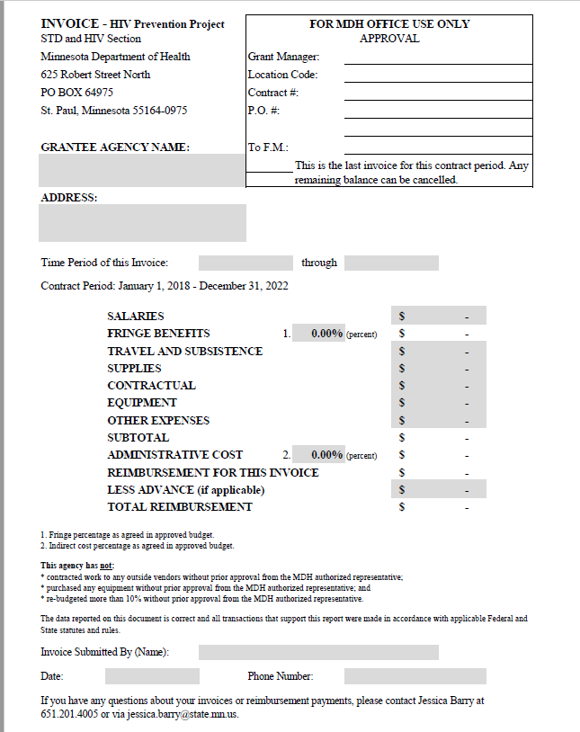
Invoices
Invoices shall be submitted monthly on the invoice template provided by MDH within 30 days of the end of the month.
Notes:
Invoices shall be submitted monthly on the invoice template provided by MDH within 30 days of the end of the month.

Slide 6
Budgets
Annual budgets are required to be submitted to MDH according to the schedule in the grant agreement. MDH will review and send an email with the approved budget.
Budget Period Budget Plan Due
January 1, 2018 through December 31, 2018 January 31, 2018
January 1, 2019 through December 31, 2019 December 3, 2018
January 1, 2020 through December 31, 2020 December 2, 2019
January 1, 2021 through December 31, 2120 December 7, 2020
January 1, 2022 through December 31, 2022 December 6, 2021
Notes:
Annual budgets are required to be submitted to MDH according to the schedule in the grant agreement. MDH will review and send an email with the approved budget.

Slide 7
Budgets cont.
Funds are not allowed to be carried forwarded from year to year.
MDH will not reimburse for travel expense incurred outside the State of Minnesota unless prior written approval is given by MDH.
Any modifications to the approved budget must be sent to MDH.
Budget shifts equal to or less than 10 percent of any budget line item are allowed without prior written approval but need to be communicated to MDH.
Budget shifts greater than 10 percent of any budget line item require prior written approval from MDH.
Notes:
Funds are not allowed to be carried forwarded from year to year.
MDH will not reimburse for travel expense incurred outside the State of Minnesota unless prior written approval is given by MDH.
Any modifications to the approved budget must be sent to MDH.
Budget shifts equal to or less than 10 percent of any budget line item are allowed without prior written approval but need to be communicated to MDH.
Budget shifts greater than 10 percent of any budget line item require prior written approval from MDH.

Slide 8
Financial Reconciliations
A financial reconciliation will be completed during the grant period. An email will be sent requesting supporting documents for MDH to perform the financial reconciliation. Documentation is required to be submitted to MDH within 30 days. Supporting documentation includes, but is not limited to, general ledgers, payroll ledgers/documentation, purchase orders/requisitions, invoices, receipts, bank statements, travel vouchers.
Notes:
A financial reconciliation will be completed during the grant period. An email will be sent requesting supporting documents for MDH to perform the financial reconciliation. Documentation is required to be submitted to MDH within 30 days. Supporting documentation includes, but is not limited to, general ledgers, payroll ledgers/documentation, purchase orders/requisitions, invoices, receipts, bank statements, travel vouchers.

Slide 9
Thank you!
Jessica Barry
612-201-4005
jessica.barry@state.mn.us
Notes:
Contact Jessica with questions about budget and invoices.

Slide 10
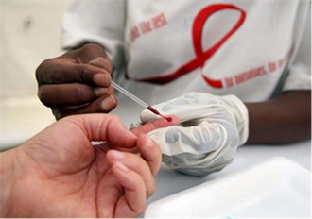
HIV Testing Program
Peggy Darrett-Brewer| HIV Testing Coordinator
2018
Notes:
Welcome to the HIV Testing Program Grantee Training. My name is Peggy Darrett-Brewer, HIV Testing Coordinator

Slide 11
Overview
HIV Testing Scope of Work
Methods of Testing
Clinical Laboratory Improvements (CLIA)
Integration Condom Distribution/STD’s/PrEP
Evaluation Web
Upcoming Training Dates
Notes:
Overview:
HIV Testing Scope of Work
Methods of Testing
Clinical Laboratory Improvements (CLIA)
Integration Condom Distribution/STD’s/PrEP
Evaluation Web
Upcoming Training Dates

Slide 12



HIV Testing Scope of Work
Notes:
HIV Testing Scope of Work: The primary goals of the HIV Testing Programs: * Increase number of people living with HIV who know their status. * Decrease the transmission of HIV in populations at highest risk through PrEP/PEP/expedited linkage to HIV primary care and treatment * Decrease HIV stigma by promoting testing programs that include anti-stigma approaches to testing. HIV testing programs are expected to yield at least a 1% rate of newly identified HIV-positive tests annually. 75% or 3/4ths of individuals tested by your agency should be of your target population.

Slide 13
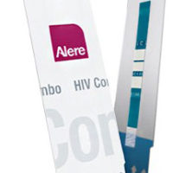
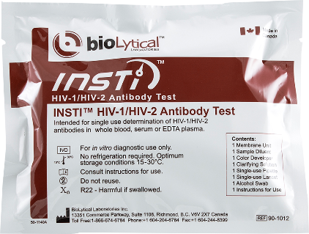
Methods of HIV Testing: Preliminary
HIV Preliminary Rapid Testing
OR
Determine Combo INSTI
Notes:
Methods of HIV Testing: Preliminary:
Utilizes one rapid testing technology to identify preliminary positive results. Individuals
HIV Preliminary Rapid Testing: Is providing prevention counseling and referred for confirmatory testing. Individuals testing positive will be linked to confirmatory testing. Individuals testing negative are provided prevention counseling and referrals for Pre-Exposure Prophylaxis (PrEP), PEP (Post-Exposure Prophylaxis), and other support services as appropriate.
HIV Confirmed Rapid HIV Testing: utilizes two separate testing technologies to identify and confirm newly diagnosed individuals and immediately link them to HIV primary care. Individuals testing negative are provided prevention counseling and referrals for PrEP, PEP, and other support services as appropriate.

Slide 14

Methods of HIV Testing: Confirmed
HIV Confirmed Rapid HIV Testing
AND
Determine Combo INSTI
Notes:
HIV Confirmed Rapid Testing: utilizes two separate testing technologies to identify and confirm newly diagnosed individuals and immediately link them to HIV primary care. Individuals testing negative are provided prevention counseling and referrals for PrEP, PEP, and other support services as appropriate.

Slide 15
CLIA Waiver Is Required.
It is required that any facility examining human specimens for diagnosis, prevention, treatment of a disease or for assessment of health must register with the federal Centers for Medicare Services (CMS) and obtain certification.
CLIA Contact Information:
Minnesota department of Health CLIA Program
3333 West Division Street, Ste 212
St. Cloud, MN 56301-4557
Phone: 651-201-4120
Email: health.clia@state.mn.us
Notes:
CLIA Waiver Is Required
It is required that any facility examining human specimens for diagnosis, prevention, treatment of a disease or for assessment of health must register with the federal Centers for Medicare Services (CMS) and obtain certification.
CLIA Contact Information:
Minnesota department of Health CLIA Program
3333 West Division Street, Ste 212
St. Cloud, MN 56301-4557
Phone: (651) 201-4120
Email: health.clia@state.mn.us

Slide 16
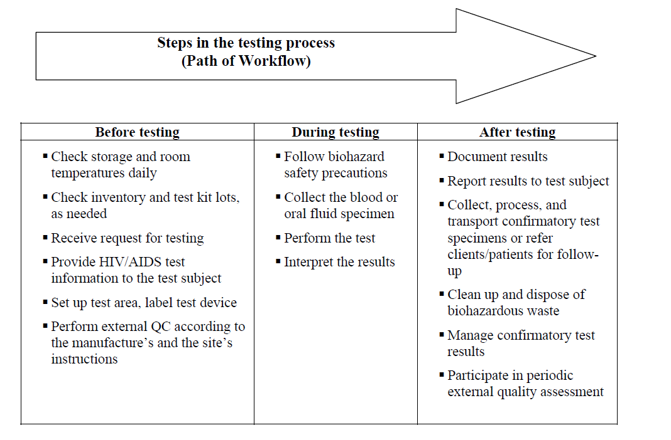

CLIA Waiver
The CLIA Waiver establishes quality standards for laboratory testing to ensure the accuracy, reliability and timeliness of patient testing results.
Notes:
CLIA Waiver
The CLIA Waiver establishes quality standards for laboratory testing to ensure the accuracy, reliability and timeliness of patient testing results.

Slide 17
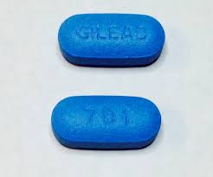
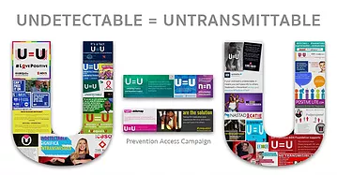

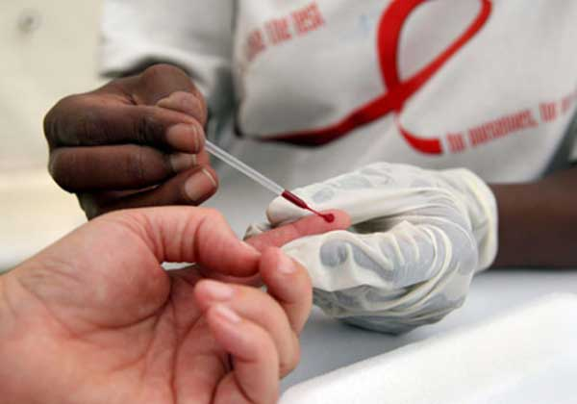
Condom Distribution/STD/PrEP/U=U Integration
For more information contact:
PrEP: Japhet Nyakundi 651-201-4030, or visit Pre-Exposure Prophylaxis (www.health.state.mn.us/divs/idepc/diseases/hiv/prep.html)
Undetectable = Untransmittable (www.health.state.mn.us/uu) or Mariah.Wilberg@state.mn.us
For Condom Distribution questions/concerns contact: Kathy Chinn 651-201-4008 or Kathy.chinn@state.mn.us
Notes:
Condom Distribution/STD/PrEP Integration:
As a component of your HIV testing program your agency should be distributing condoms and tracking condom distribution in Evaluation Web.
HIV testing programs will need to utilized risk information for other sexually transmitted diseases to either conduct or refer client for STD testing.
HIV testing programs should either be providing education and referral for PrEP. For resources and assistance with PrEP providers you can contact Japhet Nyakundi at 651-201-4030 or go to our PrEP web page.
U=U- Undetectable = Untransmittable Campaign. Mariah Wilburg will talk about this later.
For more information contact:
PrEP: Japhet Nyakundi (651) 201-4030, or visit Pre-Exposure Prophylaxis (www.health.state.mn.us/divs/idepc/diseases/hiv/prep.html)
Undetectable = Untransmittable (www.health.state.mn.us/uu)
For Condom Distribution questions/concerns contact: Kathy Chinn (651) 201-4008 or Kathy.chinn@state.mn.us

Slide 18
Evaluation Web
E-Authentication- Contact Tina Klein, Evaluation Web System Administrator 651-201-4022
EvaluationWeb: e-Authentication and User Registration Steps (www.health.state.mn.us/divs/idepc/diseases/hiv/evaluationweb/eauthentication.html)
Reminders
Country of Birth
Local Fields
L1 –Tribal Affiliation
L2 – Use this field to indicate if your client identifies as “MSM” yet the risk profile does not indicate such a risk. For example, the client identifies as MSM yet has no risk of anal sex with male, or indicates only sexual risk was oral sex only (which is not identified by gender) In Local Use L2 , write in the letters MSM to ensure your data reflect you are reaching your target population MSM.
L3- We do not use, please leave blank.
L4-Use this field for tracking PrEP education and referral. EDU for education and or REF for referral, and EDU/REF for both.
Notes:
Evaluation Web
E-Authentication- Contact Tina Klein, Evaluation Web System Administrator (651) 201-4022
EvaluationWeb: e-Authentication and User Registration Steps (www.health.state.mn.us/divs/idepc/diseases/hiv/evaluationweb/eauthentication.html)
Reminders
Country of Birth
Local Fields
L1 –Tribal Affiliation
L2 – Use this field to indicate if your client identifies as “MSM” yet the risk profile does not indicate such a risk. For example, the client identifies as MSM yet has no risk of anal sex with male, or indicates only sexual risk was oral sex only (which is not identified by gender) In Local Use L2 , write in the letters MSM to ensure your data reflect you are reaching your target population MSM.
L3- We do not use, please leave blank.
L4-Use this field for tracking PrEP education and referral. EDU for education and or REF for referral, and EDU/REF for both.
If you haven’t had someone e-authenticated from your agency please do so by either contacting Tina Klein, or going out to the link above.
Evaluation Web does not separate Africans, from African American’s, so Country of Birth is really important in distinguishing between them.

Slide 19
Upcoming Trainings
Rapid-Rapid HIV Testing Method Webinar-Tuesday, February 20, 2018-2:30pm-4pm
Fundamentals of HIV Prevention Counseling – Wednesday, February 21, 2018-9:00am-4:30pm
HIV Test Results-Thursday, February 22, 2018-9:00am-4:30pm
Evaluation Web Training- March 15, 2018,
Basic/Advanced 9am-11am
Basic/Advanced 1pm-3pm
Notes:
Upcoming Trainings:
Rapid-Rapid HIV Testing Method Webinar-Tuesday, February 20, 2018-2:30pm-4pm
Fundamentals of HIV Prevention Counseling – Wednesday, February 21, 2018-9:00am-4:30pm
HIV Test Results-Thursday, February 22, 2018-9:00am-4:30pm
Evaluation Web Training- March 15, 2018,
Basic/Advanced 9am-11am
Basic/Advanced 1pm-3pm

Slide 20
Thank you!
Peggy Darrett-Brewer
HIV Testing Coordinator
Peggy.darrett-brewer@state.mn.us
651 -201-4011
Notes:
Contact Peggy with questions about HIV testing.

Slide 21

Syringe Services Program (SSP)
Kathy Chinn| Capacity Building Coordinator
2018
Notes:
Hello, I’m Kathy Chinn, STD/HIV/TB Section Capacity Building Coordinator. I’m also the grant manager for they Syringe Services Programs.

Slide 22
Overview
SSP Scope of Work
All Guidelines for HIV Testing Program Apply
HCV Testing
Condom Distribution/STD’s/PrEP/ U=U
Upcoming Training Dates
Coordination Meetings and Technical Assistance
Notes:
The MDH funded HIV Prevention Syringe Services Programs (aka- SSPs) provide a combination of services for injection drug users. We’ll be briefly going over the scope of work for the SSPs, including the HIV and HCV testing requirements. We’ll touch on some other elements of the programming and lastly take note of upcoming training, coordination and technical assistance opportunities.

Slide 23
SSP Scope of Work
Syringe Exchange – Primary focus & recruitment
HIV and HCV Testing – Always offered and encouraged
Overdose Prevention – The most basic harm reduction
Making it work smoothly:
harm reduction lens
cultural competency (MSM/IDU, race/ethnicity, sex work, etc.)
relationship with law enforcement
Notes:
The MDH funded Syringe Services Programs have 3 primary goals:
Syringe Exchange- which is the primary focus and is what brings participants in the doors,
HIV and HCV testing- which allows participants to learn their status and if positive, get connected to medical care which in turn improves health and reduces transmission.
And Overdose Prevention-Which is the distribution of naloxone kits and training in how to use them, as well as education on Steve’s Law – the most basic form of harm reduction is helping people stay alive.
Other required activities and elements of the scope of work help SSPs stay client focused, culturally competent and able to function well.

Slide 24
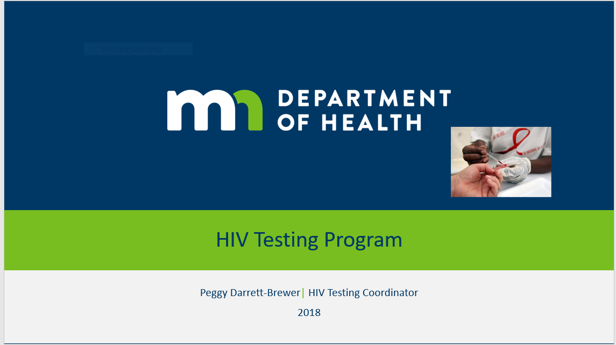
All Guidelines of HIV Testing Program Apply
Notes:
As all SSPs are required to conduct rapid HIV testing. All the guidelines covered in Peggy’s presentation on HIV Testing Programs apply to SSPs. This includes training, data collection and reporting, CLIA waiver, etc. All 5 funded SSPs have identified that they will be conducting HIV Confirmed Rapid HIV Testing also known as Rapid-Rapid testing.

Slide 25

HCV Testing
Why HCV Testing?
Guidelines
Who do I contact?
Training – February 21st 9:30-11:00 at MDH (see email sent earlier)
Data collection, monitoring and reporting
Notes:
Why HCV testing? Injection drug users have significantly high levels of HCV infection. Some SSPs have found up to 20% positivity rate. There are great opportunities for harm reduction as well as referral for medical care and possibly treatment for those who test positive.
Guidelines : A detailed email and rapid HCV testing guideline was sent out in late January
Who do I contact? Email me, Kathy Chinn with any questions or concerns. Email CJ Olson and CC Kathy to order kits. This is also in the email sent out in late January.
Rapid HCV testing training: Next Weds. February 21st the OraSure rep. will conduct training for new staff at agencies. An email was sent on January 26th regarding this training.
Data collection and reporting: The detailed email sent out by me in late January also included an excel spreadsheet to track an monitor your HCB testing. This excel spreadsheet is required to be submitted along with your semi-annual progress report. A Hepatitis Testing Report needs to be completed on anyone testing positive and faxed to the number on the report. Questions about reporting positive tests? Contact Genny Grilli 651.201.5557 This reporting form was also sent with the detailed email in January.

Slide 26
Condom Distribution/STD/PrEP/U=U Integration
For more information contact:
PrEP: Japhet Nyakundi 651-201-4030, or visit Pre-Exposure Prophylaxis (www.health.state.mn.us/divs/idepc/diseases/hiv/prep.html)
Undetectable = Untransmittable (www.health.state.mn.us/uu) or Marian.Wilberg@state.mn.us
For Condom Distribution questions/concerns contact: Kathy Chinn 651-201-4008 or Kathy.chinn@state.mn.us
Notes:
As a component of your HIV testing program your agency should be distributing condoms and tracking condom distribution in Evaluation Web.
HIV testing programs will need to utilized risk information for other sexually transmitted diseases to either conduct or refer client for STD testing.
HIV testing programs should either be providing education and referral for PrEP. For resources and assistance with PrEP providers you can contact Japhet Nyakundi at 651-201-4030 or go to our PrEP web page.
U=U- Undetectable = Untransmittable Campaign. Mariah Wilburg will talk about this later.

Slide 27
Upcoming Trainings
Rapid-Rapid HIV Testing Method Webinar-Tuesday, February 20, 2018-2:30pm-4pm
Fundamentals of HIV Prevention Counseling – Wednesday, February 21, 2018-9:00am-4:30pm
Rapid HCV Testing – Wednesday, February 21, 2018-9:30am-11:00am
HIV Test Results-Thursday, February 22, 2018-9:00am-4:30pm
Evaluation Web Training-TBD
More HIV Testing Trainings offered in June. See STD/STD/Hepatitis Training Opportunities (www.health.state.mn.us/divs/idepc/diseases/hiv/training/index.html)
Notes:
Here is a list of upcoming trainings. We regret the overlap of the Fundamentals of HIV Prevention Counseling and the Rapid HCV Testing training. However, all the HIV testing trainings will be offered again in June. As Peggy mentioned earlier, there will be a training specific to Evaluation Web that all staff responsible for Eval Web data entry and supervisors will need to take. We are working on scheduling that training.

Slide 28
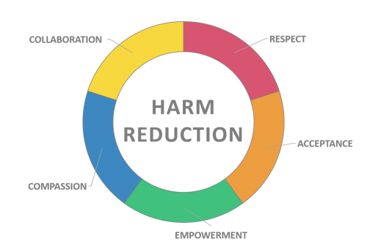
Coordination Meetings and Technical Assistance
Shared goals, challenges, opportunities
First coordination meeting held at MAP Jan. 26th, stay posted for more
Technical assistance needs or questions? Call or email Kathy!
Possibly bringing in Harm Reduction Coalition for training in 2018
Notes:
This is an exciting time for SSPs as new programs start up and seasoned programs continue their good work. MAP generously hosted the first SSP coordination meeting at which all agreed that there is an ongoing need for meeting. Stay posted for follow-up.
I’m here to support your programs and address your concerns, questions, and technical assistance needs as we begin this grant contract period. Please don’t hesitate to email or call me any time.
We are looking into possibly bringing the Harm Reduction Coalition to provide training to SSPs in MN at some point in 2018. Stay tuned for more on that.

Slide 29

Thank you!
Kathy Chinn
Capacity Building Coordinator
Kathy.chinn@state.mn.us
651 -201-4008
Notes:
Contact Kathy with questions about SSPs.

Slide 30

Condom Distribution Tracking and Reporting
Kathy Chinn| Capacity Building Coordinator
2018

Slide 31
Overview
All HIV Prevention Programs are required to distribute condoms
Tracking Form
Reporting in both Eval Web and Semi-Annual Progress Report

Slide 32
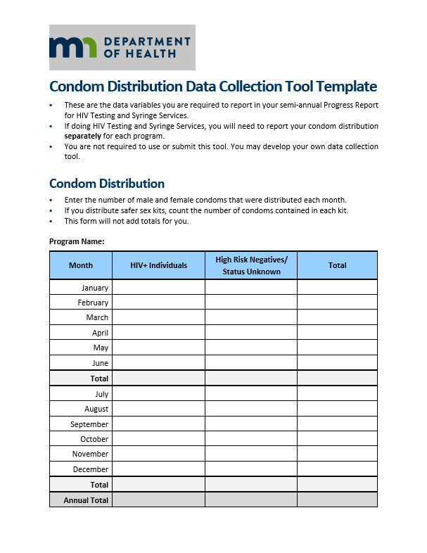
Condom Distribution Data Collection Form
Notes:
We will provide you this data collection tool. You are not required to use it, however you are required to report using these variables, so it’s a useful tool to use. Note that you must track by condoms given to HIV + individuals or high risk negatives/status unknown. These categories are set by CDC. We don’t expect you to ask people their HIV status, but if you are distributing to folks you know are positive or in venues in which you can assume most or all folks are positive, then please log it as such.

Slide 33
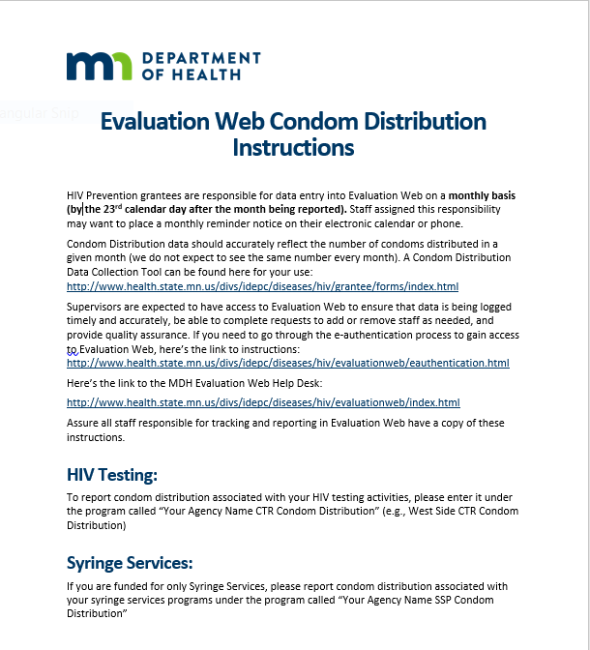
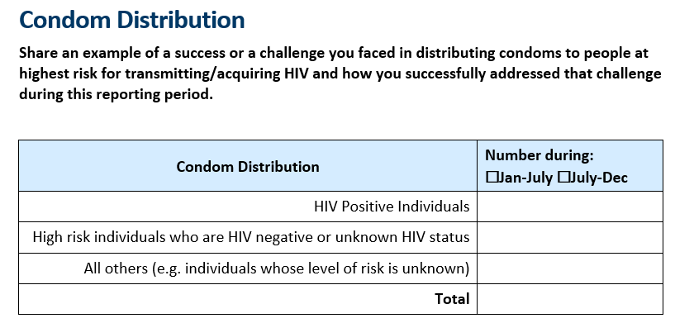
Condom Distribution Reporting
Notes:
Your programs report condom distribution both in Evaluation Web and in the Semi-Annual Progress Report. The instructions for how to report in Eval Web will be sent to you. Eval Web reporting is done on a monthly basis. The Progress Report templates have a section about condom distribution and covers a 6-month period.

Slide 34
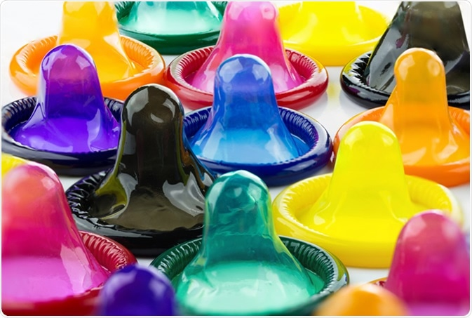
Thank you!
Kathy Chinn
Capacity Building Coordinator
Kathy.chinn@state.mn.us
651 -201-4008
Notes:
Contact Kathy with questions about condom distribution.

Slide 35
Semi-Annual Progress Reports
Chryssie Jones | Prevention Unit Supervisor

Slide 36
Progress Reports
HIV TESTING PROGRAM PROGRESS REPORT
# OF TESTS/POSITIVES
ENGAGEMENT/RECRUITEMENT UPDATES
OUTREACH STATISTICS
CONDOM DISTRIBUTION
INTEGRATION
TARGET POPULATION INPUT
MONITORING AND EVALUATION
SYRINGE SERVICES PROGRAM PROGRESS REPORT
# OF EXCHANGES
# CLIENTS SERVED
TARGET POPULATION INPUT
DISPOSAL
OVERDOSE PREVENTION
HCV/HIV TESTING
MONITORING AND EVALUATION
Notes:
Semi-annual progress reports are required for all funded programs. Templates are provided by MDH and are used to collect information on challenges and successes of your program. For HIV testing programs information on number of tests and positives, outreach and how participants were recruited, condoms distributed and integration of PrEP, U equals U and other STDs is collected. Grantees will also share about their ongoing target population input and monitoring and evaluation activities, particularly the use of Evaluation Web.
For syringe services programs similar information is collected. Additionally, information about the number of exchanges, clients utilizing programs and overdose prevention information is reported.
Information gathered through these progress reports as used to respond the CDC progress report MDH is required to submit on an annual basis.

Slide 37
Thank you!
Chryssie Jones
christine.jones@state.mn.us
Notes:
Contact Chryssie for questions about progress reports.

Slide 38
Prioritized Populations and the Importance of Data Reporting
Jared Shenk, MPH
HIV Care and Prevention Epidemiologist
Minnesota Department of Health
Notes:
Hello, my name is Jared Shenk and I am the HIV care and prevention epidemiologist at the Minnesota Department of Health. I’m going to briefly cover the selection of prioritized populations for this round of HIV prevention grant funding and the importance of complete and timely data reporting to the Minnesota Department of Health.

Slide 39
Prioritization of Populations for HIV Prevention
2 Tracks
7-County Metro Area:
HIV Testing
Syringe Exchange (Includes HIV/HCV Testing)
Greater Minnesota:
HIV Testing
Syringe Exchange (Includes HIV/HCV Testing)
Notes:
For this round of HIV prevention funding, there are two tracks: one in the 7-county metro area that includes funding streams for HIV testing and for syringe exchange, which also includes HIV and HCV testing services. The same two funding streams are part of the Greater Minnesota track, which includes counties outside of the 7-county metro area.

Slide 40
Prioritization of Populations for HIV Prevention, cont.
CDC Guidelines for Targeted HIV Prevention
Review CTR Data
Review HIV Surveillance Data
EvalWeb
eHARS
Notes:
For the prioritization of populations, the Minnesota Department of Health reviewed three different resources:
CDC guidelines for targeted HIV prevention
Counseling, Testing, and Referral data from the last round of grant funding as entered directly into EvaluationWeb by grantees
HIV surveillance data reported to the Minnesota Department of Health during the last round of grant funding
Complete data in both EvaluationWeb for all HIV tests and eHARS for confirmed HIV-positives are essential for HIV care and prevention, and we will discuss this more in later slides.
We’ll now briefly review the targeted populations in both the 7-county metro area and Greater Minnesota. Most people have seen these slides already, but we have included them as a reminder.

Slide 41
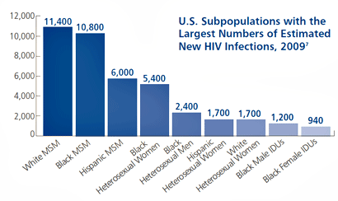
7-County Metro Area Populations
HIV Testing:
MSM (158.1 per 100,000)
Black (20.8% of Metro MSM, 3.8 rate)
Hispanic (10.1% of Metro MSM, 1.6 rate)
White (61.9% of Metro MSM, 0.8 rate)
Black Women (34.8 per 100,000)
African-American (95% in Metro)
African-Born (89% in Metro)
Transgender (13.8 per 100,000)
Syringe Exchange
MSM/IDU, 77% of all IDU in Metro
Source: http://www.cdc.gov/hiv/policies/hip/risk.html
Source: eHARS HIV Surveillance System 2013-2015
Notes:
In the 7-county metro area, there are three targeted populations for HIV testing: MSM, Black Women, and Transgender populations. Within MSM, Black, Hispanic, and white MSM are prioritized with separate funding streams. For syringe exchange, programs targeting MSM/IDU are prioritized.

Slide 42
Greater Minnesota Populations
17% of new HIV cases, need to target
HIV Testing:
All MSM (51% of all new HIV)
Syringe Exchange:
All IDU (50% IDU, 50% MSM/IDU)
Source: http://www.cdc.gov/hiv/policies/hip/risk.html
Source: eHARS HIV Surveillance System 2013-2015
Notes:
In Greater Minnesota, HIV testing will target all MSM, and syringe exchange services will target all injection substance users.

Slide 43
Importance of Good Data Reporting
Planning for RFPs and prioritization of populations for funding streams
Data requests from community based agencies so that they can apply for other funding opportunities
Evaluation of community-based testing programs
Evaluation of Minnesota as a state compared to other states
Connecting non names-based system (EvalWeb) with names-based system (eHARS) – EvalWeb ID field on case report form
Notes:
As grantees of the Minnesota Department of Health, timely and accurate reporting of data is essential to providing comprehensive HIV testing and syringe services. There are many ways that data you report to us are used to support HIV services in the state:
Data are used for planning RFPs like this one and for prioritizing populations per CDC guidelines.
Data are also used to complete requests from community based organizations and related agencies who apply for other funding opportunities.
Community-based programming is evaluated with data entered into EvaluationWeb. Making sure what you enter is correct helps us know about the great work you’re doing.
Minnesota as a state is evaluated in relation to other states by data entered into EvaluationWeb.
Complete data entry on case reports for HIV-positive tests – especially the EvalWeb ID field on the case report form – is the only way we can link EvaluationWeb and the HIV surveillance system, since EvaluationWeb is a de-identified data system with only basic demographic information.

Slide 44
What happens when we don’t report?
We cannot assure that patients linked to care and were reported as confirmed cases
Minnesota receives less federal money, because morbidity is artificially lower
Less prevention money means fewer organizations funded and at lower levels
Community-based organizations who rely on state-level data for funding applications don’t get what they need
Ultimately, communities receive incomplete/inadequate services
Notes:
So what happens when we have incomplete reporting in either EvaluationWeb or the HIV surveillance system? Unfortunately, a few things that ultimately impact HIV care and prevention services in the state, including:
Inability to assure that newly diagnosed patients from community-based testing sites are linked to care and reported as confirmed cases in the HIV surveillance system
Potentially less federal money for Minnesota, because our HIV prevalence numbers are artificially low
Less prevention money, which could lead to fewer funded organizations and lower grant awards overall
Other funding streams (like the entire Ryan White system), which rely on HIV surveillance data are underfunded because HIV prevalence is artificially low
And ultimately, communities most at risk for infection and affected by HIV receive both incomplete and inadequate services
Take-home point: data reporting is labor-intensive at both the grantee and health department levels, but critical to supporting a comprehensive response to HIV

Slide 45
Country of Birth Information
Not a CDC-required variable
But a Minnesota-required local variable
Why? Because around 25% of new HIV infections every year in Minnesota are in foreign-born populations.
With a large African-born population in Minnesota, lack of country of birth information means these people are misclassified as African-American
In most recent analyses, we were not able to separate African-born, Black and non African-born, Black populations because country of birth was only filled out around 25% of the time
Notes:
One variable in EvaluationWeb we would like to cover is the client’s Country of Birth. In racial/ethnic demographic analyses of HIV surveillance data, we often differentiate between African-born and non African-born Black populations in Minnesota. We are able to do this because the HIV case report form for positive cases asks for country of birth information. This breakdown is very important in Minnesota, because around 25% of our new HIV infections are among foreign-born populations. With a large African-born population in Minnesota, not having the country of birth variable complete in EvaluationWeb means that these clients are racially misclassified as African-American. It’s very important in the new round of grant funding that we work to make sure the country of birth variable is complete for every HIV testing event.

Slide 46
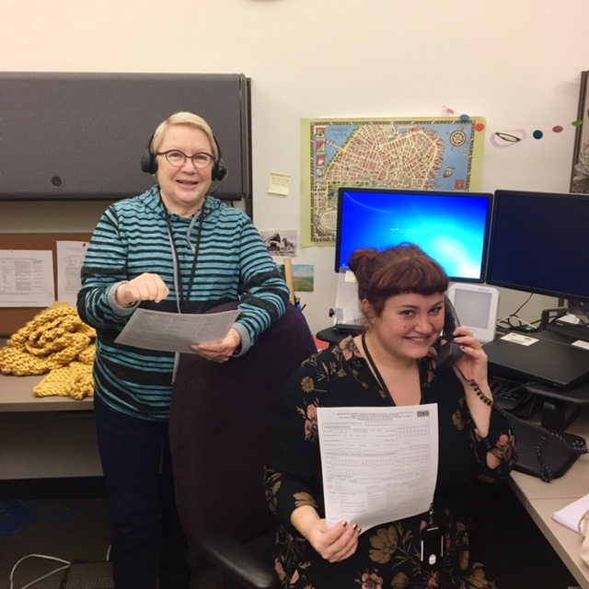
How to report a new or new-to-you case of HIV to MDH
Call Gabrielle or Sue in the HIV surveillance office:
Gabrielle Morgenstern: 651-201-3568
Sue Bedard-Johnson: 651-201-4006
Fill out an HIV case report form and submit through mail or secure FAX (651-797-1972) at this link: http://www.health.state.mn.us/divs/idepc/dtopics/reportable/forms/hivform.html
Please call these amazing people!
Notes:
As HIV prevention grantees, it is very important that you report any new or new-to-you positive results – including preliminary positives – to the Minnesota Department of Health within 72 hours of the testing event. The adult HIV case report form can be found on our website at the link on this slide. It can be submitted through either secure FAX or mail. If you have questions about how to complete the form, please contact either Gabrielle Morgenstern or Sue Bedard-Johnson in our HIV surveillance office. As a side note, Sue Bedard-Johnson will be out on leave until early April 2018.

Slide 47
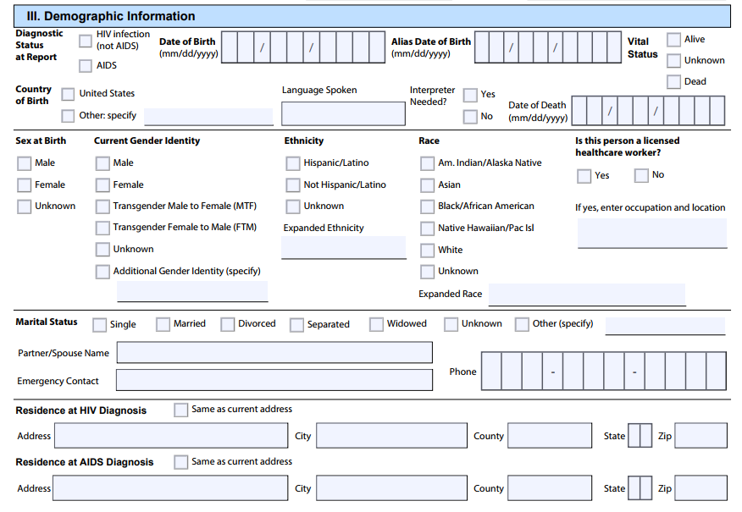
What should you fill out on the Case Report Form (1)?
Notes:
As community-based organizations, we understand that you may not have all of the information available for every field on the adult case report form; especially for a preliminary positive. We’ll briefly cover the three main sections of the form to complete for preliminary and confirmatory positives. The first section is basic demographic information about the client.

Slide 48
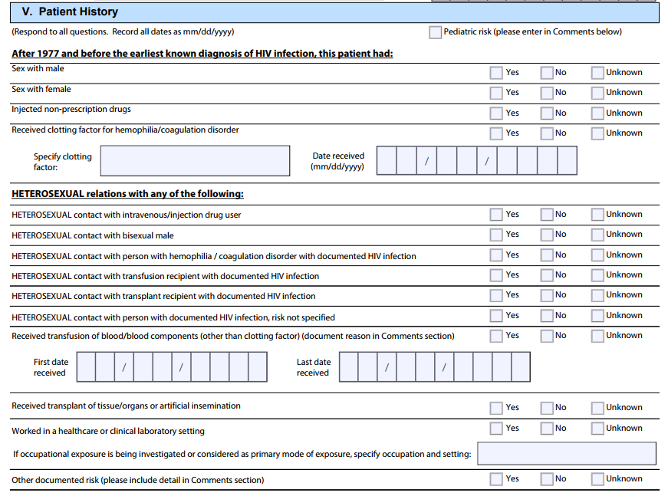
What should you fill out on the Case Report Form (2)?
Notes:
The second section of the HIV adult case report form to complete is the patient history, including all known transmission risk information.

Slide 49
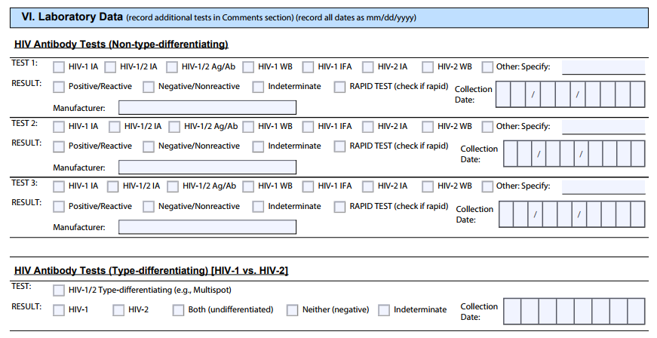
What should you fill out on the Case Report Form (3)?
Notes:
The third section of the HIV adult case report form to complete is the laboratory data. It is very important to complete the field for the manufacturer of any rapid tests you run for the diagnosis.
Please fill out any additional information you have. These three sections are the minimum we need to process a new case.

Slide 50
Why is all of this important?
Diagnosed and unreported in medical records (???)
Diagnosed and reported HIV-positive in HIV surveillance system (8500)
Ryan White Clients in CAREWare (4500)
We SHOULD receive funding based on this number
Unaware
We receive funding based on this number
Notes:
So, why is all of this important? We currently have around 8500 people in the HIV surveillance system in Minnesota (represented by the dark blue circle). Around 4500 of those are receiving Ryan White services in any given year (represented by the smaller purple circle(. We know that there are gaps in reporting, so there is a theoretical HIV positive population that is larger (represented by the largest dark green circle). We currently receive HIV funding in the state based off the 8500 number, when we really should receive funding based on the number of diagnosed and unreported cases. But this is where you – as a grantee – can help. By diagnosing new infections in the unaware population, you can assure that those clients are reported to the health department and connected with services like Ryan White if eligible.

Slide 51
Thank you!
Jared Shenk, MPH
jared.shenk@state.mn.us
Notes:
Contact Jared with any questions about prioritized populations or data reporting.

Slide 52
HIV Pre-Exposure Prophylaxis (PrEP) Integration
Japhet M. Nyakundi, MSW| PrEP Coordinator
2018

Slide 53
What is PrEP?
“PrEP” stands for pre-exposure prophylaxis
A fixed-dose combination HIV medicine - (tenofovir – 300m and emtricitabine – 200m) - Truvada® for PrEP.
USA FDA approved on July 2012 as PrEP
One pill taken once daily regardless of plans for sex
As part of a comprehensive HIV prevention plan with other safer sex practices
Studies have shown that PrEP is safe and highly effective and can reduce risk of HIV infection when taken as prescribed.
PrEP does not protect against other STDs
Notes:
PrEP stands for pre-exposure prophylaxis. Prophylaxis means taking a drug or drugs before exposed to an organism that could cause an infection.
On July 2012, the USA Food and Drug Administration (FDA) approved a fixed-dose combination HIV medicines in one pill taken once daily known as Truvada® as PrEP for HIV-negative individuals at high risk to prevent them from acquiring HIV.
PrEP is part of a comprehensive HIV prevention plan that includes regular HIV testing, periodic STIs screening, drug safety, adherence support and condoms use to prevent STDs and other prevention methods.
Studies have shown that daily PrEP reduces the risk of getting HIV from sex by more than 90% and by more than 70% among people who inject drugs. But PrEP does not protect against other sexually transmitted infections (STIs).

Slide 54
Who can benefit from taking PrEP?
Federal guidelines recommends PrEP for people without HIV who are at very high risk for getting it from sex or injection drug use.
Sexually active men who have sex with men
Sexually active heterosexual men and women
People who inject drugs (PWID)
Partners in mixed – status couples, including heterosexual couples seeking natural conception
Notes:
According to Centers for Disease Control and Prevention (CDC), PrEP may benefit people without HIV wo are at very high risk for getting it from sex or injection drug use. Specifically for:
Sexually active men who have sex with men
Sexually active heterosexual men and women
People who inject drugs
Partners in mixed status couples including heterosexuals couples seeking natural conception.

Slide 55
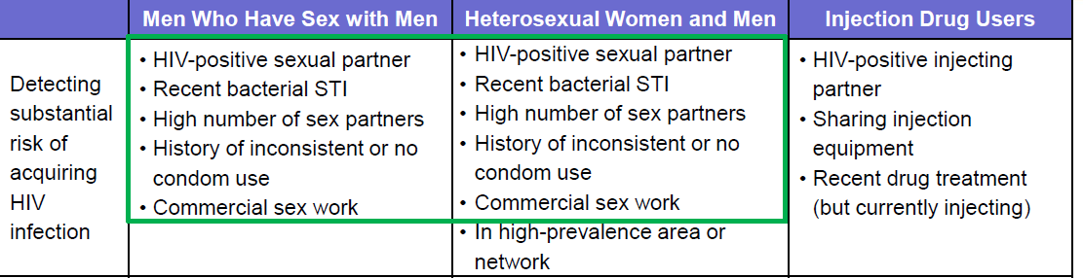
Who can benefit from taking PrEP? cont.
Notes:
According to CDC, PrEP may benefit a person if HIV-negative and any of the following apply and are gay/bisexual/heterosexual/ inject drugs and:
have an HIV-positive partner
Recently had a sexually transmitted infection (STI)
have multiple partners, a partner with multiple partners or a partner whose HIV status is unknown
have history of inconsistent condom use
engaging in commercial sex work
share needles or equipment to inject drugs
recently went a drug treatment program

Slide 56
What are the goals of PrEP integration?
Promoting education, awareness, access and use
Screening for HIV risk and assessing individuals who may be eligible for PrEP
Actively referring/linking PrEP –eligible and interested with PrEP providers
Identifying individuals who are vulnerable to HIV infection
Tracking and reporting individuals actively referred or linked with PrEP providers
Notes:
Overall, PrEP integration can be viewed as an ongoing continuum of point of care delivery that include: promoting, identifying and screening individuals at risk, actively referring individuals eligible and willing with PrEP providers, documenting referrals and reporting.

Slide 57
How does PrEP integrated Process look?
Organization Capacity – conduct PrEP training.
HIV Result – Negative: offer condom & risk reduction and PrEP referrals as appropriate
PrEP Referrals –for clients interested, eligible and at risk, follow-up referrals
Testing Outreach – promote PrEP use consumer materials
Point of Care – CTR /or Syringe services HIV Testing include PrEP risk assessment
Data collection – Evaluation Web
Notes:
Organization capacity is critical in PrEP integration that include trained and competent staff and PrEP is fully incorporated into all program protocols. Where PrEP becomes part of the program that is seamless promoted to consumers including conducting PrEP risk assessment during Counseling testing and referral (CTR), encouraging condom use and other risk reduction strategies, actively referring, collecting data and entering into Evaluation-web.

Slide 58
How do you monitor PrEP activities?
Inquiry from every client getting an HIV-negative test, about PrEP awareness, current/or past PrEP use
Has the client ever heard of PrEP?
Is the client currently taking daily PrEP methods?
Has the client used PrEP anytime in the last 12 months?
HIV Testers are expected to:
Screen for PrEP eligibility
Provide referrals for individuals eligible for PrEP
Provide referrals to PrEP providers
Provide services to assist with linkage to a PrEP providers
Notes:
The monitoring of integrated PrEP activities is extremely important to knowing the extent of PrEP use in the state. For every client getting an HIV test shall be asked whether they have ever heard of PrEP, are currently taking PrEP or used PrEP anytime in the past 12 months.
Also, the HIV Testers shall document responses to these four questions into the EvaluationWeb. Was the client:
screened for PrEP eligibility?
eligible for PrEP referral?
Referred to a PrEP provider?
Provided services to assist with linkage to a PrEP provider?

Slide 59
Thank you!
Japhet M. Nyakundi, MSW.
Japhet.nyakundi@state.mn.us
651-201-4030
Notes:
Contact Japhet with any questions about PrEP.

Slide 60
Undetectable = Untransmittable (U=U)
Mariah Wilberg | Communications Specialist
Notes:
Hello, my name is Mariah Wilberg and I am a Communications Specialist at MDH. Today I will be covering the Undetectable=Untransmittable, or U=U campaign. Minnesota became the third state to endorse this international campaign last October.

Slide 61

Antiretroviral Therapy
HIV medication is so effective that is causes the amount of HIV in the body to be too low to measure, or undetectable.
This keeps the immune system working properly and allows people living with HIV (PLWH) to live long, healthy lives.
It can also prevent HIV transmission.
Notes:
For most of you this is review, so just a refresher on HIV medications or antiretroviral therapy. They are so effective that when take daily as prescribed, people living with HIV have long and healthy lives. We also know that effective treatment preventions transmission

Slide 62
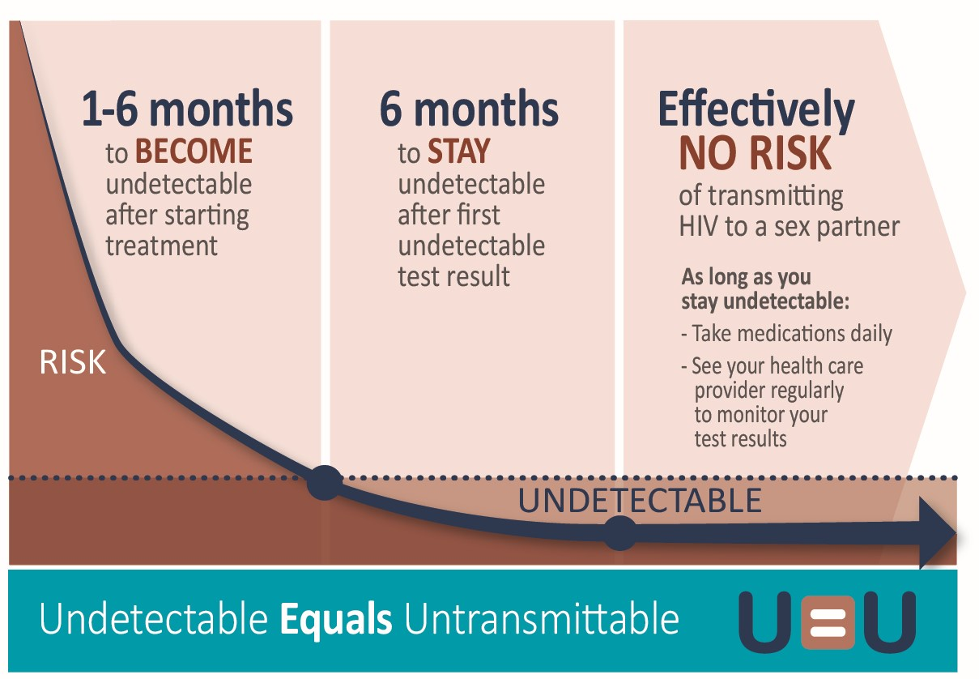
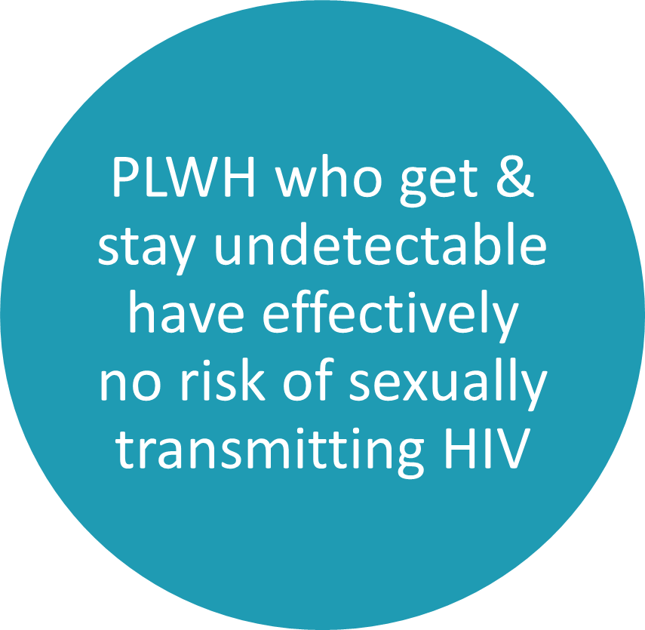
Undetectable=Untransmittable
Notes:
U=U is based of the scientific consensus that people living with HIV who get and stay undetectable have effectively no risk of transmitting HIV to a sex partner. To use this prevention strategy a person should get undetectable, which can take up to 6 months. They should have a second undetectable viral load test 6 months after, and then there’s effectively no risk of transmission as long as they stay undetectable by taking meds daily and getting ongoing screening from their provider

Slide 63

The Evidence
HPTN 052
1763 mixed status couples
PARTNER
1166 mixed status couples
58,000 sex acts (condom & PrEP-less)
Opposites Attract
358 mixed status couples
17,000 sex acts
Notes:
Evidence for U=U has been accumulating since the 1990’s, and within the last few years several large studies were completed and published. These 3 studies had over 70,000 sex acts among over 3000 couples, and ZERO cases of HIV transmission from a person living with HIV who was undetectable. There has never, in the history of HIV, been a single case of documented transmission from a person who is undetectable.

Slide 64




U=U Campaign
PLWH are not getting this message consistently from providers
So it’s up to us to take the lead and educate people about U=U
Knowledge that U=U will reduce stigma for PLWH and their loved ones
It can also provide incentive for PLWH get and stay in care.
Notes:
We are hearing anecdotally that people are not getting this message consistently from providers. U=U represents a huge paradigm shift, we have to expand our definition of safe sex beyond the condoms only messaging that has dominated HIV prevention for the entire epidemic. Also, some providers may only share with clients that they trust—perhaps clients that don’t have adherence challenges or barriers to health care. This perpetuates health disparities as the people and communities most impacted by HIV in Minnesota may have the least knowledge about this prevention strategy.
So its up to us to take the lead and educate. MDH campaign activities include: internal capacity building, such as incorporating U=U across different units and programs at MDH, identifying and educating partners, such as yourself, a bus campaign that’s currently running in the Metro area, developing a webpage and other products like fact sheet, infographics, and clinic posters, and we will be promoting U=U at all events this year. We will be sending educational materials to you as they are completed.
U=U can be transformative for people living with HIV. It stops stigma in it’s tracks, it can reduces or eliminates much of the stigma and shame that people can feel after an HIV diagnosis and it changes how people in general think about HIV..
Finally, U=U can be a huge incentive for people living with HIV to get and stay in care.

Slide 65

Key Messages
Adherence is key—encourage PLWH to take their meds daily and have ongoing viral load monitoring
U=U is only one tool in the HIV prevention toolbox. People may choose to use one or more strategies depending on needs
U=U applies only to sexual transmission of HIV, not perinatal or IDU transmission
U=U does not protect against STDs/pregnancy
Notes:
When discussing U=U the most important part is adherence. People need to stay undetectable by taking meds daily and staying in care so they can have their viral load monitored regularly
U=U is only one tool in the HIV prevention toolbox. We support ALL evidence-based prevention methods, such as U=U, condoms, and PrEP. People may choose to use one or more strategies depending on their needs. They may want to consider their partner or partners HIV status, and if living with HIV their viral load, whether or not preventing pregnancy or other STDs is a concern, and comfort level. HIV prevention is not a one size fits all approach.
U=U applies only to sexual transmission of HIV. While being undetectable is a large part of preventing perinatal transmission, there are the additional steps of not breastfeeding and the infant receiving prophylaxis. As for injection drug use transmission, there isn’t enough data. We can however, say that being undetectable is presumably offers risk reduction regrading IDU transmission.
Finally, U=U prevents HIV only, not other STDs or pregnancy

Slide 66

For More Information
Undetectable = Untransmittable (U=U), MDH
10 Things to Know about HIV Suppression, NIAID
Prevention Access Campaign
U=U taking off in 2017, The Lancet
HIV Treatment as Prevention, CDC
HIV U=U Information for Providers, NYC Health
The evidence for U=U: why negligible risk is zero risk
Notes:
I hope that we’ve inspired you, and that you are ready to be a U=U champion. I’ve included a slide with the best U=U resources that I’ve found on the web. It includes our page, CDC’s page, 10 things to know about viral suppression which has a short educational video, the Prevention Access Campaign, who founded U=U has a robust frequently asked questions section and you can also sign on as a community partner like MDH did, and there are frequently asked questions for patients and providers available from the New York City Health Department, among other resources.
I will also be sending you key messages and talking points for U=U, a language guide, and other resources.

Slide 67
Thank you!
Mariah Wilberg
Mariah.Wilberg@state.mn.us
651-201-5096
Notes:
Please contact Mariah with questions about U=U.

Slide 68
HIV-Related Materials Review Panel
McKinzie Woelfel, MPH
HIV & STD Prevention Planning Coordinator
Minnesota Department of Health
Notes:
Hello my name is McKinzie Woelfel and I am the HIV & STD Prevention Planning Coordinator at the Minnesota Department of Health. I’m going to do a brief overview of the HIV-Related Material Review Panel. This panel was recently called the AIDS Material Review Board (AMRB) which many of you will be familiar with.

Slide 69
HIV-Related Educational Materials Review Panel
The Center for Disease Control (CDC) requires that HIV-related educational materials with educational content, to be used in a MDH or CDC-direct funded HIV Prevention Project, must be submitted to MDH and be approved by a review panel before being used.
Notes:
The Center for Disease Control (CDC) requires that HIV-related educational materials with educational content, to be used in a MDH or CDC-direct funded HIV Prevention Project, must be submitted to MDH and be approved by a review panel before being used.

Slide 70
Materials Review Procedure
Visit HIV-Related Education Materials Review
(www.health.state.mn.us/divs/idepc/diseases/hiv/grantee/materialsreview.html)
Complete the HIV-Related Educational Materials Approval Request Form for each item being submitted
Send an electronic copy or link of the item to be reviewed and the corresponding form to health.hivprevention@state.mn.us
If the item is in physical form only, mail to HIV Prevention Unit, Minnesota Department of Health P.O. Box 64975, St. Paul, MN. 55164-0975
This process can take 2-4 weeks so please plan ahead
Notes:
The materials review procedure can be found at http://www.health.state.mn.us/divs/idepc/diseases/hiv/grantee/materialsreview.html
The process is fairly simple. Each item that needs review must be submitted with a copy of the HIV-Related Educational Materials Approval Request form. This form is found on the website address listed above.
Items can be submitted by email if in electronic from or mail if in physical form. Please plan ahead as this process will likely take between 2-4 weeks.

Slide 71
Materials That Require Review
Materials to be reviewed include any educational materials to be used in a MDH or CDC-direct funded HIV Prevention Project, including written materials, audio visuals, pictorials, newsletters, questionnaires, website & app content and curriculum.
This includes materials created by the grantee or acquired from other sources.
The complete list of what does and does not need review can be found on the HIV-Related education Materials Review webpage
Notes:
Materials to be reviewed include any educational materials to be used in a MDH or CDC-direct funded HIV Prevention Project, including written materials, audio visuals, pictorials, newsletters, questionnaires, website & app content and curriculum.
This includes materials created by the grantee or acquired from other sources.
The complete list of what does and does not need review can be found on the HIV-Related education Materials Review webpage

Slide 72
Thank You!
McKinzie Woelfel, MPH
McKinzie.Woelfel@state.mn.us
Notes:
If you have any questions about the review process please contact McKinzie Woelfel at mckinzie.Woelfel@state.mn.us.

Slide 73
Thank you!
Health.hivprevention@state.mn.us
651-201-5414
Notes:
If you have further questions you can contact either the person directly, or use this general HIV Prevention email and phone number.

