Slide 1
Rapid-Rapid Point of Care Testing
Peggy Darrett-Brewer HIV Testing Coordinator
July 13, 2018

Slide 2
Rapid-Rapid Point of Care Testing
Peggy Darrett-Brewer HIV Testing Coordinator
July 13, 2018

Slide 3
National HIV/AIDS Strategy
National HIV/AIDS Strategy Goal 4: Achieving A More Coordinated National Response To The HIV Epidemic
Indicator 4: Increase the percentage of newly diagnosed persons linked to HIV medical care within one month of
their HIV diagnosis to at least 85 percent.
Notes:
National HIV/AIDS Strategy
According to the Minnesota HIV Continuum of Care 2016, 83% of 301 people (251) were linked to HIV care. With the rapid-rapid HIV testing method we are linking positive individuals much sooner than preliminary point of care HIV testing which increases chances of patient being linked to care within one month.

Slide 4
What is Rapid-Rapid Point of Care Testing?
Utilizing one rapid HIV testing technology to identify a reactive or preliminary positive result.
Confirming the above mentioned positive result with a second testing technology.
Linking the patient to HIV primary care.
Notes:
What is Rapid-Rapid Point of Care Testing?
It is utilizing one rapid HIV testing technology to identify a reactive or preliminary positive result;
Then confirming the above mentioned positive result with a second testing technology, and;
Lastly, linking them to HIV primary care.

Slide 5
Generations HIV Testing Technology
4th Generation
Notes:
Generations HIV Testing Technology
Fourth-generation HIV tests are the latest crop of screening tools for the disease. Earlier-generation HIV tests worked by identifying HIV antibodies—proteins produced by the immune system when it detects HIV—in the bloodstream. Fourth-generation tests, on the other hand, work by not only detecting HIV antibodies but also detecting p24 antigen, a protein that is found in the virus itself.

Slide 6
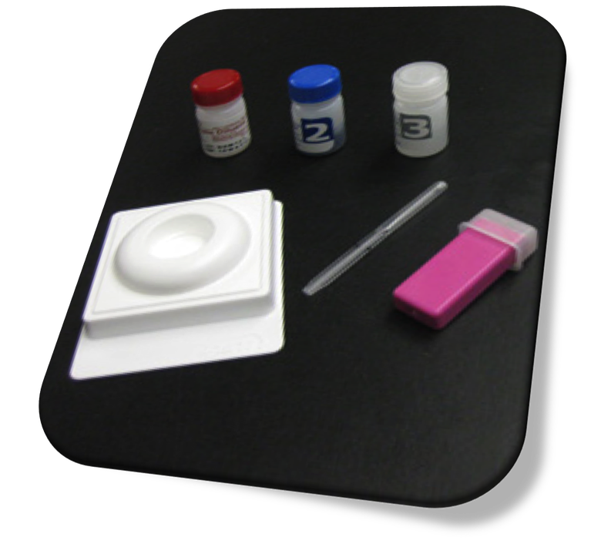
Generations HIV Testing Technology Continued
Notes:
Generations HIV Testing Technology
2nd and 3rd gen tests detect antibodies.
2nd generation test: It takes the body three month to create enough antibodies to be detected in 2nd gen test.
3rd generation test: It takes the body 4-6 weeks to create enough antibodies to be detected by a 3rd generation test.

Slide 7
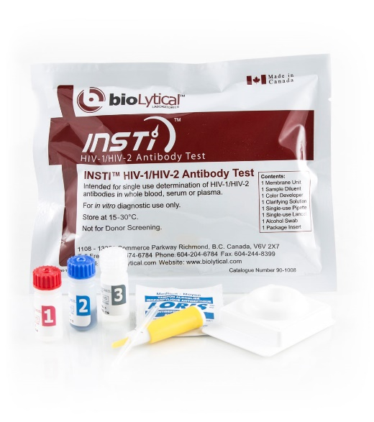
Minnesota Department of Health Recommended Test Technologies
INSTI HIV-1/HIV-2-BioLytical
3 Generation Test
CLIA Waived
Stable- stores at 59-86F
Instant-processes in 60 seconds
Sensitivity/Specificity:
Finger Stick Sensitivity 99.8%
Finger Stick Specificity 99.5%
Notes:
Minnesota Department of Health Recommended Test Technologies
INSTI HIV-1/HIV-2-BioLytical
3 Generation Test
CLIA Waived
Stable- stores at 59-86F
Instant-processes in 60 seconds
Sensitivity/Specificity:
Finger Stick Sensitivity 99.8%
Finger Stick Specificity 99.5%

Slide 8
Minnesota Department of Health Recommended Test Technologies Continued
Alere Determine HIV-1/2 Ag/Ab Combo Kit
Tests for both antibodies and antigens
Diagnosis acute infection
Processes in 20 minutes
99.9% overall clinical sensitivity for all samples
Notes:
Minnesota Department of Health Recommended Test Technologies
Alere Determine HIV-1/2 Ag/AB Combo Kit
Tests for both antibodies and antigens
Diagnosis acute infection
Processes in 20 minutes
99.9% overall clinical sensitivity for all samples

Slide 9
Window Period (Pg. 19)
Notes:
No test can detect HIV immediately after infection. The time between when a person gets HIV and when a test can accurately detect it is called the window period. The window period varies from person to person.
Most tests are antibody tests. Antibodies are produced by your immune system when you’re exposed to viruses like HIV or bacteria.
Antibody Tests
The soonest an antibody test will detect infection is 3 weeks.
4th Gen Tests
A combination or fourth gen test look both HIV antibodies and antigens. Antigens are foreign substances that cause your immune system to activate. The antigen is a part of the virus itself and is present during acute HIV infection. Most people will make enough antigens and antibodies for fourth-generation or combination tests to accurately detect infection (14-15days) after infection.
Nucleic Acid Test RNA
NAT look for HIV in the blood. It looks for the virus and not the antibodies to the virus. It is expensive and not routinely used for screening unless they had a high risk exposure. Most, but not all people will have enough HIV in their blood for a nucleic acid test to detect between (10days)

Slide 10
What you will need to do this work?
To do this work your will need the following:
Client Consent
Release of Information
Testing Log
Provider Agreements and Expectation
Notes:
What will you need to do this work?
Client Consent Client must give consent for testing. The consent should cover the test process, confidentiality vs., anonymous testing, the widow period, and explain that if rapid-rapid testing, the confirmatory can be given on the spot.
Release of Information s needed to inquire about client’s in-care status.
It is required that you update in Evaluation Web all preliminary and or confirmed testing events for confirmatory and linkage to care.
Testing Log – Should track the following: Evaluation Web Form ID, Client ID, Test Temperature, Specimen Type (finger stick), Kit Name and Lot #, Kit Expiration #, Test Start Time/Read Time, Test Result1 (Preliminary), Test Result 2 (Confirmed), Tester Initials, Time Client Given Result, Client Linkage to Care Date
Provider Agreements and Expectation - The purpose of the agreement is to ensure HIV testing grantees provide active referrals through formal provider agreements. This agreement should be with social service agencies, HIV providers, mental health providers ect.

Slide 11
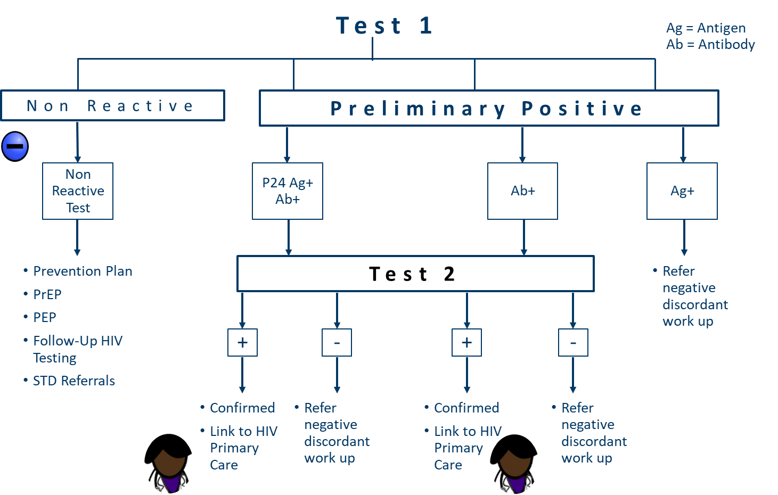
Rapid-Rapid Testing Algorithm
Notes:
Rapid-Rapid Testing Algorithm- Utilizing the 4th Generation test and the INSTI test.
Preliminary Positive: Scenerio # 1: 1. Antigen/Antibody with 4th generation test, positive; 2. Run a second testing technology INSTI test to confirm 3. If INSITI is negative, send out as discordant work-up, if INSTI is positive link to HIV primary care. Scenerio # 2: 1. 4th Generation Antibody positive; 2: If INSTI is positive, refer patient into HIV primary care. Scenario #3: 4th Generation Antibody Positive, INSTI negative refer for discordant work-up; Scenerio #4: 4th Generation Antigen positive, send out for confirmatory testing, there isn’t another rapid antigen testing technology available.

Slide 12
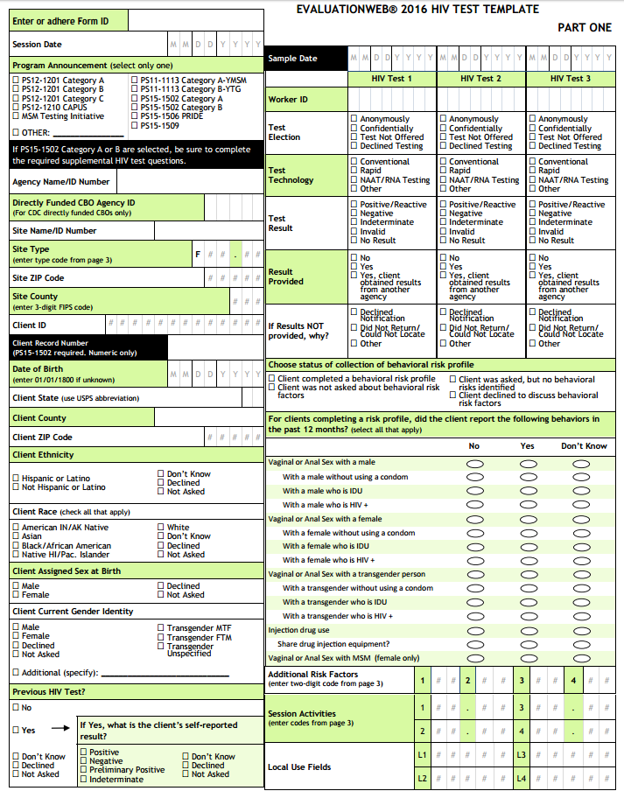
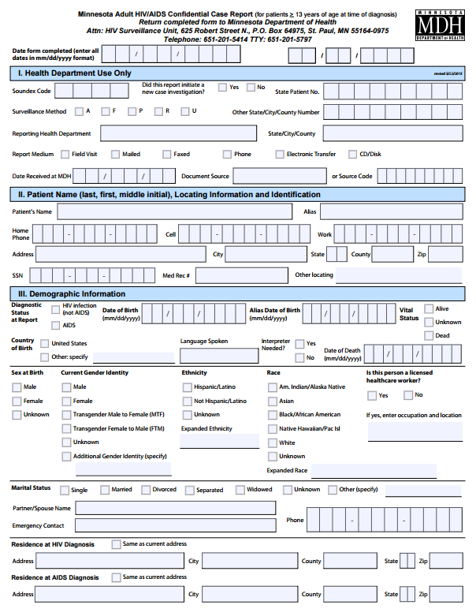
Reporting a Positive Result
With a positive result, you are required to notify MDH two ways – EvaluationWeb and HIV Case Report.
Notes:
When you have a positive result, you are required to notify MDH two ways: via Evaluation Web and through HIV Surveillance System on a HIV Case Report form.

Slide 13
Evaluation Web Reporting
The Center for Disease Control (CDC) has new and modified variables for the 2018 HIV testing template.
All organizations should be using the new templates by December, 2018.
Letters sent in May, 2018 outlined these changes with a timeline. If you did not receive this letter please contact the HIV Testing Coordinator.
Keys to Evaluation Web reporting.
All data should be entered by the 23rd of each month.
Completely answer all variables within testing variable. Some data, you may not know, so please indicate with the “Don’t Know”, selection. At the end of the year, CDC will present MDH with a report with all missing variables in Evaluation Web.
If you need to be e-authenticated or for any questions or issues you may have with Evaluation Web, contact Tina Klein at 651 201-4022.
Notes:
Evaluation Web Reporting (if you are a MN Department of Health Testing Grantee there are changes on the horizon)
New Variables-the Center for Disease (CDC) control has new, deleted, and modified variables for 2018 HIV testing template. All should be utilizing the new templates by December of 2018. Letters were sent out in May of 2018 outlining changes along with a timeline for changes. If you didn’t receive this letter please let me know.
No let’s discuss some key things to remember with Evaluation Web reporting:
All data should be entered by the 23rd of each month
Please, completely answer all variables asked. There may be some data you do not know that should be indicated with the “Don’t Know”, selection.
We need data to be thorough as it is used for our funding prioritization process and at the end of the year CDC will present MDH with a report with all missing variables in Evaluation Web.
If you need to be e-authenticated contact Tina Klein at 651 201-4022, or for any questions or issues you may have with Evaluation Web.

Slide 14
Case Reporting
As per the Minnesota Communicable Disease Rule 4605: HIV, both a case (confirmed positive) or suspect case (preliminary positive), must be reported via confidential fax. Case reports must be submitted within 72 hours of the testing event.
Case reporting details:
Case report forms should be sent to MDH’s Epidemiology & Surveillance Unit, attention Sue Bedard-Johnson, or Gabrielle Morgenstern at confidential fax (651) 797-1972.
A copy should be sent to the HIV Testing Coordinator with the Evaluation Web “Form ID” written at the top of the page. Fax copy to (651) 201-4011.
Notes:
Case Reporting
As per the Minnesota Communicable Disease Rule 4605, HIV both a case which is a (confirmed positive) or suspect case which is a (preliminary positive), must be reported via a case report form to a confidential fax to the Minnesota Department of Health’s Epidemiology & Surveillance Unit at (651) 797-1972, attention Sue Bedard-Johnson or Gabrielle Morgenstern. Case reports must be submitted within 72 hours of the testing event.
Important things to remember about case reporting:
Case Report forms should be sent attention Sue Bedard-Johnson, or Gabrielle Morgenstern at confidential fax (651) 797-1972.
A copy should be sent to the HIV Testing Coordinator with the Evaluation Web “Form ID” written at the top of the page. Fax to (651) 201-4011. Particularly important as certain variables pertaining to Partner Services and Surveillance will need to be updated by the HIV Testing Coordinator and this information cannot be updated without the “Form ID”.

Slide 15
Minnesota Department of Health Partner Services How you can help?
The Partner Services Program has been negatively labeled previously due the invasive nature of the work and a lack of knowledge of roles. However, Partner Services actually serves the community by discreetly intervening in the spread of HIV and STD’s. Here is how you can help spread this message.
Understand the facts about the service. The Partner Services Program provides positive individuals the following options to be performed by representatives:
Inform partners in a sensitive, discreet, and private way
Provide HIV & STD testing and referrals
Protect privacy, identity, and personal information
Answer questions and offer options
Notes:
Minnesota Department of Health Partner Services How you can help?
In the past the Partner Services Program representatives were negatively labeled due the invasive nature of the work, as well as a lack of knowledge of Partner Services roles and responsibilities. When in fact the Partner Services Program serves the community by discreetly intervening in the spread of HIV and STD’s. Here is how you can help extend our reach into community to help stop the spread of HIV and STD’s:
By understanding and knowing the facts about the service. The Partner Services Program provides positive individuals the following options. They will:
Inform partners in a sensitive, discreet, and private way
Provide HIV & STD testing and referrals
Protect privacy, identity, and personal information
Answer questions and offer options
Provide PrEP information and referrals

Slide 16
Minnesota Department of Health Partner Services How you can help? Contd.
2. Collect any data that positive patients are willing to give about their partners. Please note any of the following information in the comment section of the Case Report form.
Name (first, last and nicknames)
Address
Phone numbers
Partners race, age, sex, and DOB
Date of last exposure
Notes:
Minnesota Department of Health Partner Services How you can help? Contd.
You Can Also Help By:
By collecting any data positive patients are willing to give on their partners. Please any of the following information you collect in the comment section of the Case Report form:
Name (first, last and nicknames)
Address
Phone numbers
Partners race, age, sex, and DOB
Date of last exposure

Slide 17
The Importance of Active Referrals w/ Rapid-Rapid Method of Testing
As a rapid-rapid point of care testing facility, your agency must work closely with mental health, HIV, social service, and chemical dependency providers. It is important for your agency to make active referrals. Begin by:
Assessing client needs: Determine what clients need and eliminate any barriers to care.
Plan referring: Determine referral agency or provider and take client’s culture, sexual orientation, language, and age into consideration.
Providing access referrals: Know times of operation, provider’s cultural sensitivity and LGTBQ inclusiveness, and transportation needs.
Following-up: Ensure client made an appointment.
Notes:
The Importance of Active Referrals w/ Rapid-Rapid Method of Testing
It is important as a rapid-rapid point of care testing facility that your agency work closely with, mental health, HIV, social service, and chemical dependency providers. It is important that your agency can make active referrals. Begin by:
Assessing client needs- determining what the clients needs and through this assessment eliminating any barriers to care
Plan referral- determine referral agency or provider based on client needs assessment. Taking into consideration, client’s culture, sexual orientation, language, age.
Access Referrals- knowing times of operation, providers cultural sensitivity and LGTBQ inclusiveness, and transportation needs
Follow-up-ensuring client made appointment

Slide 18
Summary
Rapid- Rapid method of testing allows you to diagnose HIV at point of care, which means clients can be linked directly to care.
You need:
Two separate testing technologies
Consent for Testing
Formal Provider Agreement
Release of Information
Establish Active Referrals
Report positives to the Minnesota Department of Health’s Surveillance Unit via case reporting
Notes:
Summary
Rapid- Rapid method of testing diagnosis HIV at point of care, client’s can be linked directly to care.
You need:
Two separate testing technologies
Consent for Testing
Formal Provider Agreement
Release of Information
Establish Active Referrals

Slide 19
Questions
Notes:
Questions

Slide 20
Thank You!
Sue Bedard-Johnson
Surveillance Unit
651 201-4006
Gabrielle Morgenstern
Surveillance Unit
651 201-3568
Peggy Darrett-Brewer
HIV Testing Coordinator
651 201-4011
Notes:
Thank you!
Sue Bedard-Johnson
Surveillance Unit
651 201-4006
Gabrielle Morgenstern
Surveillance Unit
651 201-3568
Peggy Darrett-Brewer
HIV Testing Coordinator
651 201-4011

