Slide 1
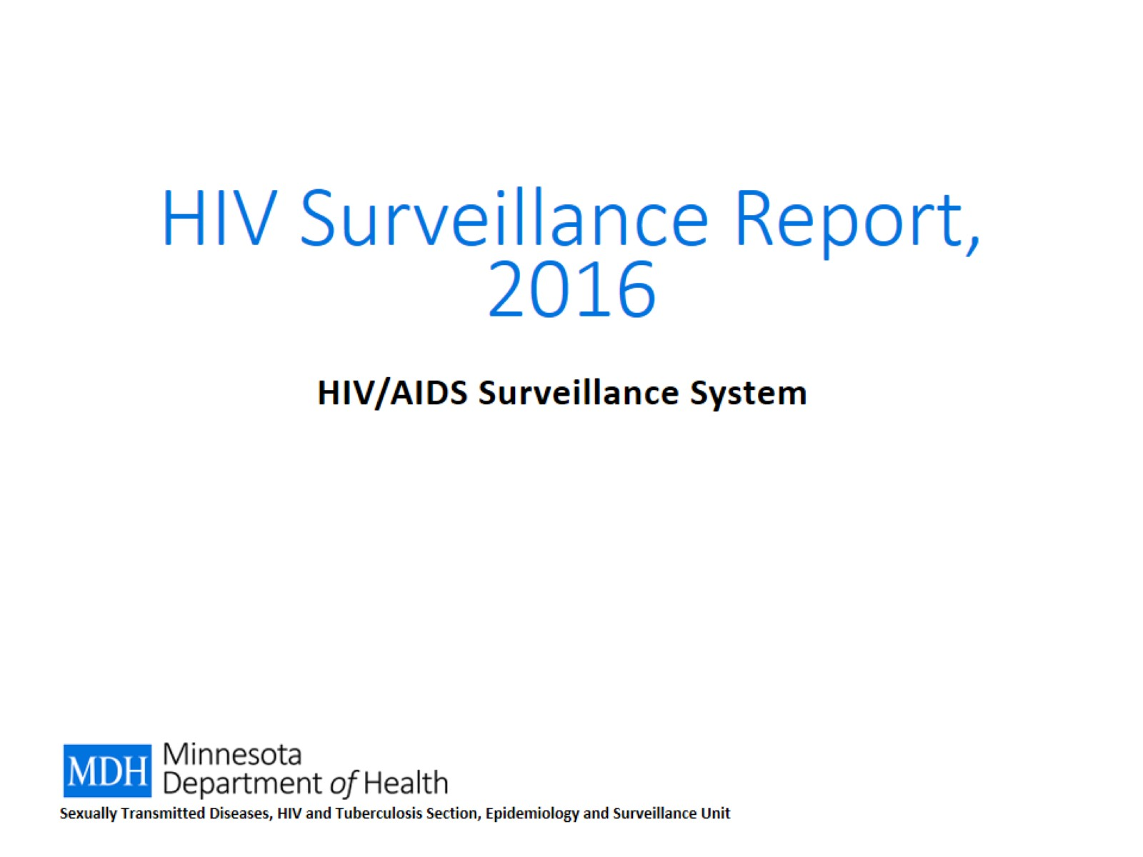
HIV Surveillance Report, 2016

Slide 2
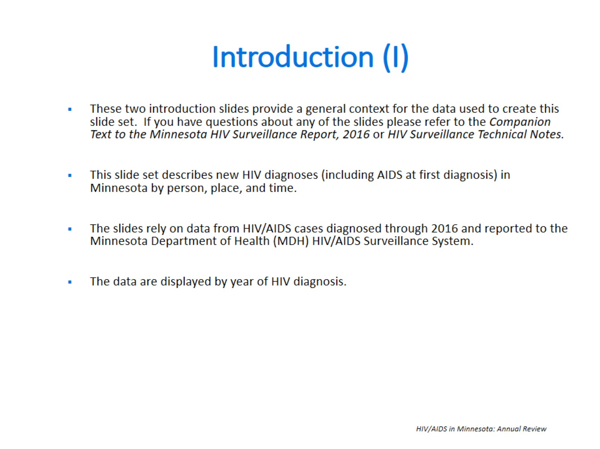
Introduction (I)

Slide 3
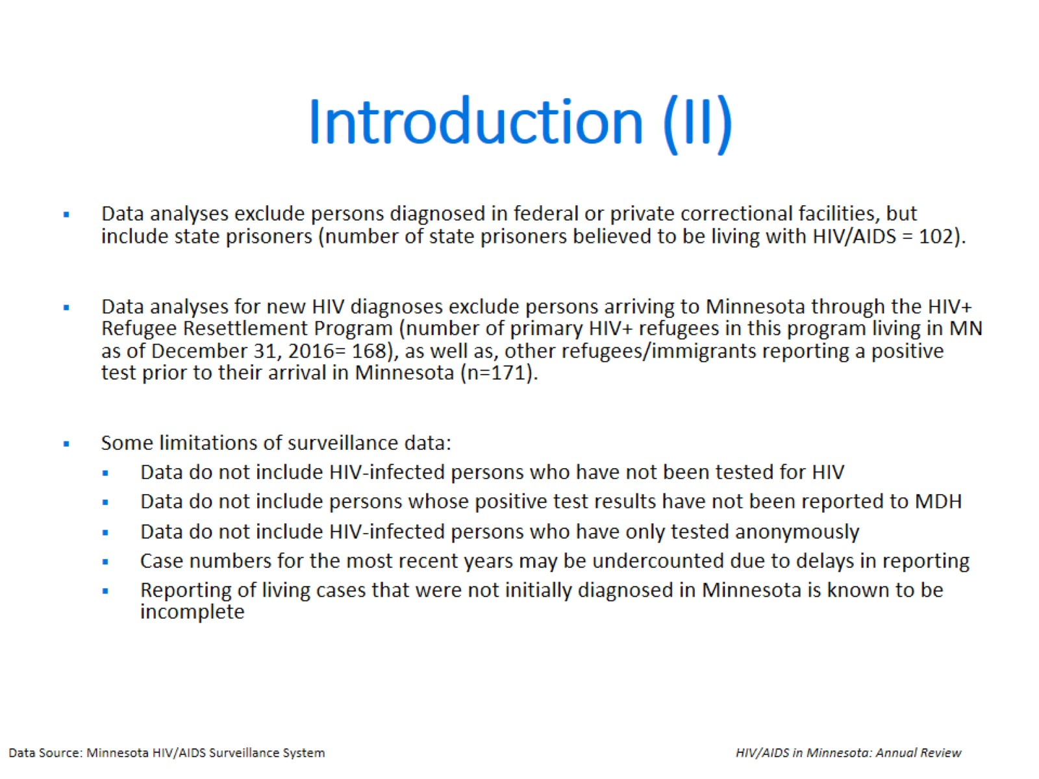
Introduction (II)

Slide 4


Slide 5
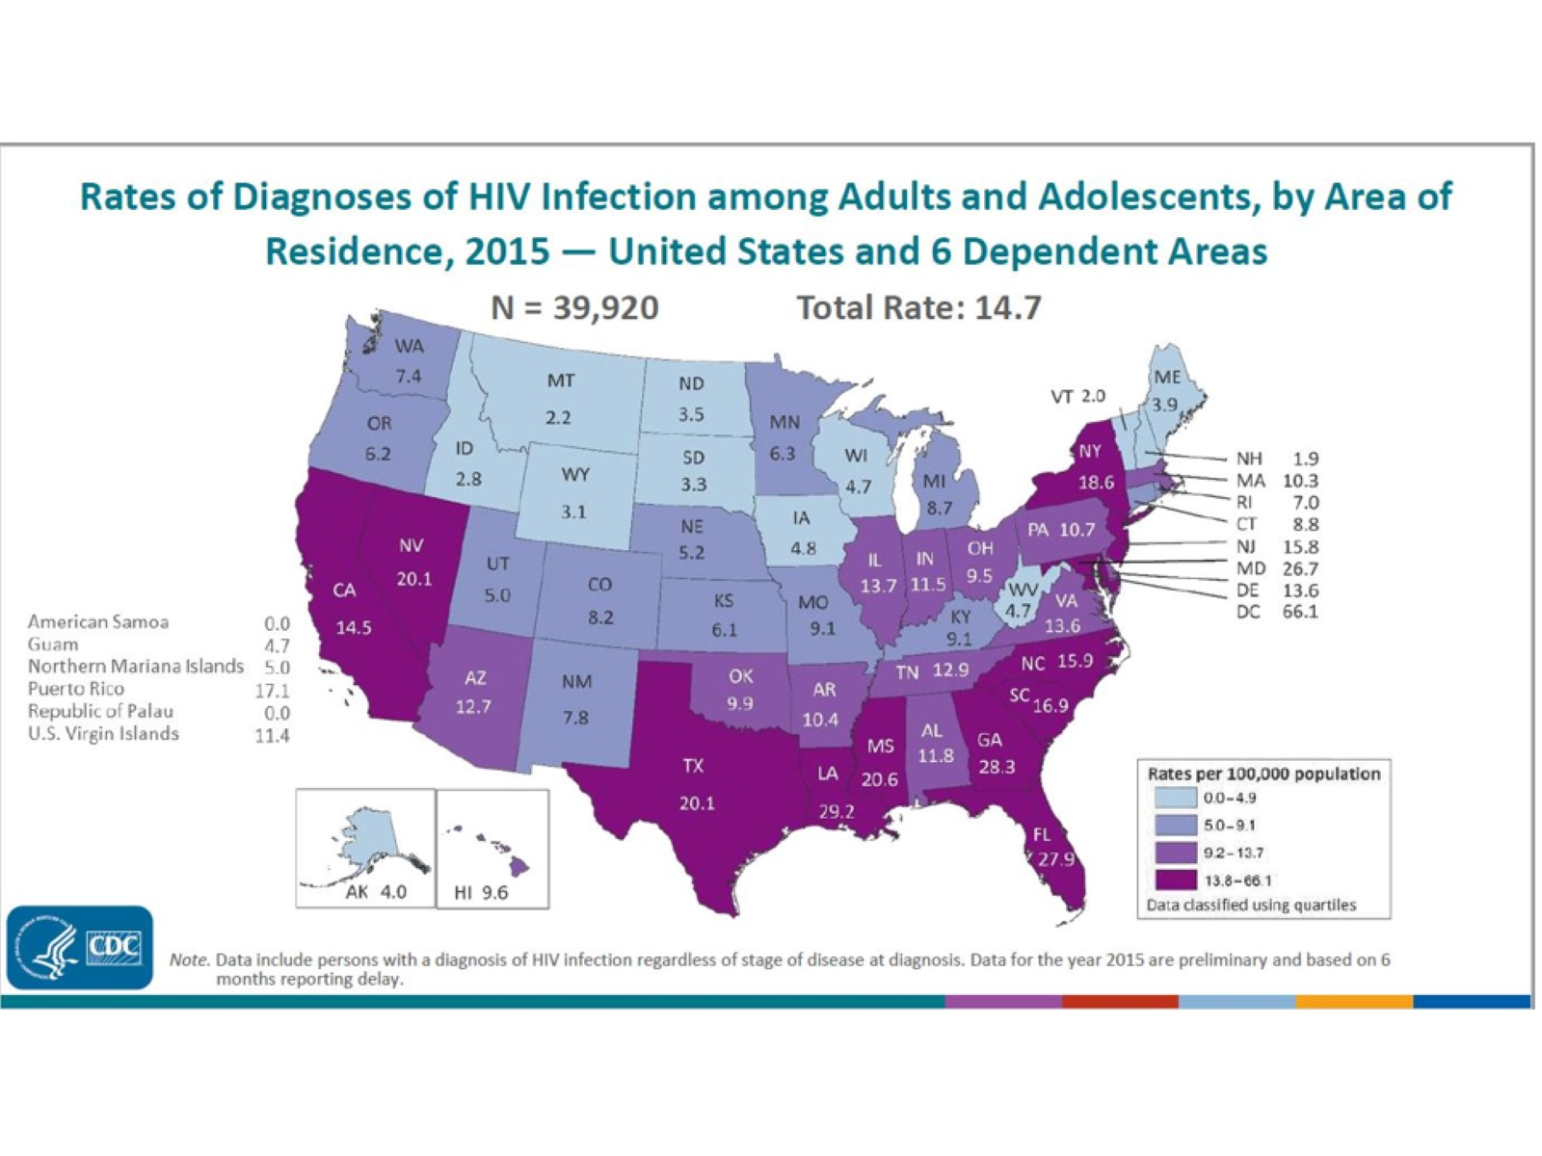
Notes:
In the United States and 6 dependent areas, the estimated rate of diagnoses of HIV infection among adults and adolescents was 14.7 per 100,000 population in 2015. The rate of diagnoses of HIV infection for adults and adolescents ranged from zero per 100,000 in American Samoa and the Republic of Palau to 66.1 per 100,000 in the District of Columbia.
The District of Columbia (i.e., Washington, DC) is a city; use caution when comparing the HIV diagnosis rate in DC with the rates in states.
Data include persons with a diagnosis of HIV infection regardless of stage of disease at diagnosis. All displayed data are estimates. Estimated numbers resulted from statistical adjustment that accounted for reporting delays, but not for incomplete reporting.

Slide 6
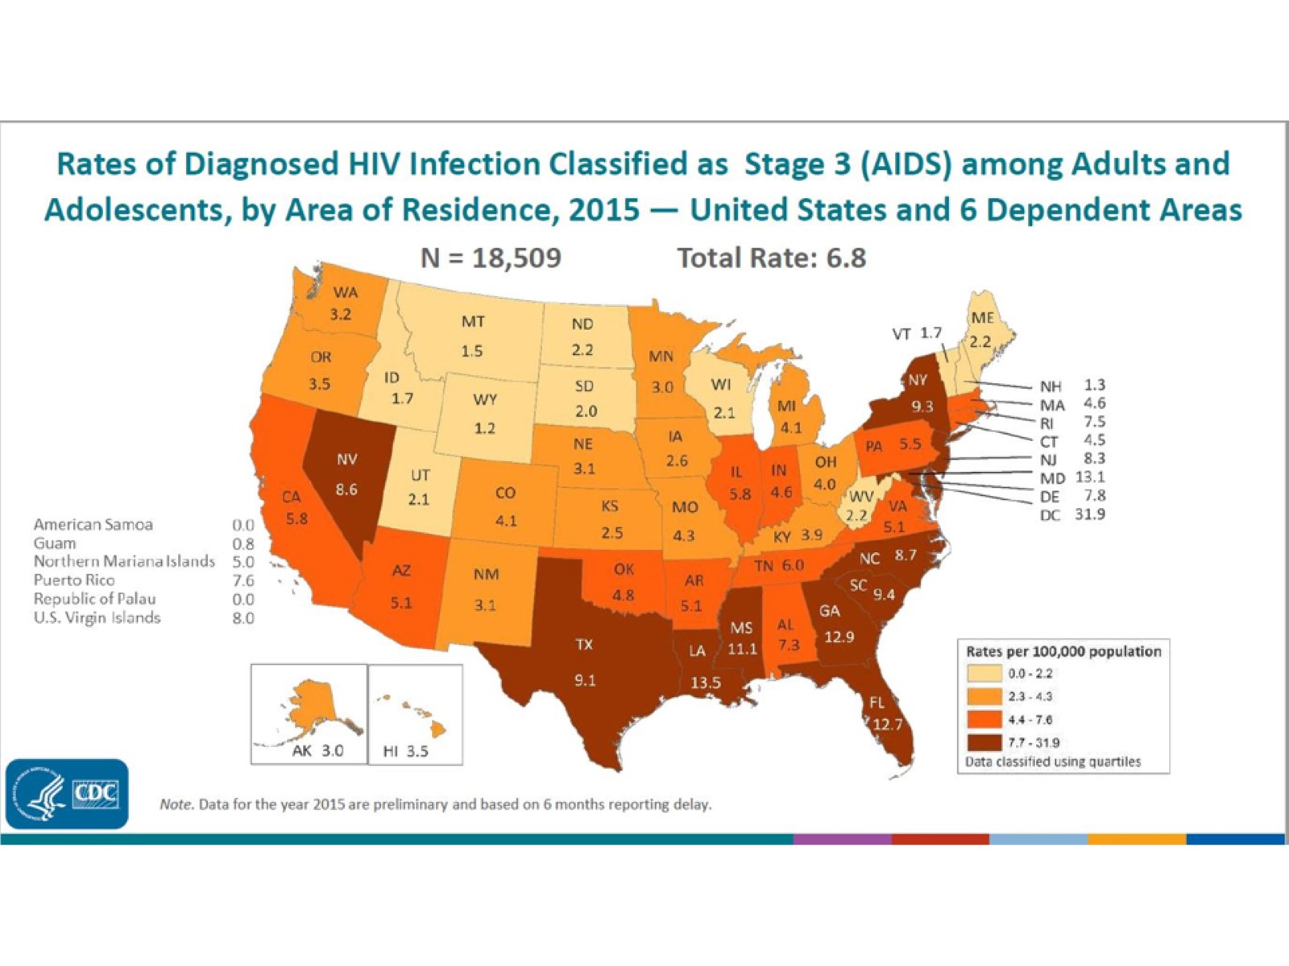
Notes:
The estimated rates (per 100,000 population) of stage 3 (AIDS) classifications in 2015 for persons (all ages) with HIV infection are shown for each state, the District of Columbia, American Samoa, Guam, the Northern Mariana Islands, Puerto Rico, the Republic of Palau, and the U.S. Virgin Islands.
Areas with the highest rates of stage 3 (AIDS) in 2015 were the District of Columbia (31.9), Louisiana (13.5), Maryland (13.1), Georgia (12.9), Florida (12.7), and Mississippi (11.1). The District of Columbia (i.e., Washington, DC) is a city; use caution when comparing the stage 3 (AIDS) rate in DC with the rates in states.
All displayed data are estimates. Estimated numbers resulted from statistical adjustment that accounted for reporting delays, but not for incomplete reporting.

Slide 7
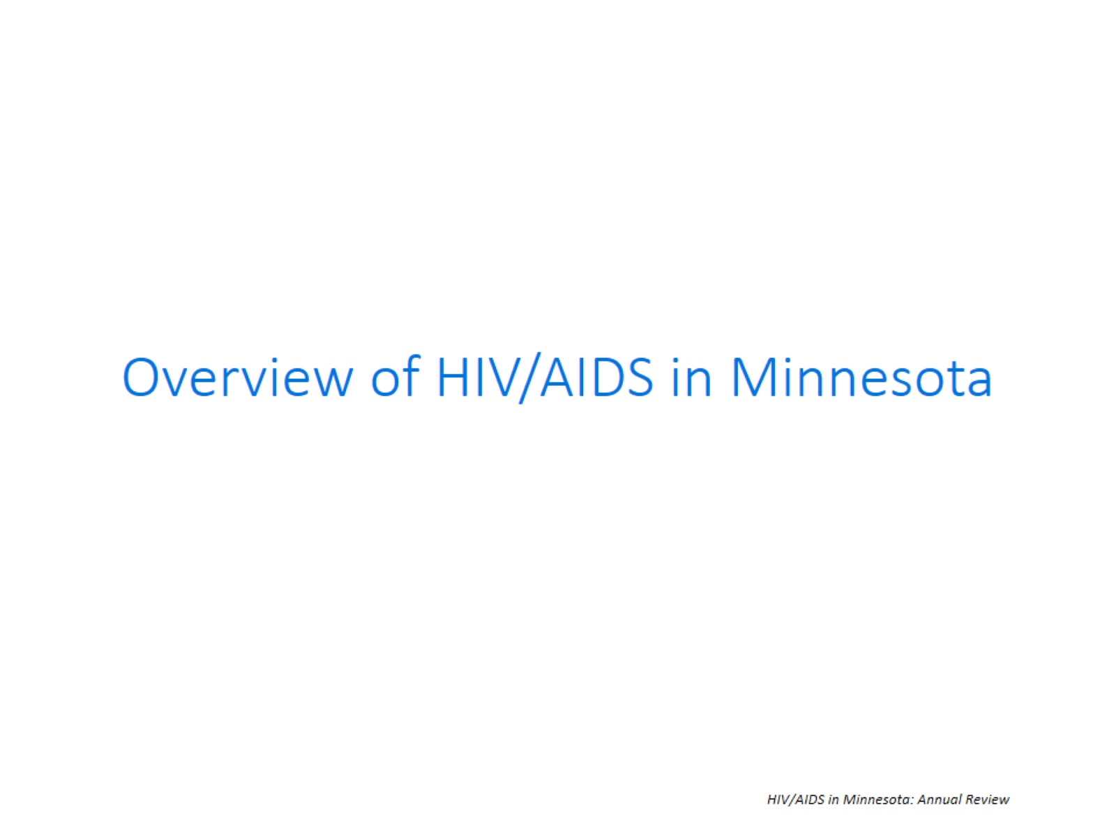

Slide 8
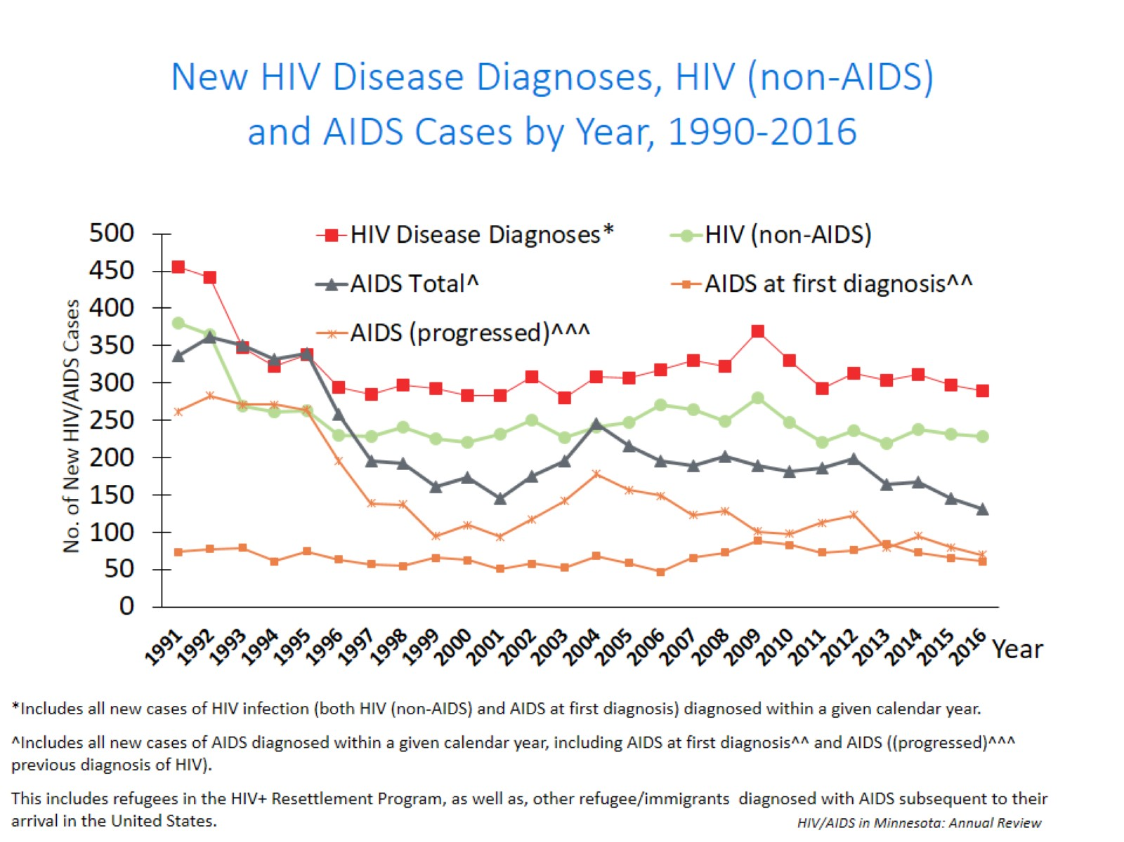
Notes:
Nationally, Minnesota is considered within the low to moderate risk of HIV and AIDS infections as defined by the Centers for Disease Control and Prevention (CDC). The annual number of new HIV and AIDS cases increased steadily from the beginning of the epidemic to the early 1990s. Beginning in 1996, both the number of newly diagnosed AIDS cases and the number of deaths among AIDS cases declined sharply, primarily due to the success of new antiretroviral therapies including protease inhibitors. These treatments do not cure, but can delay progression to AIDS among persons with HIV (non-AIDS) infection and improve survival among those with AIDS. These treatments have been shown to be effective at preventing transmission of HIV. Over the past five years, the number of HIV/AIDS cases diagnosed has remained relatively stable with an average of 300 cases diagnosed each year. By the end of 2016, an estimated 8,554 persons with HIV/AIDS were assumed to be living in Minnesota.
This number includes persons whose most recently reported state of residence was Minnesota, regardless of residence at time of diagnosis. This estimate does not include persons with undiagnosed HIV infection.

Slide 9
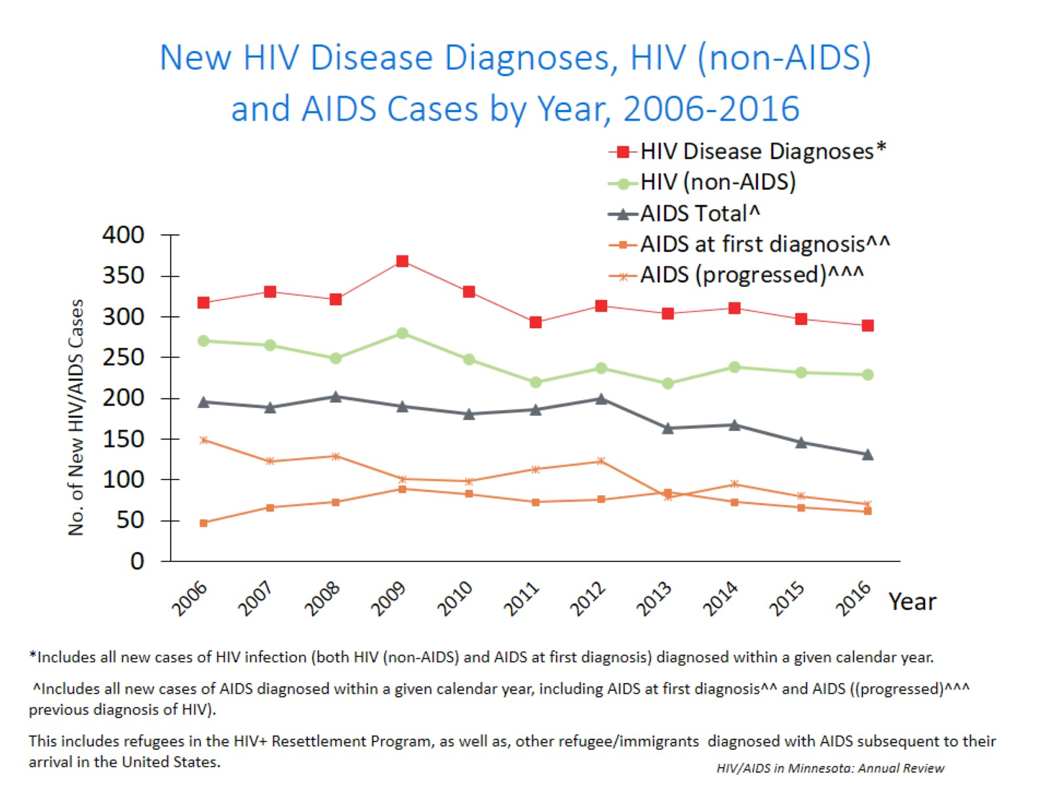
Notes:
In this report, the term “new HIV diagnoses” refers to HIV-infected Minnesota residents who were diagnosed in a particular calendar year and reported to MDH. This includes persons whose first diagnosis of HIV infection is AIDS (AIDS at first diagnosis). HIV diagnoses data are displayed by earliest known date of HIV diagnosis.
In 2016, there was a slight decrease of new HIV diagnoses from 2015. In 2016 there were 290 newly diagnosed cases, as compared to 298 cases in 2015. This represents a decrease of about 3% compared to 2015. In reviewing newly diagnosed cases since 2012, 290 cases for 2016 is below the 5 year average of 300 cases per year.

Slide 10
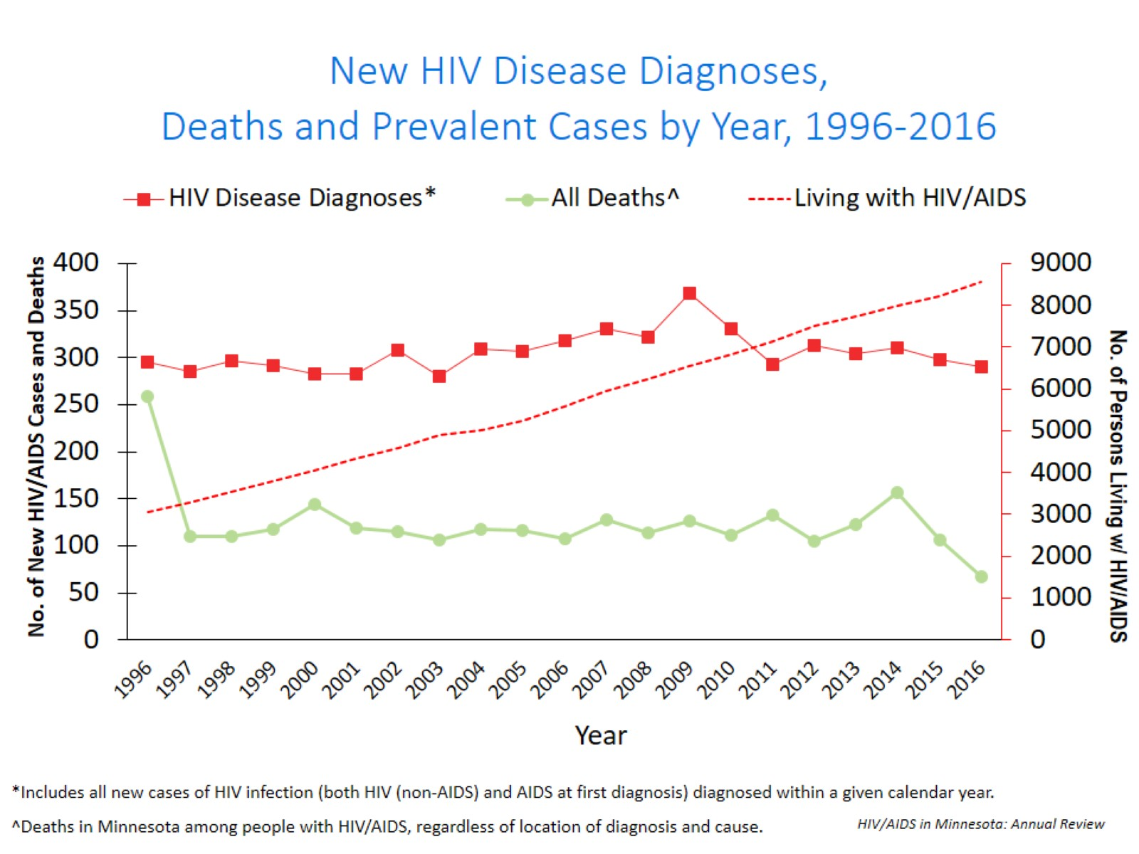
Notes:
Since 1996, the number of new diagnoses has remained relatively stable in Minnesota at around 300 cases per year. During this same time, deaths among HIV+ people in Minnesota has decreased dramatically. As people with HIV are living longer and healthier lives, the number of people living with HIV in Minnesota continues to grow as seen in the Red line here. At the end of 2016, 8,554 people were estimated to be living with HIV or AIDS in Minnesota.
This number does not include about 1300 persons who were first reported with HIV or AIDs in Minnesota and subsequently moved out of the state. Although it DOES include about 2000 persons who were first reported with HIV or AIDS elsewhere and subsequently moved to Minnesota.

Slide 11
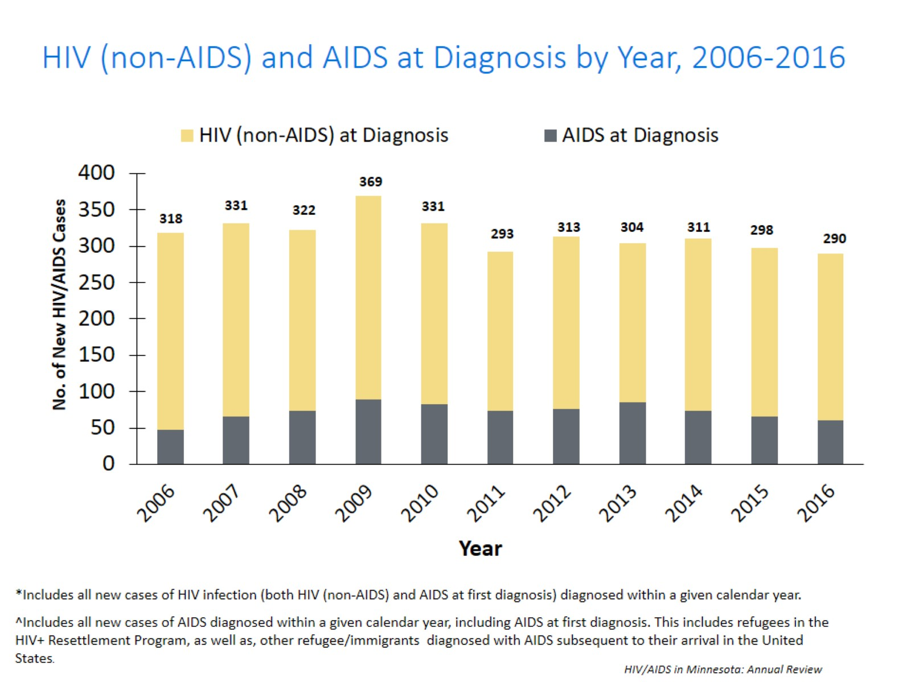
Notes:
During the past 10 years, the proportion of cases being diagnosed with AIDS at initial HIV diagnosis has remained the same at about 25% of all new cases.

Slide 12
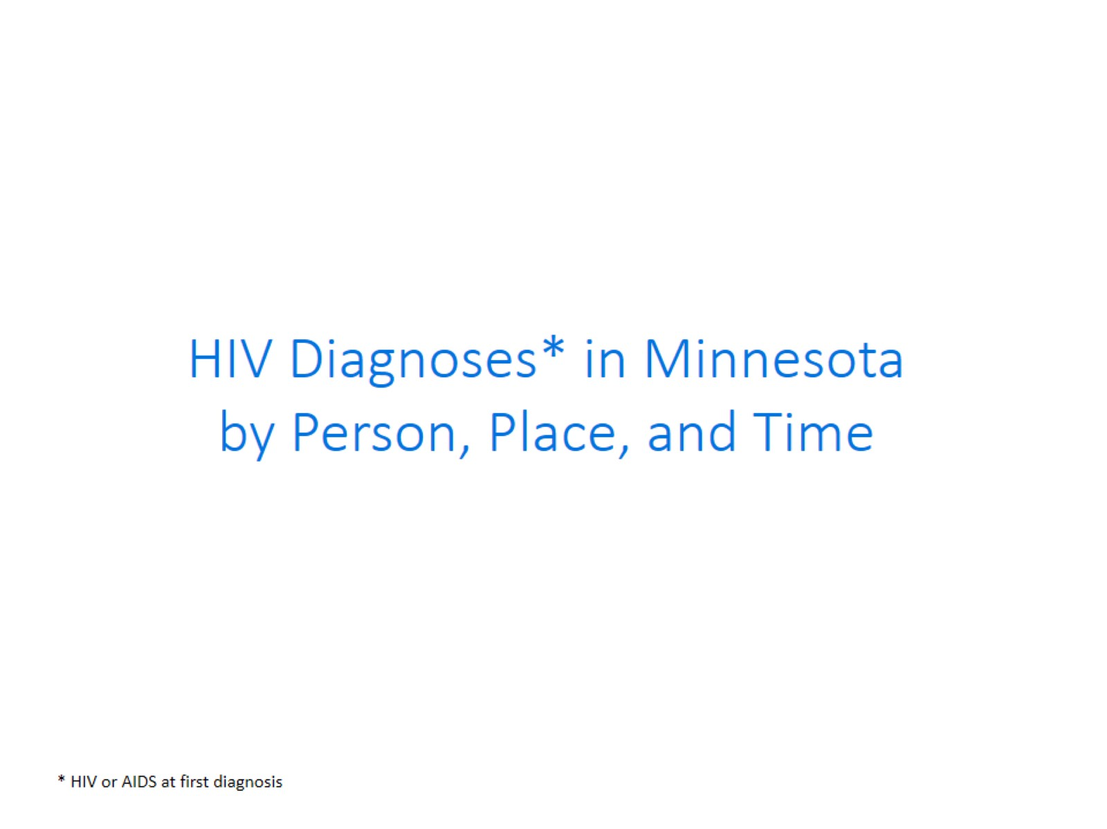

Slide 13


Slide 14
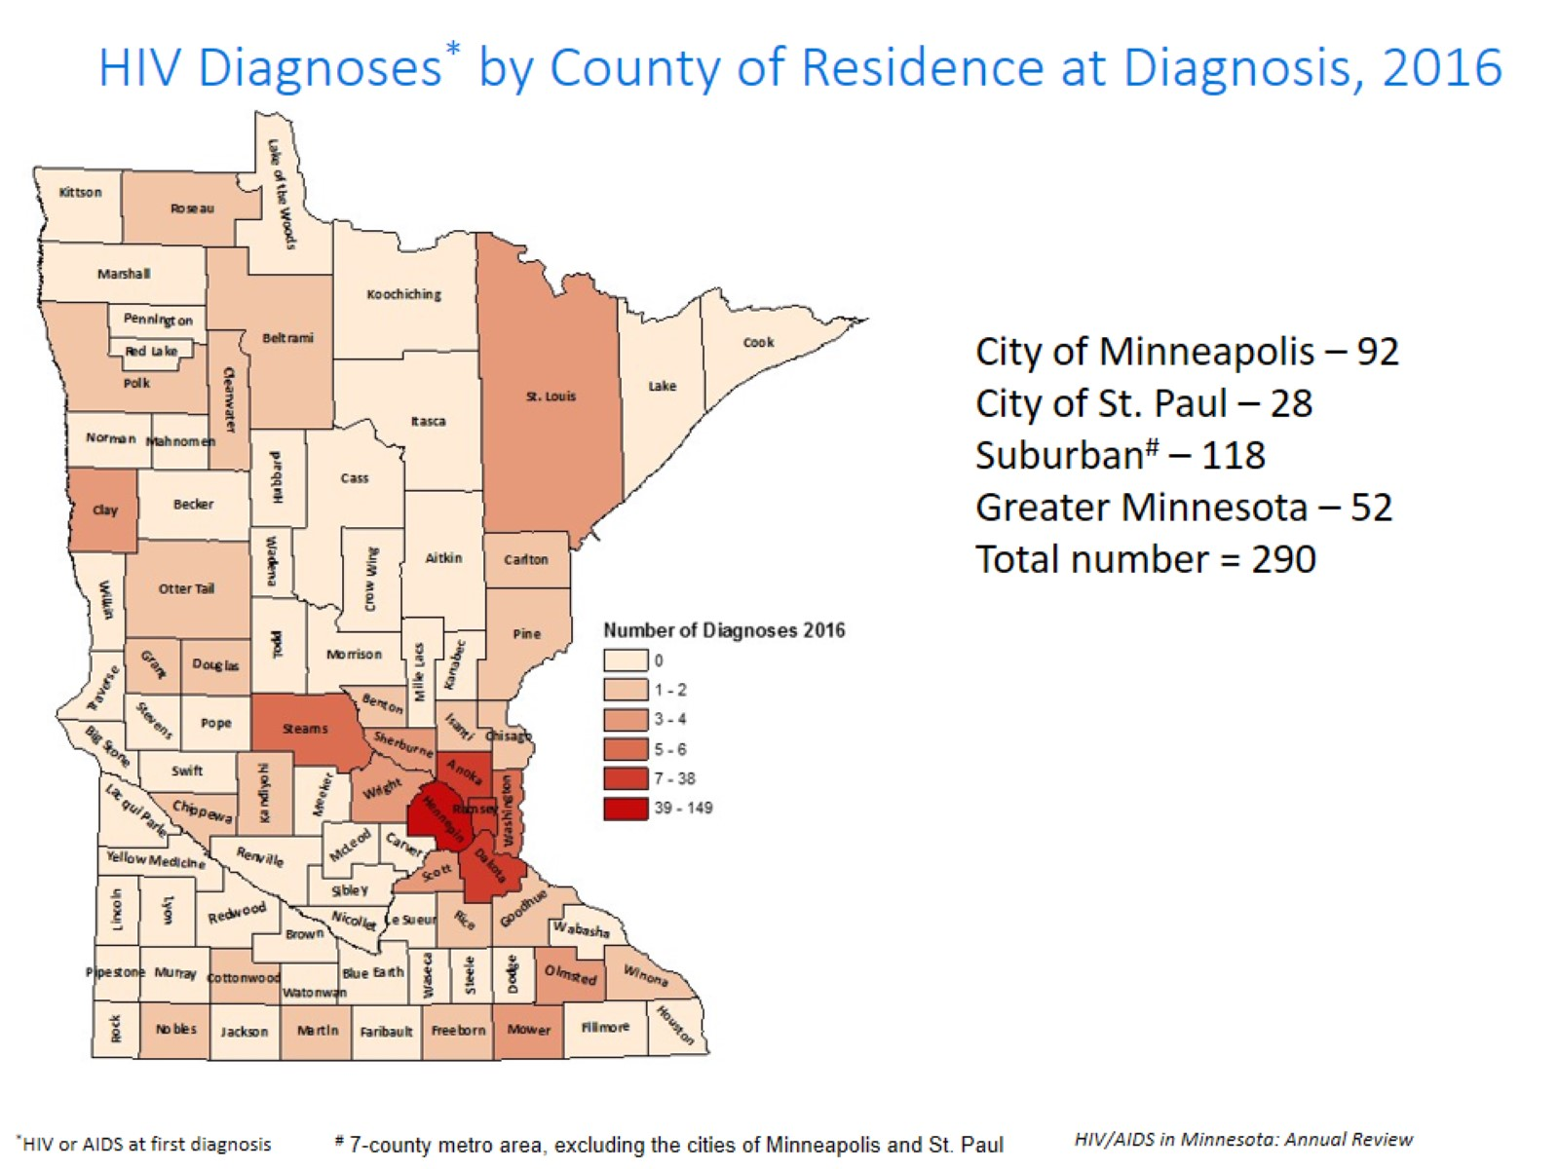
Notes:
Historically, about 90% of new HIV infections diagnosed in Minnesota have occurred in Minneapolis, St. Paul and the surrounding seven-county metropolitan area. In 2016,
geographically, the new cases were concentrated in the twin cities metro area, with 82% of the cases located in the seven county twin cities metro region with 32% in Minneapolis, 10% in St. Paul, and 41% in the remaining suburban area (excluding Minneapolis/St. Paul). In greater Minnesota, there were 52 newly diagnosed HIV cases in 28 counties.

Slide 15
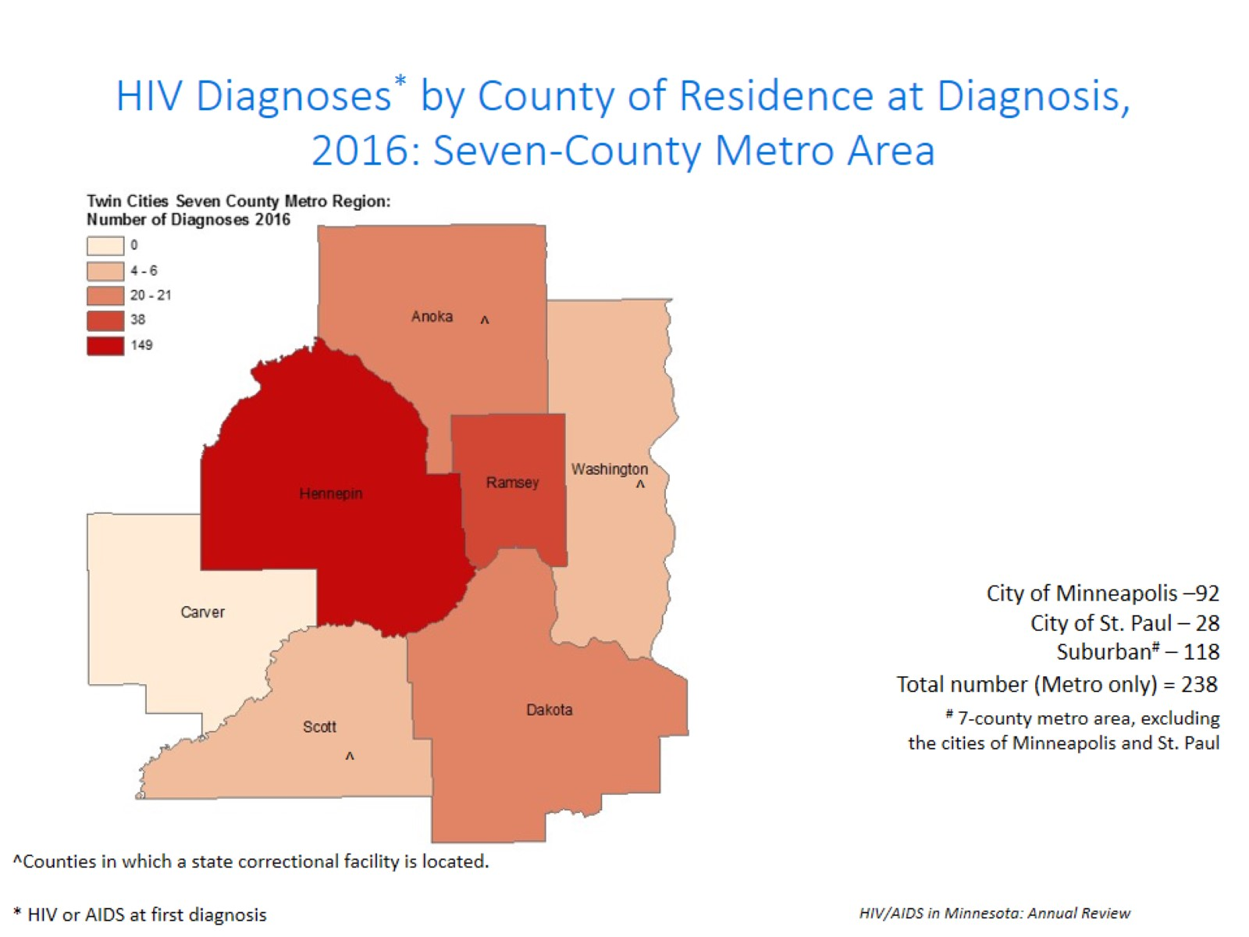
Notes:
While 82% of all new HIV diagnoses in Minnesota occur in the metro area, the cases in the metro area are concentrated in Hennepin and Ramsey counties.

Slide 16
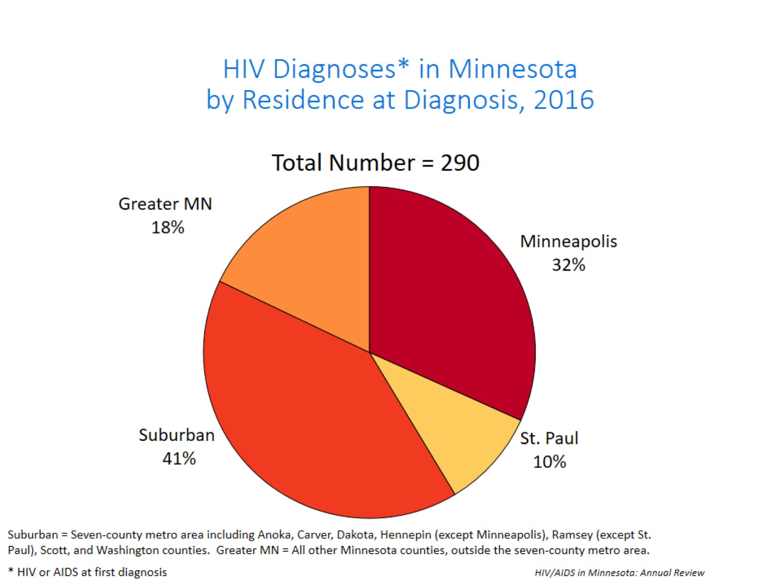
Notes:
Overall, of the 290 HIV diagnoses in Minnesota in 2016, 41% were among residents of suburban seven-county metro area, 32% were residents of Minneapolis and 10% were residents of St. Paul, and 18% were residents of Greater Minnesota at the time of diagnosis.

Slide 17
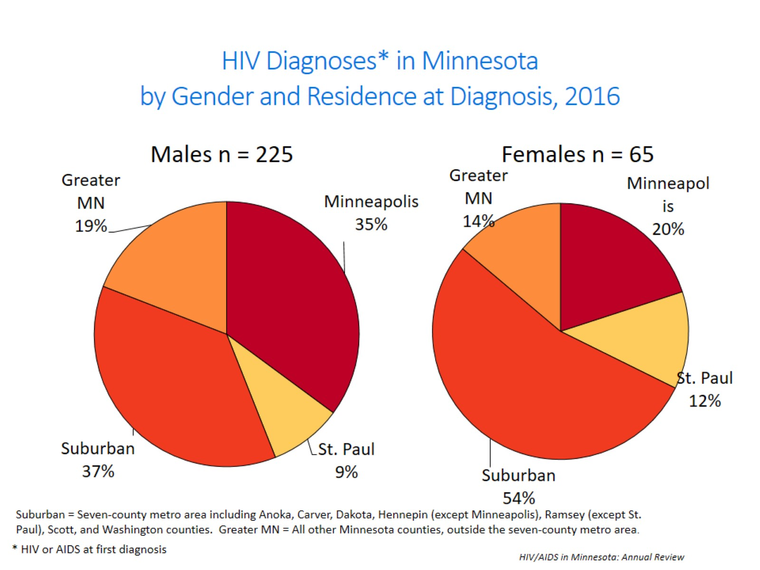
Notes:
In 2016, the geographic distribution of cases differed greatly by gender. You can see that a greater proportion of males resided in the cities of Minneapolis and St. Paul (44%) at diagnosis while a majority of females resided in the suburbs (54%).

Slide 18
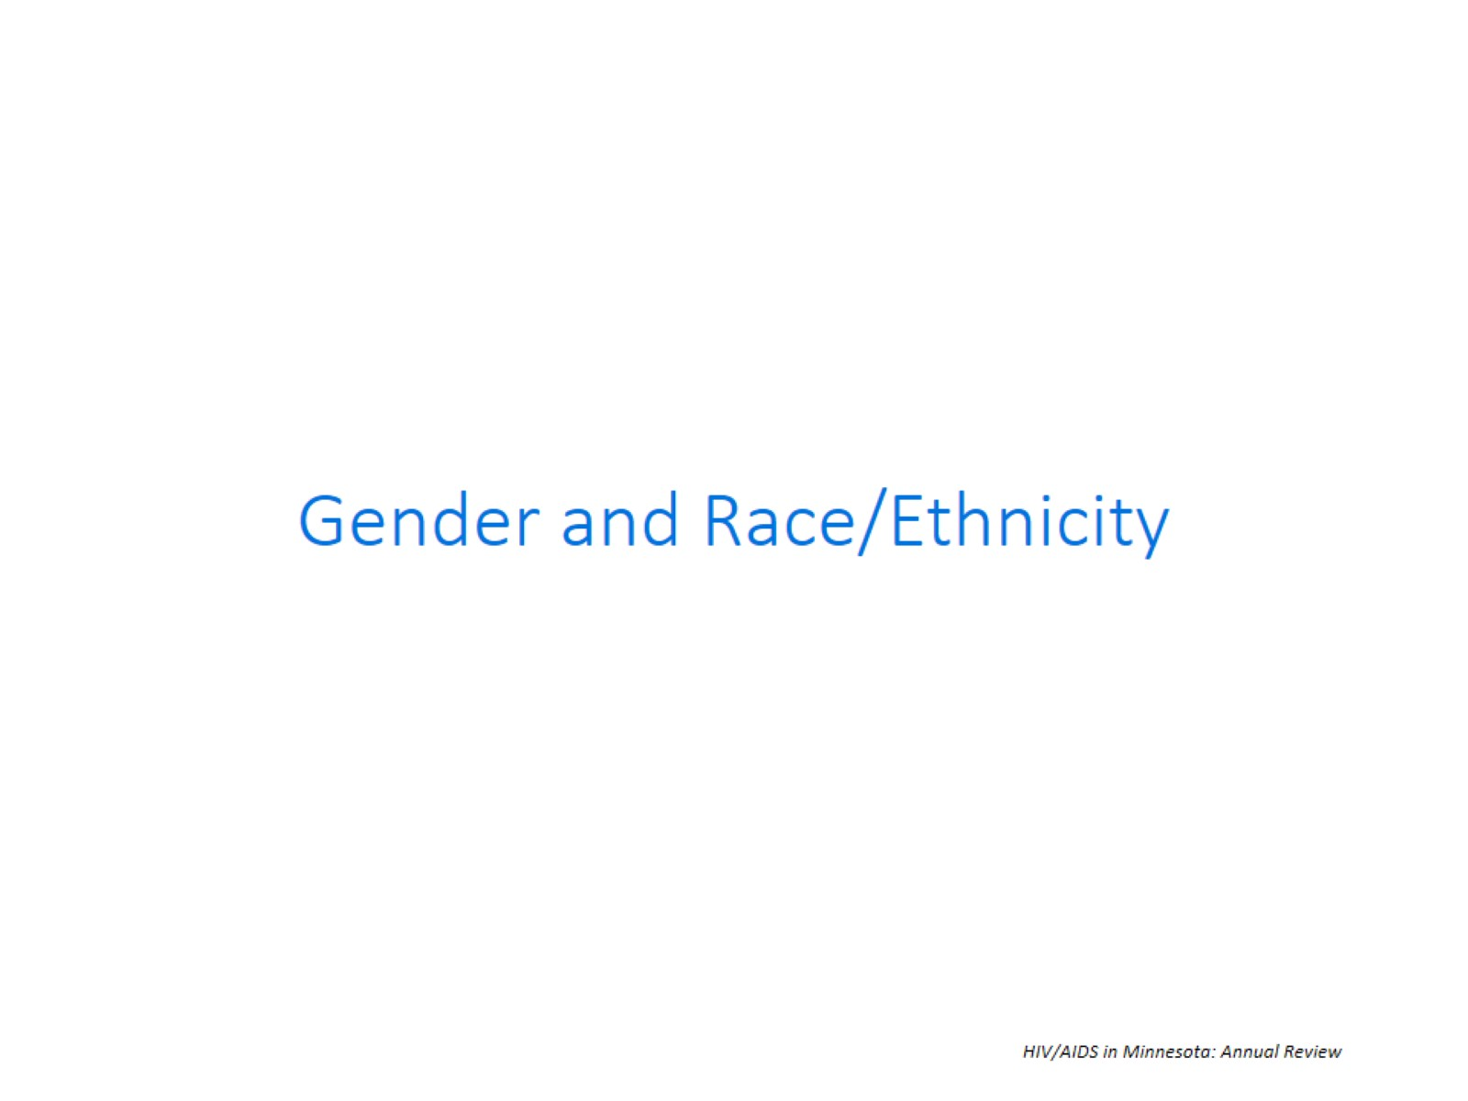

Slide 19
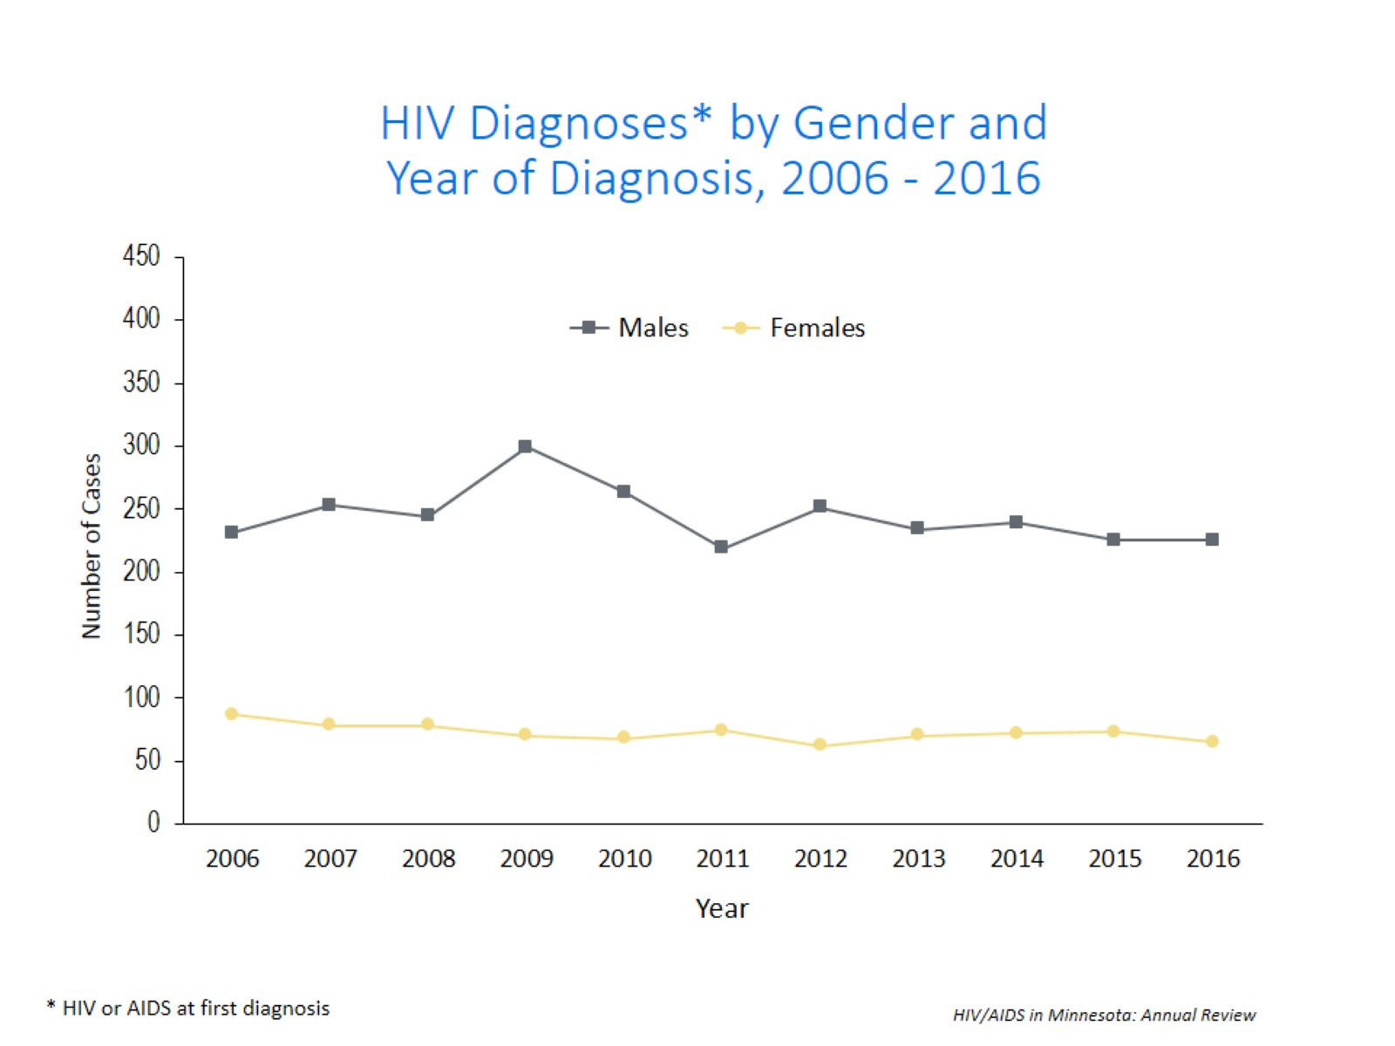
Notes:
In 2016, males made up 78% of newly reported cases while females made up 22%. The number of male cases remained the same at 225 in 2016 as compared to 2015; and the number of female cases decreased from 73 in 2015 to 65 in 2016 which is a decrease of 11% for females.

Slide 20
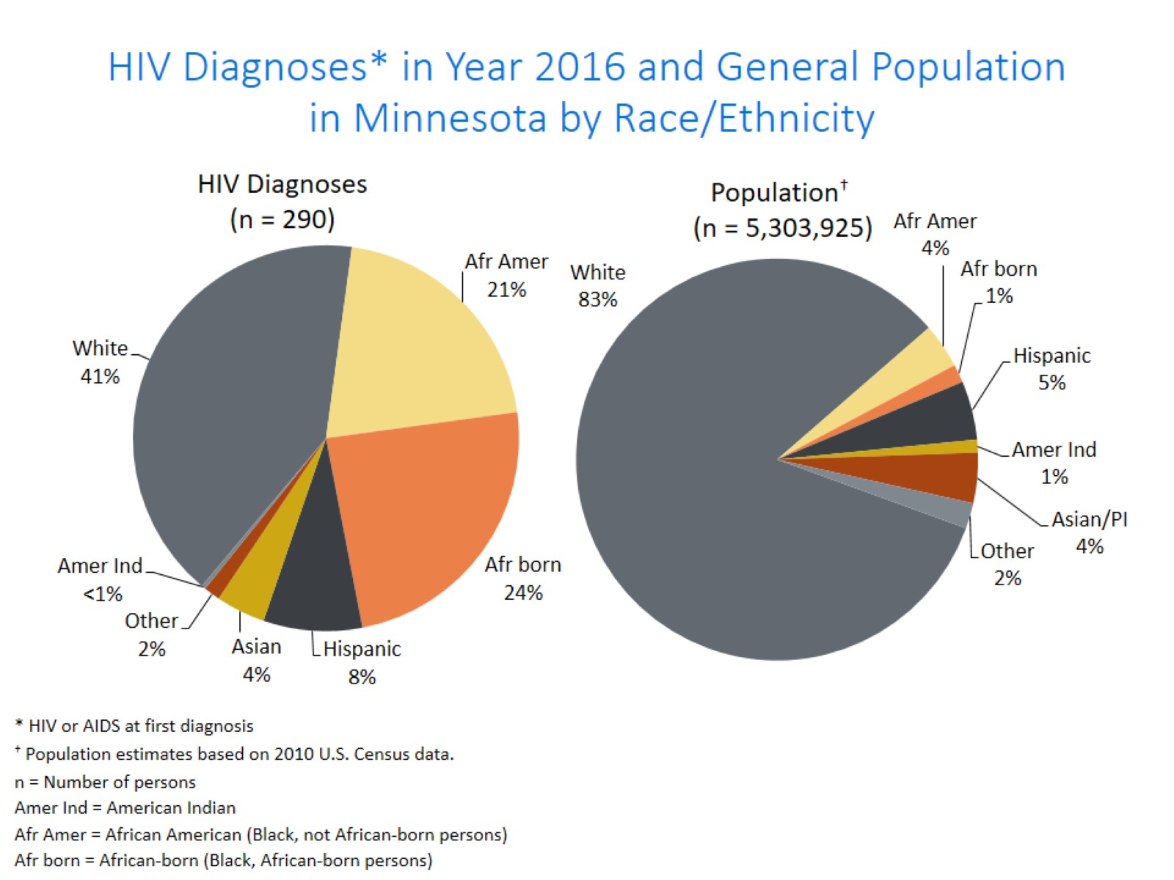
Notes:
When you look at the racial/ethnic distribution of new HIV diagnoses for both genders compared to the racial/ethnic distribution of the general population of Minnesota, it is apparent that disparities continue to exist among persons of color. Non-Hispanic African-American and Black African-born Minnesotans jointly make up about 5% of the population in Minnesota, yet, account for 45% of the newly diagnosed cases of HIV in 2016. Similarly, Hispanics of any race also account for approximately 5% of the population but 8% of the newly diagnosed cases.

Slide 21
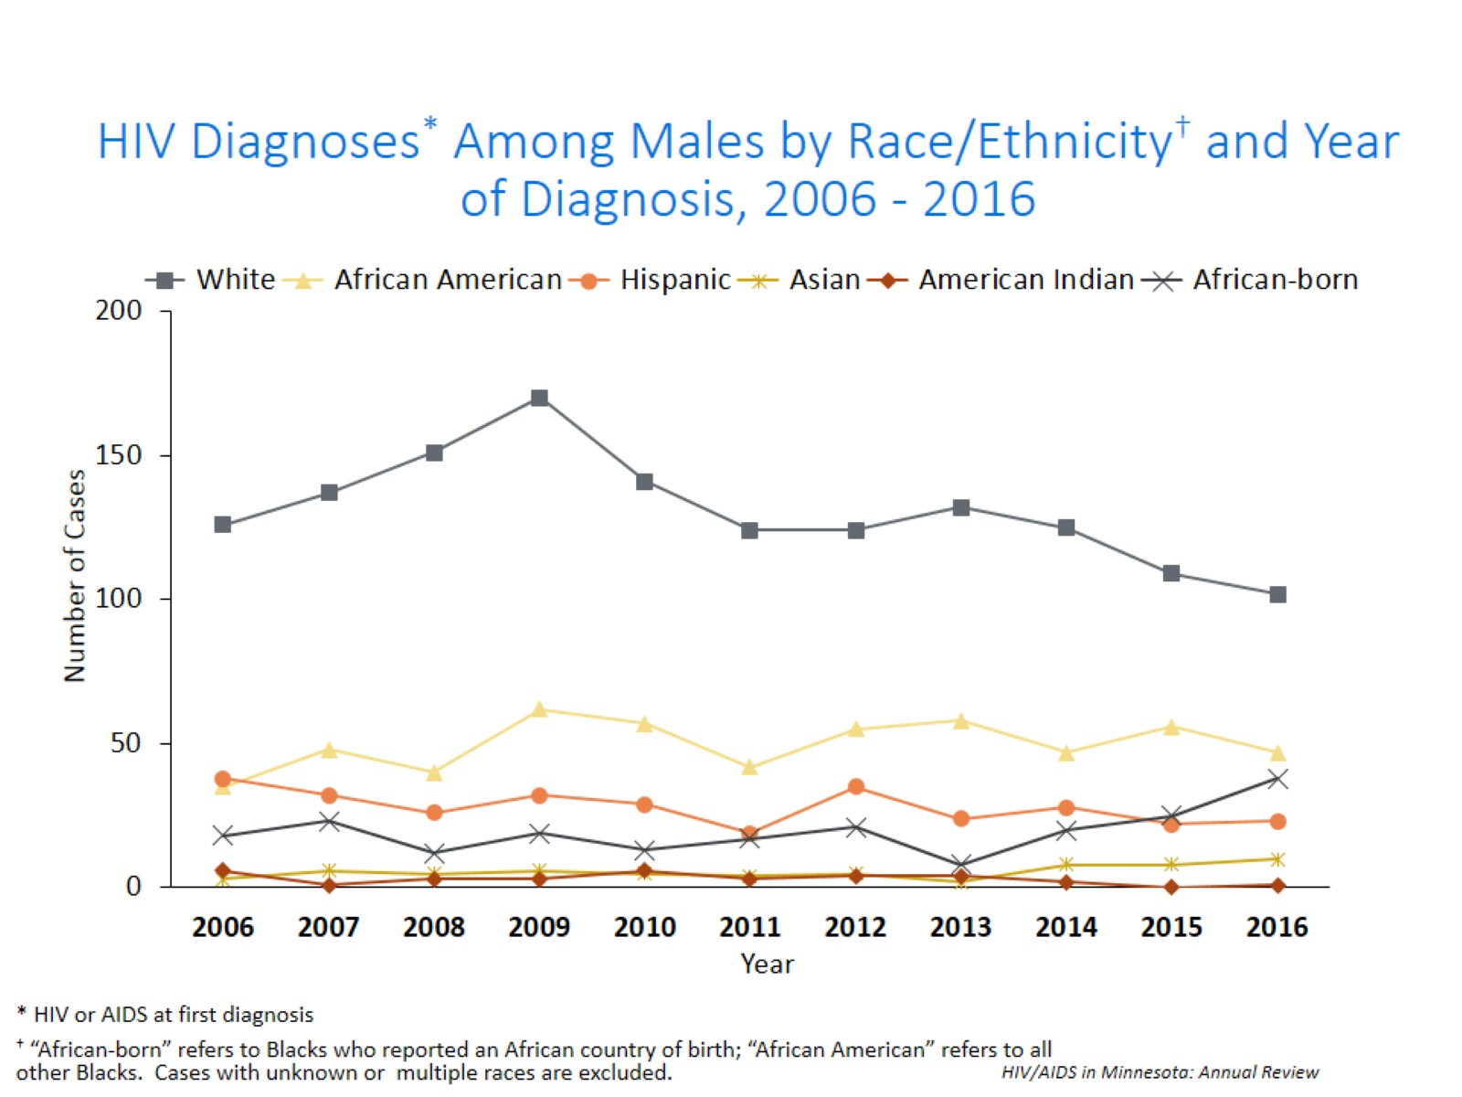
Notes:
Trends in the annual number of new HIV infections diagnosed among males differ by racial/ethnic group. White males account for the largest number of new infections, but the proportion of cases that white males account for has decreased over time. In 2016, white males accounted for 45% of the new HIV diagnoses among men, with 102 diagnoses. During the past decade, the number of cases among African-American males has fluctuated from year to year, with 47 new HIV diagnoses in 2016.
The annual number of HIV infections diagnosed among Hispanic has remained relatively stable, with fluctuation from year to year. HIV infections in Hispanic males was similar to the previous year with 23 cases in 2016. Thirty-eight African-born males were diagnosed with HIV in 2016; this is an increase of 65% from 2015 when 23 cases were diagnosed.

Slide 22
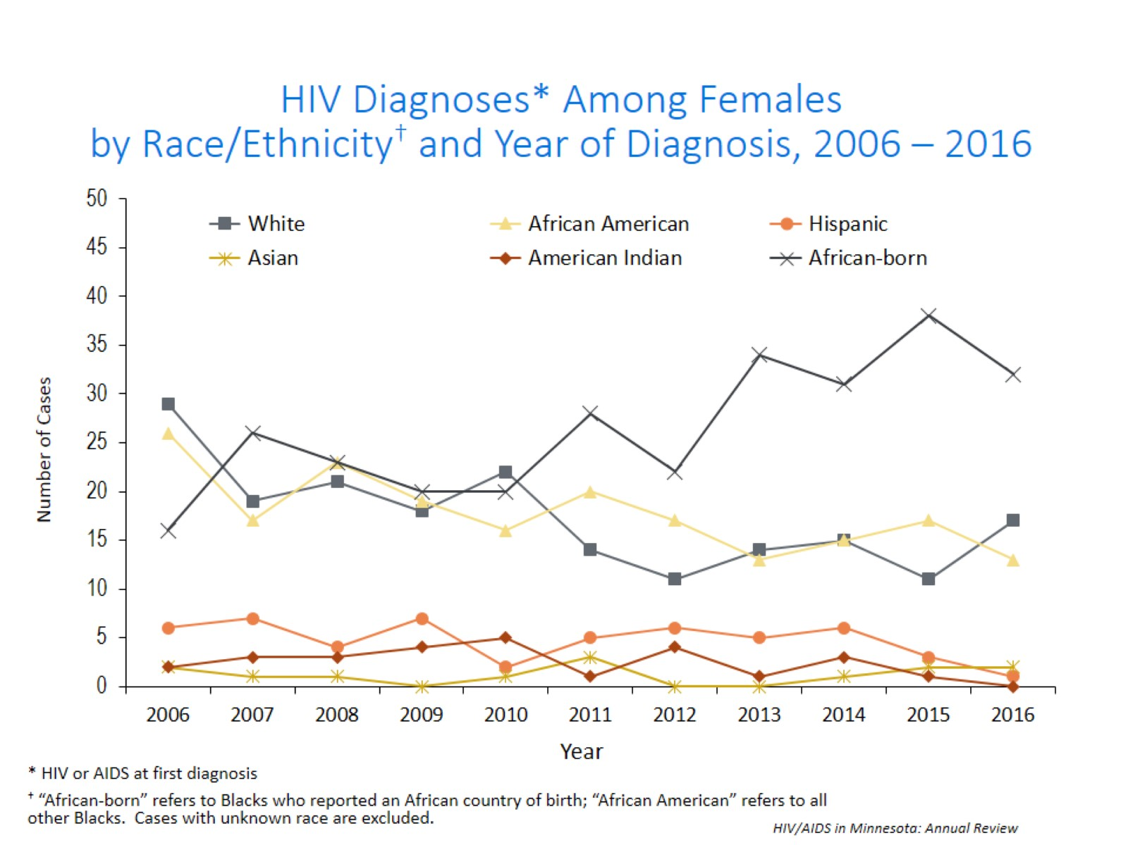
Notes:
Similarly, trends in the annual number of HIV infections diagnosed among females differ by racial/ethnic group. In 2016 women of color white women accounted for 74% of the new diagnoses in Minnesota, with 48 new cases while white women accounted for 26% of new diagnoses (17 cases)
Since 2006, the annual number of new infections diagnosed among African American females has decreased overall. In 2016 there were 13 cases diagnosed among African American women, compared to 15 in 2015. The number of diagnoses among African-born women has been increasing over the past decade. In 2016 the number of new cases among African-born women was 32, accounting for 49% of all new diagnoses among women. The annual number of new infections diagnosed among Hispanic, American Indian, Asian, and multi-racial females continues to be quite small (7 cases or fewer per year for each of these groups).

Slide 23
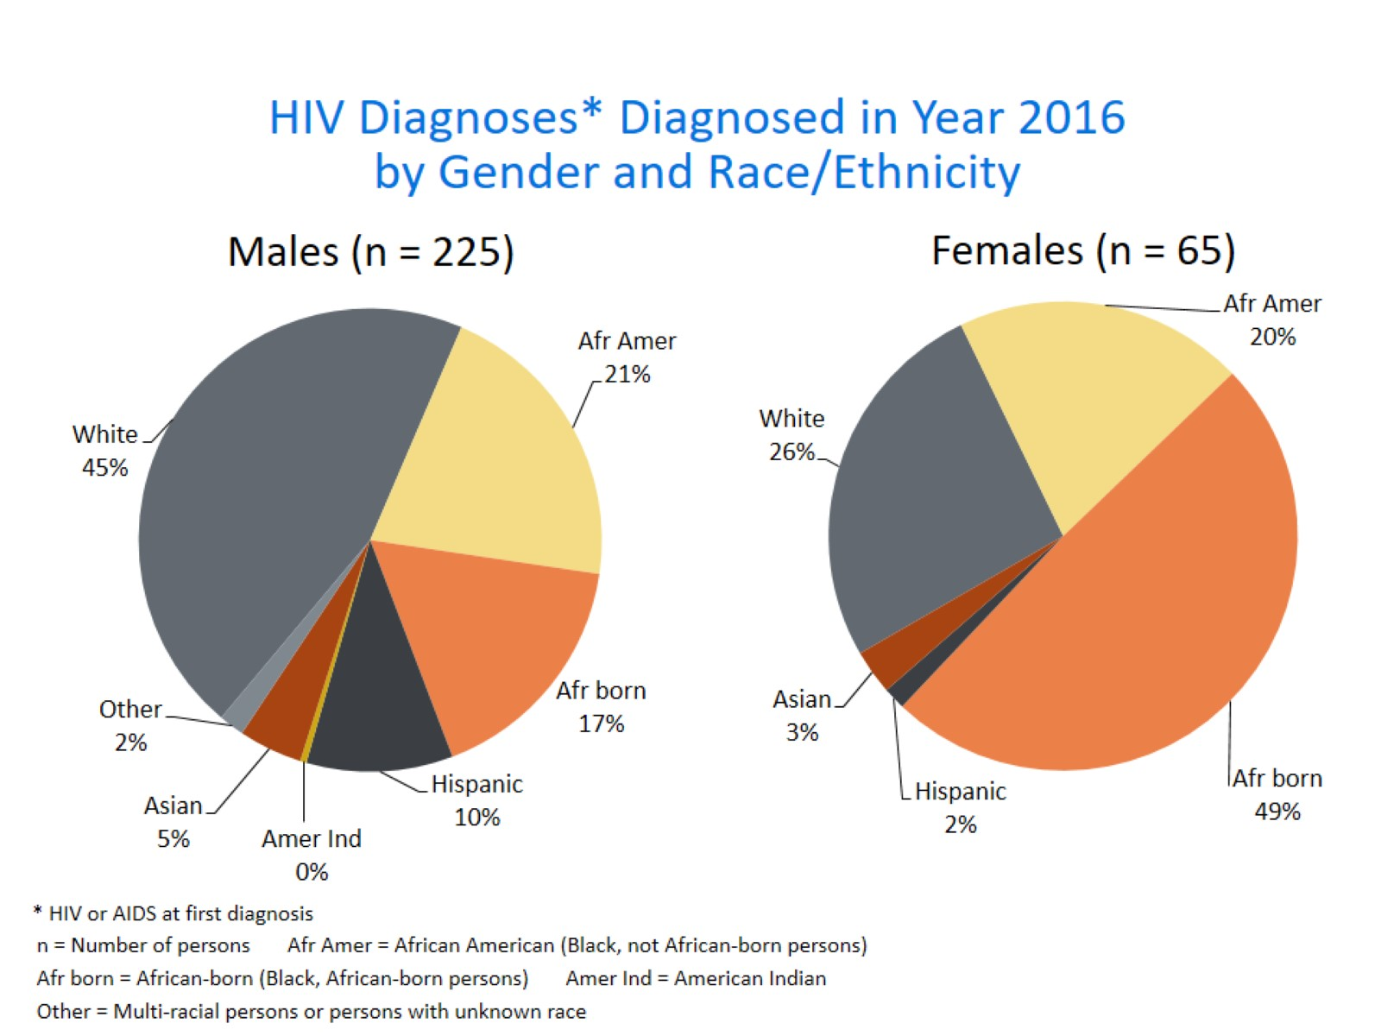
Notes:
There are differences in the racial/ethnic distribution by gender. Among males, while 45% of the 2016 cases diagnosed in Minnesota are Non-Hispanic white;
Non-Hispanic African American and African-born black persons made up 38% of cases and Hispanic of any race accounted for 10% of cases. Of note, cases among black, African-born men increased by 65% from the previous year with 38 cases in 2016 compared 23 cases in 2015.
Among women, the disparities are even more apparent with women of color representing 74% of all the newly diagnosed females in 2016, with black African-born women accounting for almost half (49%) of cases and Non-Hispanic African-American women accounting for 20% of cases.

Slide 24
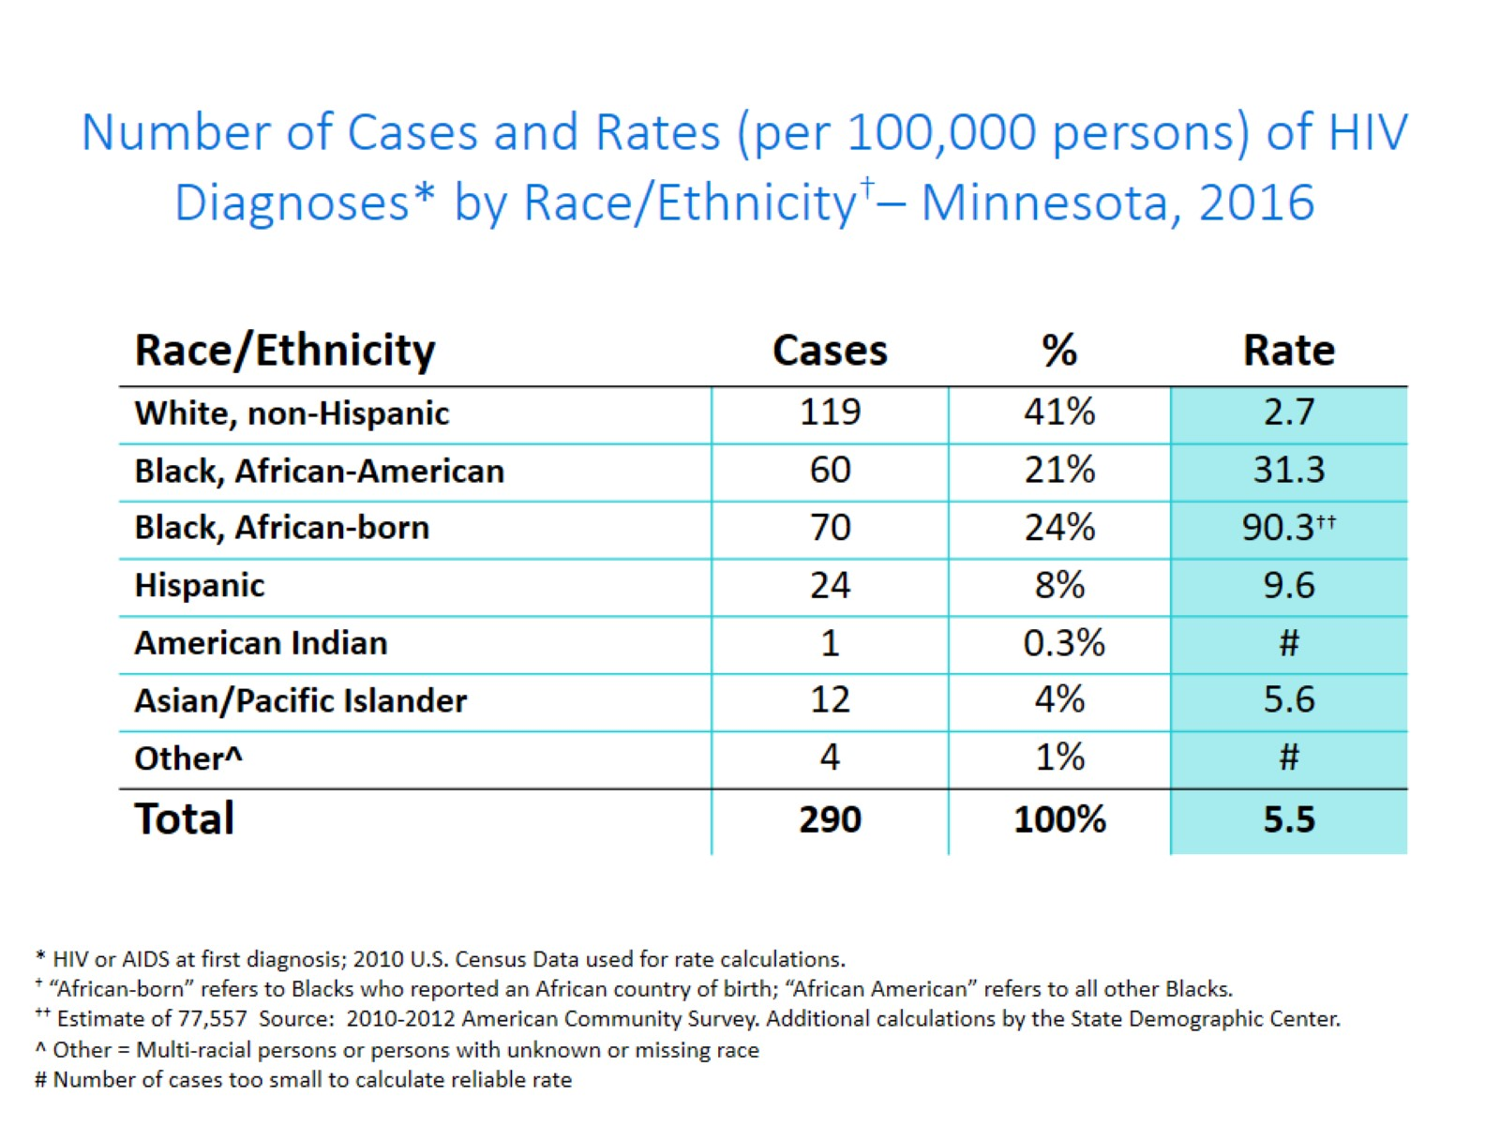
Notes:
Each year we calculate the rate of diagnosis for each racial/ethnic group represented in the surveillance system to assess the impact of HIV within each community. The rate takes into account the size of the population of each group.
Non-Hispanic black African-born and African-Americans had the highest rate of diagnoses in 2016 with 90.3 HIV diagnoses per 100,000 population and 31.3 HIV diagnoses per 100,000 population respectively. This represents a rate of HIV diagnosis among the black African-born community that is 33 times higher than the white non-Hispanic population in Minnesota. The rate among African-American non-Hispanic population is 12 times higher than white non-Hispanic population.
Hispanic persons of any race have the next highest rate of newly diagnosed HIV cases in Minnesota at 9.6 per 100,000 persons; this is a rate of more than 3 times higher than white, non-Hispanic persons.
Finally Asian/Pacific Islanders have a rate of persons newly diagnosed with HIV of 5.6 per 100,000 persons; this accounts for a rate 2 times higher than the rate among white non-Hispanic persons.

Slide 25
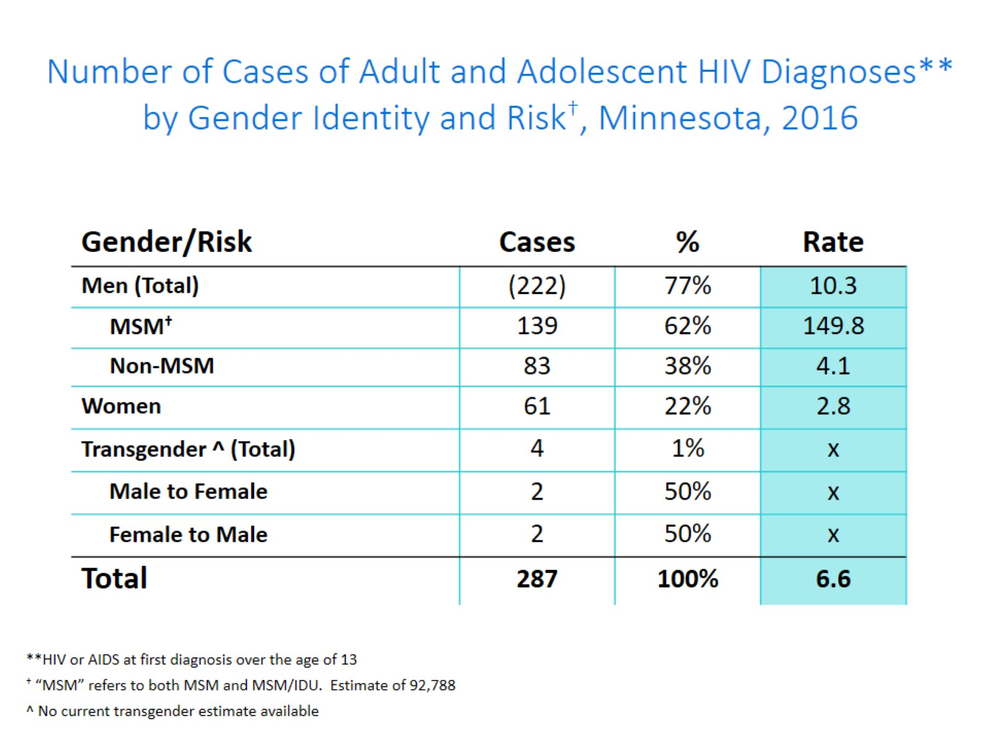
Notes:
This slide shows the number of new adult HIV cases by gender identity (male, female, or transgender (male to female or female to male)).
Men who have Sex with Men have the highest rate of HIV diagnosis than any other sub-category. In 2016, the estimated rate of HIV diagnosis among MSM was 149.8 per 100,000 population. This is more than 37 times higher than the rate among non-MSM men.
It’s important to note that MSM contains cases from all racial/ethnic categories and therefore cannot be directly compared to the rates on the previous slide. For more information on how this rate was estimated, see the HIV Surveillance Technical Notes which are available on our website.
In 2016, there were 4 transgender newly reported HIV cases in Minnesota (2 male to female and 2 female to male transgender). This represents 1% of new cases reported in the state.

Slide 26
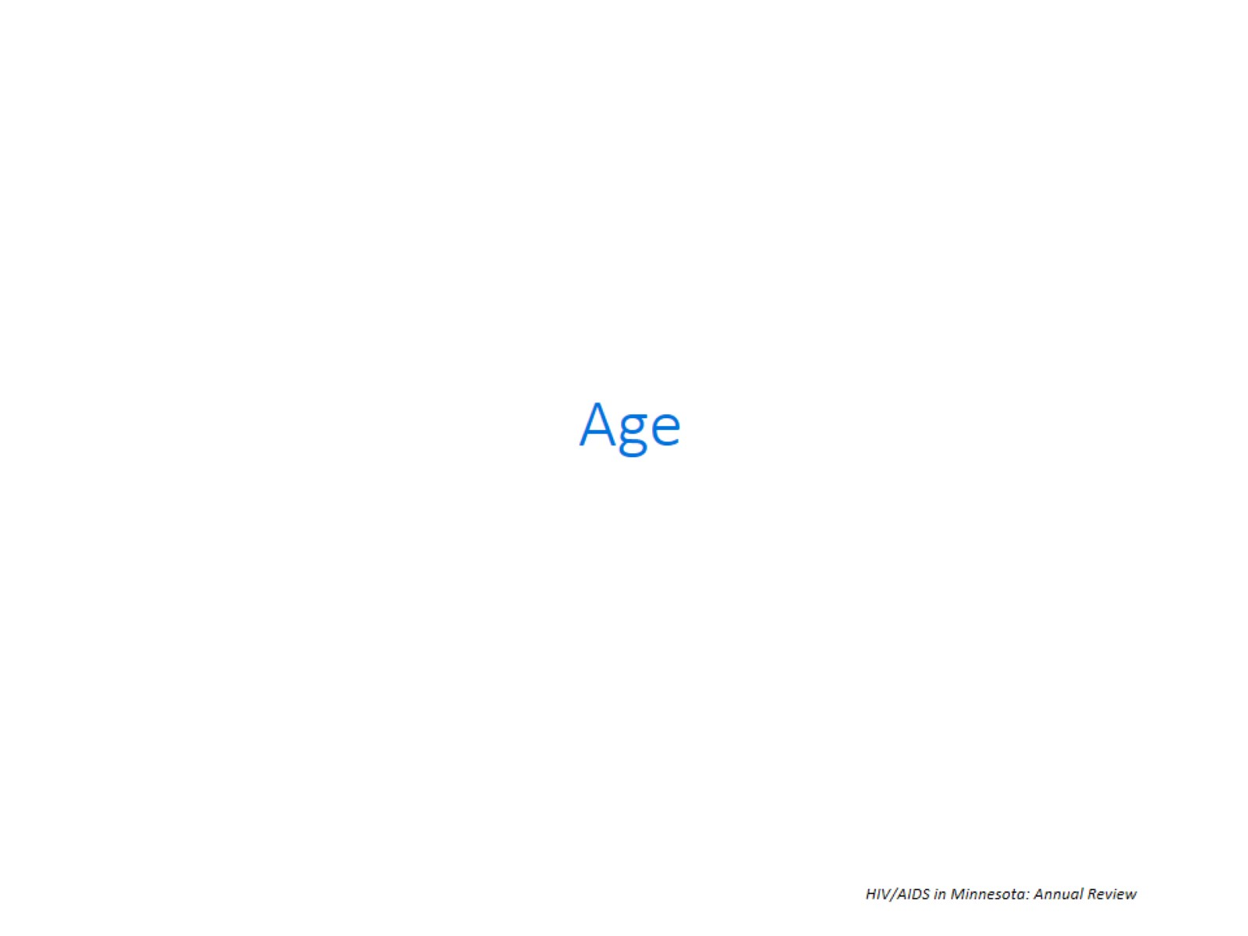

Slide 27
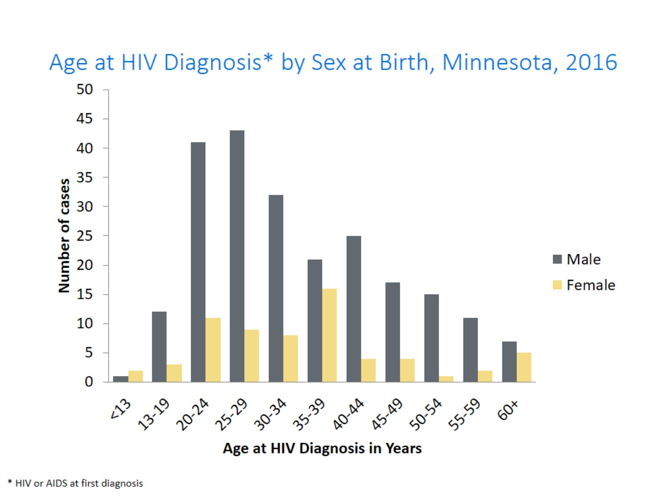
Notes:
In 2016, there were 122 cases diagnosed under the age of 30. This accounts for 42% of all cases. Most of these cases were among young males, where 80% of cases under the age of 30 were male. The age groups from 20-29 continue to be the highest as was also seen in the previous year of 2015.

Slide 28
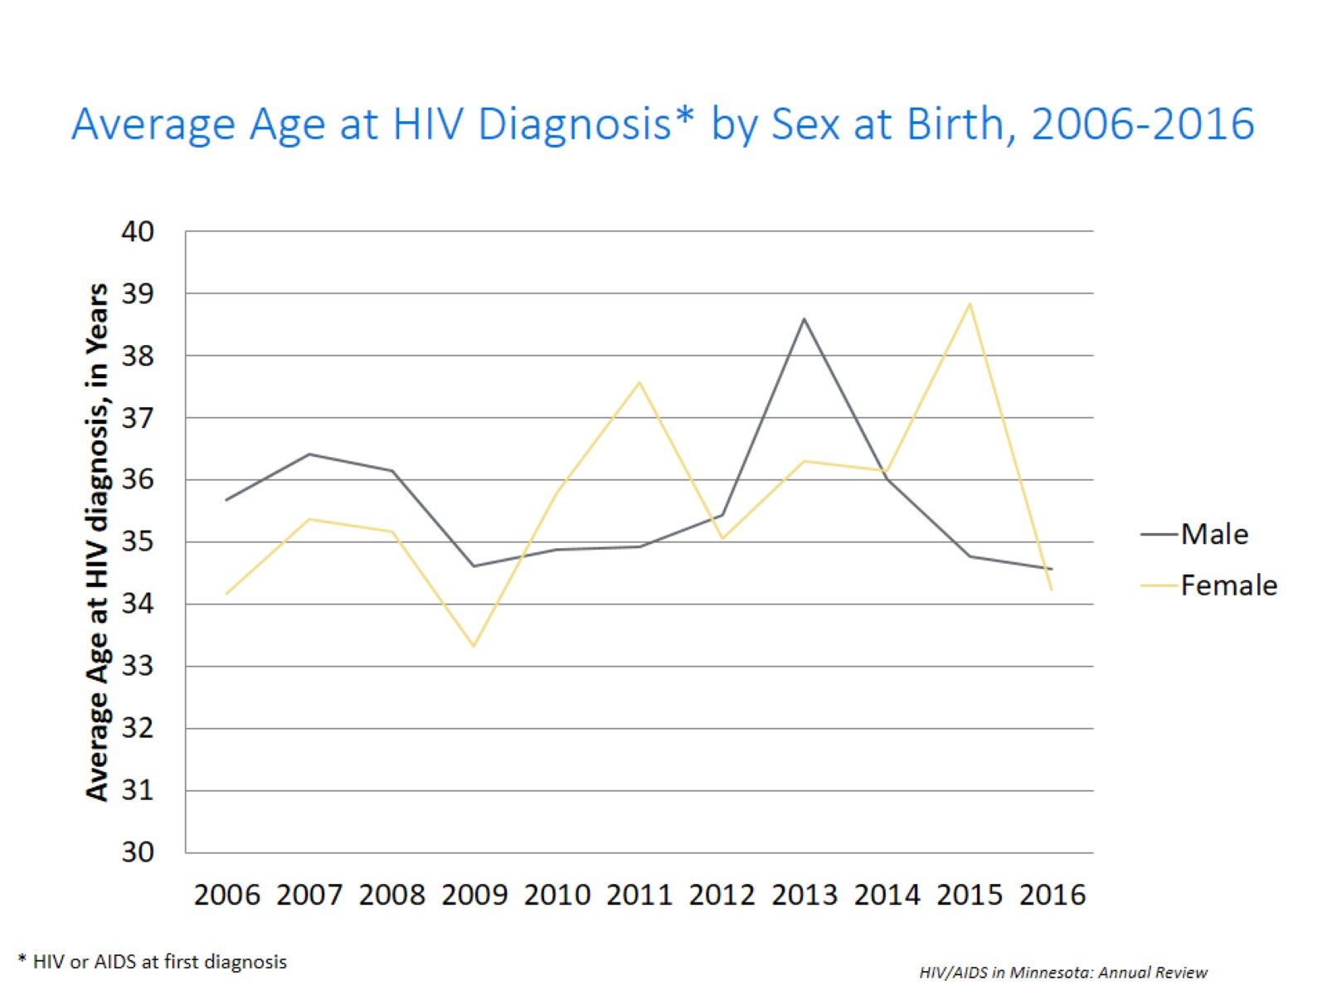
Notes:
The average age at diagnosis among males in 2016 remained the same at 35 years as compared to the previous year. The average age at diagnosis among women was 34 years in 2016.

Slide 29
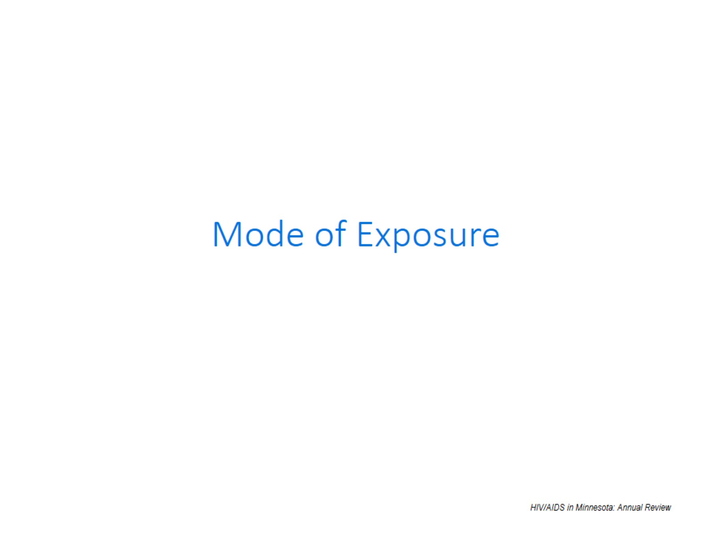
Notes:
Starting in 2004, MDH has used a risk re-distribution method to estimate mode of exposure among those cases with unknown risk. For additional details on how this was done please read the HIV Surveillance Technical Notes. All mode of exposure numbers referred to in the text are based on the risk re-distribution.

Slide 30
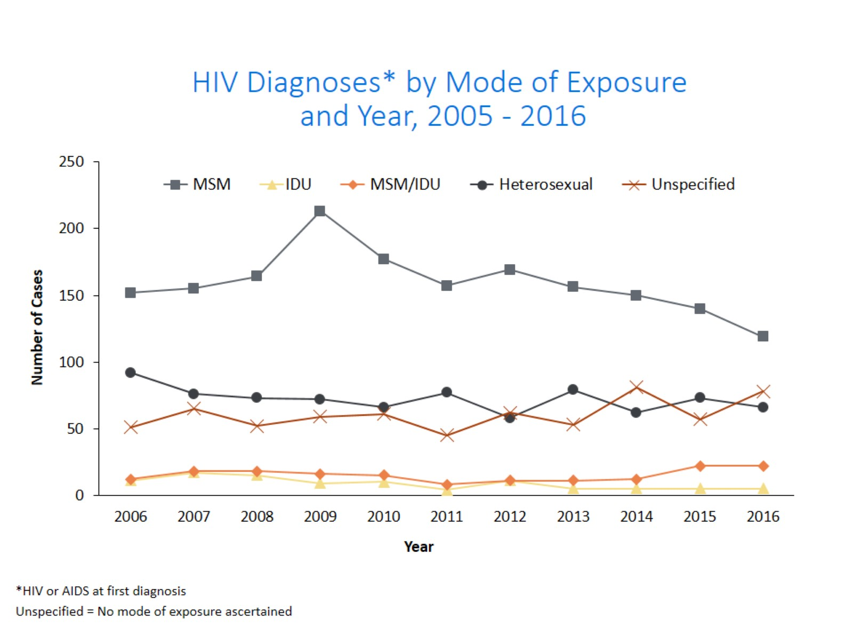
Notes:
This slide depicts risk for all persons diagnosed with HIV in Minnesota during the past decade and since the beginning of the epidemic, Men who have sex with Men has been the most commonly reported risk factor. In 2016, MSM accounted for 49% of all new HIV diagnoses in Minnesota with 141 cases diagnosed.
In 2016, females comprised 80% of heterosexual mode of exposure for HIV diagnoses.
The number of cases among injection drug users (IDUs) (MSM/IDU and IDU (bottom 2 lines on the graph) was similar with 27 cases in 2016 compared to 26 cases in 2015, which indicates a continuing trend of increased HIV infection among IDU in the state over the last two years.

Slide 31
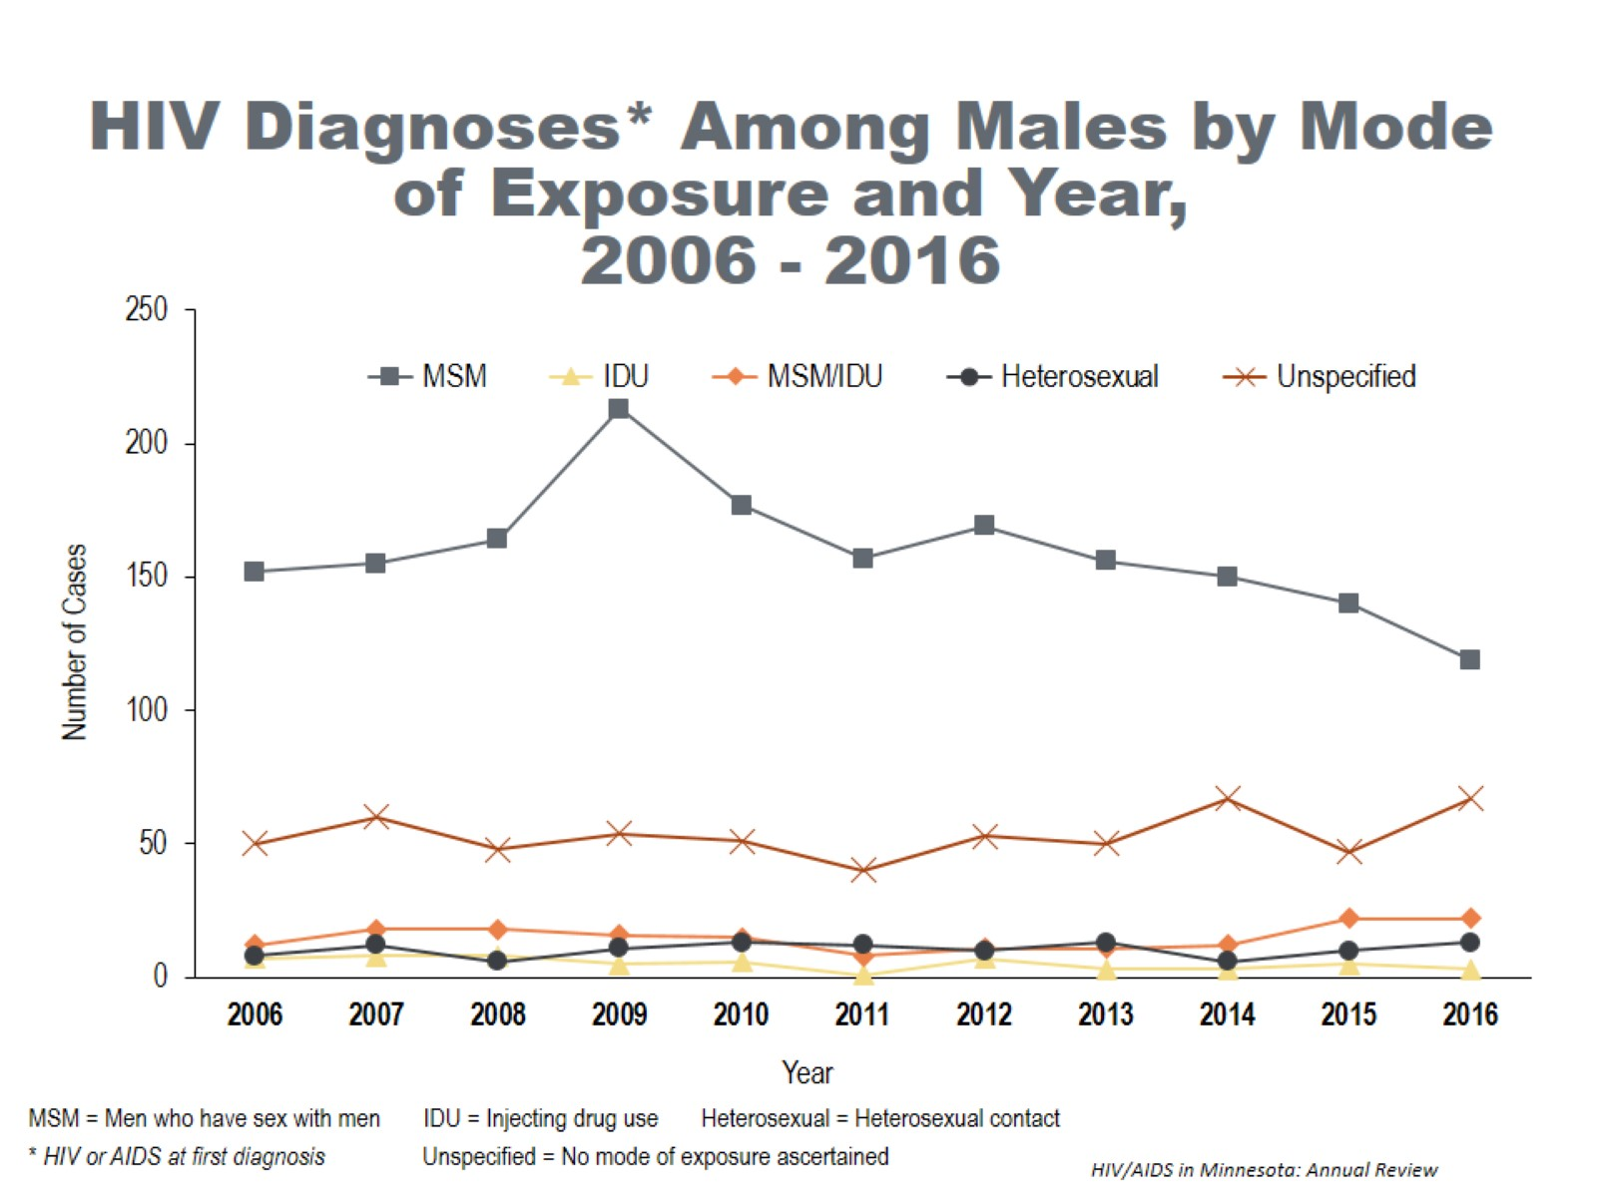
Notes:
When we look at HIV diagnoses only among males, MSM accounts for a larger proportion of the new diagnoses. In 2016, MSM and MSM/IDU accounted for 63% of the newly diagnosed cases among men. Throughout the past decade and again in 2016, unspecified risk is the second most common mode of exposure and has been accounting for an increasing proportion of cases since 2011.
There has been a stable increased number of cases of injection drug users (including IDU only and MSM/IDU) since 2015 at 25 cases for 2016.

Slide 32
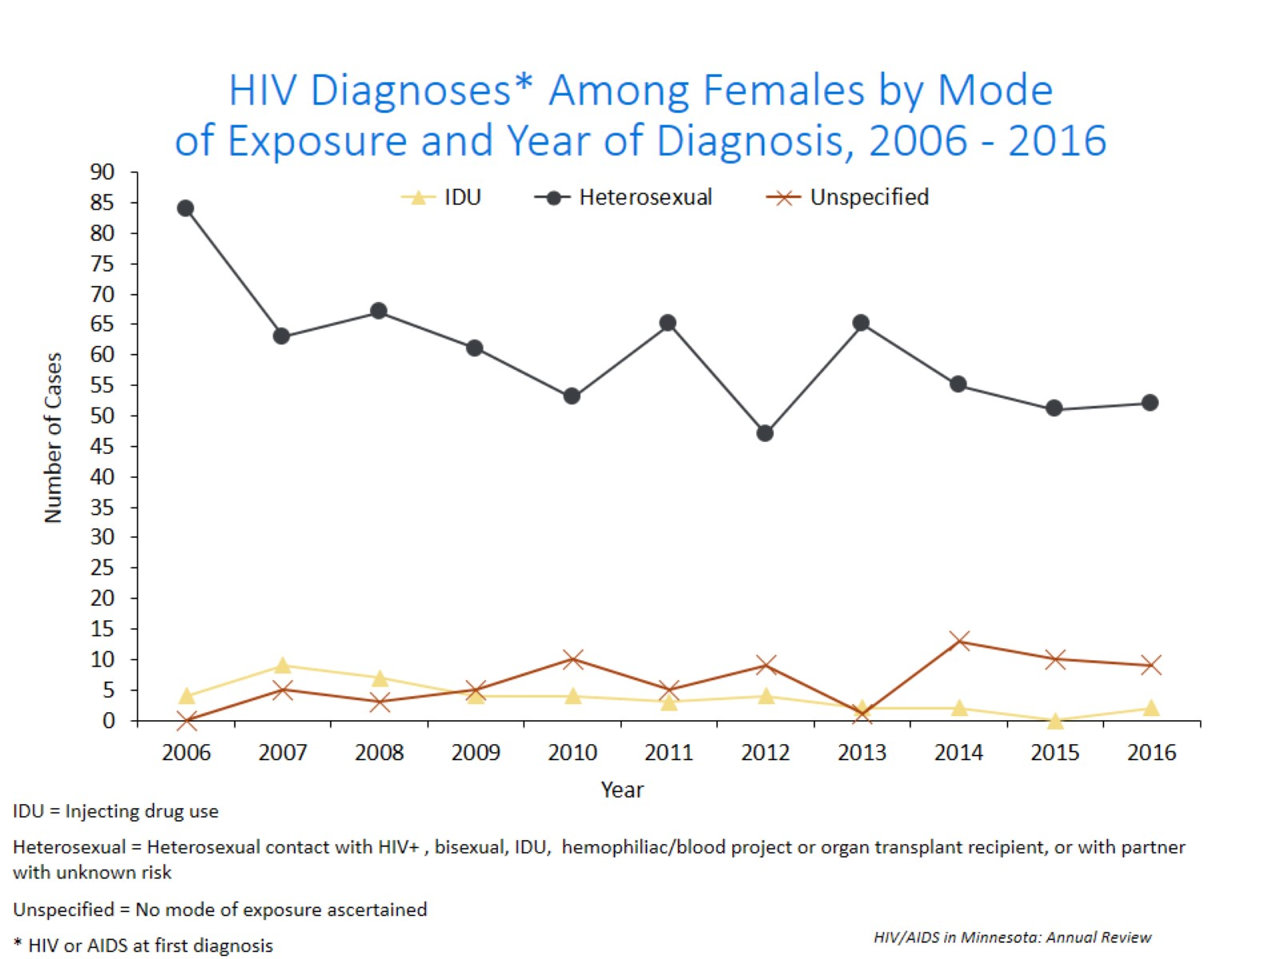
Notes:
For women, the most common mode of exposure for the past decade has been Heterosexual contact. However, like men the number of cases with unspecified risk is increasing.

Slide 33
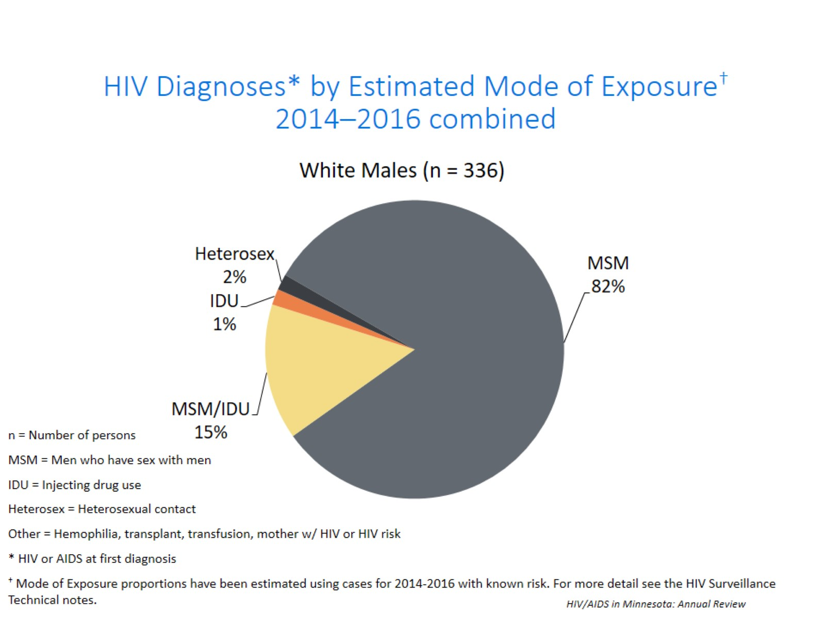
Notes:
The proportion of cases attributable to a certain mode of exposure differs not only by gender, but also by race. Of the 336 new HIV infections diagnosed among white males between 2014 and 2016, MSM or MSM/IDU accounted for an estimated 97% of cases; Injection Drug Use (IDU) accounted for 1% of cases, and heterosexual contact accounted for the remaining 2% of cases.

Slide 34
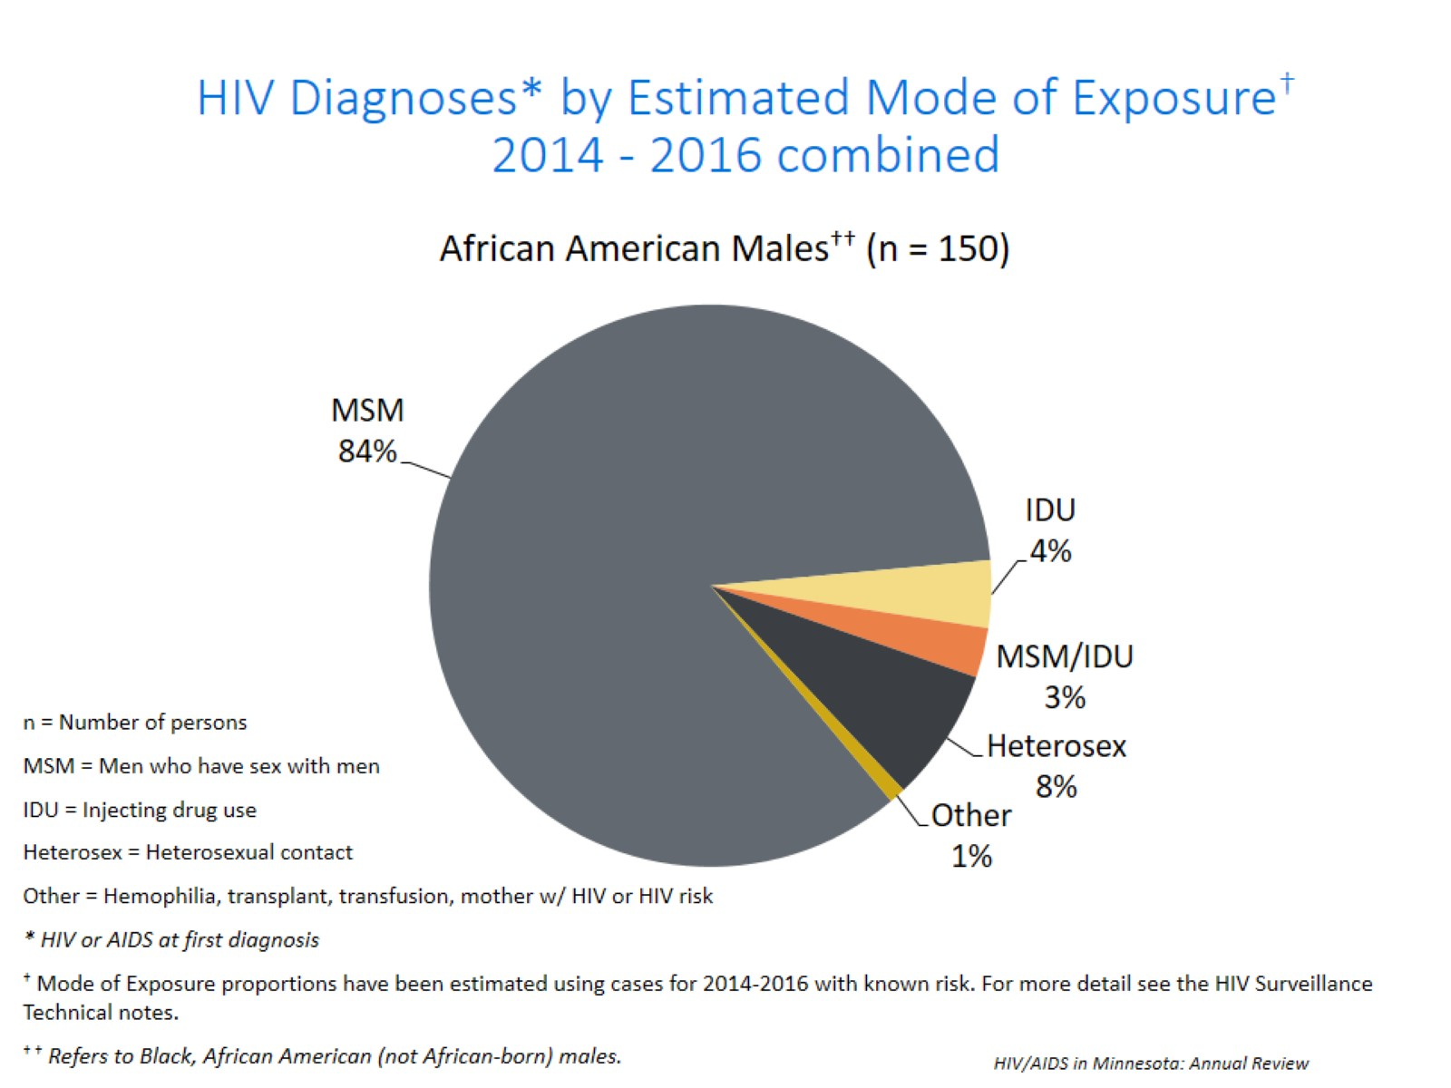
Notes:
Of the 150 new HIV infections diagnosed among African American males between 2014 and 2016, MSM or MSM/IDU accounted for an estimated 87% of cases; IDU accounted for 4% of cases, heterosexual contact accounted for 8% of cases and other risk accounted for the remaining 1% of cases.

Slide 35
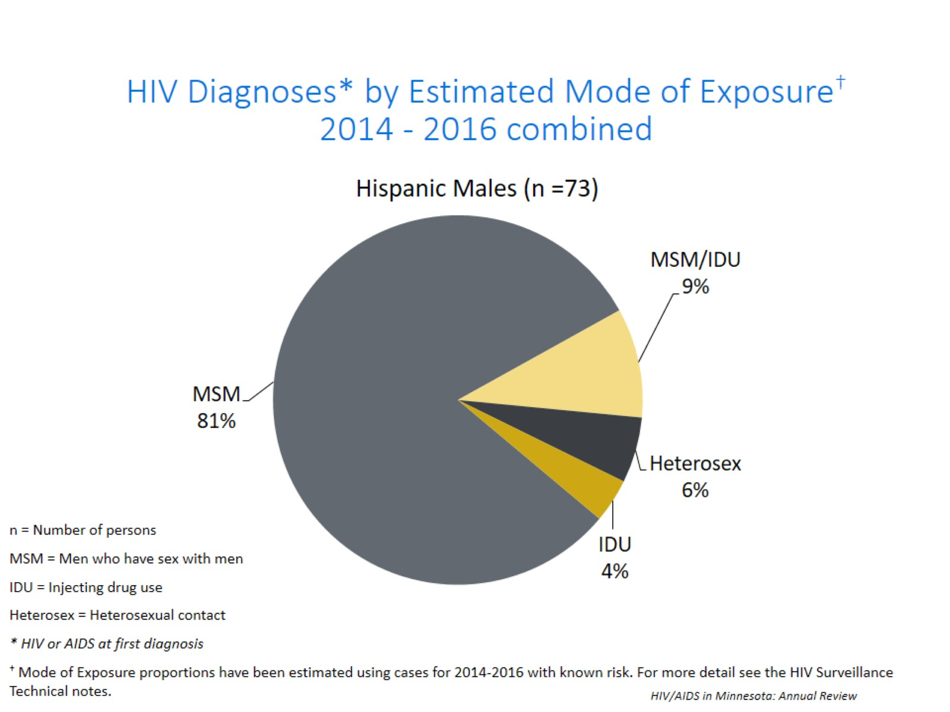
Notes:
Of the 73 new HIV infections diagnosed among Hispanic males between 2014 and 2016, MSM or MSM/IDU accounted for an estimated 90% of cases; heterosexual contact accounted for 6% of cases and IDU risk accounted for the remaining 4% of cases.

Slide 36
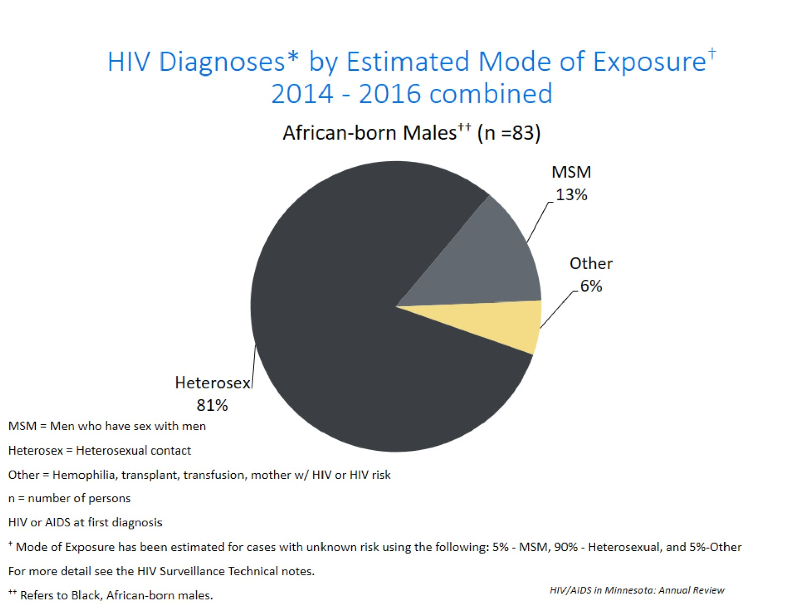
Notes:
Of the 83 new HIV infections diagnosed among African-born males between 2014 and 2016, MSM or MSM/IDU accounted for an estimated 13% of cases; heterosexual contact accounted for 81% of cases and other risk accounted for the remaining 6% of cases.

Slide 37
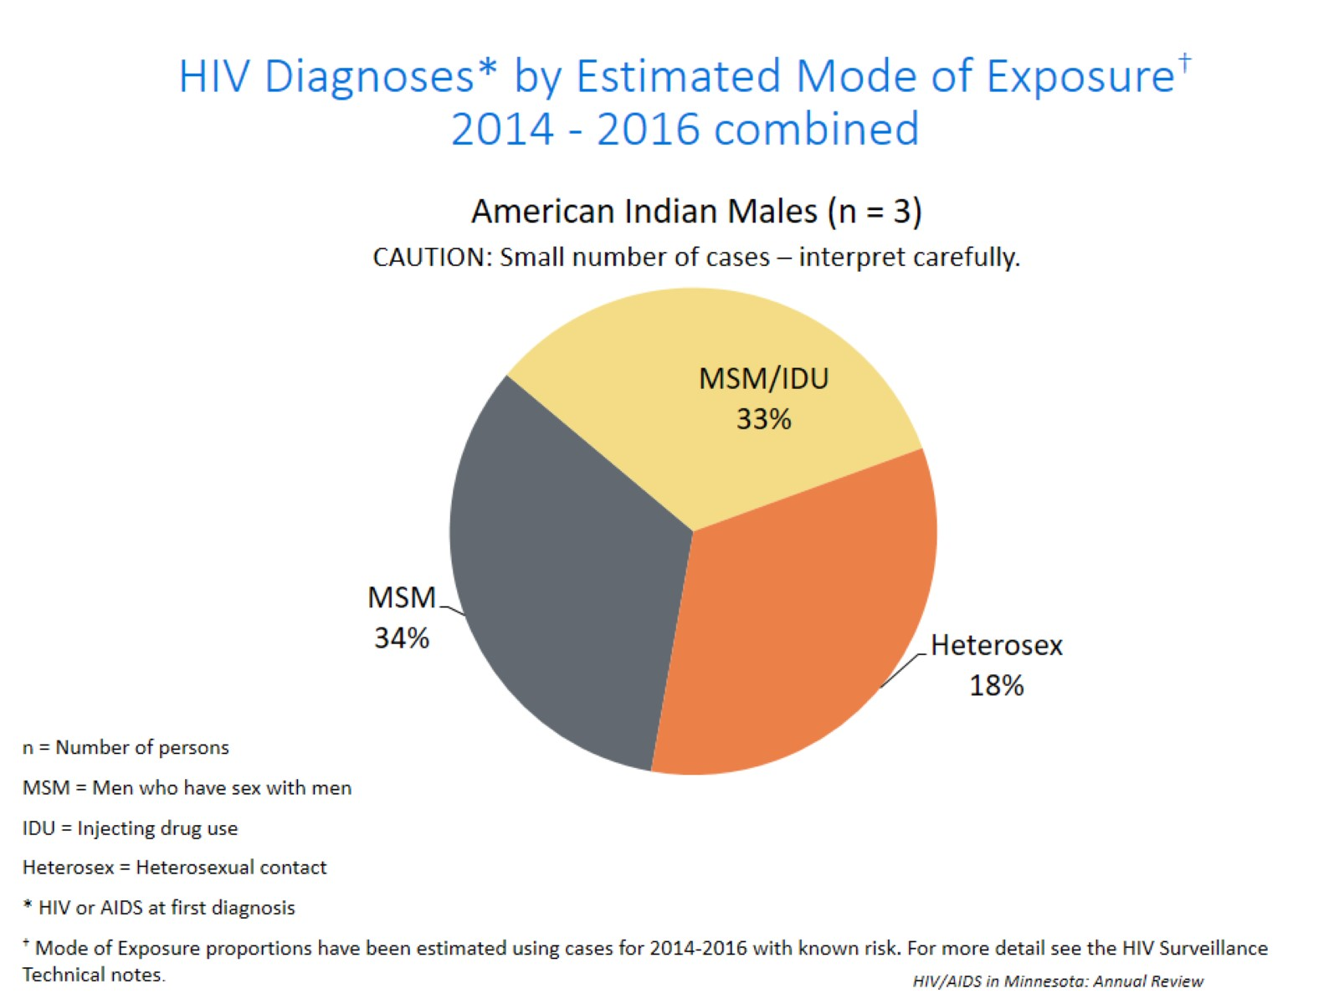
Notes:
Of the 3 new HIV infections diagnosed among American Indian males between 2014 and 2016, MSM or MSM/IDU accounted for an estimated 67% of cases; heterosexual contact accounted for 18% of cases. However, the number of cases among American Indian men during this time period is insufficient to make generalizations regarding risk. These numbers should be interpreted carefully.

Slide 38
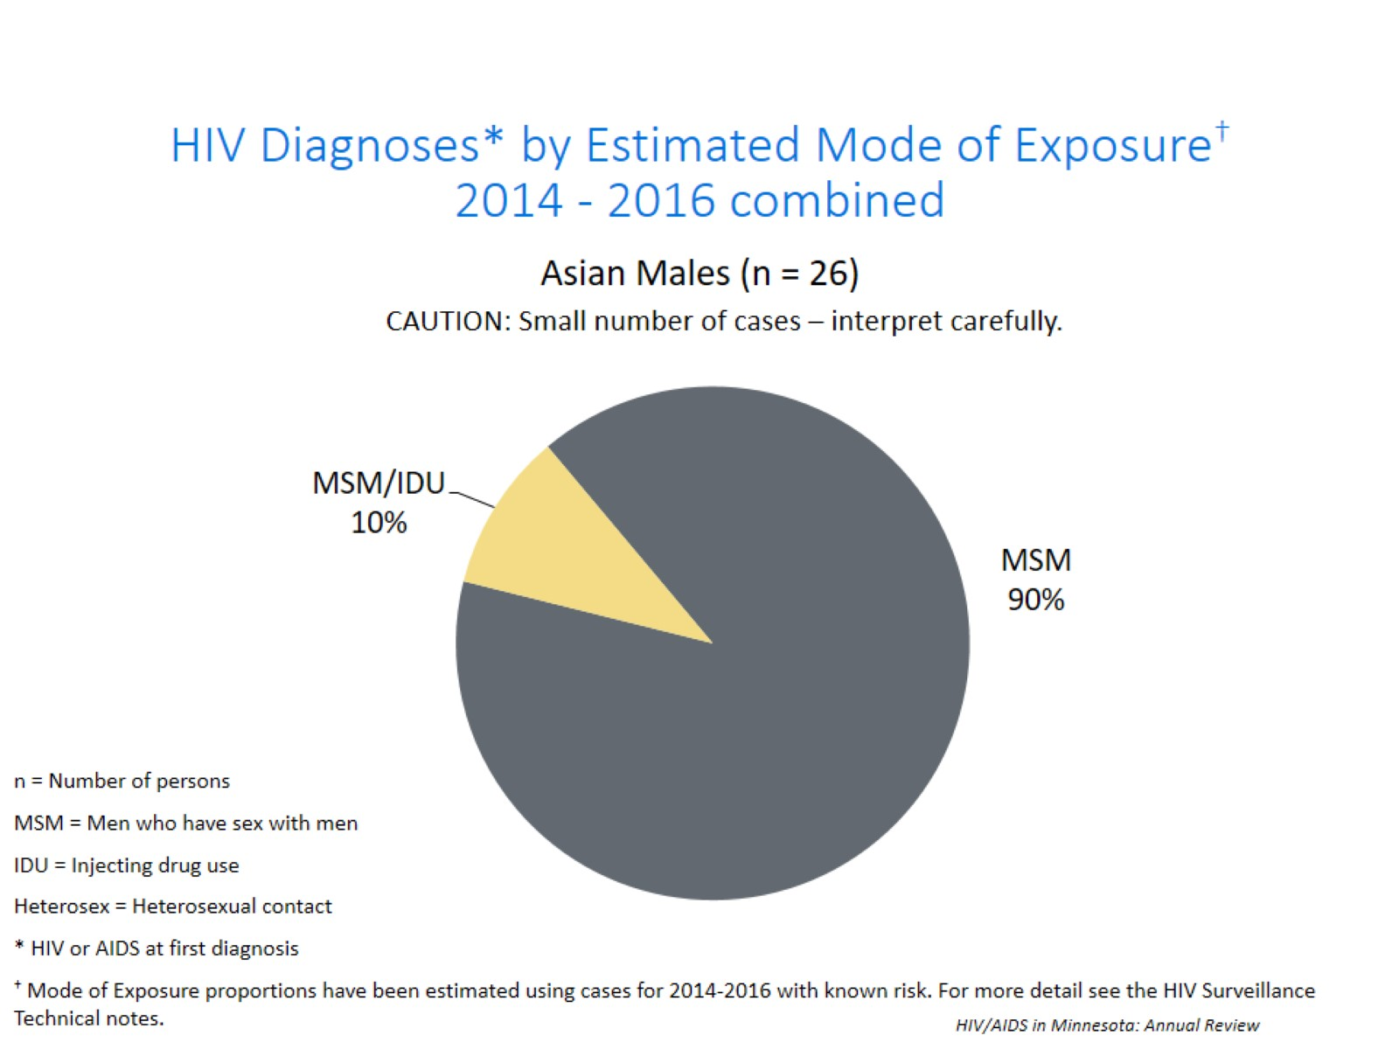
Notes:
Of the 26 new HIV infections diagnosed among Asian males between 2014 and 2016, MSM or MSM/IDU accounted for all cases. However, the number of cases among Asian men during this time period is insufficient to make generalizations regarding risk. These numbers should be interpreted carefully.

Slide 39
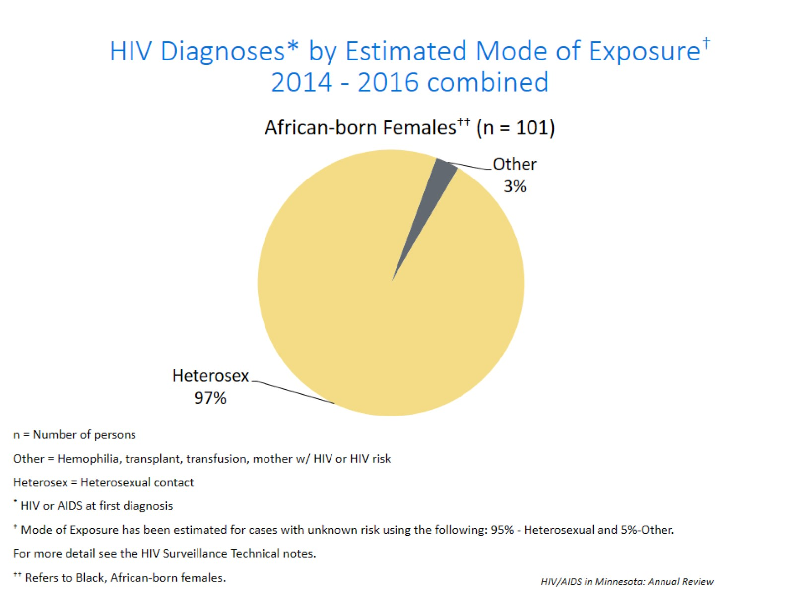
Notes:
Of the 101 new HIV infections diagnosed among African-born females between 2014 and 2016,Heterosexual contact accounted for an estimated 97% of cases and Other risk accounted for the remaining 3% of cases.

Slide 40
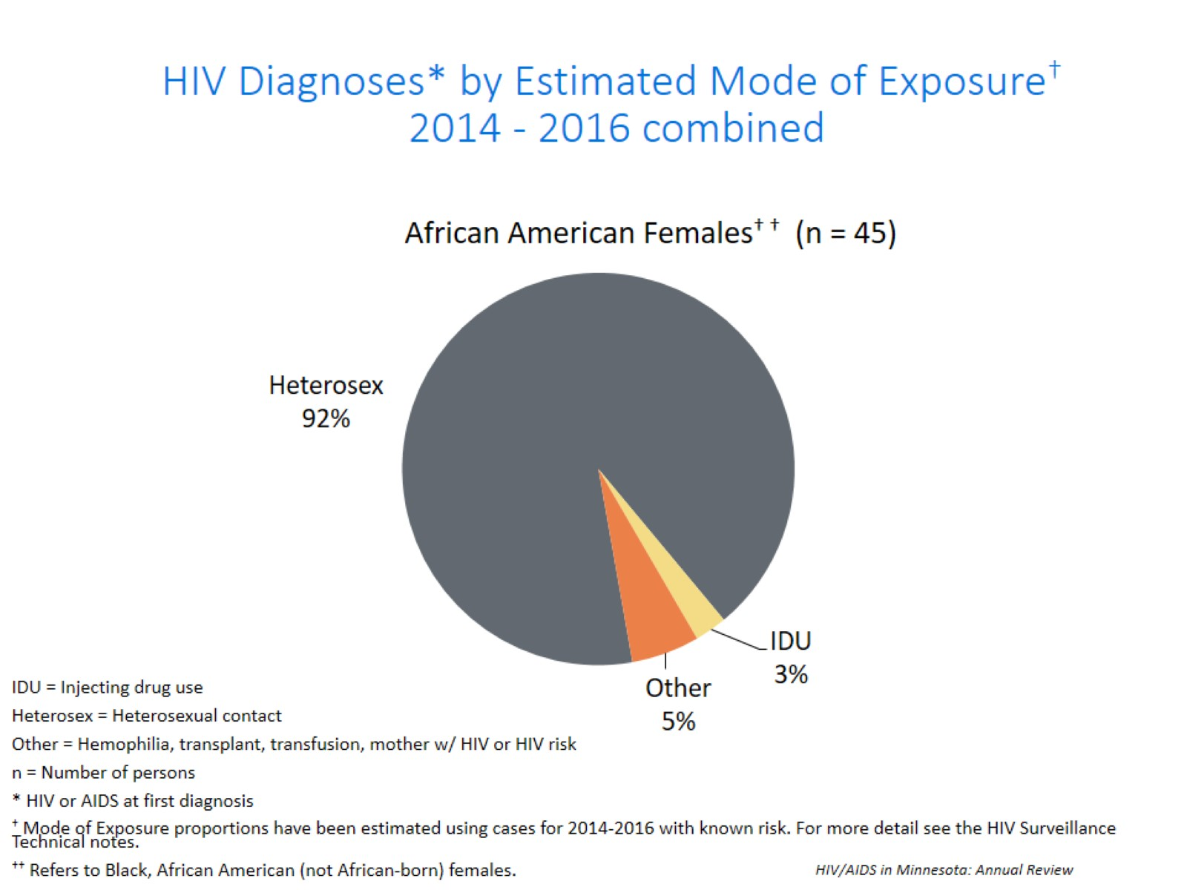
Notes:
Of the 45 new HIV infections diagnosed among African American females between 2014 and 2016, Heterosexual contact accounted for an estimated 92% of cases and other risk accounted for 5% of cases and IDU risk accounted for the remaining 3% of cases.

Slide 41
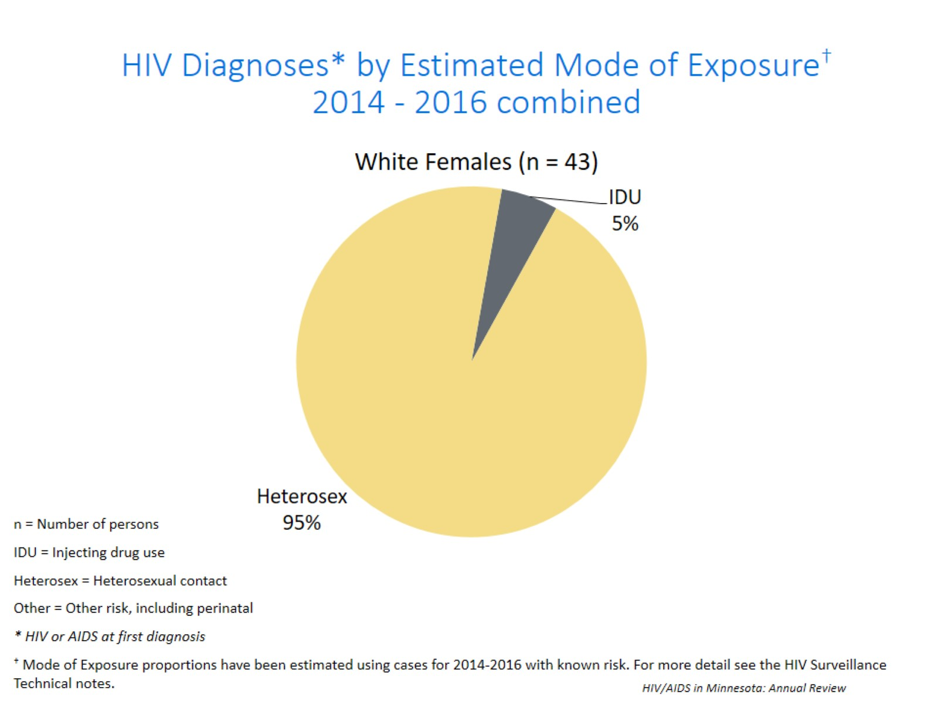
Notes:
Of the 43 new HIV infections diagnosed among white females between 2014 and 2016, Heterosexual contact accounted for an estimated 95% of cases, and IDU accounted for an estimated 5% of cases.

Slide 42
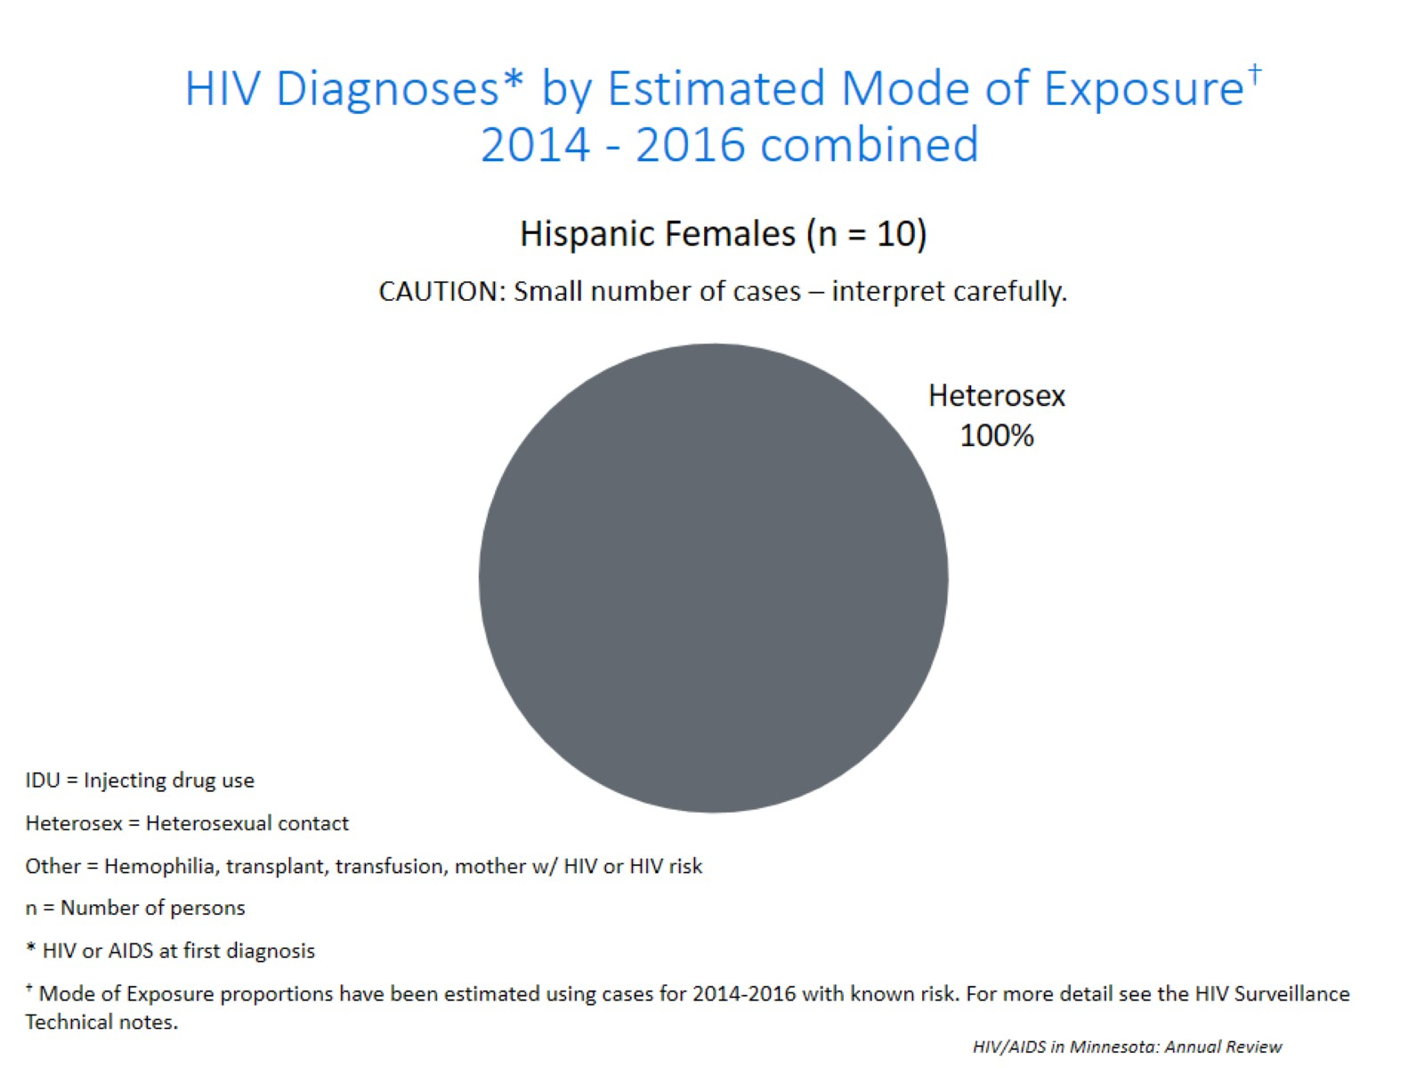
Notes:
Of the 10 new HIV infections diagnosed among Hispanic females between 2014 and 2016, Heterosexual contact accounted for an estimated 100% of cases. However, the number of cases among Hispanic women during this time period is insufficient to make generalizations regarding risk. These numbers should be interpreted carefully.

Slide 43
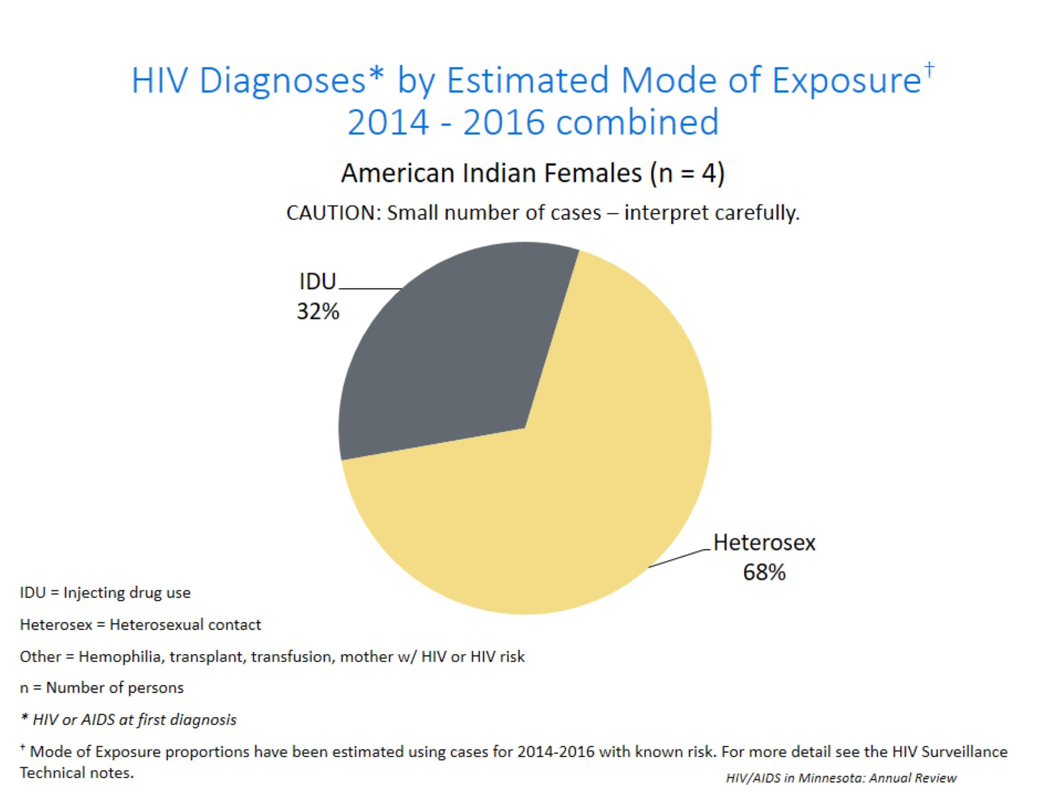
Notes:
Of the 4 new HIV infections diagnosed among American Indian females between 2014 and 2016, Heterosexual contact accounted for an estimated 68% of cases, and IDU accounted for an estimated 32% of cases. However, the number of cases among American Indian women during this time period is insufficient to make generalizations regarding risk. These numbers should be interpreted carefully.

Slide 44
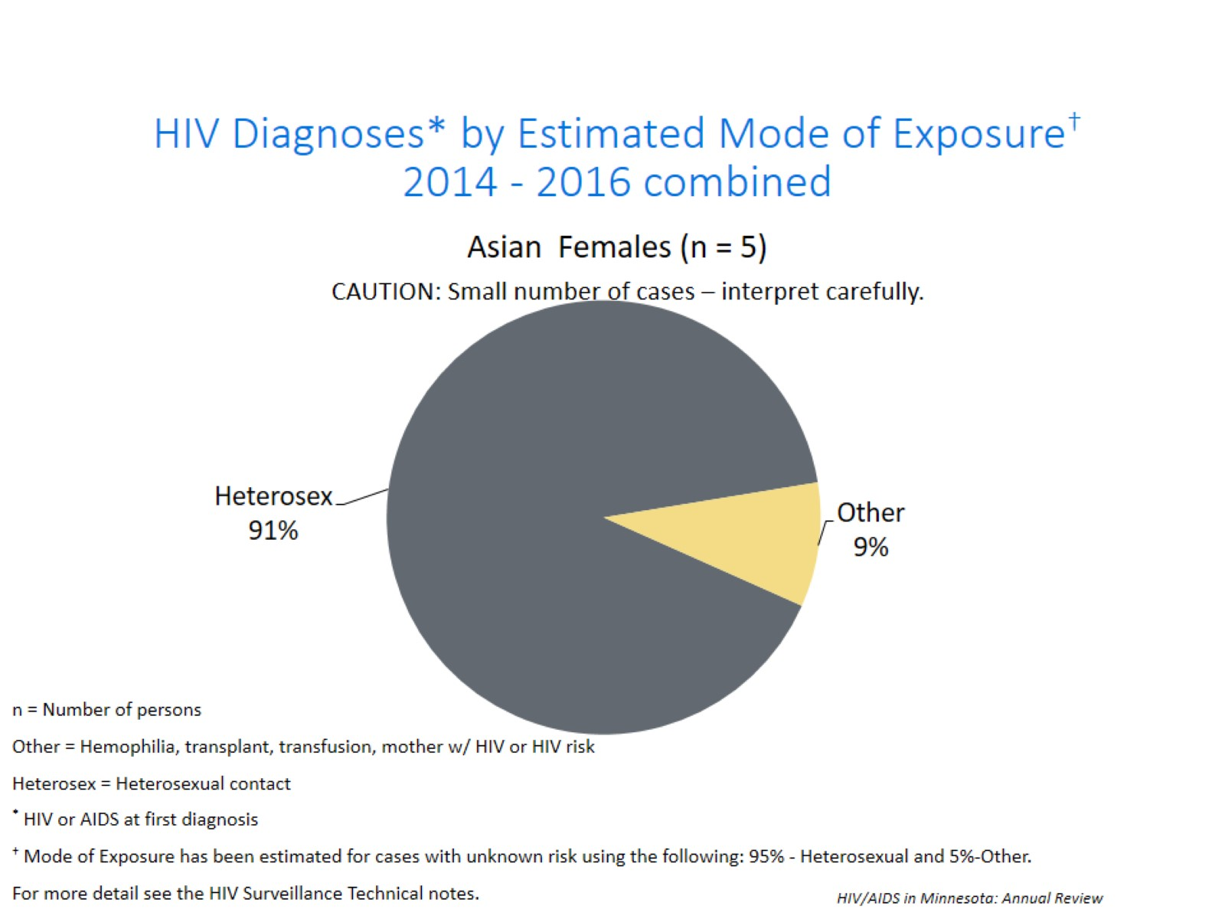
Notes:
Of the 5 new HIV infection diagnosed among Asian-Pacific Islander females between 2014 and 2016, Heterosexual contact accounted for an estimated 91% of cases, and other accounted for the remaining 9% of cases. However, the number of cases among Asian women during this time period is insufficient to make generalizations regarding risk. These numbers should be interpreted carefully.

Slide 45
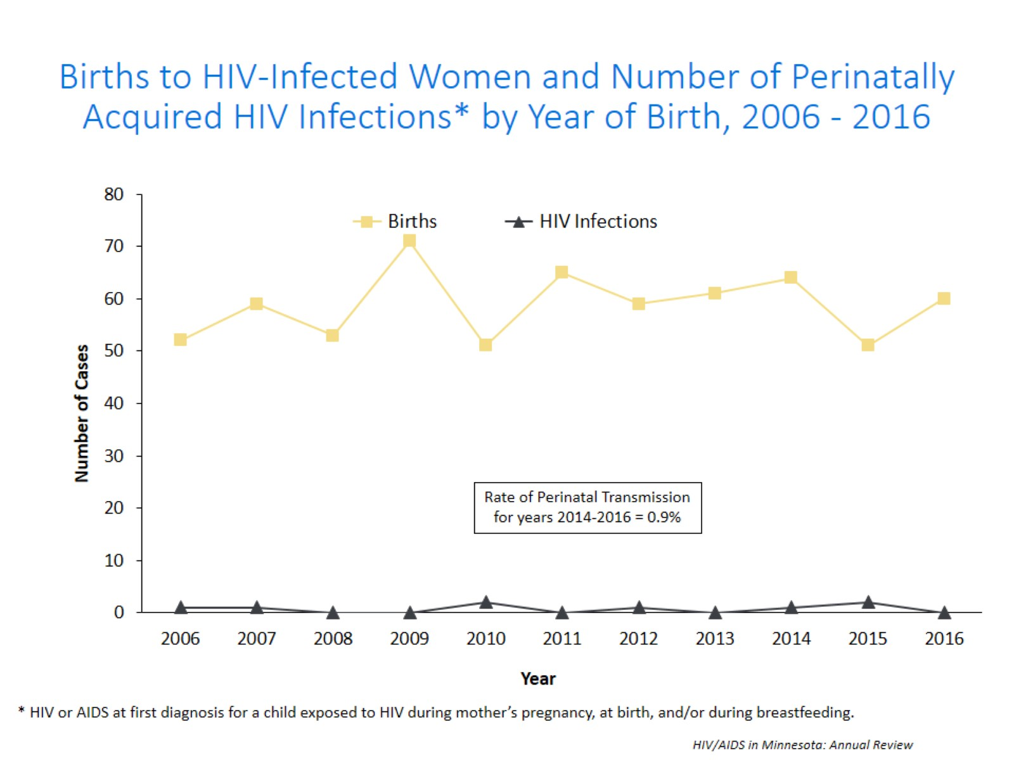
Notes:
The ability to interrupt the transmission of HIV from mother to child via antiretroviral therapy and appropriate perinatal care is an important accomplishment in the history of the HIV/AIDS epidemic. Newborn HIV infection rates range from 25-30% without antiretroviral therapy, but decrease to 1-2% with appropriate medical intervention.
For the past decade the number of births to HIV-infected women increased steadily from 52 in 2005 to 60 births in 2016. The rate of transmission has decreased from 15% between 1994 and 1996 to 0.9% in the past three years, with no HIV+ baby born to HIV+ mother in Minnesota in 2016.

Slide 46
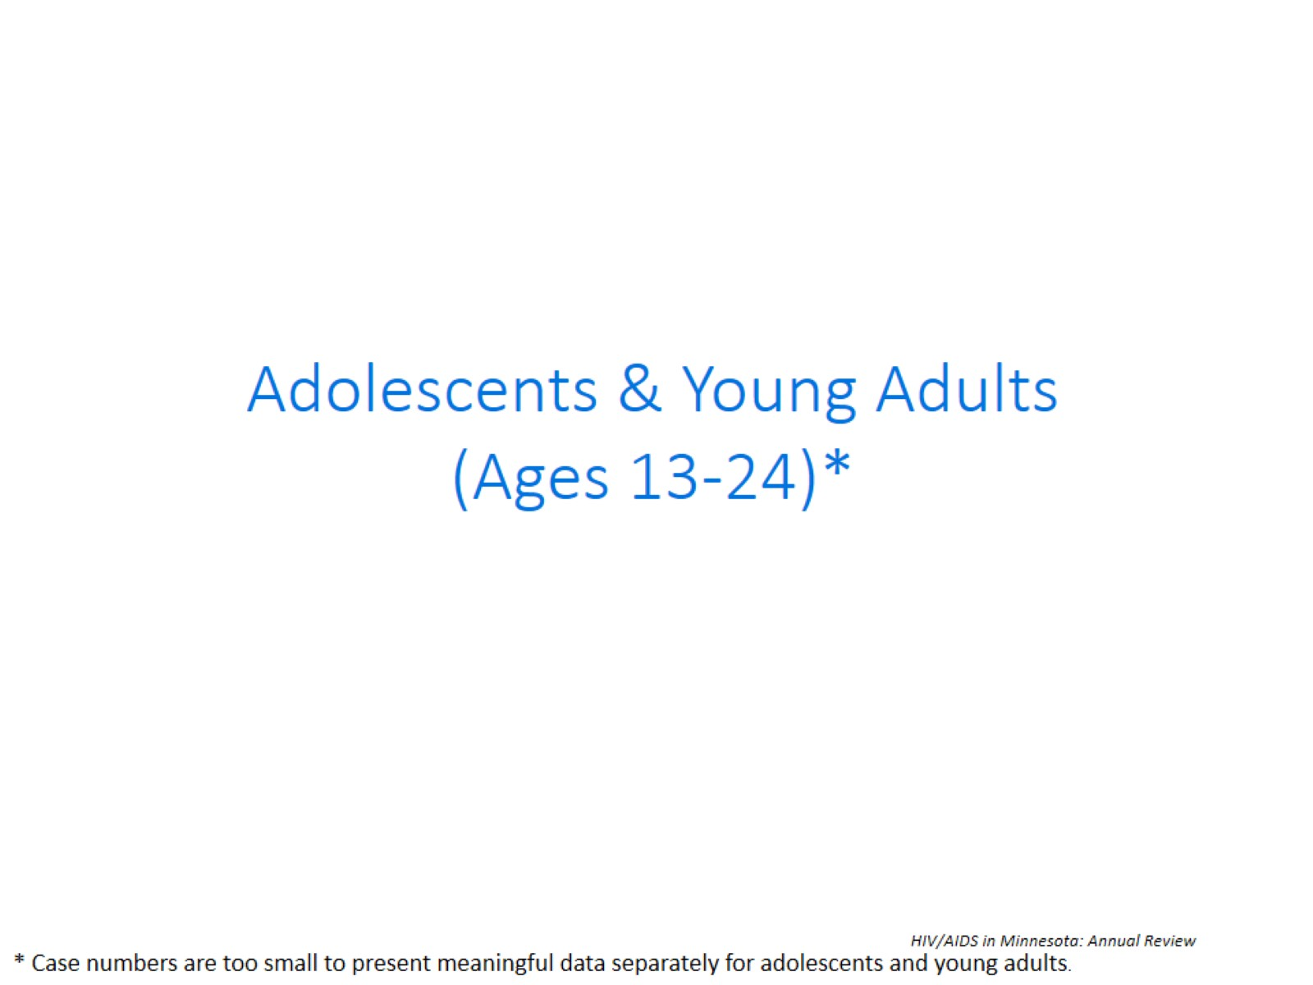

Slide 47
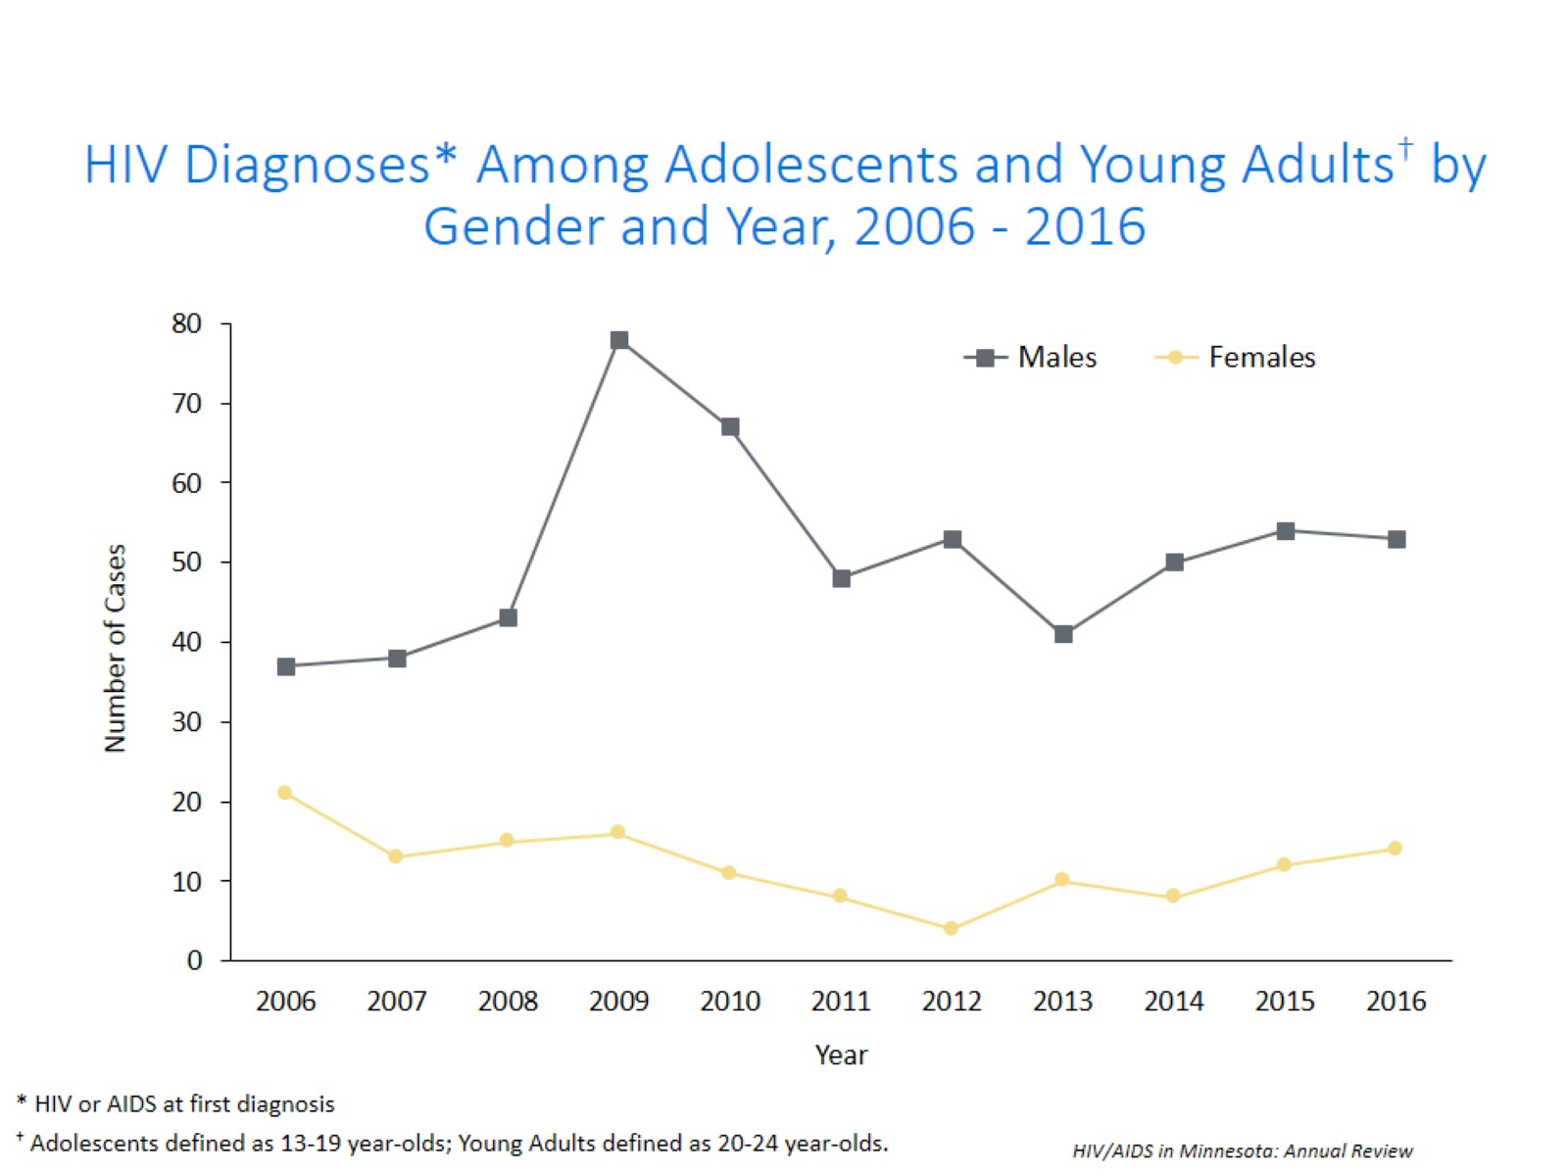
Notes:
Between 2006 and 2009 the number of new HIV diagnoses among males aged 13-24 increased rapidly. Since 2009, we’ve seen a promising trend of a decreasing number of new diagnoses in this age group. In 2016, the number of cases remained similar to the previous year with 54 cases in 2015 and 53 cases in 2016.
Unlike young men, the annual number of new HIV infections diagnosed among adolescent and young adult women fluctuates due to smaller numbers, but, there appears to be a small increase over the past 3 years. In 2016, the number of cases remained similar to the previous year with 12 cases in 2015 and 14 cases in 2016.

Slide 48
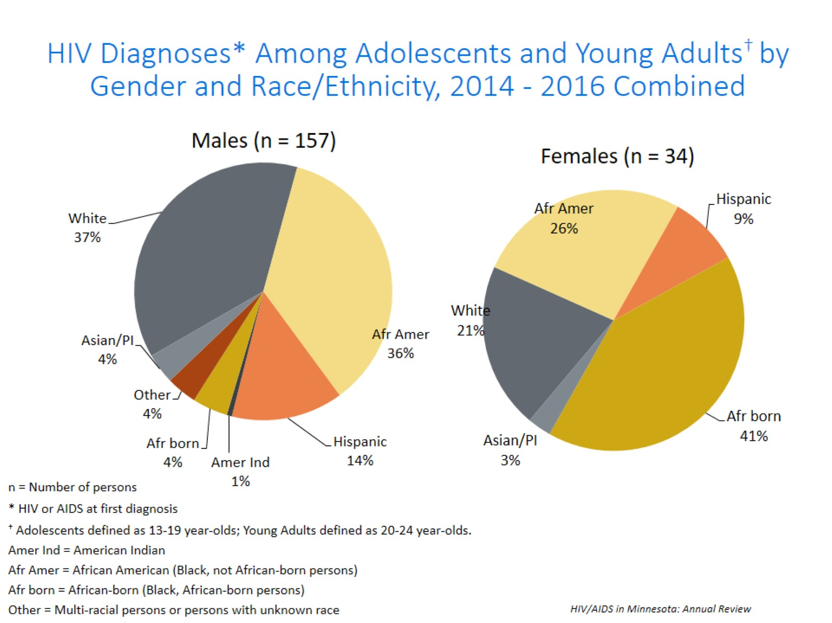
Notes:
Between the years 2014 and 2016 we had 157 males cases reported among adolescents and young adults, and 34 females reported in the 13-24 age group. For males, Non-Hispanic white and African-American males each accounted for 37% and 36% respectively, and Hispanic males of any race accounted for 14% in the 13-24 age group. Among females, Non-Hispanic black African-born and African-Americans together accounted for 67% of the cases; while non-Hispanic white females accounted for 21%, and Hispanic women of any race accounted for 9% of cases.

Slide 49
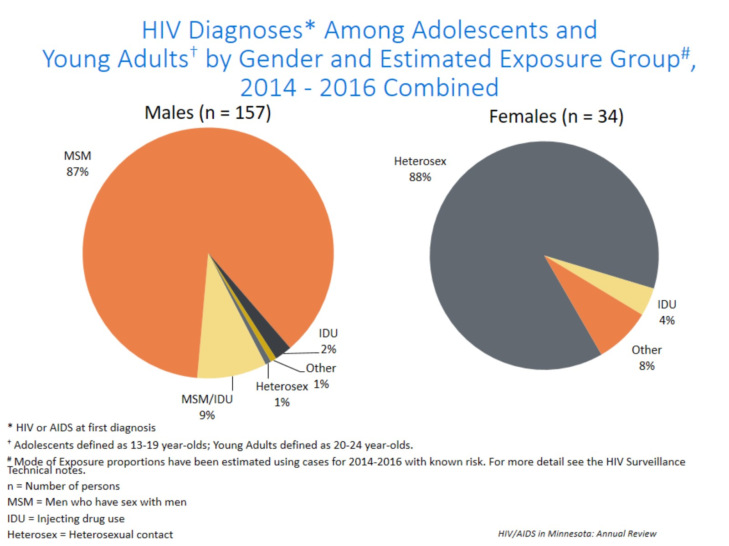
Notes:
For mode of exposure among males in the 13-24 age group, Male to Male sex was estimated to account for 87% of the cases, while the combined risk of MSM and IDU was estimated to account for 9% of the cases and 1% was attributed to heterosexual contact.
Among females, 88% of cases were estimated to have heterosexual contact as their mode of exposure, while 4% were attributed to injection drug use in the 13-24 age group.

Slide 50
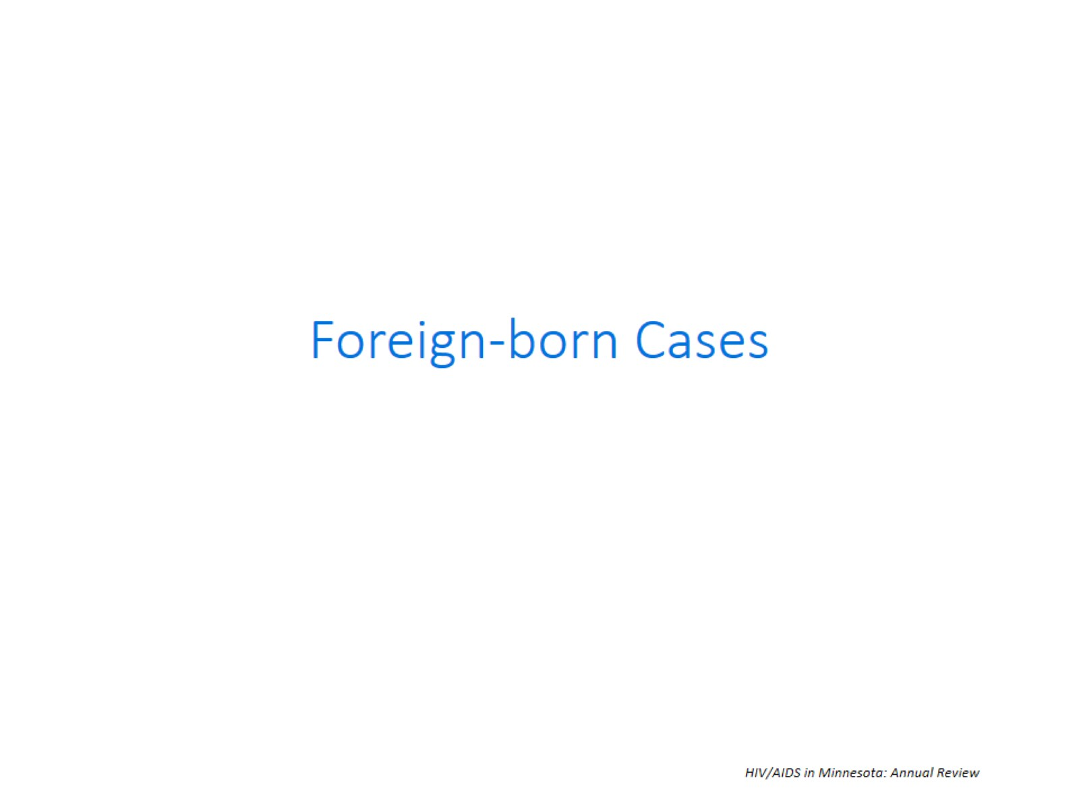

Slide 51
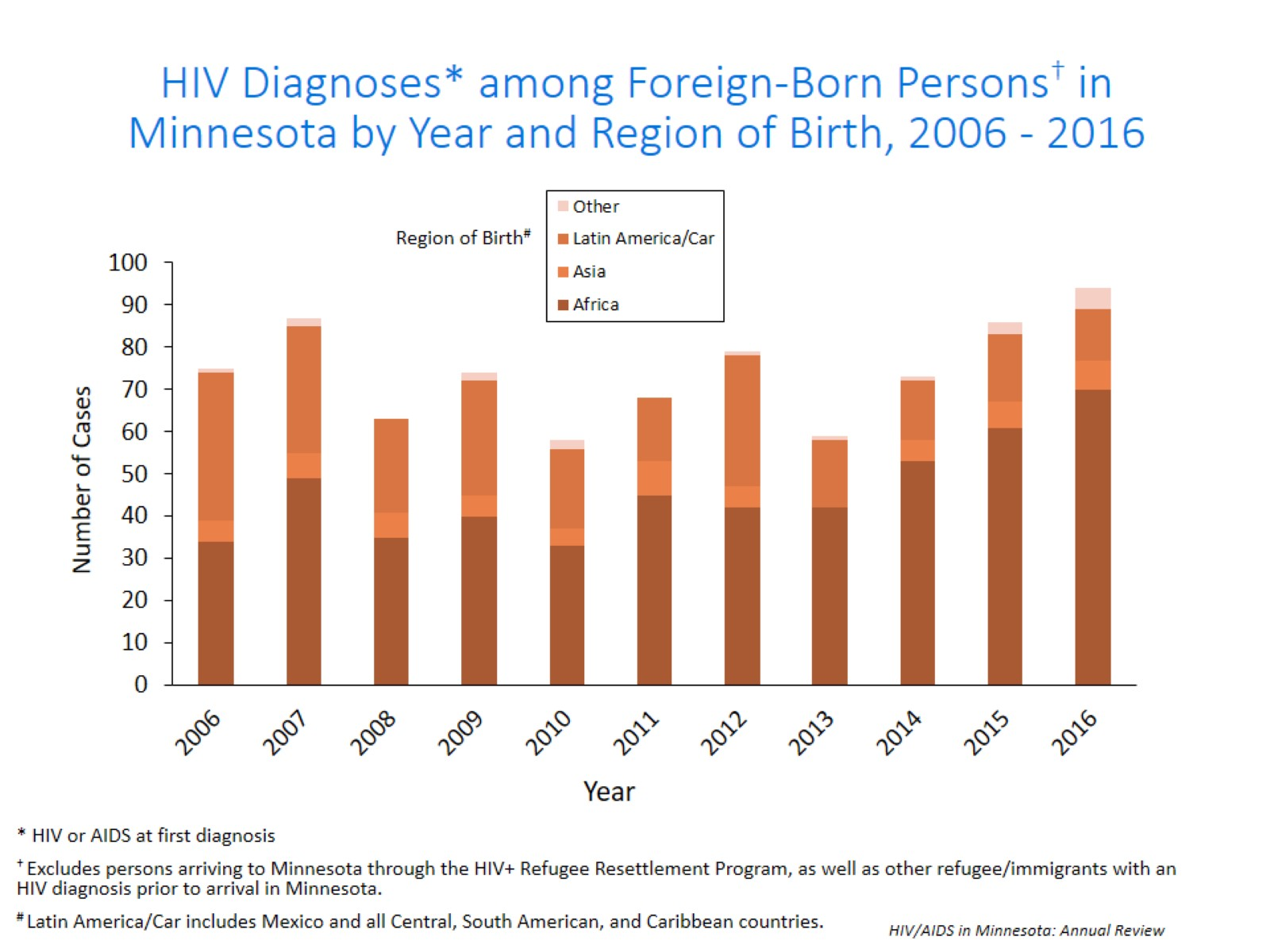
Notes:
The number of new HIV infections diagnosed among foreign-born persons in Minnesota has steadily increased from 20 cases in 1990 to 94 cases in 2016. This increase has been largely driven by the increase of cases among African-born persons from 8 cases in 1990 to 70 cases in 2016, as well as, persons from Mexico, Central and South America from 6 cases in 1990 to 12 cases in 2016. Among new HIV infections diagnosed in 2016, 32% were among foreign-born persons. Based on 2010-2012 American Community Survey data, foreign-born persons make up 7% of the total Minnesota population and are, therefore, disproportionately affected by HIV. Among African-born this disparity is even more evident, while African-born persons make up just over 1% of the Minnesota population they accounted for 24% of new HIV infections in 2016.
In 2016, there were 94 cases of newly reported HIV among foreign-born persons, representing nearly 1 out of 3 of all new cases. The majority of foreign born cases in 2016 were from Africa, followed by Latin America and the Caribbean.

Slide 52
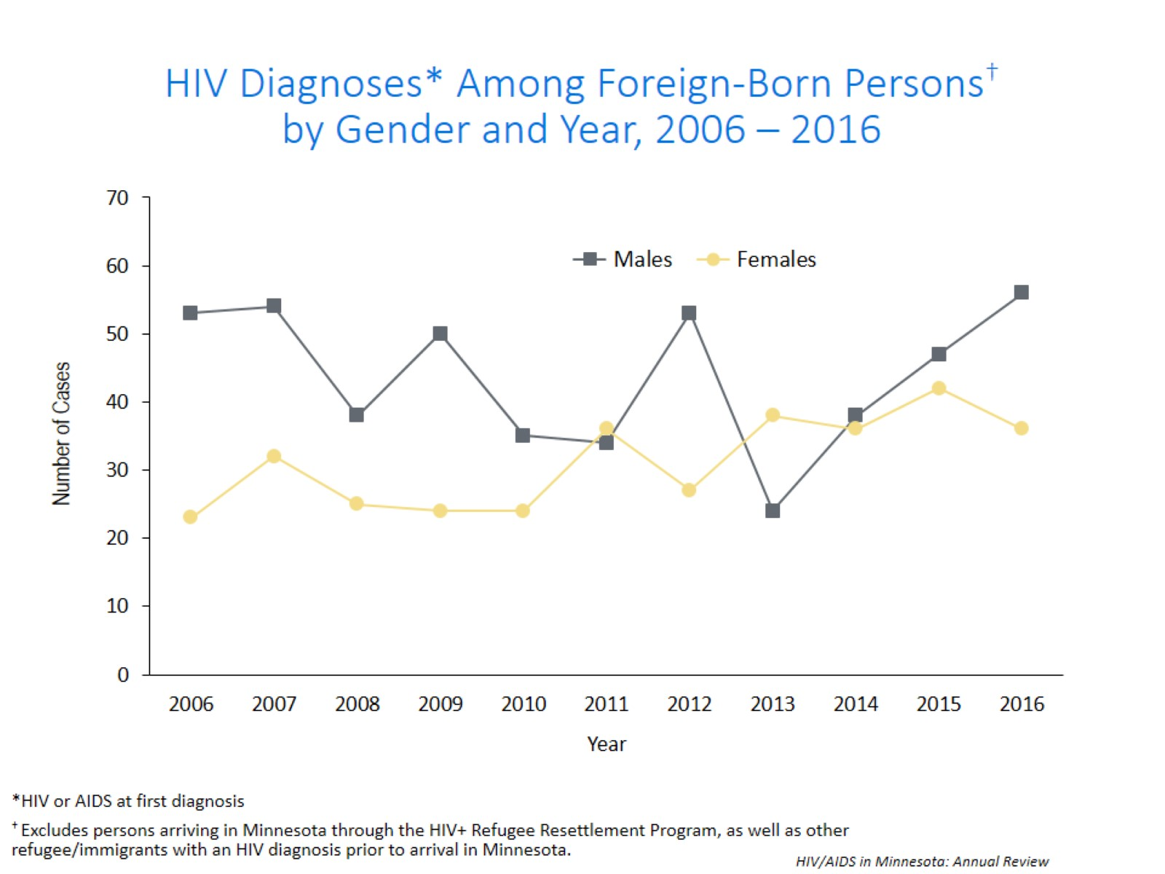
Notes:
In 2016, the number of foreign-born males increased from 47 cases in 2015 to 56 in 2016.
There was a decrease for foreign-born females from 42 in 2015 to 36 in 2016.

Slide 53

Notes:
Four countries (Liberia, Ethiopia, Somalia, and Mexico) accounted for a majority of new infections among foreign-born persons, however there are over 27 countries represented among the 94 new foreign born cases in 2016.

Slide 54

Notes:
Late testers are defined as anyone with an AIDS diagnosis within one year of their initial HIV diagnosis. This is an important trend to watch as people who progress to AIDS within one year of their HIV diagnosis represent persons who are likely diagnosed well after their initial infection and represent missed testing opportunities earlier in the course of their infection.

Slide 55

Notes:
In 2015, 28% of new cases were late testers. This proportion of cases has remained relatively the same over the past 10 years, ranging between 27-34%. Most late testers, about 85%, are diagnosed with AIDS at the same time they are initially diagnosed with HIV infection.
For 2016, 23% of new cases were late testers so far, which represents only a partial follow-up year to only March 20, 2017.
As with other characteristics of the HIV epidemic in Minnesota, the proportion of late testers varies by demographic characteristics. Historically, foreign-born persons have had a higher proportion of late-testers.

Slide 56

Notes:
The proportion of late testers can vary by gender. In 2016, the proportion of late testers among females decreased to 24%, while the proportion of late testers among males decreased to 20%.

Slide 57

Notes:
As with other characteristics of the HIV epidemic in Minnesota, the proportion of late testers varies by demographic characteristics. The most significant differences occur by race/ethnicity, with the proportion of late testers in 2016 among African-born black (35%), whites (28%), and Hispanic (24%) being higher than among African Americans (19%). Similar data for American Indians and Asian/Pacific Islanders in a single year had fewer than 10 cases and are considered not stable and are therefore not represented here.

Slide 58

Notes:
Differences by age are as expected with the percentage of late testers increasing with age at time of diagnosis. In 2016, 6% of those diagnosed between the ages of 13 and 24 were late testers compared to 41% of those 40-44 years old. Percentage of late testers for 2016 includes only those progressing to AIDS through January 2017. As such, this percentage is likely to increase as additional reports are made to the MDH. Caution should be used due to smaller numbers by age group when interrupting the data.

Slide 59

Notes:
Differences by mode of transmission were not as great in 2016 as compared to previous years. In 2016, persons with a risk category of unspecified risk had the highest proportion of late testers at 37%, followed by heterosexual contact at 22%, IDU at 19%, and finally IDU MSM had the lowest proportion of late testers at 16%.

Slide 60

Notes:
During the past decade, foreign-born cases have a higher rate of late testers compared to US-born cases. In 2016, 34% of foreign-born cases were late testers compared to 18% of US-born cases.

