Slide 1
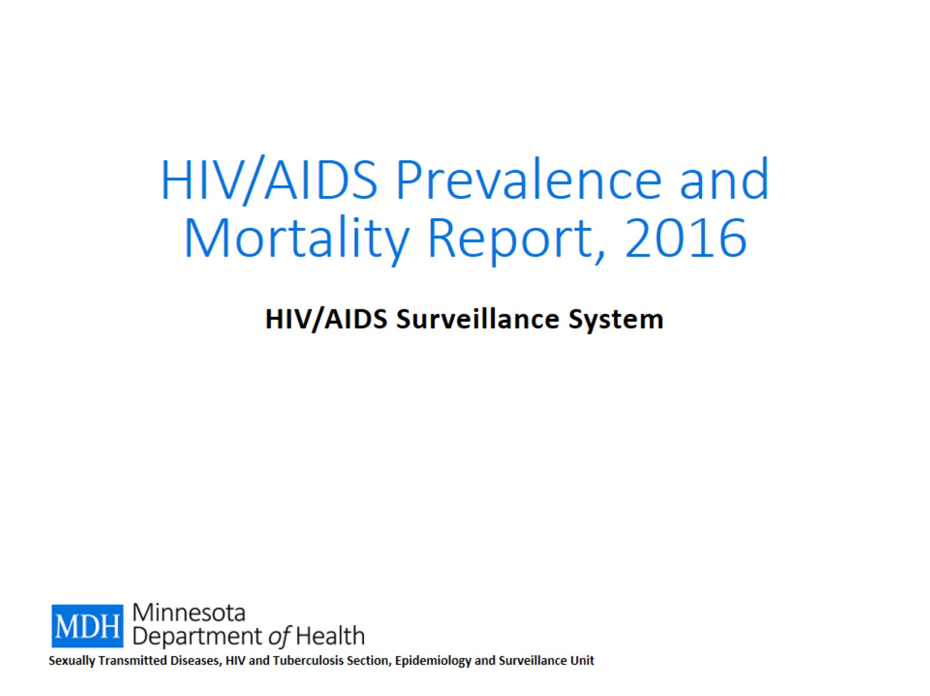
HIV/AIDS Prevalence and Mortality Report, 2016

Slide 2
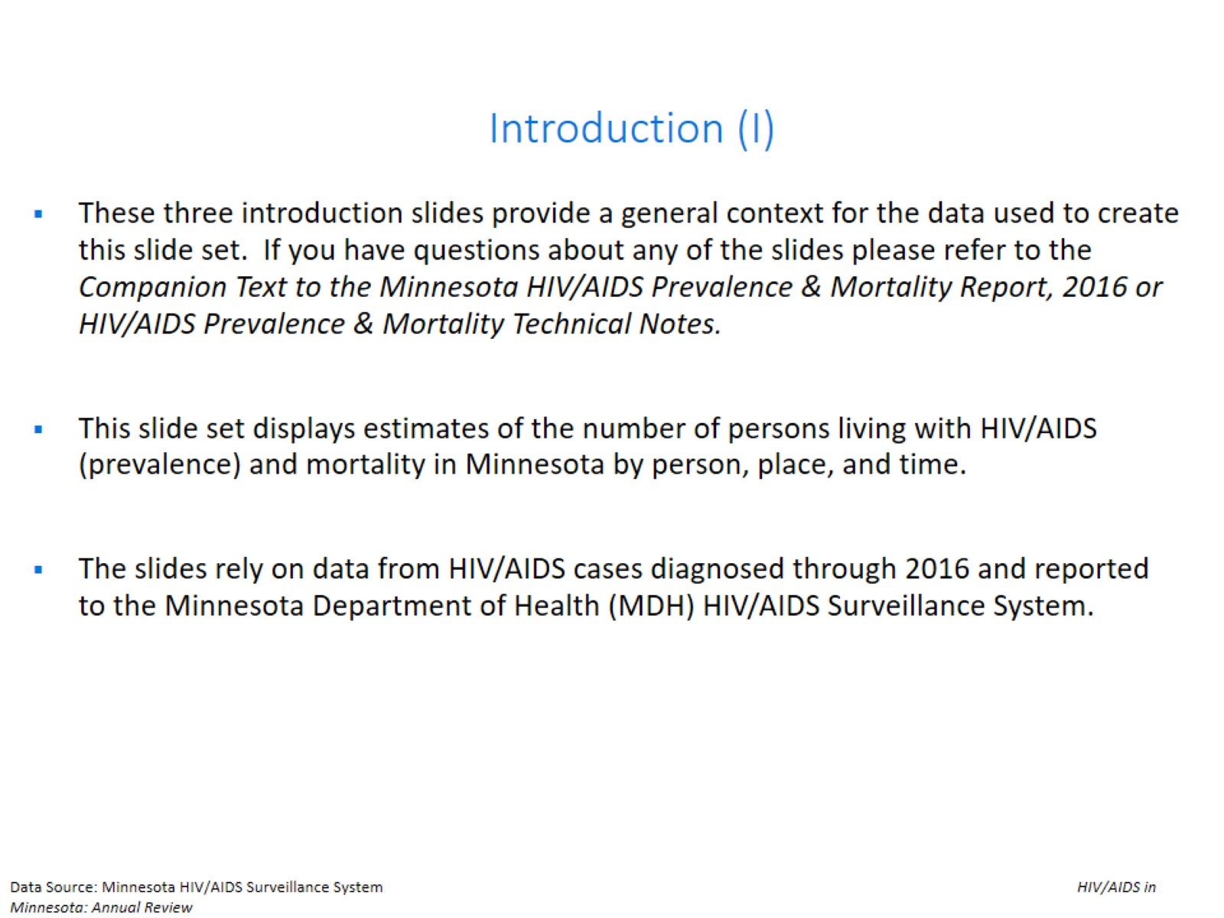
Introduction (I)

Slide 3
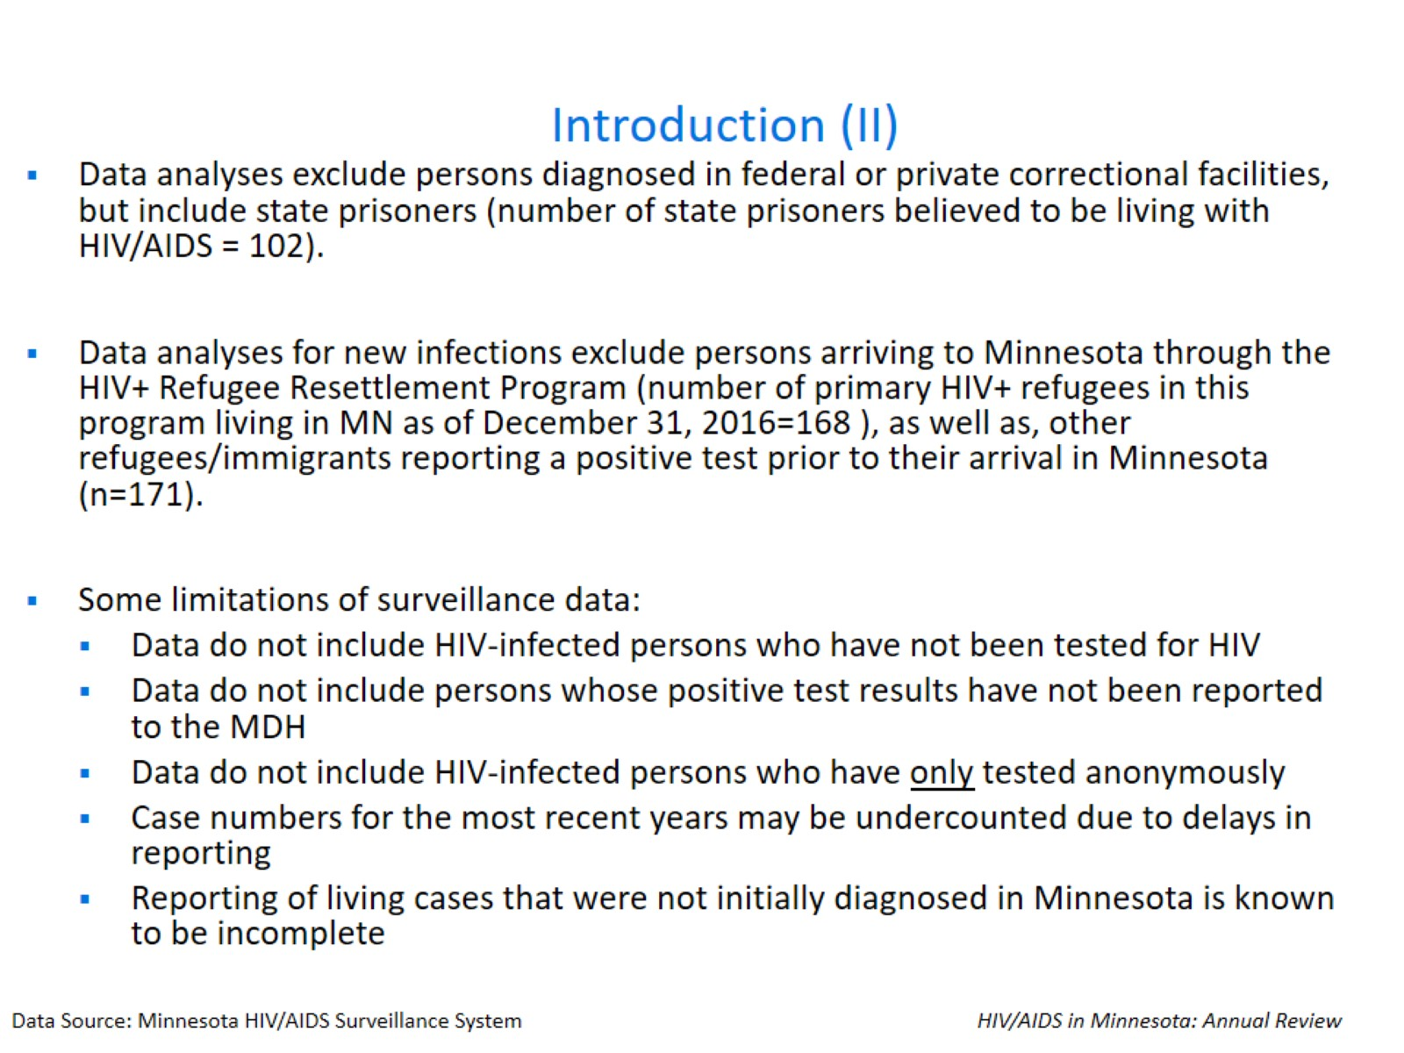
Introduction (II)

Slide 4
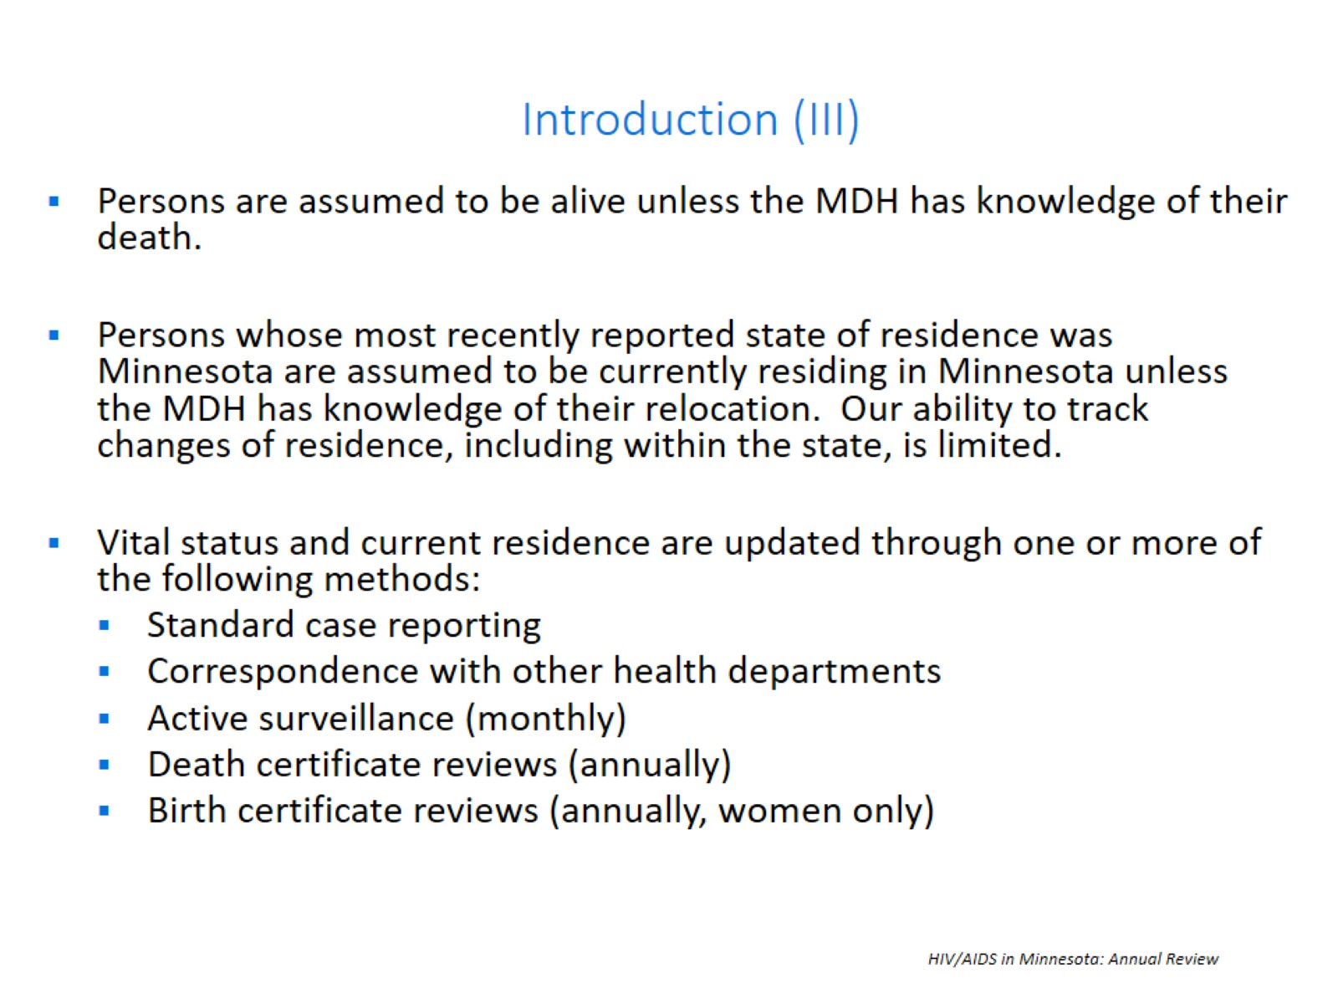
Introduction (III)

Slide 5
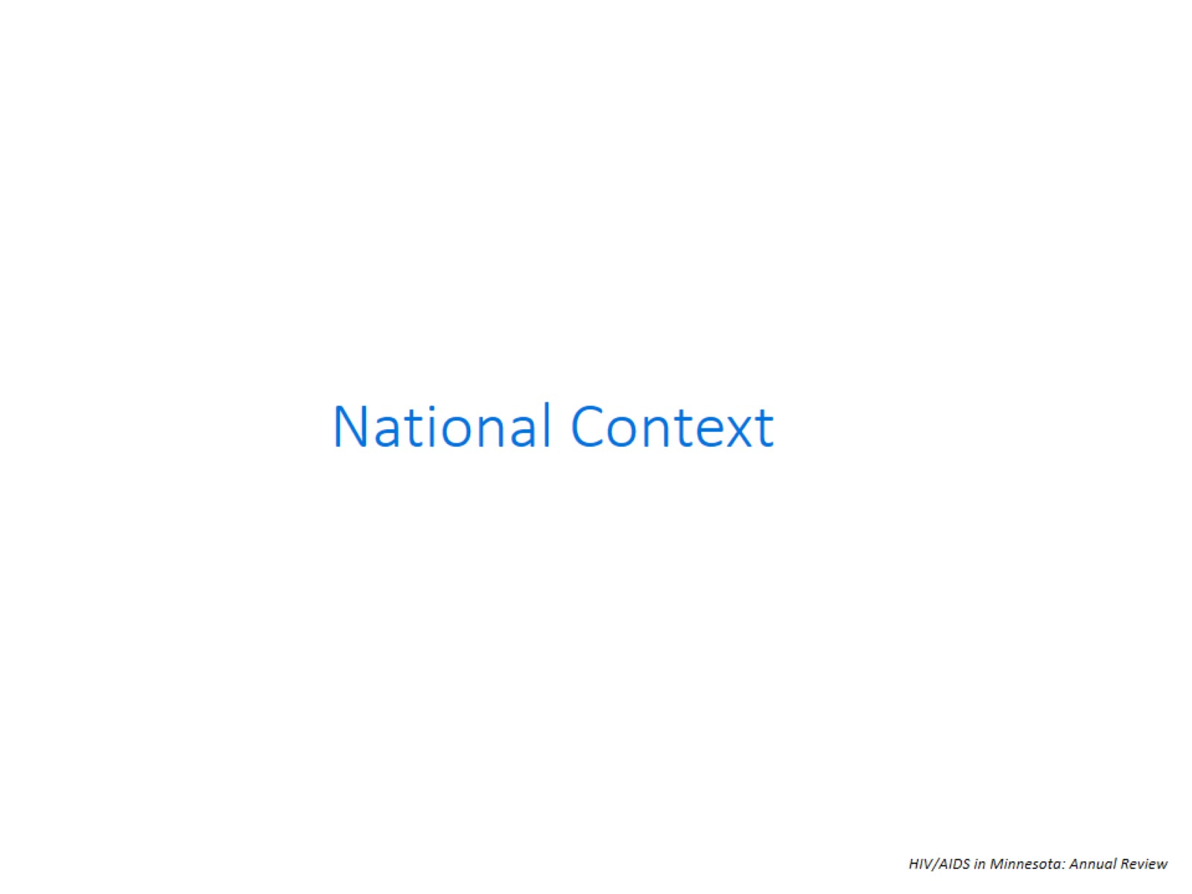

Slide 6
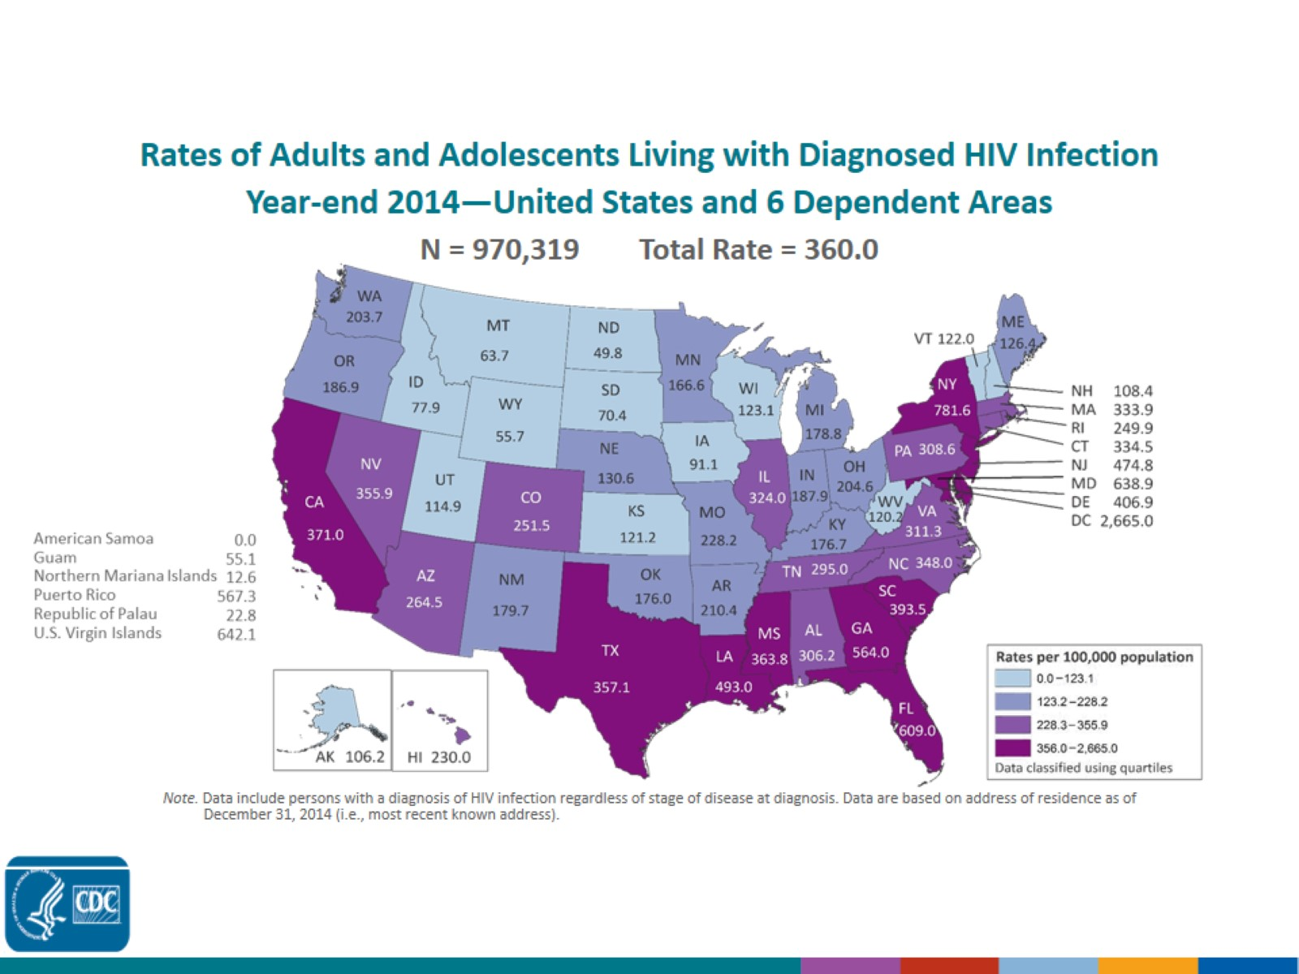
Rates of Adults and Adolescents Living with Diagnosed HIV Infection Year-end 2014—United States and 6 Dependent Areas N = 970,319 Total Rate = 360.0
Notes:
This slide presents rates (per 100,000 population) of adults and adolescents living with diagnosed HIV infection at the end of 2014 in the United States and 6 dependent areas.
Areas with the highest rates of persons living with diagnosed HIV infection at the end of 2014 were the District of Columbia (2,665.0), New York (781.6), the U.S. Virgin Islands (642.1), Maryland (638.9), Florida (609.0), Puerto Rico (567.3), and Georgia (564.0).
The District of Columbia (i.e., Washington, DC) is a city; use caution when comparing the rate of persons living with diagnosed HIV infection in DC with the rates in states.
Data include persons with a diagnosis of HIV infection regardless of stage of disease at diagnosis. Data are based on address of residence as of December 31, 2014 (i.e., most recent known address).
Persons living with a diagnosis of HIV infection are classified as adult or adolescent based on age at year-end 2014.

Slide 7
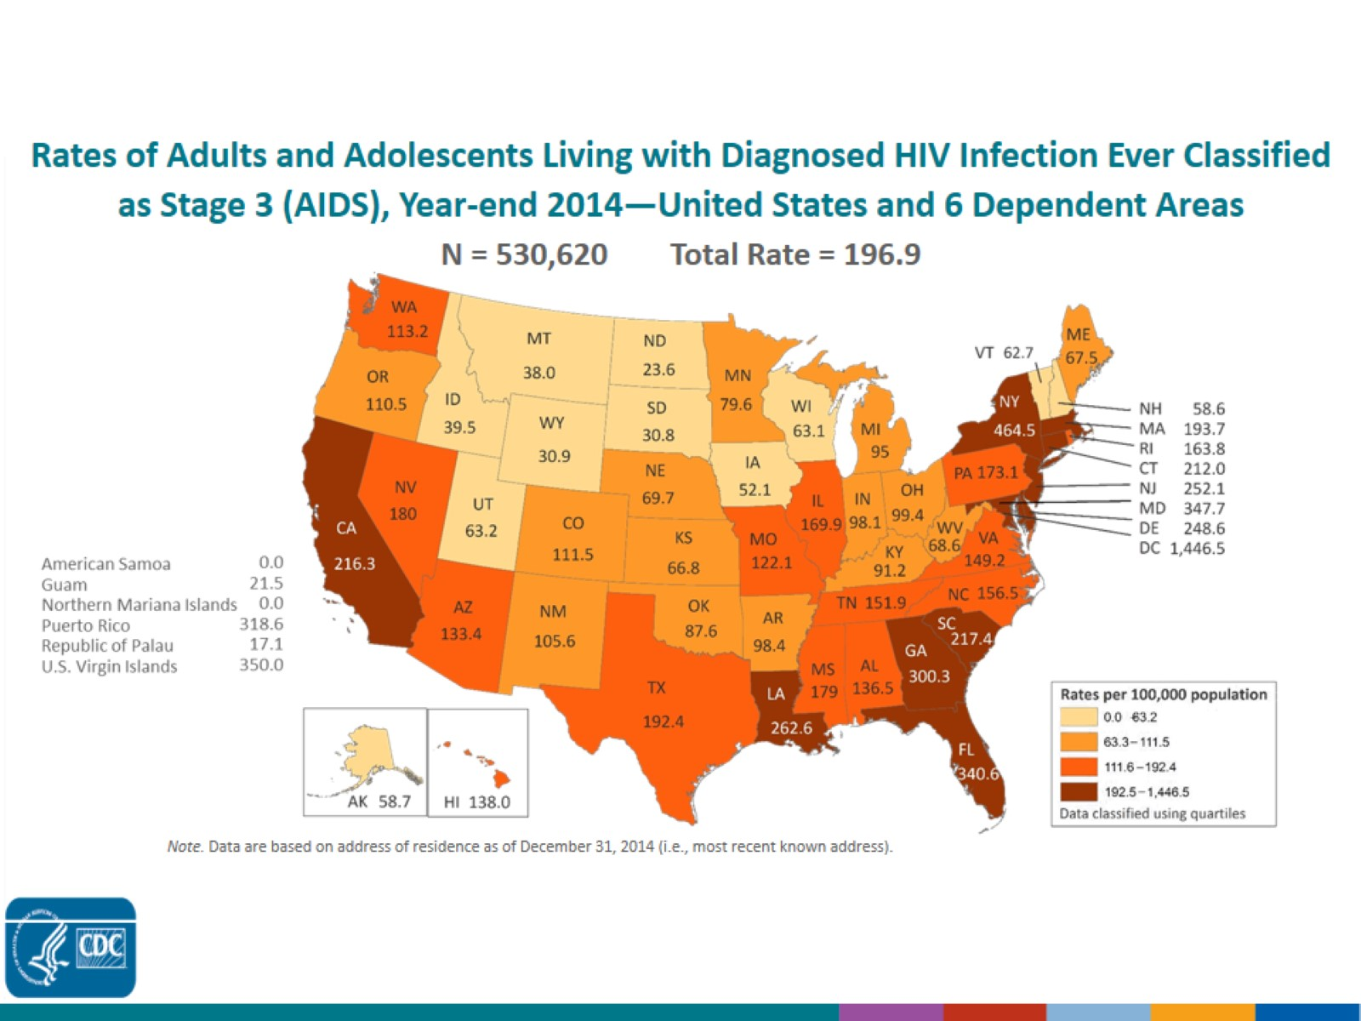
Rates of Adults and Adolescents Living with Diagnosed HIV Infection Ever Classified as Stage 3 (AIDS), Year-end 2014—United States and 6 Dependent Areas N = 530,620 Total Rate = 196.9
Notes:
In the United States and dependent areas, the rate of adults and adolescents living with diagnosed HIV infection ever classified as stage 3 (AIDS) was 196.9 per 100,000 population at the end of 2014. Areas with the highest rates were the District of Columbia (1,446.5), New York (464.5), U.S. Virgin Islands (350.0), Maryland (347.7), Florida (340.6), Puerto Rico (318.6), and Georgia (300.3).
The District of Columbia (i.e., Washington, DC) is a city; use caution when comparing the rate of persons living with stage 3 (AIDS) in DC with the rates in states.
Data are based on address of residence as of December 31, 2014 (i.e., most recent known address).
Persons living with stage 3 (AIDS) are classified as adult or adolescent based on age at end of 2014.

Slide 8
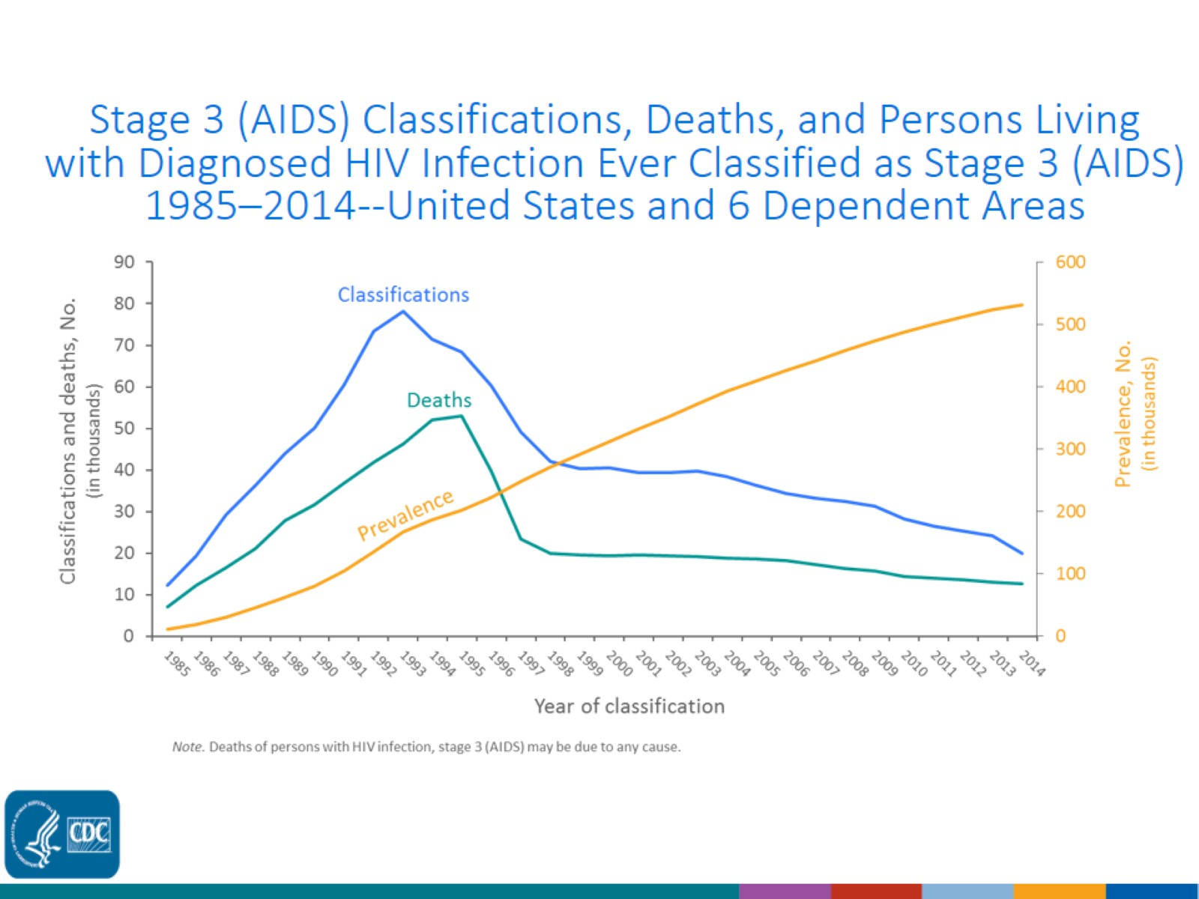
Stage 3 (AIDS) Classifications, Deaths, and Persons Living with Diagnosed HIV Infection Ever Classified as Stage 3 (AIDS) 1985–2014--United States and 6 Dependent Areas
Notes:
This slide presents trends from 1985 through 2014 in the numbers of stage 3 (AIDS) classifications, deaths of persons with diagnosed HIV infection ever classified as stage 3 (AIDS), and persons living with diagnosed HIV infection ever classified as stage 3 (AIDS) (i.e., prevalence), among persons of all ages, in the United States and 6 dependent areas. Stage 3 (AIDS) classifications and deaths of persons with stage 3 (AIDS) increased during the beginning of the epidemic. The overall declines in stage 3 (AIDS) classifications and deaths of persons with stage 3 (AIDS) are due to breakthroughs in early detection of HIV infection, improved screening technologies, advances in antiretroviral and combination drug therapies, prophylactic medications against opportunistic infections, and HIV prevention awareness campaigns. The prevalence of stage 3 (AIDS) has steadily increased throughout 1985-2014.

Slide 9
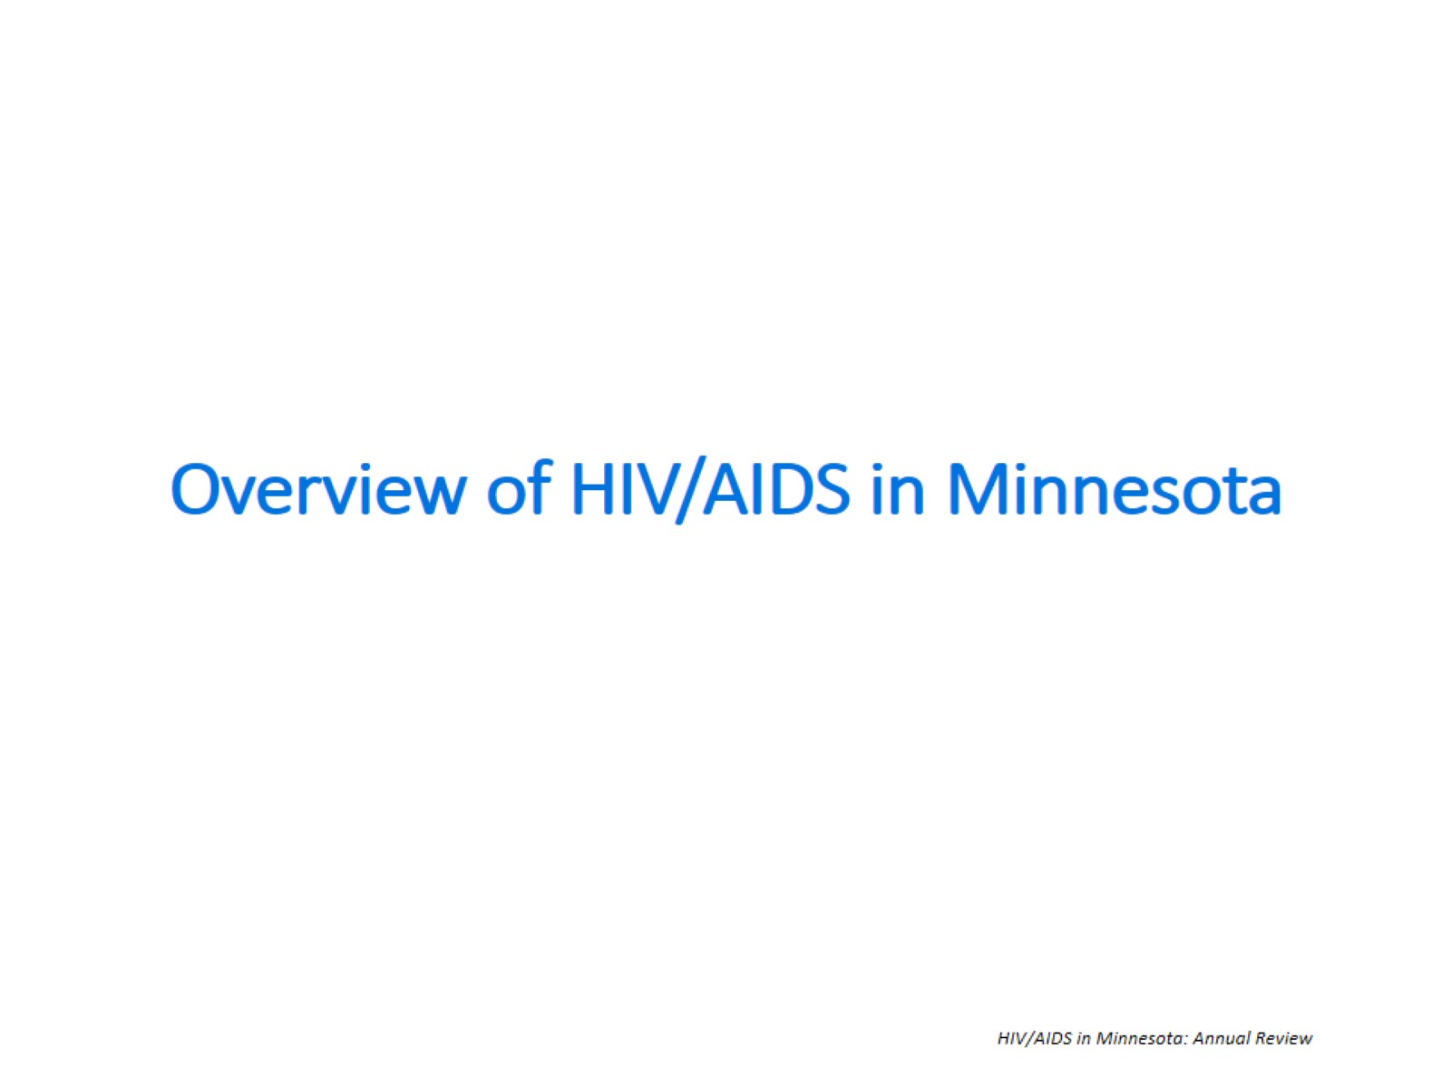

Slide 10
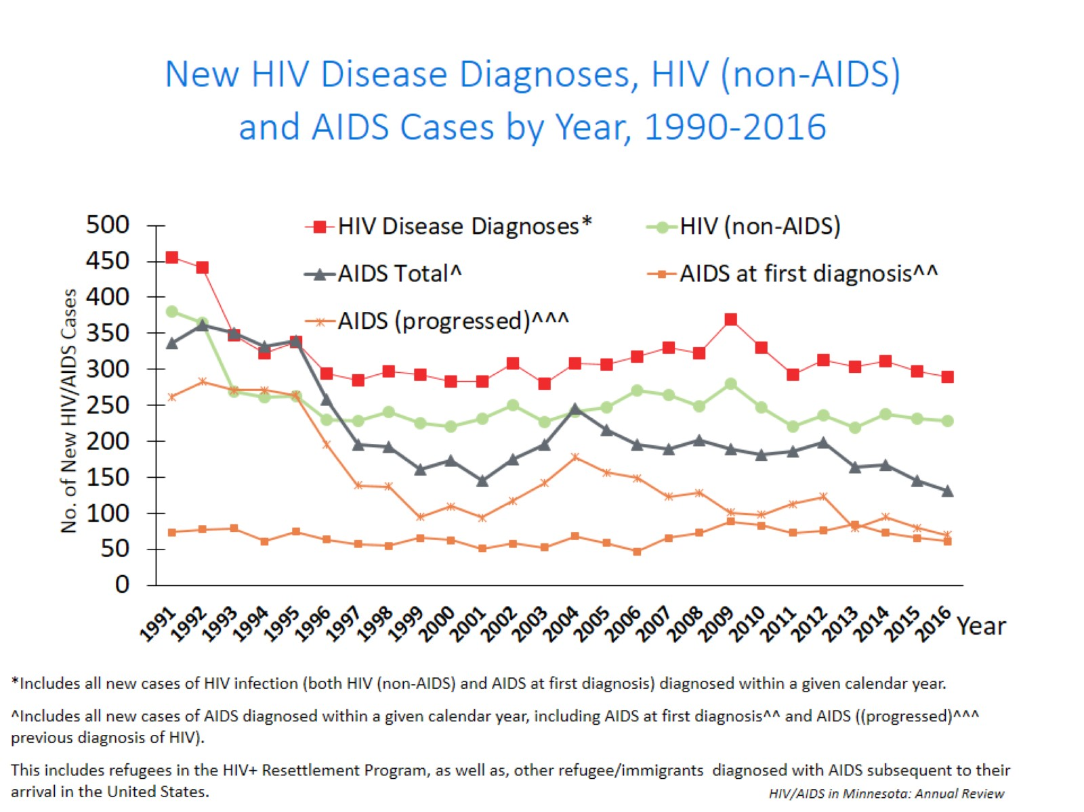
Notes:
In this report, the term “new HIV diagnoses” refers to HIV-infected Minnesota residents who were diagnosed in a particular calendar year and reported to MDH. This includes persons whose first diagnosis of HIV infection is AIDS (AIDS at first diagnosis). HIV diagnoses data are displayed by earliest known date of HIV diagnosis.
In 2016, there was a slight decrease of new HIV diagnoses from 2015. In 2016 there were 290 newly diagnosed cases, as compared to 298 cases in 2015. This represents a decrease of about 3% compared to 2015.

Slide 11
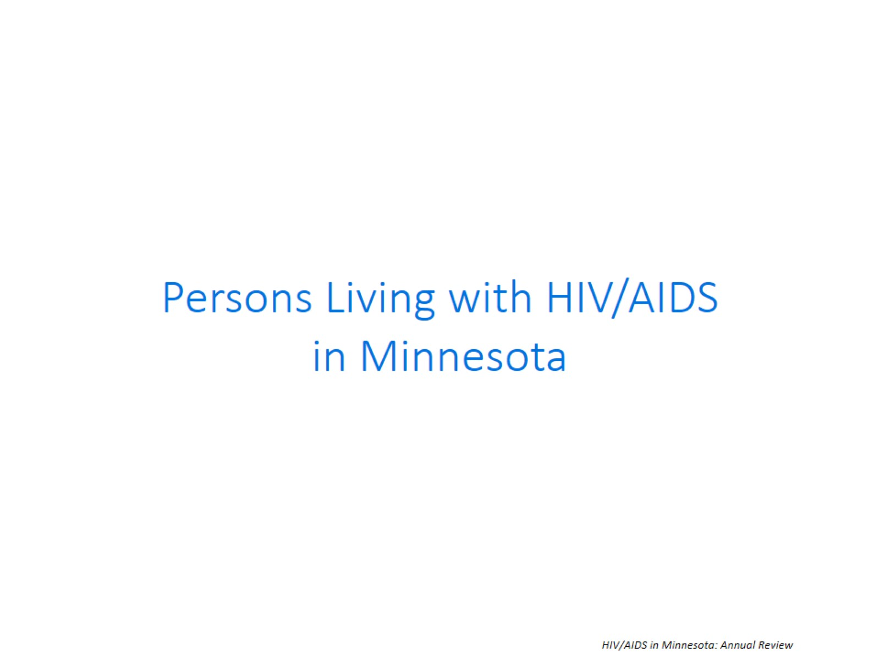

Slide 12
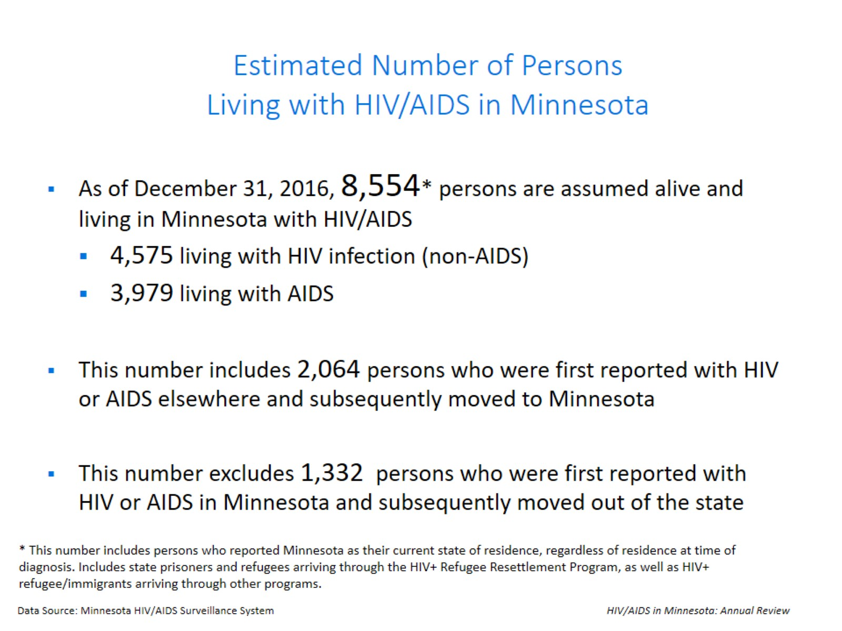
Estimated Number of Persons Living with HIV/AIDS in Minnesota

Slide 13


Slide 14
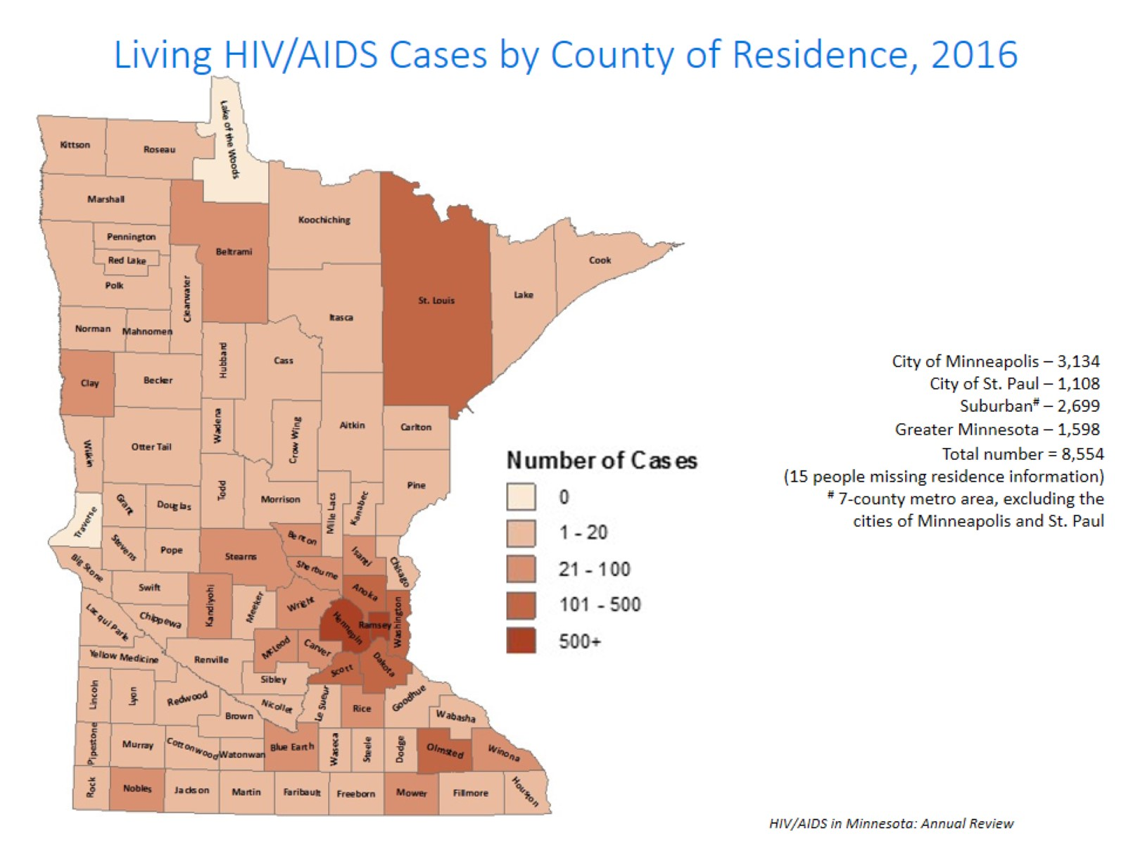
Notes:
The majority (81%) of prevalent cases reside in the seven-county metropolitan area surrounding the Twin Cities of Minneapolis and St. Paul (Hennepin, Ramsey, Anoka, Carver, Dakota, Scott, and Washington counties). Although HIV infection is more common in communities with higher population densities and greater poverty, there are people living with HIV or AIDS in 98% of counties in Minnesota.

Slide 15
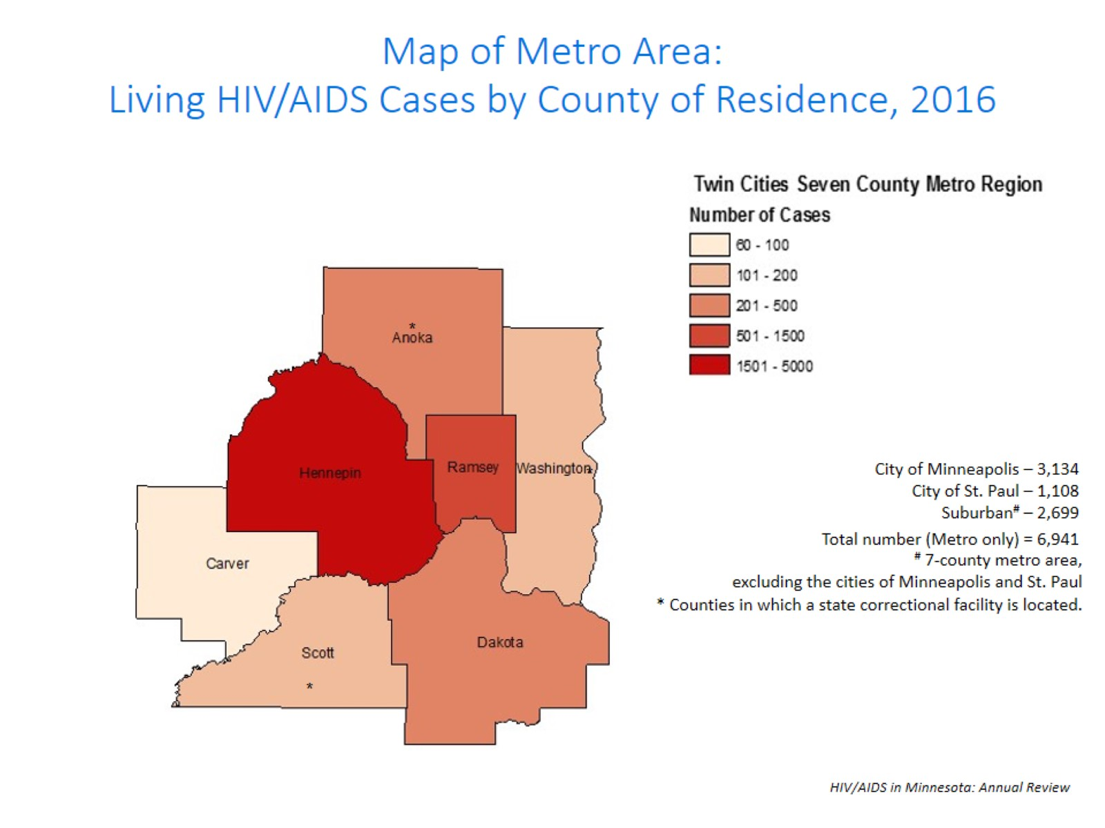
Notes:
While 81% of all people living with HIV/AIDS in Minnesota reside in the metro area, the cases in the metro area are concentrated in Hennepin and Ramsey counties.

Slide 16
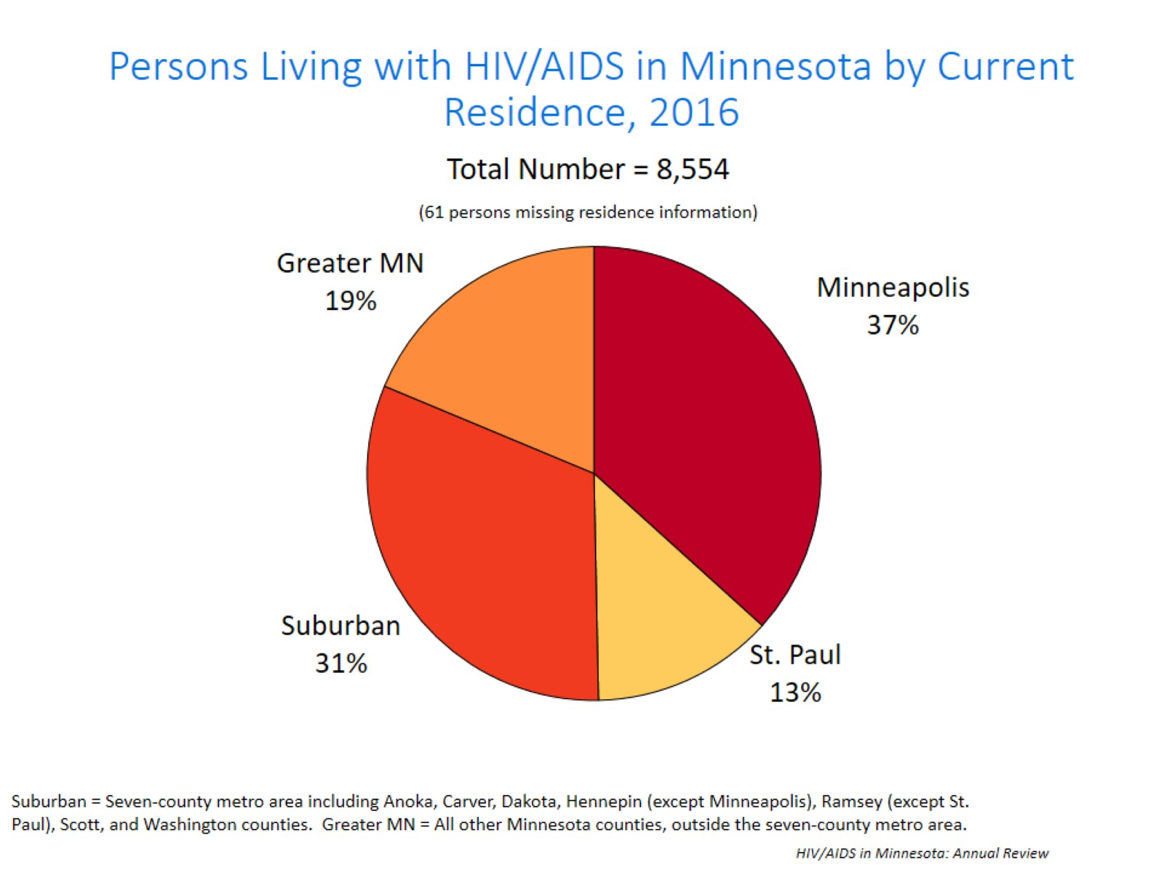
Notes:
Overall, of the 8,554 people living with HIV/AIDS for whom residence information is available, 37% of all people living with HIV/AIDS in Minnesota live in the city of Minneapolis, followed by 31% that living in the surrounding suburban area. People living with HIV/AIDS in Greater Minnesota account for 19% of all people living with HIV/AIDS. Finally, people living with HIV/AIDS in St. Paul account for 13% of all people living with HIV/AIDS.

Slide 17
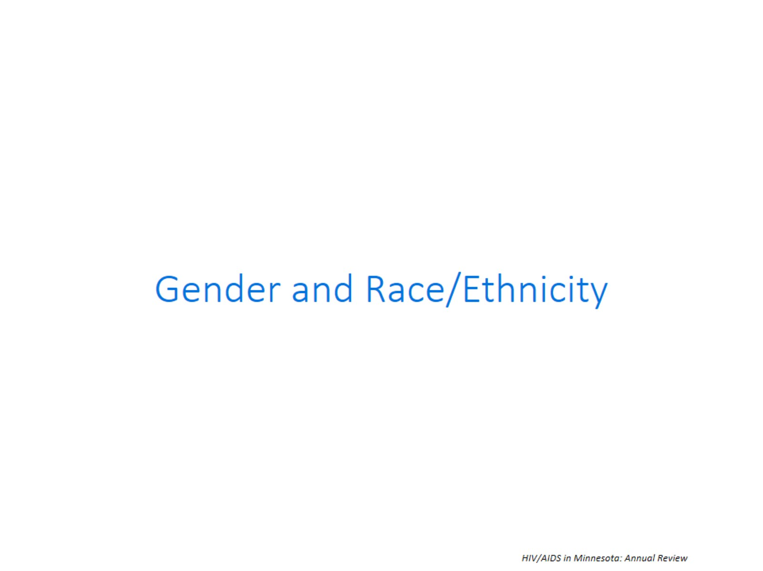

Slide 18
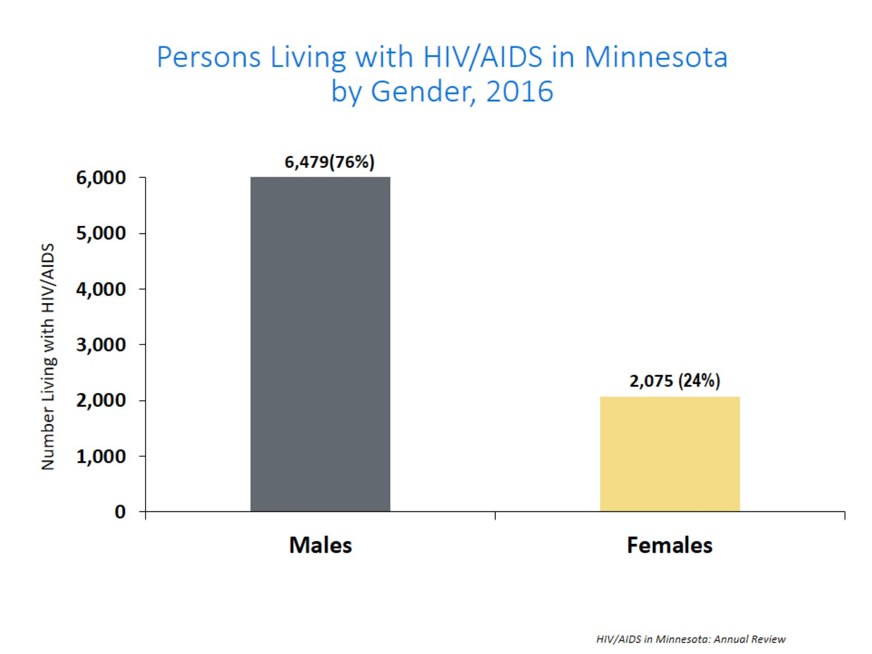
Notes:
Seventy-six percent (76%) of prevalent HIV/AIDS cases are males while 24% are females.

Slide 19
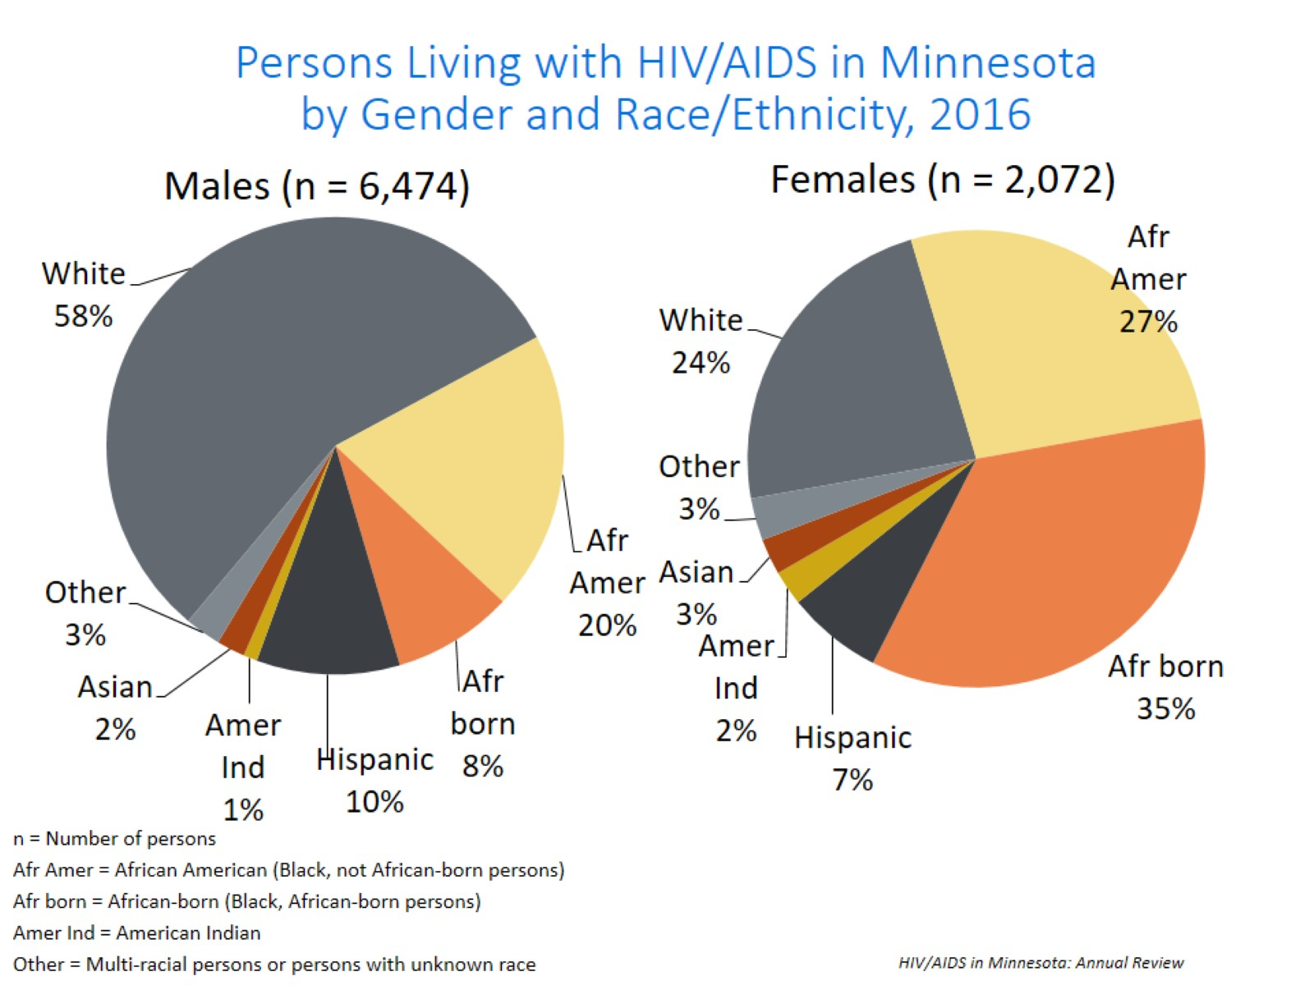
Notes:
Seventy-six percent (76%) of prevalent HIV/AIDS cases are males. Broken down by race/ethnicity, 58% of male cases are white, 20% African American, 10% Hispanic, 8% African-born, 1% American Indian, 2% Asian/Pacific Islander, and 3% are persons of multiple or unknown race. In total, 42% of males living with HIV/AIDS are among men of color; whereas only 17% of the general male population comprised of people of color. Among female cases, the distribution is even more skewed toward women of color: 35% African-born, 27% African American, 24% white, 7% Hispanic, 3% American Indian, 3% Asian/Pacific Islander, and 3% persons of multiple or unknown race. Thus, 76% of prevalent female HIV/AIDS cases are among women or color whereas only 17% of the general female population in Minnesota is comprised of women of color.
Please note that race is not considered a biological reason for disparities related to HIV/AIDS experienced by persons of color. Race, however, can be considered a marker for other personal and social characteristics that put a person at greater risk for HIV exposure. These characteristics may include, but are not limited to, lower socioeconomic status, less education, and less access to health care.

Slide 20
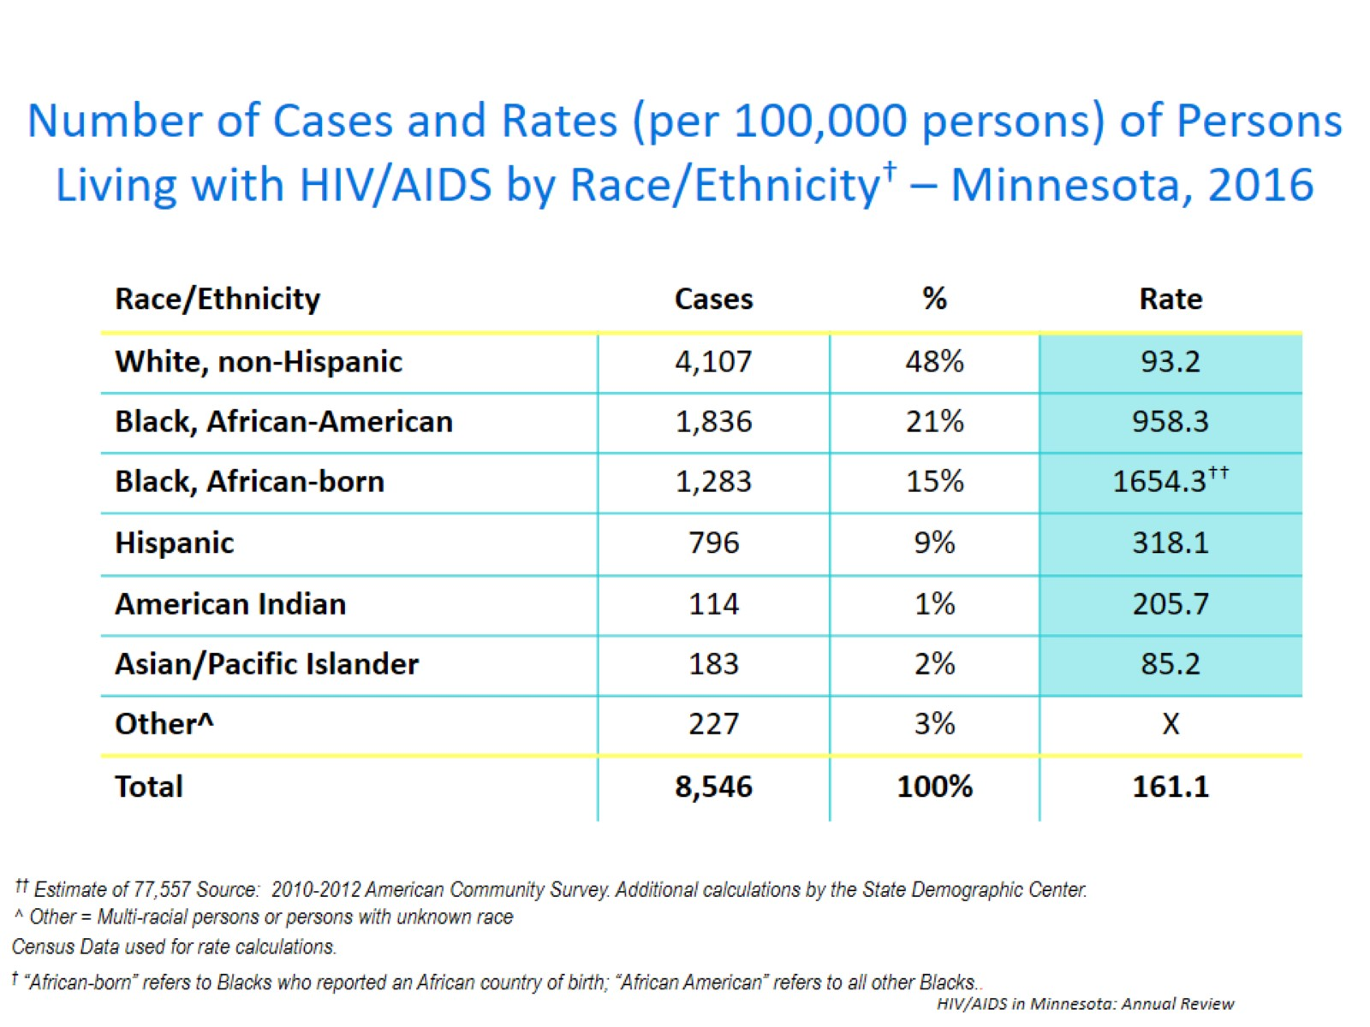
Notes:
While white persons account for the greatest number of persons living with HIV/AIDS in Minnesota (4,107 cases), they have one of the lowest rates of people living with HIV/AIDS (93.2per 100,000 persons). Black, African-born persons account for 1,283 cases living with HIV/AIDS in Minnesota, however since this population makes up a small proportion of the overall population in Minnesota, the rate of people living with HIV/AIDS in this community is higher than other race ethnicities. The rate of African-born persons living with HIV/AIDS is 1,654.3 per 100.000 persons; this is a rate of more than 15 times greater than white, non-Hispanic persons. Black, African American have the second highest rate of people living with HIV/AIDS at 958.3 per 100,000 persons; this is 10 times higher than the rate among white people. Hispanic persons have the next highest rate of people living with HIV/AIDS in Minnesota at 318.1 per 100,000; this is a rate of more than 3 times higher than white, non-Hispanic persons. American Indians have a rate of people living with HIV/AIDs of 205.7 per 100,000 persons; this is a rate two times higher than white non-Hispanic persons. Finally Asian/Pacific Islanders have a rate of people living with HIV/AIDS of 85.2; this accounts for a rate lower than the rate among white non-Hispanic persons.

Slide 21
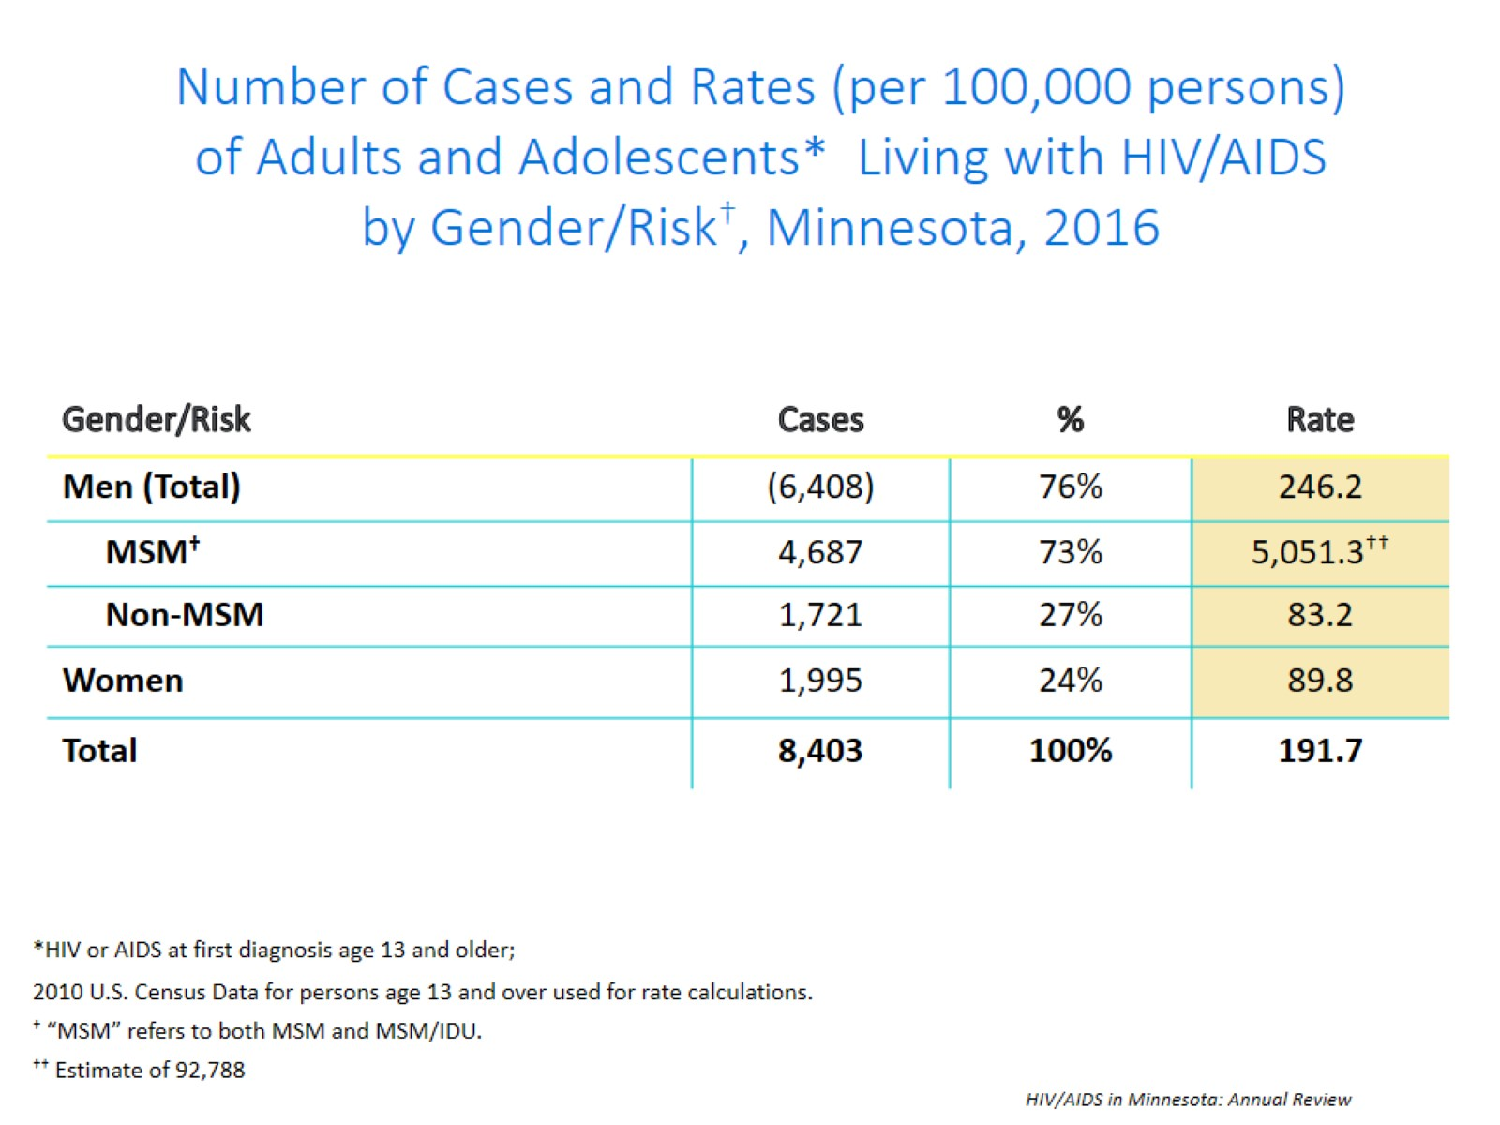
Notes:
Beginning in 2012, MDH began estimating the number of MSM living in Minnesota. Men who have sex with Men have the highest rate of persons living with HIV/AIDS than any other sub-group. In 2016, the estimated rate of people living with HIV/AIDS among MSM was 5051.3 per 100,000 population. This is more than 60 times higher than the rate among non-MSM men (83.2 per 100,000 population). It’s important to note that MSM contains cases from all racial/ethnic categories and therefore cannot be directly compared to the rates by race/ethnicity. For more information on how this was estimated, see the HIV/AIDS Prevalence & Mortality Technical Notes.

Slide 22
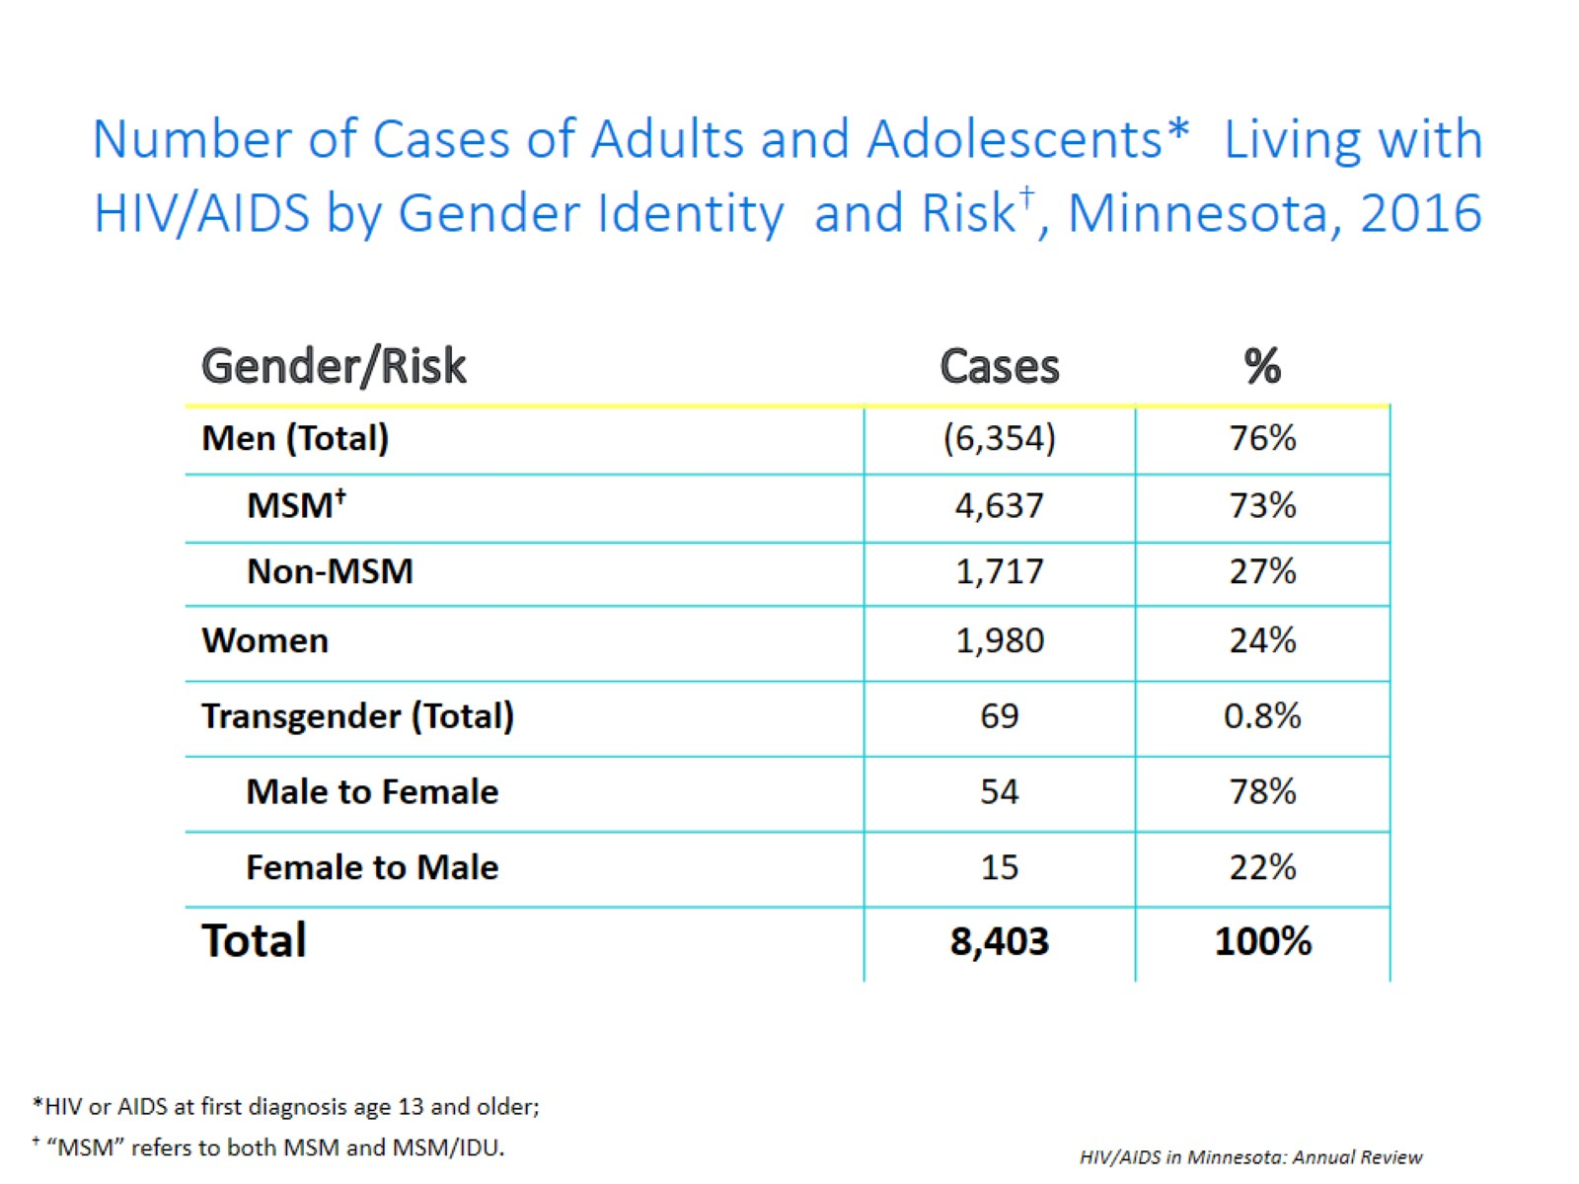
Notes:
This slide shows the number of people living with HIV/AIDS by gender identity (male, female, or transgender (male to female or female to male)).
As of 2016, there are 69 transgender people living HIV/AIDS in Minnesota, of which the majority are male to female (78%) and 15 transgender female to male. This represents about 1% of people living with HIV/AIDS in the state.

Slide 23
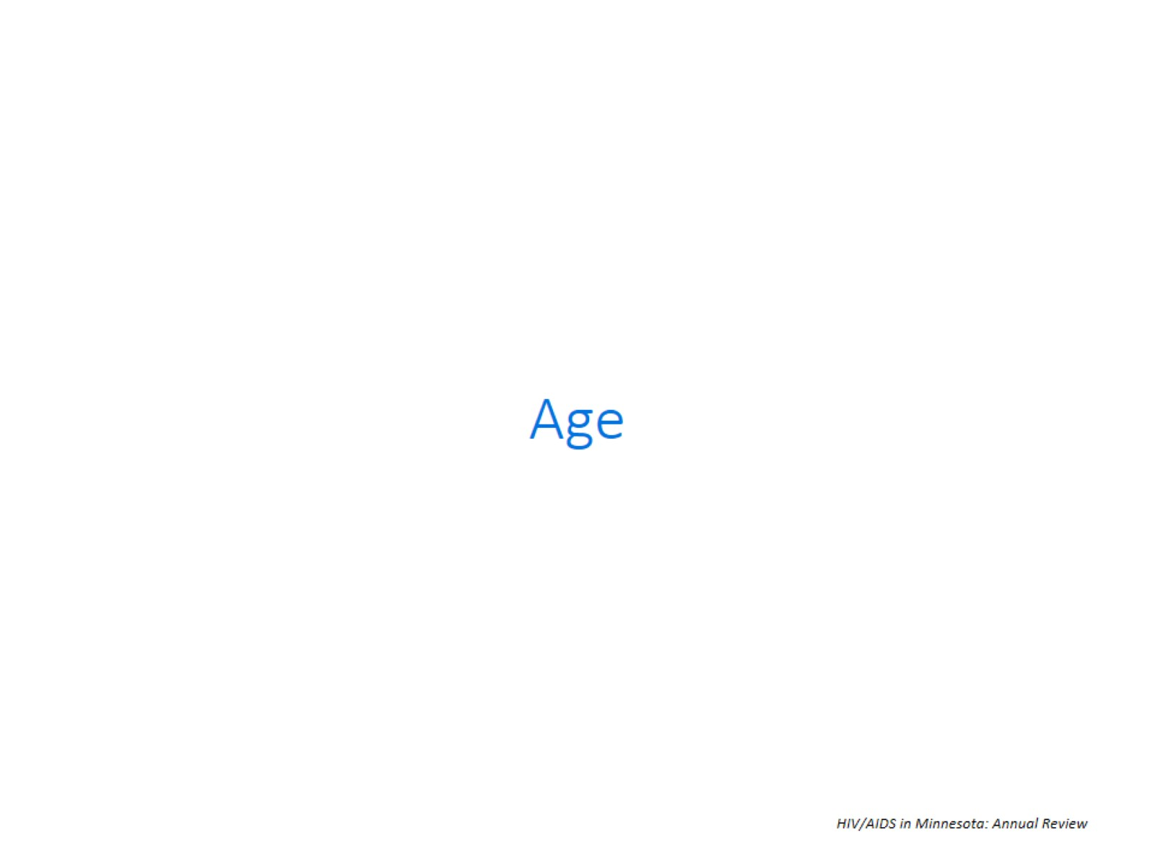

Slide 24
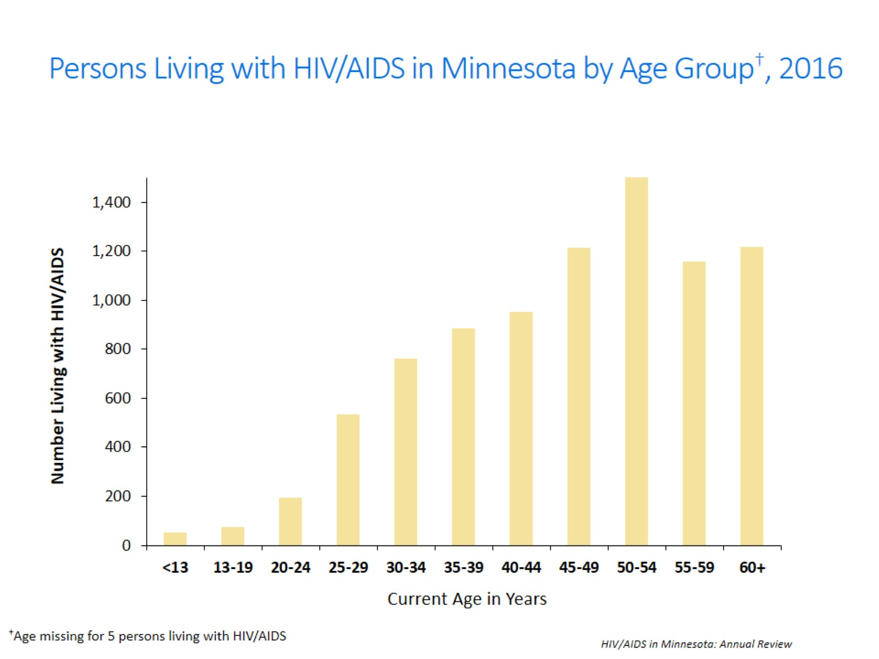
Notes:
Seventy-one percent (71%) of persons living with HIV/AIDS in 2016 are currently 40 years of age or older. As with new cases, there are differences by gender in the age of living cases.

Slide 25
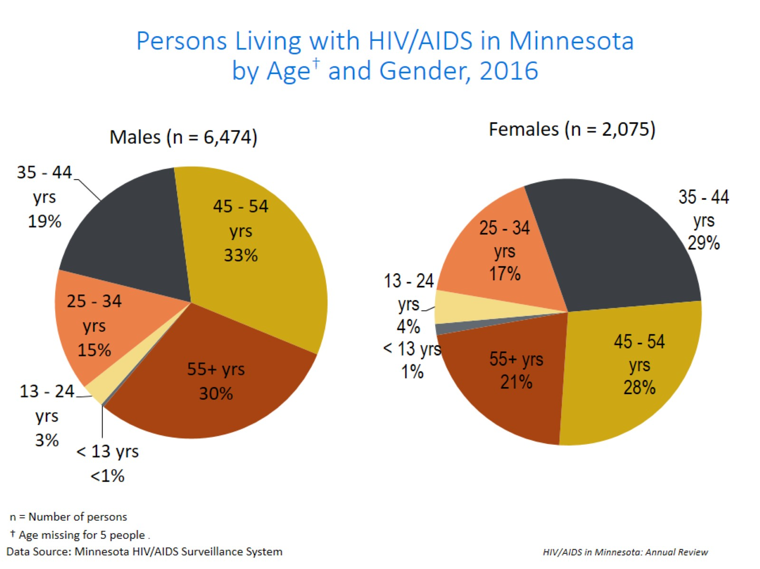
Notes:
While males age 25 to 34 account for 15% of male living cases, females of the same age account for 17% of female living cases.

Slide 26
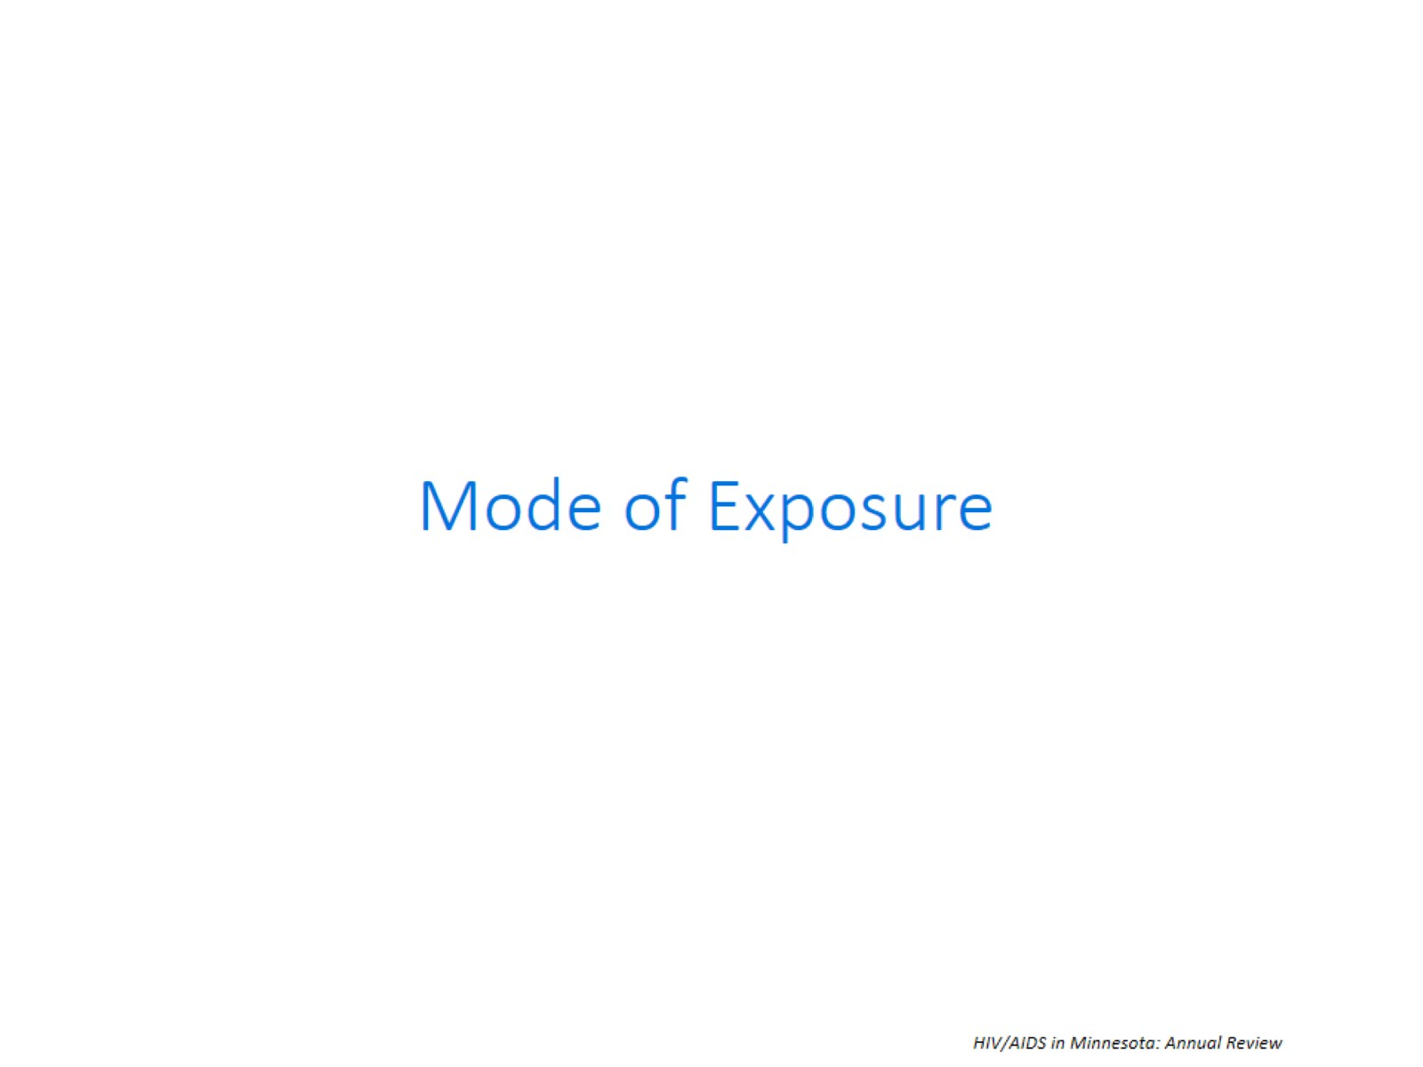
Notes:
In 2015, MDH used a risk re-distribution method to estimate the mode of exposure among cases with unknown risk. For additional details on how this was done please read the HIV Prevalence and Mortality Technical Notes. All mode of exposure numbers referred to in the text are based on the risk re-distribution

Slide 27
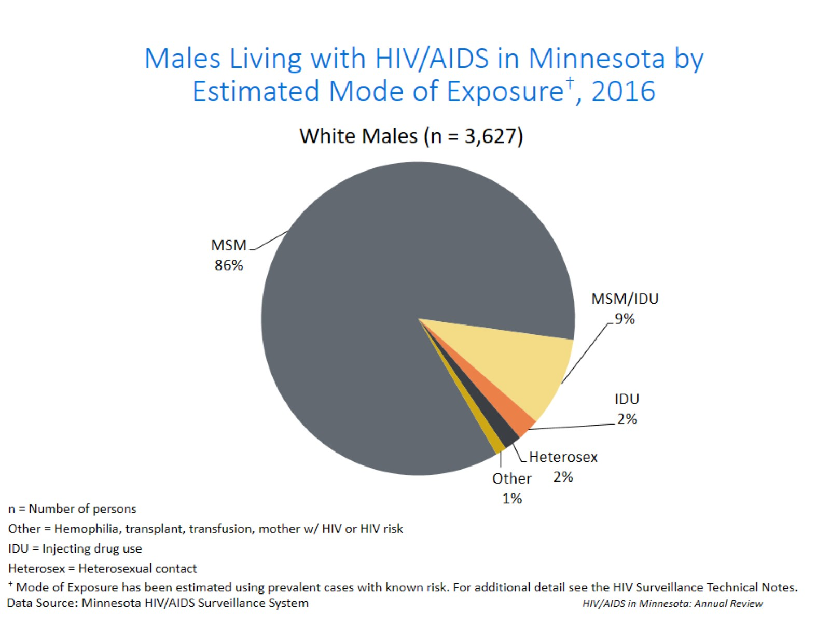
Notes:
The proportion of cases attributable to a certain mode of exposure differs not only by gender, but also by race. Of the 3,627 white males living with HIV/AIDS in Minnesota in 2016, MSM or MSM/IDU accounted for an estimated 95% of cases; Injection Drug Use (IDU) accounted for 2% of cases, heterosexual contact accounted for 2% of cases, and other risk accounted for the remaining 1% of cases.

Slide 28
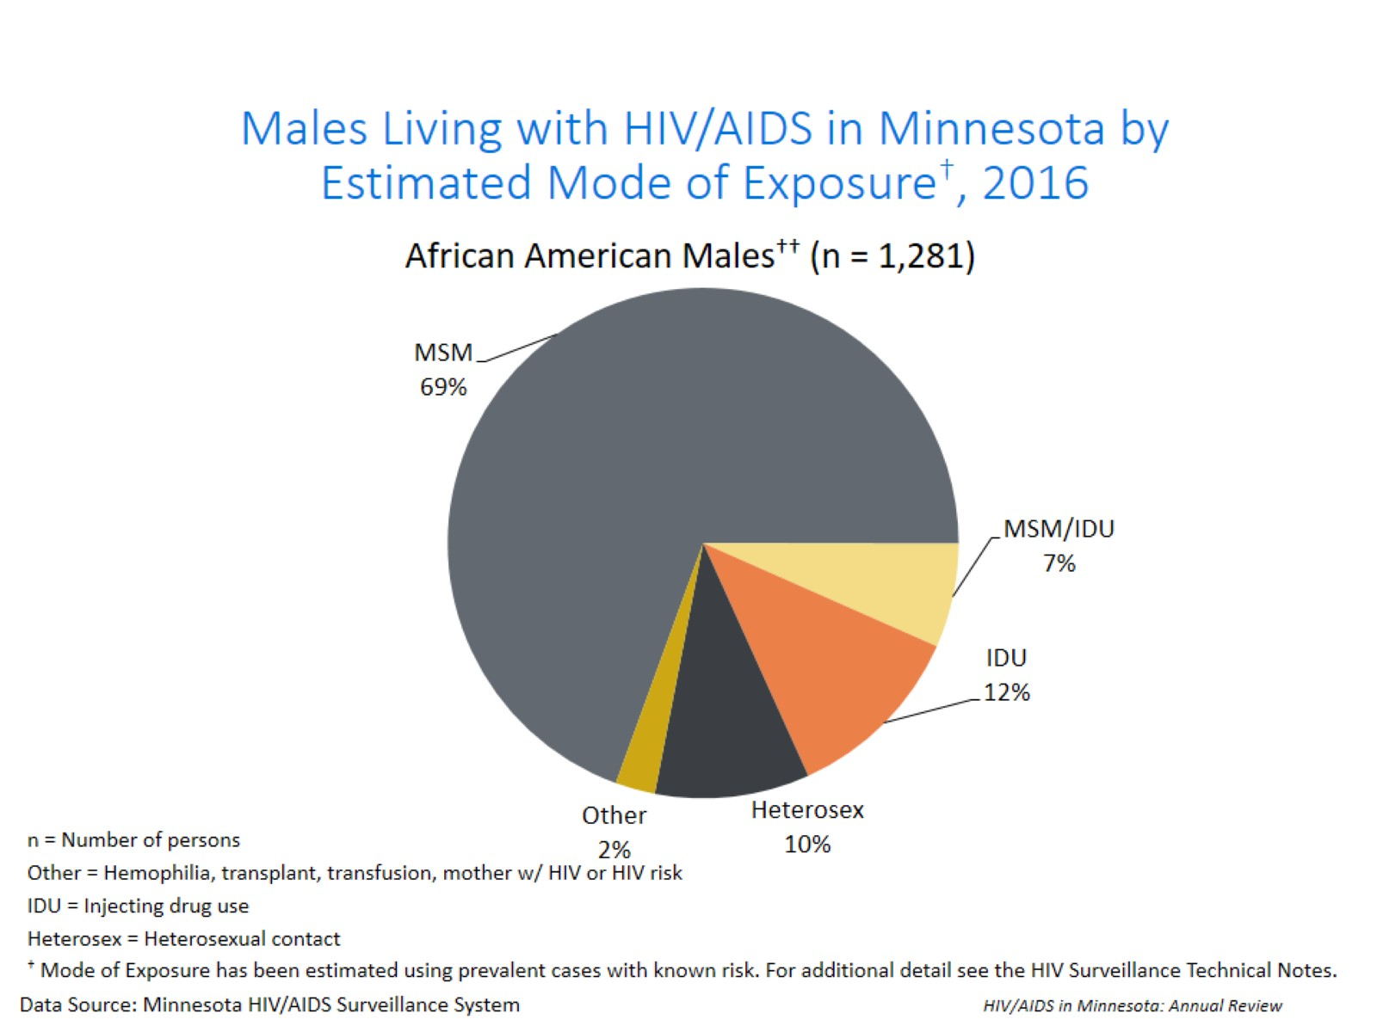
Notes:
Of the 1,281 African American males living with HIV/AIDS in Minnesota in 2016, MSM or MSM/IDU accounted for an estimated 76% of cases; Injection Drug Use (IDU) accounted for 12% of cases, heterosexual contact accounted for 10% of cases, and other risk accounted for the remaining 2% of cases.

Slide 29
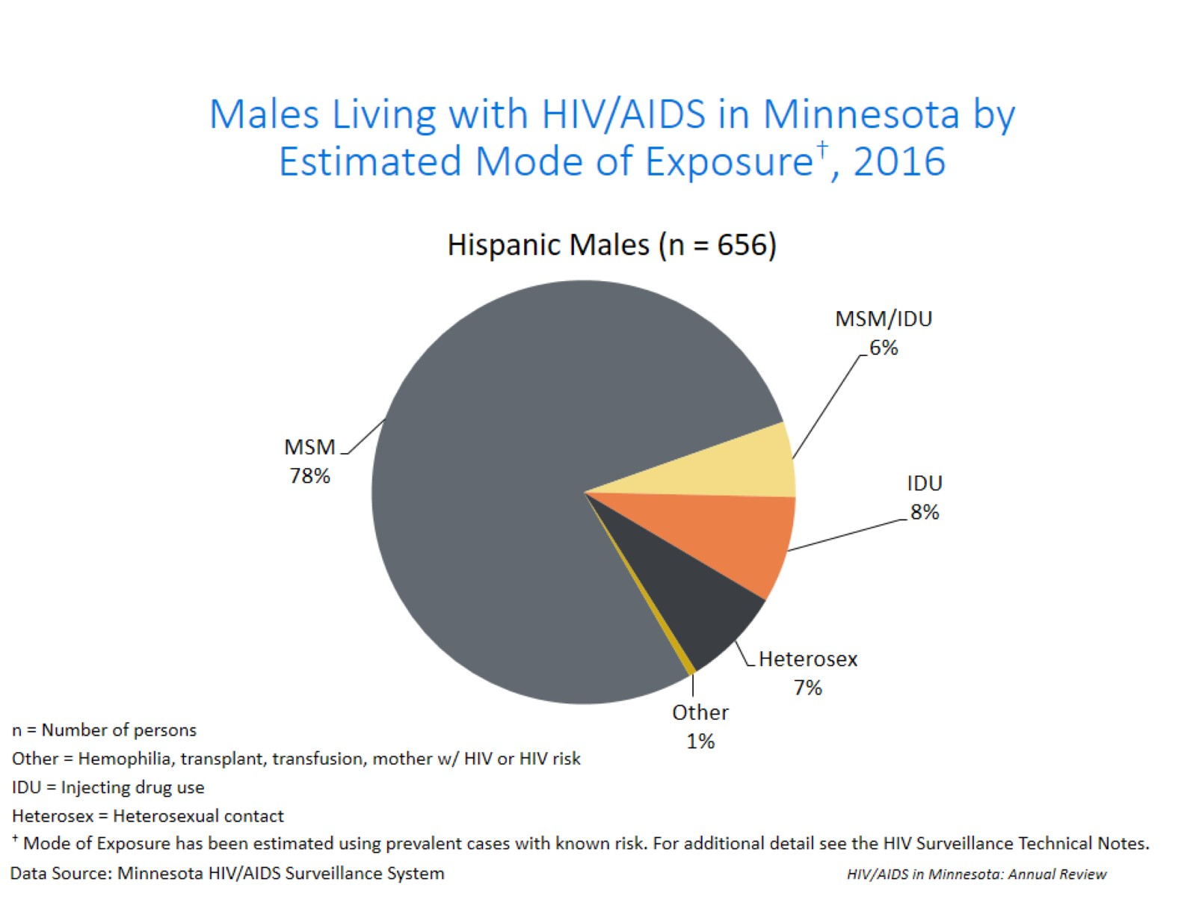
Notes:
Of the 656 Hispanic males living with HIV/AIDS in Minnesota in 2016, MSM or MSM/IDU accounted for an estimated 84% of cases; Injection Drug Use (IDU) accounted for 8% of cases, heterosexual contact accounted for 7% of cases, and other risk accounted for the remaining 1% of cases.

Slide 30
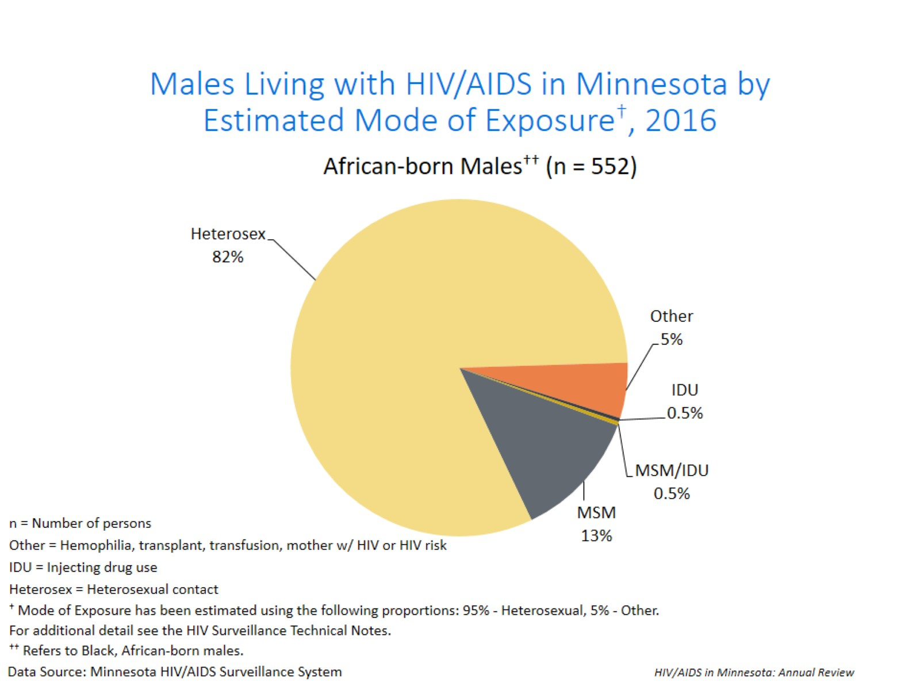
Notes:
Of the 552 African-born males living with HIV/AIDS in Minnesota in 2016, heterosexual contact accounted for 82% of cases, MSM or MSM/IDU accounted for an estimated 13.5% of cases; Injection Drug Use (IDU) accounted for 0.5% of cases, and other risk accounted for the remaining 5% of cases.

Slide 31
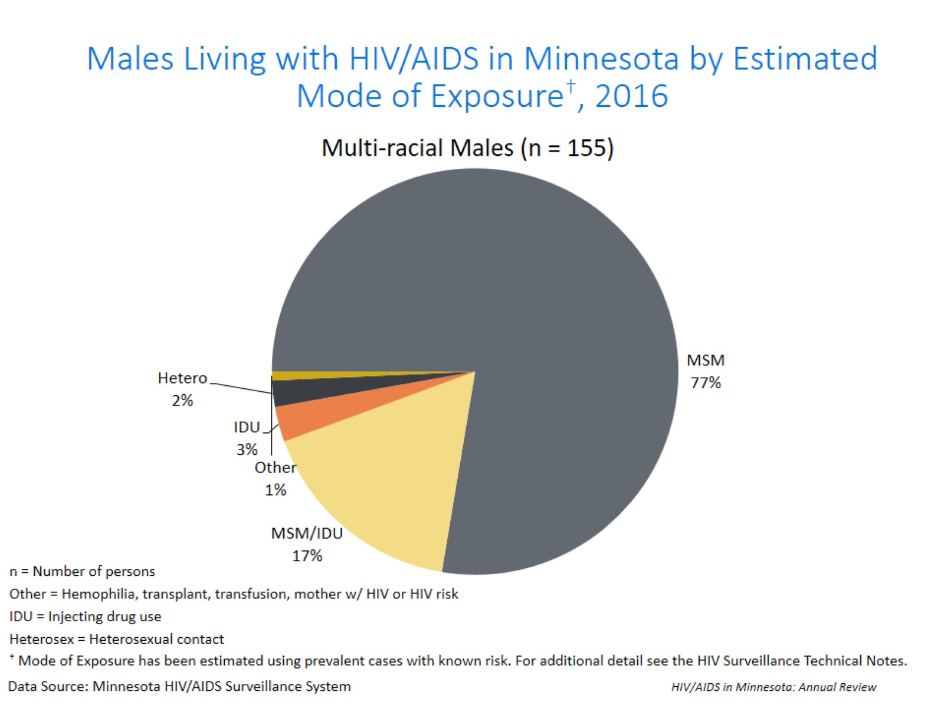
Notes:
Of the 155 multi-racial males living with HIV/AIDS in Minnesota in 2016, MSM or MSM/IDU accounted for an estimated 94% of cases; heterosexual contact accounted for 2% of cases, and Injection Drug Use (IDU) accounted for 3% of cases.

Slide 32
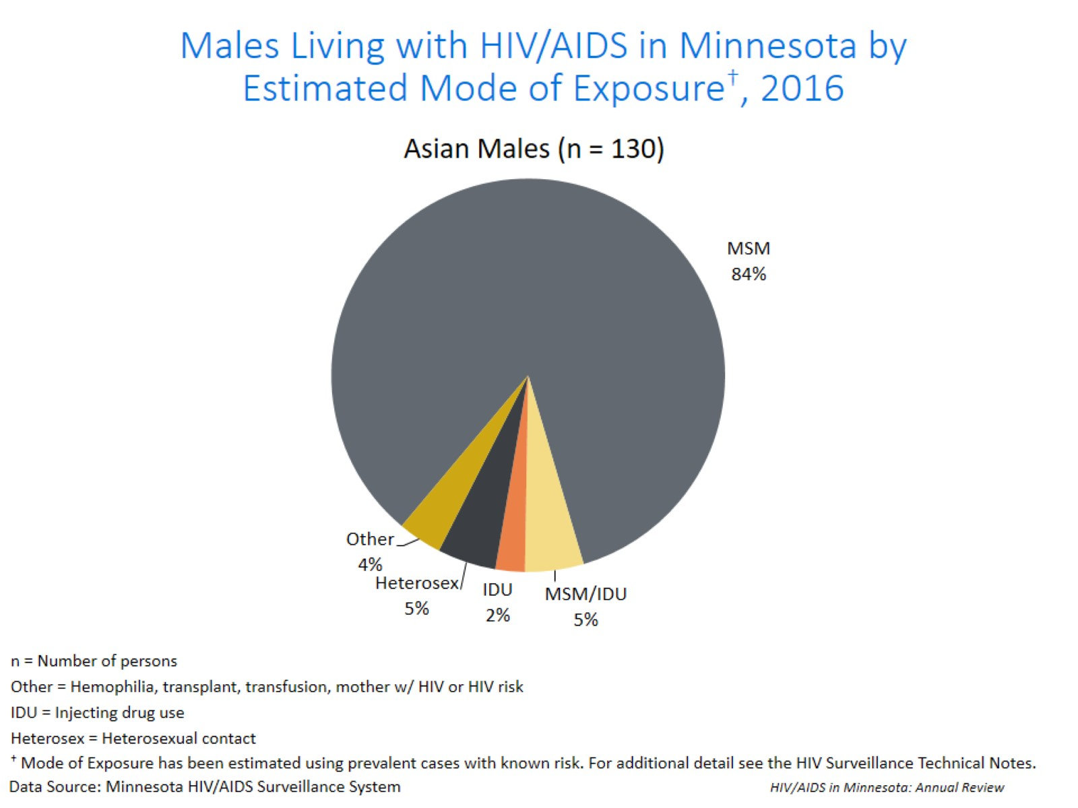
Notes:
Of the 130 Asian/Pacific Islander males living with HIV/AIDS in Minnesota in 2016, MSM or MSM/IDU accounted for an estimated 89% of cases; heterosexual contact accounted for 5% of cases, Injection Drug Use (IDU) accounted for 2% of cases, and other risk accounted for the remaining 4% of cases.

Slide 33
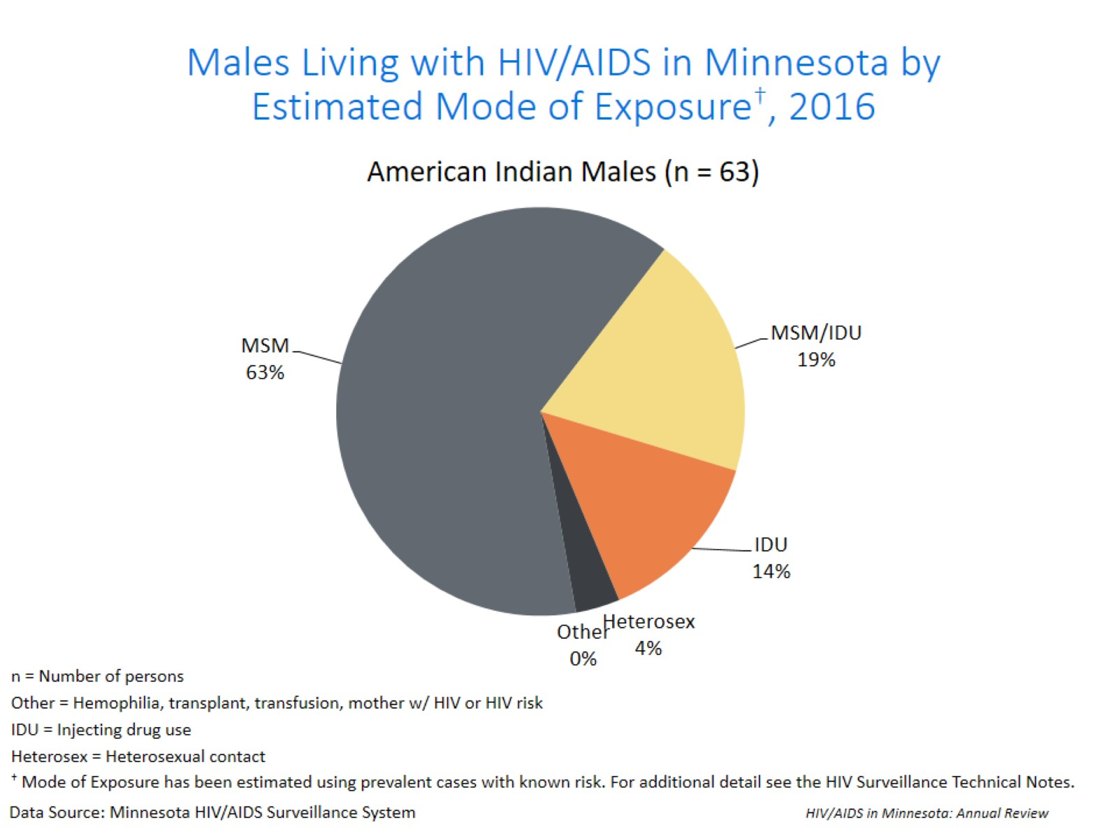
Notes:
Of the 63 American Indian males living with HIV/AIDS in Minnesota in 2016, MSM or MSM/IDU accounted for an estimated 82% of cases; heterosexual contact accounted for 4% of cases, and Injection Drug Use (IDU) accounted for 14% of cases.

Slide 34
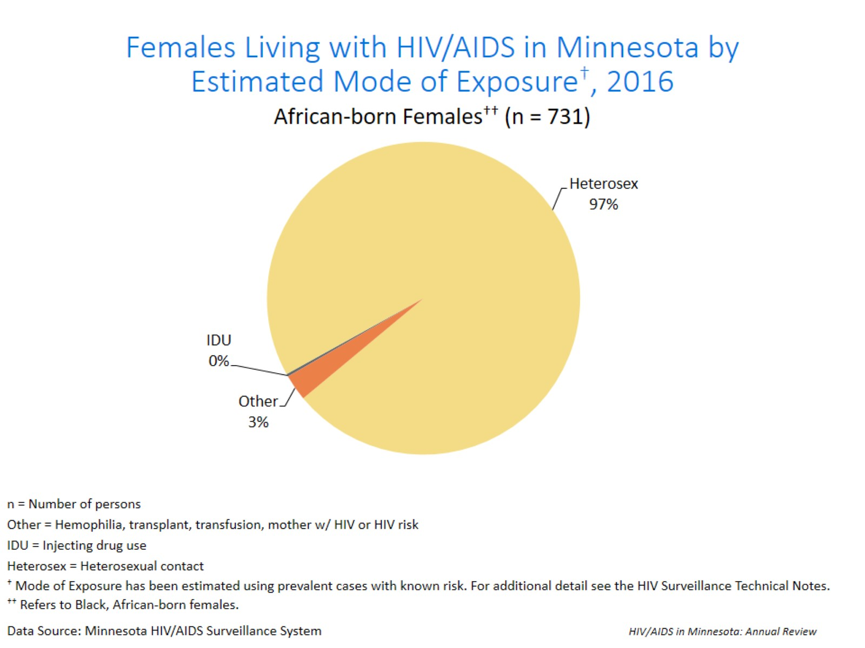
Notes:
Across all race/ethnicity groups, females most frequently report heterosexual contact as their mode of HIV exposure. Among the 731 African-born females living with HIV/AIDS in Minnesota in 2016, an estimated 97% of cases were attributed to heterosexual contact and other risk accounted for the remaining 3% of cases.

Slide 35
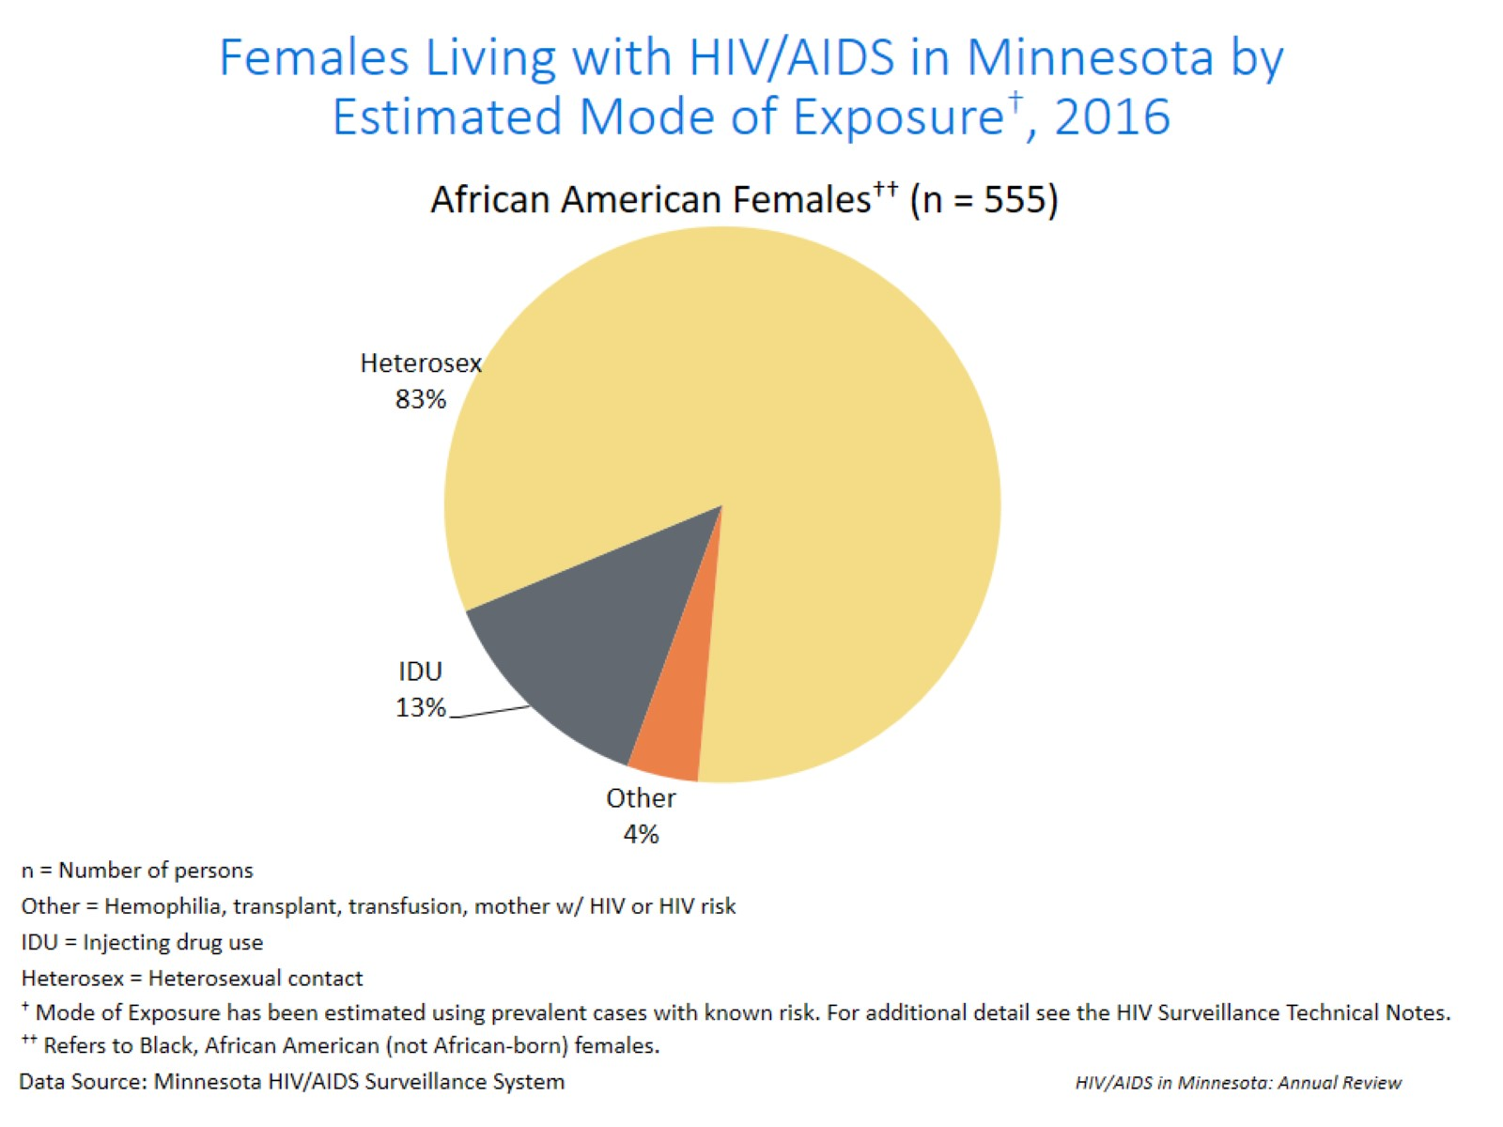
Notes:
Among the 555 African American females living with HIV/AIDS in Minnesota in 2016, an estimated 83% of cases were attributed to heterosexual contact, 13% of the cases were attributed to injection drug use (IDU) and other risk accounted for the remaining 4% of cases.

Slide 36
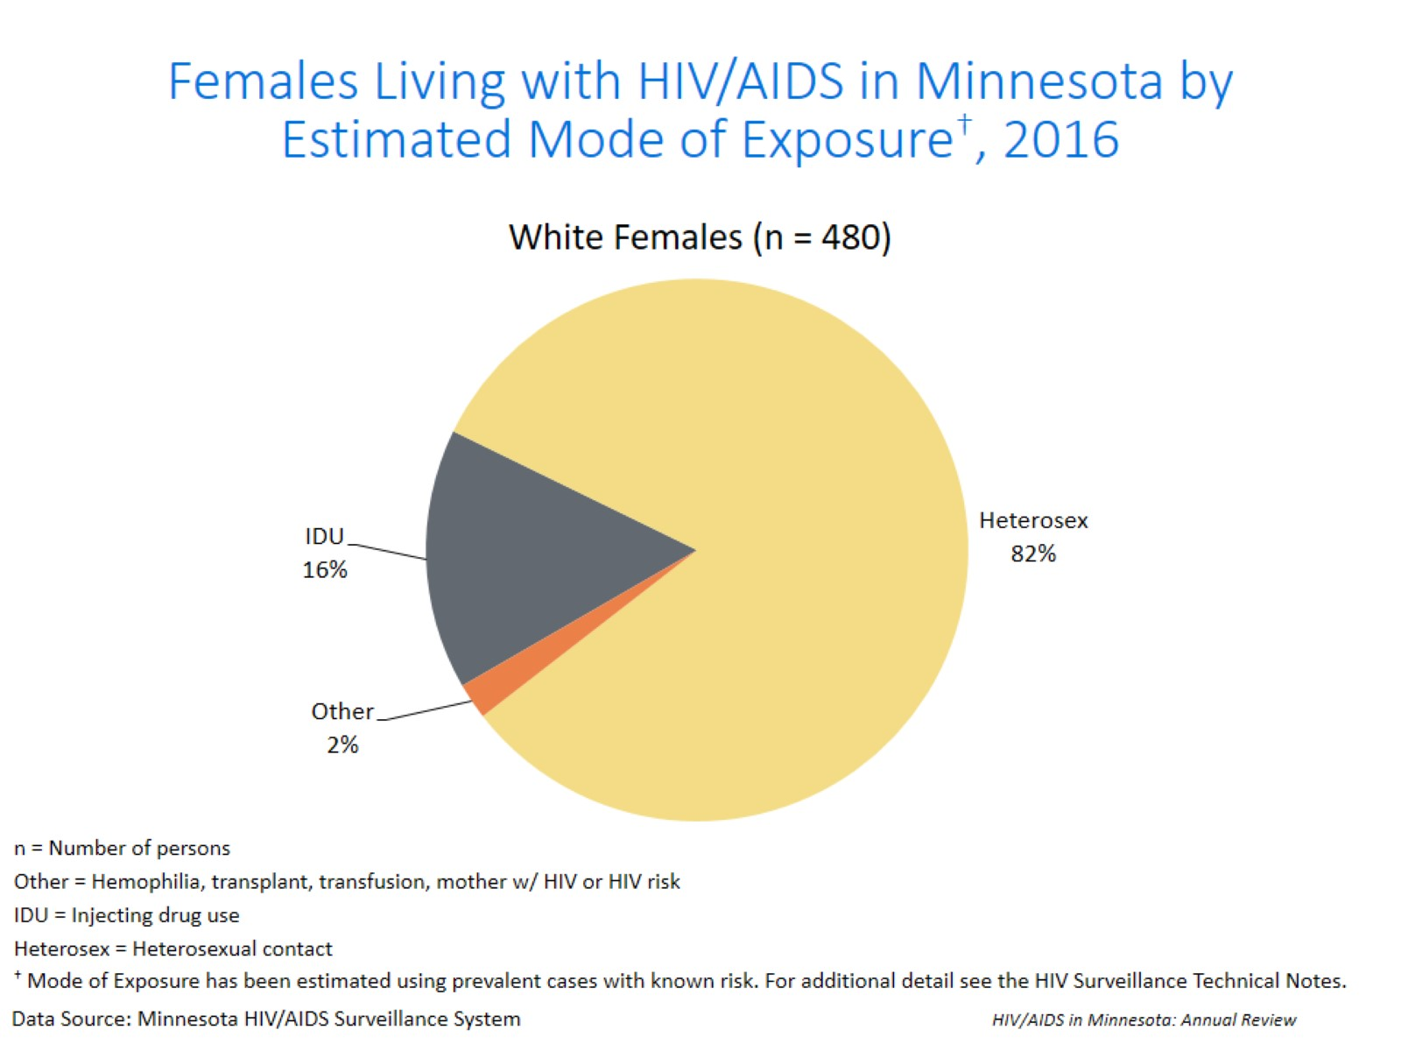
Notes:
Among the 480 white females living with HIV/AIDS in Minnesota in 2016, an estimated 82% of cases were attributed to heterosexual contact, 16% of the cases were attributed to injection drug use (IDU) and other risk accounted for the remaining 2% of cases.

Slide 37
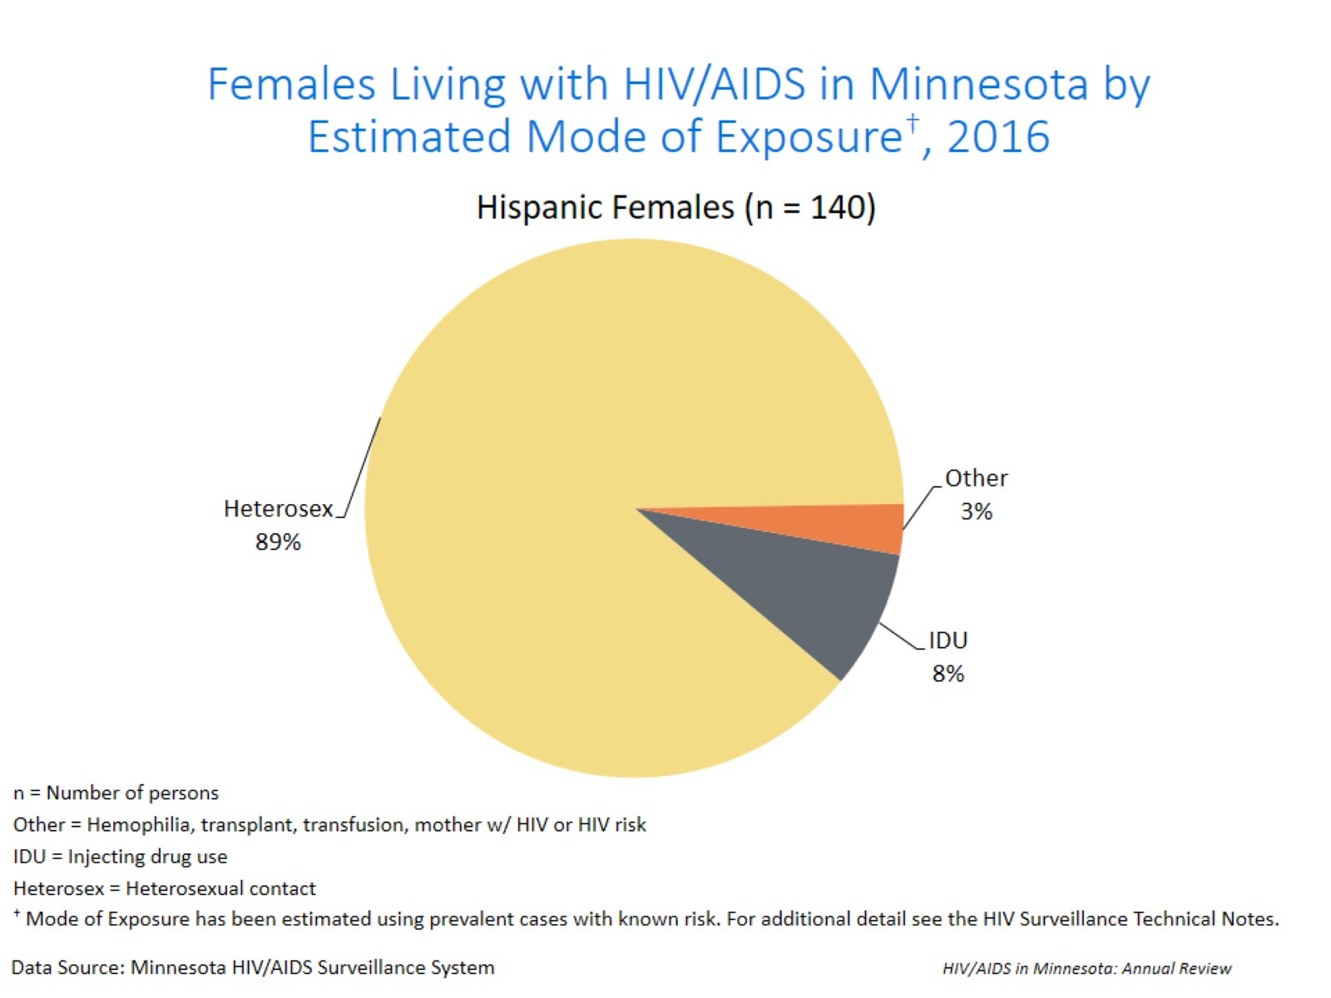
Notes:
Among the 140 Hispanic females living with HIV/AIDS in Minnesota in 2016, an estimated 89% of cases were attributed to heterosexual contact, 8% of the cases were attributed to injection drug use (IDU) and other risk accounted for the remaining 3% of cases.

Slide 38
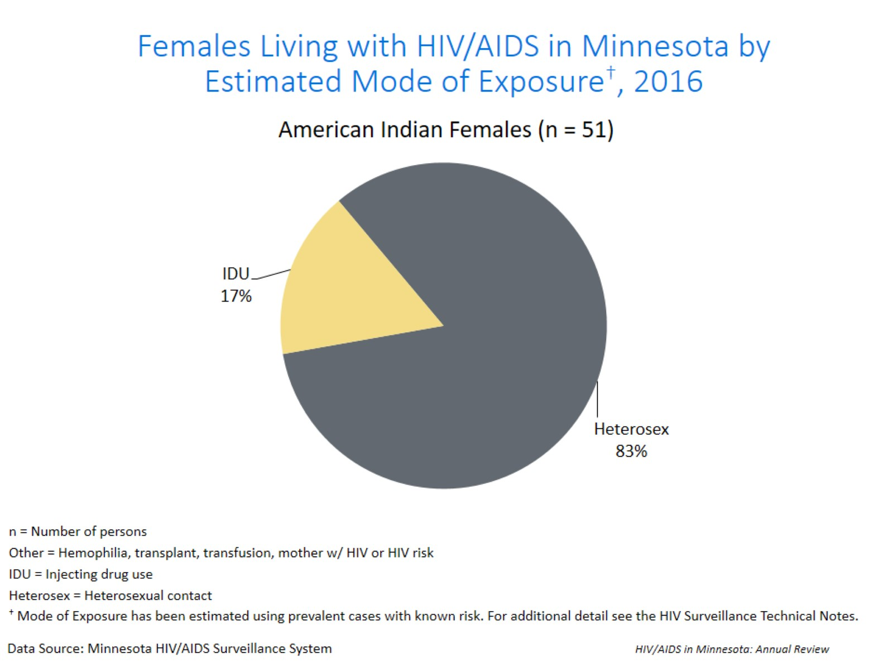
Notes:
Among the 51 American Indian females living with HIV/AIDS in Minnesota in 2016, an estimated 83% of cases were attributed to heterosexual contact, and the remaining 17% of the cases were attributed to injection drug use (IDU).

Slide 39
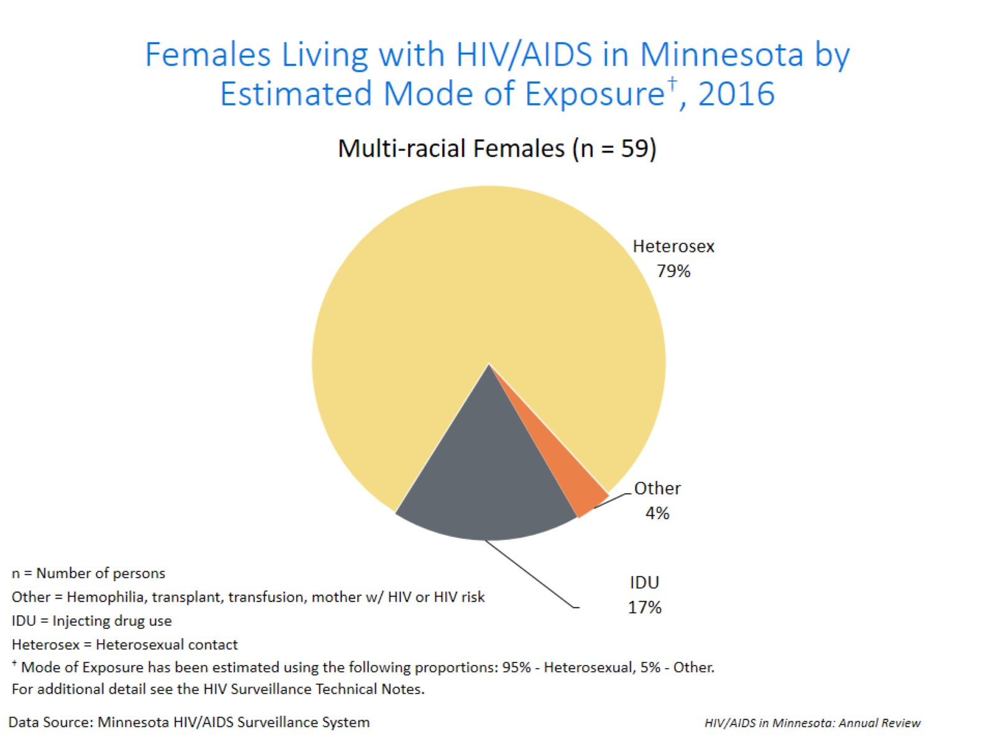
Notes:
Among the 59 multi-racial females living with HIV/AIDS in Minnesota in 2016, an estimated 79% of cases were attributed to heterosexual contact, 17% of the cases were attributed to injection drug use (IDU) and the remaining 4% were attributed to other risk.

Slide 40
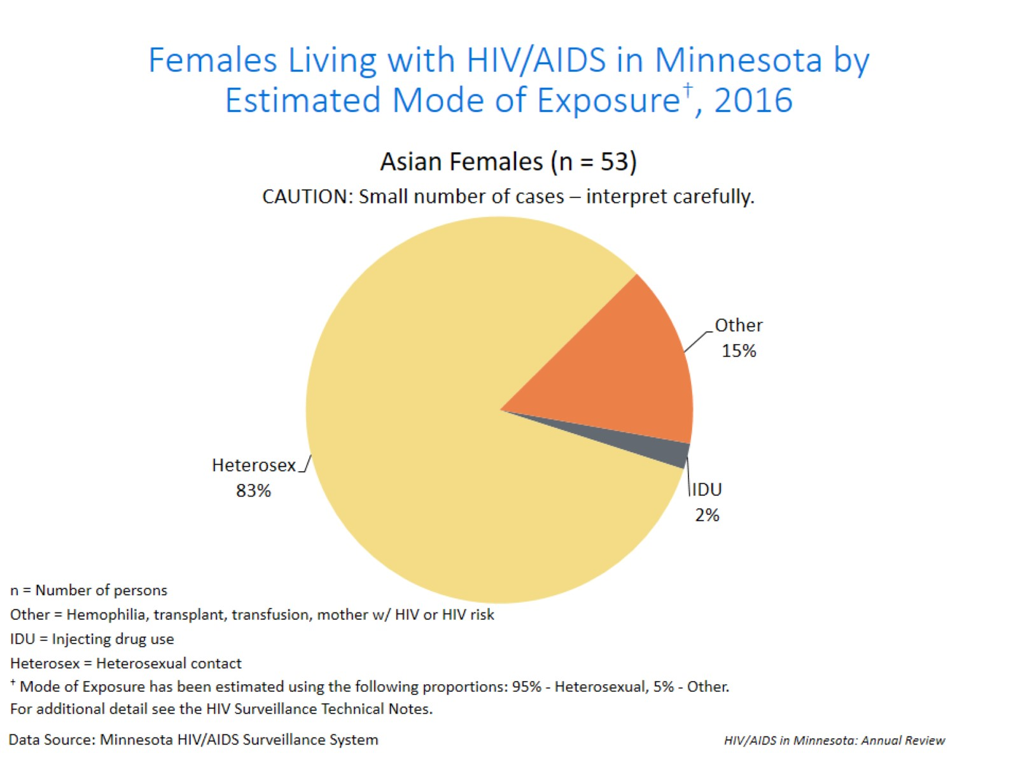
Notes:
Among the 53 Asian/Pacific Islander females living with HIV/AIDS in Minnesota in 2016, an estimated 83% of cases were attributed to heterosexual contact, 15% of the cases were attributed to other risk and the remaining 2% were attributed to injection drug use (IDU).

Slide 41
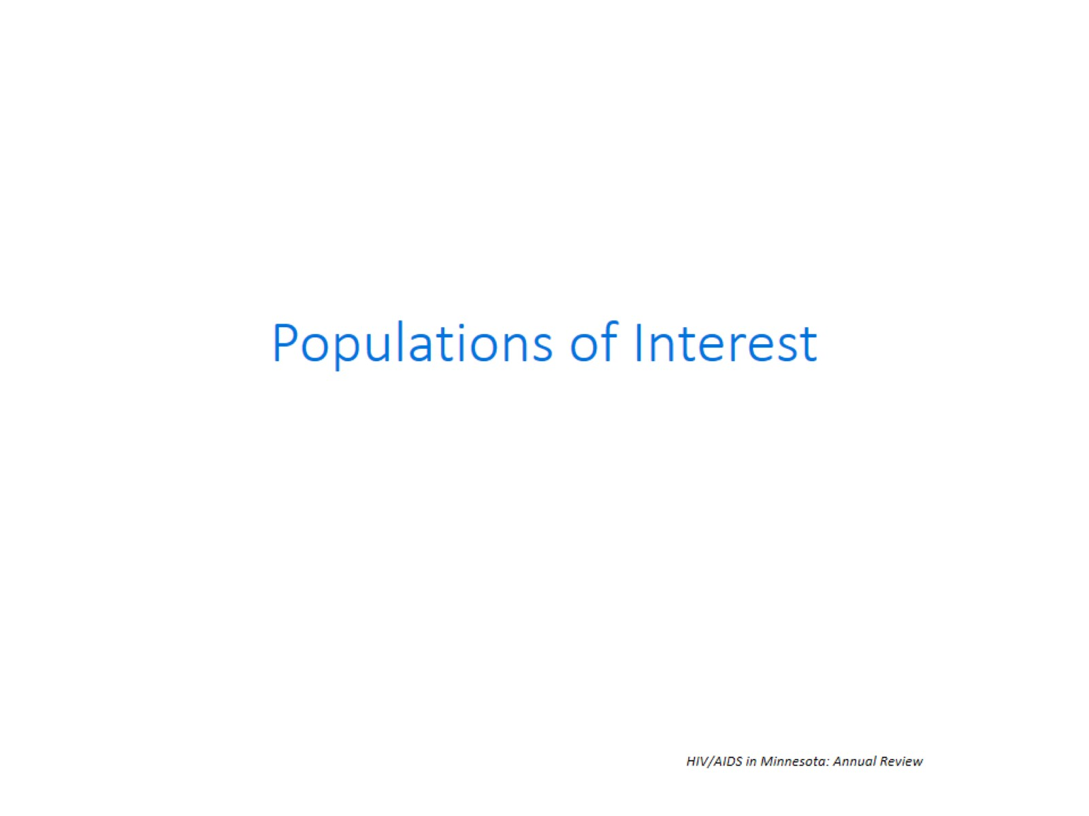

Slide 42
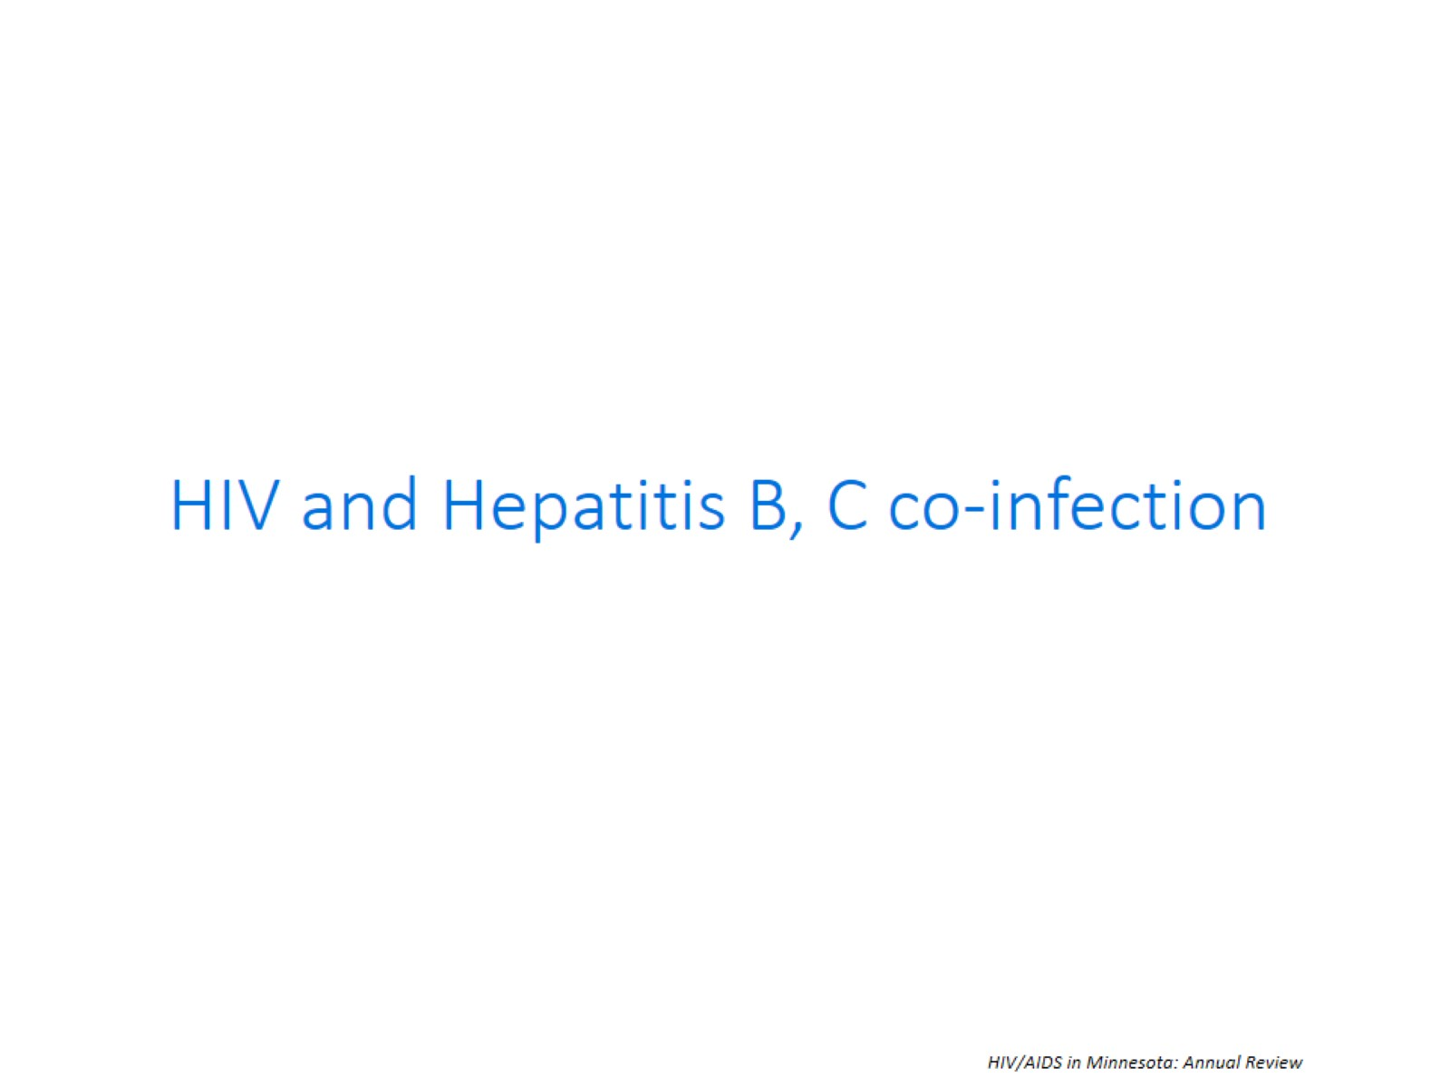

Slide 43
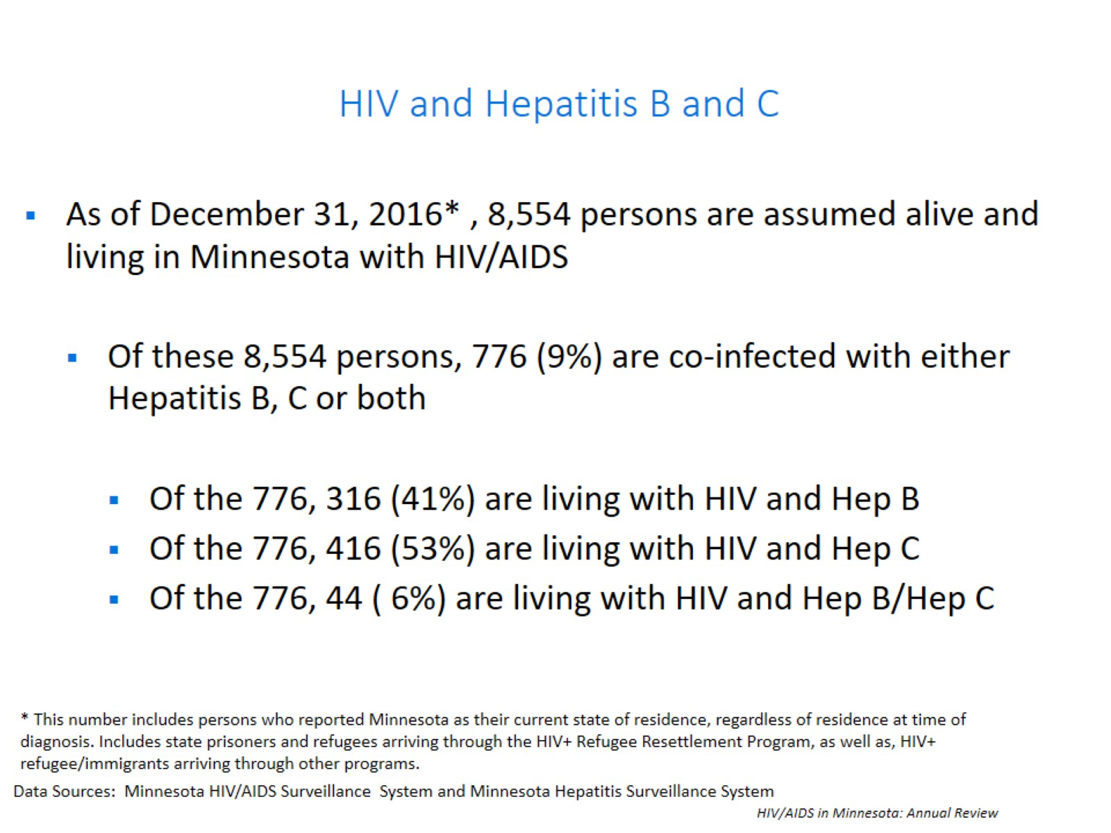
HIV and Hepatitis B and C

Slide 44
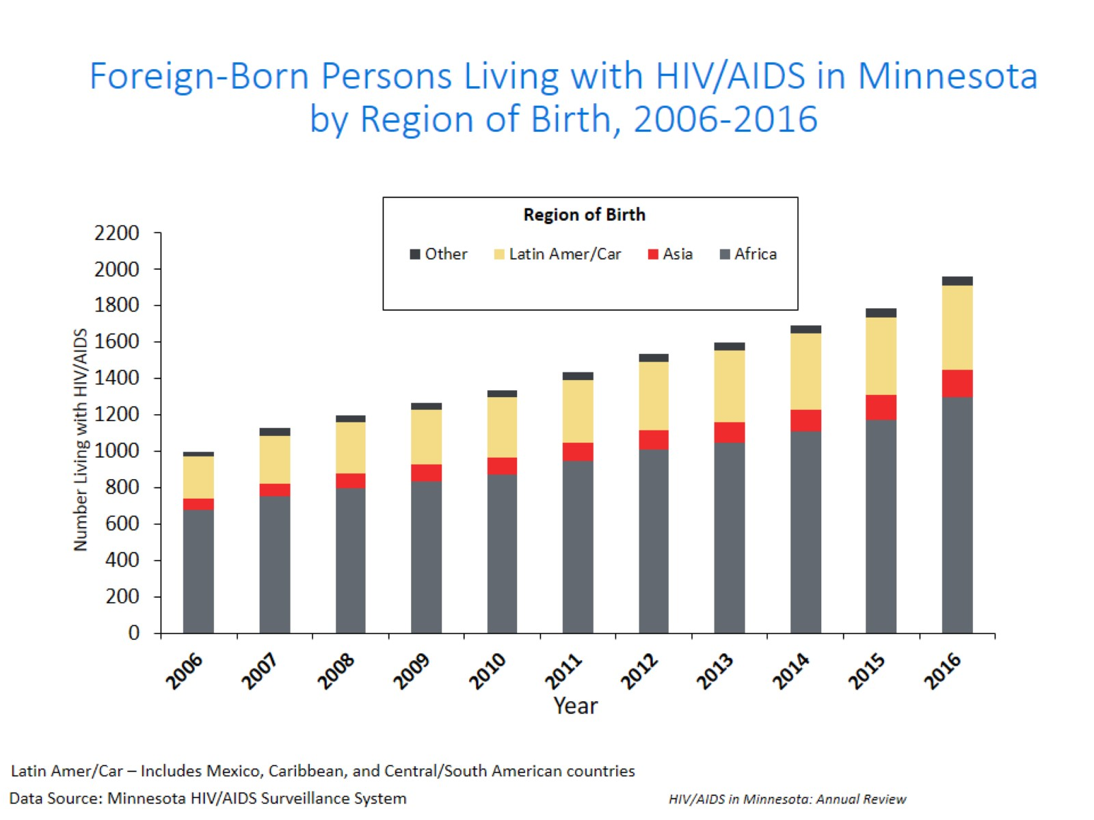
Notes:
Between 1990 and 2016, the number of foreign-born persons living with HIV/AIDS in Minnesota increased substantially, especially among the African-born population. In 1990, 50 foreign-born persons were reported to be living with HIV/AIDS in Minnesota, and by 2003 this number had increased twelve-fold to 692 persons. In 2016, the total number of foreign-born persons living with HIV/AIDS in Minnesota was 1,785, a nearly 10% increase from 2015. This trend illustrates the growing diversity of the infected population in Minnesota and the need for culturally appropriate HIV care services and prevention efforts.

Slide 45
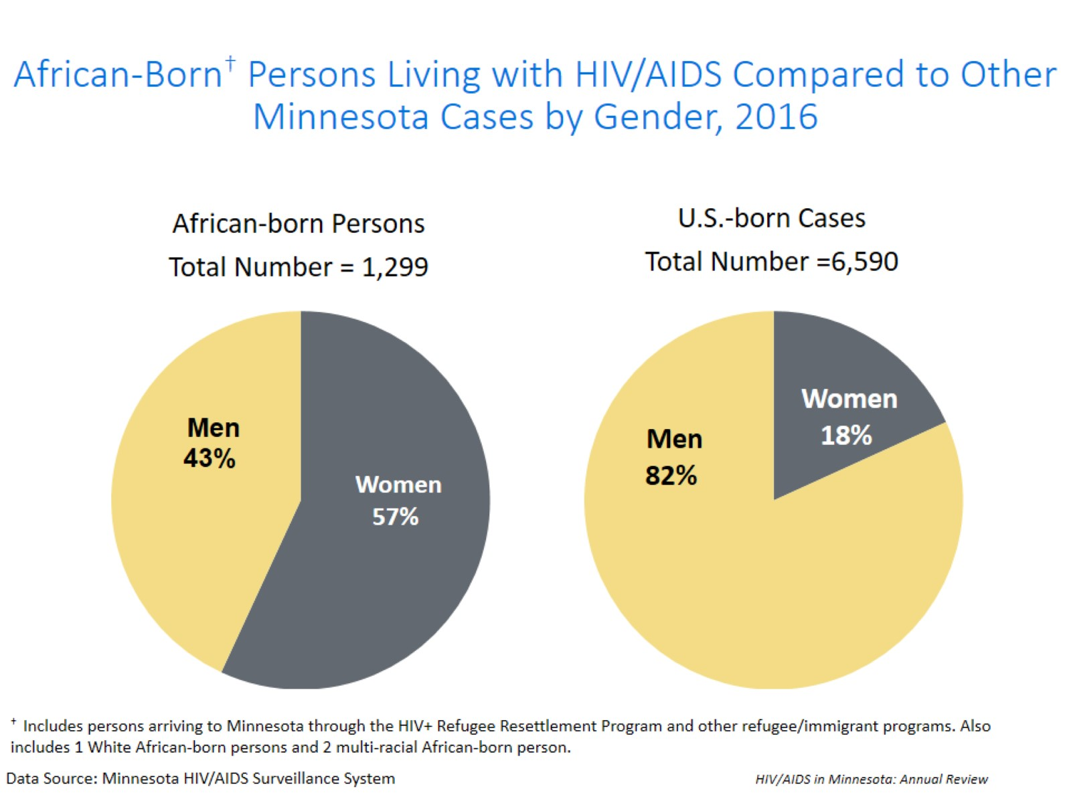
Notes:
The characteristics of foreign-born persons living with HIV/AIDS in Minnesota differ from U.S.-born, especially in gender. While females account for 18% of cases among U.S.-born persons, they account for 44% of foreign-born cases. This is especially noticeable among African-born cases, where women account for 57% of those living with HIV/AIDS in Minnesota.

Slide 46
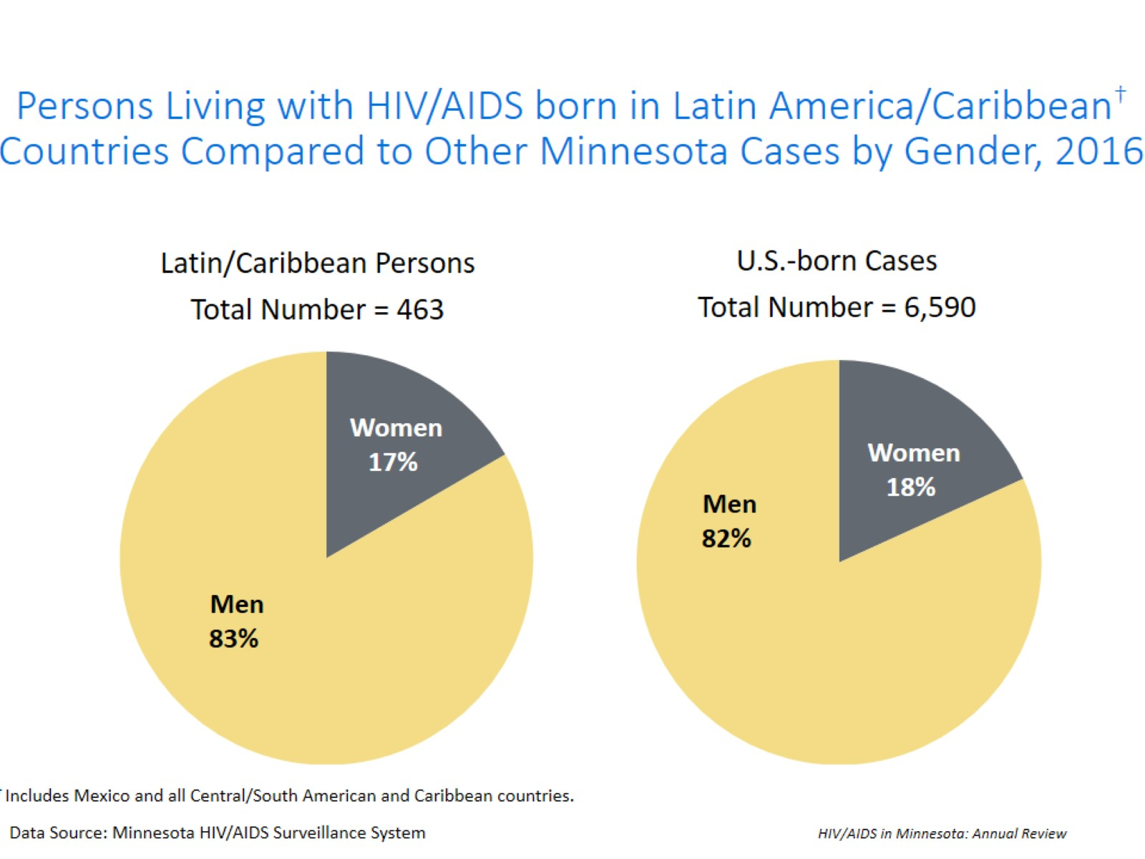
Notes:
The gender distribution among cases born in Latin America/the Caribbean is similar to that of U.S.-born cases, where 17% of prevalent cases are among women.

Slide 47
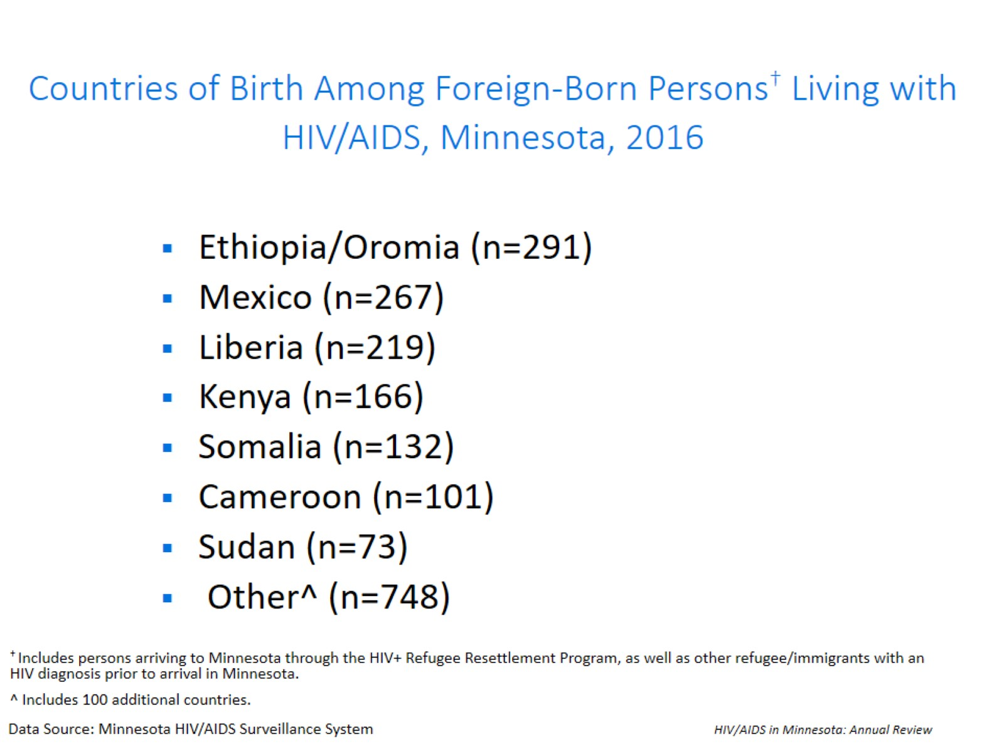
Notes:
Seven countries (Ethiopia, Mexico, Liberia, Kenya, Somalia, Cameroon, and Sudan) account for a majority (63%) of living foreign-born cases, however there are 100 additional countries represented among the 1,997 foreign-born persons living with HIV infection in Minnesota.

Slide 48
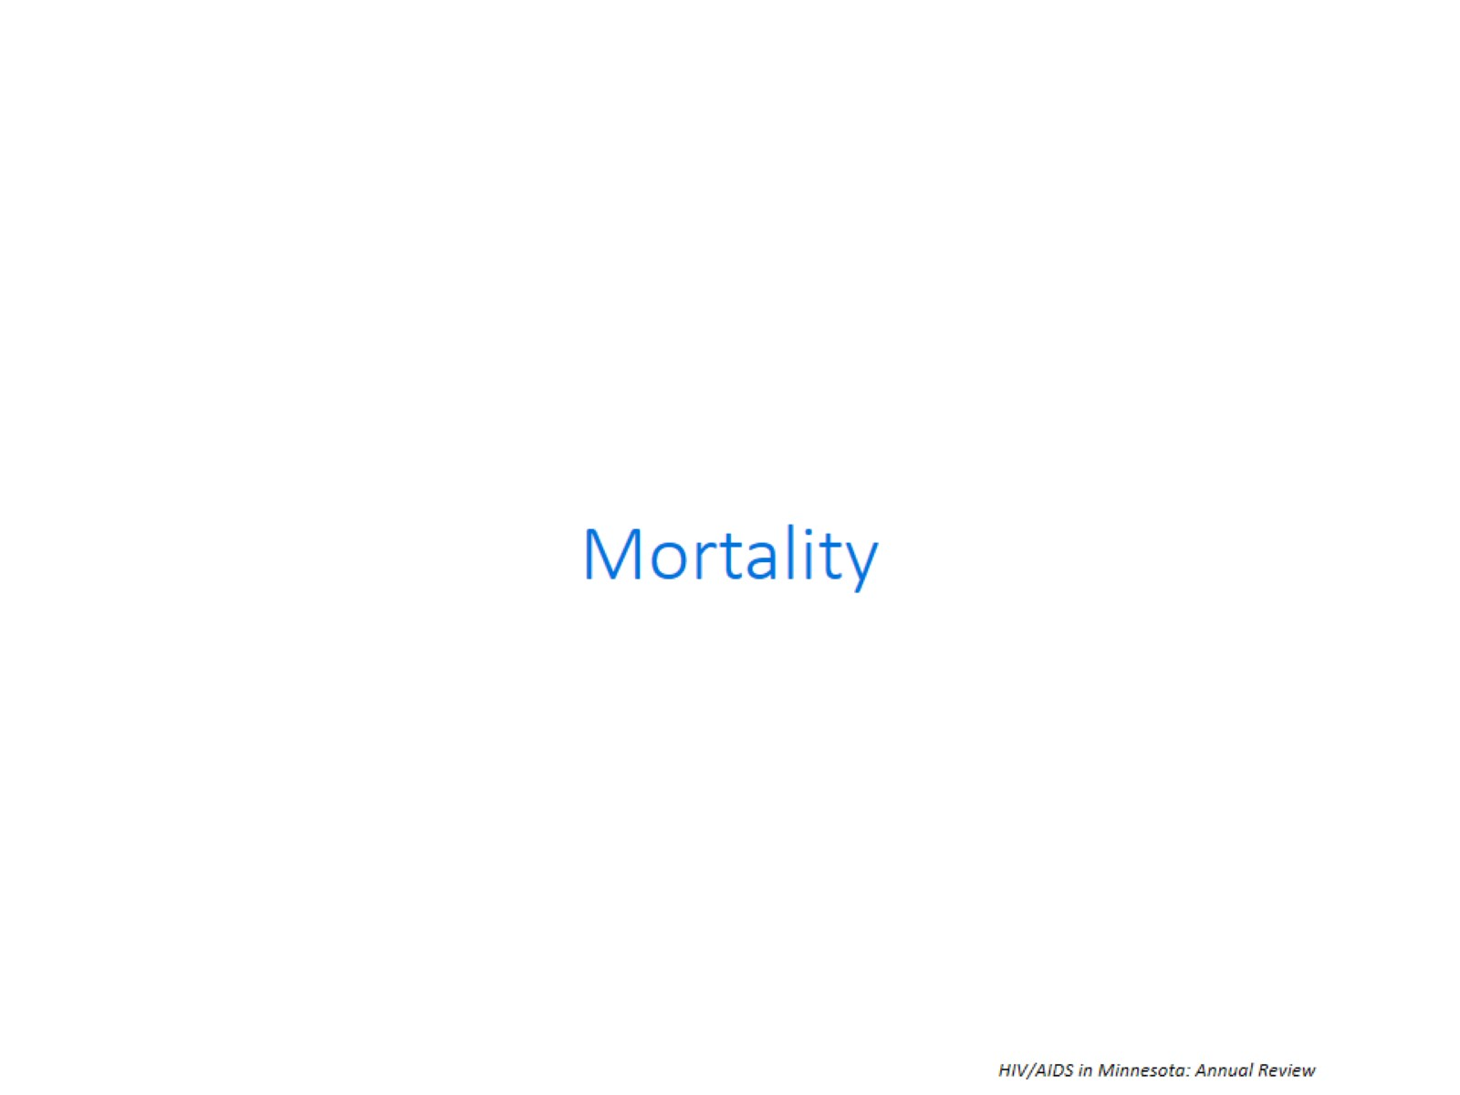

Slide 49
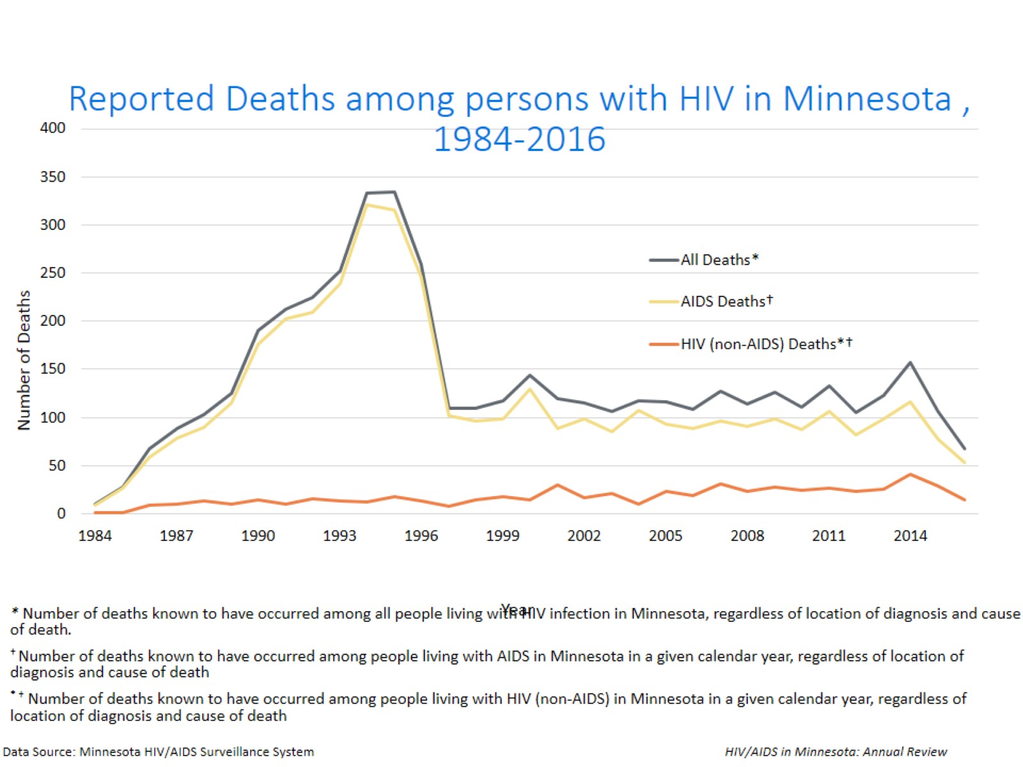
Notes:
The number of deaths among all people living with HIV infection in Minnesota decreased dramatically between 1995 and 1997 and has remained relatively constant over the past decade. In 2016, a total of 67 deaths were reported people living with HIV infection in Minnesota. The total number of deaths reported in Minnesota for those living with AIDS was 53(79% of all deaths) in 2016.
Includes all deaths known to have occurred among all people living with HIV infection in Minnesota, regardless of location of diagnosis and cause of death.
Number of deaths known to have occurred among people living with AIDS in Minnesota in a given calendar year, regardless of location of diagnosis and cause of death.

