Slide 1
Minnesota Department of Health
STD, HIV and Hepatitis C 2016 Data Release
Notes:
Good Afternoon and welcome to the STD, HIV and Hepatitis C 2016 data release webinar. My name is Krissie Guerard and I am the STD/HIV/TB section manager for the Minnesota Department of Health.

Slide 2
Acronyms
MDH = Minnesota Department of Health
STD = Sexually transmitted disease
MSM = Men who have sex with men
HCV = Hepatitis C virus
HBV = Hepatitis B virus
IDU = Injection drug use
SSuN = STD Surveillance Network
Notes:
Before we begin I would like to define some common acronyms that will be used in todays presentation.
MDH = Minnesota Department of Health
STD = Sexually transmitted disease, also know as STI or sexually transmitted infection
MSM = Men who have sex with men
HCV = Hepatitis C virus
HBV = Hepatitis B virus
IDU = Injection drug use
SSuN = STD Surveillance Network

Slide 3
Announcements
STD Overview
Syphilis
Gonorrhea
SSuN
Chlamydia
HIV
Hepatitis C
Notes:
I would like to begin with a few announcements. We will have a series of presentations and we will hold all questions until the end, but you can type in questions for us that we will address at the conclusion of the webinar, lines will be muted until the conclusion of all 4 presenters. Contact information for all of the speakers will be provided at the end so individuals can follow up with the speakers more directly if additional information is needed. This session is being recorded and will be available on our website in a day or so.
The webinar will begin with Dawn Ginzl, the STD Surveillance Coordinator and Epidemiologist with MDH, and Laura Tourdot, the SSuN Coordinator highlighting the 2016 STD surveillance data report, next will be Cheryl Barber, the HIV Surveillance Coordinator presenting the 2016 HIV data report. Lastly, a presentation on 2016 Hepatitis C data by Kristin Sweet, the Hepatitis Epidemiology Supervisor.
Thanks to everyone for joining us today. I will now turn it over to Dawn to begin the 2016 STD surveillance report.

Slide 4
Highlights from the STD Surveillance Report, 2016
Minnesota Department of Health STD Surveillance System

Slide 5
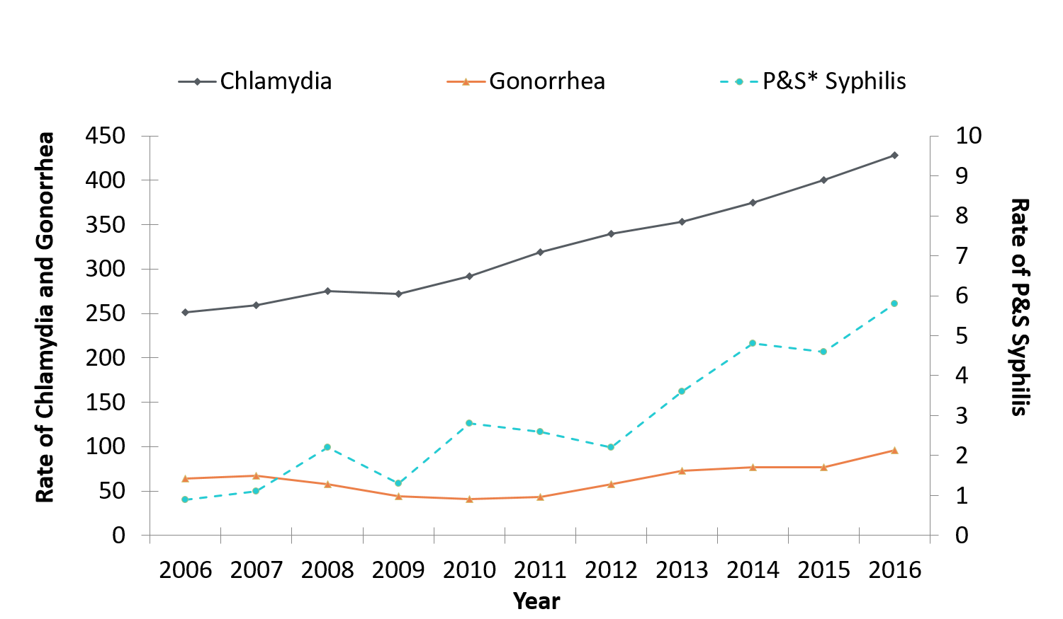
STDs in Minnesota Rate per 100,000 by Year of Diagnosis, 2006-2016
* P&S = Primary and Secondary
Notes:
The rate of chlamydia in MN reached an all time high at 428 per 100,000. This is a rate increase of 7% from 2015.
The rate of gonorrhea in MN increased 25% to 96 per 100,000 compared to 77 per 100,000 in 2015.
The rate of primary and secondary syphilis is at 5.8 per 100,000. This is an increase of 26% from 2015.

Slide 6
STDs in Minnesota Number of Cases Reported in 2016
Total of 28,631 STD cases reported to MDH in 2016:
22,675 Chlamydia cases
5,104 Gonorrhea cases
852 Syphilis cases (all stages. Including 6 congenital syphilis)
0 Chancroid cases

Slide 7
Syphilis

Slide 8
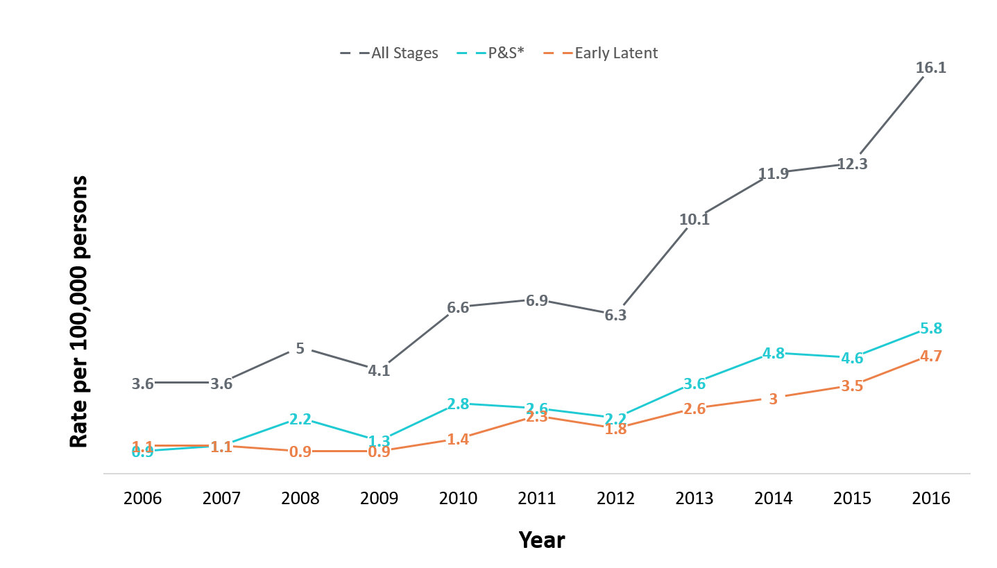
Syphilis Rates by Stage of Diagnosis Minnesota, 2006-2016
* P&S = Primary and Secondary
Notes:
The overall syphilis rate is now up to 16.1 per 100,000. Compared to the low of 3.6 back in 2006 & 2007.
Of concern is the rate of primary and secondary syphilis which is 5.8 per 100,000.

Slide 9
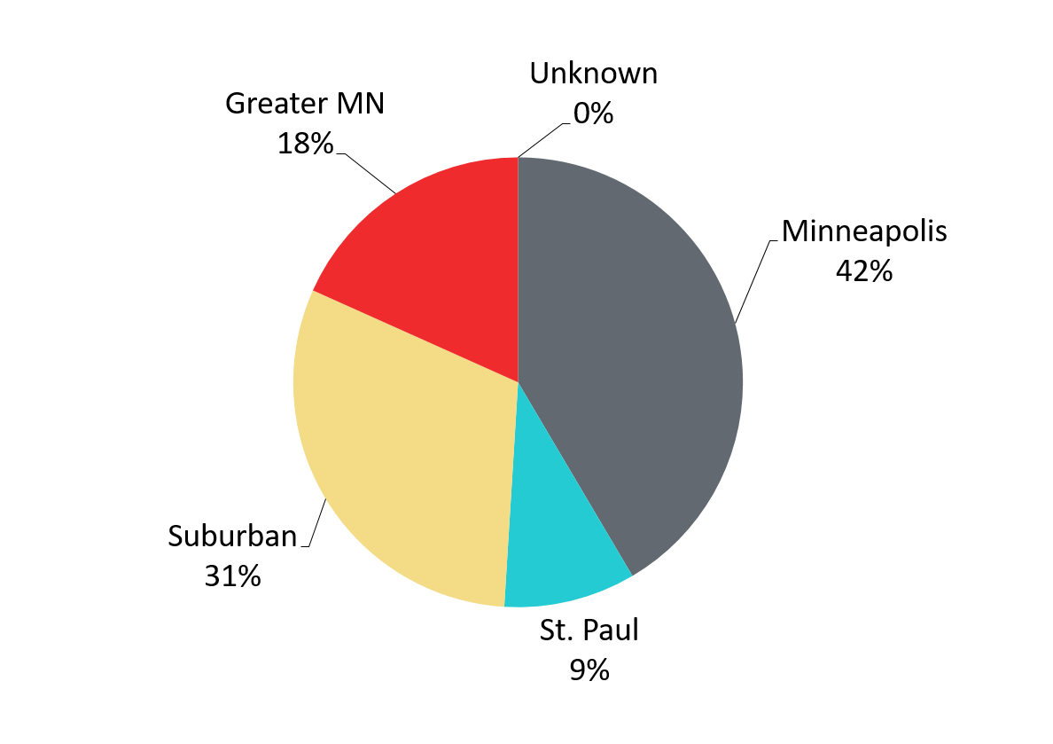
Primary & Secondary Syphilis Infections in Minnesota by Residence at Diagnosis, 2016
Total Number of Cases = 306
Suburban = Seven-county metro area including Anoka, Carver, Dakota, Hennepin (excluding Minneapolis), Ramsey (excluding St. Paul), Scott, and Washington counties.
Greater MN = All other Minnesota counties outside the seven-county metro area.
Notes:
The City of Minneapolis has 42% of all reported primary and secondary cases.
The suburban area has 31% of the cases, St. Paul has 9% of the cases, and Greater Minnesota has 18% of the cases.
The largest increase was in Greater Minnesota at 115%

Slide 10
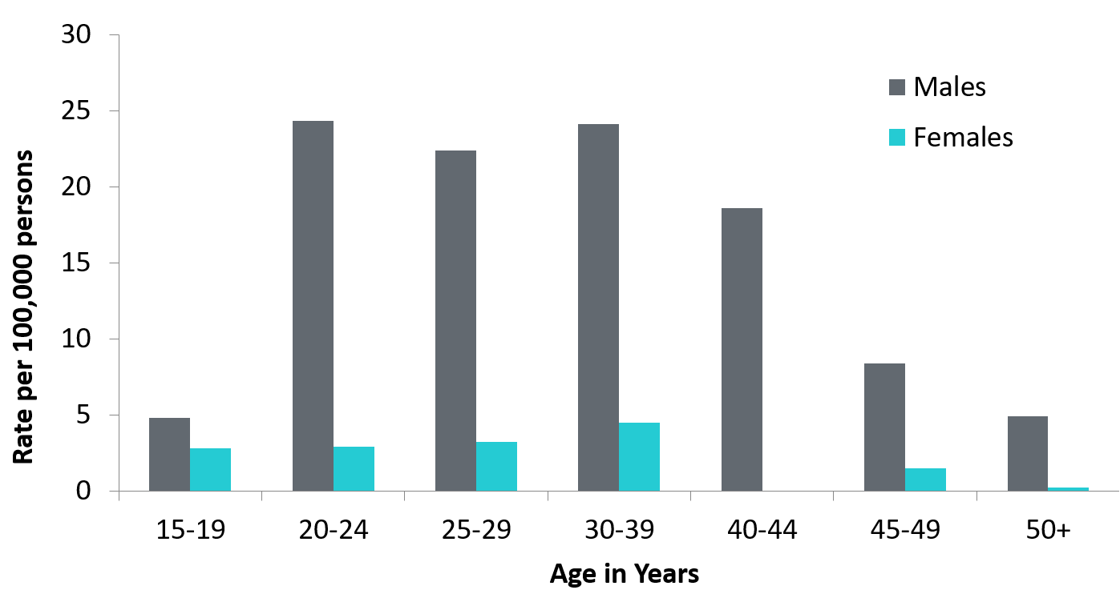
Age-Specific Primary & Secondary Syphilis Rates by Gender, Minnesota, 2016
Notes:
Males have higher rates of primary and secondary syphilis than females in all age groups. The rate in males is 7 times higher than females.
The 20-24 yr old males have the highest rate at 24.3 per 100,000
The 30-39 yr old females have the highest rate of the female population at 4.5 per 100,000

Slide 11
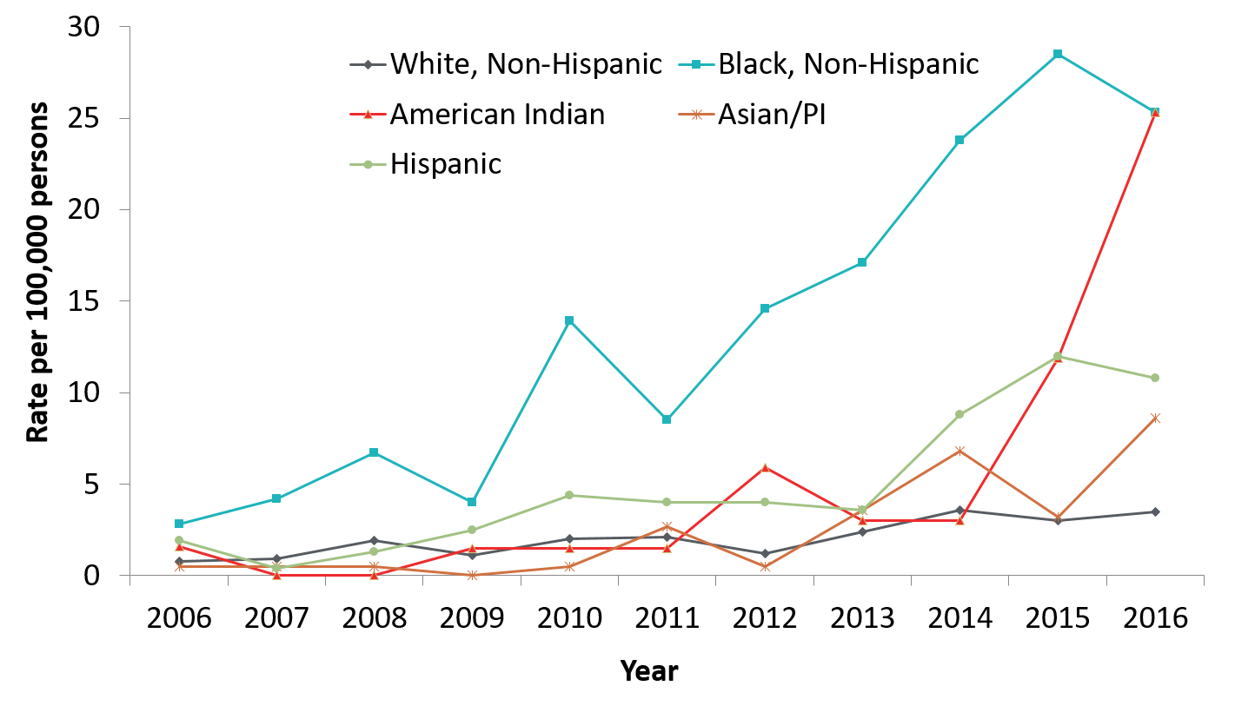
Primary & Secondary Syphilis Rates by Race/Ethnicity Minnesota, 2006-2016
* Persons of Hispanic ethnicity can be of any race.
Notes:
The rates of primary and secondary syphilis are 7 times higher in the Black/African American, Non-Hispanic and American Indian populations than that of the White, Non-Hispanic population.
The rates of primary and secondary syphilis in the Black/African American, Non-Hispanic population are 25.3 per 100,000 compared to 3.5 per 100,000 in the White, Non-Hispanic population.
The rates in the American Indian population are also 25.3 per 100,000.
The rates in the Hispanic/Latino population are 10.8 per 100,000 which is 3 times higher than the White, Non-Hispanic population.
The rates in the Asian/Pacific Islander population are 8.6 per 100,000 which is 2.5 times higher than the White, Non-Hispanic population.

Slide 12
Early Syphilis Among Men Who Have Sex With Men in Minnesota

Slide 13
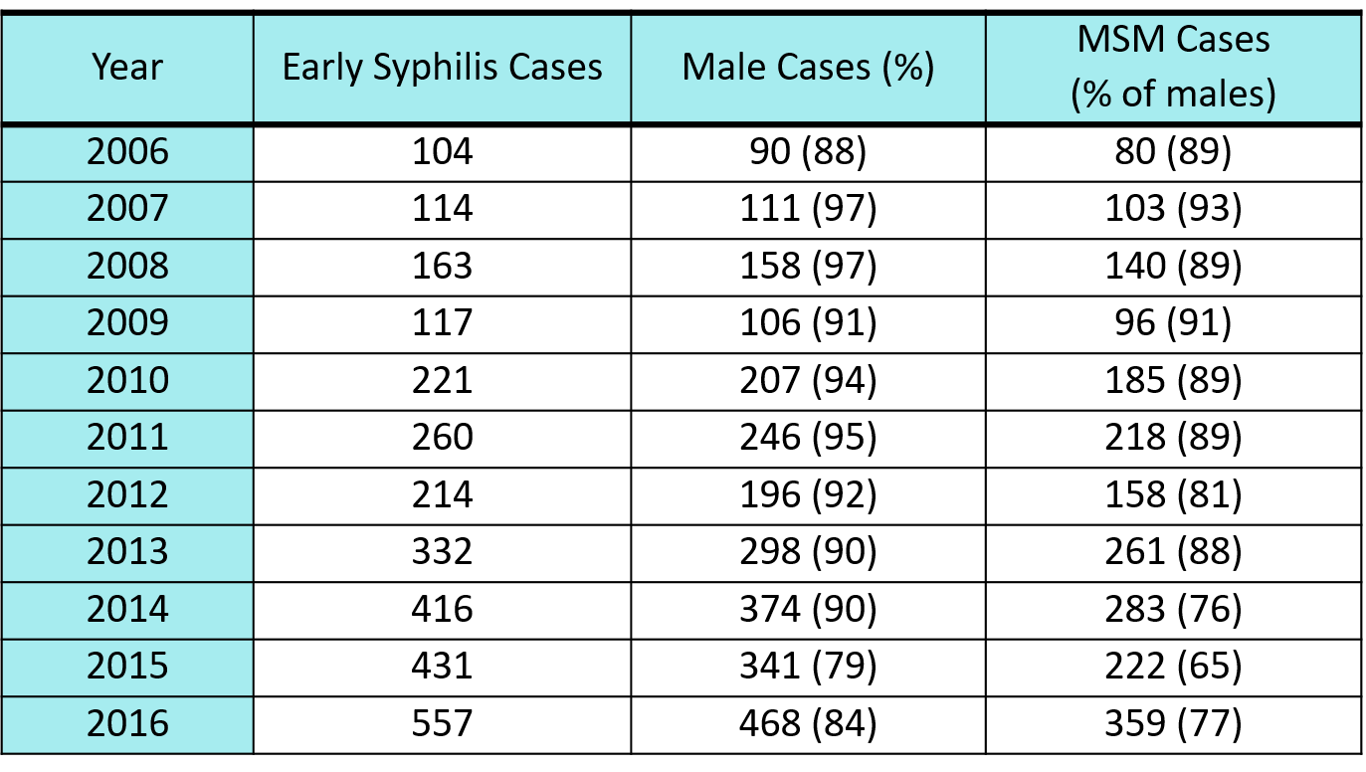
Early Syphilis† by Gender and Sexual Behavior Minnesota, 2006-2016
† Early Syphilis includes primary, secondary, and early latent stages of syphilis.

Slide 14
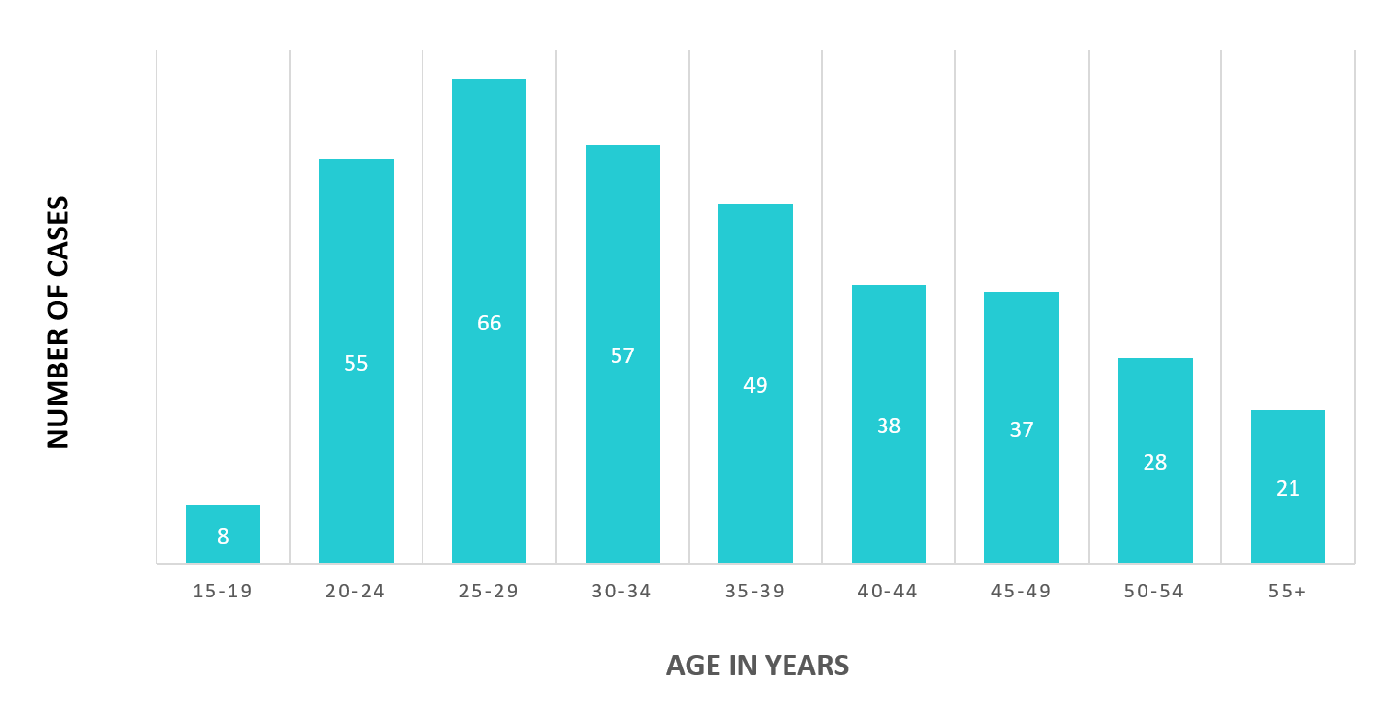
Early Syphilis† Cases Among MSM by Age Minnesota, 2016 (n=359)
Mean Age = 36 years
Range: 16 to 72 years
MSM=Men who have sex with men
† Early Syphilis includes primary, secondary, and early latent stages of syphilis.
Notes:
The average age of MSM with early syphilis 36 years of age.
Ages ranged from 16 – 72 years of age
The 25-29 year old age group had the highest number of cases at 66.

Slide 15
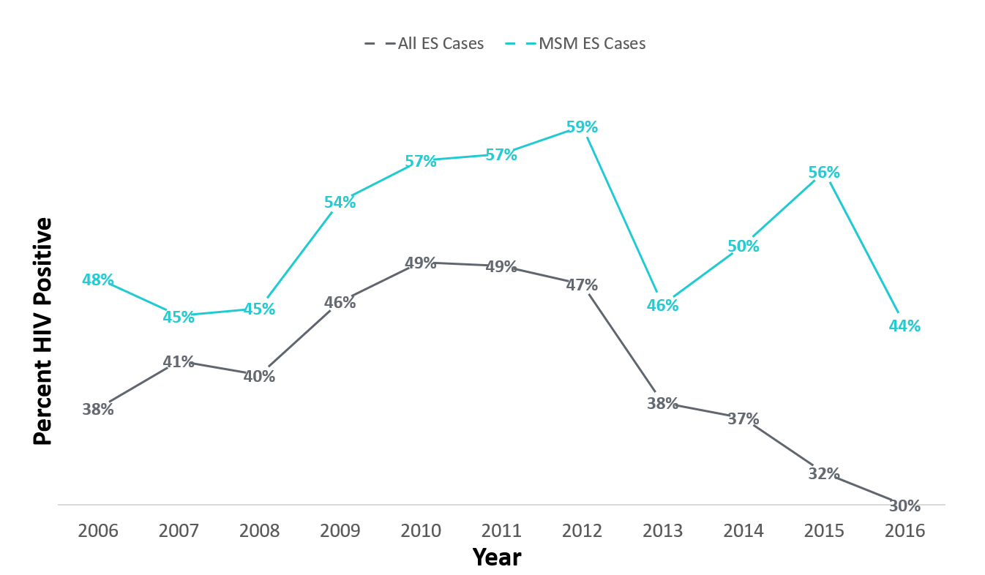
Early Syphilis† (ES) Cases Co-infected with HIV, 2006-2016
MSM=Men who have sex with men
† Early Syphilis includes primary, secondary, and early latent stages of syphilis.
Notes:
Thirty percent of all early syphilis cases were co-infected with HIV.
Forty-four percent of all MSM early syphilis cases were co-infected with HIV.

Slide 16
Characteristics of Early Syphilis† Cases Among MSM, Minnesota, 2016
Gay and bisexual men account for 77% of cases among men.
62% of cases among MSM are White, but a disproportionate number of cases (17%) are African American.
44% of cases are also infected with HIV.
MSM=Men who have sex with men
† Early Syphilis includes primary, secondary, and early latent stages of syphilis.

Slide 17
Syphilis Among Females and Congenital Syphilis in Minnesota
Notes:
There was a large increase in the number of cases of syphilis found in females in 2015

Slide 18
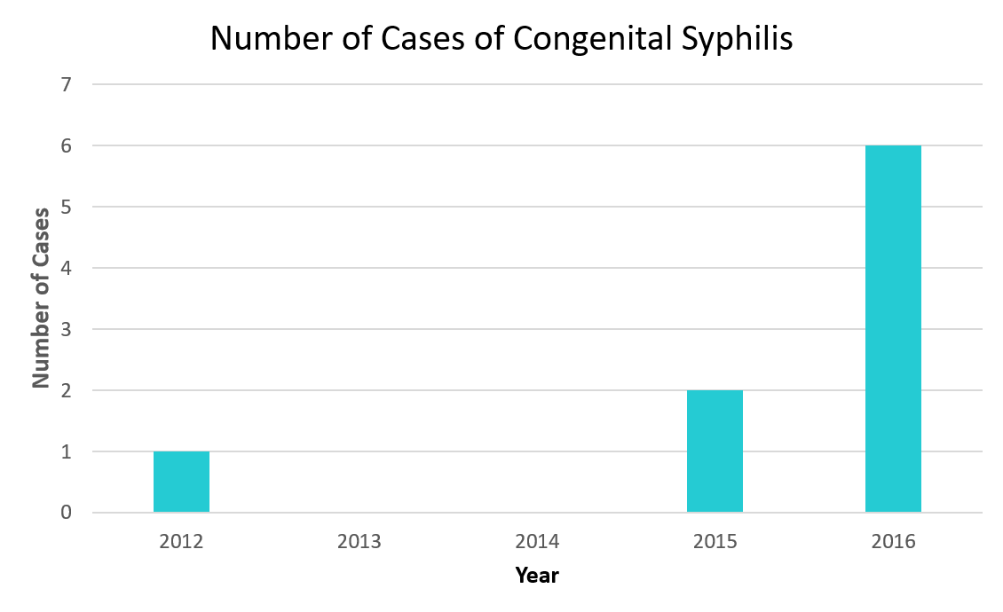
Congenital Syphilis in Minnesota 2012-2016
Notes:
Screening recommendations for all pregnant women were introduced in January 2016.
In 2016, we had 6 cases of congenital syphilis reported in MN

Slide 19
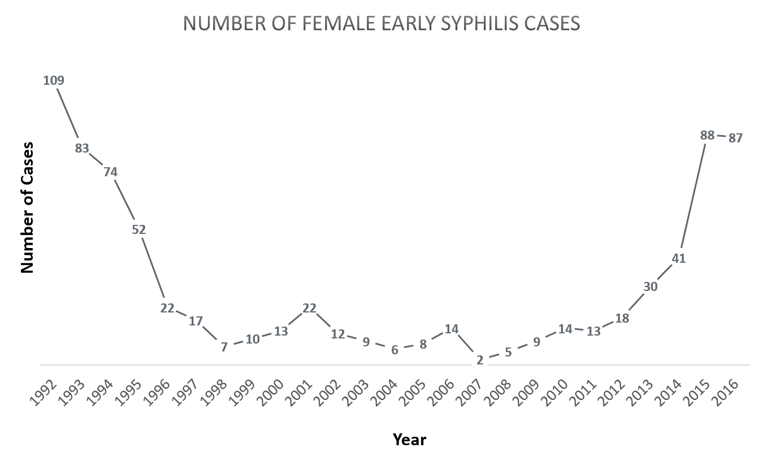
Female Early Syphilis cases

Slide 20
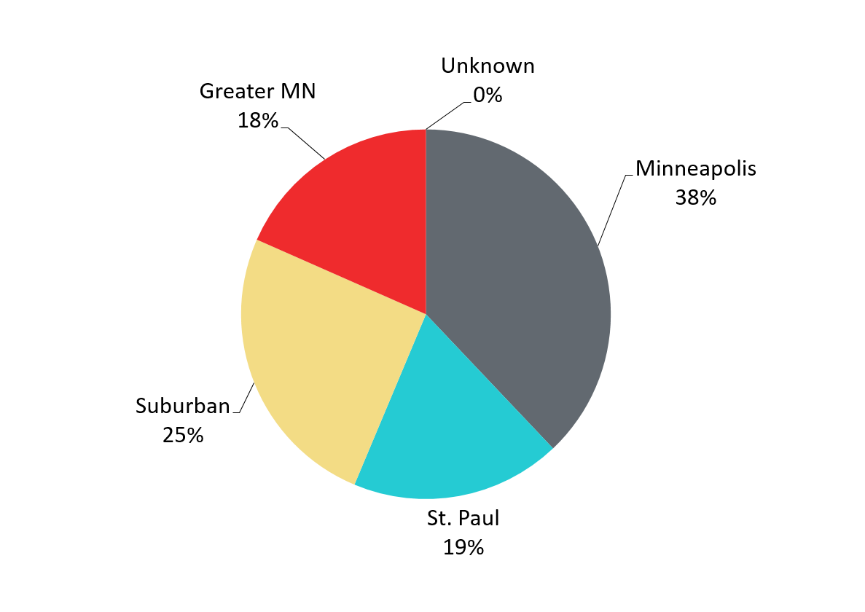
Early Syphilis Infections in Women in Minnesota by Residence at Diagnosis, 2016
Total Number of Cases = 87
Suburban = Seven-county metro area including Anoka, Carver, Dakota, Hennepin (excluding Minneapolis), Ramsey (excluding St. Paul), Scott, and Washington counties.
Greater MN = All other Minnesota counties outside the seven-county metro area.
Notes:
Thirty-eight percent of female early syphilis cases were residents of the City of Minneapolis
Twenty-five percent of female early syphilis cases were residents of the Suburbs of the seven-county metro area
Nineteen percent were City of St. Paul residents, and 18% were Greater MN residents.

Slide 21
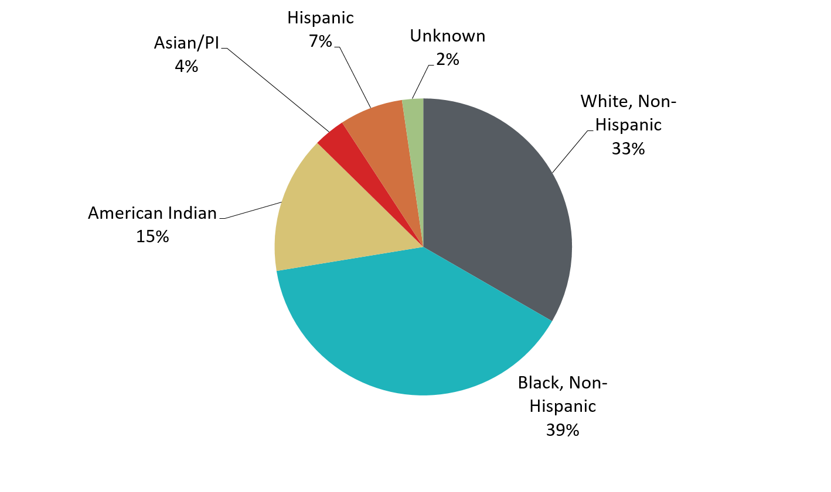
Early Syphilis Cases in Females by Race Minnesota, 2016
Total Number of Cases = 87
*Includes persons reported with more than one race
Notes:
There are large disparities in women with syphilis. Thirty-nine percent of all early syphilis cases in females are found in the Black/African American population and 15% in the American Indian population.

Slide 22
Gonorrhea
Notes:
Hello I am Laura Tourdot the SSuN Coordinator and Epidemiologist with the Minnesota Department of Health. I will be highlighting the 2016 gonorrhea surveillance data and the CDC funded STD Surveillance Network (SSuN).

Slide 23
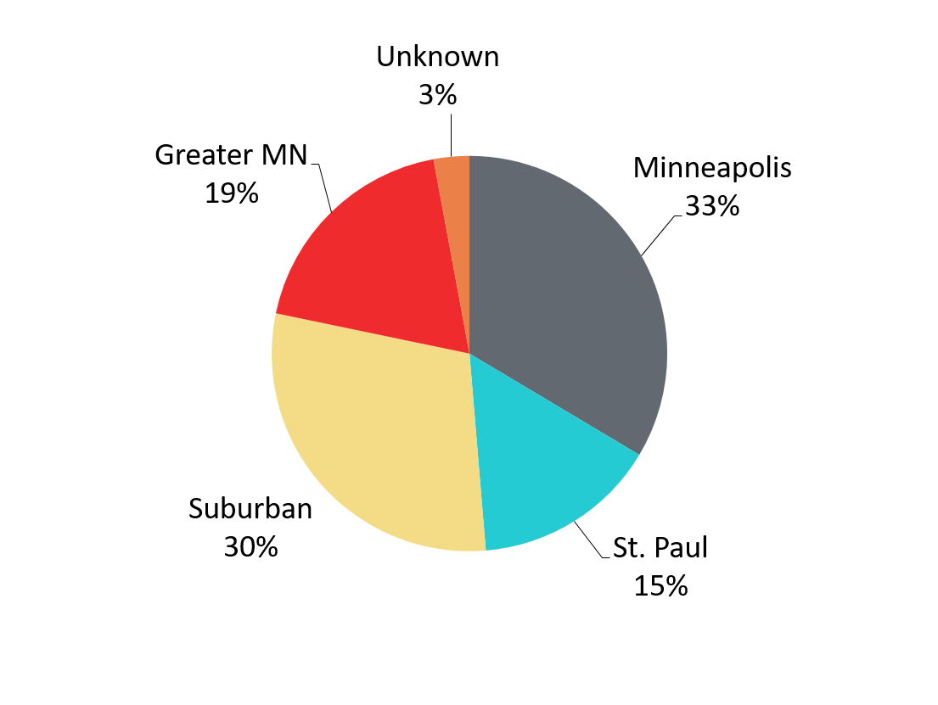
Gonorrhea Infections in Minnesota by Residence at Diagnosis, 2016
Total Number of Cases= 5,104
Suburban = Seven-county metro area including Anoka, Carver, Dakota, Hennepin (excluding Minneapolis), Ramsey (excluding St. Paul), Scott, and Washington counties.
Greater MN = All other Minnesota counties outside the seven-county metro area.
Notes:
The majority of the gonorrhea cases, 33%, continue to be residents of the City of Minneapolis.
The next highest area is the Suburban area at 30%. The Suburban area also had the highest increase at 41%.

Slide 24
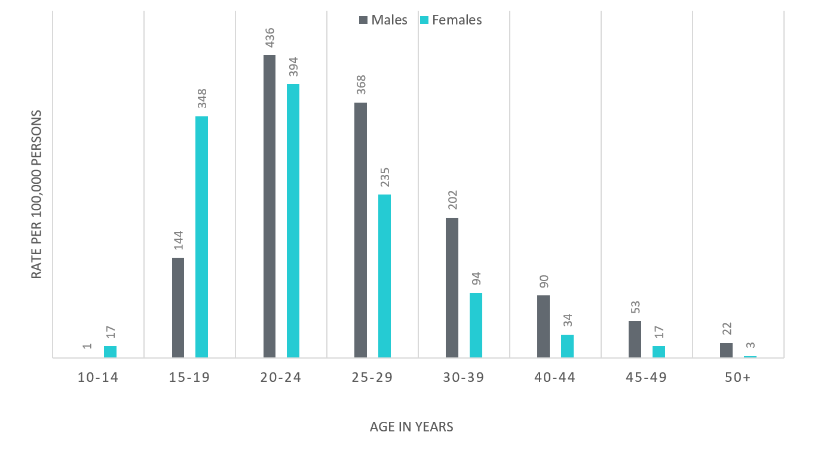
Age-Specific Gonorrhea Rates by Gender Minnesota, 2016
Notes:
The rates of gonorrhea went up in both males and females in 2016. Females continue to have higher rates of gonorrhea than males in age groups 19 and under. In 2016 the males have higher rates in the 20 and over age groups. The rate in females increased more than the rate in males in 2016.
The highest rates of gonorrhea are in males 20-24 at 436 per 100,000.

Slide 25
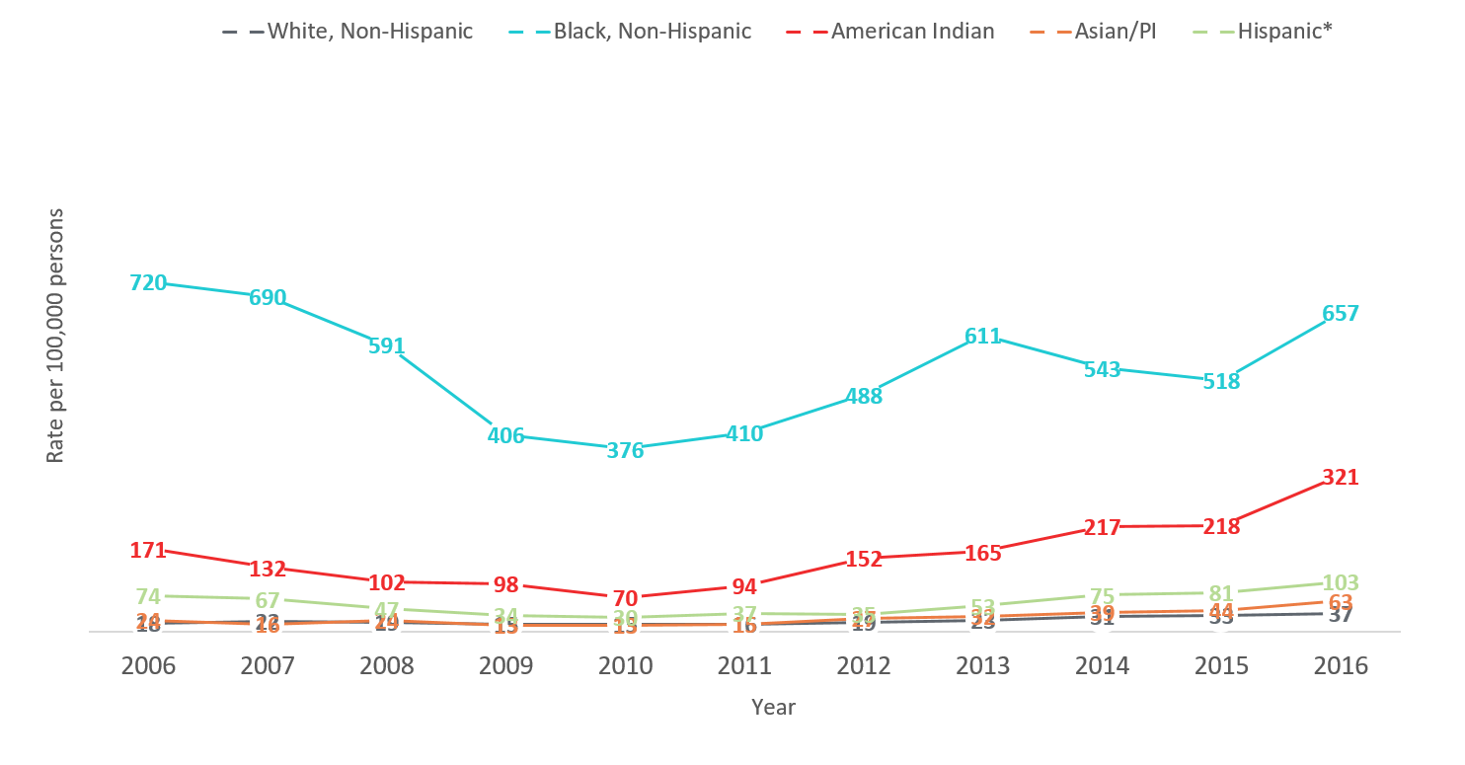
Gonorrhea Rates by Race/Ethnicity Minnesota, 2006-2016
2016 rates compared with Whites:
Black, Non-Hispanic = 18x higher
American Indian = 9x higher
Asian/PI = 2x higher
Hispanic* = 3x higher
Notes:
There continues to be disparities in rates of gonorrhea.
The Black/African American, Non-Hispanic population has rates that are 18 times higher than that of whites. The rate in the Black/African American population was 657 per 100,000 compared to the rate in the White, Non-Hispanic population at 37 per 100,000.
The American Indian population had a rate that was 9 times higher at 321 per 100,000
The Asian/Pacific Islander population had a rate that was 2 times higher at 63 per 100,000
The Hispanic/Latino population, which can be of any race, had a rate that was 3 times higher at 103 per 100,000

Slide 26
SSuN
Notes:
MDH is participating in the CDC funded STD Surveillance Network (SSuN). SSuN is an enhanced STD surveillance project that focuses on collecting additional gonorrhea surveillance information from both patients and providers. Twenty percent of the gonorrhea cases reported to MDH are randomly selected for enhanced surveillance.
MDH is using the collected surveillance data to created targeted gonorrhea prevention in MN and to help develop a comprehensive picture of gonorrhea nationwide.

Slide 27
Provider Investigation
Notes:
For the 20% of gonorrhea cases who are randomly selected, providers will receive a standard fax form requesting additional surveillance information including: classification of treating provider, does the patient have health insurance, symptoms present during exam, all anatomic sites tested for GC, was the patient test for HIV and gender of sex partner.

Slide 28
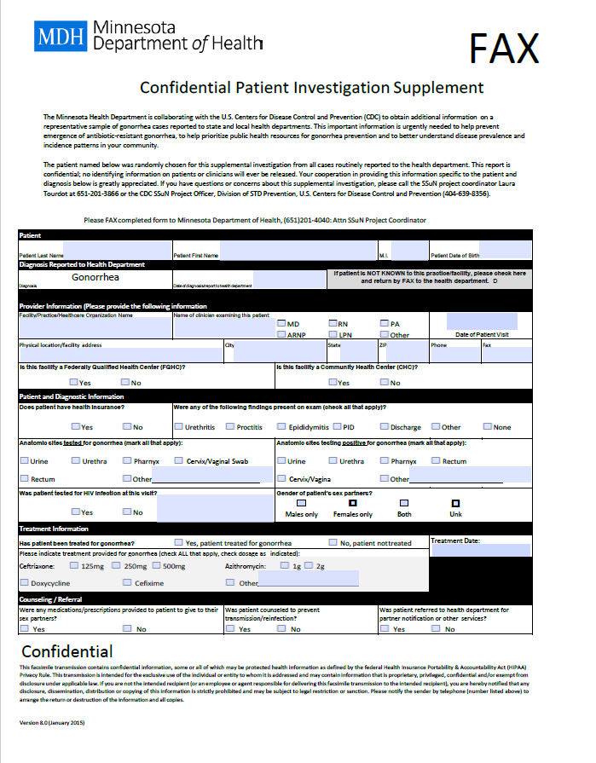
Notes:
Example of SSuN “Confidential Patient Investigation Supplement form”
Providers Investigations are required for the 20% of gonorrhea cases that are randomized for the SSuN enhanced surveillance project. In 2016 we had an overall response rate of 72.92%. We prefer to send the fax forms to providers so providers can fill out the few extra questions for SSuN cases whenever they have time. However, there are several clinics that never responded to our fax forms. To gather the necessary information we will need to start calling these providers directly for the necessary information.

Slide 29
Patient Investigation
Notes:
20% of all reported gonorrhea cases are randomized for a follow up phone call from MDH. The phone questionnaire generally takes about 5-10 minutes.

Slide 30
Gonorrhea is a notifiable condition in MN
Please remember to notify all patients after any STD diagnosis that their name and information is required by law to be reported to MDH.
Please ensure all STD case and lab reports are submitted to MDH with proper contact information.
Please inform your patients, after a STD diagnosis, that they have a chance of being contacted by MDH for additional follow up.
Notes:
Many SSuN cases are shocked when they received a call from MDH regarding their gonorrhea infection. They did not know their name was required by law to be reported to MDH.
We are one of 10 sites across the United States participating in the SSuN enhanced surveillance project. With the 25% increase in reported gonorrhea cases from 2015-2016 we plan to use SSuN data for creating targeted gonorrhea prevention in MN. SSuN is an unique opportunity to focus on gonorrhea prevention in MN, using enhanced surveillance data.
The SSuN patient interview asks a variety of questions regarding self identified race/ethnicity, insurance status, reason for visiting treating provider, EPT, HIV testing, prep usage, gender and number of sex partners along with demographic information regarding the SSuN case’s most recent sex partner.
Two of the questions asked during the SSuN patient interview we would like to highlight are gender of sex partner and PrEP usage.

Slide 31
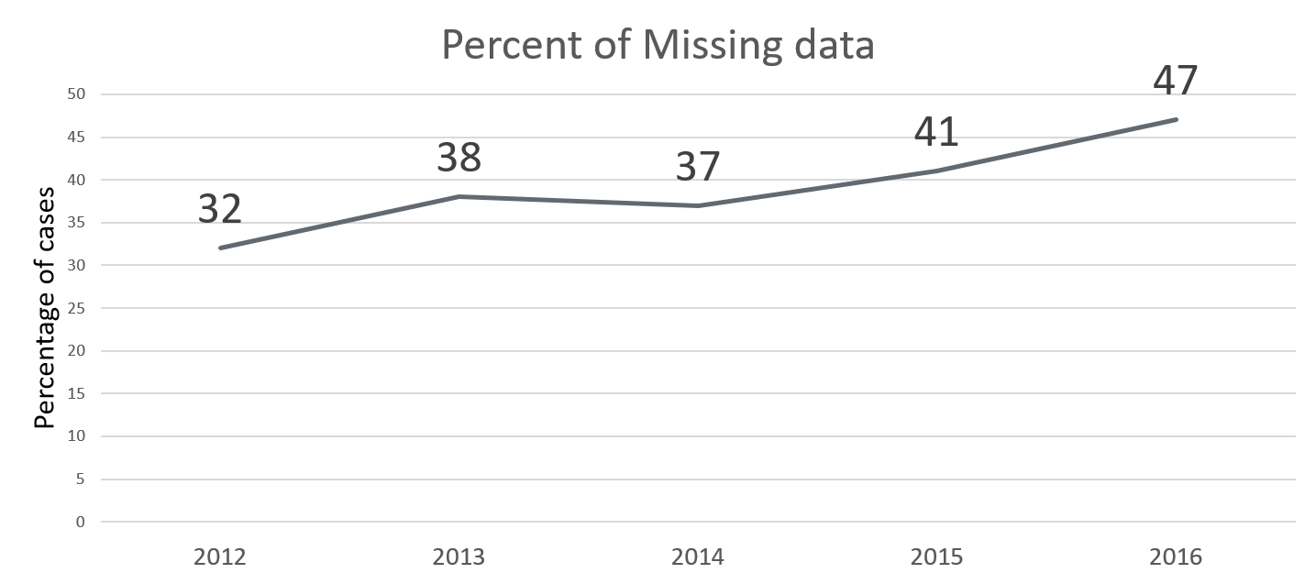
Gender of Sex Partner
Notes:
Gender of sex partner, which helps the MDH to determine GC risk, is very frequently missing from case reports, and with increasing frequency over the last few years.
SSuN is the only additional source MDH can use to determine gender of sex partner, when the information is not filled in on the case report
Of the 302 SSuN cases who were interviewed and had gender of sex partner documented on their case report form, 14/302 (4.64%) reported a different gender(s) of sex partner compared to what their provider reported.

Slide 32
PrEP
Currently, SSuN is the only source for PrEP data
Notes:
Changes are coming to the Minnesota Department of Health STD case report, which will include asking if the gonorrhea case is currently taking PrEP (pre-exposure prophylaxis) but currently SSuN is the only source for this information.
of the 334 SSuN cases interviewed, who were diagnosed with gonorrhea in 2016, 38 (11.37%) reported currently taking PrEP
36/38 (94.74%) of SSuN cases reporting using PrEP cases were men
Of the 36 men using PrEP, 34/36 (94.44%) reported sex with only men in the past 12 months
Of the 36 men using PrEP, 1/36 (2.78%) reported sex with only women in the past 12 months
Of the 36 men using PrEP, 1/36 (2.78%) reported sex with both men and women in the past 12 months

Slide 33
Questions regarding SSuN
Please contact Laura Tourdot
Laura.Tourdot@state.mn.us
651-201-3866

Slide 34
Chlamydia

Slide 35
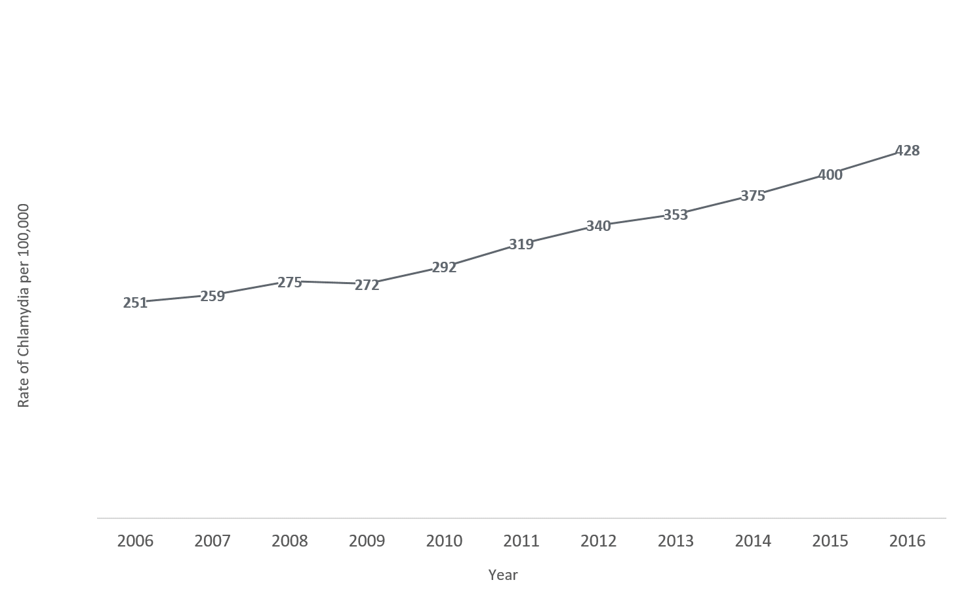
Chlamydia in Minnesota Rate per 100,000 by Year of Diagnosis, 2006-2016
428 per 100,000
251 per 100,000
Notes:
As mentioned previously, the rate of chlamydia in MN reached an all time high at 428 per 100,000. This is a rate increase of 7% from 2015.

Slide 36
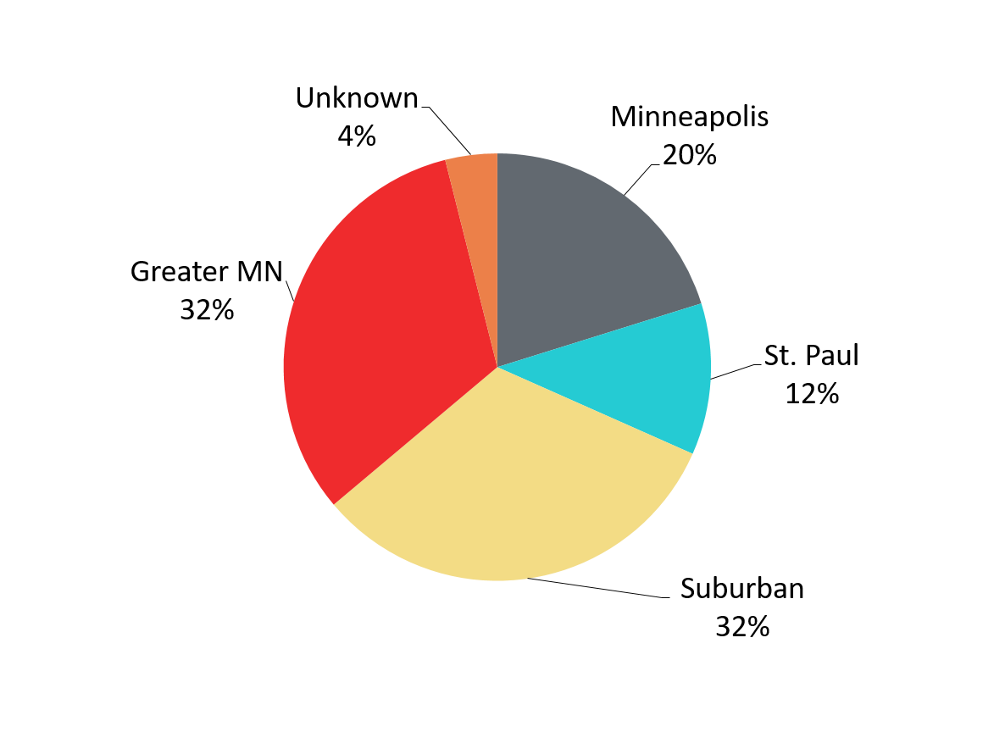
Chlamydia Infections by Residence at Diagnosis Minnesota, 2016
Total Number of Cases = 22,675
Suburban = Seven-county metro area including Anoka, Carver, Dakota, Hennepin (excluding Minneapolis), Ramsey (excluding St. Paul), Scott, and Washington counties.
Greater MN = All other Minnesota counties outside the seven-county metro area.
Notes:
All parts of Minnesota are affected by chlamydia. Roughly a third of the cases are in the cities of Minneapolis and St. Paul, a third in the Suburban area surround the cities, and a third in Greater Minnesota.

Slide 37
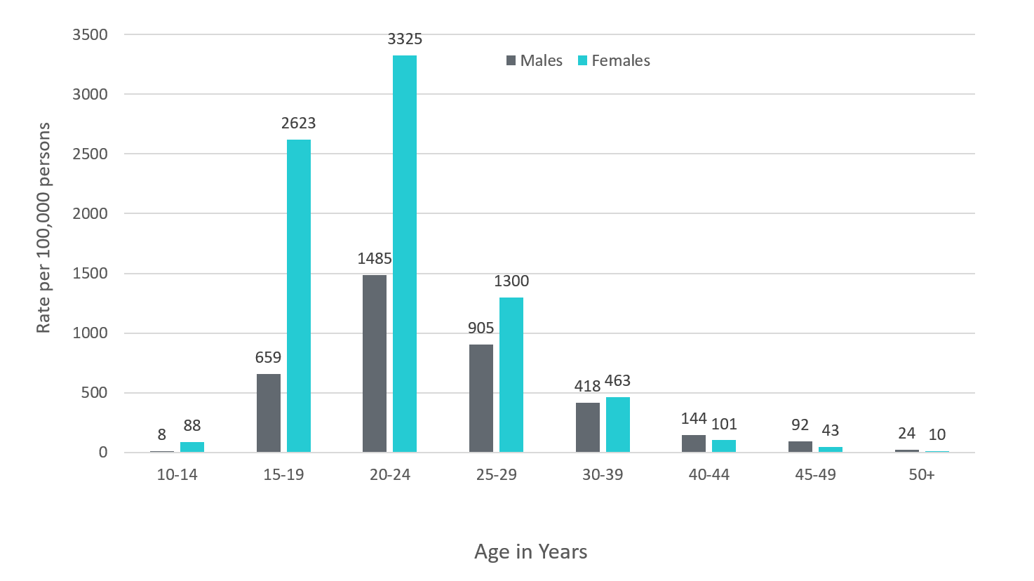
Age-Specific Chlamydia Rates by Gender Minnesota, 2016
Notes:
The age group with the largest increase in rate was males 10-14 at a 66% increase over 2015.
The rates of chlamydia went up in both males and females in 2016.
Females continue to have higher rates of chlamydia than males in age groups 39 and under.
In 2016 the males have higher rates in the 40 and over age groups. The rate in males increased more than the rate in females in 2016.
The highest rates of chlamydia continue to be in females 20-24 year of age at 3325 per 100,000.

Slide 38
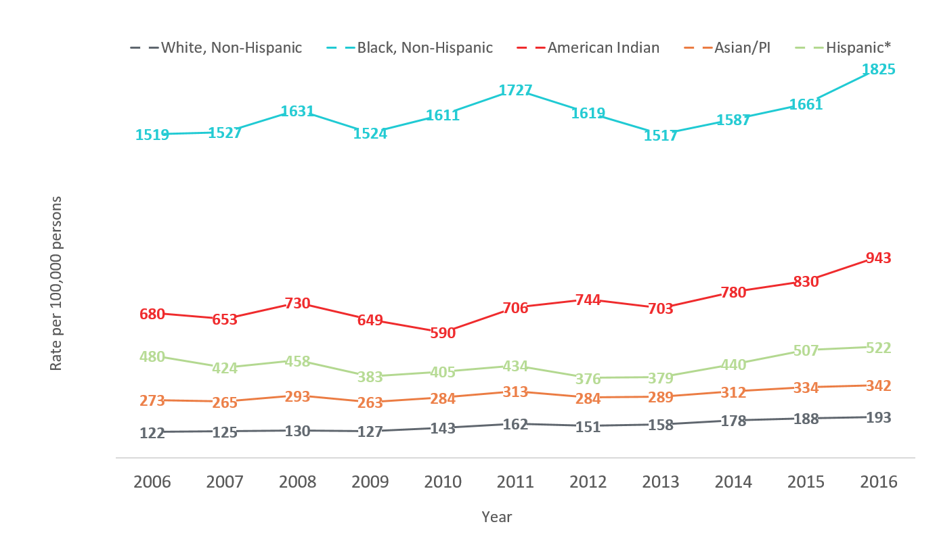
Chlamydia Rates by Race/Ethnicity Minnesota, 2006-2016
2016 rates compared with Whites:
Black, Non-Hispanic = 9.5x higher
American Indian = 5x higher
Asian/PI = 2x higher
Hispanic* = 3x higher
Notes:
There continues to be disparities in rates of chlamydia.
The Black/African American, Non-Hispanic population has rates that are 9.5 times higher than that of whites. The rate in the Black/African American population was 1825 per 100,000 compared to the rate in the White, Non-Hispanic population at 193 per 100,000.
The American Indian population had a rate that was 5 times higher at 943 per 100,000
The Asian/Pacific Islander population had a rate that was 2 times higher at 342 per 100,000
The Hispanic/Latino population, which can be of any race, had a rate that was 3 times higher at 522 per 100,000

Slide 39
STD Surveillance Summary
Minnesota Department of Health STD Surveillance System

Slide 40
Summary of STD Trends in Minnesota
From 2006-2016, the chlamydia rate increased by 71%. The rate of gonorrhea increased by 25%. Rates of reported syphilis increased in 2016 compared to 2015 by 30%.
Minnesota has seen a resurgence of syphilis over the past decade, with men who have sex with men and those co-infected with HIV being especially impacted. However, the number of females is near the record high for the last decade.
Persons of color continue to be disproportionately affected by STDs.
STD rates are highest in the cities of Minneapolis and Saint Paul. However, chlamydia and gonorrhea cases in the Twin Cities suburbs and Greater Minnesota account for 61% of the reported cases in 2016.
Between 2015 and 2016, early syphilis cases increased by 29%. Men who have sex with men comprised 77% of all male cases in 2016; cases among women are continuing to remain high.

Slide 41
Future Updates to STD Reporting
New case report form to accommodate changes in treatment guidelines, requesting HIV testing status, and PrEP usage.
Case report form is be able to be filled out on a computer and printed to be mailed or faxed in
All cases co-infected with HIV (diagnosed in the last year)/Gonorrhea, HIV/Syphilis, and Early Syphilis will be continue to be assigned to MDH Partner Services for follow-up
All Gonorrhea cases continue to have the potential for being contacted by MDH for additional follow-up

Slide 42
For more information, contact:
STD Surveillance Data
Dawn.Ginzl@state.mn.us, 651-201-4041
MDH Partner Services Program
Brian.Kendrick@state.mn.us, 651-201-4021

Slide 43
Highlights from the HIV Surveillance Report, 2016
Minnesota Department of Health HIV/AIDS Surveillance System
Notes:
Thank you for participating in the webinar today. I’m Cheryl Barber, the HIV/AIDS Surveillance Coordinator at the Minnesota Department of Health. Today we are releasing our annual surveillance report for the year 2016. During the webinar, I will be primarily discussing highlights from data on new HIV diagnoses that occurred during 2016. The information that I will present is just a snapshot of the data we are releasing today and the full slide set, as well as, accompanying tables are available on our website.

Slide 44
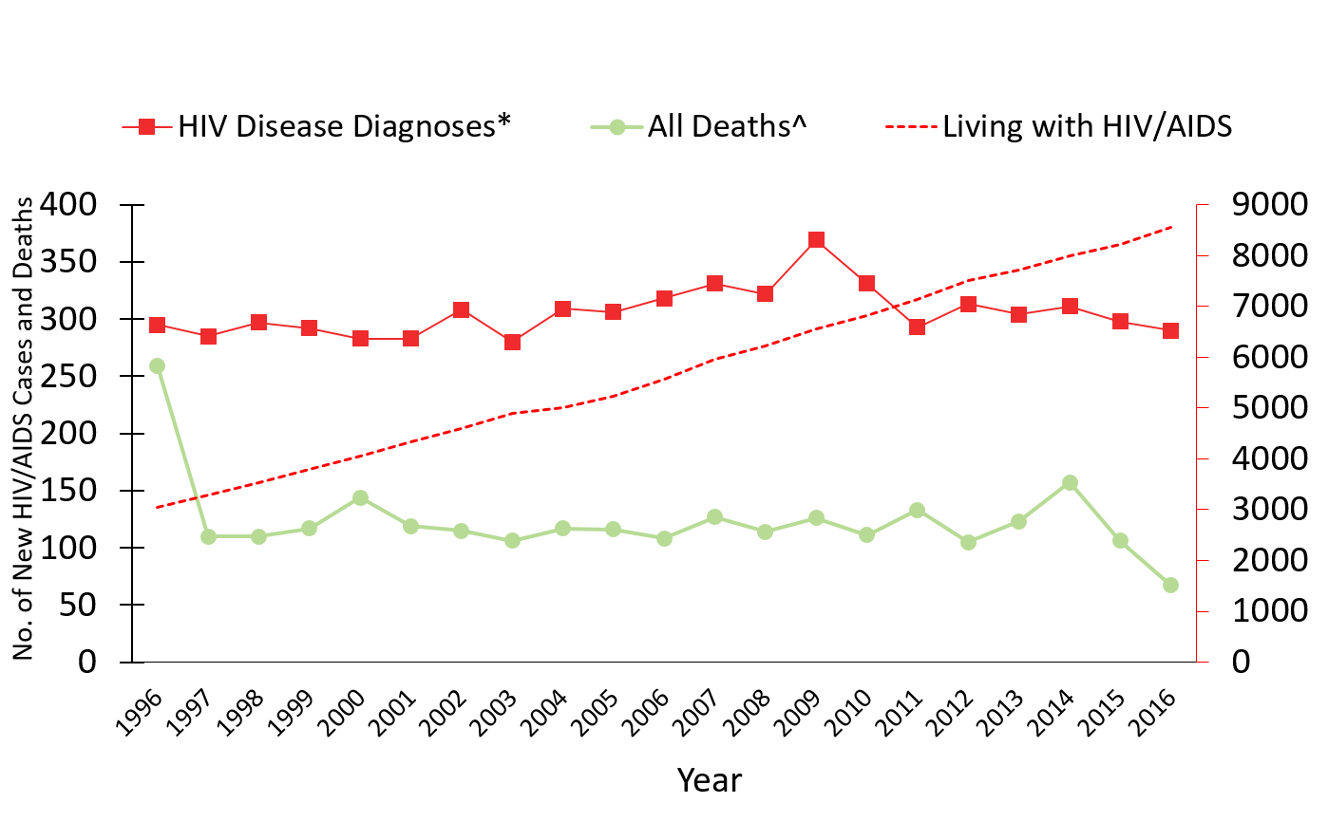
HIV/AIDS in Minnesota New HIV Disease Diagnoses, Deaths and Prevalent Cases by Year, 1996-2016
No. of Persons Living w/ HIV/AIDS
*Includes all new cases of HIV infection (both HIV (non-AIDS) and AIDS at first diagnosis) diagnosed within a given calendar year.
^Deaths in Minnesota among people with HIV/AIDS, regardless of location of diagnosis and cause.
Notes:
Since 1996, the number of new diagnoses has remained relatively stable in Minnesota at around 300 cases per year. During this same time, deaths among HIV+ people in Minnesota has decreased dramatically. As people with HIV are living longer and healthier lives, the number of people living with HIV in Minnesota continues to grow as seen in the Red line here. At the end of 2016, 8,554 people were estimated to be living with HIV or AIDS in Minnesota.
This number does not include about 1300 persons who were first reported with HIV or AIDs in Minnesota and subsequently moved out of the state. Although it DOES include about 2000 persons who were first reported with HIV or AIDS elsewhere and subsequently moved to Minnesota.

Slide 45
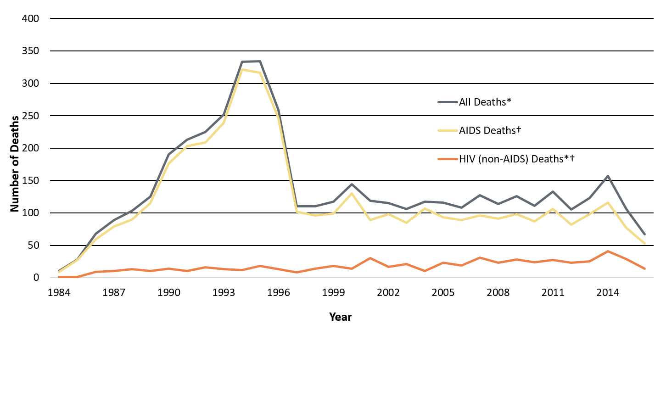
Reported Deaths among Persons with HIV in Minnesota , 1984-2016
* Number of deaths known to have occurred among all people living with HIV infection in Minnesota, regardless of location of diagnosis and cause of death.
† Number of deaths known to have occurred among people living with AIDS in Minnesota in a given calendar year, regardless of location of diagnosis and cause of death
* † Number of deaths known to have occurred among people living with HIV (non-AIDS) in Minnesota in a given calendar year, regardless of location of diagnosis and cause of death
Data Source: Minnesota HIV/AIDS Surveillance System
Notes:
This slide shows the breakdown of reported deaths.
The number of deaths among all people living with HIV infection in Minnesota decreased dramatically between 1995 and 1997 and has remained relatively constant over the past decade until 2014. In 2016, a total of 67 deaths were reported people living with HIV infection in Minnesota.
As you can see, over the last three years there has been a steady decline in deaths.
There was a 37% decrease in deaths for all causes of PLWHA in Minnesota, with 67 deaths in 2016 compared to 106 deaths in 2015.
The total number of deaths reported in Minnesota for those living with AIDS was 53 (79% of all deaths) in 2016. Whereas, the total number of deaths reported in Minnesota for those living HIV was 14 (21% of all deaths) in 2016.

Slide 46
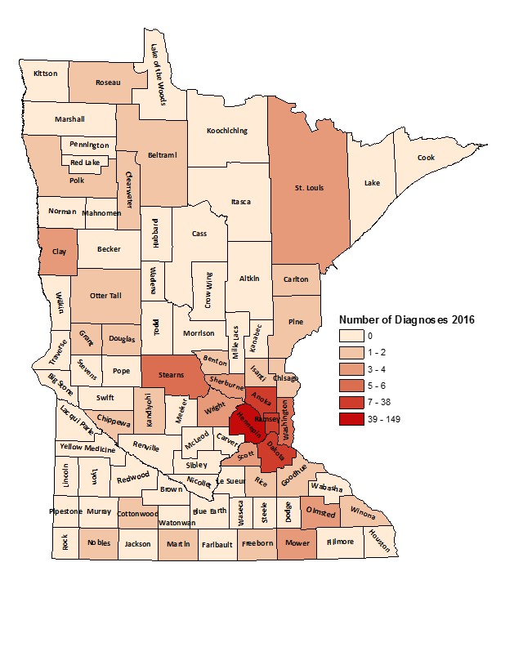
HIV Diagnoses* by County of Residence at Diagnosis, 2016
Minneapolis | 92
St. Paul | 28
Suburban# | 118
Greater Minnesota | 52
Total Number | 290
*HIV or AIDS at first diagnosis
# 7-county metro area, excluding the cities of Minneapolis and St. Paul
Notes:
HIV diagnoses by County of Residence at Diagnosis, 2016
Geographically, the new cases were concentrated in the twin cities metro area, with 82% of the cases located in the seven county twin cities metro region with 32% in Minneapolis, 9% in St. Paul, and 41% in the remaining suburban area (excluding Minneapolis/St. Paul). In greater Minnesota, there were 52 newly diagnosed HIV cases in 28 counties. This is a 41% increase in new HIV cases in Greater Minnesota since 2015 where there were 37 cases.
Paul). In greater Minnesota, there were 52 newly diagnosed HIV cases in 28 counties.

Slide 47
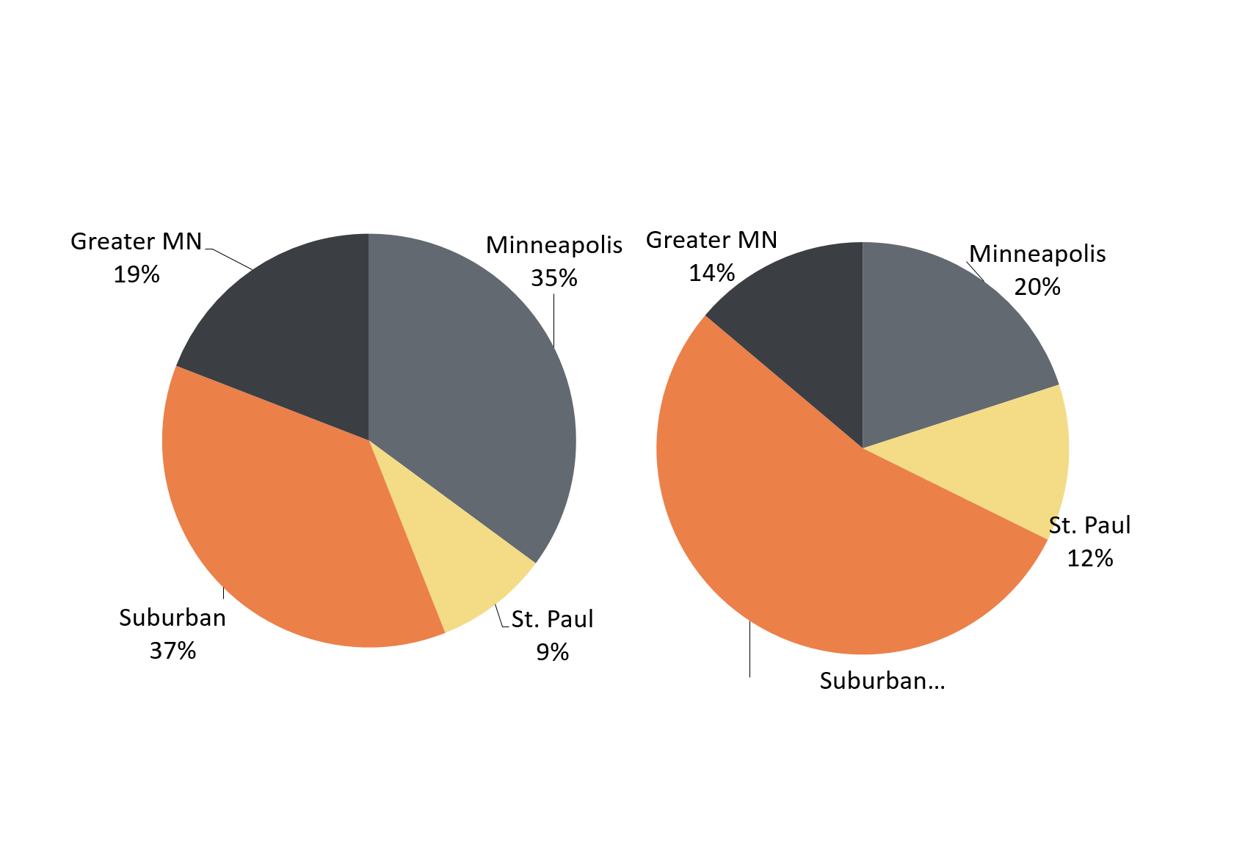
HIV Diagnoses* in Minnesota by Gender and Residence at Diagnosis, 2016
Males n = 225
Females n = 65
Suburban = Seven-county metro area including Anoka, Carver, Dakota, Hennepin (except Minneapolis), Ramsey (except St. Paul), Scott, and Washington counties.
Greater MN = All other Minnesota counties, outside the seven-county metro area.
* HIV or AIDS at first diagnosis
Notes:
In 2016, the geographic distribution of cases differed greatly by gender. You can see that a greater proportion of males resided in the cities of Minneapolis and St. Paul (44%) at diagnosis while a majority of females resided in the suburbs (54%).

Slide 48
Gender and Race/Ethnicity
Notes:
Next we will look at newly reported cases by gender and race

Slide 49
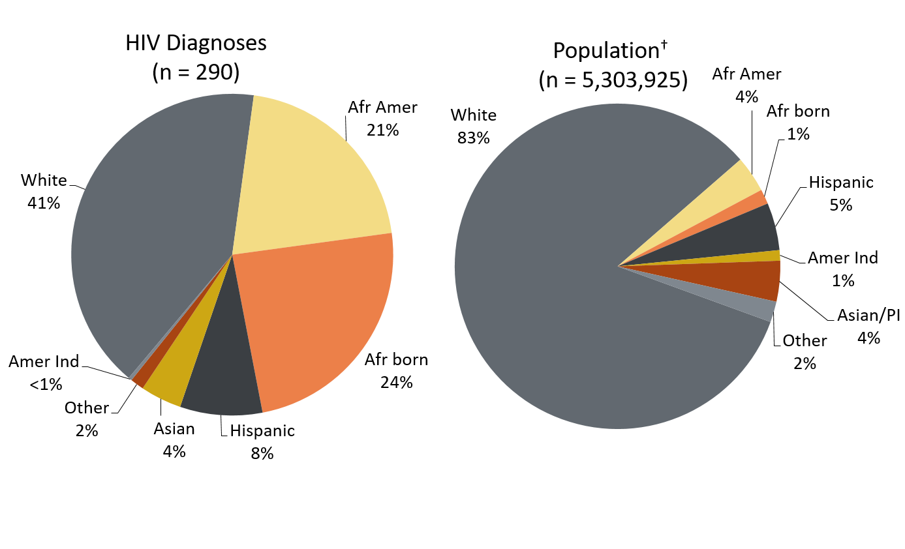
HIV Diagnoses* in Year 2016 and General Population
in Minnesota by Race/Ethnicity
* HIV or AIDS at first diagnosis
† Population estimates based on 2010 U.S. Census data.
n = Number of persons
Amer Ind = American Indian
Afr Amer = African American (Black, not African-born persons)
Afr born = African-born (Black, African-born persons)
Notes:
When you look at the racial/ethnic distribution of new HIV diagnoses for both genders compared to the racial/ethnic distribution of the general population of Minnesota, it is apparent that disparities continue to exist among persons of color. Non-Hispanic African-American and Black African-born Minnesotans jointly make up about 5% of the population in Minnesota, yet, account for 45% of the newly diagnosed cases of HIV in 2016. Similarly, Hispanics of any race also account for approximately 5% of the population but 8% of the newly diagnosed cases.

Slide 50
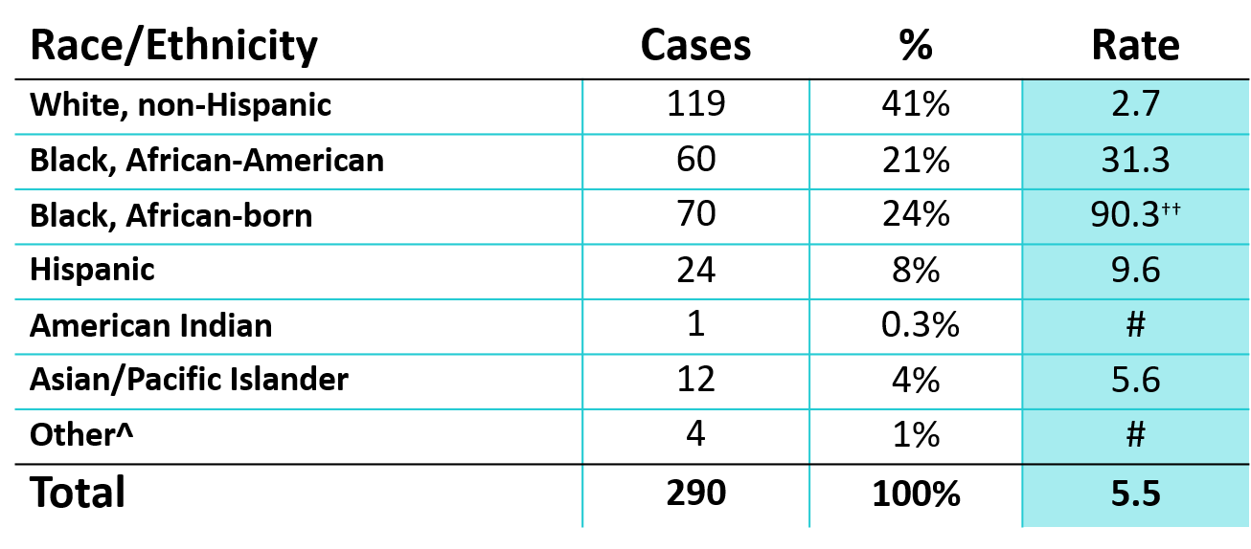
Number of Cases and Rates (per 100,000 persons) of HIV Diagnoses* by Race/Ethnicity†– Minnesota, 2016
* HIV or AIDS at first diagnosis; 2010 U.S. Census Data used for rate calculations.
† “African-born” refers to Blacks who reported an African country of birth; “African American” refers to all other Blacks.
†† Estimate of 77,557 Source: 2010-2012 American Community Survey. Additional calculations by the State Demographic Center.
^ Other = Multi-racial persons or persons with unknown or missing race
# Number of cases too small to calculate reliable rate
Notes:
Each year we calculate the rate of diagnosis for each racial/ethnic group represented in the surveillance system to assess the impact of HIV within each community. The rate takes into account the size of the population of each group.
Non-Hispanic black African-born and African-Americans had the highest rate of diagnoses in 2016 with 90.3 HIV diagnoses per 100,000 population and 31.3 HIV diagnoses per 100,000 population respectively. This represents a rate of HIV diagnosis among the black African-born community that is 33 times higher than the white non-Hispanic population in Minnesota. The rate among African-American non-Hispanic population is 12 times higher than white non-Hispanic population.
Hispanic persons of any race have the next highest rate of newly diagnosed HIV cases in Minnesota at 9.6 per 100,000 persons; this is a rate of more than 3 times higher than white, non-Hispanic persons.
Finally Asian/Pacific Islanders have a rate of persons newly diagnosed with HIV of 5.6 per 100,000 persons; this accounts for a rate 2 times higher than the rate among white non-Hispanic persons.

Slide 51
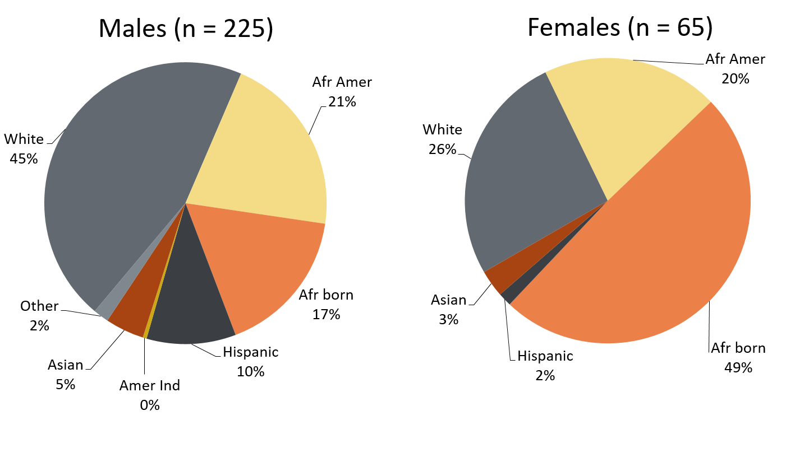
HIV Diagnoses* Diagnosed in Year 2016 by Gender and Race/Ethnicity
* HIV or AIDS at first diagnosis
n = Number of persons
Afr Amer = African American (Black, not African-born persons)
Afr born = African-born (Black, African-born persons)
Amer Ind = American Indian
Other = Multi-racial persons or persons with unknown race
Notes:
There are differences in the racial/ethnic distribution by gender. Among males, while 45% of the 2016 cases diagnosed in Minnesota are Non-Hispanic white;
Non-Hispanic African American and African-born black persons made up 38% of cases and Hispanic of any race accounted for 10% of cases. Of note, cases among black, African-born men increased by 65% from the previous year with 38 cases in 2016 compared 23 cases in 2015.
Among women, the disparities are even more apparent with women of color representing 74% of all the newly diagnosed females in 2016, with black African-born women accounting for almost half (49%) of cases and Non-Hispanic African-American women accounting for 20% of cases.

Slide 52
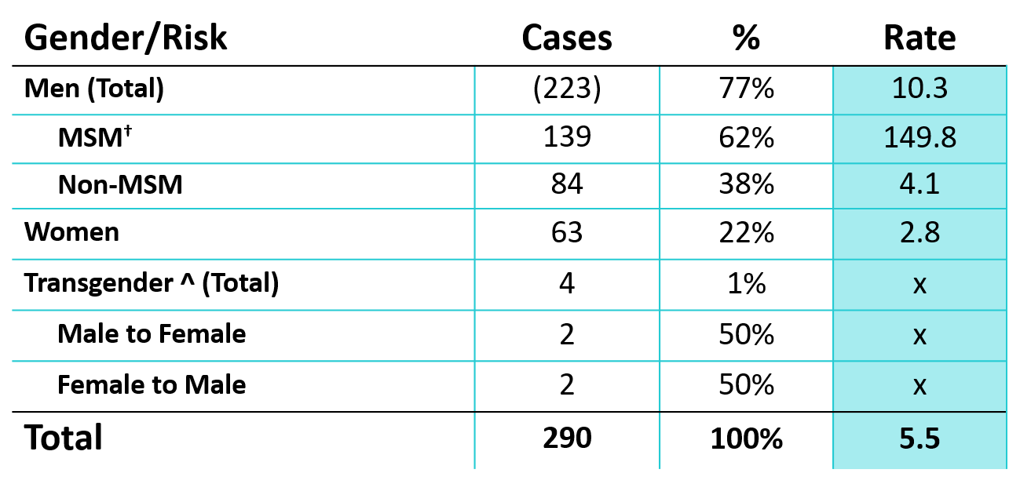
Number of Cases of Adult and Adolescent HIV Diagnoses** by Gender Identity and Risk†, Minnesota, 2016
**HIV or AIDS at first diagnosis over the age of 13
† “MSM” refers to both MSM and MSM/IDU. Estimate of 92,788
^ No current transgender estimate available
Notes:
This slide shows the number of new adult HIV cases by gender identity (male, female, or transgender (male to female or female to male)).
Men who have Sex with Men have the highest rate of HIV diagnosis than any other sub-category. In 2016, the estimated rate of HIV diagnosis among MSM was 149.8 per 100,000 population. This is more than 45 times higher than the rate among non-MSM men.
It’s important to note that MSM contains cases from all racial/ethnic categories and therefore cannot be directly compared to the rates on the previous slide. For more information on how this rate was estimated, see the HIV Surveillance Technical Notes which are available on our website.
In 2016, there were 4 newly reported HIV cases in transgender persons in Minnesota (2 male to female and 2 female to male transgender). This represents 1% of new cases reported in the state.

Slide 53
Age
HIV/AIDS in Minnesota: Annual Review
Notes:
Next some information about age at HIV diagnosis.

Slide 54
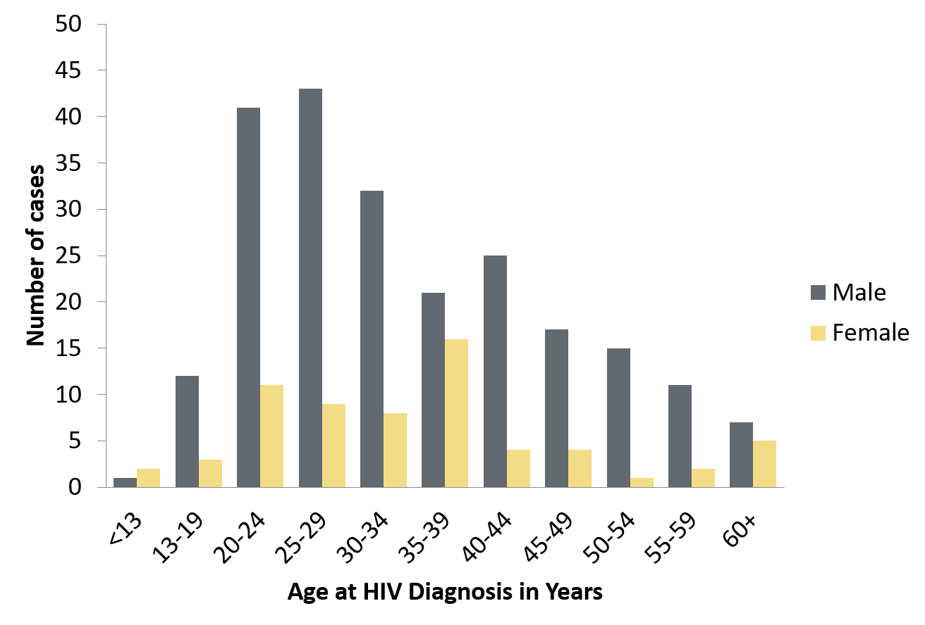
Age at HIV Diagnosis* by Sex at Birth,
Minnesota, 2016
* HIV or AIDS at first diagnosis
Notes:
In 2016, there were 122 cases diagnosed under the age of 30. This accounts for 42% of all cases. Most of these cases were among young males, where 80% of cases under the age of 30 were male. The age groups from 20-29 continue to be the highest as was also seen in the previous year of 2015.

Slide 55
Mode of Exposure
HIV/AIDS in Minnesota: Annual Review
Notes:
MDH collects risk information on newly diagnosed cases to ascertain mode of exposure.

Slide 56
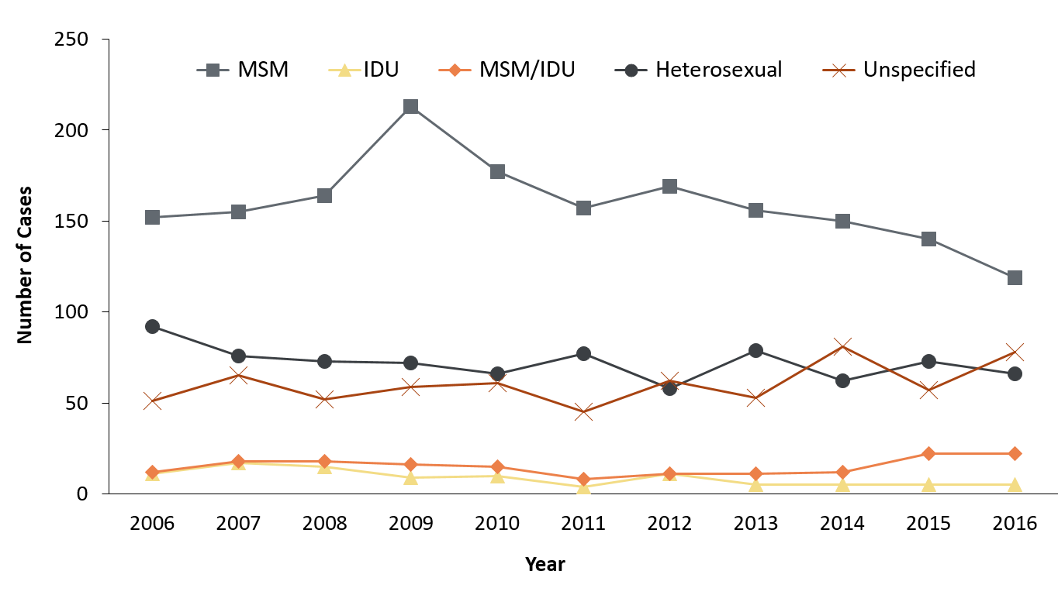
HIV Diagnoses* by Mode of Exposure
and Year, 2005 - 2016
*HIV or AIDS at first diagnosis
Unspecified = No mode of exposure ascertained
Notes:
This slide depicts risk for all persons diagnosed with HIV in Minnesota during the past decade and since the beginning of the epidemic, Men who have sex with Men has been the most commonly reported risk factor. In 2016, MSM accounted for 49% of all new HIV diagnoses in Minnesota with 141 cases diagnosed.
In 2016, females comprised 80% of heterosexual mode of exposure for HIV diagnoses.
The number of cases among injection drug users (IDUs) (MSM/IDU and IDU (bottom 2 lines on the graph) was similar with 27 cases in 2016 compared to 26 cases in 2015, which indicates a continuing trend of increased HIV infection among IDU in the state over the last two years.

Slide 57
Foreign-born Cases
HIV/AIDS in Minnesota: Annual Review
Notes:
We’ve seen an increasing number of foreign-born persons living with HIV in Minnesota and track the number of newly reported cases among foreign-born individuals.

Slide 58
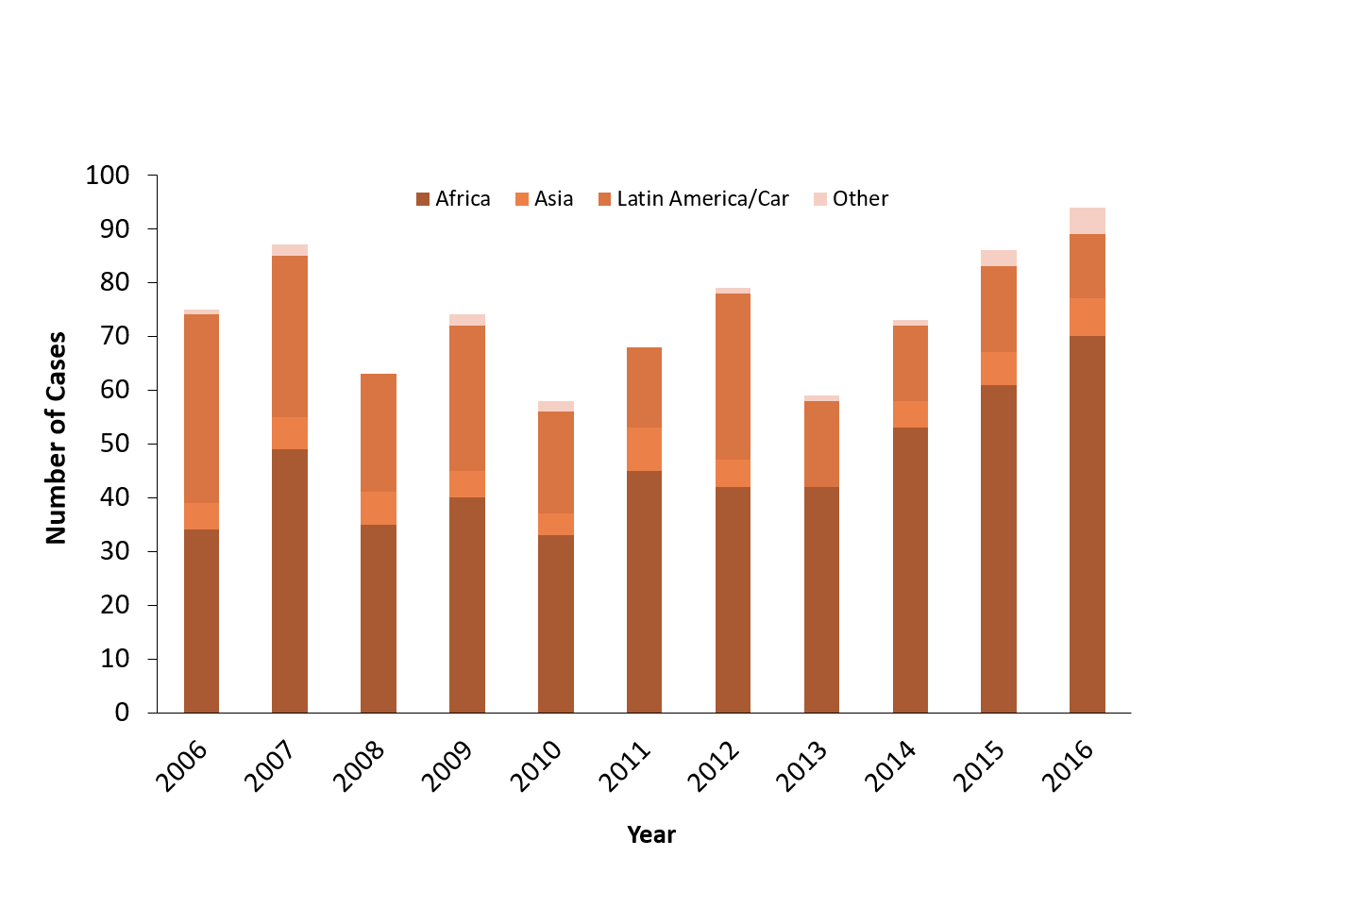
HIV Diagnoses* among Foreign-Born Persons† in Minnesota by Year and Region of Birth, 2006 - 2016
Region of Birth#
* HIV or AIDS at first diagnosis
† Excludes persons arriving to Minnesota through the HIV+ Refugee Resettlement Program, as well as other refugee/immigrants with an HIV diagnosis prior to arrival in Minnesota.
# Latin America/Car includes Mexico and all Central, South American, and Caribbean countries.
Notes:
In 2016, there were 94 cases of newly reported HIV among foreign-born persons, representing nearly 1 out of 3 of all new cases. This is up from 86 cases in 2015. The majority of foreign born cases in 2016 were from Africa (70), followed by Latin America and the Caribbean (12).
The top 5 countries include the following that had foreign-born persons living in Minnesota with new HIV infections in 2016:
Liberia (N=24)
Ethiopia (N=11)
Somalia (N=9)
Mexico (N=8)
Kenya (N=7)

Slide 59
Late Testers:
AIDS Diagnosis within one year of HIV Diagnosis
HIV/AIDS in Minnesota: Annual Review
Notes:
Late testers are defined as anyone with an AIDS diagnosis within one year of their initial HIV diagnosis. This is an important trend to watch as people who progress to AIDS within one year of their HIV diagnosis represent persons who are likely diagnosed well after their initial infection and represent missed testing opportunities earlier in the course of their infection.

Slide 60
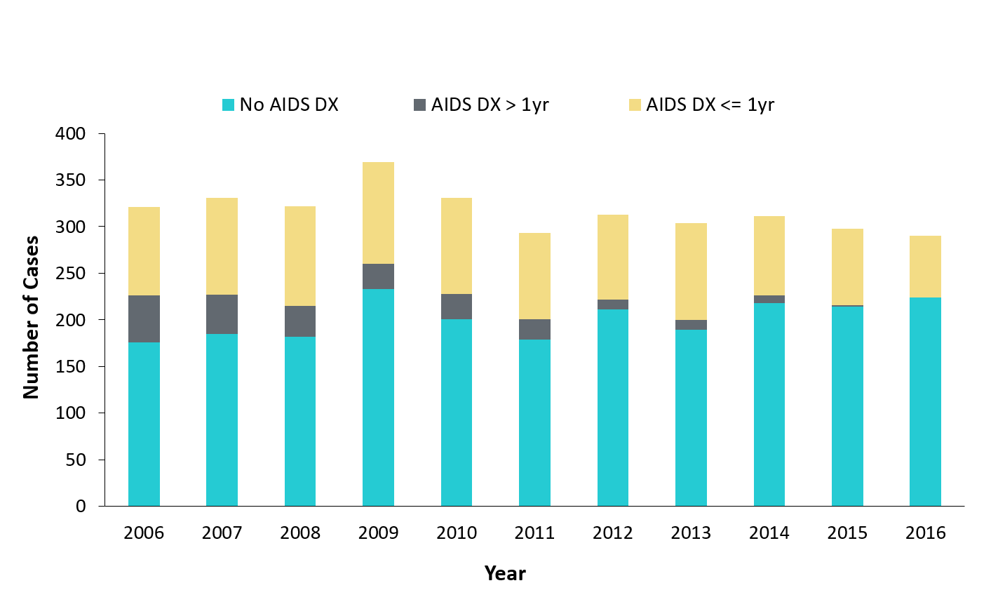
Time of Progression to AIDS for HIV Diagnoses in Minnesota*,2006 - 2016†
29.5%^
29.9%^
31.4%^
33.2%^
31.1%^
31.4%^
29.1%^
34.2 %^
27.3%^
*Numbers include AIDS at 1st report but exclude persons arriving to Minnesota through the HIV+ Refugee Resettlement Program, as well as other refugee/immigrants with an HIV diagnosis prior to arrival in Minnesota.
^ Percent of cases progressing to AIDS within one year of initial diagnosis with HIV
† Numbers/Percent for cases diagnosed in 2016 only represents cases progressing to AIDS through March 20, 2017.
Notes:
In 2015, 28% of new cases were late testers. This proportion of cases has remained relatively the same over the past 10 years, ranging between 27-34%. Most late testers, about 85%, are diagnosed with AIDS at the same time they are initially diagnosed with HIV infection.
For 2016, 23% of new cases were late testers so far, which represents only a partial follow-up year to only March 20, 2017.
As with other characteristics of the HIV epidemic in Minnesota, the proportion of late testers varies by demographic characteristics. Historically, foreign-born persons have had a higher proportion of late-testers.

Slide 61
Births to HIV-Infected Women
Perinatal Acquired HIV Infections
HIV/AIDS in Minnesota: Annual Review
Notes:
Next we will review births to HIV-infected women and perinatal acquired HIV infections.

Slide 62
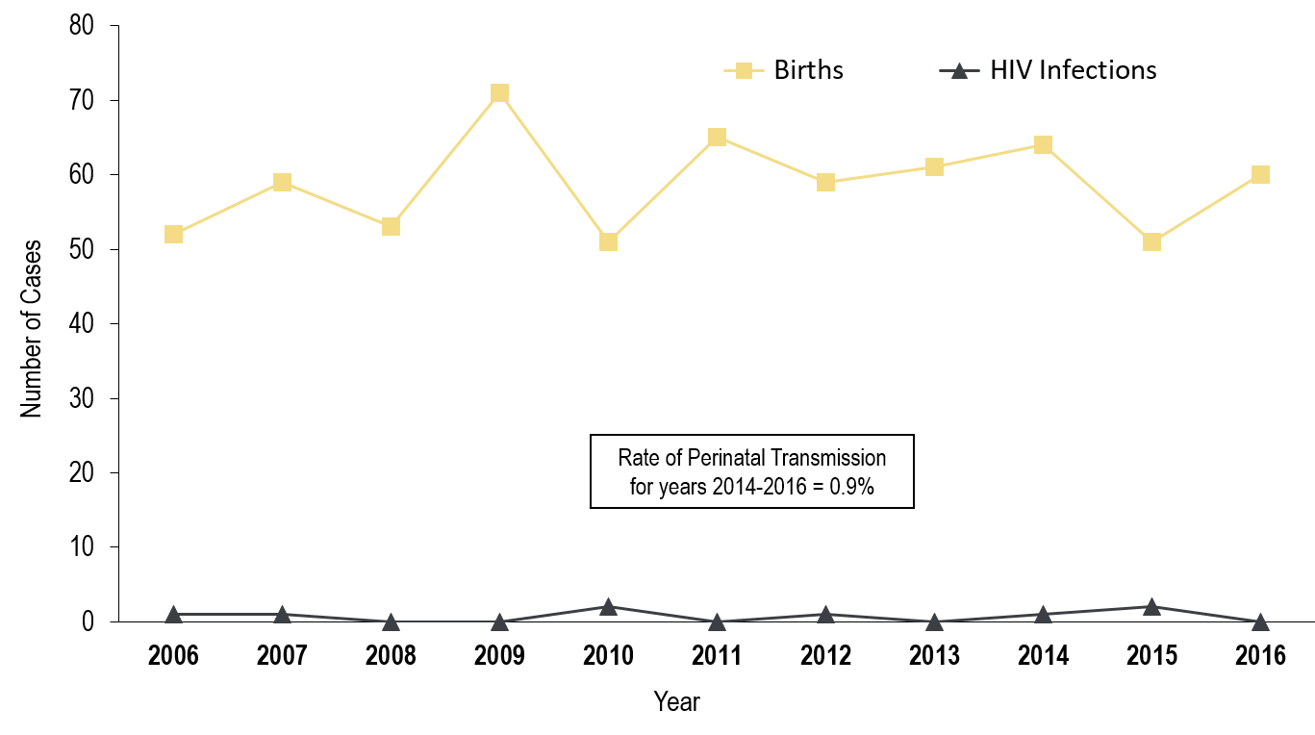
Births to HIV-Infected Women and Number of Perinatally Acquired HIV Infections* by Year of Birth, 2006 - 2016
* HIV or AIDS at first diagnosis for a child exposed to HIV during mother’s pregnancy, at birth, and/or during breastfeeding.
Notes:
The ability to interrupt the transmission of HIV from mother to child via antiretroviral therapy and appropriate perinatal care is an important accomplishment in the history of the HIV/AIDS epidemic. Newborn HIV infection rates range from 25-30% without antiretroviral therapy, but decrease to 1-2% with appropriate medical intervention.
For the past decade the number of births to HIV-infected women increased steadily from 52 in 2005 to 60 births in 2016. The rate of transmission has decreased from 15% between 1994 and 1996 to 0.9% in the past three years, with no HIV+ baby born to HIV+ mother in Minnesota in 2016.

Slide 63
Conclusion
Total HIV diagnoses for 2016 similar to 2015
Male to Male sex remains the leading risk factor for HIV
More than half of newly reported cases were among communities of color
Cases among 20-29 year olds remain high
Cases of injection drug users indicate a continuing increase over the last two years
Regionally, there was a 41% increase in new HIV cases in Greater Minnesota from the previous year
Notes:
To conclude, the number of cases in 2016 is down 3% from 2015. Most of the new infections were concentrated in the seven county Twin Cities metro region, although the number of new infections persist in greater Minnesota with a 41% increase in new HIV cases from the previous year.
Male to Male sex remains the leading risk factor for acquiring HIV in Minnesota.
Disparities in HIV infection persist among populations of color.
More than half of newly reported cases were among communities of color
Almost half among black African-born women
Cases among black, African-born men increased by 65% from the previous year
Cases of HIV among injection drug users indicate a continuing trend to monitor in Minnesota.
Cases among 20-29 year olds remain high and will continue to be monitored in Minnesota.
I want to note that the next presentation will review hepatitis infections and will include some data about HIV and Hepatitis B & C co-infections in Minnesota.

Slide 64
Thank You!
For more information, please contact:
Cheryl Barber, HIV/AIDS Surveillance Coordinator
Cheryl.barber@state.mn.us
(651) 201-5624
Notes:
Thank you for your time. If you have questions regarding the slides and annual report you can contact me. My contact information is here on the slide. And again, the full set of slides, text and tables are now available on our website for you to use.

Slide 65
Highlights from the Hepatitis Surveillance Report, 2016
Minnesota Department of Health Hepatitis Surveillance System

Slide 66
Introduction
Data in this presentation are current through 2016
Definitions:
Acute case:
Infected within the last six months
Symptomatic OR negative test in six months before diagnosis
Chronic case:
Infected for over six months
Asymptomatic or symptomatic
Resolved cases:
No evidence of current infection
Evidence of past infection
Notes:
Before we start going through the viral hepatitis data, I will review the definitions I will be using throughout the presentation. First, acute cases are those cases where the person was infected in the last six months. These cases were either symptomatic or had a documented seroconversion from negative to positive. Second, a chronic cases is a person who has been infected for at least six months. These cases can be either symptomatic or asymptomatic. Last, resolved cases are those with no evidence of current infection but who do have evidence of past infection.

Slide 67
Data limitations
The slides rely on data from HCV and HBV cases diagnosed through 2016 and reported to the Minnesota Department of Health (MDH) Hepatitis Surveillance System.
Some limitations of surveillance data:
Data do not include hepatitis-infected persons who have not been tested
Data do not include persons whose positive test results have not been reported to the MDH
Persons are assumed to be alive unless the MDH has knowledge of their death. Most recent match with Minnesota death records was in 2017.
Persons whose most recently reported state of residence was Minnesota are assumed to be currently residing in Minnesota unless MDH has knowledge of their relocation.
Notes:
There are a number of limitations to the data I will present today. The slides rely on data from HCV and HBV cases diagnosed through 2016 and reported to MDH. Data do not include hepatitis-infected persons who have not been tested or positive test results not reported to MDH
Persons are assumed to be alive unless the MDH has knowledge of their death and the most recent match with Minnesota death records was in 2017.
Persons whose most recently reported state of residence was Minnesota are assumed to be currently residing in Minnesota unless MDH has knowledge of their relocation.

Slide 68
Acute Viral Hepatitis
Acute case:
Infected within the last six months
Symptomatic OR negative test within 6 months before diagnosis
Notes:
I will start be reviewing trends in acute cases over time.

Slide 69
Reported rate per 100,000 population of acute viral hepatitis, United States, 1998-2015
Notes:
In the United States, over the last 15 years acute hepatitis A and B cases have decreased. These are both vaccine preventable infections and vaccination rates have also increased over time.
From 1998 through the early 2000s we also saw a decrease in acute hepatitis C infections. Unfortunatly starting in 2011 we saw an increase in acute hepatitis C cases in the U.S.

Slide 70
Number of Acute* Cases per year Minnesota, 1998-2016
Notes:
In Minnesota, over the last 15 years we see the same trend for acute hepatitis A and B case.
In the past few years we have seen an increase in acute hepatitis C cases as well, with 51 cases reported in 2016. This is the most cases of acute hepatitis C that we have seen in the past 15 years.

Slide 71
Chronic Hepatitis C

Slide 72
Overview of HCV in Minnesota
A hepatitis C case is defined as current infection with hepatitis C and includes:
Chronic cases
Probable – anti-HCV + alone
Confirmed – HCV RNA +
Notes:
Most of the cases of hepatitis C reported to MDH are chronic infections. For the remaining slides, I will share data on these cases.
A chronic hepatitis C infection is defined as either probable, a person with only a positive antibody test, or confirmed, HCV RNA positive.

Slide 73
Reported Number of Persons Living with HCV in MN
As of December 31, 2016, 35,623* persons are assumed alive and living in MN with HCV
*Includes persons with unknown city of residence
Note: Includes all acute, chronic, probable chronic, and resolved cases.
Data Source: MN Viral Hepatitis Surveillance System
Notes:
At the end of 2016, 35,623 persons are assumed alive and living in MN with HCV

Slide 74
Changes in Case Counting, 2016
Removed resolved infections from case counts
Completed match with death registry for 1997 through 2016
Notes:
In 2016 we changed the way we counted hepatitis C cases in Minnesota and the United States.
Because of these changes, we removed resolved infections from case counts.
In Minnesota, we also completed match with death registry for 1997 through 2016 and removed deceased persons from the registry.

Slide 75
Changes in Case definitions
The national case definition changed for 2016
Confirmed cases must have detectable RNA
Probable cases have ONLY a positive antibody test
Notes:
The national case definition changed in 2016. Confirmed cases must now have a detectable RNA while probable cases have ONLY a positive antibody test. Those with undetectable HCV RNA tests are not counted as cases using the new case definition.

Slide 76
Persons Living with HCV in Minnesota by Current Residence, 2016
Total number with residence information = 34,798
(825 missing residence information)
Suburban = Seven-county metro area including Anoka, Carver, Dakota, Hennepin (except Minneapolis), Ramsey (except St. Paul), Scott, and Washington counties including those in Hennepin County or Ramsey County with unknown city. Greater MN = All other Minnesota counties, outside the seven-county metro area.
Notes:
Hepatitis C cases are distributed through the state. 43% of cases are in Greater Minnesota, 31% are the seven-county metropolitan area outside of Minneapolis and Saint Paul, 20% in Minneapolis ,and 6% in Saint Paul.

Slide 77
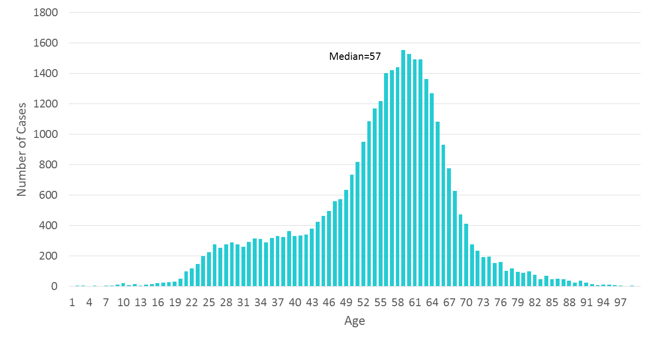
Persons Living with HCV in MN by Age, 2016
Notes:
The median age of cases is 57 years. The largest proportion of cases are in those born between 1945 and 1965 which is consistent with national infection rates in that cohort.

Slide 78
Persons Living with HCV in Minnesota by Gender*, 2016
*Includes anonymous methadone patients

Slide 79
Persons Living with Chronic HCV in Minnesota by Race, 2016
Notes:
The largest proportion of HCV cases are white followed by African American or black. 31% of cases do not have a race reported.

Slide 80
Persons Living with HCV in Minnesota by Race rates (per 100,000 persons*), 2016
*Rates calculated using 2014 U.S. Census ACS data
Excludes persons with multiple races or unknown race, n=12,238
Notes:
If we look at race rates per 100,000 population, we can see that hepatitis C disproportionately impacts American Indian and African American or Black Minnesotans.

Slide 81
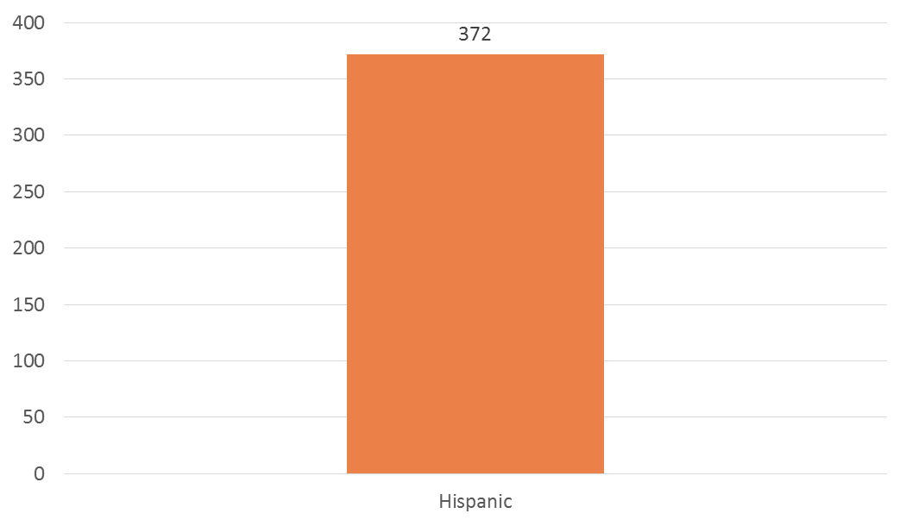
Persons Living with HCV in Minnesota by ethnicity rates (per 100,000 persons*), 2016
*Rates calculated using 2014 U.S. Census ACS data
Excludes persons with unknown ethnicity, n=20,068
Notes:
The rate of HCV in those reporting Hispanic or Latino ethnicity 272 per 100,000.

Slide 82
Resolved HCV Infection
Previously included in overall HCV case counts
Defined as:
A positive HCV RNA test followed by a negative HCV RNA test
Does NOT include:
Anti-HCV positive with a negative HCV RNA with NO past positive HCV RNA
Notes:
Because of the change to the case definition in 2016, resolved HCV infections were removed from the registry. These cases were previously included in overall HCV case counts. These cases are defined as a positive HCV RNA test followed by a negative HCV RNA test and does NOT include those with an anti-HCV positive with a negative HCV RNA with NO past positive HCV RNA.

Slide 83
Resolved HCV, 2016
Total of 3,502 Resolved Infections
Median Age: 58
Notes:
At the end of 2016, we removed a total of 3,502 resolved infections from the case count. The median age of these resolved cases was 58.

Slide 84
Resolved HCV, 2016 cont.
Notes:
At the end of 2016, we removed a total of 3,502 resolved infections from the case count. The median age of these resolved cases was 58.

Slide 85
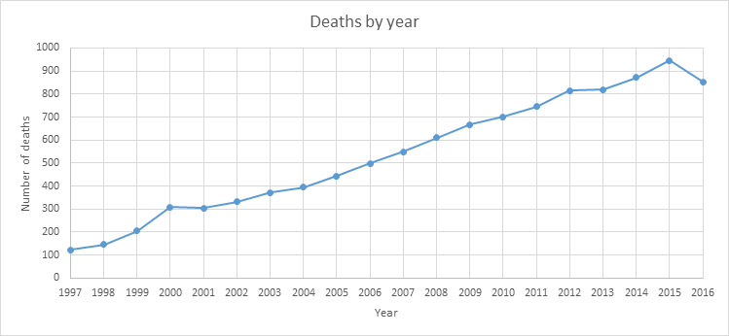
Match with Death Registry, 2016
HCV Cases Removed: 9,200
Notes:
In 2016 we also removed deceased individuals from the registry based on a match with Minnesota death records from 1997 through 2016. This graph shows the year of death for hepatitis C cases removed from the registry and that the number of deaths increased over time. These are deaths from all causes, not just hepatitis related causes. We had partial data for2016.

Slide 86
HCV in Persons Under 30
Notes:
Over the past 10 years we have seen an increase in hepatitis C infections in persons under 30.

Slide 87
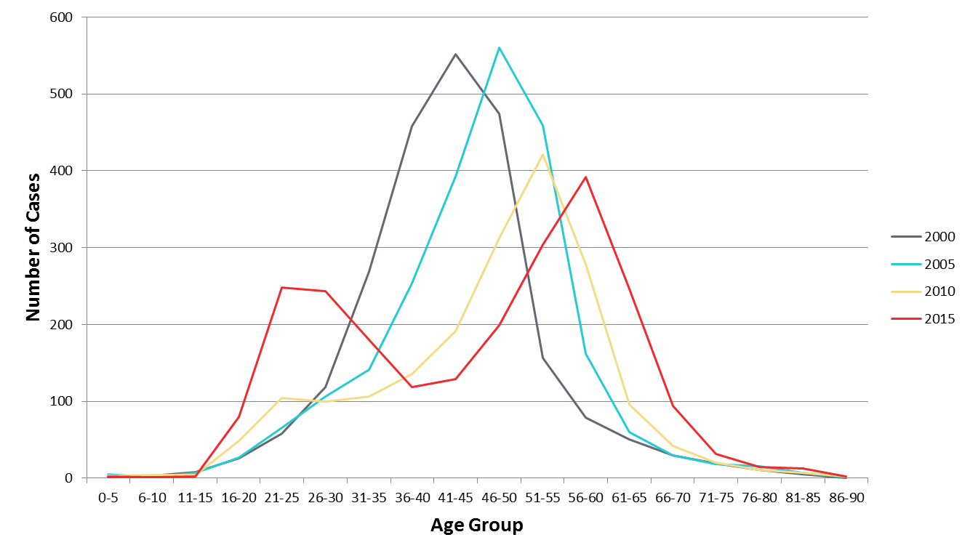
New Reports of HCV in Minnesota by Age Group, 2015
Notes:
This graph shows the number of reports of hepatitis C in persons by age at 4 different points in time. As you can see, in 2000 and 2005 there were not many cases in those under 30 years of age. In 2010, there was a slight increase, and in 2015 there was a peak of cases in the 21 to 30 year old age groups. This is concerning as these are likely recent infections and are occurring in age groups where we have not historically seen much hepatitis C.

Slide 88
Hepatitis and HIV

Slide 89
HIV and Hepatitis B and C
As of December 31, 2016* , 8,554 persons are assumed alive and living in Minnesota with HIV/AIDS
Of these 8,554 persons, 776 (9%) are co-infected with either Hepatitis B, C or both
Of the 776, 316 (41%) are living with HIV and Hep B
Of the 776, 416 (53%) are living with HIV and Hep C
Of the 776, 44 ( 6%) are living with HIV and Hep B/Hep C
* This number includes persons who reported Minnesota as their current state of residence, regardless of residence at time of diagnosis. Includes state prisoners and refugees arriving through the HIV+ Refugee Resettlement Program, as well as, HIV+ refugee/immigrants arriving through other programs.
Data Sources: Minnesota HIV/AIDS Surveillance System and Minnesota Hepatitis Surveillance System
Notes:
Each year we match the viral hepatitis registry to our HIV registry. In 2016, 10% of all HIV cases were also infected with hepatitis B or hepatitis C.

Slide 90
Thank you!
Kristin Sweet, PhD, MPH
kristin.sweet@state.mn.us
651.201.4888

Slide 91
Questions
Notes:
This concludes our 2016 data release presentation. We will be muting the line for a moment while we get all of our presenters in the room, then we will open it up for questions.
Please take this time to type your questions into the chat box, if you have not done so already.

