Slide 1

HIV/AIDS Prevalence and Mortality Report, 2018
HIV/AIDS Surveillance System

Slide 2
Introduction (I)
These three introduction slides provide a general context for the data used to create this slide set. If you have questions about any of the slides, please refer to the HIV/AIDS Surveillance Technical Notes on our website.
This slide set displays estimates of the number of persons living with HIV/AIDS (prevalence) and mortality in Minnesota by person, place, and time.
The slides rely on data from HIV/AIDS cases diagnosed through 2018 and reported to the Minnesota Department of Health (MDH) HIV/AIDS Surveillance System, which is a part of the National HIV/AIDS Surveillance System (NHSS).

Slide 3
Introduction (II)
Data analyses exclude persons diagnosed in federal or private correctional facilities, but include state prisoners (number of state prisoners believed to be living with HIV/AIDS = 30).
Data analyses for new infections exclude persons arriving to Minnesota through the HIV+ Refugee Resettlement Program (number of primary HIV+ refugees in this program living in Minnesota as of December 31, 2018 = 169), as well as other refugees/immigrants reporting a positive test prior to their arrival in Minnesota (n = 164).
Some limitations of surveillance data:
  Do not include people living with HIV who have not been tested for HIV
  Do not include persons whose positive test results have not been reported to MDH
  Do not include people living with HIV who have only tested anonymously
  Case numbers for the most recent years may be undercounted due to delays in reporting
  Reporting of living cases that were not initially diagnosed in Minnesota is known to be incomplete, as well as transfer of living cases that have moved to other states from Minnesota

Slide 4
Introduction (III)
Persons are assumed to be alive unless MDH has knowledge of their death.
Persons whose most recently reported state of residence was Minnesota are assumed to be currently residing in Minnesota unless MDH has knowledge of their relocation. Our ability to track changes of residence, including within the state, is limited and subject to reporting delays.
Vital status and current residence are updated through one or more of the following methods:
  Standard case reporting
  Correspondence with other health departments
  Active surveillance
  Death certificate reviews (annually)
  Birth certificate reviews (annually, pregnant persons only)

Slide 5
National Context

Slide 6
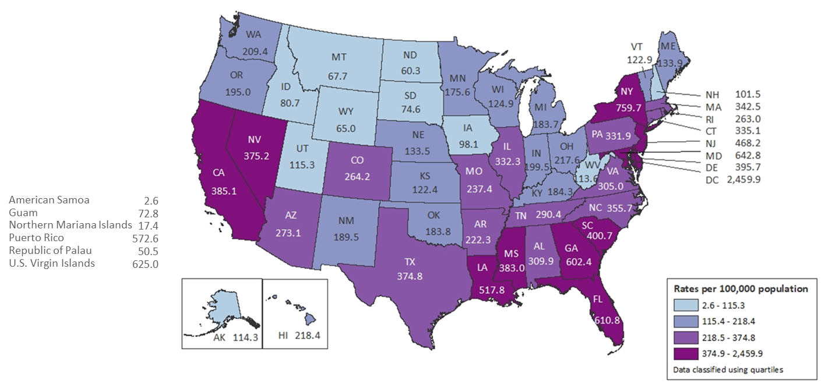
Rates of Adults and Adolescents with Diagnosed HIV Infection, by Area of Residence, Year-end 2016 — U.S. and 6 Dependent Areas
N = 1,006,691 Total Rate: 367.6
Data are based on address of residence as of December 31, 2016 (i.e., most recent known address).
Notes:
At the end of 2016, the rate of adults and adolescents in the United States living with diagnosed HIV infection was 367.6 per 100,000. The rates of adults and adolescents living with diagnosed HIV infection ranged from 2.6 per 100,000 in American Samoa to 2,459.9 per 100,000 in the District of Columbia. The rate of adults and adolescents living with diagnosed HIV infection in Minnesota was 175.6 per 100,000.
The District of Columbia (i.e., Washington, DC) is a city; use caution when comparing the rate of persons living with diagnosed HIV infection in DC with the rates in states.
Data are based on address of residence as of December 31, 2016 (i.e., most recent known address).

Slide 7
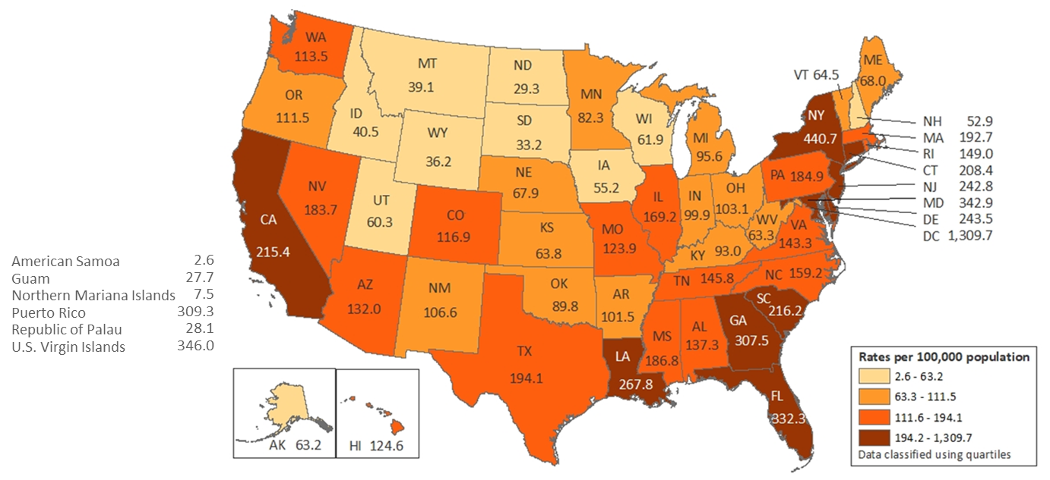
Rates of Adults and Adolescents with HIV Infection Ever Classified as Stage 3 (AIDS), by Area of Residence, Year-end 2016— U.S. and 6 Dependent Areas
N = 534,515 Total Rate: 195.2
Data are based on address of residence as of December 31, 2016 (i.e., most recent known address).
Notes:
At the end of 2016, the rate of adults and adolescents in the United States living with diagnosed HIV infection ever classified as stage 3 (AIDS) was 195.2 per 100,000. The rates of adults and adolescents living with diagnosed HIV infection ever classified as stage 3 (AIDS) ranged from 2.6 per 100,000 in American Samoa to 1,309.7 per 100,000 in the District of Columbia. The rate of adults and adolescents living with diagnosed HIV infection in Minnesota ever classified as stage 3 (AIDS) was 82.3 per 100,000.
The District of Columbia (i.e., Washington, DC) is a city; use caution when comparing the rate of persons living with diagnosed HIV infection in DC with the rates in states.
Data are based on address of residence as of December 31, 2016 (i.e., most recent known address).

Slide 8
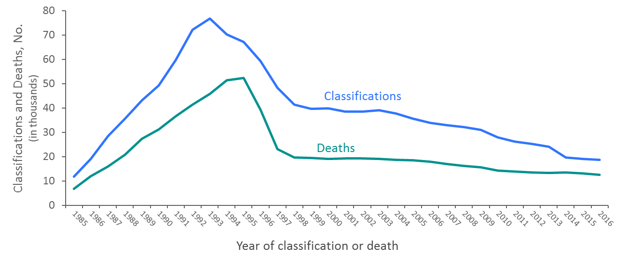
Stage 3 (AIDS) Classifications and Deaths of Persons with Diagnosed HIV Infection Ever Classified as Stage 3 (AIDS) 1985–2016, U.S. and 6 Dependent Areas
Deaths of persons with HIV infection, stage 3 (AIDS) may be due to any cause.
Notes:
The upper curve on the line graph represents the number of stage 3 (AIDS) classifications among adults and adolescents with diagnosed HIV infection in the United States and dependent areas, by year of classification from 1985 through 2016; the lower curve represents the number of deaths of adults and adolescents with diagnosed HIV infection ever classified with stage 3 (AIDS), by year of death from 1985 through 2016.
The peak in stage 3 (AIDS) in 1993 can be associated with the expansion of the HIV surveillance case definition implemented in January 1993. The overall declines in stage 3 (AIDS) and deaths of persons with stage 3 (AIDS) are due in part to the success of highly active antiretroviral therapies, introduced in 1996.
In recent years, stage 3 (AIDS) classifications and deaths of persons with stage 3 (AIDS) have continued to decline.
Deaths of persons with stage 3 (AIDS) may be due to any cause (may not be HIV-related). Deaths of persons with stage 3 (AIDS) are classified as adult or adolescent based on age at death.

Slide 9
Overview of HIV/AIDS in Minnesota

Slide 10
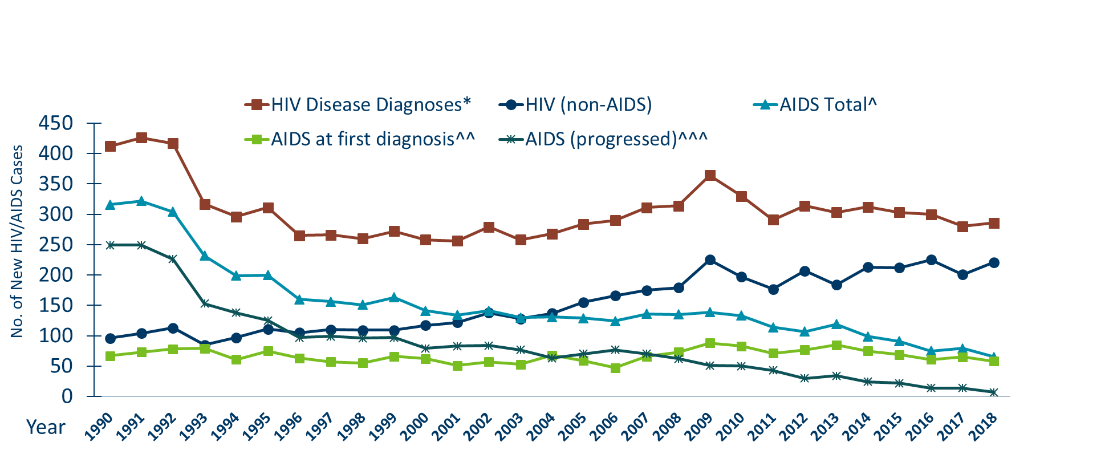
New HIV Diagnoses, HIV (non-AIDS) and AIDS Cases by Year of HIV Diagnosis, 1990-2018
Notes:
Nationally, Minnesota is considered within the low to moderate risk of HIV and AIDS infections as defined by the Centers for Disease Control and Prevention (CDC). The annual number of new HIV and AIDS cases increased steadily from the beginning of the epidemic to the early 1990s. Beginning in 1996, both the number of newly diagnosed AIDS cases and the number of deaths among AIDS cases declined sharply, primarily due to the success of new antiretroviral therapies including protease inhibitors. These treatments do not cure, but can delay progression to AIDS among persons with HIV (non-AIDS) infection and improve survival among those with AIDS. These treatments have been shown to be effective at preventing transmission of HIV. Over the past five years, the number of HIV/AIDS cases diagnosed has remained relatively stable with an average of almost 300 cases diagnosed each year. By the end of 2018, an estimated 8,981 persons with HIV/AIDS were assumed to be living in Minnesota.
This number includes persons whose most recently reported state of residence was Minnesota, regardless of residence at time of diagnosis. This estimate does not include persons with undiagnosed HIV infection.

Slide 11
Persons Living with HIV/AIDS in Minnesota

Slide 12
Estimated Number of Persons Living with HIV/AIDS in Minnesota
As of December 31, 2018 8,981* persons are assumed alive and living in Minnesota with HIV/AIDS. This includes:
  4,937 (55%) living with HIV infection (non-AIDS)
  4,044 (45%) living with AIDS
This number includes 2,331 persons who were first reported with HIV or AIDS elsewhere and subsequently moved to Minnesota
This number excludes 1,560 persons who were first reported with HIV or AIDS in Minnesota and subsequently moved out of the state

Slide 13
Place

Slide 14
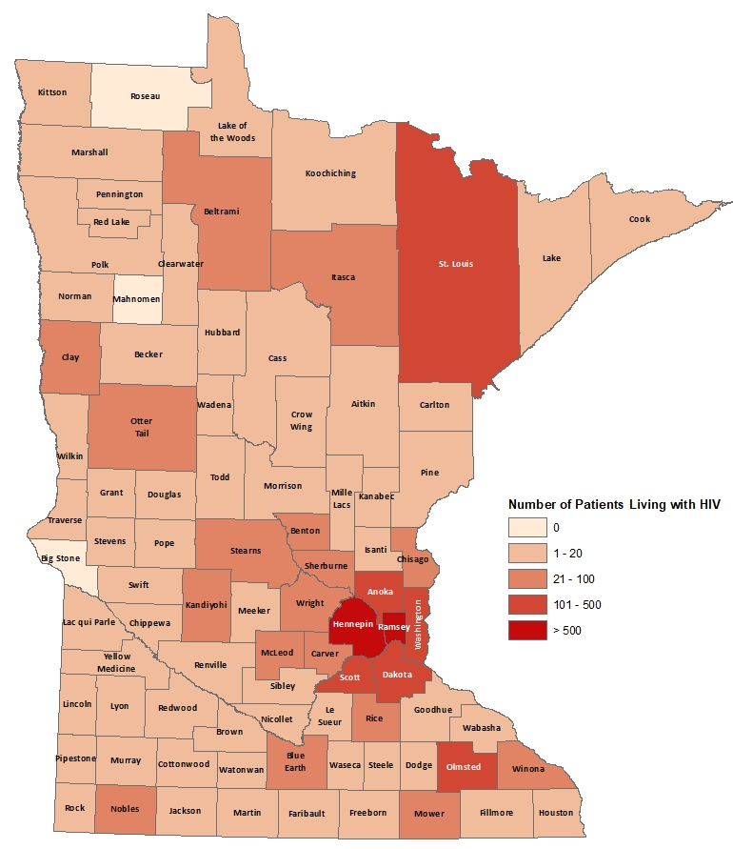
Minnesota Patients Living with HIV# by County of Current Residence, 2018
City of Minneapolis
City of St. Paul
Suburban*
Greater Minnesota
Total
3,190 cases (833.8 per 100,000)
1,149 cases (403.1 per 100,000)
3,105 cases (142.3 per 100,000)
1522 cases (62.0 per 100,000)
8,966 cases (169.0 per 100,000)
#HIV or AIDS at last appointment
*7-county metro area, excluding the cities of Minneapolis and St. Paul

Slide 15
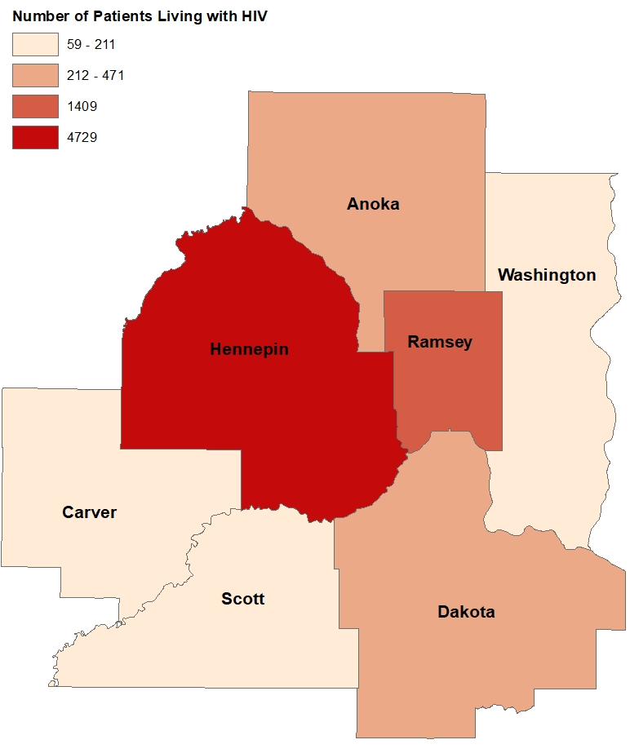
2018 Minnesota Patients Living with HIV by Metro County
City of Minneapolis
City of St. Paul
Suburban*
Greater Minnesota
Total
3,190 cases (833.8 per 100,000)
1,149 cases (403.1 per 100,000)
3,105 cases (142.3 per 100,000)
1522 cases (52.0 per 100,000)
8,966 cases (169.0 per 100,000)
*7-county metro area, excluding the cities of Minneapolis and St. Paul

Slide 16
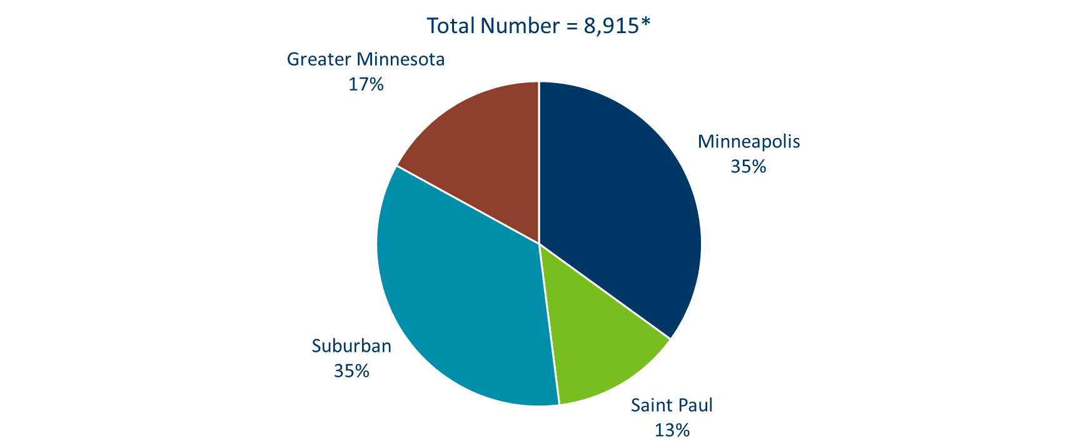
Persons Living with HIV/AIDS in Minnesota by Current Residence, 2018
Notes:
Overall, of the 8,981 people living with HIV/AIDS for whom complete residence information is available, 35% of all people living with HIV/AIDS in Minnesota live in the city of Minneapolis, along with 35% living in the surrounding suburban area. People living with HIV/AIDS in Greater Minnesota account for 17% of all people living with HIV/AIDS. Finally, people living with HIV/AIDS in Saint Paul account for 13% of all people living with HIV/AIDS.

Slide 17
Sex Assigned at Birth and Race/Ethnicity

Slide 18
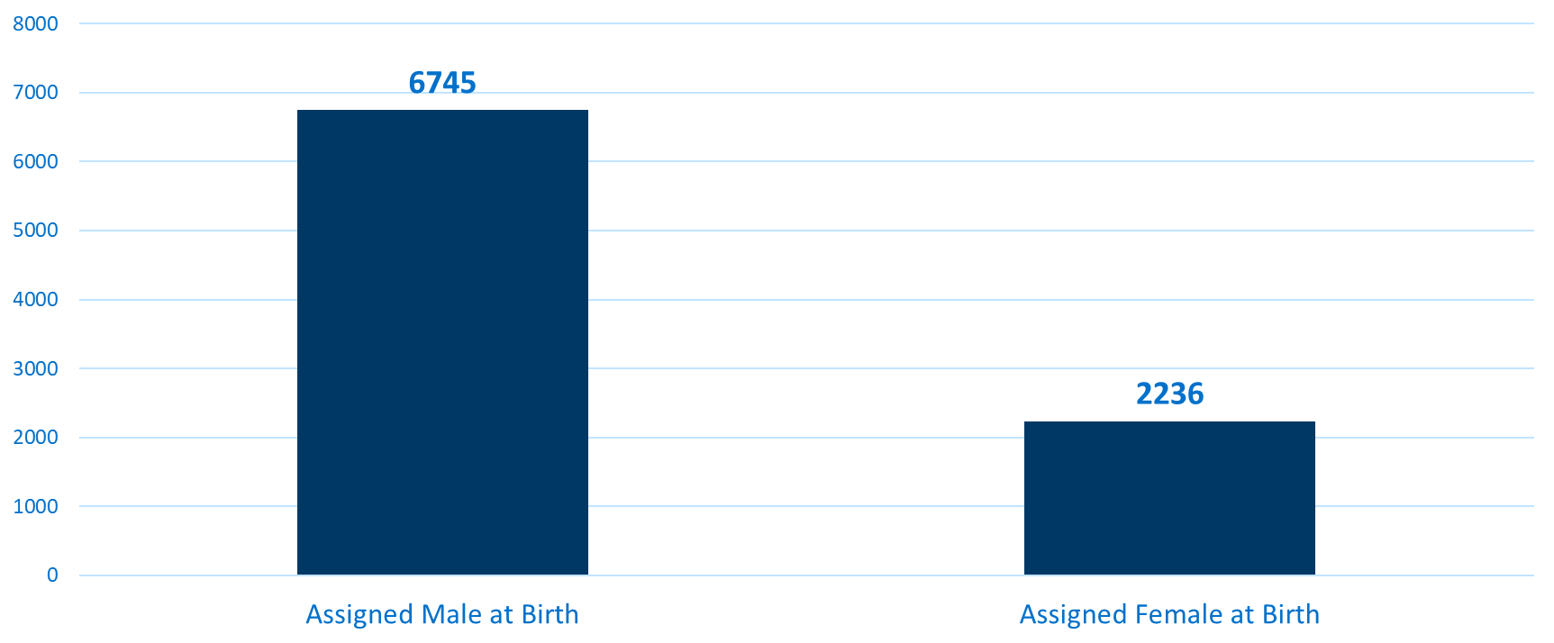
Persons Living with HIV/AIDS in Minnesota by
Sex Assigned at Birth, 2018
Notes:
Seventy-five percent (75%) of prevalent HIV/AIDS cases are males, while twenty-five percent (25%) are females.

Slide 19
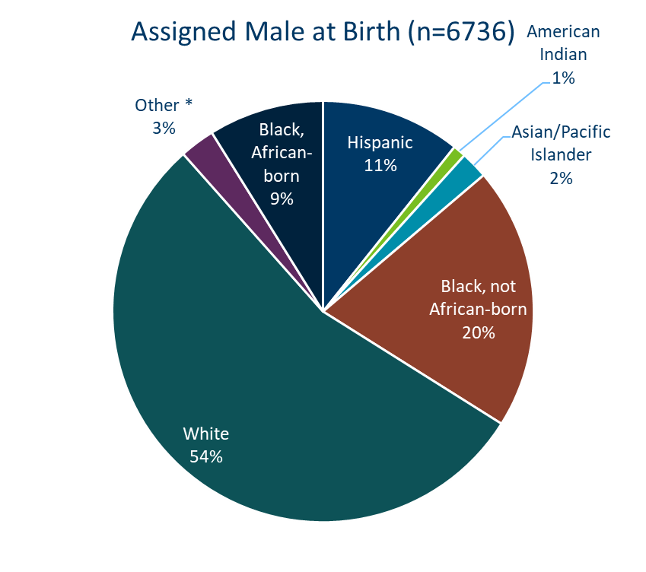
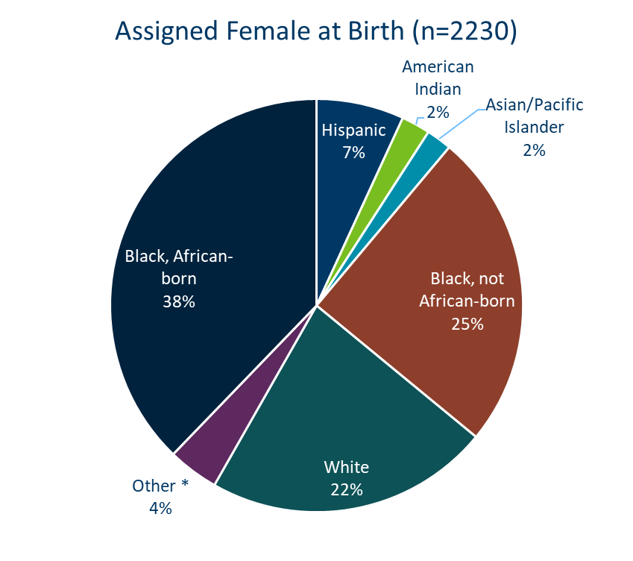
Persons Living with HIV/AIDS in Minnesota by Sex Assigned at Birth and Race/Ethnicity, 2018
Notes:
Seventy-five percent (75%) of prevalent HIV/AIDS cases are males. Broken down by race/ethnicity, 54% of male cases are white, 20% Black not African-born, 11% Hispanic, 9% African-born, 1% American Indian, 2% Asian/Pacific Islander, and 3% are persons of multiple or unknown race. In total, 46% of males living with HIV/AIDS are among men of color; whereas only 17% of the general male population are people of color. Among female cases, the distribution is even more skewed toward women of color: 38% African-born, 25% Black not African-born, 22% white, 7% Hispanic, 2% American Indian, 3% Asian/Pacific Islander, and 3% persons of multiple or unknown race. Thus, 78% of prevalent female HIV/AIDS cases are among women or color whereas only 17% of the general female population in Minnesota is comprised of women of color.
Please note that race is not considered a biological reason for disparities related to HIV/AIDS experienced by persons of color. Race, however, can be considered a marker for other personal and social characteristics that put a person at greater risk for HIV exposure. These characteristics may include, but are not limited to, lower socioeconomic status, less education, and less access to health care.

Slide 20
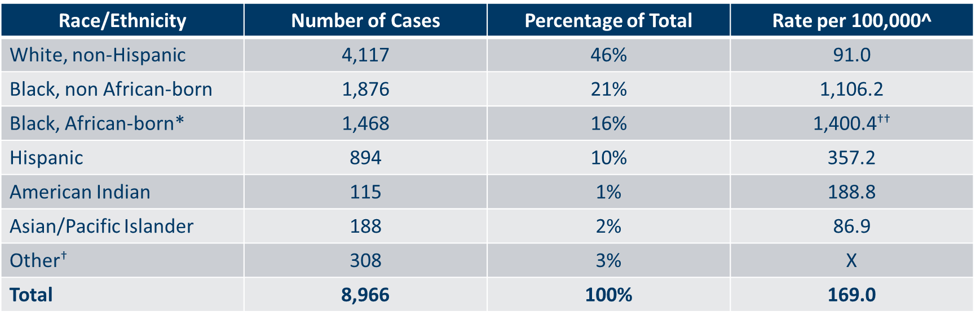
Number of Cases and Rates (per 100,000 persons) of Persons Living with HIV/AIDS by Race/Ethnicity in Minnesota, 2018
Notes:
While white persons account for the greatest number of persons living with HIV/AIDS in Minnesota (4,117 cases), they have one of the lowest rates of people living with HIV/AIDS (91.0 per 100,000 persons). Black, African-born persons account for 1,468 cases living with HIV/AIDS in Minnesota, however since this population makes up a small proportion of the overall population in Minnesota, the rate of people living with HIV/AIDS in this community is higher than other races and ethnicities. The rate of African-born persons living with HIV/AIDS is 1,400.1 per 100.000 persons; this is a rate of more than 15 times greater than white, non-Hispanic persons. Black, non African-born persons have the second highest rate of people living with HIV/AIDS at 1,106.2 per 100,000 persons; this is 12 times higher than the rate among white people. Hispanic persons have the next highest rate of people living with HIV/AIDS in Minnesota at 357.2 per 100,000; this is a rate of more than 3 times higher than white, non-Hispanic persons. American Indians have a rate of people living with HIV/AIDS of 188.8 per 100,000 persons; this is a rate two times higher than white non-Hispanic persons. Finally, Asian/Pacific Islanders have a rate of people living with HIV/AIDS of 86.9 per 100,000; this accounts for an HIV/AIDS rate similar to the rate among white non-Hispanic persons. The overall rate of HIV/AIDS in Minnesota is 169.0 per 100,000.

Slide 21
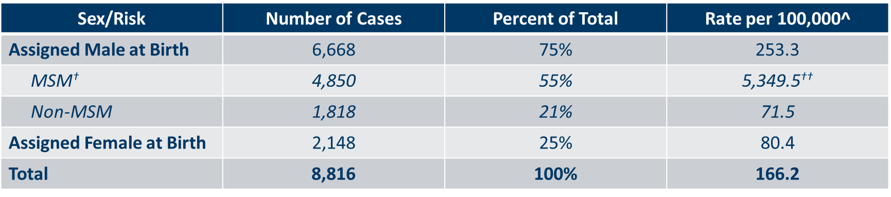
Number of Cases and Rates (per 100,000 persons) of Adults and Adolescents* Living with HIV/AIDS by Sex Assigned at Birth and Risk† in Minnesota, 2018
Notes:
Beginning in 2012, MDH began estimating the number of MSM living in Minnesota. This number was updated in 2017 with more recent data from Emory University. Men who have sex with Men have the highest rate of persons living with HIV/AIDS than any other sub-group. In 2018, the estimated rate of people living with HIV/AIDS among MSM was 5,349.5 per 100,000 population. This is 75 times higher than the rate among non-MSM men (71.5 per 100,000 population). It’s important to note that MSM contains cases from all racial/ethnic categories and therefore cannot be directly compared to the rates by race/ethnicity. For more information on how this was estimated, see the HIV Surveillance Technical Notes.

Slide 22
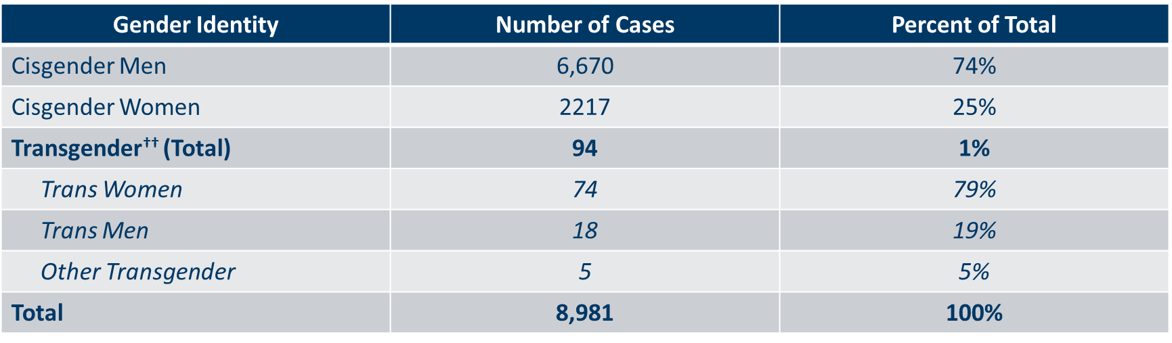
Number of Cases of Adults and Adolescents* Living with HIV/AIDS by Gender Identity in Minnesota, 2018
Notes:
This slide shows the number of people living with HIV/AIDS by gender identity (male, female, or transgender).
As of 2018, there are 94 transgender people living with HIV/AIDS in Minnesota, of which the majority are trans women (78%) and 19% trans men. This represents about 1% of people living with HIV/AIDS in the state.

Slide 23
Age

Slide 24
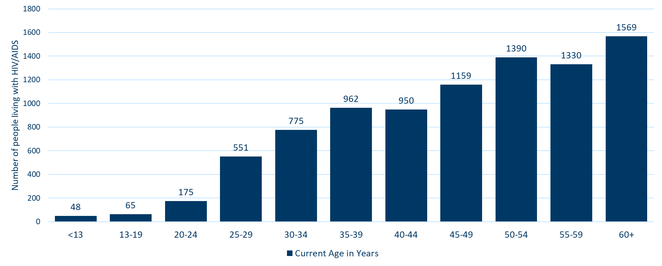
Persons Living with HIV/AIDS in Minnesota by Age Group*, 2018
Notes:
Over 70% of persons living with HIV/AIDS as of 2018 are currently 40 years of age or older. As with new cases, there are differences by gender in the age of living cases.

Slide 25
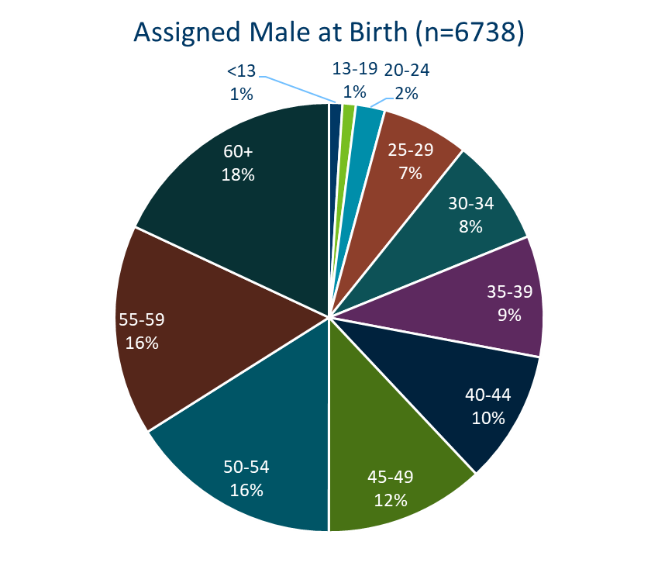
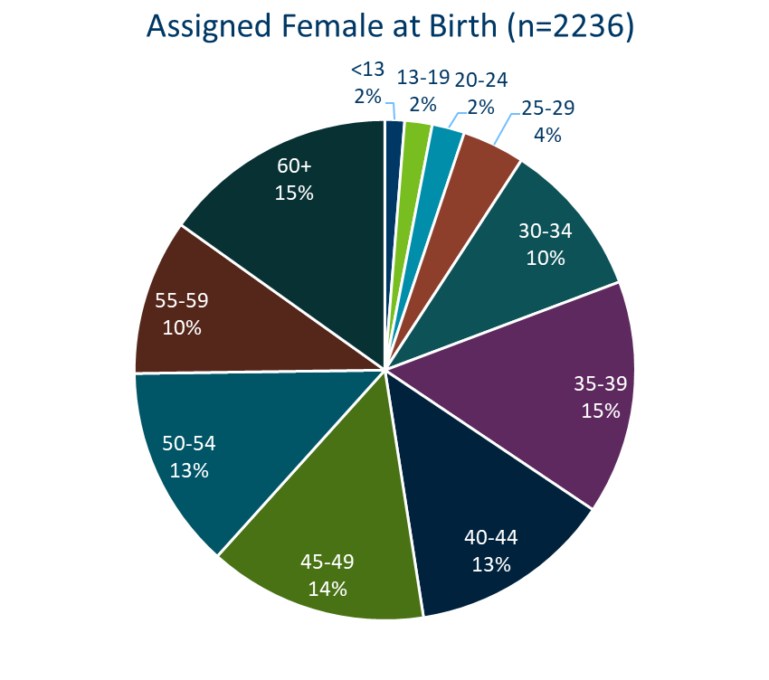
Persons Living with HIV/AIDS in Minnesota by Age* and Sex Assigned at Birth, 2018

Slide 26
Foreign Born Populations

Slide 27
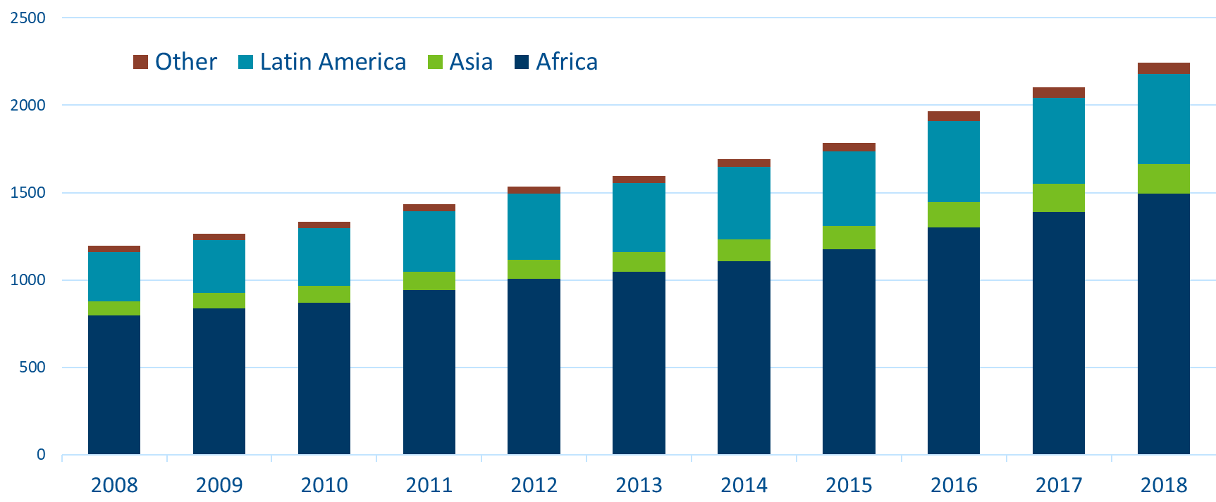
Foreign Born Persons Living with HIV/AIDS in Minnesota by Region of Birth, 2008-2018
*This number includes persons who reported Minnesota as their current state of residence, regardless of residence at time of diagnosis. It also includes state prisoners and refugees arriving through the HIV+ Refugee Resettlement Program, as well as HIV+ refugees/immigrants arriving through other programs.
Notes:
One particular population of interest in Minnesota that sets us apart from other states is our larger foreign-born HIV-positive population. Between 1990 and 2018, the number of foreign-born people living with HIV/AIDS in Minnesota increased substantially, especially among the African-born population. In 1990, 50 foreign-born people were reported to be living with HIV/AIDS in Minnesota, and by 2007 this number had increased to 1,126 people. In 2018, the total number of foreign-born people living with HIV/AIDS in Minnesota was 2,244, a nearly 7% increase from 2016. The majority of these people immigrated to the United States from Africa and Latin America. This trend illustrates the growing diversity of the HIV-positive population in Minnesota and the need for culturally appropriate HIV care and prevention efforts.

Slide 28
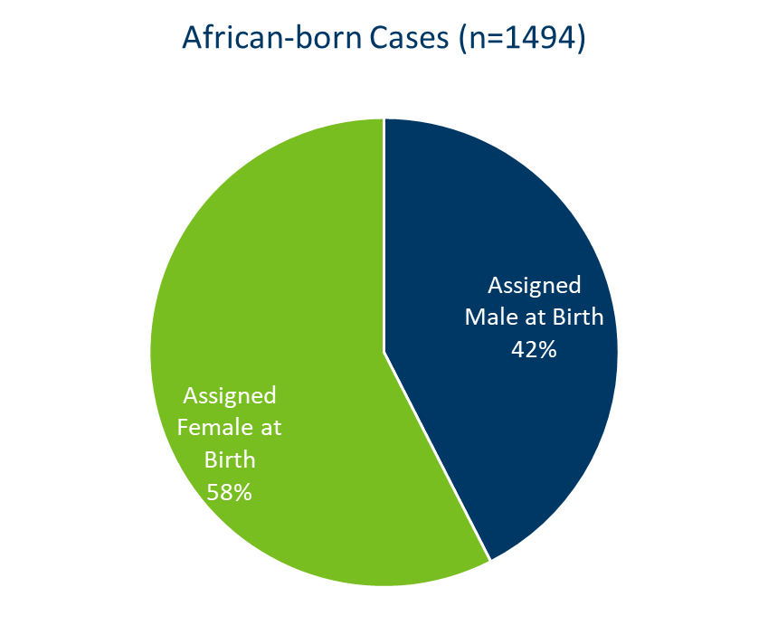
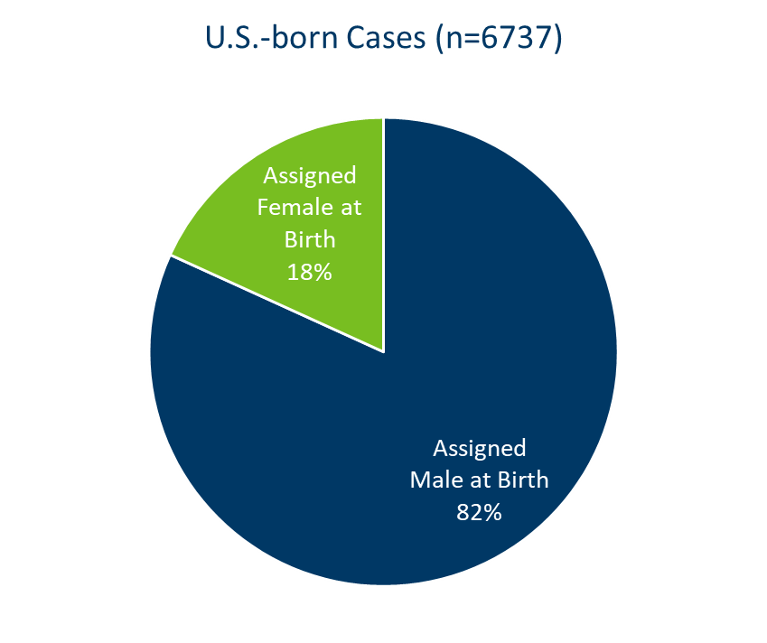
African-Born* Persons Living with HIV/AIDS Compared to Other Minnesota Cases by Sex Assigned at Birth, 2018
Notes:
The characteristics of foreign-born persons living with HIV/AIDS in Minnesota differ from U.S.-born, especially in gender. While females account for 18% of cases among U.S.-born persons, they account for 45% of foreign-born cases. This is especially noticeable among African-born cases, where women account for 58% of those living with HIV/AIDS in Minnesota.

Slide 29
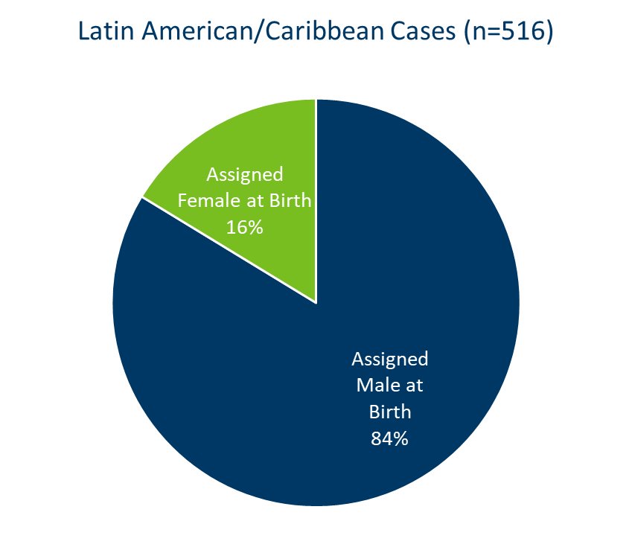
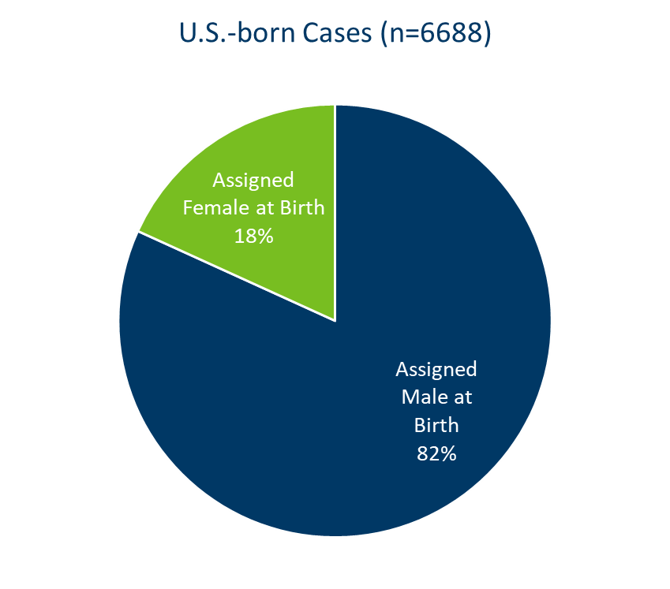
Latin American/Caribbean* Persons Living with HIV/AIDS Compared to Other Minnesota Cases by Sex Assigned at Birth, 2018
Notes:
The gender distribution among cases born in Latin America/the Caribbean is similar to that of U.S.-born cases, where 16% of prevalent cases are among women.

Slide 30
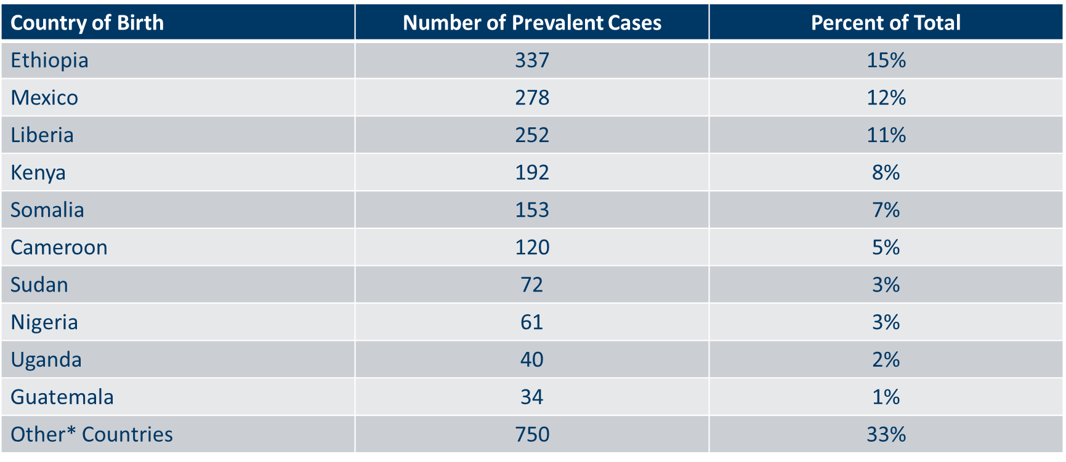
Countries of Birth Among Foreign Born Persons* Living with HIV/AIDS in Minnesota, 2018

Slide 31
Mortality

Slide 32
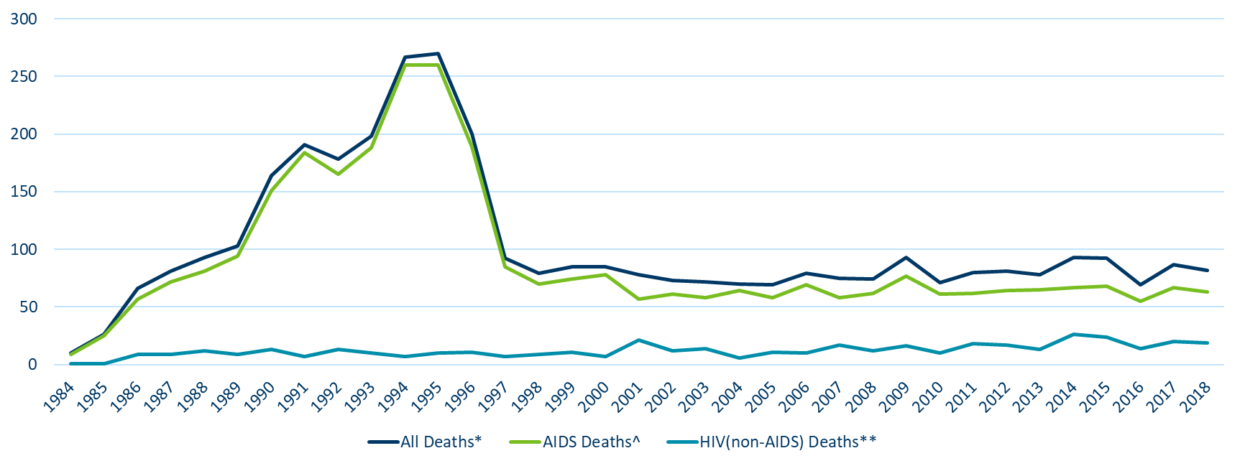
Reported Deaths Among Persons living with HIV/AIDS in Minnesota, 1984-2018
Notes:
The number of deaths among all people living with HIV infection in Minnesota decreased dramatically between 1995 and 1997 and has remained relatively constant over the past decade. In 2018, a total of 82 deaths were reported among people living with HIV infection in Minnesota. The total number of deaths reported in Minnesota for those living with AIDS was 63 (77% of all deaths) in 2018.

