Slide 1
HIV/AIDS Incidence Report, 2022
HIV/AIDS Surveillance System
April 2023
Notes:
.

Slide 2
Land Acknowledgement
Every community owes its existence and vitality to generations from around the world who contributed their hopes, dreams, and energy to making the history that led to this moment. Some were brought here against their will, some were drawn to leave their distant homes in hope of a better life, and some have lived on this land for more generations than can be counted. Truth and acknowledgment are critical to building mutual respect and connection across all barriers of heritage and difference.
We begin this effort to acknowledge what has been buried by honoring the truth. We are standing on the ancestral lands of the Dakota people. We want to acknowledge the Dakota, the Ojibwe, the Ho Chunk, and the other nations of people who also called this place home. We pay respects to their elders past and present. Please take a moment to consider the treaties made by the Tribal nations that entitle non-Native people to live and work on traditional Native lands. Consider the many legacies of violence, displacement, migration, and settlement that bring us together here today. Please join us in uncovering such truths at any and all public events.*
*This is the acknowledgment given in the USDAC Honor Native Land Guide – edited to reflect this space by Shannon Geshick, MTAG, Executive Director Minnesota Indian Affairs Council
Notes:
Before we begin our webinar, we take a moment to acknowledge that Minnesota stands on ancestral land of tribal nations… including the Dakota, Ojibwe, Ho Chunk, and other nations. Please take a moment to consider the treaties made by the Tribal nations that entitle non-native people to live and work on traditional Native lands.

Slide 3
New HIV Diagnoses in Minnesota, 2022

Slide 4
Introduction (I)
These two introduction slides provide a general context for the data used to create this slide deck. If you have questions about any of the slides, please refer to HIV Surveillance Technical Notes.
This slide deck describes new HIV diagnoses (including AIDS at first diagnosis) in Minnesota by person, place, and time.
The slides rely on data from HIV/AIDS cases diagnosed through 2022 and reported to the Minnesota Department of Health (MDH) HIV/AIDS Surveillance System.
The data are displayed by year of HIV diagnosis.

Slide 5
Introduction (II)
Data analyses exclude people diagnosed in federal or private correctional facilities but include people incarcerated by the state (number of people incarcerated by the state believed to be living with HIV/AIDS [n=17]).
Data analyses for new HIV diagnoses exclude people arriving to Minnesota through the HIV+ Refugee Resettlement Program (number of primary HIV+ refuges in this program living in MN as of December 31, 2022 = 163), as well as other refugees and immigrants reporting a positive test prior to their arrival in Minnesota (n=160).
Some limitations of surveillance data:
  Data do not include people living with HIV who have not been tested for HIV
  Data do not include people whose positive test results have not been reported to MDH
  Data do not include people living with HIV who have only tested anonymously
  Case numbers for the most recent years may be undercounted due to delays in reporting
  Reporting of living cases that were not initially diagnosed in Minnesota is known to be incomplete

Slide 6
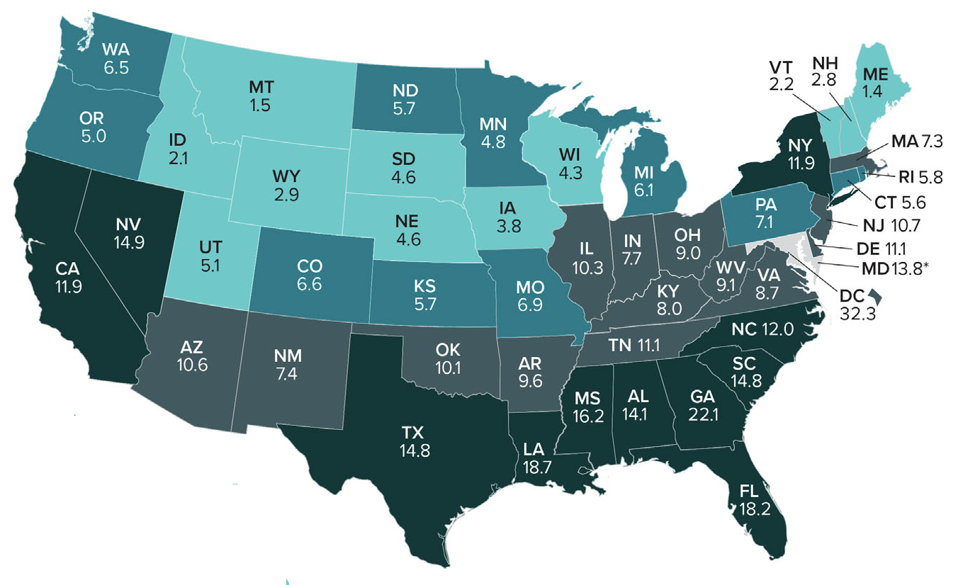
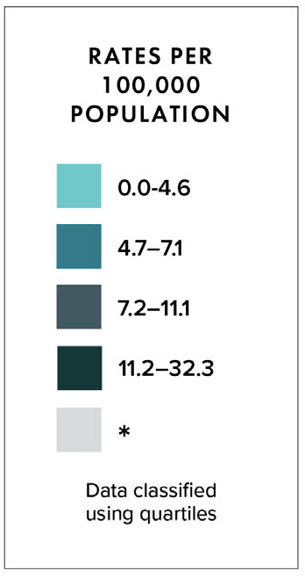
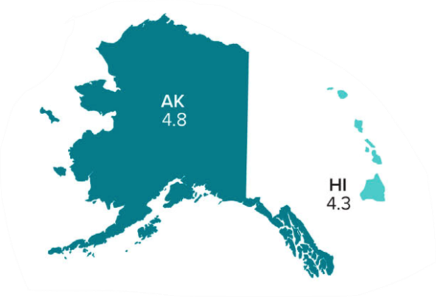
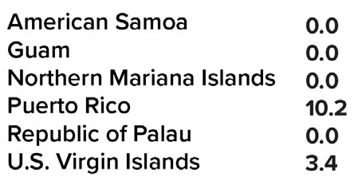
Rates of Diagnoses of HIV Infection among Adults >13
2020—United States and 6 Dependent Areas
N = 30,635 Total Rate = 10.9
Notes:
Please note that the most recent data available for national context was last prepared for 2020.
In the United States and 6 dependent areas, the rate of diagnoses of HIV infection among adults was 10.9 per 100,000 population in 2020. The rate of diagnoses of HIV infection for adults and adolescents ranged from zero in American Samoa, Guam, the Northern Mariana Islands and the Republic of Palau to 42.4 per 100,000 in the District of Columbia. This represents a 17% decline in new diagnoses from 2019, a reduction likely due to COVID-associated disruptions in clinical services, changes in patient care-seeking behaviors, and shortages in HIV testing materials. More time will be required to fully assess the COVID pandemic’s affect on HIV nationally.
The District of Columbia (i.e., Washington, DC) is a city; use caution when comparing the HIV diagnosis rate in DC with the rates in states.

Slide 7
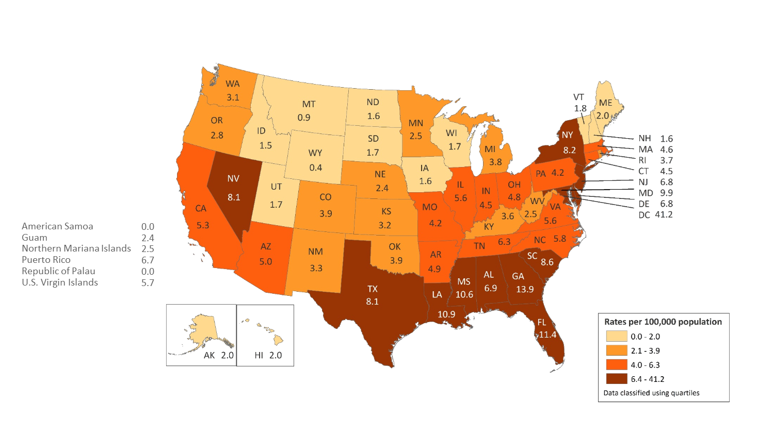
Rates of Diagnosed HIV Infection Classified as Stage 3 (AIDS) among Adults and Adolescents, by Area of Residence, 2018—United States and 6 Dependent Areas
N = 17,186 Total Rate: 6.2
Note. Data for the year 2018 are considered preliminary and based on 6 months reporting delay.
Notes:
In 2018, in the United States and 6 dependent areas, the rate of stage 3 (AIDS) classifications among adults and adolescents with HIV Infection was 6.2 per 100,000 population. The rates of stage 3 (AIDS) classifications ranged from 0.0 per 100,000 in American Samoa and the Republic of Palau to 41.2 per 100,000 in the District of Columbia.
The District of Columbia (i.e., Washington, DC) is a city; use caution when comparing the rate of people living with diagnosed HIV infection in DC with the rates in states.
Data for the year 2018 are considered preliminary and based on 6 months reporting delay.

Slide 8
Overview of HIV/AIDS in Minnesota

Slide 9
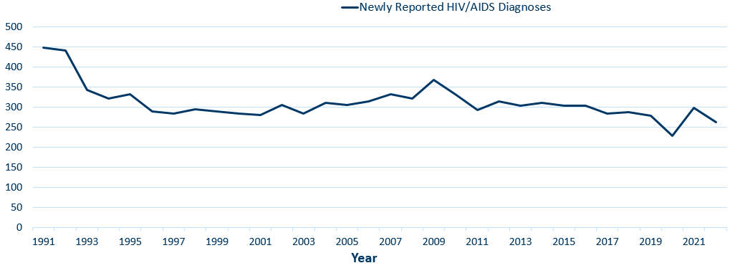
New HIV Disease Diagnoses*
HIV/AIDS Cases by Year, 1991–2022
*Includes all new cases of HIV infection (both HIV (non-AIDS) and AIDS at first diagnosis) diagnosed within a given calendar year.
Data: HIV Incidence Report 2022 Tables (PDF)
Notes:
Nationally, Minnesota is considered a low- to moderate-risk state for HIV and AIDS infections as defined by the Centers for Disease Control and Prevention (CDC). The annual number of new HIV and AIDS cases increased steadily from the beginning of the epidemic to the early 1990s. Beginning in 1996, the number of newly diagnosed AIDS cases declined sharply, primarily due to the success of new antiretroviral therapies including protease inhibitors. These treatments have been shown to be effective at preventing transmission of HIV.

Slide 10
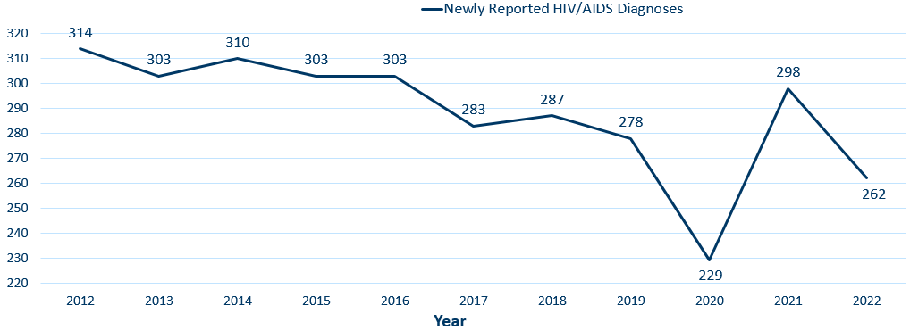
New HIV Disease Diagnoses*
HIV/AIDS Cases by Year, 2012–2022
*Includes all new cases of HIV infection (both HIV (non-AIDS) and AIDS at first diagnosis) diagnosed within a given calendar year.
Data: HIV Incidence Report 2022 Tables (PDF)
Notes:
In this report, the term “new HIV diagnoses” refers to Minnesota residents living with HIV who were diagnosed in a particular calendar year and reported to MDH. This includes people whose first diagnosis of HIV infection is AIDS (AIDS at first diagnosis). HIV diagnoses data are displayed by earliest known date of HIV diagnosis. In the decade prior to 2020, there were an average of 300 new diagnoses per year, trending down on average 5.5 diagnoses per year. 2020 saw a 16% decrease in HIV diagnoses from 2019, and a rebound effect was seen in 2021. The 262 new diagnoses in 2022 is a possible return to trend.
As discussed earlier, it may take more time and data analysis to accurately assess COVID-19’s impact on HIV over the last 3 years.

Slide 11
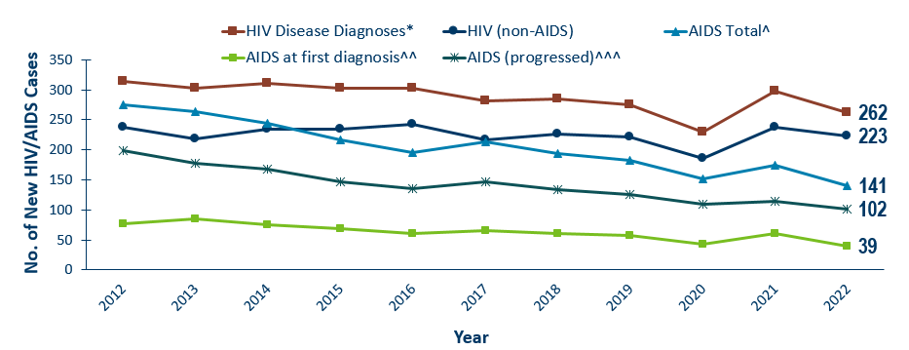
New HIV Diagnoses, HIV (non-AIDS) and AIDS Cases by Year of HIV Diagnosis, 2012–2022
*Includes all new cases of HIV infection (both HIV (non-AIDS) and AIDS at first diagnosis diagnosed within a given calendar year.
^Includes all cases diagnosed with HIV in that year who subsequently progressed to AIDS diagnosis status, including those diagnosed with AIDS when they were first diagnosed with HIV^^ and those who were diagnosed with AIDS in subsequent years^^^
This includes refugees in the HIV+ Resettlement Program, as well as, other refugee/immigrants diagnosed with AIDS subsequent to their arrival in the United States.
Data: HIV Incidence Report 2022 Tables (PDF)
Notes:
Of the 262 diagnoses in 2022, 223 were new HIV diagnoses, while 39 were simultaneous HIV and AIDS diagnoses.

Slide 12
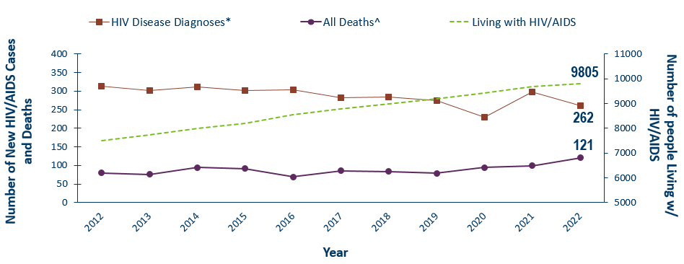
New HIV Diagnoses, Deaths and Prevalent Cases by Year, 2012–2022
Category | 1996 | 1997 | 1998 | 1999 | 2000 | 2001 | 2002 | 2003 | 2004 | 2005 | 2006 | 2007 | 2008 | 2009 | 2010 | 2011 | 2012 | 2013 | 2014 | 2015 | 2016 | 2017 | 2018 | 2019 | 2020 | 2021 | 2022
HIV Disease Diagnoses* | 291 | 285 | 297 | 291 | 282 | 282 | 307 | 281 | 308 | 305 | 315 | 330 | 322 | 366 | 331 | 291 | 314 | 302 | 311 | 302 | 303 | 282 | 285 | 275 | 230 | 298 | 262
All Deaths^ | 205 | 87 | 81 | 84 | 85 | 79 | 73 | 72 | 70 | 69 | 79 | 74 | 74 | 91 | 71 | 80 | 80 | 76 | 95 | 92 | 69 | 86 | 84 | 79 | 95 | 99 | 121
Living with HIV/AIDS | 3051 | 3287 | 3539 | 3790 | 4046 | 4331 | 4598 | 4895 | 5002 | 5233 | 5566 | 5950 | 6221 | 6552 | 6814 | 7136 | 7516 | 7723 | 7998 | 8215 | 8554 | 8789 | 8981 | 9193 | 9422 | 9697 | 9805
Includes all new cases of HIV infection (both HIV (non-AIDS) and AIDS at first diagnosis) diagnosed within a given calendar year.
^Deaths in Minnesota among people with HIV/AIDS, regardless of location of diagnosis or cause of death.
Notes:
Beginning in 1996, both the number of newly diagnosed AIDS cases and the number of deaths among AIDS cases declined sharply, primarily due to the success of new antiretroviral therapies including protease inhibitors. These treatments do not cure but can delay progression to AIDS among people with HIV (non-AIDS) infection and improve survival among those with AIDS. These treatments have been shown to be effective at preventing transmission of HIV.
Since 1996, the number of new diagnoses has remained relatively stable in Minnesota at around 300 cases per year. During this same time, deaths among HIV positive people in Minnesota has decreased dramatically. As people with HIV are living longer and healthier lives, the number of people living with HIV in Minnesota continues to grow as seen in the green line here.
At the end of 2022, there were 9,805 people estimated to be living with HIV or AIDS in Minnesota.
This number does not include 1,734 people who were first reported with HIV or AIDs in Minnesota and subsequently moved out of the state, but it does include 2,702 people who were first reported with HIV or AIDS elsewhere and subsequently moved to Minnesota.

Slide 13
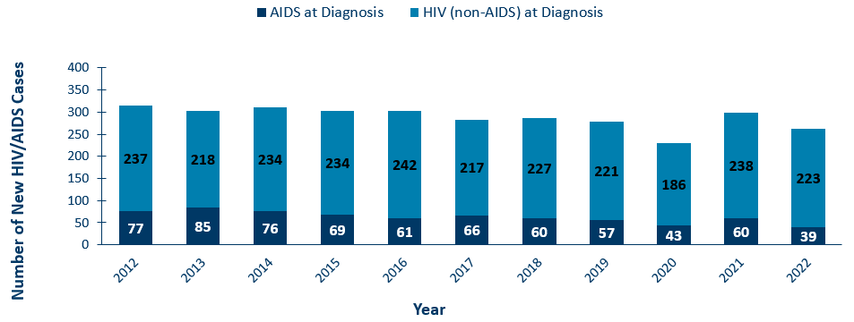
HIV (non-AIDS) and AIDS^ at Diagnosis by Year, 2012–2022
^Includes all new cases of HIV that were diagnosed with HIV and AIDS simultaneously
This includes refugees in the HIV+ Resettlement Program, as well as, other refugee/immigrants diagnosed with AIDS subsequent to their arrival in the United States.
Data: HIV Incidence Report 2022 Tables (PDF)
Notes:
Over the last 10 years, the proportion of cases diagnosed with AIDS at initial HIV diagnosis has tended to be between 20 and 25%, averaging 22.4%.
In 2022, the proportion of cases diagnosed with AIDS at initial HIV diagnosis was below average at under 15%.

Slide 14
HIV Diagnoses in Minnesota by Person, Place, and Time

Slide 15
Place

Slide 16
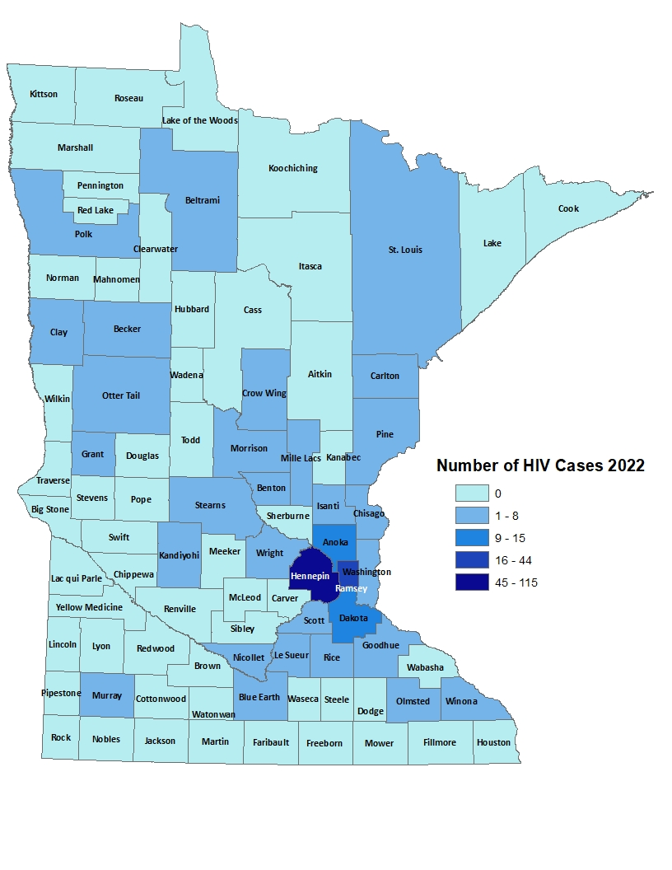
HIV Diagnoses# by County of Residence at Diagnosis, 2022
City of Minneapolis
City of St. Paul
Suburban*
Greater Minnesota
Total
70 cases (27%)
37 cases (14%)
86 cases (33%)
69 cases (26%)
262 cases
#HIV or AIDS at first diagnosis
*7-county metro area, excluding the cities of Minneapolis and St. Paul
Data: HIV Incidence Report 2022 Tables (PDF)
Notes:
Historically, about 80% of new HIV infections diagnosed in Minnesota have occurred in Minneapolis, St. Paul and the surrounding seven-county metropolitan area.
In 2022, of 262 total HIV diagnoses, 74% of the cases were in the seven-county Twin Cities metro region with 27% in Minneapolis, 14% in St. Paul, and 33% in the remaining suburban area (excluding Minneapolis/St. Paul). In greater Minnesota, there were 69 newly diagnosed HIV cases across 26 counties.

Slide 17
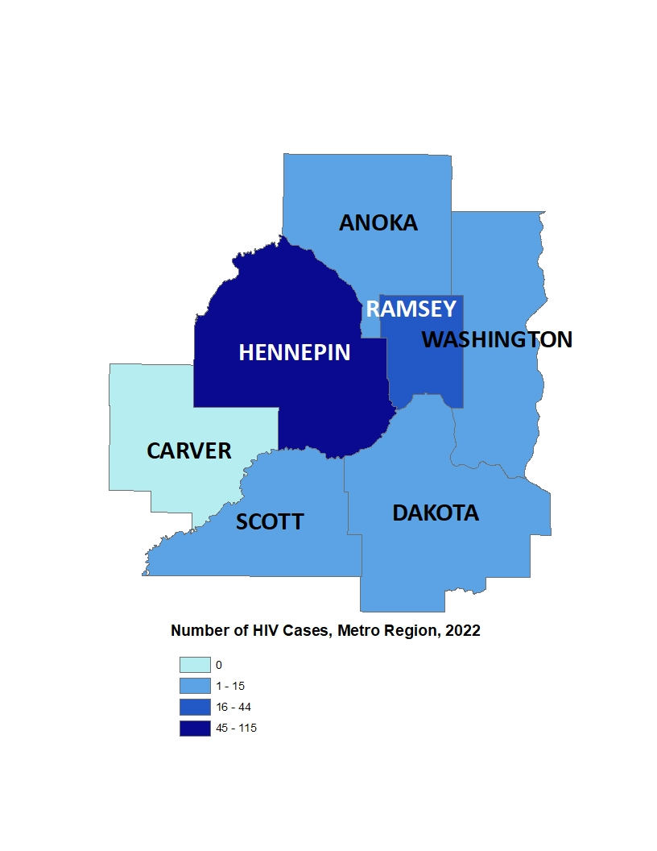
2022 Minnesota HIV New Diagnoses by Metro County
City of Minneapolis
City of St. Paul
Suburban*
Greater Minnesota
Total
70 cases (27%)
37 cases (14%)
86 cases (33%)
69 cases (26%)
262 cases
HIV or AIDS at first diagnosis
*7-county metro area, excluding the cities of Minneapolis and St. Paul
Data: HIV Incidence Report 2022 Tables (PDF)
Notes:
While 74% of all new HIV diagnoses in Minnesota occur in the Twin Cities seven-county metropolitan area, the cases in the metro area are concentrated in Hennepin and Ramsey counties.

Slide 18
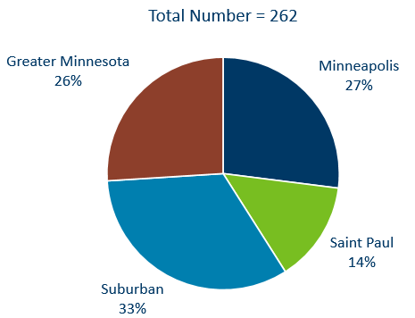
HIV Diagnoses* in Minnesota by Residence at Diagnosis, 2022
*Suburban includes the 7-county metro area of Anoka, Carver, Dakota, Hennepin (except Minneapolis), Ramsey (except St. Paul), Scott, and Washington counties. Greater Minnesota includes all other counties outside of the 7-county metro area.
Notes:
Overall, of the 262 HIV diagnoses in Minnesota in 2022, 74% were among residents of suburban seven-county metro area. Of these, 27% were residents of Minneapolis and 14% were residents of St. Paul. The remaining 26% were residents of Greater Minnesota at the time of diagnosis.

Slide 19
Sex at Birth, Gender, and Race/Ethnicity

Slide 20
Transmission Categories
CDC defines Transmission categories as “the term for classification of cases that summarizes an adult’s or adolescent’s possible HIV risk factors; the summary classification results from selecting, from the presumed hierarchical order of probability, the single risk factor most likely to have been responsible for transmission.”
  Male-to-male sexual contact (MMSC): includes individuals assigned male sex at birth, regardless of current gender identity, who have had sexual contact with other males, and individuals assigned male sex at birth who have had sexual contact with both males and females (bisexual contact)
  Injection drug use (IDU): includes persons who injected nonprescription drugs or who injected prescription drugs for nonmedical purposes
  Male-to-male sexual contact and injection drug use (MMSC/IDU): includes individuals assigned male sex at birth, regardless of current gender identity, who have had sexual contact with other males and injected nonprescription drugs or injected prescription drugs for nonmedical purposes
  Heterosexual contact: includes persons who have ever had sexual contact with a person known to have, or with a risk factor for, HIV infection
  Perinatal: includes persons who acquired HIV through mother-to-child transmission
  Other: includes persons with other risk factors (ie. blood transfusion, hemophilia) or whose risk factor was not reported or identified
Technical Notes | Volume 33 | HIV Surveillance | Reports | Resource Library | HIV/AIDS | CDC

Slide 21
Gender Identity
  Gender identity refers to a “person’s internal understanding of their own gender, or gender with which a person identifies. HIV surveillance personnel collect data on gender identity, when available, from sources such as case report forms submitted by health care or HIV testing providers and medical records, or by matching with other health department databases”
  Cisgender “is a term used to indicate that a person’s sex assigned at birth and current gender identity are the same (ie. a person assigned male at birth and who currently identifies as a man is a cisgender male)
  Transgender woman: “a person assigned “male” sex at birth who identifies as female”
  Transgender man: “a person assigned “female” sex at birth who identifies as male”
Technical Notes | Volume 33 | HIV Surveillance | Reports | Resource Library | HIV/AIDS | CDC
Notes:
How do we use these definitions: We follow CDC’s transmission category hierarchy
We use person-first language (ie. gender identity) to better represent HIV data in our state, specifically where transmission categories fall short in representing the HIV burden in each community
How can you help us gather more complete, accurate, and inclusive data:
Continue/start to collect and include gender identity on case report forms and lab documents. Without this we don’t have much data to understand the true, granular HIV burden on every community

Slide 22
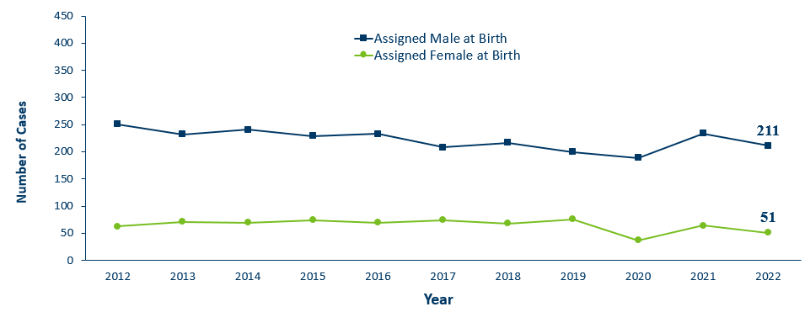
HIV Diagnoses* by Sex Assigned at Birth and Year of Diagnosis
2012–2022
Sex assigned at birth | 2008 | 2009 | 2010 | 2011 | 2012 | 2013 | 2014 | 2015 | 2016 | 2017 | 2018 | 2019 | 2020 | 2021 | 2022
Assigned Male at Birth | 244 | 296 | 263 | 218 | 251 | 232 | 241 | 229 | 233 | 208 | 217 | 200 | 189 | 234 | 211
Assigned Female at Birth | 78 | 70 | 68 | 74 | 63 | 71 | 70 | 74 | 70 | 74 | 68 | 76 | 37 | 64 | 51
*HIV or AIDS at first diagnosis
Notes:
By sex assigned at birth….
The number of cases among people assigned male at birth has averaged 77% for the last decade. In 2022 AMAB accounted for 80.5% of new diagnoses

Slide 23
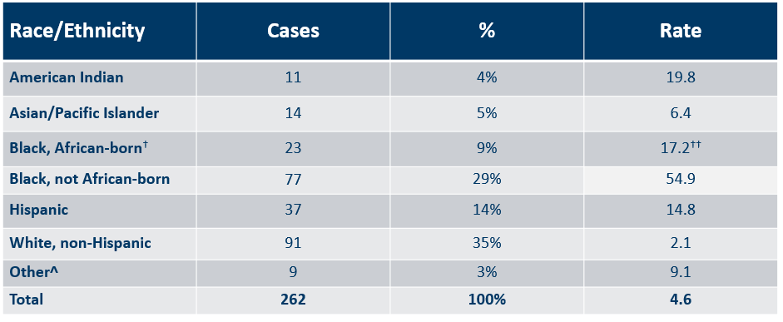
Number of Cases and Rates (per 100,000 people) of HIV Diagnoses* by Race/Ethnicity† Minnesota, 2022
* HIV or AIDS at first diagnosis; 2010 U.S. Census Data used for rate calculations.
† “Black African-born” refers to Black people who reported an African country of birth; “Black not African-born” refers to all other Black people.
†† Estimate of 125,939 Source: 2019 American Community Survey.
^ Other = Multi-racial people or people with unknown or missing race
# Unable to calculate rate, unknown denominator
Data: HIV Incidence Report 2022 Tables (PDF)
Notes:
Each year we calculate the rate of diagnosis for each racial/ethnic group represented in the surveillance system to assess the impact of HIV within each community. The rate takes into account the size of the population of each group.
Non-Hispanic Black Minnesotans had the highest rate of diagnoses in 2022 with 54.9 HIV diagnoses per 100,000 population among Black, not African-born people. For African-Americans who are not African-born, this represents a rate that is 26 times the rate in the white non-Hispanic population in Minnesota. The next highest rate was among American Indians with a rate of people newly diagnosed with HIV of 19.8 per 100,000 people, 9.4 times the rate of white, non-Hispanic people.
Black African-born people had a rate of 17.2 HIV diagnoses per 100,000 population which is 8 times that of the white non-Hispanic population.
Hispanic people of any race have the next highest rate of newly diagnosed HIV cases in Minnesota at 14.8 per 100,000 people; this is a rate 7 times that of white, non-Hispanic people.

Slide 24
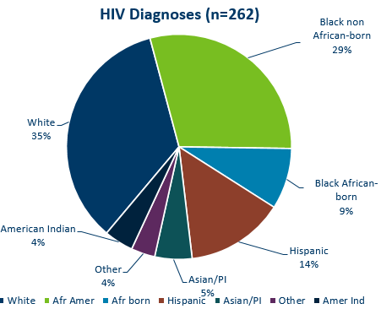
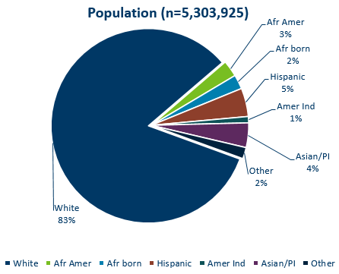
HIV Diagnoses* in Year 2022 and General Population in Minnesota by Race/Ethnicity
HIV or AIDS at first diagnosis † Population estimates based on 2010 U.S. Census data. (n = Number of people)
Data (left): HIV Incidence Report 2022 Tables (PDF)
Notes:
Comparing the racial/ethnic distribution of new HIV diagnoses [LEFT] to the general population of Minnesota [RIGHT], it is apparent that disparities continue to exist. Non-Hispanic African-American and Black African-born Minnesotans jointly make up about 5% of the population in Minnesota, yet accounted for 38% of the newly diagnosed cases of HIV in 2022. Similarly, Hispanics of any race account for approximately 5% of the population, but account for 14% of the newly diagnosed cases.
Population: 5,303,925
White: 83%
African American: 3%
African born: 2%
Hispanic: 5%
American Indian: 1%
Asian / Pacific Islander: 4%
Other: 2%

Slide 25
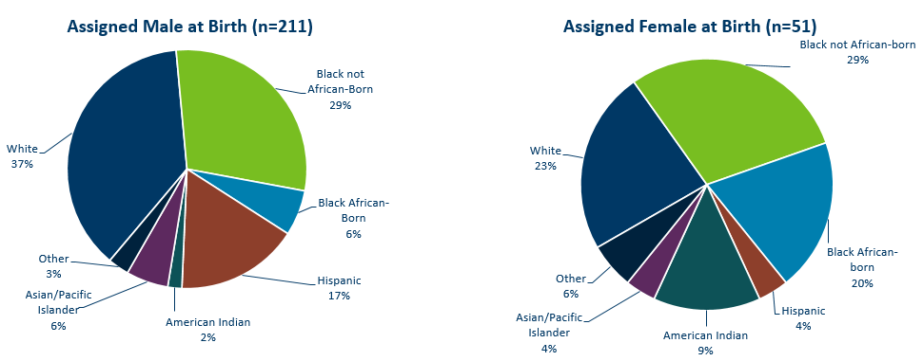
HIV Diagnoses* in 2022 by Sex Assigned at Birth and Race/Ethnicity†
*HIV or AIDS at first diagnosis (n = Number of people)
†“Black African-born” refers to Black people who reported an African country of birth; “Black not African-born” refers to all other Black people. Cases with unknown race are excluded.
Data: HIV Incidence Report 2022 Tables (PDF)
Notes:
There are differences in the racial/ethnic distribution by sex assigned at birth. Left to right are data for people assigned Male and Female at birth.
On the LEFT, among 211 people assigned the sex of male at birth, 37% of the 2022 cases diagnosed in Minnesota are Non-Hispanic white [seen in dark BLUE]. Non-Hispanic Black non-African born [In light GREEN] and black, African-born males [light BLUE] made up 35% of cases and Hispanic males of any race accounted for 17% of cases.
ON the RIGHT, Among the 51 people assigned the sex of female at birth, the disparities of new HIV diagnoses are even more apparent among people of color. They represent 77% of new HIV cases assigned female at birth vs 63% of new HIV cases assigned male at birth. Nearly half of female infections, or 49% combined, are Black, African-born and non-African born.

Slide 26
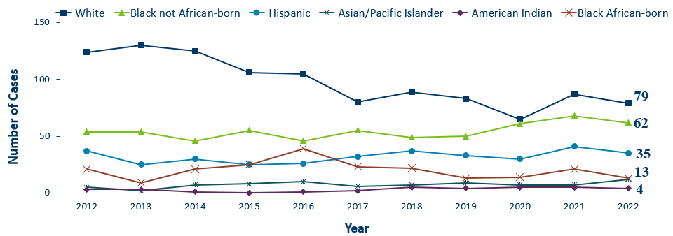
HIV Diagnoses* Among People Assigned Male Sex at Birth by Race/Ethnicity† and Year of Diagnosis 2012–2022
Race | 2006 | 2008 | 2009 | 2010 | 2011 | 2012 | 2013 | 2014 | 2015 | 2016 | 2017 | 2018 | 2019 | 2020 | 2021 | 2022
White | 126 | 151 | 167 | 139 | 123 | 124 | 130 | 125 | 106 | 105 | 80 | 89 | 83 | 65 | 87 | 79
Black not African-born | 35 | 40 | 61 | 57 | 37 | 54 | 54 | 46 | 55 | 46 | 55 | 49 | 50 | 61 | 68 | 62
Hispanic | 38 | 26 | 32 | 29 | 21 | 37 | 25 | 30 | 25 | 26 | 32 | 37 | 33 | 30 | 41 | 35
Asian/Pacific Islander | 3 | 5 | 6 | 4 | 4 | 5 | 2 | 7 | 8 | 10 | 6 | 7 | 9 | 7 | 7 | 12
American Indian | 1 | 2 | 2 | 5 | 3 | 3 | 3 | 1 | 0 | 1 | 2 | 5 | 4 | 5 | 5 | 4
Black African-born | 21 | 12 | 18 | 14 | 16 | 21 | 9 | 21 | 25 | 39 | 23 | 22 | 13 | 14 | 21 | 13
* HIV or AIDS at first diagnosis
† “African-born” refers to Black people who reported an African country of birth; “African American” refers to all other Black people. Cases with unknown or multiple races are excluded.
Notes:
Trends in the annual number of new HIV infections diagnosed among people assigned male sex at birth differ by racial/ethnic group.
White and black non-African born people accounted for the largest number of new infections.
In 2022, white people [in DARK BLUE] assigned male sex at birth accounted for (79 of 262) 30% (down from 37% in 2021) of the new HIV diagnoses among people assigned male sex at birth. [In GREEN] Cases among African-American people assigned male sex at birth has fluctuated over the past 10 years, and decreased in 2022 to 62 (24%) new HIV diagnoses (from 68 cases in 2021).
The annual number of HIV infections diagnosed among Hispanic people assigned male sex at birth has remained relatively stable, with small fluctuation from year to year. HIV infections in Hispanic people assigned male sex at birth was similar to the previous year with 35 cases in 2022. African-born people assigned male sex at birth diagnosed with HIV declined in 2022 to 13 cases.

Slide 27
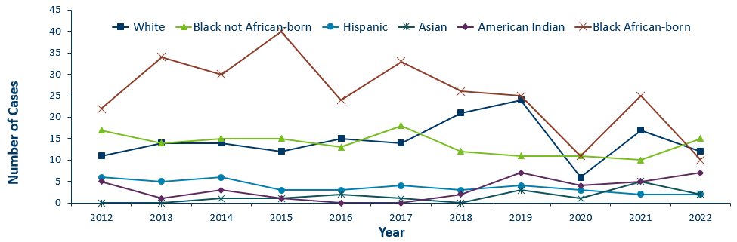
HIV Diagnoses* Among People Assigned Female Sex at Birth by Race/Ethnicity† and Year of Diagnosis 2012–2022
 |  | 2008 | 2009 | 2010 | 2011 | 2012 | 2013 | 2014 | 2015 | 2016 | 2017 | 2018 | 2019 | 2020 | 2021 | 2022
White |  | 21 | 17 | 22 | 14 | 11 | 14 | 14 | 12 | 15 | 14 | 21 | 24 | 6 | 17 | 12
Black not African-born |  | 22 | 19 | 16 | 20 | 17 | 14 | 15 | 15 | 13 | 18 | 12 | 11 | 11 | 10 | 15
Hispanic |  | 4 | 7 | 2 | 6 | 6 | 5 | 6 | 3 | 3 | 4 | 3 | 4 | 3 | 2 | 2
Asian |  | 0 | 0 | 1 | 1 | 0 | 0 | 1 | 1 | 2 | 1 | 0 | 3 | 1 | 5 | 2
American Indian |  | 3 | 2 | 5 | 1 | 5 | 1 | 3 | 1 | 0 | 0 | 2 | 7 | 4 | 5 | 7
Black African-born |  | 22 | 20 | 20 | 28 | 22 | 34 | 30 | 40 | 24 | 33 | 26 | 25 | 11 | 25 | 10
*HIV or AIDS at first diagnosis
† “Black African-born” refers to Black people who reported an African country of birth; “Black not African-born” refers to all other Black people. Cases with unknown race are excluded.
Notes:
Next, let’s look at newly diagnosed HIV among people assigned female sex at birth.
With regards to racial distribution in 2022 among people assigned female sex at birth, Both African-born black cases [In RED] and White cases [in Dark BLUE] decreased from 2021. Black African born cases, which typically experience the highest counts, decreased more than half… from 25 in 2021 to 10 cases in 2022.

Slide 28
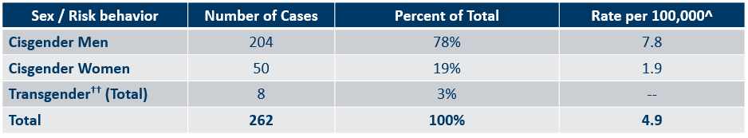
Number of Cases and Rates (per 100,000 people) of Adults and Adolescents* Diagnosed with HIV/AIDS by Gender Identity† in Minnesota, 2022
*HIV or AIDS at first diagnosis ages 13 and older.
^2010 United States Census Data used for rate calculations, except where otherwise specified.
Data: HIV Incidence Report 2022 Tables (PDF)
Notes:
Here we look at cases and rates of the 262 new HIV infections by sex assigned at birth and reported sexual behavior.
By sex assigned at birth….
The proportion of cases among cisgender men has increased over the last few years. Cisgender men represent 81% of all new HIV diagnoses.
The number of diagnoses among cisgender women has decreased to 50 in 2022 from more than 60 in 2021.
Looking further at data by risk behavior….
Men who have Sex with Men (MSM), have the highest rate of HIV diagnosis than any other sub-category. In 2022, the estimated rate of HIV diagnosis among MSM was 121.3 per 100,000 population. This is nearly 33 times higher than the rate among non-MSM cisgender men.
It’s important to note that MSM contains cases from all racial/ethnic categories and therefore, cannot be directly compared to the rates on the previous slide. For more information on how this rate was estimated, see the HIV Surveillance Technical Notes which are available on our website.

Slide 29
Age

Slide 30
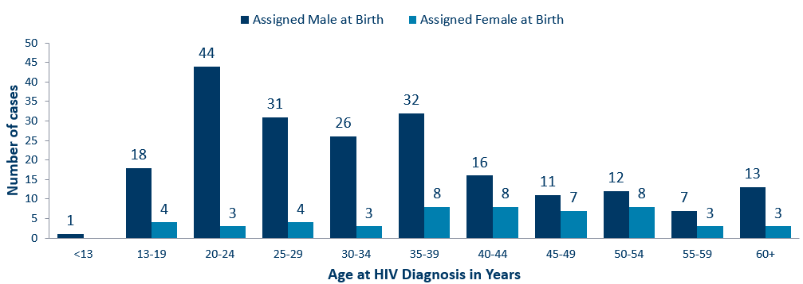
Age at HIV Diagnosis* by Sex Assigned at Birth, Minnesota, 2022
*HIV or AIDS at first diagnosis
Data: HIV Incidence Report 2022 Tables (PDF)
Notes:
In 2022, there were 105 cases diagnosed under the age of 30, accounting for 40% of all cases. 94 (90%) of these were in people assigned male sex at birth. Age groups 20-24 and 35-39 had the largest number of new cases in 2022.

Slide 31
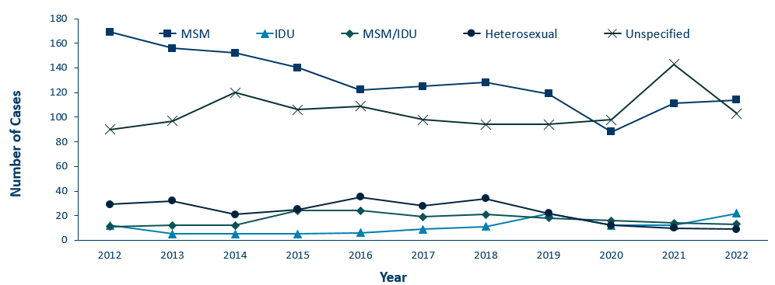
HIV Diagnoses* by Mode of Exposure and Year, 2012–2022
Category | 2009 | 2010 | 2011 | 2012 | 2013 | 2014 | 2015 | 2016 | 2017 | 2018 | 2019 | 2020 | 2021 | 2022
MSM | 211 | 177 | 154 | 169 | 156 | 152 | 140 | 122 | 125 | 128 | 119 | 88 | 111 | 114
IDU | 9 | 11 | 5 | 12 | 5 | 5 | 5 | 6 | 9 | 11 | 22 | 12 | 12 | 22
MSM/IDU | 16 | 15 | 10 | 11 | 12 | 12 | 24 | 24 | 19 | 21 | 18 | 16 | 14 | 13
Heterosexual | 43 | 43 | 32 | 29 | 32 | 21 | 25 | 35 | 28 | 34 | 22 | 12 | 10 | 9
Unspecified | 87 | 83 | 89 | 90 | 97 | 120 | 106 | 109 | 98 | 94 | 94 | 98 | 143 | 103
*HIV or AIDS at first diagnosis
MSM = Men who have sex with men IDU = Injection drug use Heterosexual = Heterosexual contact Unspecified = No mode of exposure ascertained
Notes:
This slide depicts risk for all people diagnosed with HIV in Minnesota during the past decade and since the beginning of the epidemic. In 2022, of cases where mode of transmission was reported, men having sex with men was the most common, accounting for 47% of all diagnoses and 77% of diagnoses with known modes of transmission. Mode of exposure was unknown or undisclosed in 39% of cases in 2022.
The number of cases among people who inject drugs (IDU only) was 22 cases in 2022, an increase from 2020 and 2021, which continues the trend seen since 2019 when an outbreak began among persons who inject drugs in Hennepin-Ramsey counties. Another outbreak in the Duluth region includes about half of cases that are among persons who inject drugs. More details on these outbreaks later in this slide presentation.

Slide 32
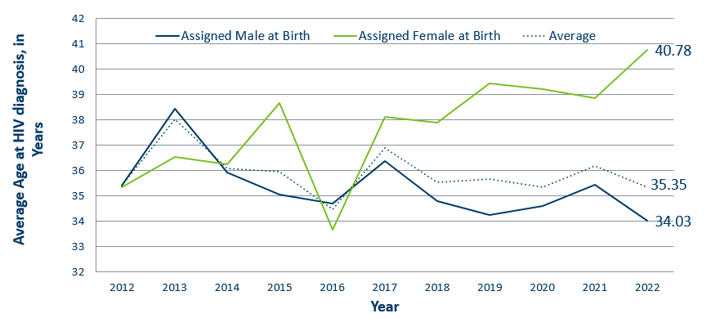
Average Age at HIV Diagnosis* by Sex Assigned at Birth, 2012–2022
Sex Assigned at Birth | 2009 | 2010 | 2011 | 2012 | 2013 | 2014 | 2015 | 2016 | 2017 | 2018 | 2019 | 2020 | 2021 | 2022
Assigned Male at Birth | 34.6936 | 34.8447 | 35.03687 | 35.42629 | 38.45455 | 35.92946 | 35.0524 | 34.70386 | 36.37019 | 34.81106 | 34.261 | 34.6145 | 35.43598 | 34.03
Assigned Female at Birth | 33.31429 | 35.79412 | 37.56757 | 35.36508 | 36.5493 | 36.25714 | 38.68493 | 33.67143 | 38.10811 | 37.89706 | 39.43421 | 39.21622 | 38.875 | 40.78
Average | - | - | - | 35.41401 | 38.033 | 36.10323 | 35.9637 | 34.46535 | 36.89753 | 35.54704 | 35.66906 | 35.35808 | 36.1745 | 35.34733
*HIV or AIDS at first diagnosis
Notes:
The average age at diagnosis in 2022 was 35.35 years. People assigned female sex at birth [In GREEN] were 6.75 years older at age of diagnosis than people assigned male at birth.

Slide 33
Mode of Exposure

Slide 34
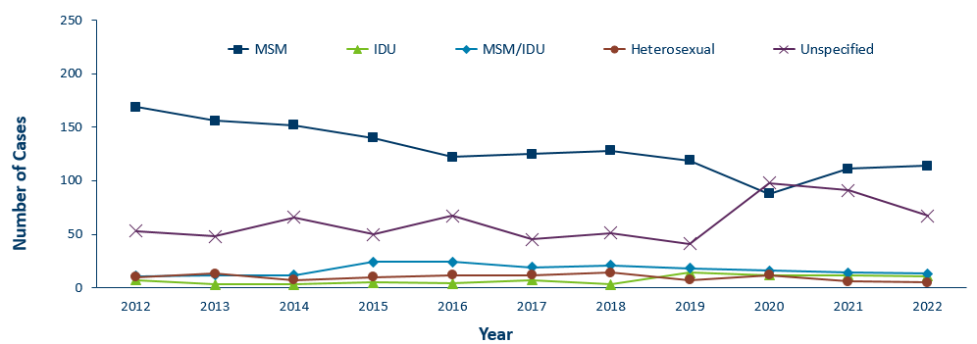
HIV Diagnoses* Among People Assigned Male Sex at Birth by Mode of Exposure and Year 2012–2022
Category | 2012 | 2013 | 2014 | 2015 | 2016 | 2017 | 2018 | 2019 | 2020 | 2021 | 2022
MSM | 169 | 156 | 152 | 140 | 122 | 125 | 128 | 119 | 88 | 111 | 114
IDU | 7 | 3 | 3 | 5 | 4 | 7 | 3 | 14 | 12 | 12 | 11
MSM/IDU | 11 | 12 | 12 | 24 | 24 | 19 | 21 | 18 | 16 | 14 | 13
Heterosexual | 10 | 13 | 7 | 10 | 12 | 12 | 14 | 7 | 12 | 6 | 5
Unspecified | 53 | 48 | 66 | 50 | 67 | 45 | 51 | 41 | 98 | 91 | 67
* HIV or AIDS at first diagnosis
MSM = Men who have sex with men IDU = Injection drug use Heterosexual = Heterosexual contact Unspecified = No mode of exposure ascertained
Notes:
By gender,
Among people assigned male sex at birth, same-sex sexual relations in male-sex with males (MSM) continues to be a leading risk, with 127 of 210 cases in 2022 (60%).
IDU are 11 of 210 cases (5%)
MSM-IDU are 13 of 210 cases (6%).
Heterosexual contact is 5 of 210 cases (2%).

Slide 35
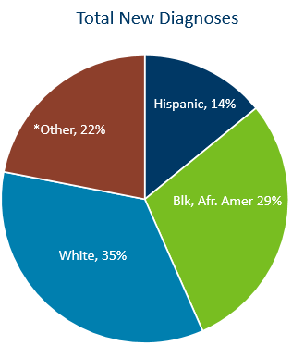
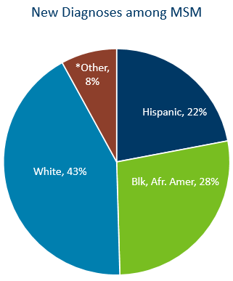
HIV Diagnoses among MSM in Minnesota by Race and Ethnicity, 2022
*Other includes Black African-born, American Indian, Asian/Pacific-Islander, multi-race, and unknown
Data (left): HIV Incidence Report 2022 Tables (PDF)
Notes:
In 2022, new diagnoses among MSM were largely made up of white (43%), Black African-American (28%), and Hispanic (22%) MSM. This is compared to total new diagnoses in Minnesota, where White people made up only 35% and other races made up 22% of all new diagnoses.
Data: New Diagnoses Among MSM
White: 43%
Black / African American: 28%
Hispanic: 22%
Other: 8%

Slide 36
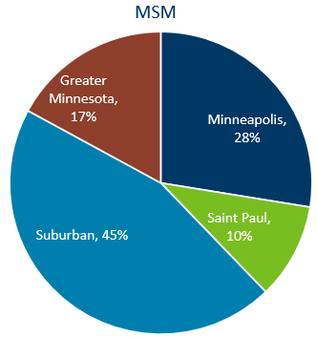
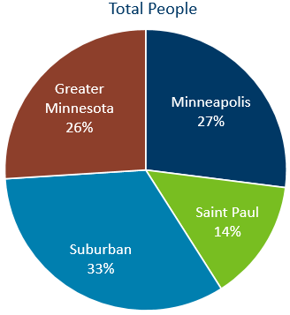
New HIV Infections of MSM in Minnesota by Current Residence, 2022
Suburban includes the 7-county metro area of Anoka, Carver, Dakota, Hennepin (except Minneapolis), Ramsey (except St. Paul), Scott, and Washington counties. Greater Minnesota includes all other counties outside of the 7-county metro area.
Data (right): HIV Incidence Report 2022 Tables (PDF)
Notes:
Of all people diagnosed with HIV in 2022, 33% reside in the suburban 7 county metro compared to 45% of MSM diagnosed. Only 10% of MSM diagnosed with HIV resided in St. Paul in 2022, compared to 14% of all people diagnosed with HIV. Only 17% of MSM diagnosed with HIV lived in Greater MN compared to 26% of all people diagnosed with HIV in 2022.
Data: MSM
Suburban: 45%
Minneapolis: 28%
Greater Minnesota: 17%
Saint Paul: 10%

Slide 37
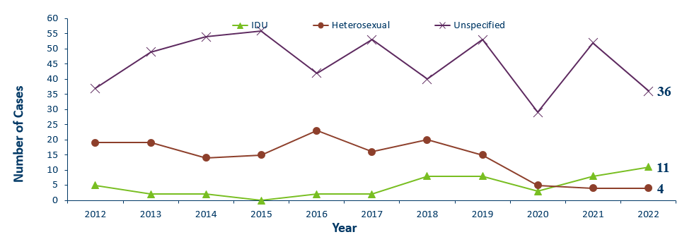
HIV Diagnoses* Among People Assigned Female Sex at Birth by Mode of Exposure and Year of Diagnosis 2012–2022
Mode of Exposure | 2012 | 2013 | 2014 | 2015 | 2016 | 2017 | 2018 | 2019 | 2020 | 2021 | 2022
IDU | 5 | 2 | 2 | 0 | 2 | 2 | 8 | 8 | 3 | 8 | 11
Heterosexual | 19 | 19 | 14 | 15 | 23 | 16 | 20 | 15 | 5 | 4 | 4
Unspecified | 37 | 49 | 54 | 56 | 42 | 53 | 40 | 53 | 29 | 52 | 36
* HIV or AIDS at first diagnosis
IDU = Injection drug use Heterosexual = Heterosexual contact Unspecified = No mode of exposure ascertained
Notes:
For people assigned female sex at birth, the most known common mode of exposure prior to 2020 was Heterosexual contact (with a person of known HIV infection), as seen in RED. In 2021, however, this changed, with IDU overtaking heterosexual contact as the most common reported mode of exposure. This trend has continued into 2022.

Slide 38
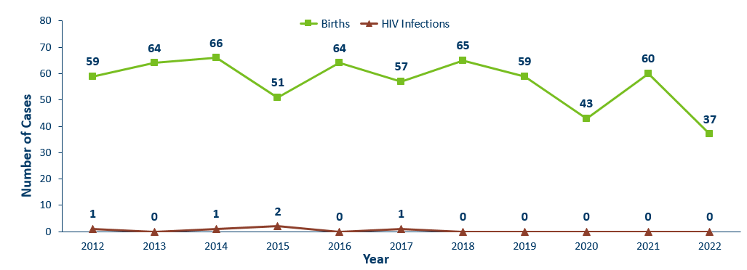
Births to Pregnant People Living with HIV and Number of Perinatal Acquired HIV Infections* by Year of Birth, 2012–2022
HIV or AIDS at first diagnosis for a child exposed to HIV during pregnant person’s pregnancy, at birth, and/or during breastfeeding.
Data: HIV Incidence Report 2022 Tables (PDF)
Notes:
The ability to interrupt the transmission of HIV from mother to child via antiretroviral therapy and appropriate perinatal care is an important accomplishment in the history of the HIV/AIDS epidemic. Without antiretroviral therapy, newborn HIV infection rates range from 25-30%, but decrease to 1-2% with appropriate medical intervention. The rate of transmission has decreased from 15% between 1994 and 1996 to 0.0% in the past three years (2020-2022). The last HIV perinatal transmission was in 2017.
For the past decade, the number of births to pregnant parents living with HIV has ranged between 37-66 births (2012-2022).
For 2022, there was a decrease to 37 births to pregnant people living with HIV with no perinatal HIV baby born to a HIV-positive pregnant person in Minnesota during the year.

Slide 39
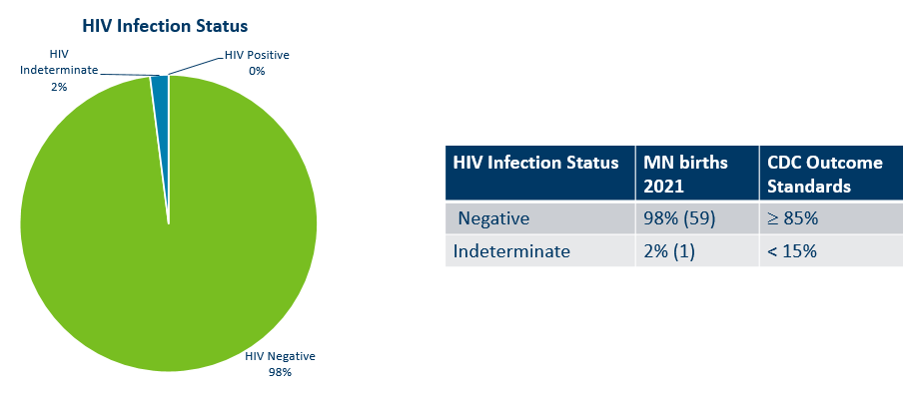
Outcome for Perinatal HIV-Exposed Infants born in 2022
Notes:
Starting in 2018, CDC HIV Surveillance required that all HIV surveillance jurisdictions conduct follow-up of perinatal HIV-exposed infants every 6 months until 18 months of age or until HIV infection status is determined.
Infants exposed to HIV at birth may or may not be infected with HIV. Because of placental transfer of HIV maternal antibodies, HIV tests at birth will be positive, regardless of the infant’s true HIV status. Therefore, perinatal exposures need to be followed up over the next 18 months until the child’s diagnostic status is known (usually with viral load lab results after one-two months of age and then every four-six months).
The pie chart above shows the HIV infection status for infants born in 2021. Data on infants born in 2021 are not available until those infants are 18 months of age.
Of the 60 perinatal HIV-exposed infants born in 2021, 98% have a HIV infection status determination of HIV negative (n=59) and none were HIV positive. Minnesota is above the CDC outcome standard of greater than or equal to 85% of HIV-exposed infants that have HIV infection status determined by 18 months of age. One of the infants had a HIV indeterminate status at 18 months of age.
Data:
HIV Infection Status
HIV Indeterminate: 2% (1 infants)
CDC Outcome Standard: More than or equal to 85%
HIV Positive: 0%
HIV Negative: 98% (59 infants)
CDC Outcome Standard: Less than 15%

Slide 40
Foreign-born Cases

Slide 41
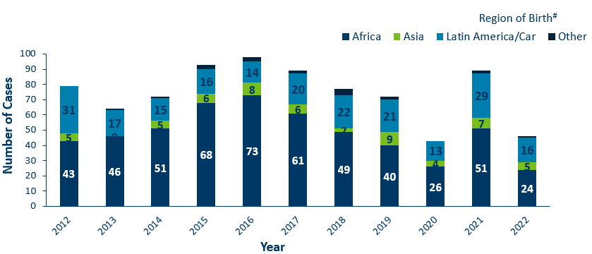
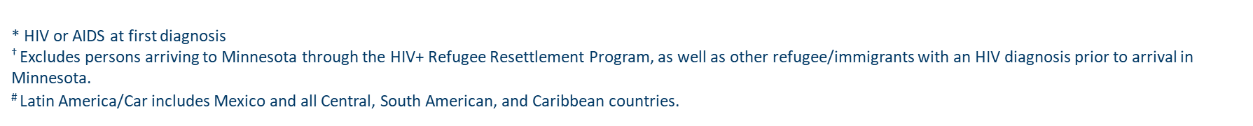
HIV Diagnoses* among Foreign-Born People† in Minnesota by Year and Region of Birth
2012–2022
Region of Birth | 2012 | 2013 | 2014 | 2015 | 2016 | 2017 | 2018 | 2019 | 2020 | 2021 | 2022
Africa | 43 | 46 | 51 | 68 | 73 | 61 | 49 | 40 | 26 | 51 | 24
Asia | 5 | 0 | 5 | 6 | 8 | 6 | 2 | 9 | 4 | 7 | 5
Latin America/Car | 31 | 17 | 15 | 16 | 14 | 20 | 22 | 21 | 13 | 29 | 16
Other | 0 | 1 | 1 | 3 | 3 | 2 | 4 | 2 | 0 | 2 | 1
Notes:
This slides describes HIV diagnoses by global region of birth among foreign-born people. In general, the number of new HIV infections diagnosed among foreign-born people in Minnesota has steadily increased from 20 cases in 1990 to an average of 82 cases over the last decade. This increase has been largely driven by the increase of cases among African-born people, as well as people from Mexico, Central and South America and the Caribbean.
In 2022, there were 46 cases of newly reported HIV among foreign-born people. This is about one in five of all new cases (18%) The majority of foreign-born cases in 2022 were from Africa, followed by Latin America and the Caribbean.

Slide 42
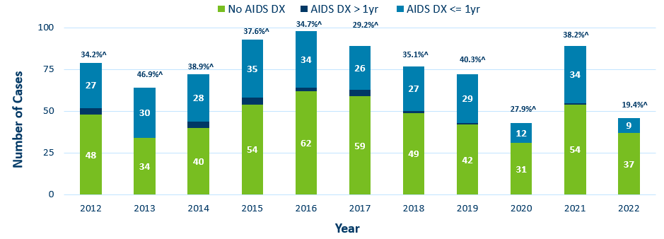
Time of Progression to AIDS for HIV Diagnoses* Among Foreign-born people
Minnesota 2012–2022 †
Diagnoses | 2012 | 2013 | 2014 | 2015 | 2016 | 2017 | 2018 | 2019 | 2020 | 2021 | 2022
No AIDS DX | 48 | 34 | 40 | 54 | 62 | 59 | 49 | 42 | 31 | 54 | 37
AIDS DX > 1yr | 4 | 0 | 4 | 4 | 2 | 4 | 1 | 1 | 0 | 1 | 0
AIDS DX <= 1yr | 27 | 30 | 28 | 35 | 34 | 26 | 27 | 29 | 12 | 34 | 9
*Numbers include AIDS at 1st report but exclude people arriving to Minnesota through the HIV+ Refugee Resettlement Program, as well as other refugee/immigrants with an HIV diagnosis prior to arrival in Minnesota.
^ Percent of cases progressing to AIDS within one year of initial diagnosis with HIV
† Numbers/Percent for cases diagnosed in 2022 only represents cases progressing to AIDS through February 2023.
Notes:
During the past decade, foreign-born cases have a higher rate of late testers compared to US-born cases. In 2021, Among 89 foreign-born cases, 34 (38%) of foreign-born cases were late testers compared to 18% of US-born cases. Over the decade, the range of foreign-born cases that were late testers ranged from 27% - 46%.
Percentage of late testers for 2022 includes only those progressing to AIDS through February 2023. Please note that cases diagnosed in 2022 may not encompass all cases diagnosed – since a full year of observation is required to capture progress to AIDS within a year (which would end later this year in December 2023).

Slide 43
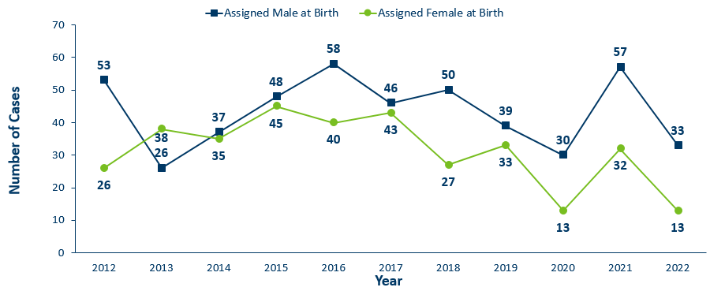
HIV Diagnoses* Among Foreign-Born people† by Sex Assigned at Birth and Year
2012–2022
Sex Assigned at Birth | 2012 | 2013 | 2014 | 2015 | 2016 | 2017 | 2018 | 2019 | 2020 | 2021 | 2022
Assigned Male at Birth | 53 | 26 | 37 | 48 | 58 | 46 | 50 | 39 | 30 | 57 | 33
Assigned Female at Birth | 26 | 38 | 35 | 45 | 40 | 43 | 27 | 33 | 13 | 32 | 13
*HIV or AIDS at first diagnosis
† Excludes people arriving in Minnesota through the HIV+ Refugee Resettlement Program, as well as other refugee/immigrants with an HIV diagnosis prior to arrival in Minnesota.
Notes:
In 2022, the number of foreign-born people assigned male sex [in DARK BLUE] at birth decreased from 57 cases in 2021 to 33 in 2022.
There was a decrease for foreign-born people assigned female sex [in GREEN] at birth from 32 in 2021 to 18 in 2022.

Slide 44
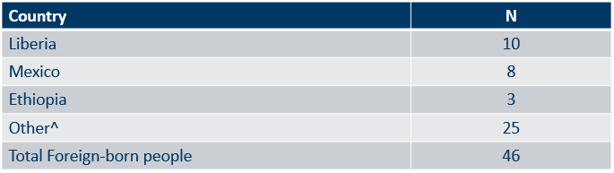
Countries of Birth Among Foreign-Born people† Diagnosed with HIV*
Minnesota, 2022
* HIV or AIDS at first diagnosis
† Excludes people arriving to Minnesota through the HIV+ Refugee Resettlement Program, as well as other refugee/immigrants with an HIV diagnosis prior to arrival in Minnesota.
^ Includes 20 additional countries with less than 3 cases.
Notes:
Two countries (Liberia and Mexico) accounted for 39 percent of new infections among foreign-born people, however there are 23 countries represented among the 46 new foreign-born cases in 2022.
Data
Liberia: 10
Mexico: 8
Ethiopia: 3
Other: 25
Total Foreign-born people: 46

Slide 45
Late-Testers
(AIDS Diagnosis within one year of initial HIV Diagnosis)
Notes:
Late testers are defined as anyone with an AIDS diagnosis within one year of their initial HIV diagnosis. This is an important trend to watch as people who progress to AIDS within one year of their HIV diagnosis represent persons who are likely diagnosed well after their initial infection and represent missed testing opportunities earlier in the course of their infection.
[This statistic helps MDH monitor whether new HIV infections are detected early, before AIDS diagnosis. People diagnosed early with HIV can start treatment that can reduce their viral load to undetectable levels… and ultimately… reduce community transmission risk. Known as U=U or undetectable equals un-transmittable, the science is clear: when people have undetectable viral loads, they can't pass HIV through sex to their partners.] To include this language for Webinar?

Slide 46
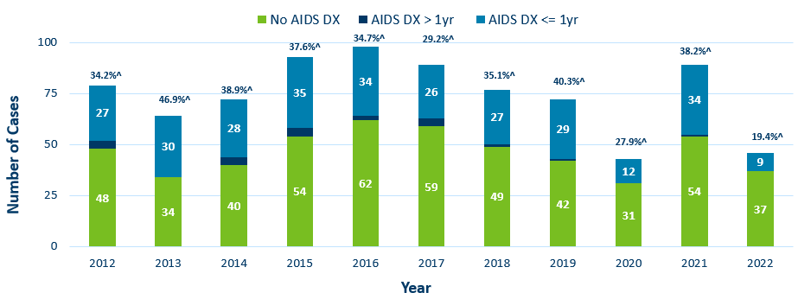
Time of Progression to AIDS for HIV Diagnoses* Among Foreign-born people
Minnesota 2012–2022 †
Diagnoses | 2012 | 2013 | 2014 | 2015 | 2016 | 2017 | 2018 | 2019 | 2020 | 2021 | 2022
No AIDS DX | 48 | 34 | 40 | 54 | 62 | 59 | 49 | 42 | 31 | 54 | 37
AIDS DX > 1yr | 4 | 0 | 4 | 4 | 2 | 4 | 1 | 1 | 0 | 1 | 0
AIDS DX <= 1yr | 27 | 30 | 28 | 35 | 34 | 26 | 27 | 29 | 12 | 34 | 9
*Numbers include AIDS at 1st report but exclude people arriving to Minnesota through the HIV+ Refugee Resettlement Program, as well as other refugee/immigrants with an HIV diagnosis prior to arrival in Minnesota.
^ Percent of cases progressing to AIDS within one year of initial diagnosis with HIV
† Numbers/Percent for cases diagnosed in 2022 only represents cases progressing to AIDS through February 2023.
Notes:
During the past decade, foreign-born cases have a higher rate of late testers compared to US-born cases. In 2021, Among 89 foreign-born cases, 34 (38%) of foreign-born cases were late testers compared to 18% of US-born cases. Over the decade, the range of foreign-born cases that were late testers ranged from 27% - 46%.
Percentage of late testers for 2022 includes only those progressing to AIDS through February 2023. Please note that cases diagnosed in 2022 may not encompass all cases diagnosed – since a full year of observation is required to capture progress to AIDS within a year (which would end later this year in December 2023).

Slide 47
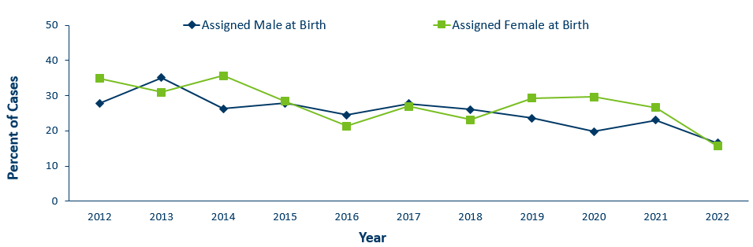
Progression to AIDS within 1 year of initial HIV Diagnosis* by Sex Assigned at Birth 2012–2022†
Sex Assigned at Birth | 2012 | 2013 | 2014 | 2015 | 2016 | 2017 | 2018 | 2019 | 2020 | 2021 | 2022
Assigned Male at Birth | 27.9 | 35.1 | 26.3 | 27.9 | 24.5 | 27.7 | 26.1 | 23.6 | 19.8 | 23.1 | 16.6
Assigned Female at Birth | 34.9 | 31 | 35.7 | 28.4 | 21.4 | 27 | 23.2 | 29.3 | 29.7 | 26.6 | 15.7
*Numbers include AIDS at 1st report but exclude people arriving to Minnesota through the HIV+ Refugee Resettlement Program, as well as other refugee/immigrants with an HIV diagnosis prior to arrival in Minnesota.
† Numbers/Percent for cases diagnosed in 2022 only represents cases progressing to AIDS through February 2023
Notes:
The proportion of late testers can vary by sex assigned at birth from year to year. Over the past decade among people assigned male sex at birth the proportion of late testers ranged from 20%- 35%. Among people assigned female sex at birth the proportion of late testers ranged from 20%-36%.
Percentage of late testers for 2022 includes only those progressing to AIDS through February 2023. Please note that cases diagnosed in 2022 may not encompass all cases diagnosed – since a full year of observation is required to capture progress to AIDS within a year (which would end later this year in December 2023).

Slide 48
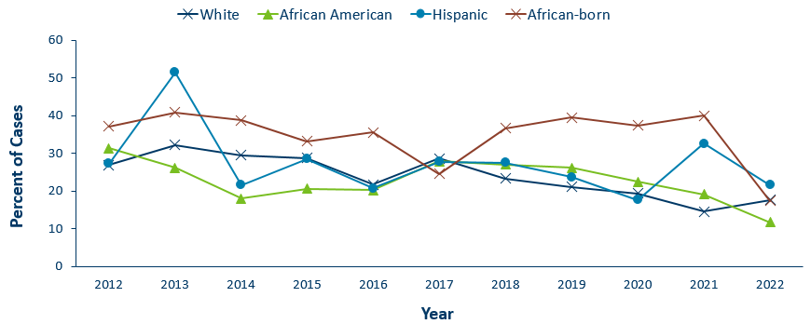
Progression to AIDS within 1 year of initial HIV Diagnoses* by Race/Ethnicity^ 2012–2022†
Race/Ethnicity | 2012 | 2013 | 2014 | 2015 | 2016 | 2017 | 2018 | 2019 | 2020 | 2021 | 2022
White | 26.9 | 32.2 | 29.5 | 28.8 | 21.8 | 28.7 | 23.4 | 21.1 | 19.4 | 14.6 | 17.6
African American | 31.4 | 26.2 | 18 | 20.6 | 20.3 | 27.9 | 27.1 | 26.2 | 22.5 | 19.2 | 11.7
Hispanic | 27.3 | 51.6 | 21.6 | 28.6 | 20.7 | 27.8 | 27.5 | 23.7 | 17.7 | 32.6 | 21.6
African-born | 37.2 | 40.9 | 38.8 | 33.3 | 35.6 | 24.6 | 36.7 | 39.5 | 37.5 | 40 | 17.4
*Numbers include AIDS at 1st report but exclude people arriving to Minnesota through the HIV+ Refugee Resettlement Program, as well as other refugee/immigrants with an HIV diagnosis prior to arrival in Minnesota.
† Numbers/Percent for cases diagnosed in 2022 only represents cases progressing to AIDS through February 2023.
^Percentage not calculated if less than 10 cases diagnosed per year
Notes:
As with other characteristics of the HIV epidemic in Minnesota, the proportion of late testers varies by demographic characteristics. Differences occur by race/ethnicity. Over the past three years of full data on late testers (2019-2021), African-born black persons have had the highest proportion of late testers ranging between 37-40%. For 2021, The proportions of late testers by race and Hispanic ethnicity include white, non-Hispanic (15%), black, African American, non-Hispanic (19%), African-born, black (40%), and Hispanic, any race (33%). Similar data for non-Hispanic American Indian and Asian/Pacific Islander persons in a single year had fewer than 10 cases and are considered not stable and are therefore not represented here.
Percentage of late testers for 2022 includes only those progressing to AIDS through February 2023. Please note that cases diagnosed in 2022 may not encompass all cases diagnosed – since a full year of observation is required to capture progress to AIDS within a year (which would end later this year in December 2023).

Slide 49
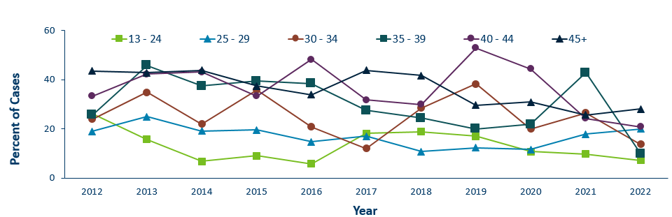
Progression to AIDS within 1 year of initial HIV Diagnosis* by Age
2012–2022†
Age | 2012 | 2013 | 2014 | 2015 | 2016 | 2017 | 2018 | 2019 | 2020 | 2021 | 2022
13 - 24 | 26.32 | 15.7 | 6.9 | 9.1 | 5.8 | 18.18 | 18.9 | 17 | 10.8 | 9.8 | 7.3
25 - 29 | 19 | 25 | 19.2 | 19.61 | 14.81 | 16.98 | 10.8 | 12.3 | 11.6 | 17.9 | 20
30 - 34 | 24 | 34.9 | 22 | 35.9 | 20.9 | 12.12 | 28.5 | 38.3 | 20 | 26.5 | 13.8
35 - 39 | 25.71 | 45.8 | 37.5 | 39.5 | 38.4 | 27.59 | 24.4 | 20 | 21.9 | 42.9 | 10
40 - 44 | 33.33 | 42.31 | 43.2 | 33.33 | 48.3 | 31.8 | 30 | 52.9 | 44.4 | 24.3 | 20.8
45+ | 43.59 | 42.9 | 43.8 | 37.5 | 33.9 | 43.8 | 41.7 | 29.7 | 30.9 | 25.7 | 28.1
*Numbers include AIDS at 1st report but exclude people arriving to Minnesota through the HIV+ Refugee Resettlement Program, as well as other refugee/immigrants with an HIV diagnosis prior to arrival in Minnesota.
† Numbers/Percent for cases diagnosed in 2022 only represents cases progressing to AIDS through February 2023.
^Percentage not calculated if less than 10 cases diagnosed per year
Notes:
Differences by age are as expected with the percentage of late testers increasing with age at time of diagnosis. In 2021, all age groups experienced notable decreases in proportion of late testers. In 2021, younger age groups had lower percentage of late testers, 13-24 and 25-29 age groups between 10-18%. Older age groups had higher percentage of late testers, between 24-43% with age group 35-39 (43% with the higest.
Percentage of late testers for 2022 includes only those progressing to AIDS through February 2023. Please note that cases diagnosed in 2022 may not encompass all cases diagnosed – since a full year of observation is required to capture progress to AIDS within a year (which would end later this year in December 2023). Caution should be used due to smaller numbers by age group when interrupting the data.

Slide 50
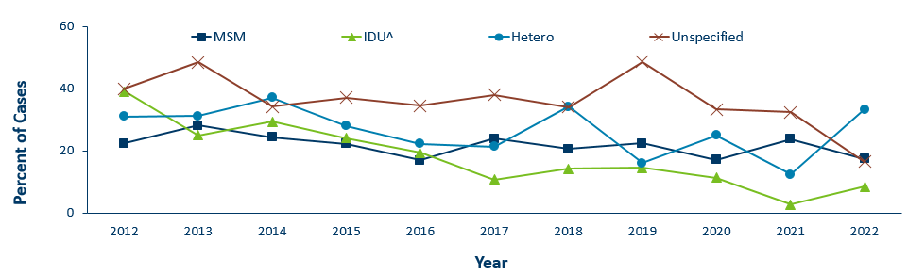
Progression to AIDS within 1 year of initial HIV Diagnosis* by Mode of Transmission 2012–2022†
Mode of Transmission | 2012 | 2013 | 2014 | 2015 | 2016 | 2017 | 2018 | 2019 | 2020 | 2021 | 2022
MSM | 22.49 | 28.21 | 24.34 | 22.3 | 16.9 | 24 | 20.6 | 22.4 | 17.2 | 23.8 | 17.5
IDU^ | 39.1 | 25 | 29.41 | 24.14 | 19.35 | 10.71 | 14.2 | 14.6 | 11.4 | 2.7 | 8.5
Hetero | 31 | 31.2 | 37.1 | 28 | 22.22 | 21.4 | 34.3 | 16 | 25 | 12.5 | 33.3
Unspecified | 40 | 48.4 | 34.2 | 37.1 | 34.6 | 38 | 34.1 | 48.6 | 33.3 | 32.4 | 16.5
*Numbers include AIDS at 1st report but exclude people arriving to Minnesota through the HIV+ Refugee Resettlement Program, as well as other refugee/immigrants with an HIV diagnosis prior to arrival in Minnesota.
† Numbers/Percent for cases diagnosed in 2022 only represents cases progressing to AIDS through February 2023.
^Includes MSM/IDU
Notes:
In 2021, people with a risk category of unspecified risk had the highest proportion of late testers at 32%, followed by MSM at 24%, heterosexual contact at 12%, and finally IDU at 3%.
Percentage of late testers for 2022 includes only those progressing to AIDS through February 2023. Please note that cases diagnosed in 2022 may not encompass all cases diagnosed – since a full year of observation is required to capture progress to AIDS within a year (which would end later this year in December 2023).

Slide 51
Adolescents & Young Adults (Ages 13-24)*

Slide 52
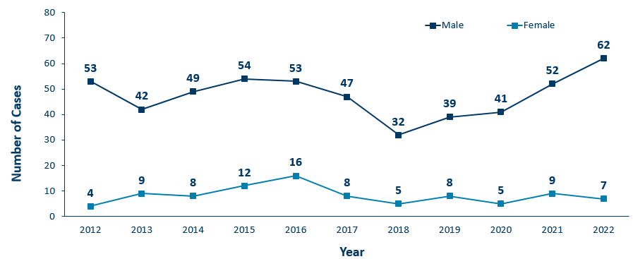
HIV Diagnoses* Among Adolescents and Young Adults† by Sex Assigned at Birth and Year 2012–2022
Sex Assigned at Birth | 2012 | 2013 | 2014 | 2015 | 2016 | 2017 | 2018 | 2019 | 2020 | 2021 | 2022
Male | 53 | 42 | 49 | 54 | 53 | 47 | 32 | 39 | 41 | 52 | 62
Female | 4 | 9 | 8 | 12 | 16 | 8 | 5 | 8 | 5 | 9 | 7
* HIV or AIDS at first diagnosis
† Adolescents defined as 13-19 year-olds; Young Adults defined as 20-24 year-olds.
Notes:
The number of new HIV diagnoses among people assigned male sex at birth aged 13-24 has ranged from 32-62 cases over the past decade. Since the low in 2018, we’ve seen an increase of new diagnoses among males in this age group where there are 62 cases reported in 2022.
In 2022, among adolescent and young adults assigned female sex at birth, there were 7 cases.
In 2022, the total number of cases among adolescents and young adults were higher from the previous year with 69 cases in 2022 compared to 61 cases in 2021.

Slide 53
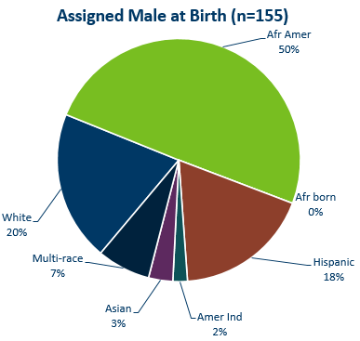
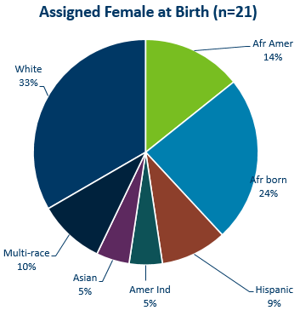
HIV Diagnoses* Among Adolescents and Young Adults† by Sex Assigned at Birth and Race/Ethnicity, 2020–2022 Combined
* HIV or AIDS at first diagnosis (n = Number of people)
Amer Ind = American Indian , Afr Amer = African American (Black, not African-born people) , and Afr born = African-born (Black, African-born people)
Notes:
Looking at racial distribution among adolescents/young adults by sex assigned at birth combining the most recent three years of data.
Between the years 2020 and 2022 we had 155 cases assigned male sex at birth [LEFT Graph] reported among adolescents and young adults, and 21 females reported in the 13-24 age group. For people assigned male sex at birth, Non-Hispanic African-American [GREEN] accounted for half of the cases, Non-Hispanic White [DARK BLUE] and Hispanic of any race [BROWN] young adults accounted for about 1 in 5 cases each in the 13-24 age group.
Among people with female sex assigned at birth [RIGHT], Non-Hispanic White [DARK BLUE] accounted for about one-third and black African-born [LIGHT BLUE] accounted for about one quarter of the cases in the 13-24 age group. Non-Hispanic African-Americans [GREEN] accounted for about 1 in 7 cases and Non-Hispanic Multi-race accounted for 1 in 10 of the cases.
Data:
Assigned Male at Birth (N=155)
African American: 50%
White: 20%
Multi-race: 7%
Asian: 3%
American Indian: 25%
Hispanic: 18%
African born: 0%
Assigned Female at Birth (N=21)
African American: 14%
White: 33%
Multi-race: 10%
Asian: 5%
American Indian: 5%
Hispanic: 9%
African Born: 24%

Slide 54
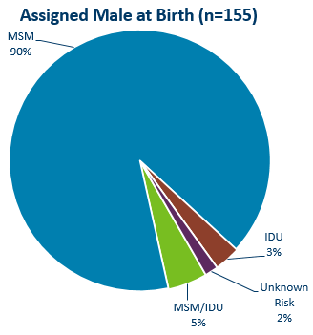
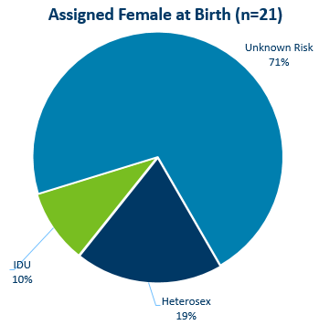
HIV Diagnoses* Among Adolescents and Young Adults† by Sex at Birth and Exposure Group 2020–2022 Combined
† Adolescents defined as 13-19 year-olds; Young Adults defined as 20-24 year-olds.
MSM = Men who have sex with men IDU = Injection drug use Heterosex = Heterosexual contact
n = Number of people
HIV or AIDS at first diagnosis
Notes:
For mode of exposure among people assigned male sex at birth in the 13-24 age group [LEFT] , Male to Male sex was found to account for 90% of the cases, while the combined risk of MSM and IDU was estimated to account for 5% of the cases and 3% was attributed to injection drug use mode of transmission.
Among adolescent people assigned female sex at birth [RIGHT], Most women HIV risk is unknown (71%) [LIGHT BLUE], while 19% of cases were found to have heterosexual contact as their mode of exposure [DARK BLUE], and 10% attributed to injection drug use [LIGHT GREEN].
Data:
Assigned Male at Birth (n=155)
MSM: 90%
IDU: 3%
MSM/IDU: 5%
Unknown Risk: 2%
Assigned Female at Birth (n=21)
Unknown Risk: 71%
Heterosex: 19%
IDU: 10%

Slide 55
Additional Topics

Slide 56
HIV Outbreak in Hennepin/Ramsey Counties
Hennepin/Ramsey Counties HIV Outbreak
In February 2020, MDH Health Alert Network declared an outbreak among persons who inject drugs (PWID)
Current Case Count: 168 cases
Inclusion Criteria:
73 encampment-related
95 MSM/IDU & IDU non-encampment
People at high-risk in the current outbreak:
People who use injection drugs (PWID) or share needles/works
People experiencing homelessness or unstable housing
People who exchange sex for income or other items they need
Notes:
Minnesota has seen an increase of HIV among certain populations in Hennepin and Ramsey Counties. An outbreak was declared in Hennepin and Ramsey counties among people who inject drugs (PWID) in 2020 with cases dating back to December 2018.
Minnesota's outbreak-associated cases have risk factors consistent with the national outbreaks.
People at high risk in the current outbreaks include:
People who use injection drugs or share needles/works.
People experiencing homelessness or unstable housing.
People who exchange sex for income and other items they need.
For more information, please see our updated HIV statistics website, described at the end of the presentation.

Slide 57
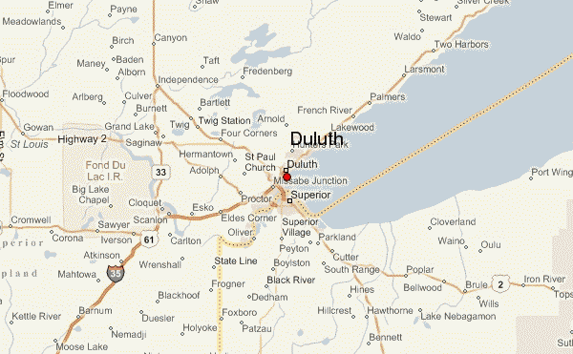
HIV Outbreak in Duluth Region
People at high-risk in the current outbreak:
  People who use injection drugs (PWID) or share needles/works
  People experiencing homelessness or unstable housing
  People who exchange sex for income or other items they need
  Men who have sex with men
Duluth Region HIV Outbreak
In March 2021, MDH Health Alert Network declared an outbreak in the Duluth Region (30-mile area) among newly diagnosed HIV cases
Current Case Count: 35 cases
Notes:
Minnesota has seen an increase of HIV in the Duluth area (30-mile radius). Minnesota declared an outbreak in 2021 in the Duluth area with cases dating back to 2019. The Duluth area outbreak includes all newly diagnosed HIV cases and linked cases within the region. Typically, there are 1-5 cases of HIV per year in St. Louis County, beginning in the fall of 2019 there was a significant increase of newly diagnosed HIV cases in the area.
People at high risk in the current outbreaks include:
People who use injection drugs or share needles/works.
People experiencing homelessness or unstable housing.
People who exchange sex for income and other items they need.
Men who have sex with men.
For more information, please see our updated HIV statistics website, described at the end of the presentation.

Slide 58
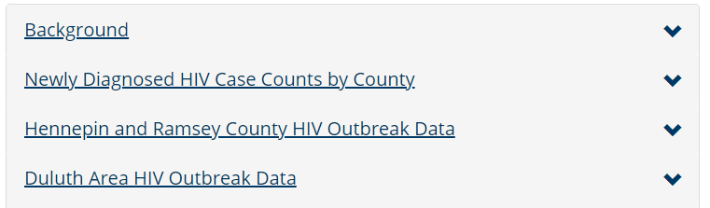
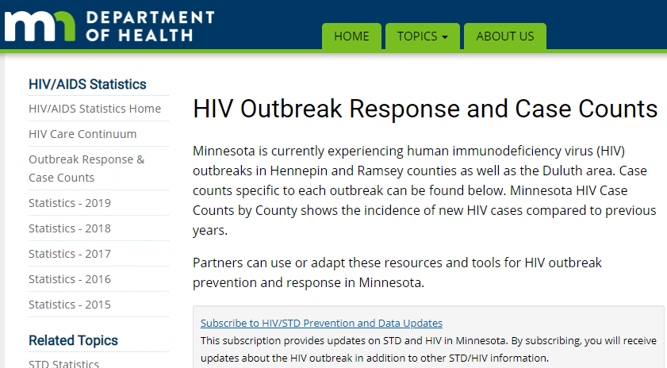
Updated webpage: Outbreak Data e-Resources
HIV Outbreak Response and Case Counts
https://www.health.state.mn.us/diseases /hiv/stats/hiv.html
Subscribe to receive our HIV/STD prevention and data e-mail updates.
Notes:
In addition to newly diagnosed HIV case counts by county, we recently updated our statistics web page to include information on outbreak data.
Please visit the Minnesota Department of Health HIV pages at www.health.state.mn for additional details.
While you’re here, you can subscribe to our listserv to receive HIV/STD prevention updates to your email.

Slide 59

Molecular Tools for Outbreak Monitoring
To address data privacy concerns:
Molecular data is from the HIV virus, and is not a person’s genetic material
Cannot infer causal directionality of infection
HIV virus sequences securely housed at the health department
Notes:
In addition to monitoring the number of cases reported in certain populations, molecular data can also be used to supplement existing outbreak investigation methods. We have been doing this with our current outbreaks. This approach compares HIV virus data collected from routine, patient-care laboratory tests.
As illustrated in the slide, imagine that each dot represents a person with diagnosed HIV infection, and their HIV virus molecular data. [in GREEN], as new people with HIV are reported in Minnesota state, we compare them to existing outbreak cases [in BLUE] using scientifically-established methods and computer software. When new HIV sequences closely match within our threshold, we prioritize those people for interview and linkage to care and treatment.
We can then examine the shared characteristics of matching data, which represent a social network, to more effectively target our outreach efforts moving forward.
At MDH, we understand that this intervention may be concerning for some community members. We want to address potential concerns about data privacy. First, this small portion of molecular data are from the HIV virus only, and are not a person’s molecular information. Further, one cannot infer causal directionality of infection. However, we continue to take the utmost care in their collection, and HIV virus molecular data are securely-housed at the health department.
For more information, please see the link on our website for a more in-depth presentation about this topic.

Slide 60
Thank you.
HIV Surveillance Team
Health.HIV.Surveillance@state.mn.us
1-800-318-8137

