Slide 1
Mosquitoes and Mosquitoborne Diseases of Minnesota
Vectorborne Diseases Unit
Last Updated May 2023
Notes:
Welcome! We are pleased to present you with information about mosquitoes and the diseases spread by mosquitoes in Minnesota.
This slide presentation and script are part of the ongoing public education efforts of the Minnesota Department of Health’s Vectorborne Diseases Unit.
The photos used in this presentation are property of the Centers for Disease Control and Prevention’s (CDC) public image library or property of the Minnesota Department of Health (MDH). Explicit permission was granted and credited for use of images not property of CDC or MDH.

Slide 2
What is a mosquitoborne disease and why should you care about it?
People can get a mosquitoborne disease when they are bitten by a mosquito that is infected with a disease agent
Mosquitoborne diseases are a large threat to human health around the world and right here in Minnesota
Personal protection methods can help keep you and your family safe from mosquito bites and the diseases they carry
Notes:
The purpose of this slide show is to educate people who live, work, and travel to Minnesota about the importance of being aware of mosquitoes and mosquitoborne diseases. A mosquitoborne disease is an illness that people or animals can get when they are bitten by a mosquito that is infected with a disease agent, like a virus. Mosquitoborne diseases are a large threat to human health around the world, including right here in Minnesota. In the following slides, we will help you and your family stay safe from mosquito bites and the diseases they carry while you enjoy the great outdoors.

Slide 3
Goals of Presentation
Understand how mosquitoes live
Be aware of the diseases spread by mosquitoes in Minnesota
Recognize basic signs and symptoms
Seek early diagnosis and treatment
Know when and where mosquitoborne disease risk is highest
Practice mosquito bite prevention methods
Know who to contact for more information
Notes:
By the end of this presentation, you will:
Understand how mosquitoes live,
Be aware of diseases spread by mosquitoes in Minnesota,
Recognize basic signs and symptoms,
Seek early diagnosis and treatment,
Know when and where mosquitoborne disease risk is highest,
Practice mosquito bite prevention methods, and
Know who to contact for more information.

Slide 4
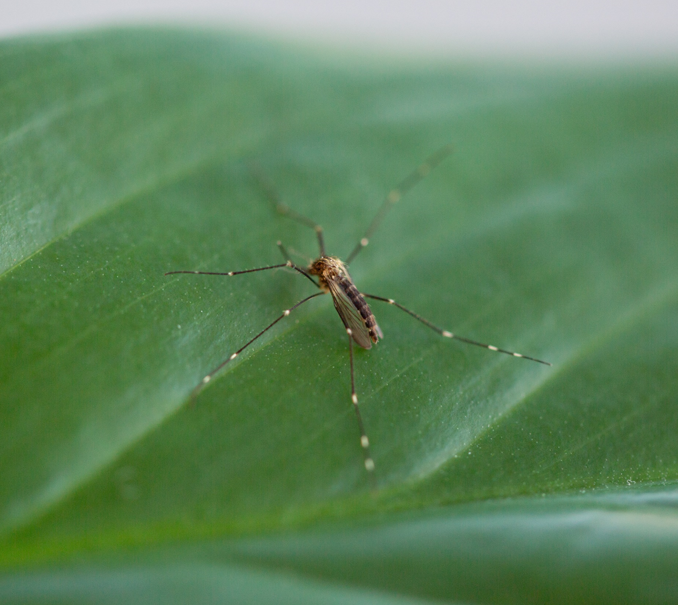
Mosquitoes in Minnesota
MN is home to about 51 species of mosquitoes
Approximately half will feed on people
Only a few of these species are able to spread disease
Notes:
To fully understand your risk of getting sick with a mosquitoborne disease, it’s important to understand how mosquitoes live and spread disease to us. Did you know Minnesota is home to about 51 species of mosquitoes? Fortunately, only about half of them will feed on people. Many types of mosquitoes in Minnesota prefer to feed on birds and other animals instead of people. Of those species that feed on us, many are considered just pests and only a few can actually spread disease.

Slide 5
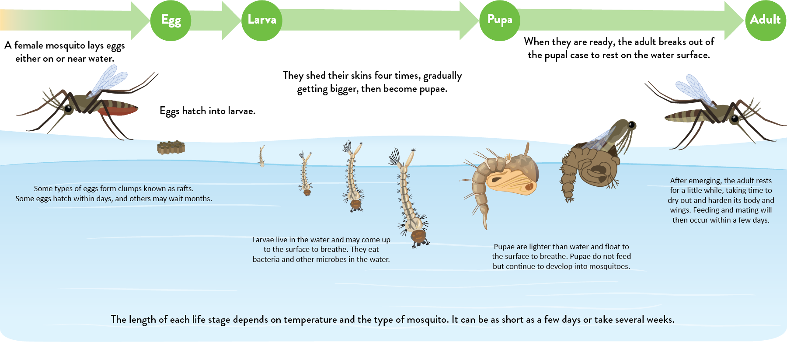
Mosquito Life Cycle
Notes:
Water is a key part of the mosquito life cycle. Here you can see the four stages of the life cycle and the importance of water. As we’ll discuss later on, some types of mosquitoes prefer to lay their eggs in larger water sources such as ditches and flooded fields. Other mosquitoes prefer to lay their eggs in small, manmade containers or naturally occurring tree holes.

Slide 6
What are the symptoms of a mosquitoborne disease?
Most people have no symptoms at all
For people who do become sick, mosquitoborne diseases have similar symptoms
Symptoms usually show up within 1-2 weeks of being bitten by an infected mosquito
Watch for symptoms like:
Fever
Headache
Stiff neck
Rash
Disorientation
Seizures
Notes:
Many mosquitoborne diseases cause similar symptoms, though most people who become infected have no symptoms at all. Symptoms usually show up within a few days or up to two weeks after being bitten by an infected mosquito.
Watch for symptoms like:
Fever
Headache
Stiff neck
Rash
Disorientation
Seizures

Slide 7
How are mosquitoborne diseases diagnosed?
If you think that you may have a mosquitoborne disease, contact your health care provider as soon as possible
Your health care provider can determine if you have a mosquitoborne disease based on your:
History of being around mosquitoes or mosquito habitat
Physical examination
Laboratory tests
Notes:
If you think that you could have a mosquitoborne disease, you should contact your health care provider as soon as possible. Your health care provider can determine if you have a mosquitoborne disease based on your history of spending time outside, a physical exam, and blood tests.

Slide 8
Are mosquitoborne diseases treatable?
Not exactly
Most illnesses go away on their own
Viruses are not treated with antibiotics so treatment involves supportive care
Some patients with more serious symptoms may require hospitalization
Notes:
Unfortunately, mosquitoborne diseases that are spread here in Minnesota are all caused by viruses so no specific treatments are available. Instead, symptoms are treated with supportive care only. People with mild illness typically recover on their own. Those with serious symptoms, like those affecting the brain, may require hospitalization and care under medical providers. Long-term nerve damage and death may occur in those with severe illness.

Slide 9
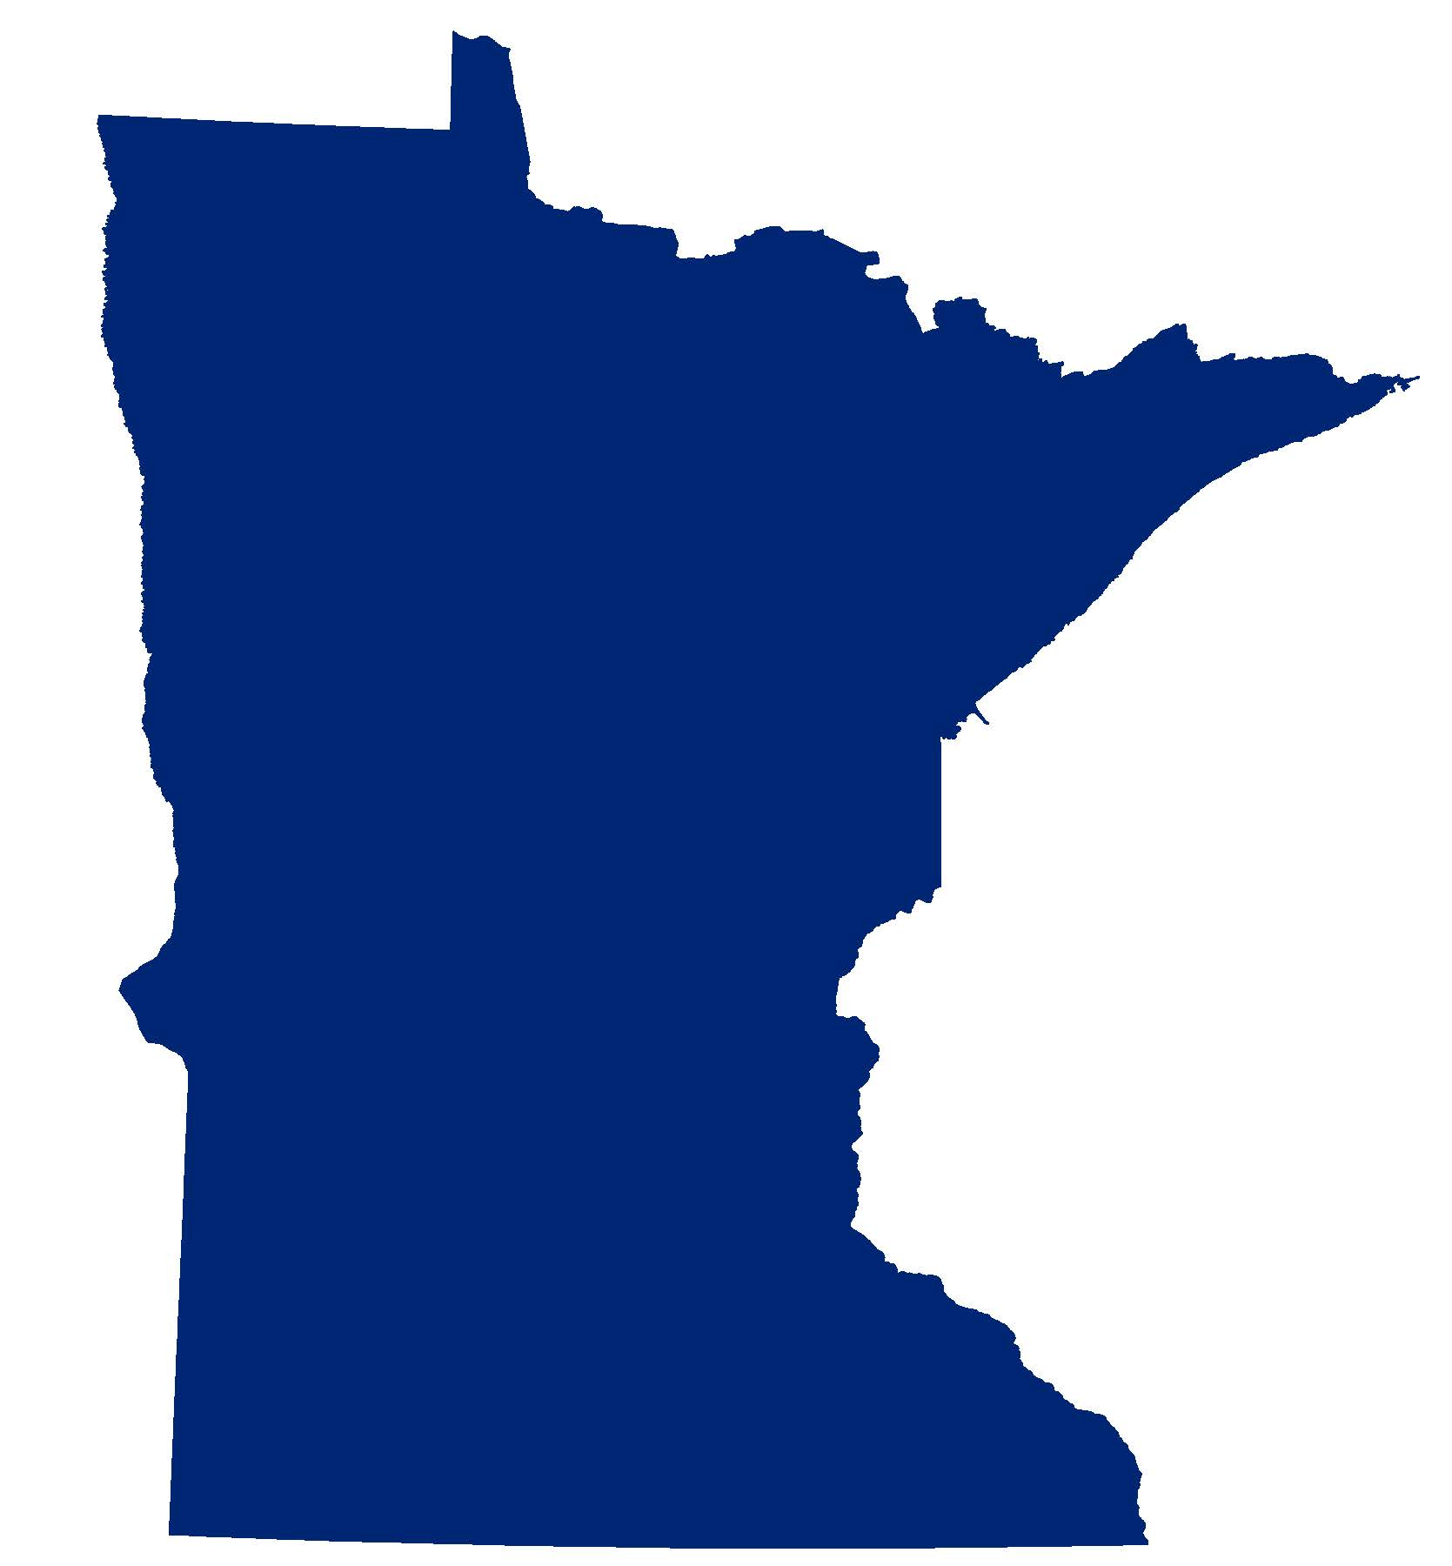
Top 3 Mosquitoborne Diseases in Minnesota
West Nile Virus Disease
La Crosse Encephalitis
Jamestown Canyon Virus Disease
Notes:
Now that you have learned about mosquitoes and how they spread diseases, let’s cover the most common diseases spread by mosquitoes in Minnesota. Here in our state, the three most commonly reported mosquitoborne diseases include West Nile virus disease, La Crosse encephalitis, and Jamestown Canyon virus disease.

Slide 10
Notes:
The number of reported cases is highly variable from year to year as mosquitoes are influenced by weather factors such as rain and temperature.
One note to add when looking at this chart is that while the number of cases reported per year may appear small, these cases typically involve serious illnesses from patients who sought medical treatment and diagnosis. Mild cases of illness from people who have no symptoms or just a mild illness to seek typically do not see a medical provider in order to get diagnosed and reported to us. Thus, many more cases of mosquitoborne disease occur in Minnesota but are not reflected in this graph.

Slide 11
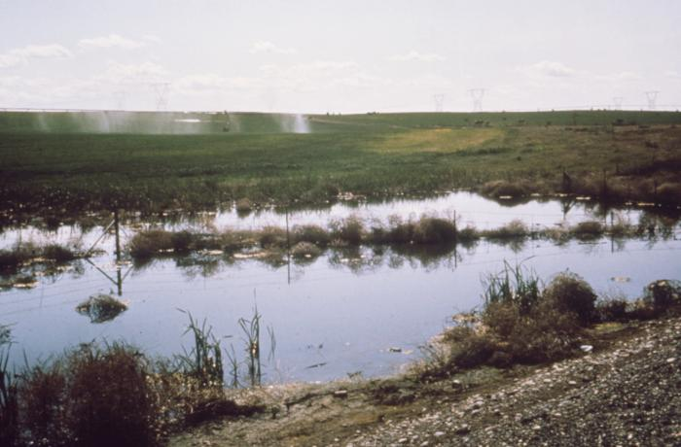
West Nile Virus Disease
First case identified in Minnesota in 2002
Culex tarsalis is the main mosquito of concern
Its habitat includes open agricultural land and prairie
Disease is most severe in elderly patients or those with weakened immune systems
Most cases occur later in the summer
Notes:
West Nile virus disease is the most commonly reported mosquitoborne disease in Minnesota. This virus was first found in the United States in 1999 in New York and Minnesota’s first case was identified in 2002. Since then, the disease has become established and human cases have occurred every year.
The main mosquito species of concern for this disease in Minnesota is Culex tarsalis. This mosquito is abundant west of the Mississippi River as it’s preferred habitat is open areas, such as farmland and prairie. This mosquito uses large, stagnant water sources to breed and will lay its eggs in drainage ditches and flooded fields. Adult mosquitoes can fly long distances and will seek shelter during the day in wooded or shady areas. People may come into contact with the mosquitoes as the mosquitoes rest in shelter belts of planted trees and bushes close to homes,. These mosquitoes primarily feed at dusk and dawn.
Persons of any age may become sick with West Nile virus; however, more severe disease is often found in older patients or those with weakened immune systems. Most cases occur later in the summer (July, August, and September) when infected mosquitoes are at their highest level.

Slide 12
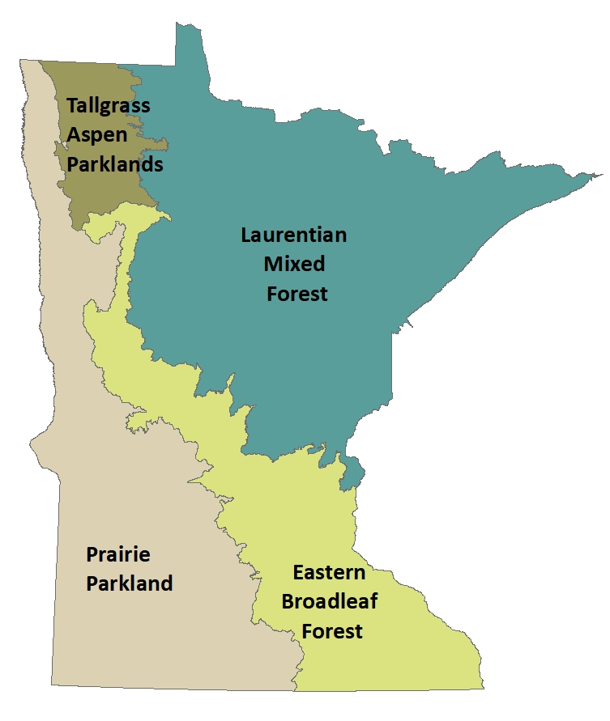
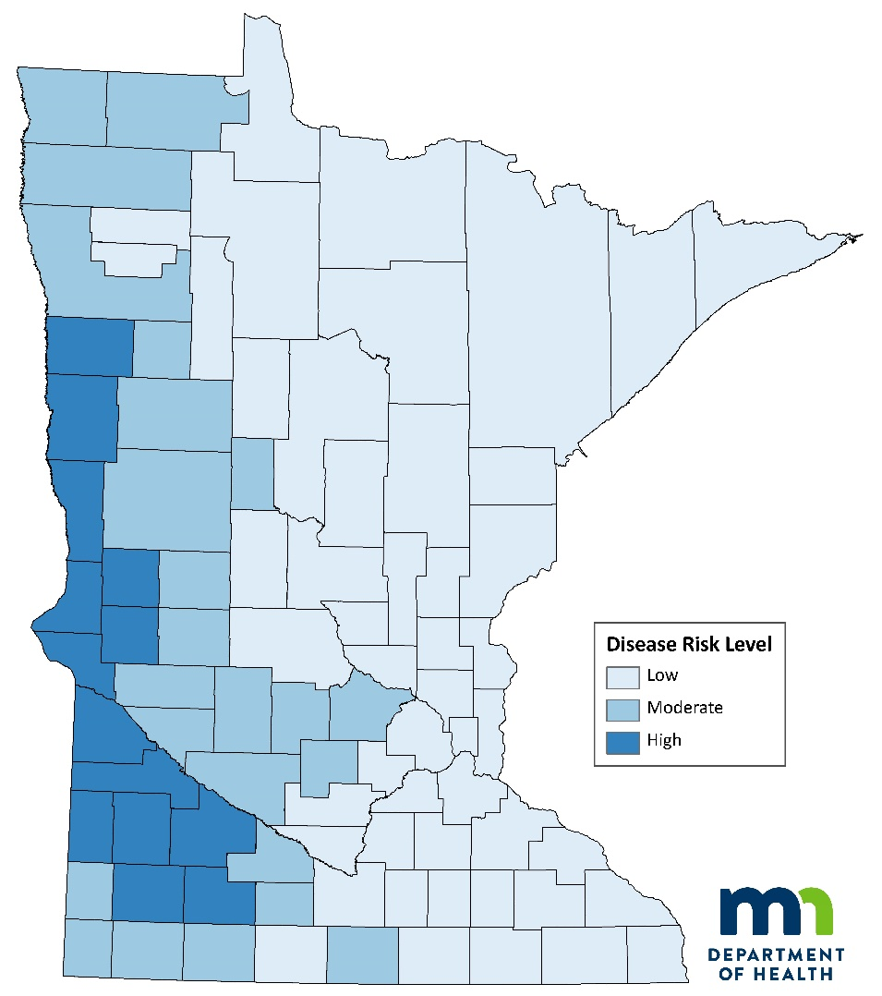
West Nile Virus Disease Risk in Minnesota
Source: Ecological Sections of Minnesota,
Minnesota Department of Natural Resources (DNR)
Notes:
In Minnesota, West Nile virus disease risk is highest in the central and western parts of the state, where agricultural land and prairie habitat are most abundant, as seen in the image on the left of the natural biomes of the state. This region of the state supplies the preferred habitat for Culex tarsalis and is where cases are most commonly reported.
Footnote: The map on the right shows the average incidence of West Nile virus disease cases (cases per 100,000 population) reported to the Minnesota Department of Health from 2002 through 2021 by the patient’s county of residence. The lightest blue color is the lowest risk level and encompasses the eastern half of Minnesota. The darkest blue is the highest risk level and encompasses much of the western edge of counties in the state. The moderate risk level is the shade of blue in between the other colors and fills in much of western Minnesota.

Slide 13
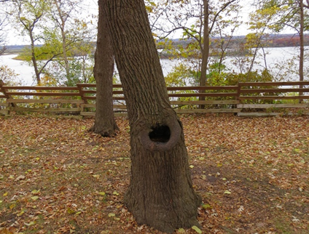
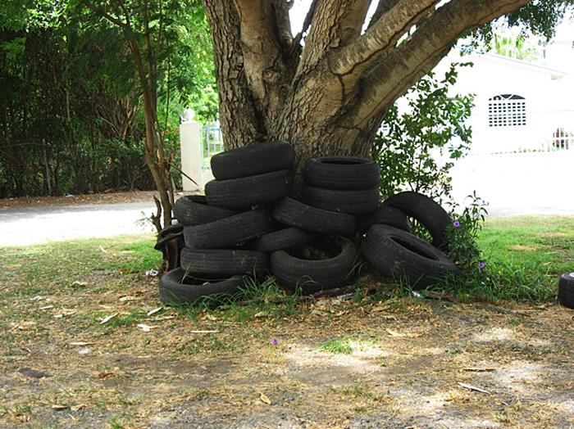
La Crosse Encephalitis
Identified for the first time in 1964
Aedes triseriatus is main mosquito species of concern in Minnesota
Its habitat includes treeholes and other water-holding containers in wooded or shaded areas
The disease primarily affects children 16 years of age or younger
Most cases occur later in the summer
Notes:
La Crosse virus was identified for the first time in the early 1960’s in a Houston County, Minnesota resident. The child died in a La Crosse, Wisconsin hospital and the virus was subsequently named after this city. The main mosquito species of concern in Minnesota is Aedes triseriatus, commonly known as the treehole mosquito. Naturally-occurring treeholes and other water-holding containers in wooded or shaded areas provide the preferred habitat for this mosquito to lay its eggs. As an adult, this mosquito usually won’t fly far from where it developed so risk tends to be heavily localized to the mosquito’s breeding site. Persons of any age may become sick although the disease primarily affects children 16 years of age or younger. Cases reported to the Minnesota Department of Health are typically severe and long-term neurologic effects are common. Most cases occur later in the summer (July, August, and September) when infected mosquitoes are at their highest level.

Slide 14
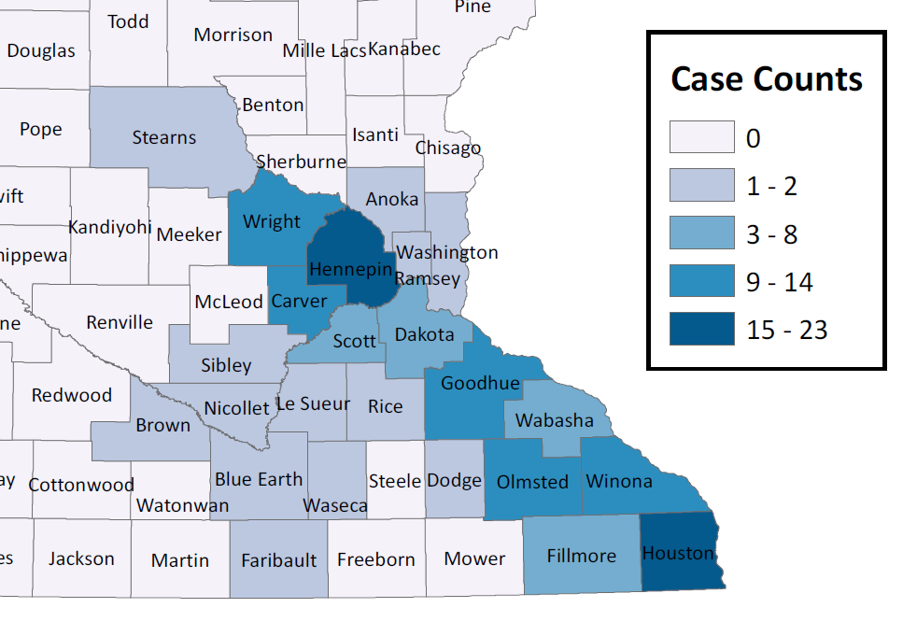
La Crosse Encephalitis Risk in Minnesota
Minnesota La Crosse Encephalitis Cases, 1985-2021
Source: Ecological Sections of Minnesota,
Minnesota Department of Natural Resources (DNR)
Notes:
All reported cases of La Crosse encephalitis in Minnesota have occurred in the southeastern area of the state where risk for this disease is highest. The hardwood forests that make up this region of the state provide the wooded and shaded habitat that the treehole mosquito prefers. On a national level, Stearns county in Minnesota represents the furthest north and west that this disease has ever been reported in the United States.
Footnote: The image on the right shows the county of residence of all cases from1985 through 2021. The blue color gradient spans case counts from zero (light blue) up to 23 cases (dark blue) per county cumulatively over the time period.

Slide 15
Jamestown Canyon Virus Disease
The virus was first identified in Colorado in 1961
Snowmelt Aedes mosquitoes are likely the main species of concern in Minnesota
Wooded and shaded areas provide the best habitat for these mosquitoes
Persons of any age may become sick
More severe disease may occur in older patients or those with weakened immune systems
Cases occur during warmer months of the year, from May through September
Notes:
Jamestown Canyon virus was first identified in Jamestown Canyon, Colorado in 1961. Though it has likely been present in Minnesota for many years, testing was not widely available until 2013. Since then, small numbers of cases have been reported each year. The total spectrum of illness is still being described for this emerging disease.
Several species of mosquitoes may be attributed to spreading this disease in Minnesota; however, “snowmelt Aedes” mosquitoes are likely the main species of concern. The eggs of this group of mosquitoes are able to overwinter in Minnesota and develop in pools of snowmelt in the early spring.
Persons of any age may become sick with Jamestown Canyon virus, although more severe disease may be found in older patients or those with weakened immune systems. Since several different types of mosquitoes may spread this illness, people may get sick from this virus earlier in the season compared to West Nile virus and La Crosse encephalitis virus, most commonly between May and September.

Slide 16
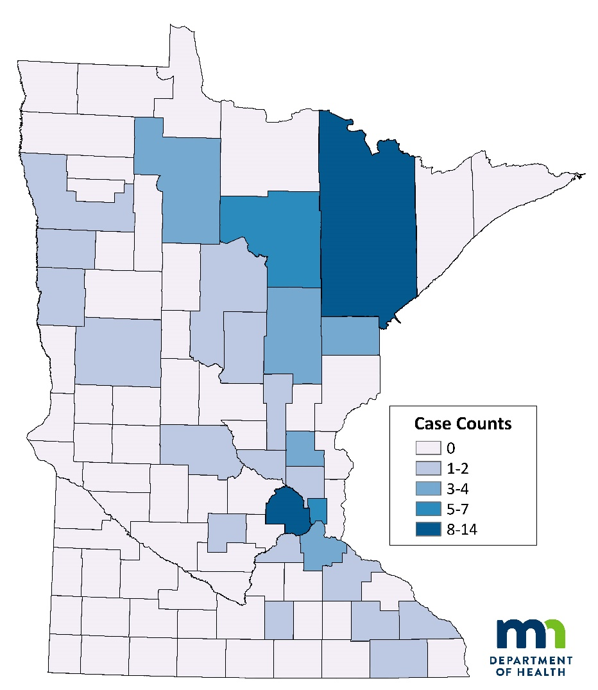
Jamestown Canyon Virus Disease Risk in Minnesota
Minnesota Jamestown Canyon virus disease cases, 2013-2021
Source: Ecological Sections of Minnesota,
Minnesota Department of Natural Resources (DNR)
Notes:
With the information we currently know about Jamestown Canyon virus disease, the highest risk areas in Minnesota include the north-central and northeastern regions. However, the virus is likely widespread throughout the state. Wooded and shaded areas provide the best habitat for these mosquitoes which may explain why all of our cases to date have largely occurred in the forested regions of the state.
Footnote: the map on the right shows the cumulative number of Jamestown canyon virus disease cases reported to the Minnesota Department of Health from 2013 through 2021, based on county of patient residence. The blue color gradient spans case counts from zero (light blue) up to 14 cases (dark blue) per county cumulatively over the time period.

Slide 17
Other Potential Mosquitoborne Diseases in Minnesota
Eastern Equine Encephalitis Virus
St. Louis Encephalitis Virus
Western Equine Encephalitis Virus
Notes:
In addition to the three mosquitoborne diseases previously covered, several other diseases may be spread by mosquito species found here in Minnesota. Eastern equine encephalitis, St. Louis encephalitis, and western equine encephalitis are all viruses found within the United States. These diseases occur rarely and sporadically throughout the country, yet there is the potential for them to occur here in Minnesota. However, Minnesota’s location in the upper Midwestern region of the country is along the edge of the historic distribution ranges associated with each of these diseases.

Slide 18
Travel-Associated Mosquitoborne Diseases Affecting Minnesotans
Chikungunya
Dengue
Malaria
Yellow Fever
Zika
Notes:
It’s also important to remember that mosquitoborne disease can also affect Minnesotans who travel. Some of the diseases previously mentioned may be found in other areas of the United States so it’s wise to be aware of any potential disease threats in the areas in which we travel. In addition, some diseases that commonly affect Minnesota residents who travel abroad each year include chikungunya virus, dengue virus, malaria, yellow fever virus, and Zika virus. Each disease varies by geography, severity, treatment, and available preventative measures.
We strongly encourage people to seek advice from their health care provider and visit a travel clinic at least a month before traveling. This will ensure you have enough time to get any necessary vaccines or medicines before travel. You should visit the Centers for Disease Control and Prevention website on Traveler’s Health, https://wwwnc.cdc.gov/travel, for specific recommendations and travel advisories pertaining to the country in which you are traveling. You can also visit the MDH’s website, International Travel Health Clinics Serving Minnesota Residents, to find a travel clinic closest to you: https://www.health.state.mn.us/people/immunize/basics/travel/yfclinic.html.

Slide 19
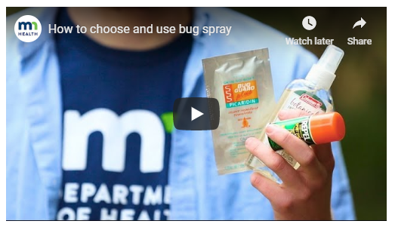
Protect Yourself from Mosquitoborne Diseases
1) Know when and where you’re at risk
Primarily July through September
Open, agricultural areas – West Nile virus
Wooded areas – La Crosse & Jamestown Canyon viruses
2) Wear EPA-registered bug spray
DEET 20-30% on skin or clothing
Permethrin 0.5% on clothing
3) Dress in appropriate clothing
Wear loose-fitting, long-sleeved shirts and pants
Notes:
Now that you know more about mosquitoborne diseases, it’s important to know how to protect yourself from mosquito bites and the diseases they may carry.
First of all, knowledge is power. Know when and where you are at risk. Mosquitoes are abundant throughout Minnesota but many are just pest mosquitoes. To summarize the information we covered in previous slides, be especially aware of mosquitoborne disease risk from July through August. Open, agricultural areas are most at risk for West Nile virus while wooded and shady areas are more at risk for La Crosse and Jamestown Canyon viruses.
Second, wear bug spray that has been registered with the EPA (Environmental Protection Agency). You can typically find an EPA-reg. number in small font near the product’s barcode. By choosing EPA-registered products, you can feel assured that the product is safe and effective for what it’s label claims. Repellents containing 20 to 30% DEET are effective at deterring mosquitoes from biting your skin. DEET is safe to apply directly on exposed skin or clothing. Products containing 0.5% permethrin is also recommended for people who spend a lot of time in the woods and can actually kill mosquitoes upon contact. Permethrin is NOT safe to use directly on the skin, but is safe to treat clothing or gear and will last through multiple washes. Other effective ingredients are available but again, be sure to only use products that are registered by the EPA. Always follow the product label’s instructions and wash yourself after coming in from the outdoors to remove any product remaining on your skin. The picture shown here is linked to a short video on the MDH website that shows you how to choose and use bug spray. You can also find the video here: https://www.health.state.mn.us/diseases/mosquitoborne/video.html.
Lastly, you can prevent mosquito bites by simply dressing in comfortable clothing when in areas where mosquitoes are active. Since mosquitoes can bite through tight-fitting fabric, wear loose-fitting, long-sleeved shirts and pants to cover exposed skin.

Slide 20
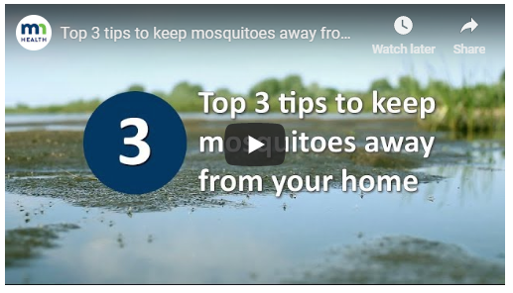
Protect Your Family from Mosquitoborne Diseases
Remove mosquito breeding habitat
Frequently empty or remove water holding containers like:
Flower pots
Bird baths
Fountains and kiddie pools
Tires
Remove debris from gutters to prevent stagnant water
Make sure tarps are tight to prevent pooling water
Notes:
It’s also important to protect your home and property from mosquitoes that may use water sources around you to breed. As discussed, mosquitoes need water to lay their eggs. So, adult female mosquitoes may seek out water-holding containers (such as tires, flower pots, kiddie pools, bird baths, dog bowls, etc.) that are holding water. In order to prevent mosquitoes from breeding around your home, frequently empty these water-holding containers, get rid of them, or store them in a dry location. If you have tires, you can take them to your local recycling center, drill a hole in the bottom for drainage, or place them in a sunny spot on the property so mosquitoes are less likely to lay their eggs in them. Gutters should be regularly cleared of debris to prevent water becoming stagnant. Lastly, tarps on wood piles or equipment should be pulled tight to prevent water pooling in the folds.
To demonstrate some of these prevention tips, you can watch a short video from the MDH website on how to keep mosquitoes away from your home. Click on the image above or visit the following link: https://www.health.state.mn.us/diseases/mosquitoborne/video.html.

Slide 21
Thank You! Vectorborne Diseases Unit 651-201-5414 health.bugbites@state.mn.us www.health.state.mn.us/mosquitoes
Notes:
Thank you very much for your attention today! We hope you found this information useful. Contact the MDH Vectorborne Diseases Unit if you have any questions.
You may also visit the MDH and CDC websites for additional information:
www.health.state.mn.us/mosquitoes
www.cdc.gov/features/stopmosquitoes/index.html

