Slide 1
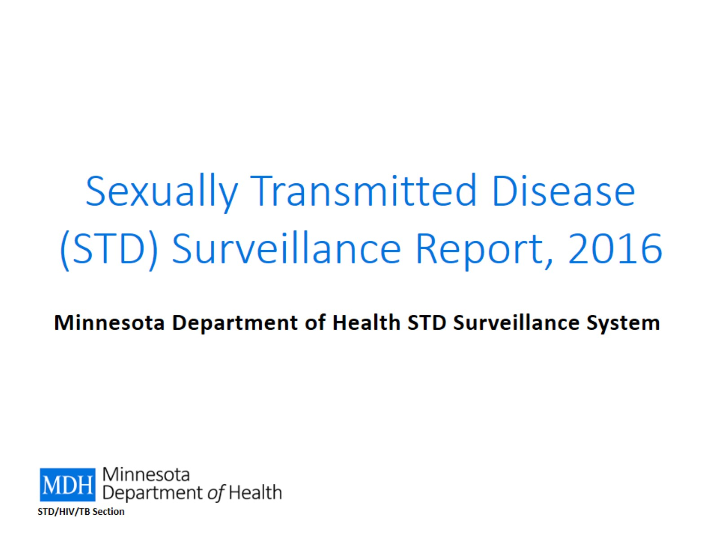
Sexually Transmitted Disease (STD) Surveillance Report, 2016

Slide 2
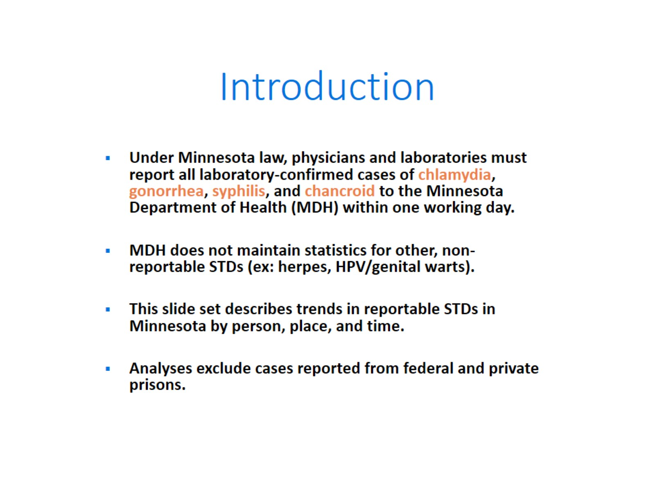
Introduction

Slide 3
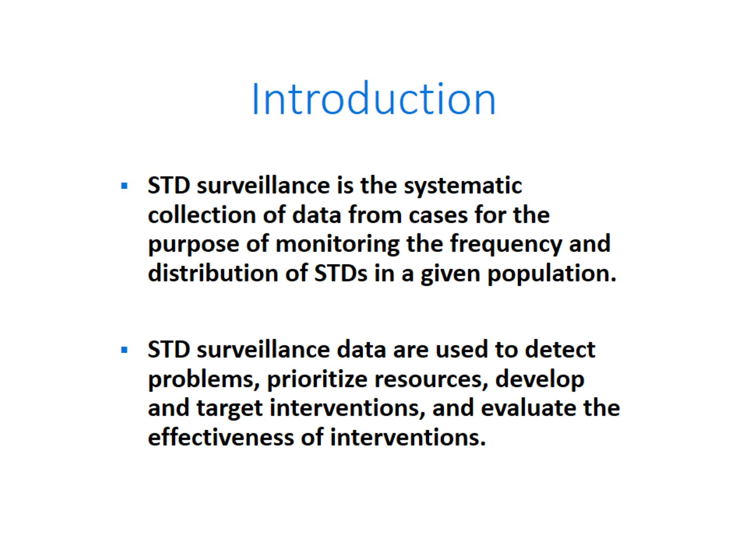
Introduction

Slide 4
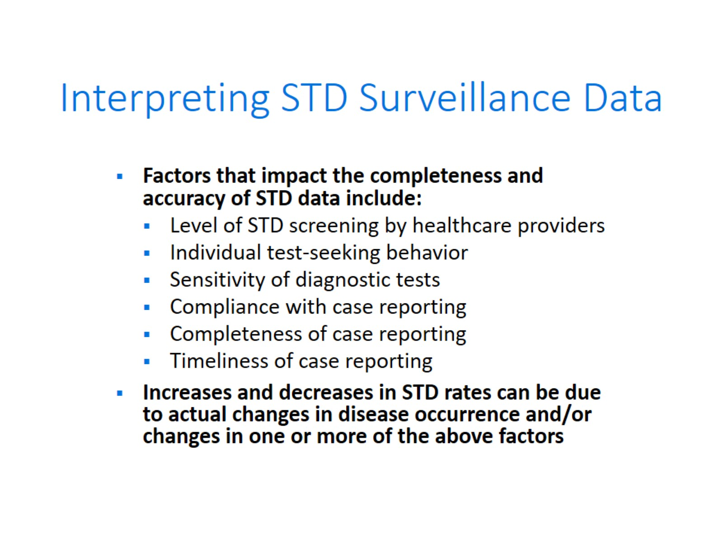
Interpreting STD Surveillance Data

Slide 5
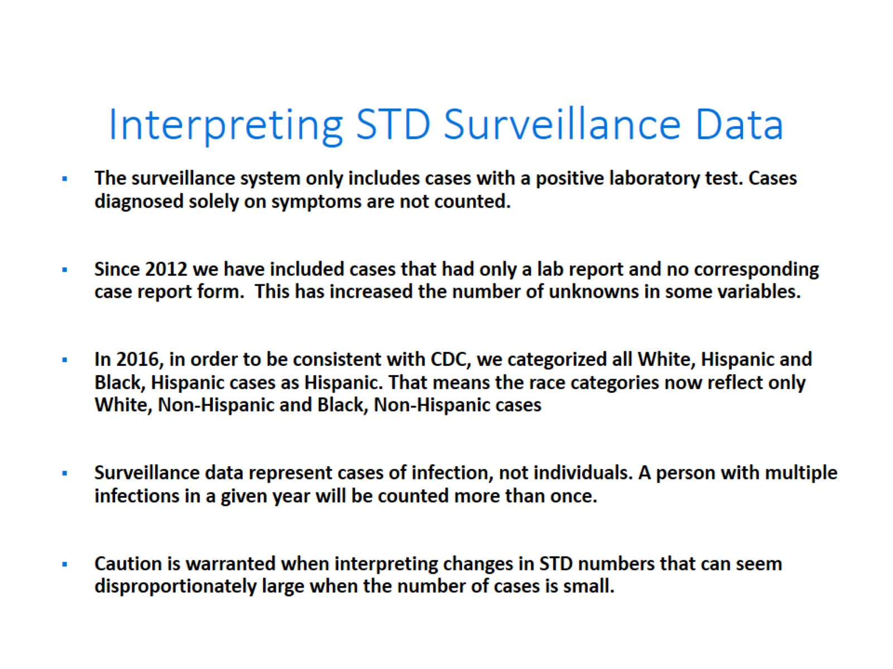
Interpreting STD Surveillance Data

Slide 6


Slide 7
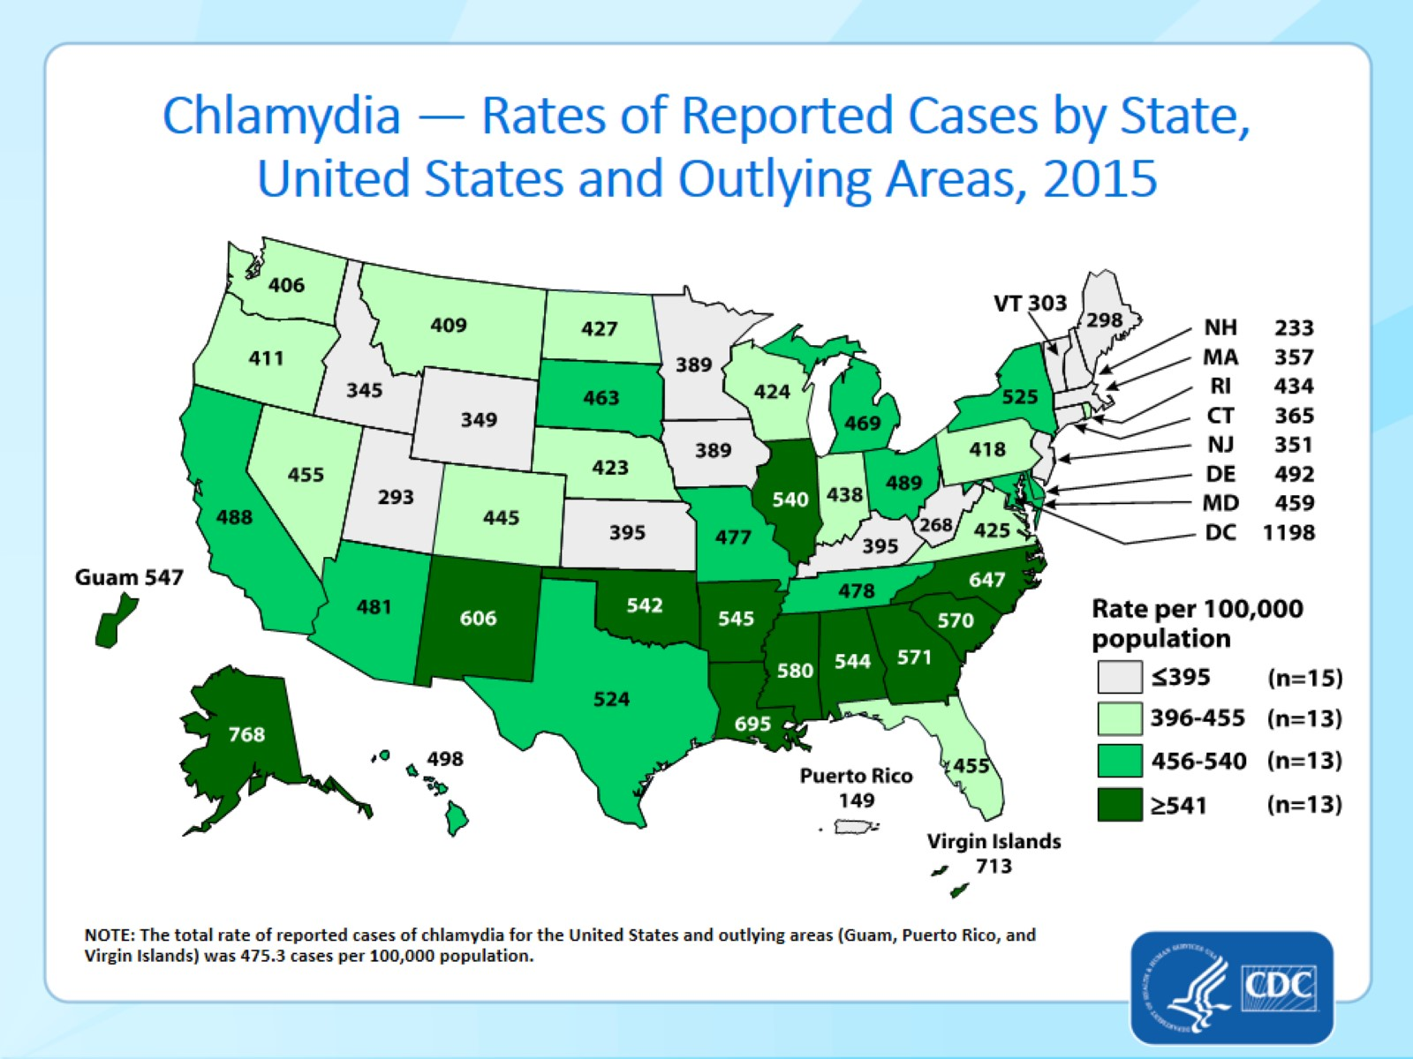
Chlamydia — Rates of Reported Cases by State, United States and Outlying Areas, 2015
Notes:
Minnesota’s chlamydia rate in 2015 was 389 per 100,000
This was lower than the national rate of 475.3 per 100,000

Slide 8
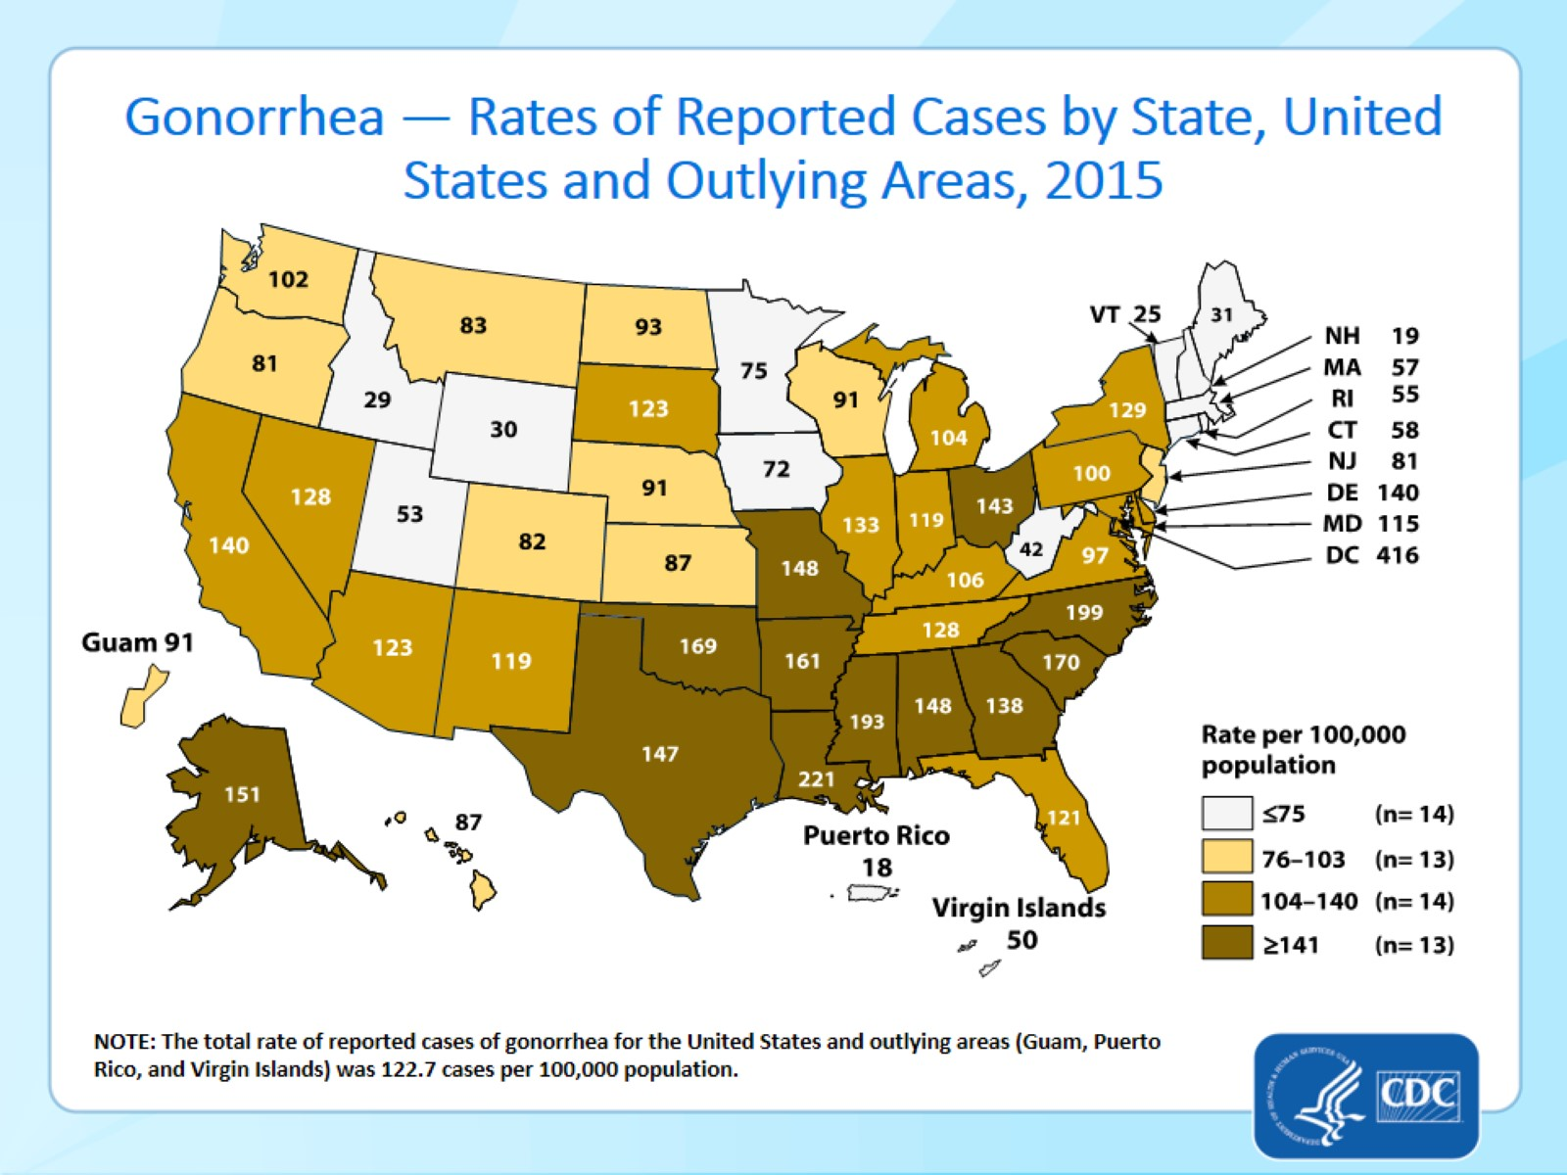
Gonorrhea — Rates of Reported Cases by State, United States and Outlying Areas, 2015
Notes:
Minnesota’s gonorrhea rate in 2015 was 75 per 100,000
This was lower than the national rate of 122.7 per 100,000

Slide 9
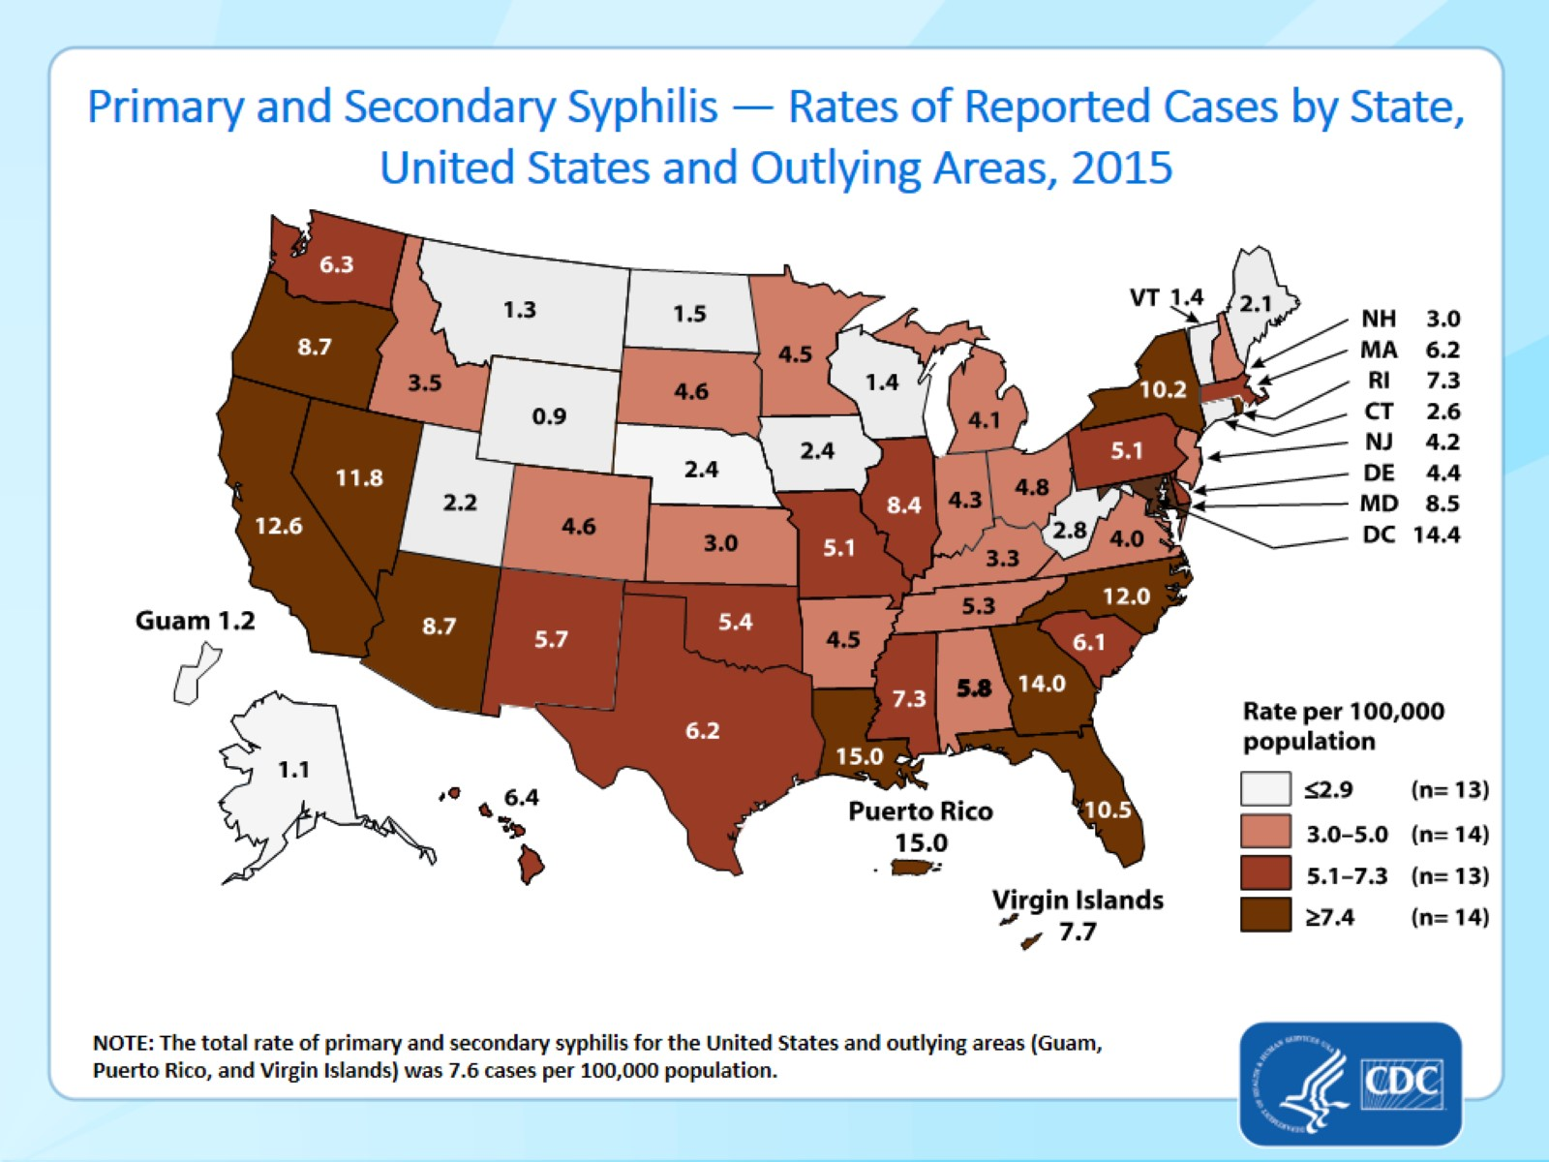
Primary and Secondary Syphilis — Rates of Reported Cases by State, United States and Outlying Areas, 2015
Notes:
Minnesota’s primary and secondary syphilis rate in 2015 was 4.5 per 100,000
This was lower than the national rate of 7.6 per 100,000

Slide 10
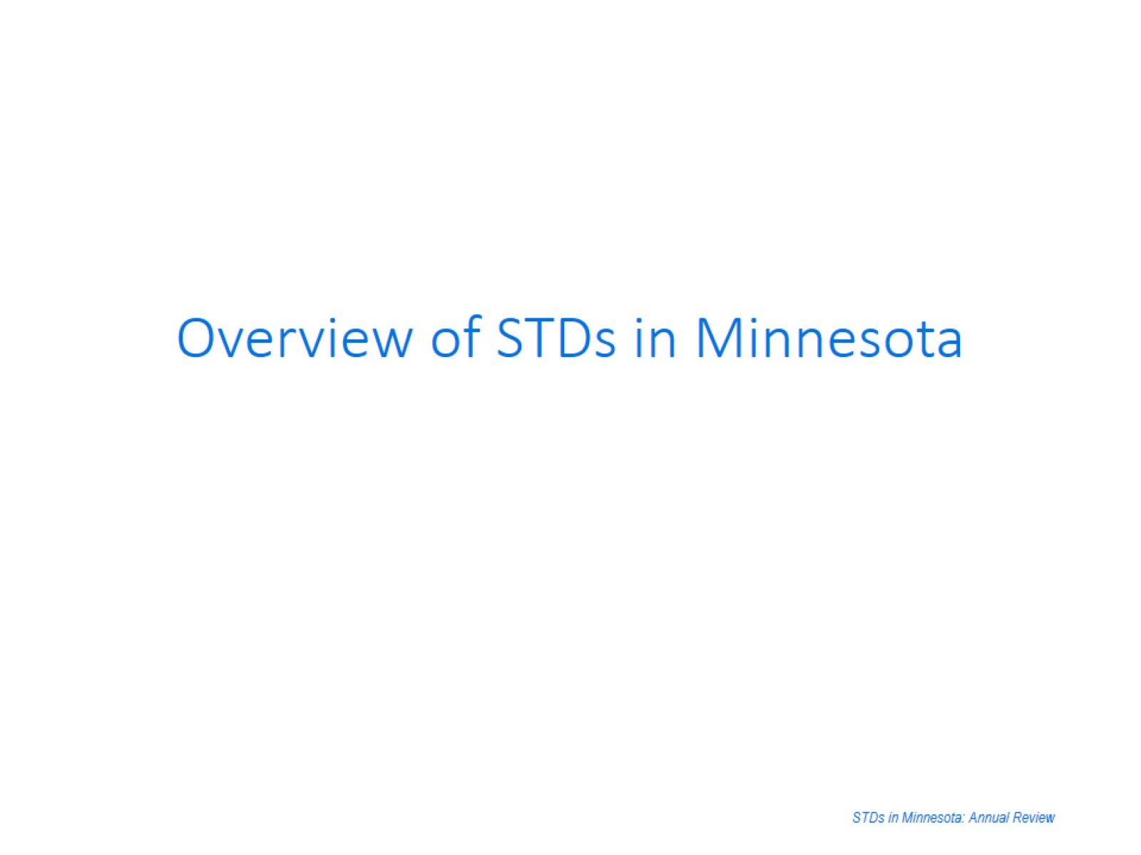

Slide 11
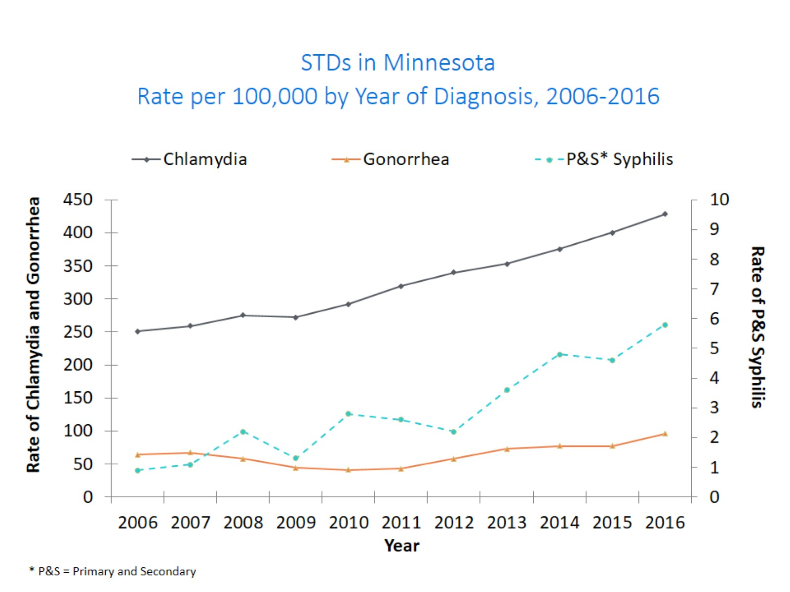
Notes:
The rate of chlamydia in MN reached an all time high at 428 per 100,000. This is a rate increase of 7% from 2015.
The rate of gonorrhea in MN increased 25% to 96 per 100,000 compared to 77 per 100,000 in 2015.
The rate of primary and secondary syphilis is at 5.8 per 100,000. This is an increase of 26% from 2015.

Slide 12
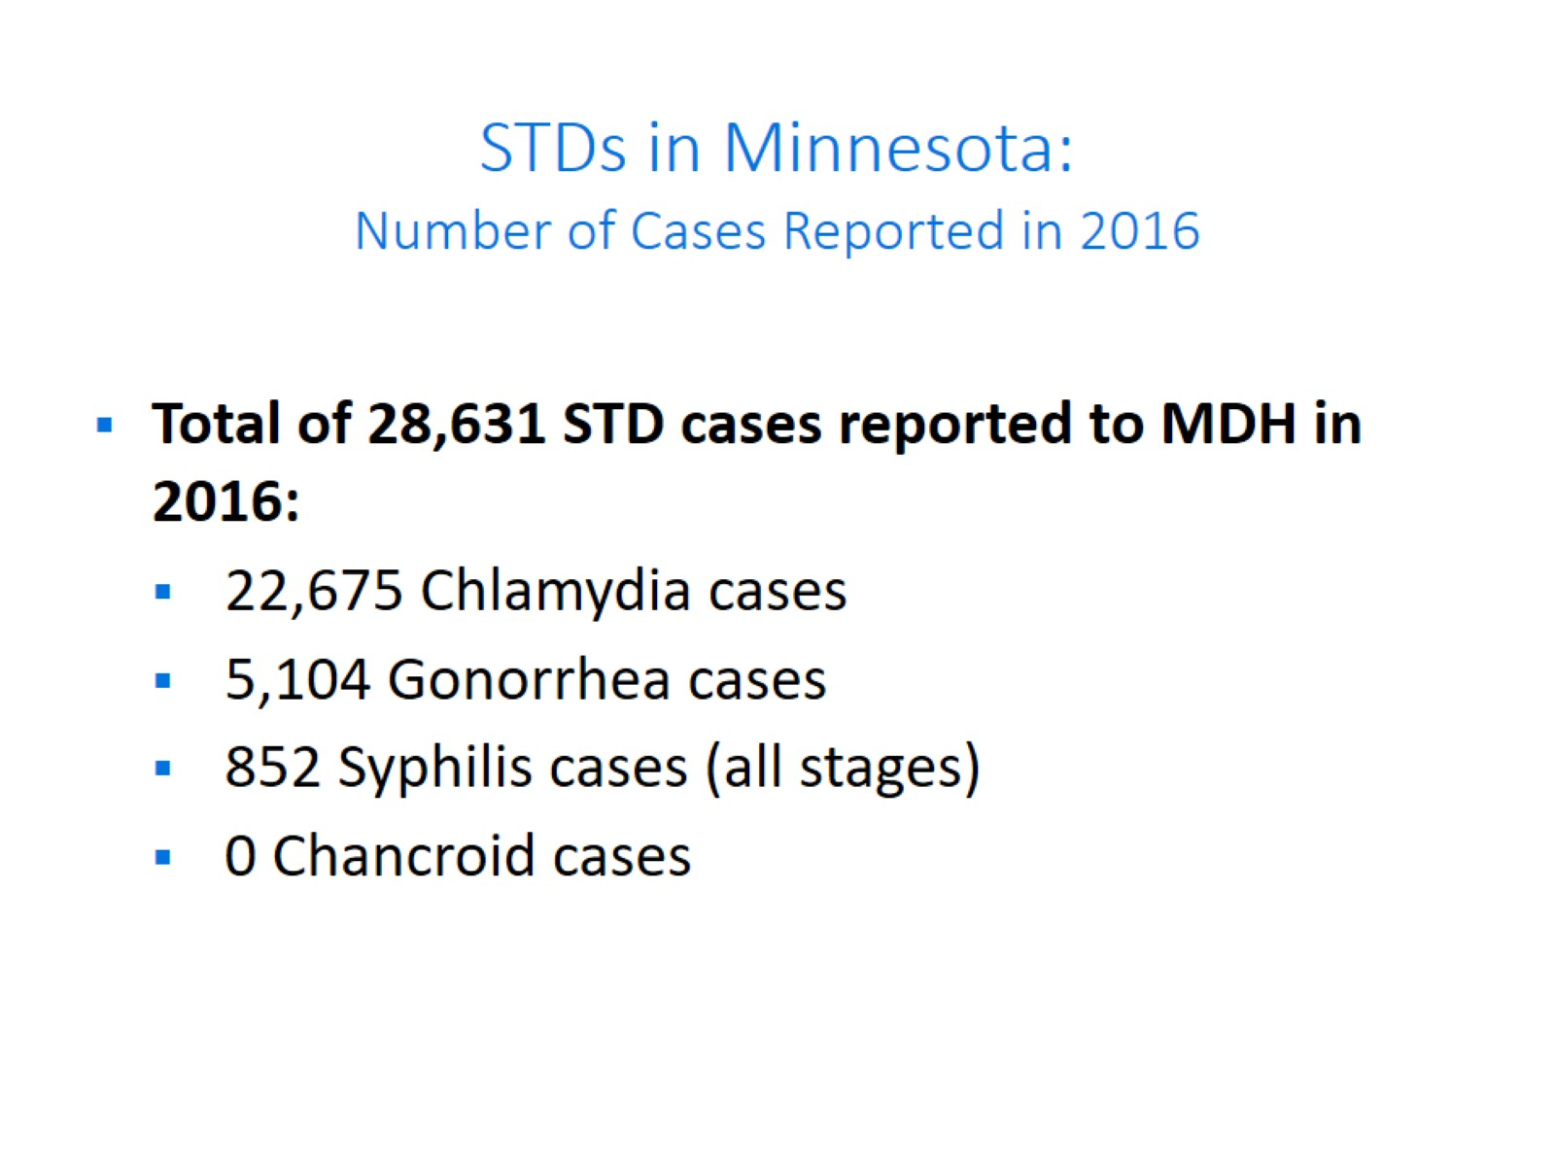
STDs in Minnesota:
Number of Cases Reported in 2016

Slide 13
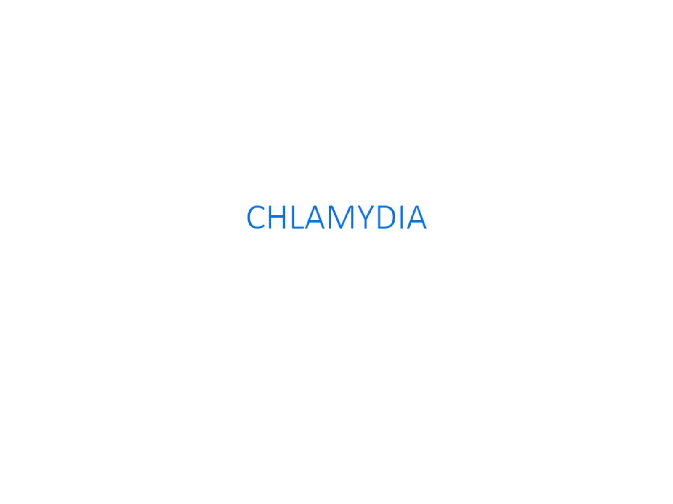

Slide 14
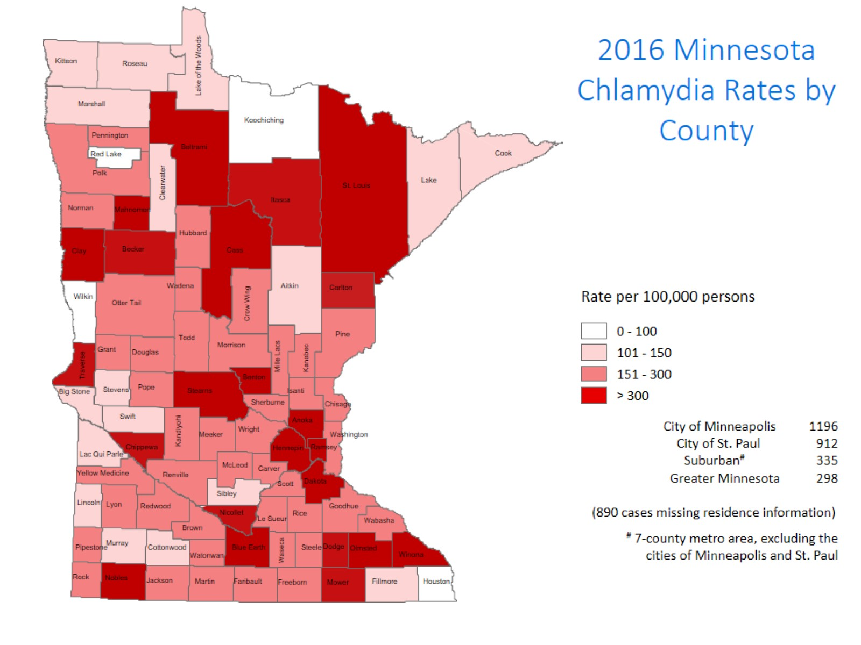
Notes:
All counties in Minnesota are affected by chlamydia. There were at least 4 cases in all counties in 2016.
The city of Minneapolis continues to have the highest rates of chlamydia at 1196 per 100,000, followed by the city of St. Paul at 912 per 100,000, the suburban area (7-county metro excluding Minneapolis & St. Paul) at 335 per 100,000 and Greater Minnesota at 298 per 100,000.
The Greater Minnesota area had the greatest increase in rates between 2015 and 2016 at 11%. The seven county metro Suburban area had an increase of 8%, the City of St. Paul an increase of 7%, and the City of Minneapolis 6% increase.

Slide 15
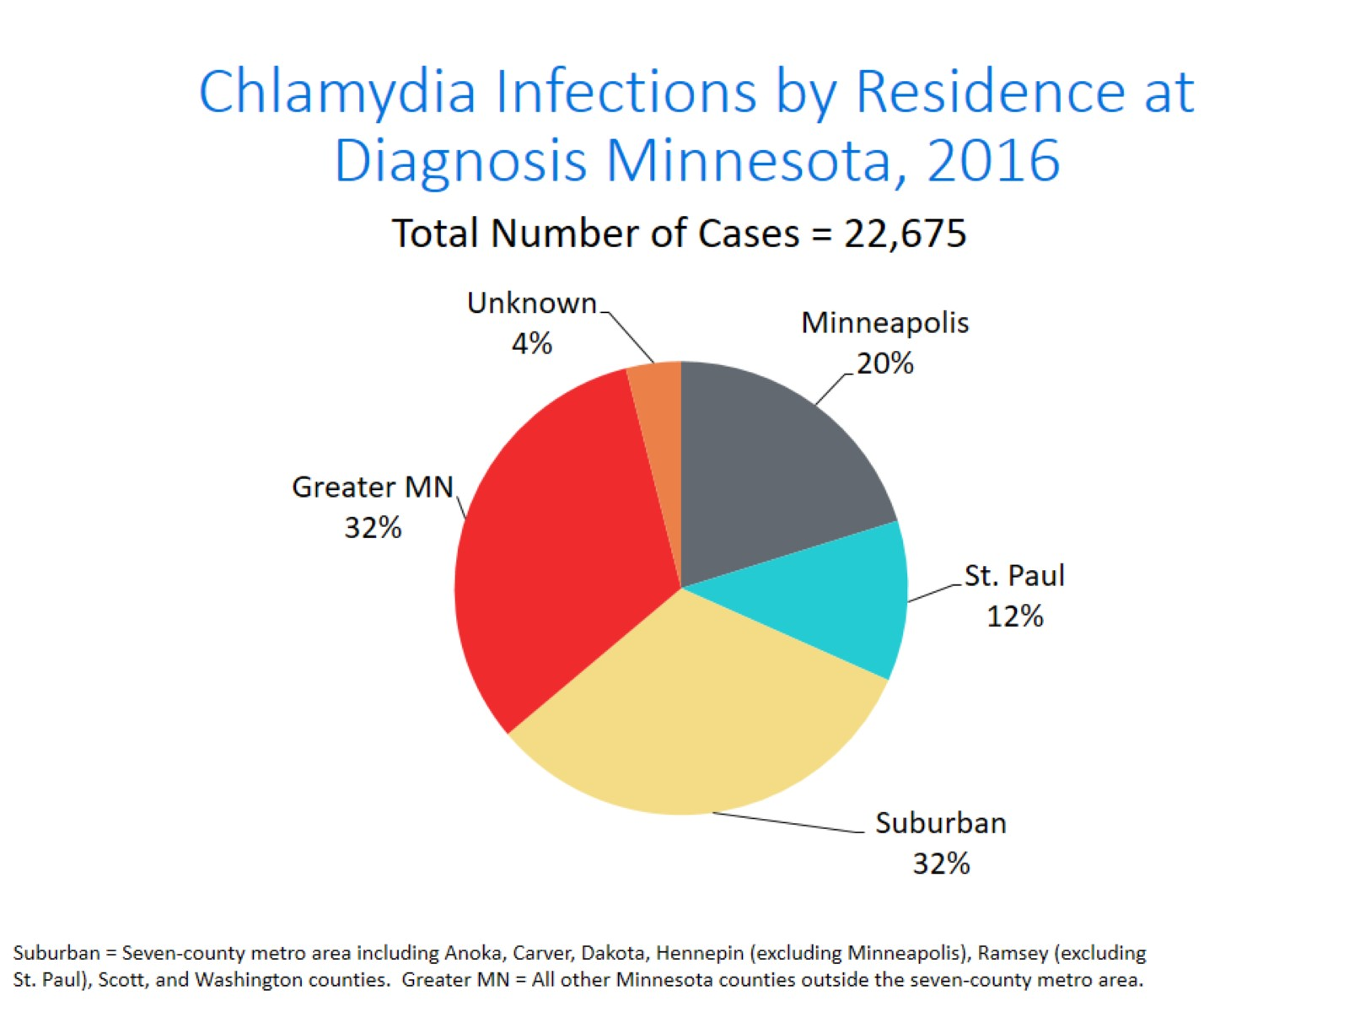
Notes:
All parts of Minnesota are affected by chlamydia. Roughly a third of the cases are in the cities of Minneapolis and St. Paul, a third in the Suburban area surround the cities, and a third in Greater Minnesota.

Slide 16
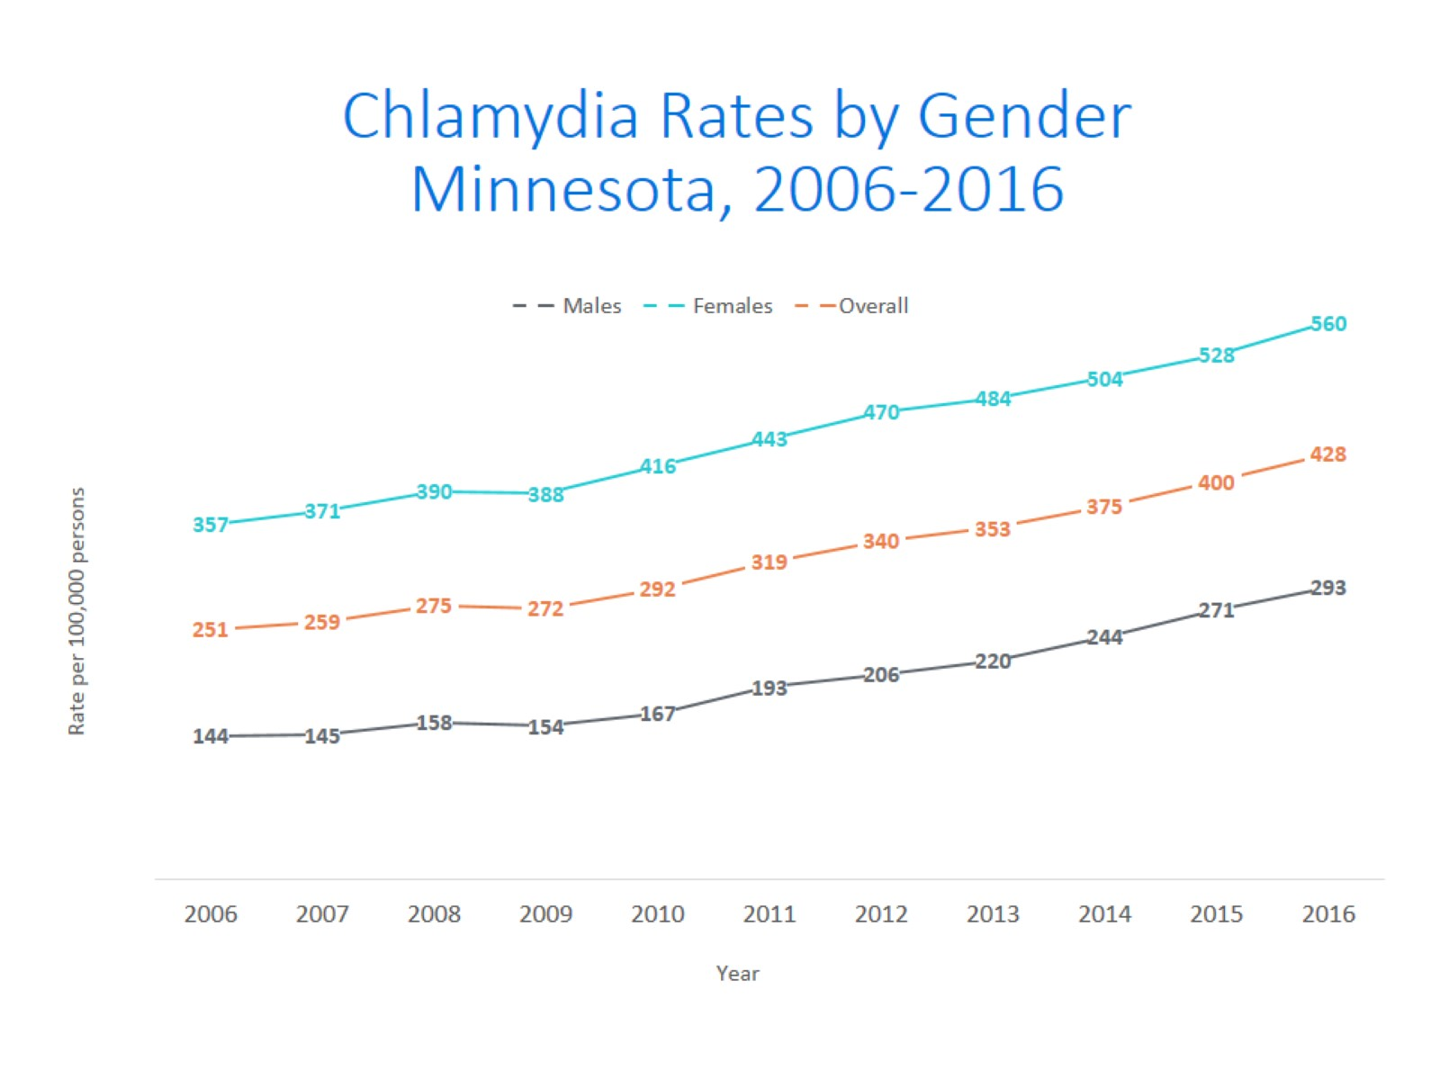
Notes:
The rates of chlamydia went up in both males and females in 2016. Females continue to have higher rates of chlamydia than males. The rate in males increased more than the rate in females in 2016.
The males had a rate of 293 per 100,000 which is an increase of 8% over the 2015 rate of 271 per 100,000.
The females had a rate of 560 per 100,000 which is an increase of 6% over the 2015 rate of 504 per 100,000.

Slide 17
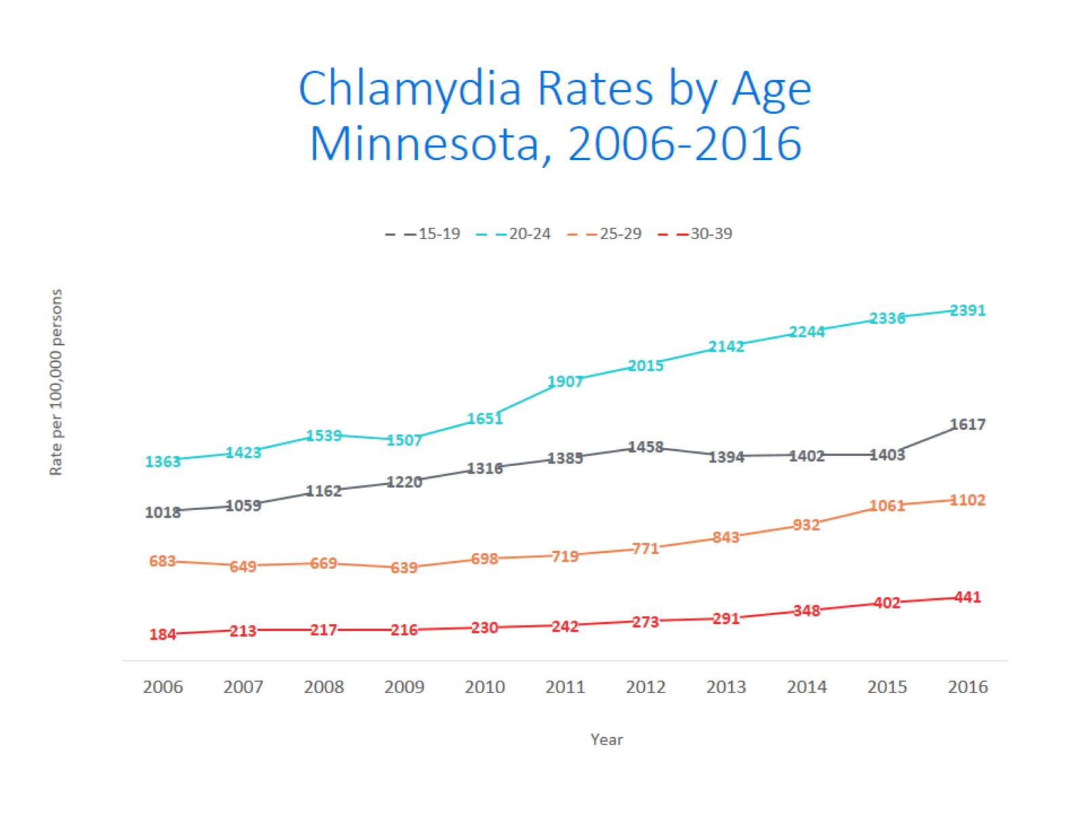
Notes:
All age groups saw an increase in chlamydia rates.
The highest rate remains in the 20-24 yr. old age group at 2391 per 100,000.
The 15-19 yr. olds had the largest rate increase from 2015 at 15%. Their rate is 1617 per 100,000. This age group still has the second highest rates of chlamydia.

Slide 18
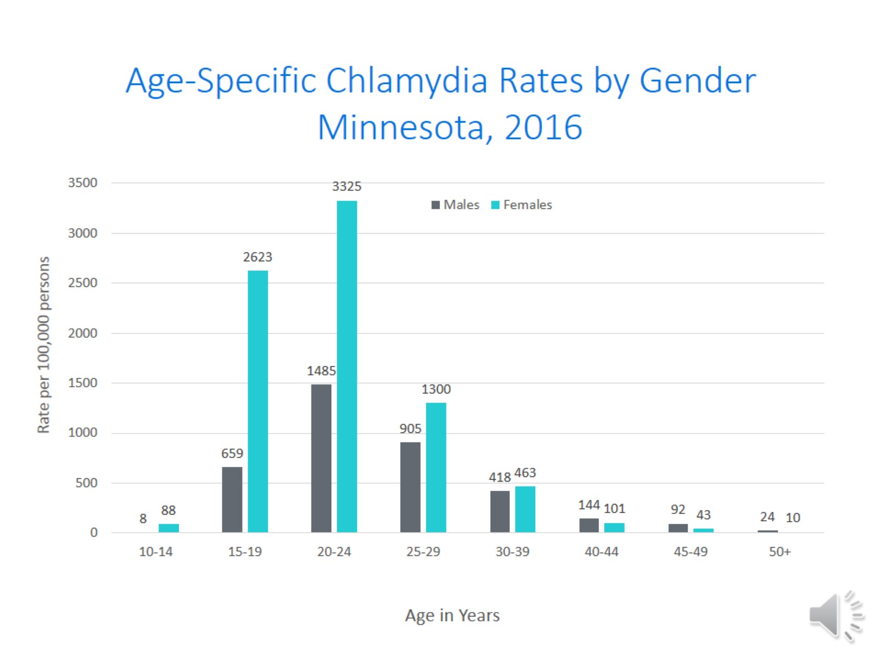
Age-Specific Chlamydia Rates by Gender
Minnesota, 2016
Notes:
The age group with the largest increase in rate was males 10-14 at a 66% increase over 2015.
The rates of chlamydia went up in both males and females in 2016.
Females continue to have higher rates of chlamydia than males in age groups 39 and under.
In 2016 the males have higher rates in the 40 and over age groups. The rate in males increased more than the rate in females in 2016.
The highest rates of chlamydia continue to be in females 20-24 year of age at 3325 per 100,000.

Slide 19
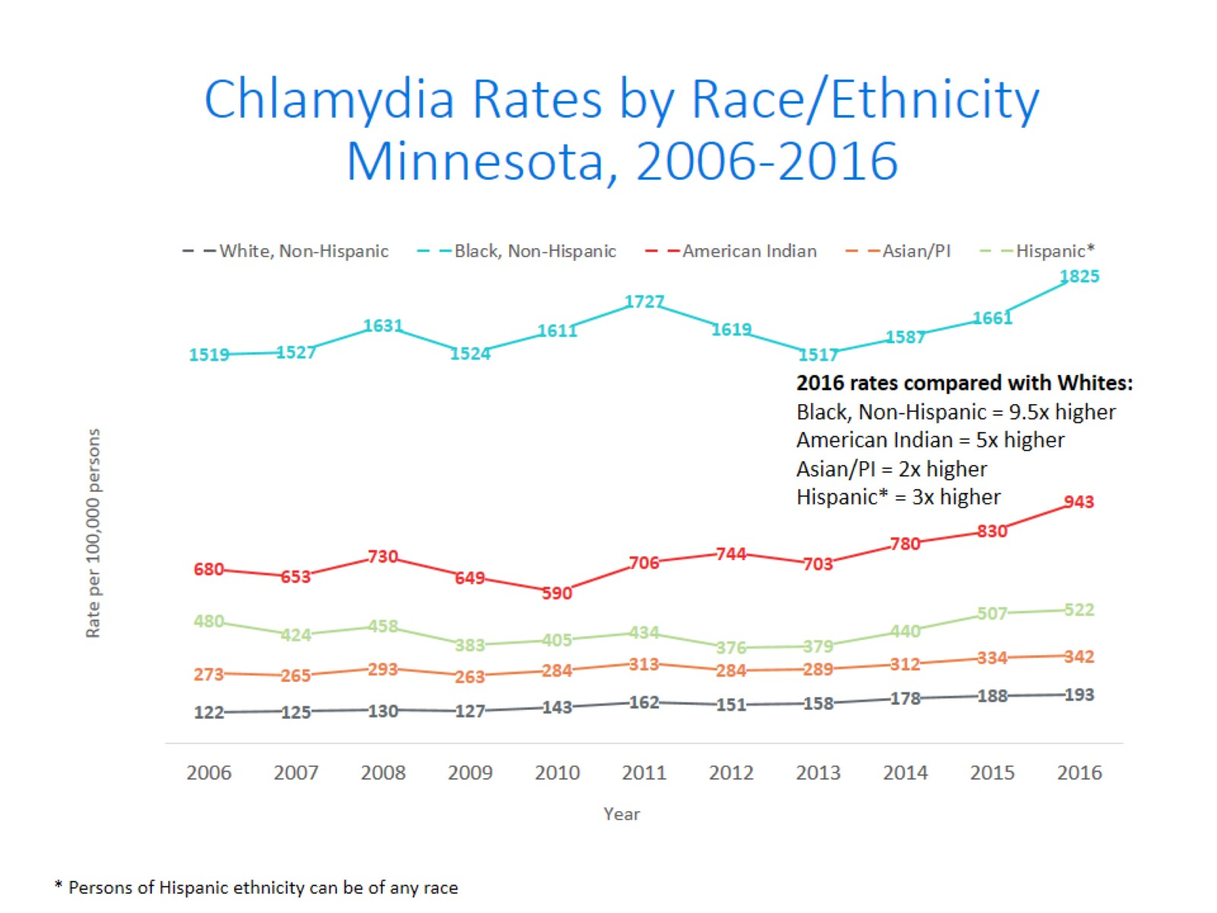
Notes:
There continues to be disparities in rates of chlamydia.
The Black/African American, Non-Hispanic population has rates that are 9.5 times higher than that of whites. The rate in the Black/African American population was 1825 per 100,000 compared to the rate in the White, Non-Hispanic population at 193 per 100,000.
The American Indian population had a rate that was 5 times higher at 943 per 100,000
The Asian/Pacific Islander population had a rate that was 2 times higher at 342 per 100,000
The Hispanic/Latino population, which can be of any race, had a rate that was 3 times higher at 522 per 100,000

Slide 20
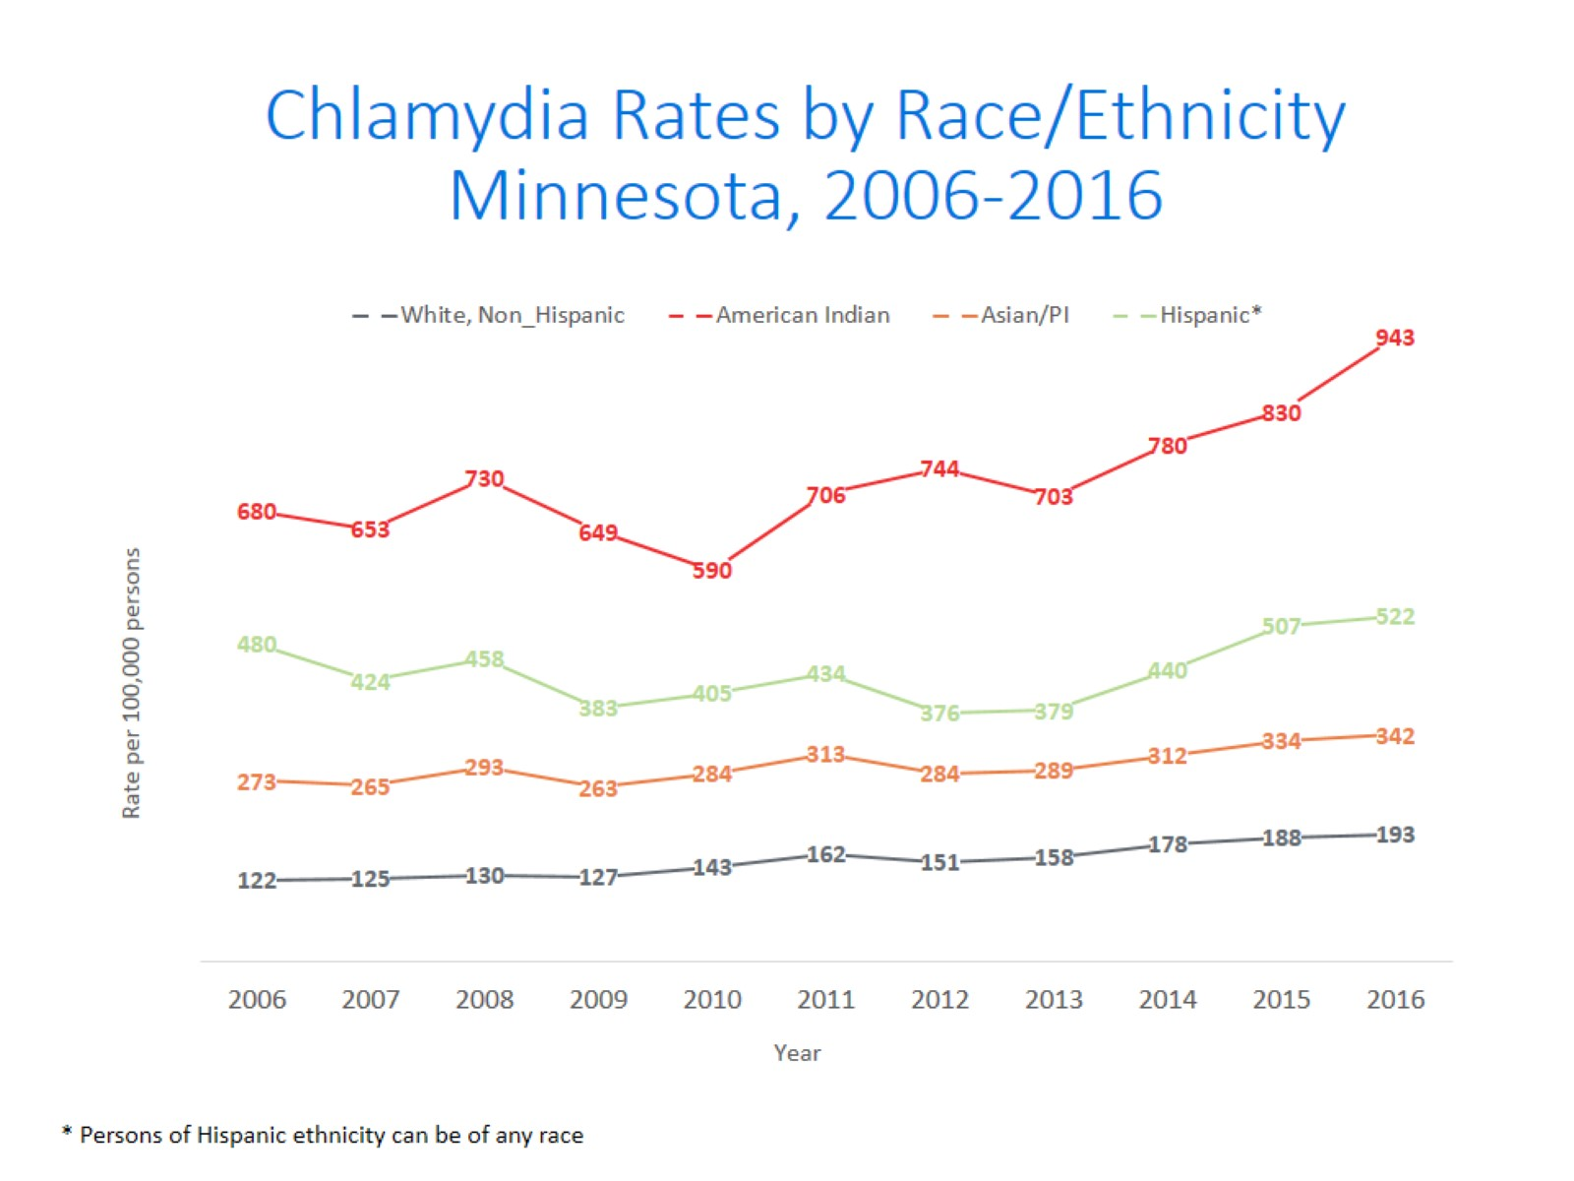
Notes:
This is a clearer view of the rates from the previous slide, removing the Black/African American, Non-Hispanic data.

Slide 21
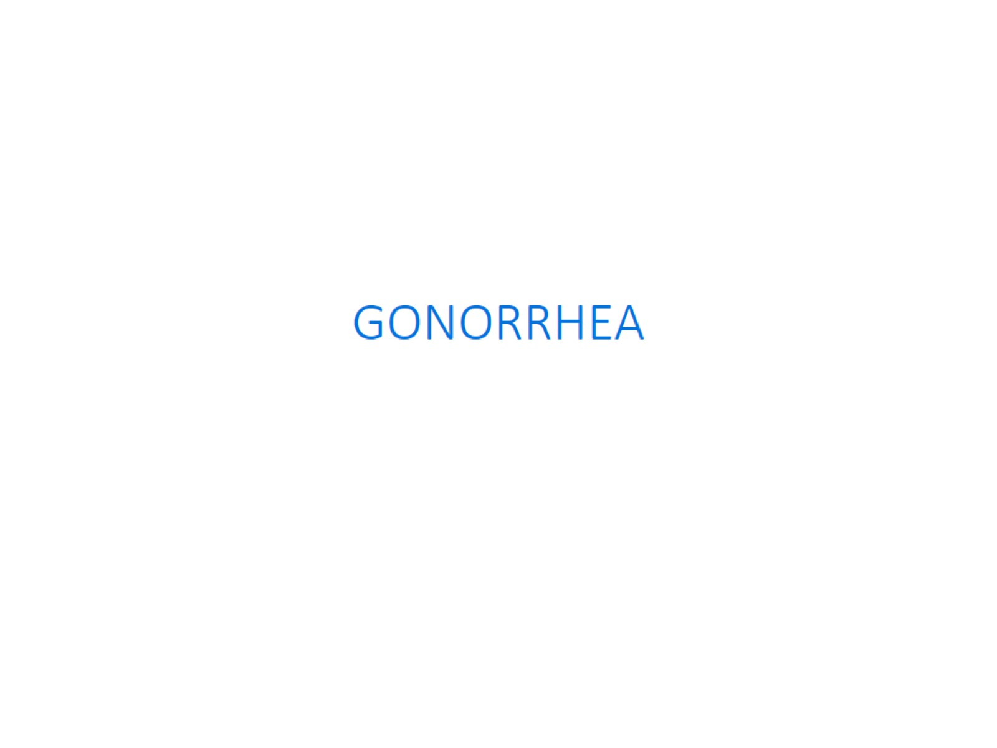

Slide 22
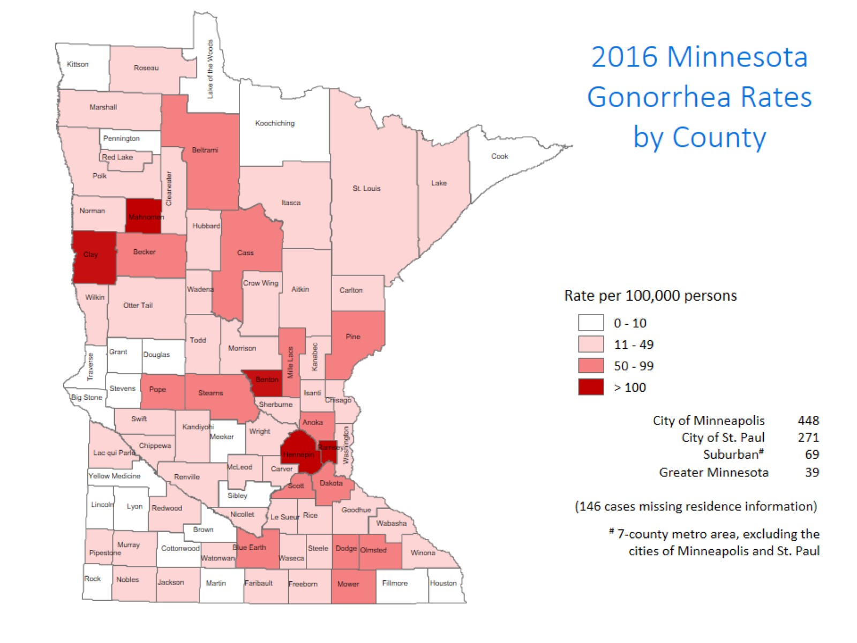
Notes:
The city of Minneapolis continues to have the highest rates of gonorrhea at 448 per 100,000, followed by the city of St. Paul at 271 per 100,000, the suburban are (7-county metro excluding Minneapolis & St. Paul) at 69 per 100,000 and Greater Minnesota at 39 per 100,000.
The seven county metro Suburban area had the highest increase at 41%, followed by Greater Minnesota with a 21% increase. The City of Minneapolis had an increase of 19%, and the City of St. Paul had the smallest increase at 18%.

Slide 23
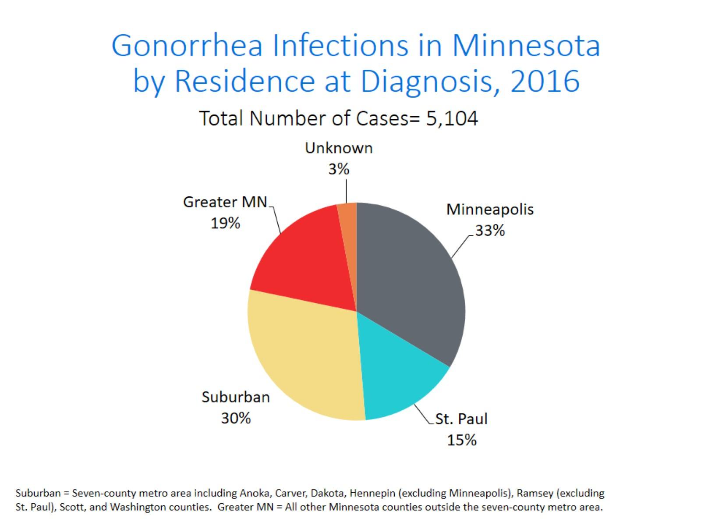
Notes:
The majority of the gonorrhea cases, 33%, continue to be residents of the City of Minneapolis.
The next highest area is the Suburban area at 30%. The Suburban area also had the highest increase at 41%.

Slide 24
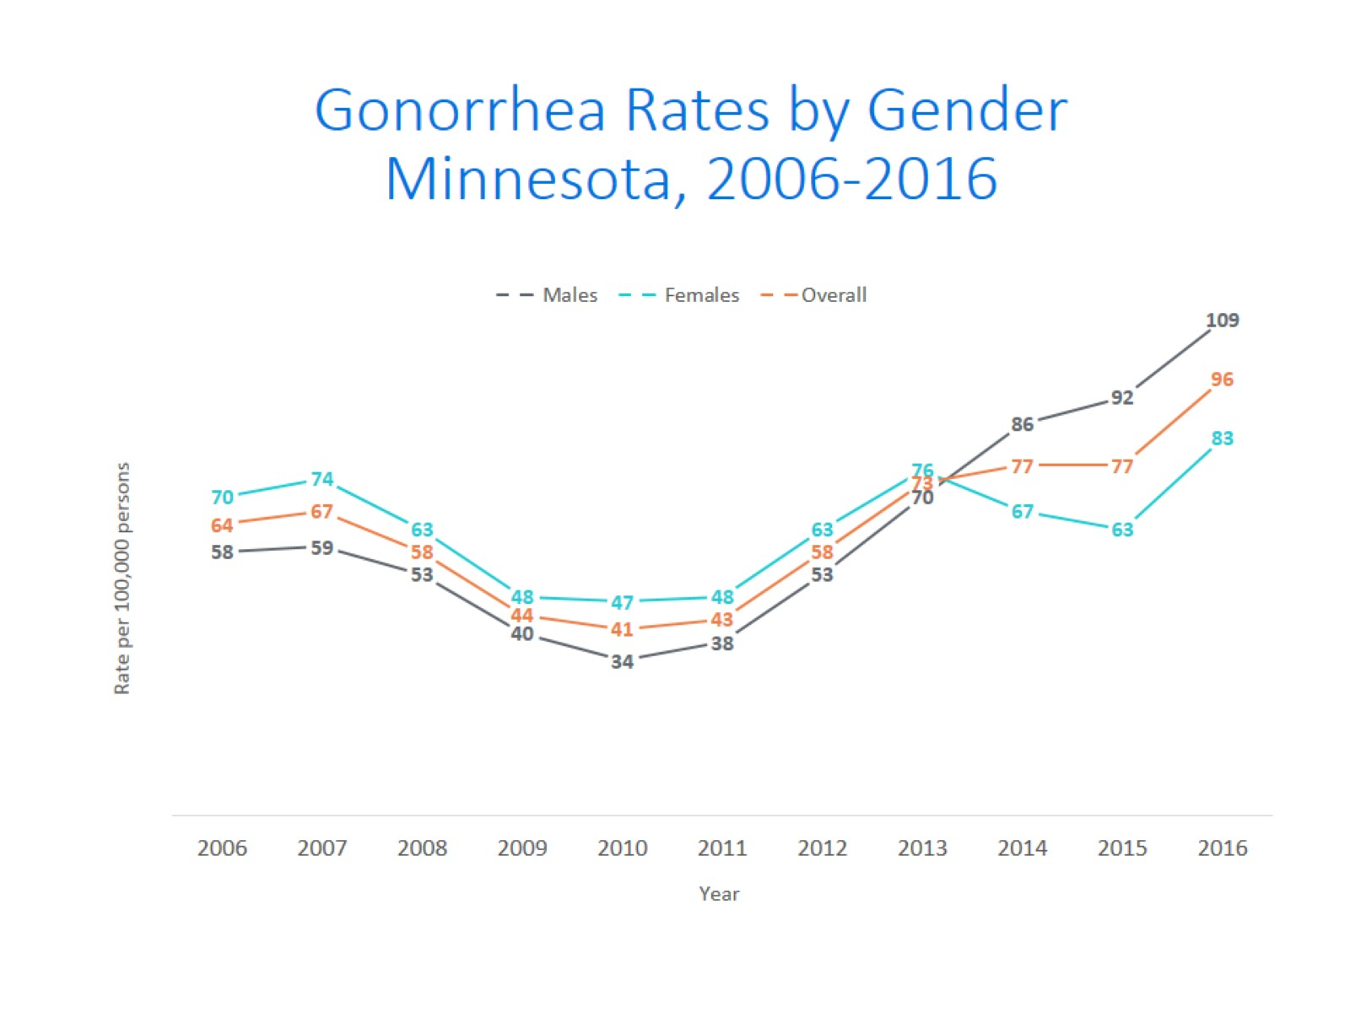
Notes:
The rates of gonorrhea went up in both males and females in 2016. Males continue to have higher rates of gonorrhea than females. The rate in females increased more than the rate in males in 2016.
The males had a rate of 109 per 100,000 which is an increase of 19% over the 2015 rate of 92 per 100,000.
The females had a rate of 83 per 100,000 which is an increase of 32% over the 2015 rate of 63 per 100,000.

Slide 25
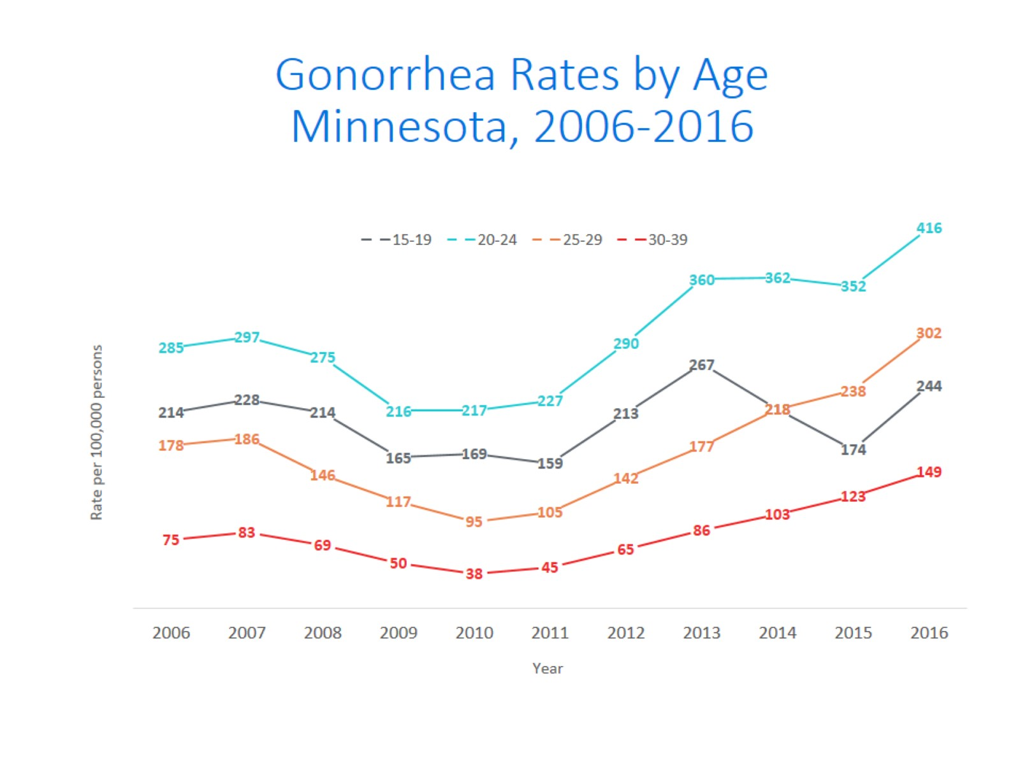
Notes:
All age groups saw an increase in gonorrhea rates.
The highest rate remains in the 20-24 yr. old age group at 416 per 100,000.
The 15-19 yr. olds had the largest rate increase from 2015 to 2016 at 40%.

Slide 26
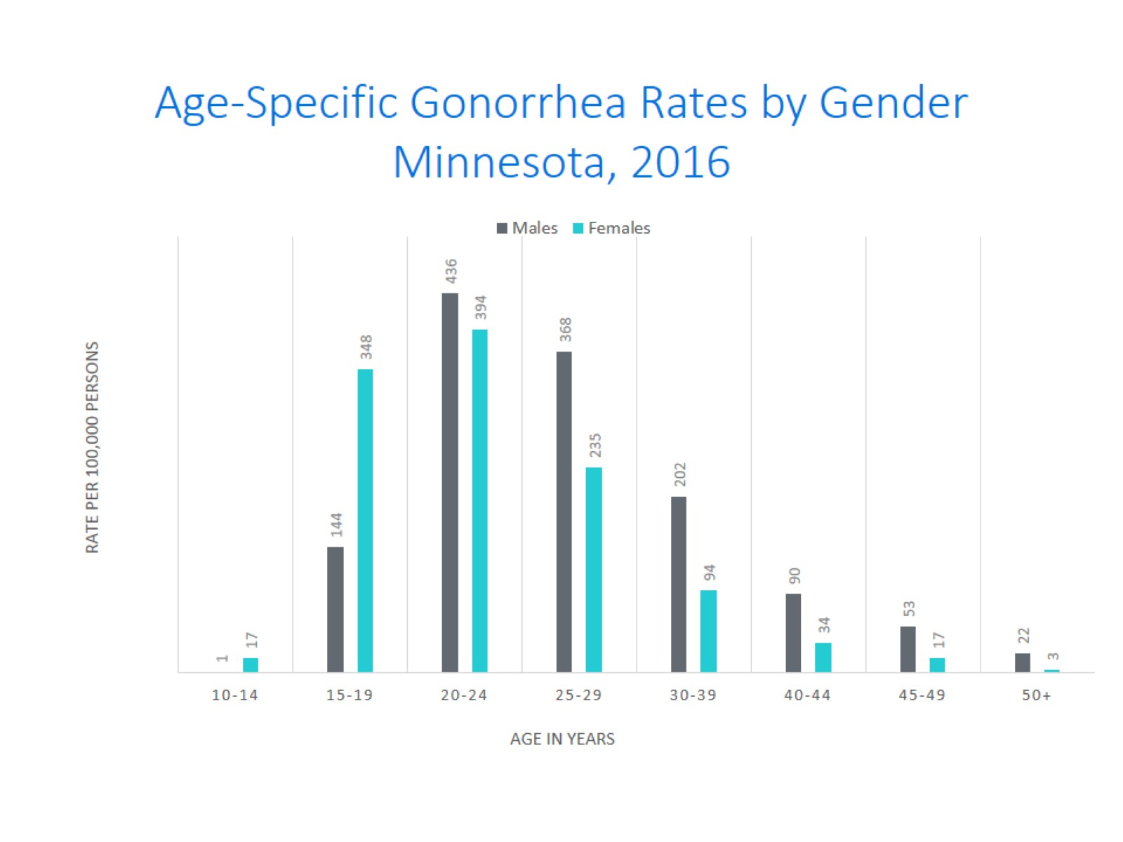
Age-Specific Gonorrhea Rates by Gender Minnesota, 2016
Notes:
The rates of gonorrhea went up in both males and females in 2016. Females continue to have higher rates of gonorrhea than males in age groups 19 and under. In 2016 the males have higher rates in the 20 and over age groups. The rate in females increased more than the rate in males in 2016.
The highest rates of gonorrhea are in males 20-24 at 436 per 100,000.

Slide 27
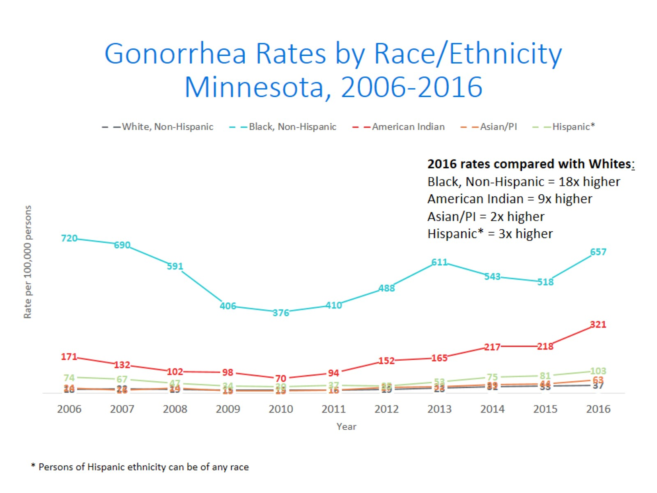
Notes:
There continues to be disparities in rates of gonorrhea.
The Black/African American, Non-Hispanic population has rates that are 18 times higher than that of whites. The rate in the Black/African American population was 657 per 100,000 compared to the rate in the White, Non-Hispanic population at 37 per 100,000.
The American Indian population had a rate that was 9 times higher at 321 per 100,000
The Asian/Pacific Islander population had a rate that was 2 times higher at 63 per 100,000
The Hispanic/Latino population, which can be of any race, had a rate that was 3 times higher at 103 per 100,000

Slide 28
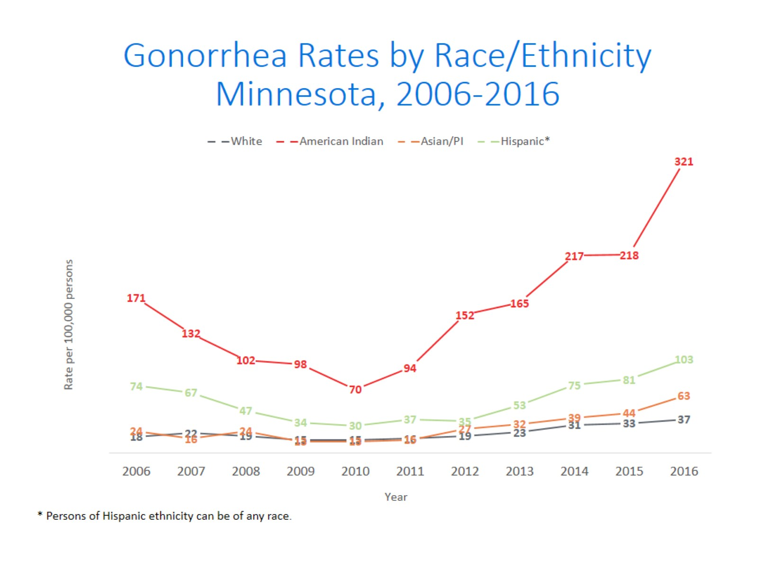
Notes:
This is a clearer view of the rates from the previous slide, removing the Black/African American, Non-Hispanic data.

Slide 29
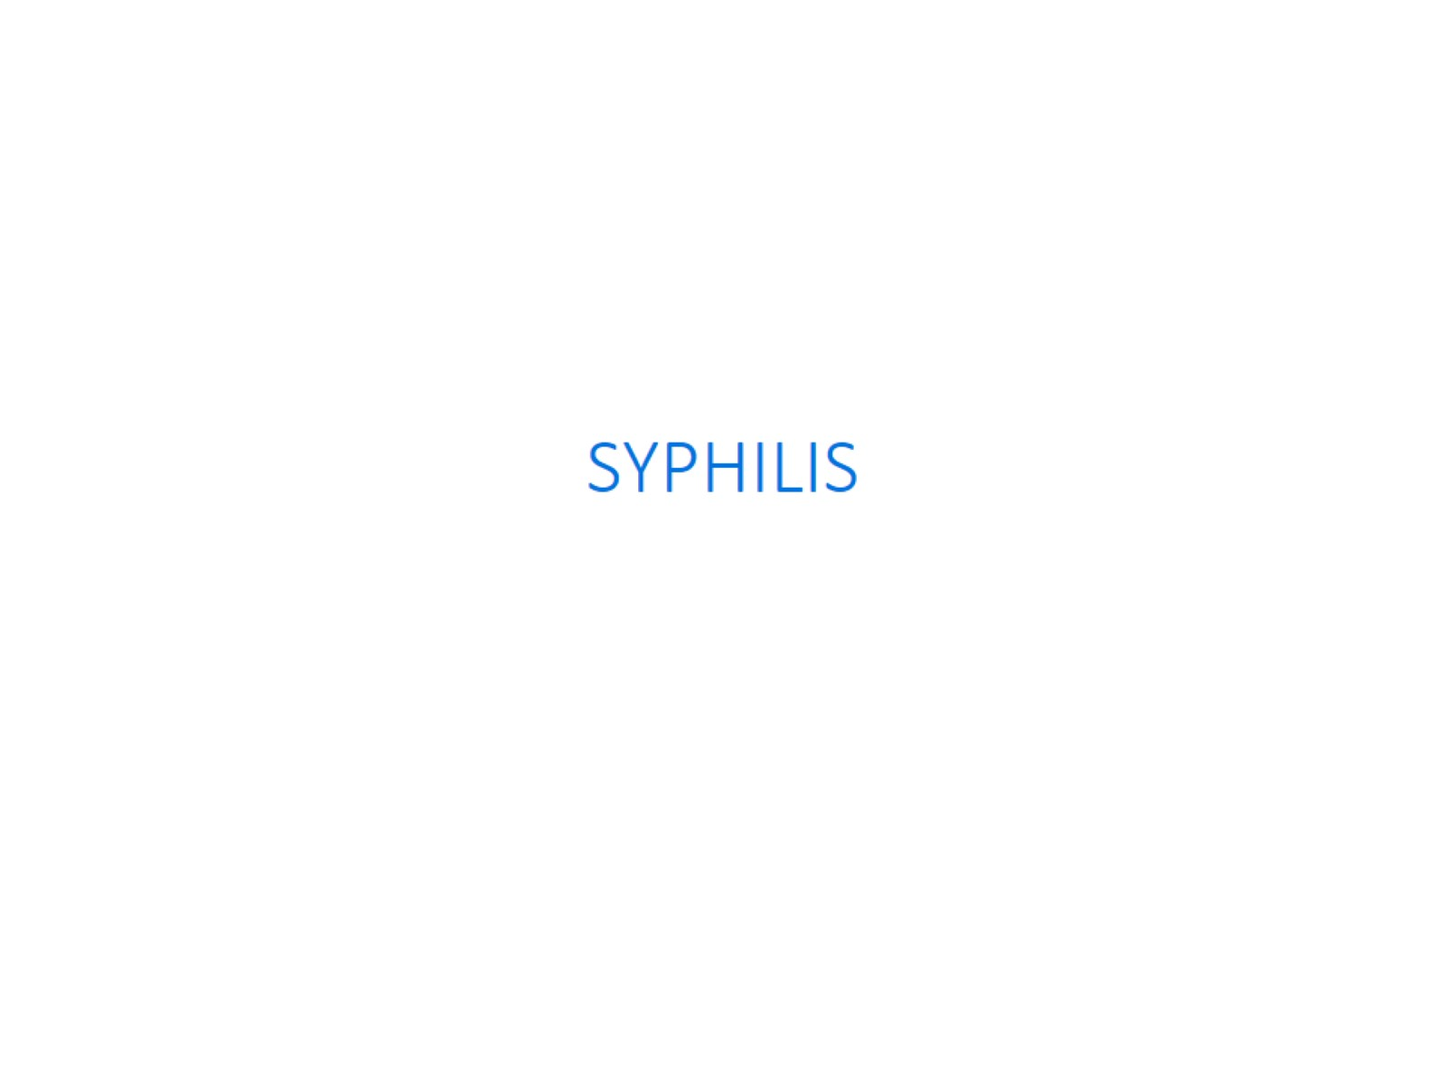

Slide 30
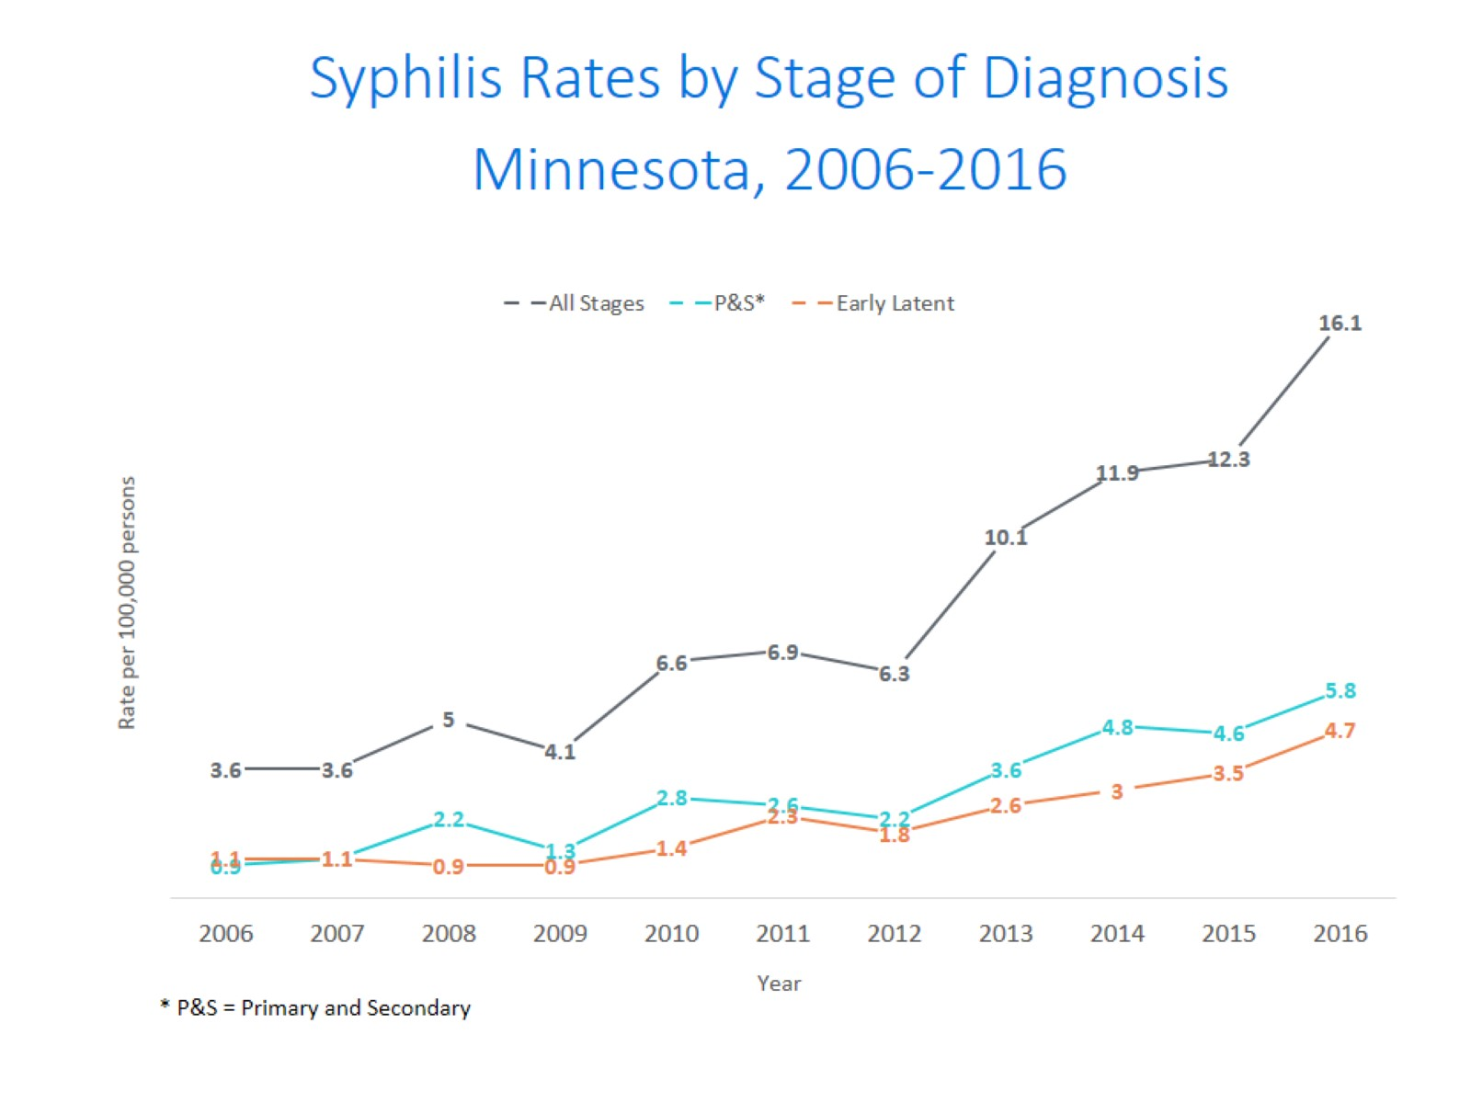
Syphilis Rates by Stage of Diagnosis Minnesota, 2006-2016
Notes:
The overall syphilis rate is now up to 16.1 per 100,000. Compared to the low of 3.6 back in 2006 & 2007.
Of concern is the rate of primary and secondary syphilis which is 5.8 per 100,000.

Slide 31
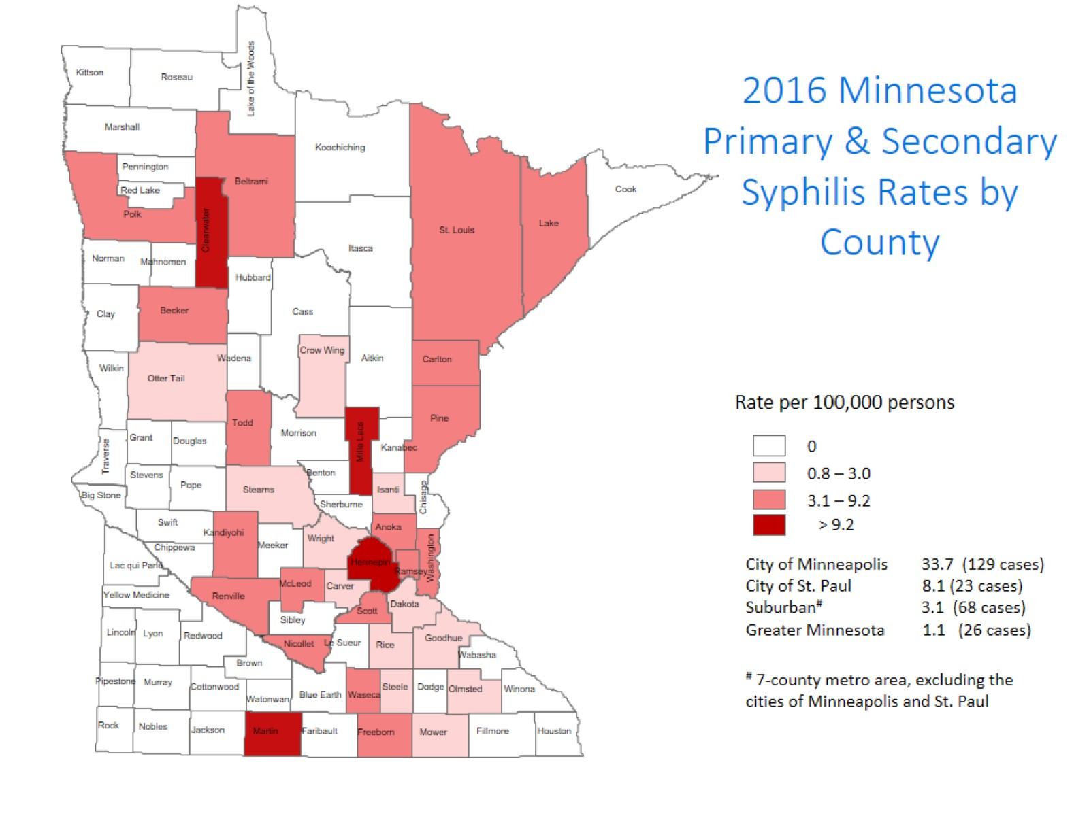
Notes:
The highest rate of primary and secondary syphilis remains in the City of Minneapolis at 33.7 cases per 100,000 population.
The City of St. Paul has the second rate at 8.1 per 100,000.

Slide 32
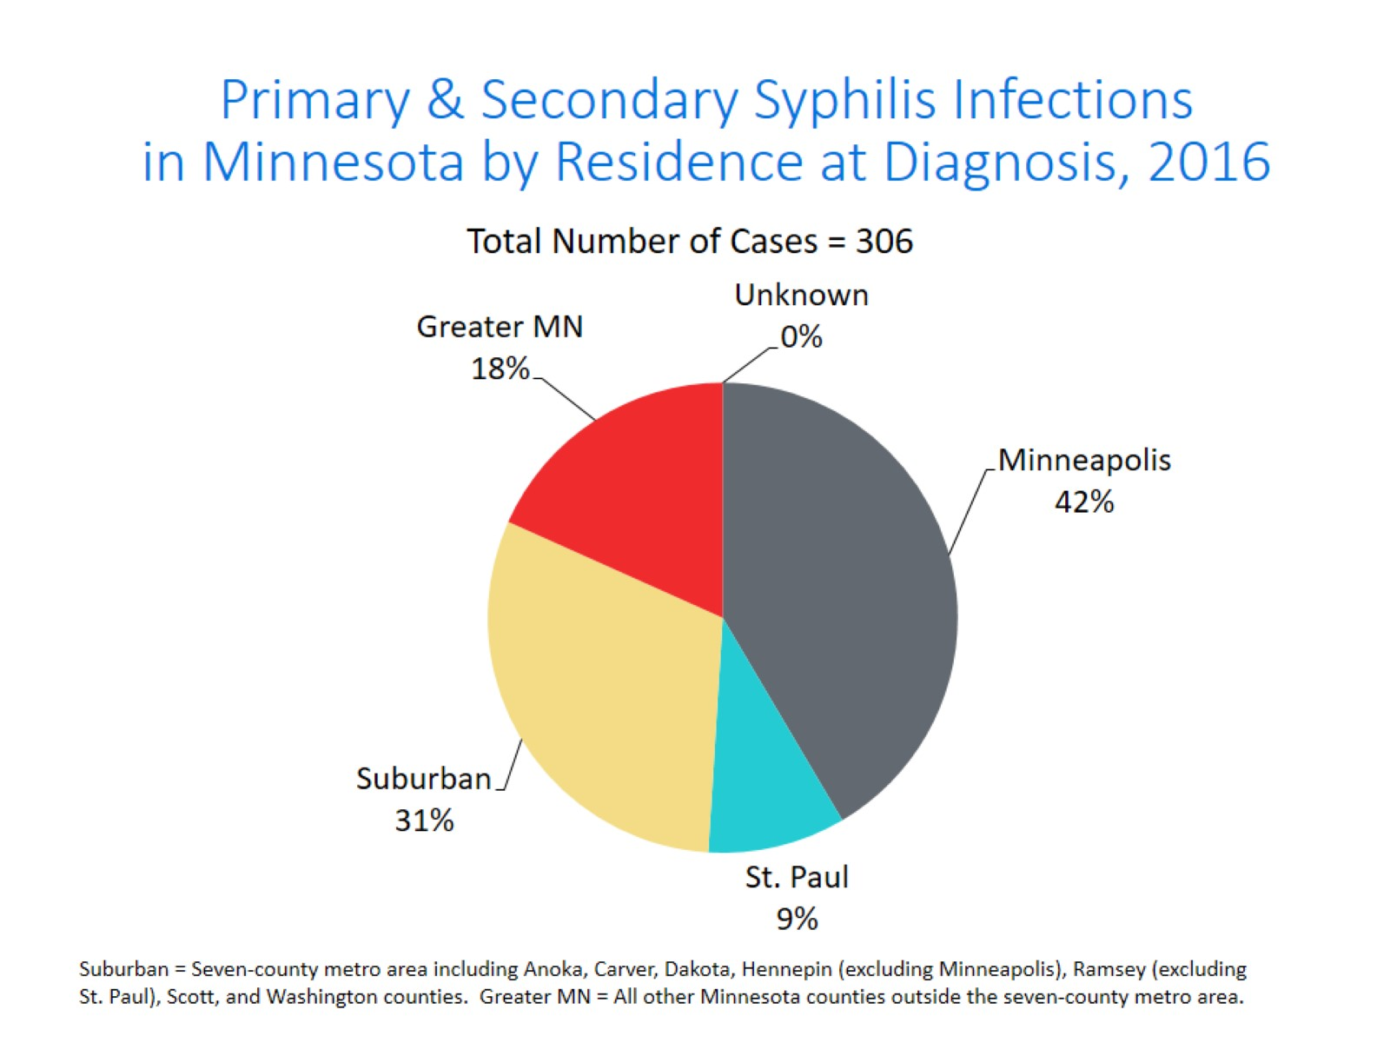
Notes:
The City of Minneapolis has 42% of all reported primary and secondary cases.
The suburban area has 31% of the cases, St. Paul has 9% of the cases, and Greater Minnesota has 18% of the cases.
The largest increase was in Greater Minnesota at 115%

Slide 33
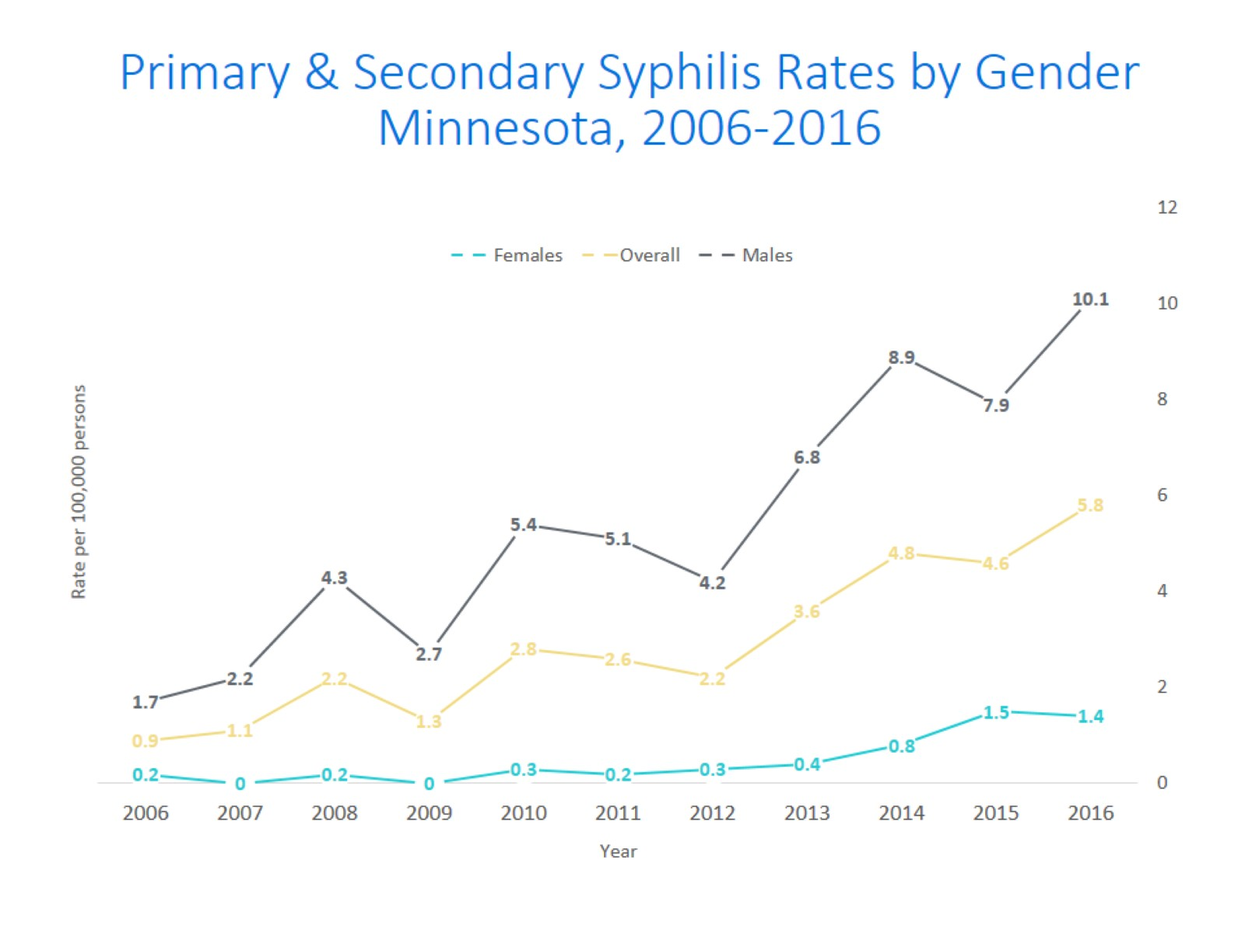
Notes:
Males have the highest rates of primary and secondary syphilis at 10.1 cases per 100,0000 population
The rate of primary and secondary syphilis in females is 1.4 per 100,000 per population.

Slide 34
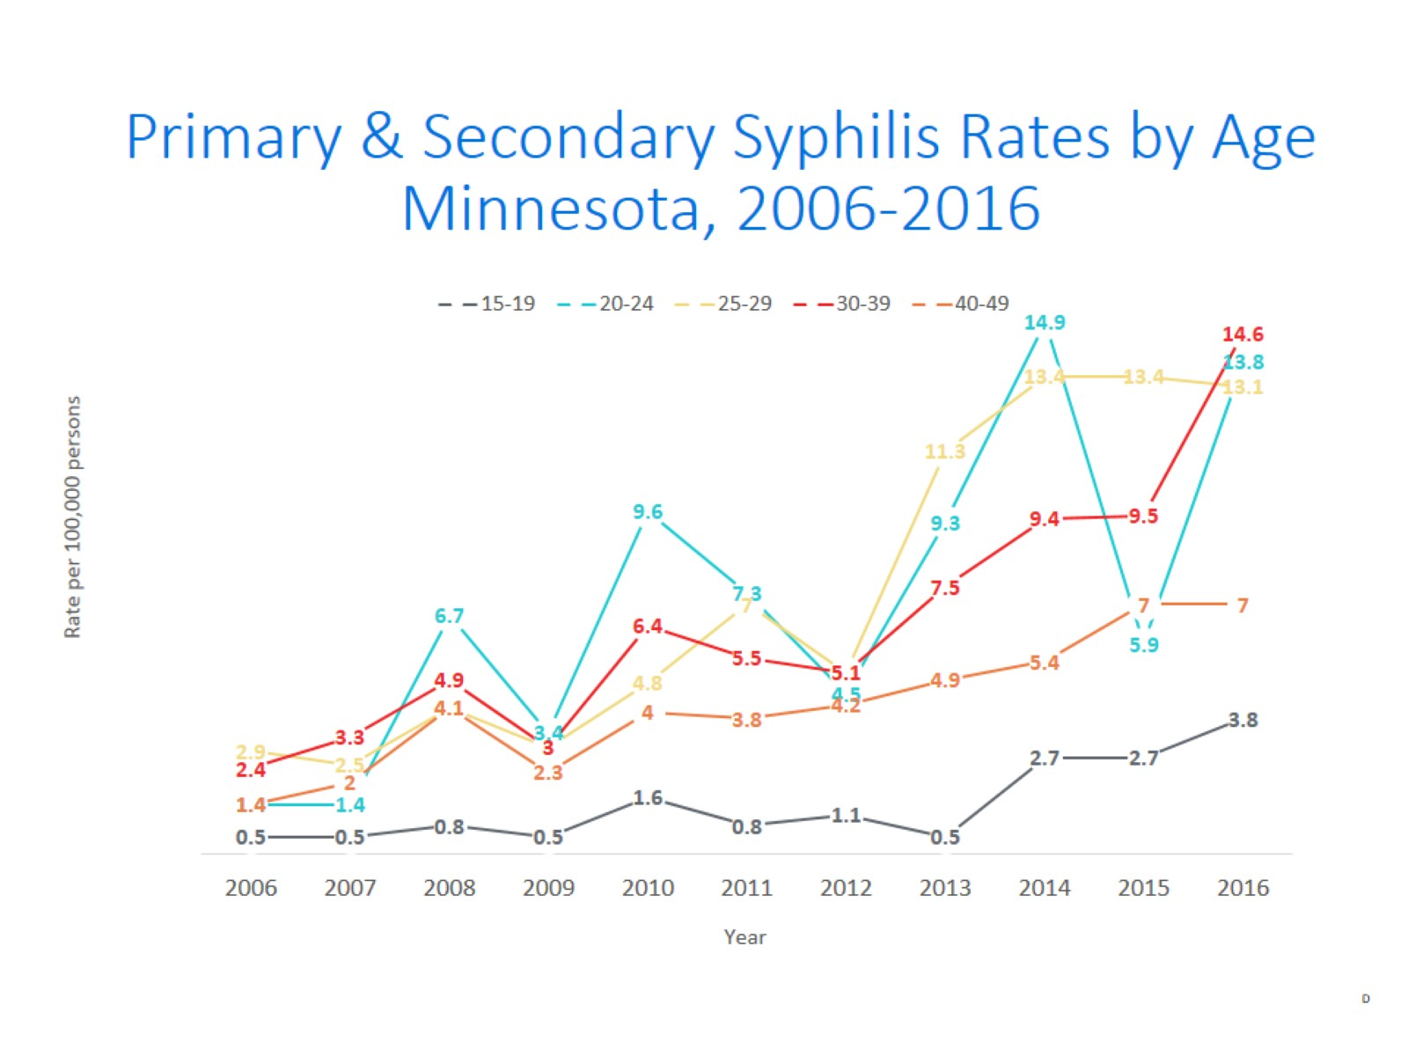
Notes:
The highest rates of primary and secondary syphilis are in the 30-39 year old age group at 14.6 cases per 100,000 population, followed by the 20-24 year old age group at 13.8 cases per 100,000 population.

Slide 35
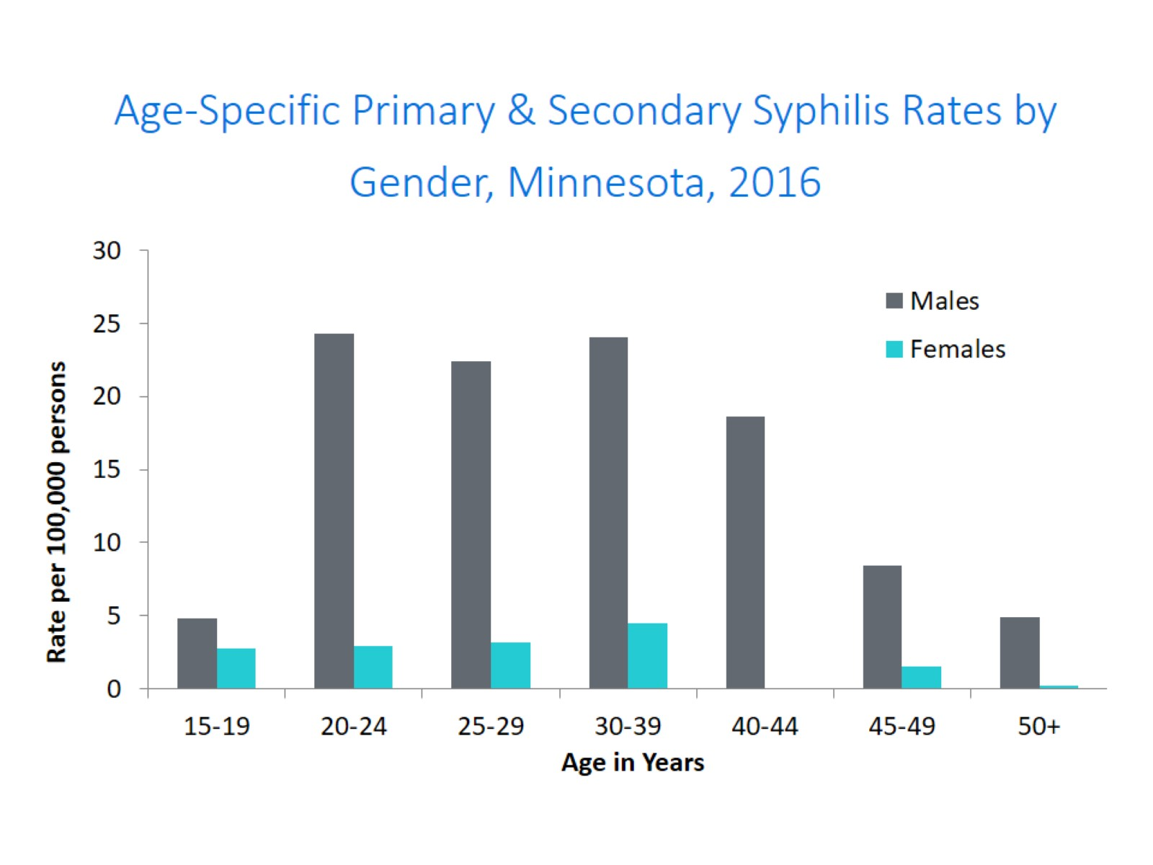
Age-Specific Primary & Secondary Syphilis Rates by Gender, Minnesota, 2016
Notes:
Males have higher rates of primary and secondary syphilis than females in all age groups. The rate in males is 7 times higher than females.
The 20-24 yr old males have the highest rate at 24.3 per 100,000
The 30-39 yr old females have the highest rate of the female population at 4.5 per 100,000

Slide 36
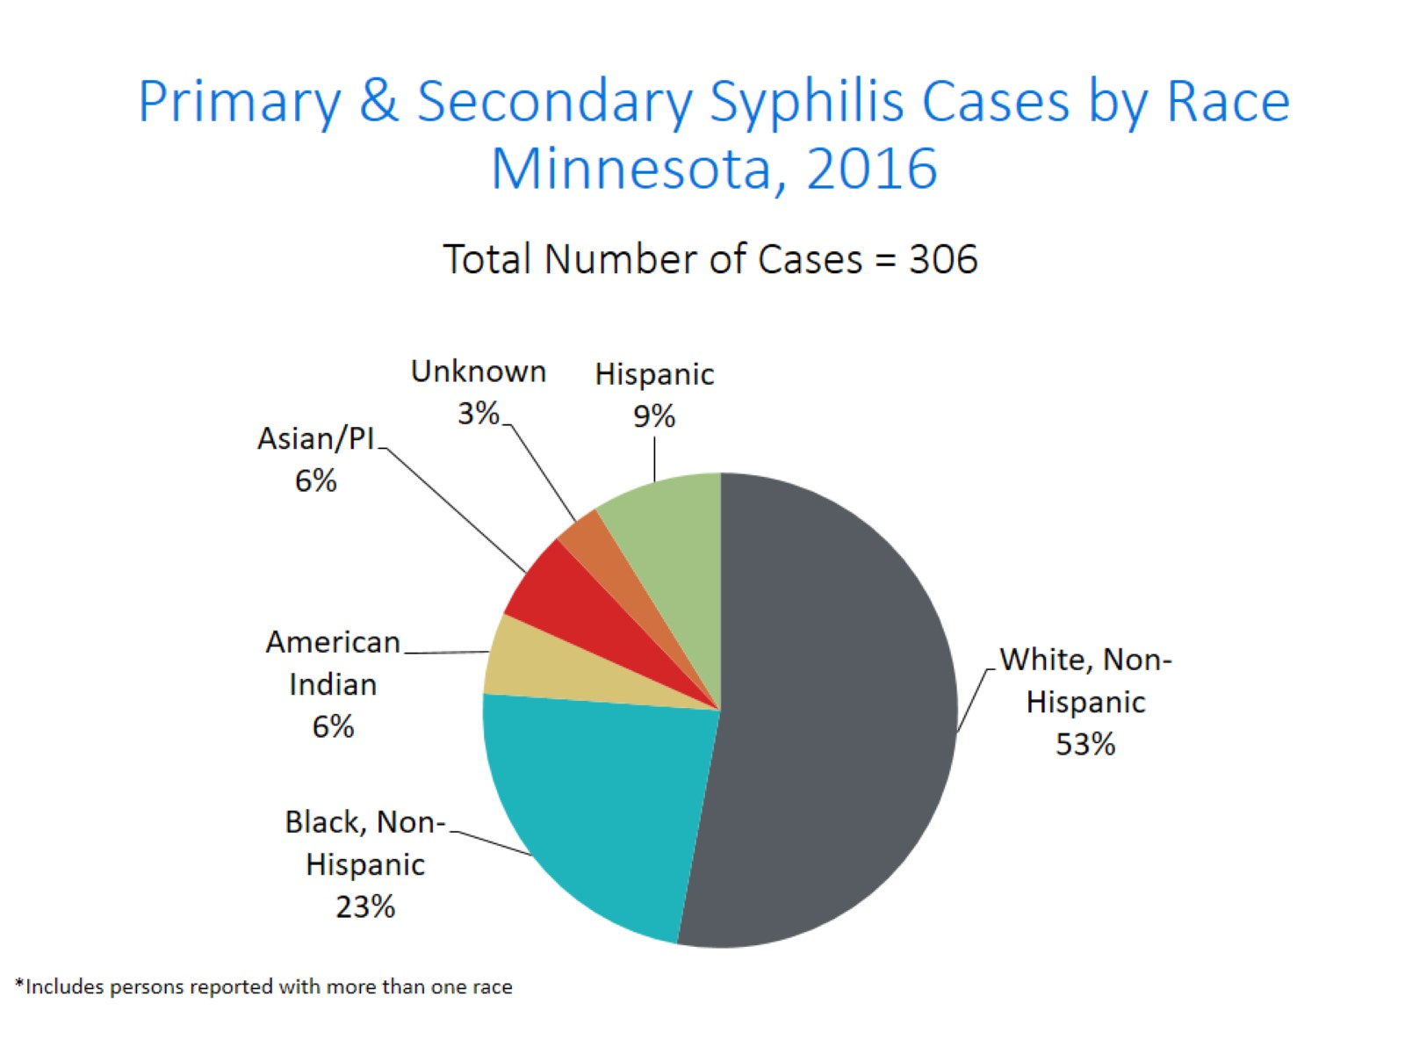
Notes:
Fifty-three percent of all primary and secondary syphilis cases are White, Non-Hispanic.
Black, Non-Hispanic cases are at 23%, Hispanic cases are at 9%, American Indian cases are 6%, and Asian/Pacific Islander cases are also 6%.

Slide 37
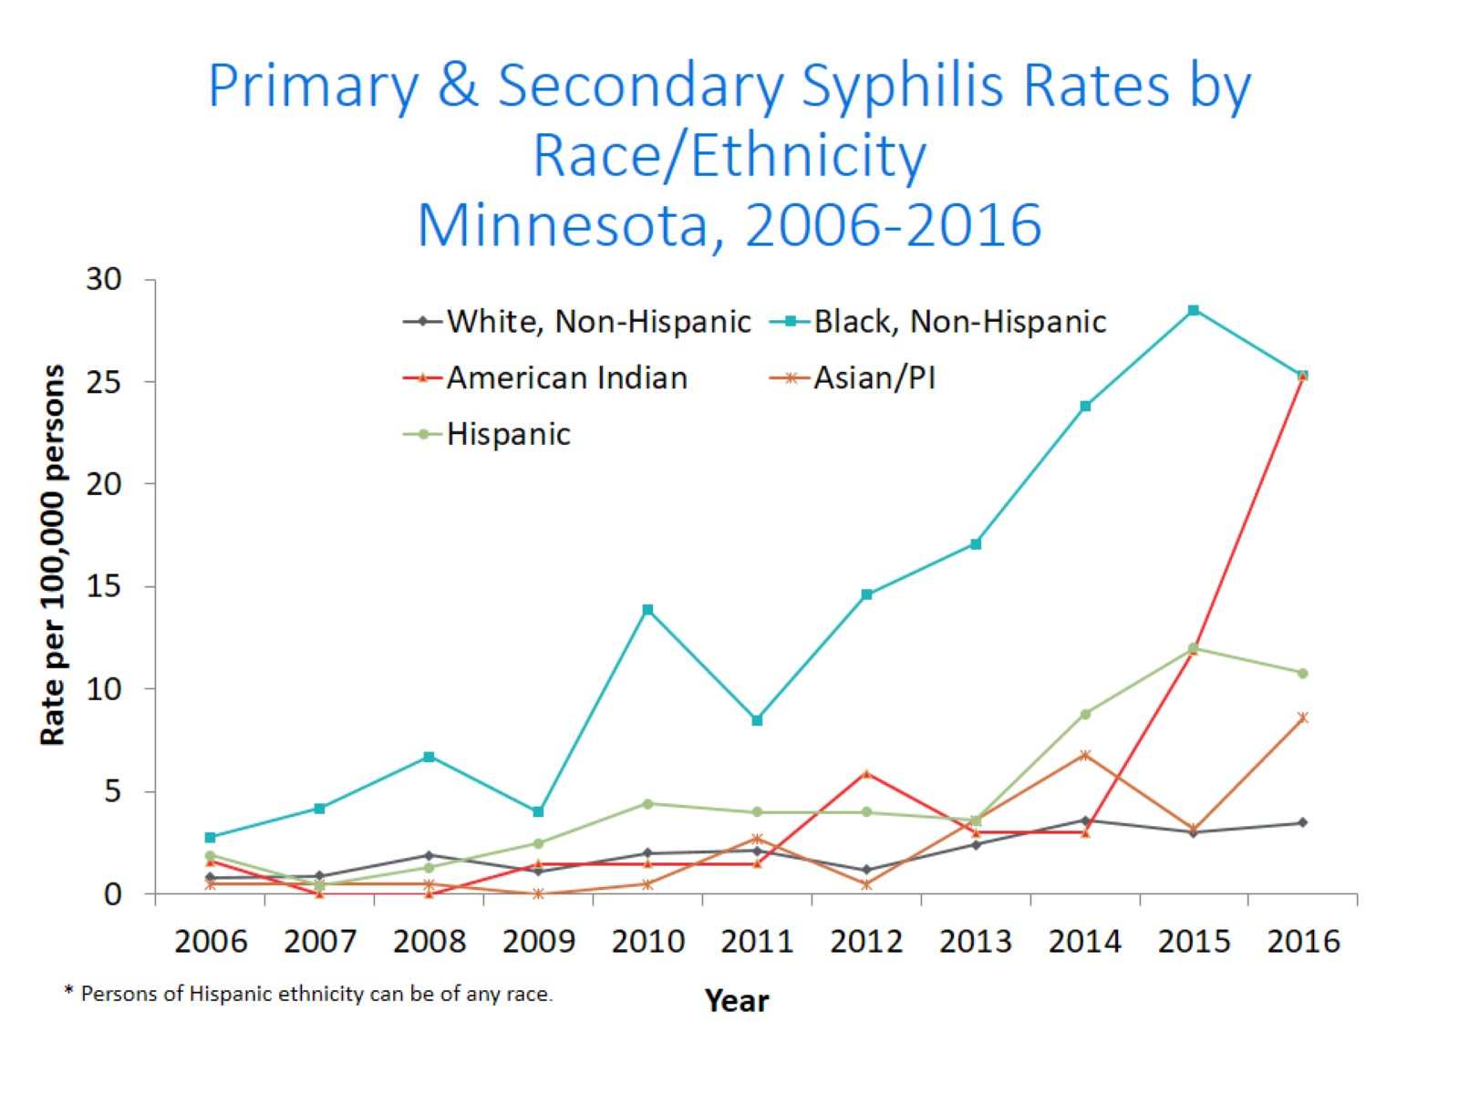
Notes:
The rates of primary and secondary syphilis are 7 times higher in the Black/African American, Non-Hispanic and American Indian populations than that of the White, Non-Hispanic population.
The rates of primary and secondary syphilis in the Black/African American, Non-Hispanic population are 25.3 per 100,000 compared to 3.5 per 100,000 in the White, Non-Hispanic population.
The rates in the American Indian population are also 25.3 per 100,000.
The rates in the Hispanic/Latino population are 10.8 per 100,000 which is 3 times higher than the White, Non-Hispanic population.
The rates in the Asian/Pacific Islander population are 8.6 per 100,000 which is 2.5 times higher than the White, Non-Hispanic population.

Slide 38
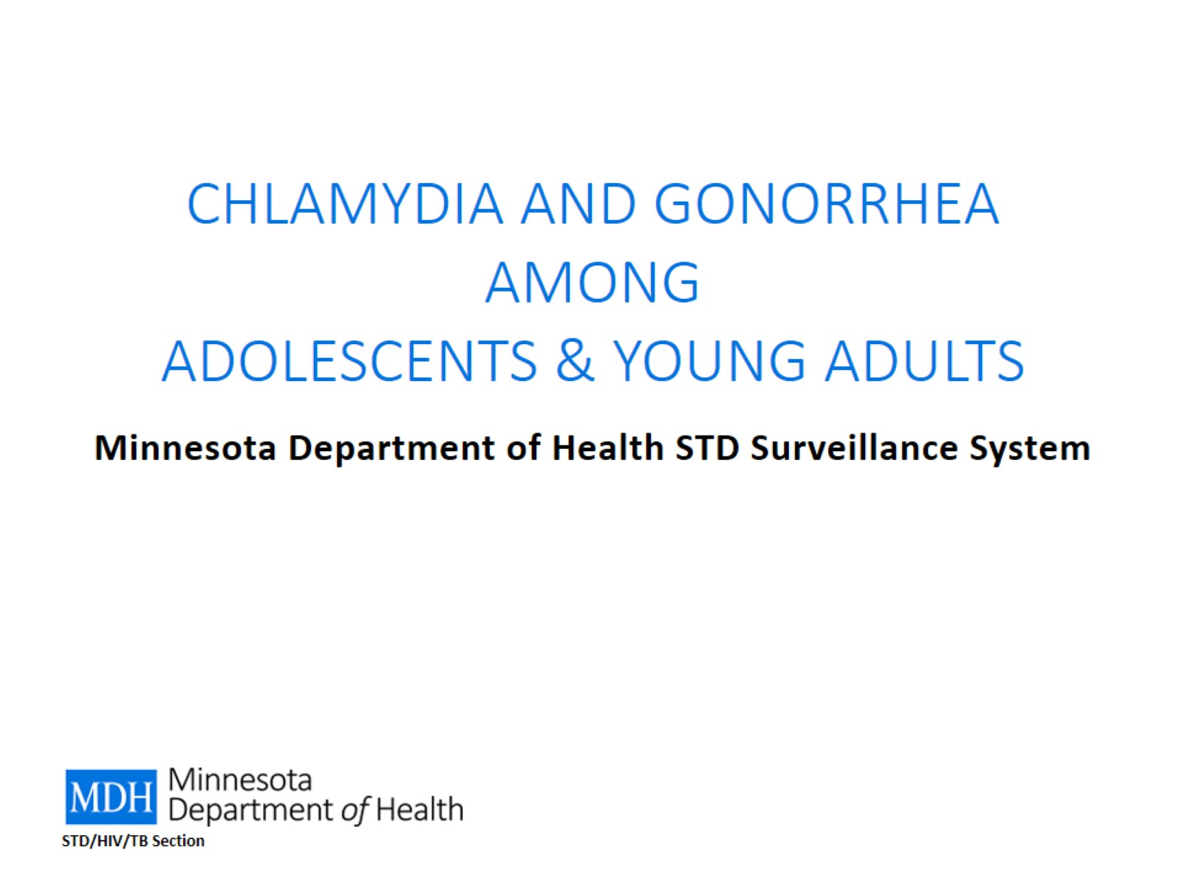
CHLAMYDIA AND GONORRHEA AMONG
ADOLESCENTS & YOUNG ADULTS

Slide 39
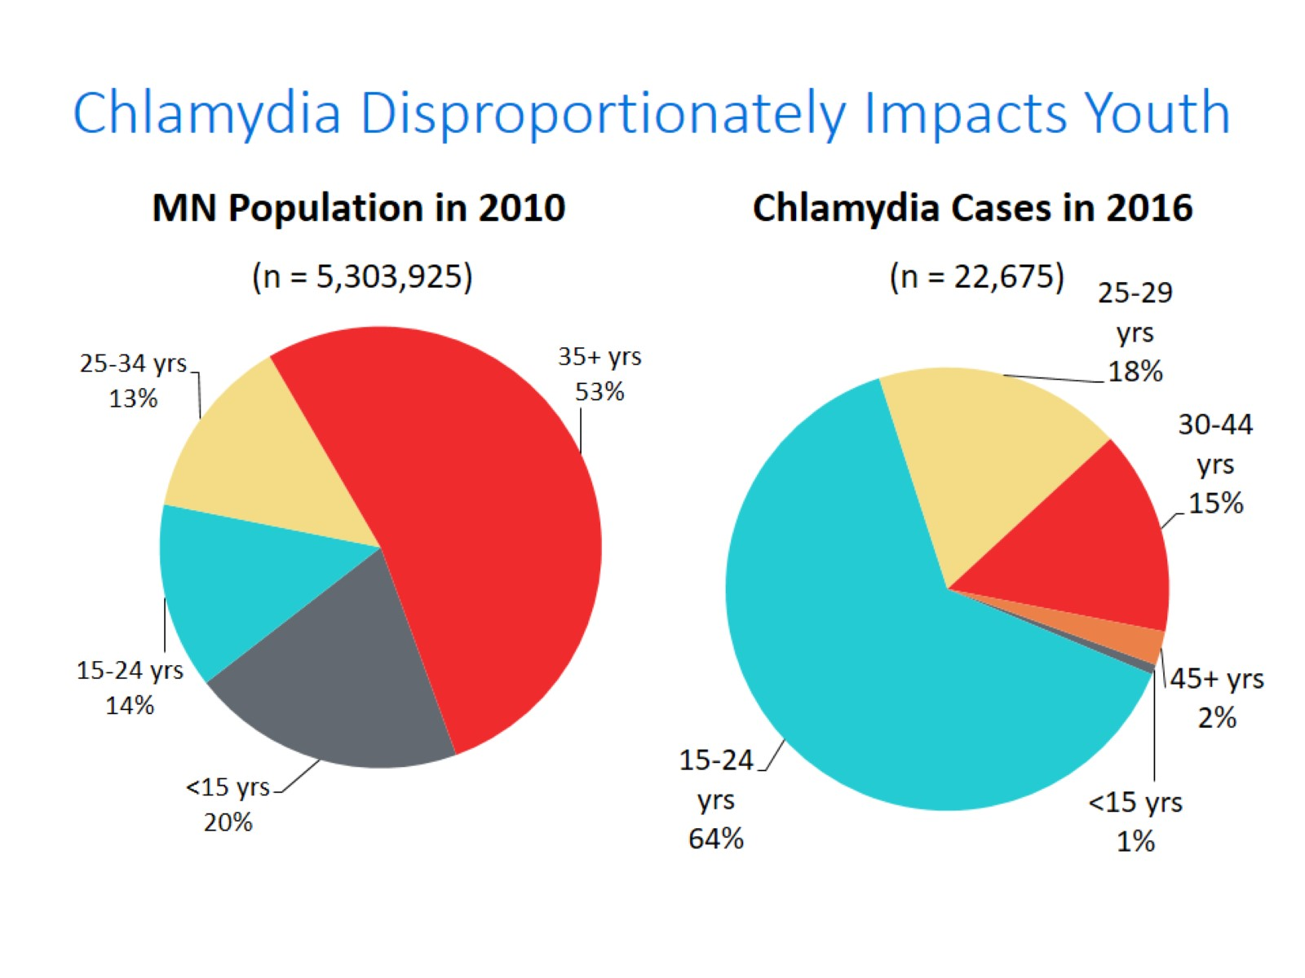
Notes:
Chlamydia continues to disproportionately impact youth. The 15-24 year olds make up only 14% of the population, but account for 64% of all chlamydia cases reported.

Slide 40
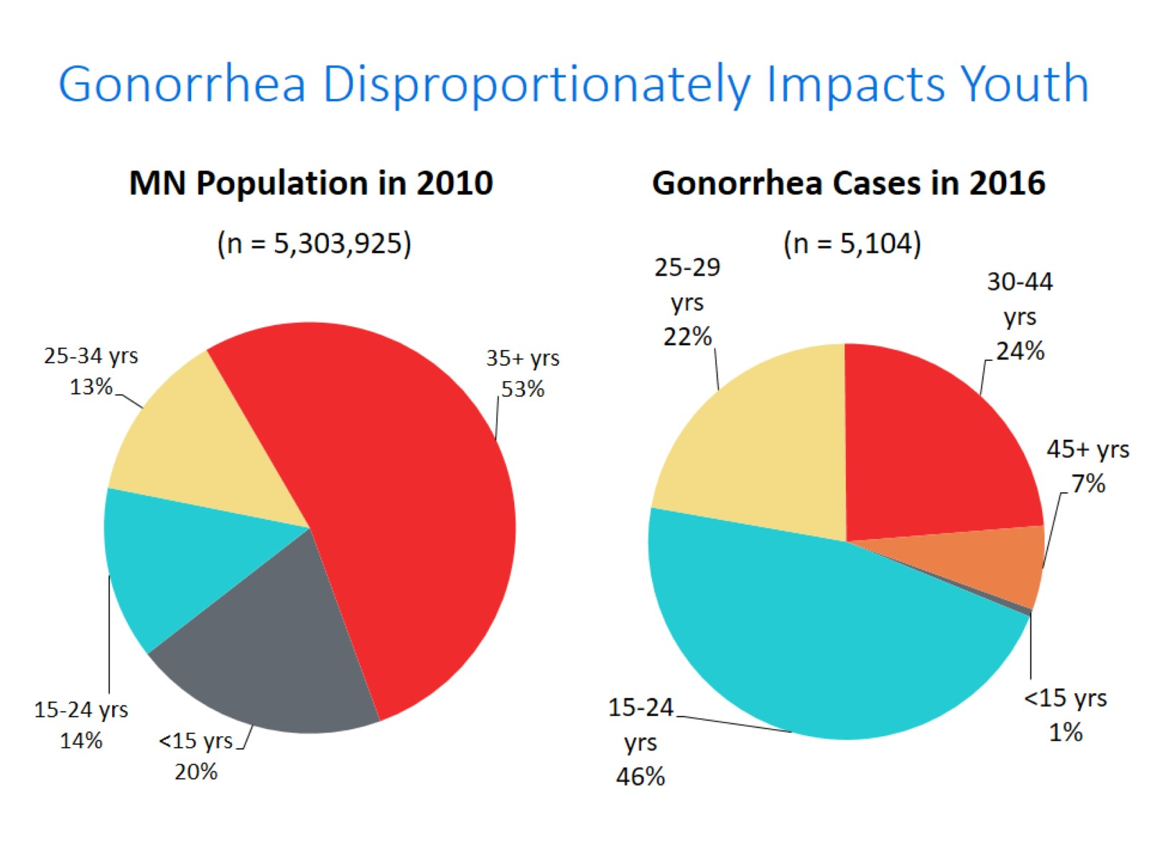
Notes:
Gonorrhea also disproportionately impacts youth. The 15-24 year olds make up only 14% of the population, but account for 46% of all gonorrhea cases reported.

Slide 41
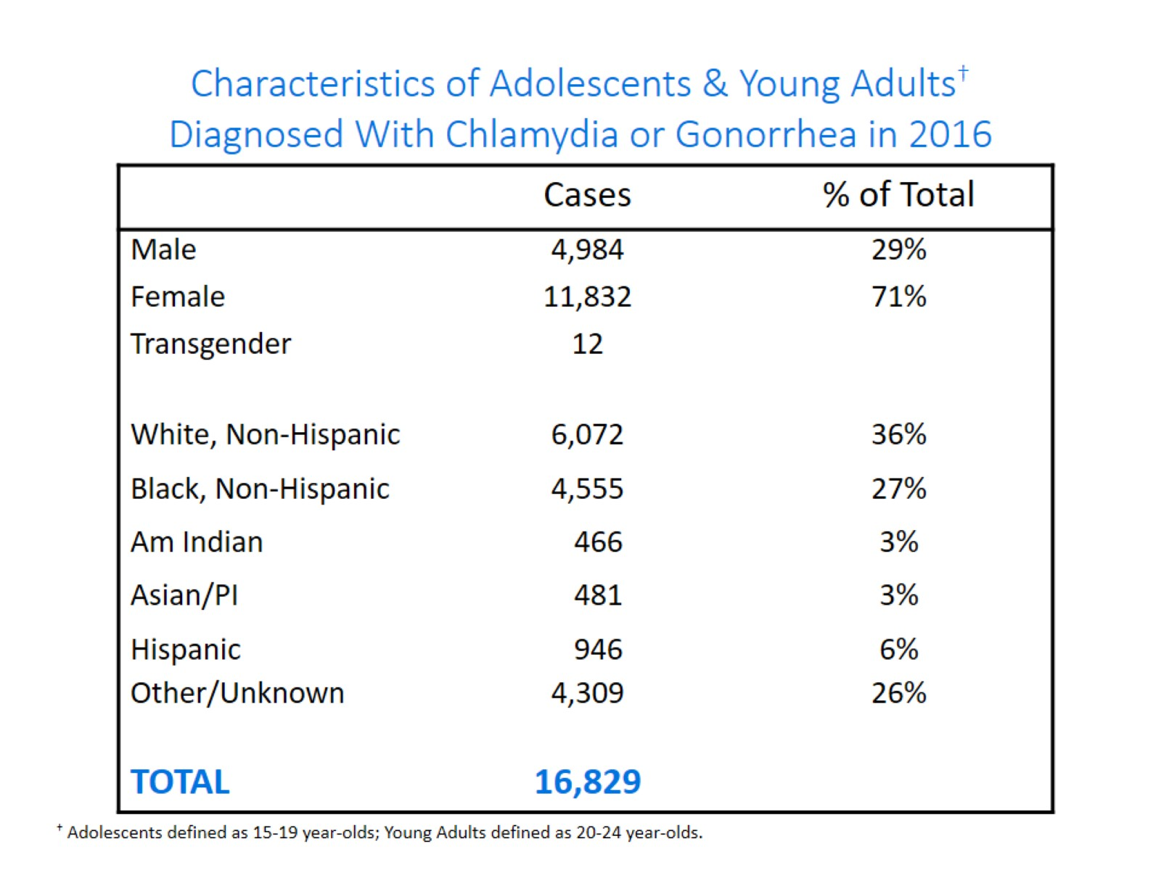
Characteristics of Adolescents & Young Adults†
Diagnosed With Chlamydia or Gonorrhea in 2016

Slide 42
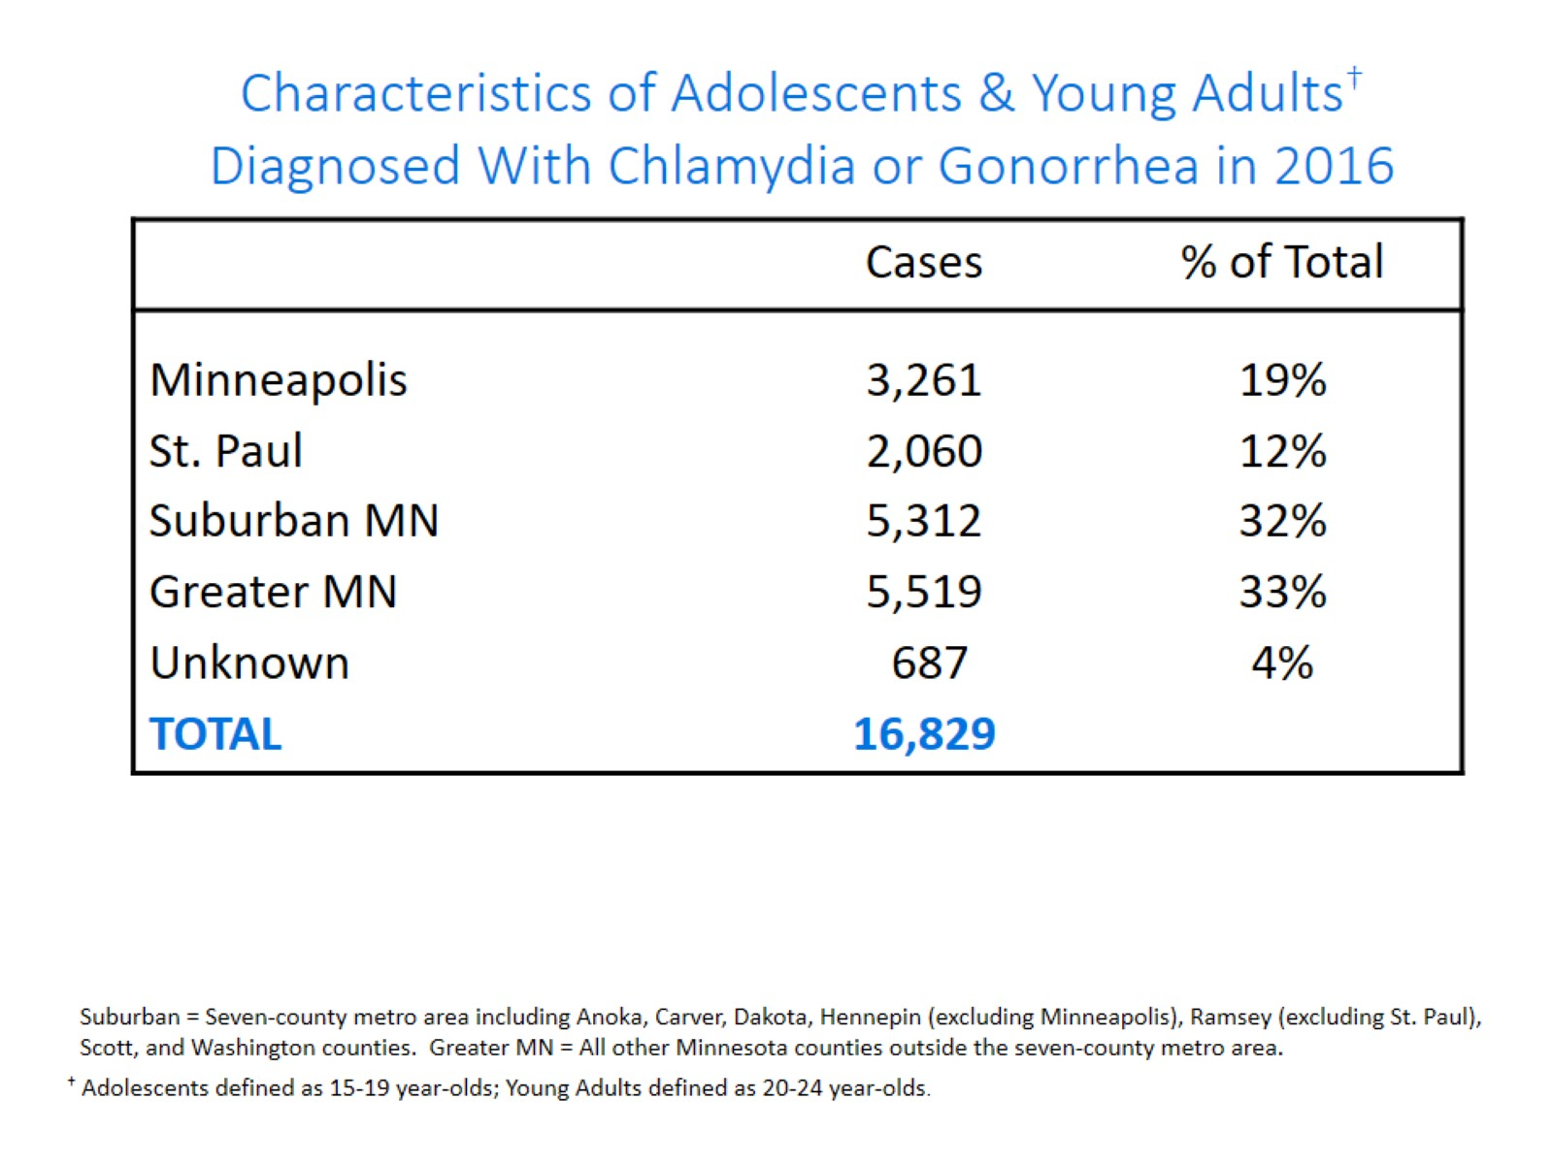
Characteristics of Adolescents & Young Adults† Diagnosed With Chlamydia or Gonorrhea in 2016

Slide 43
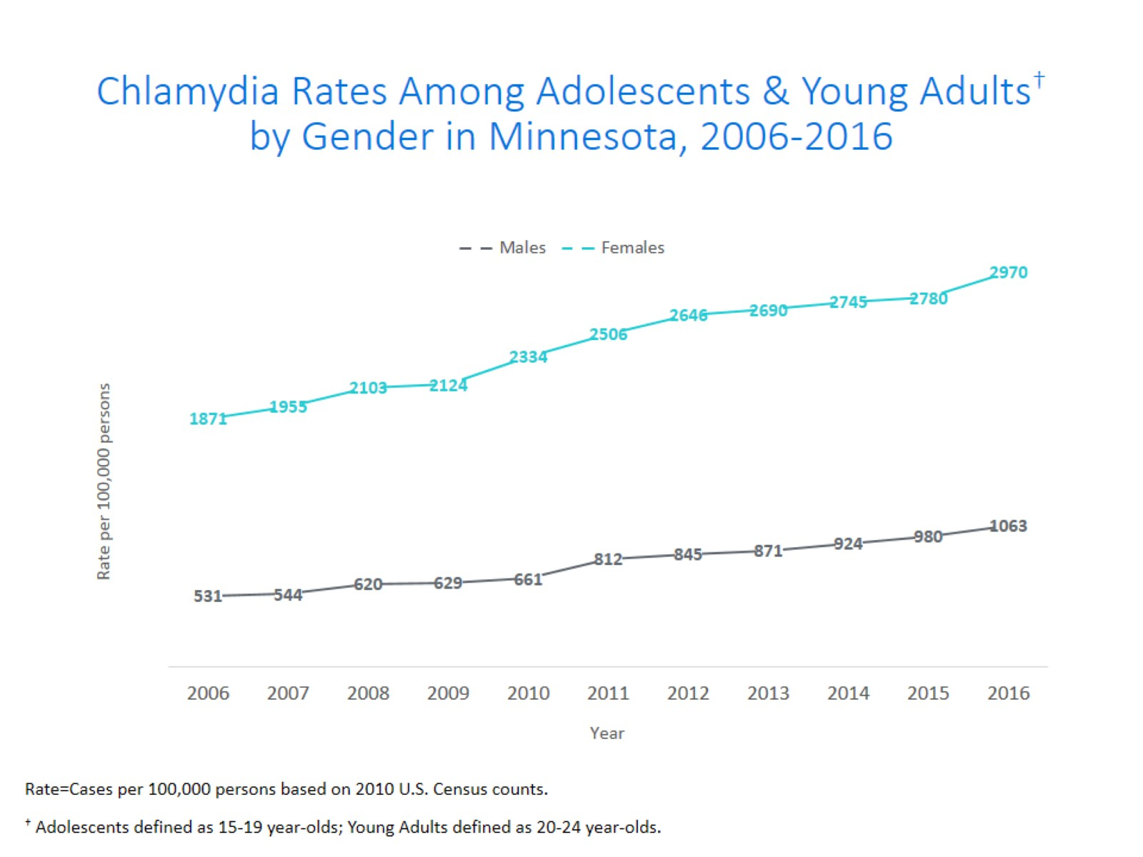
Notes:
The rates of chlamydia are higher in females compared to males in the 15-24 year old age group. The rates for females are 2970 per 100,000 population compared to males at 1063 per 100,000 population.

Slide 44
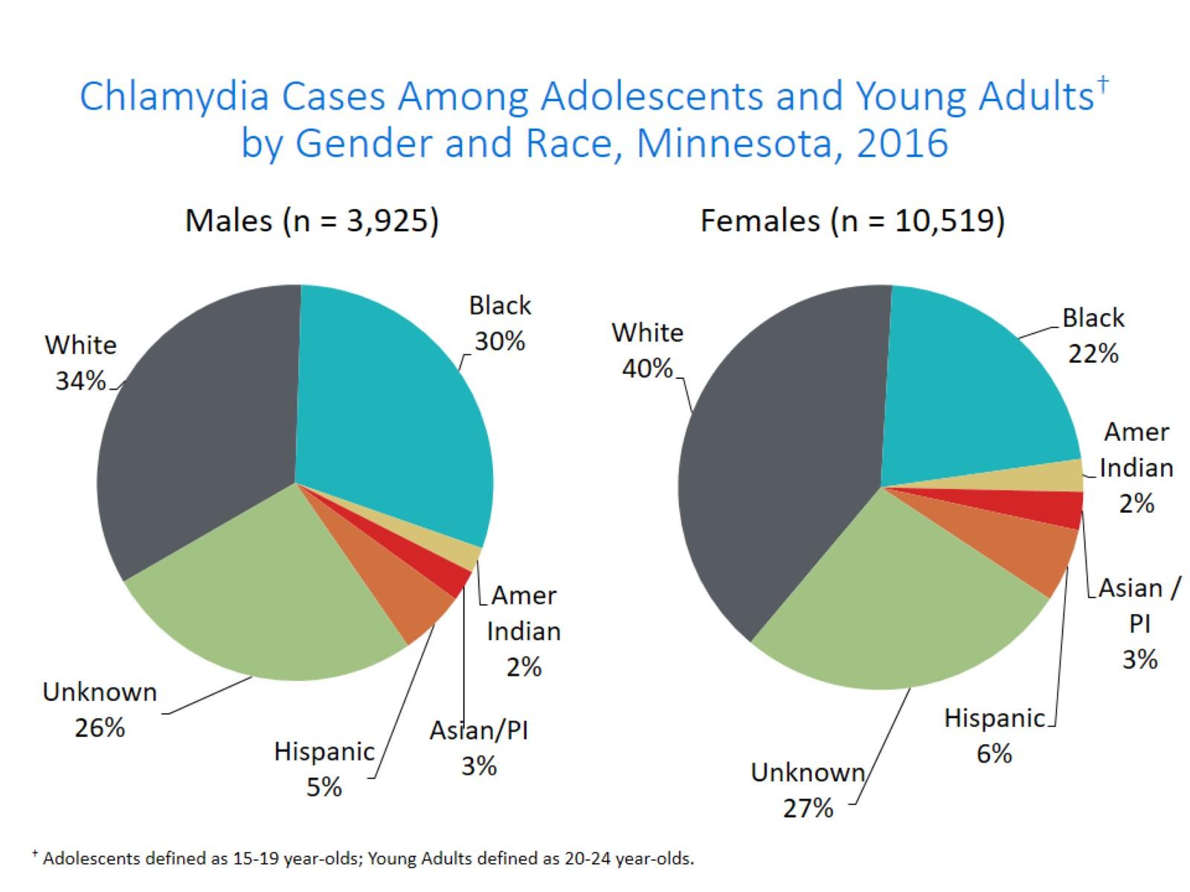
Notes:
There are a large number of chlamydia cases among adolescents and young adults that are missing race/ethnicity when reported.

Slide 45
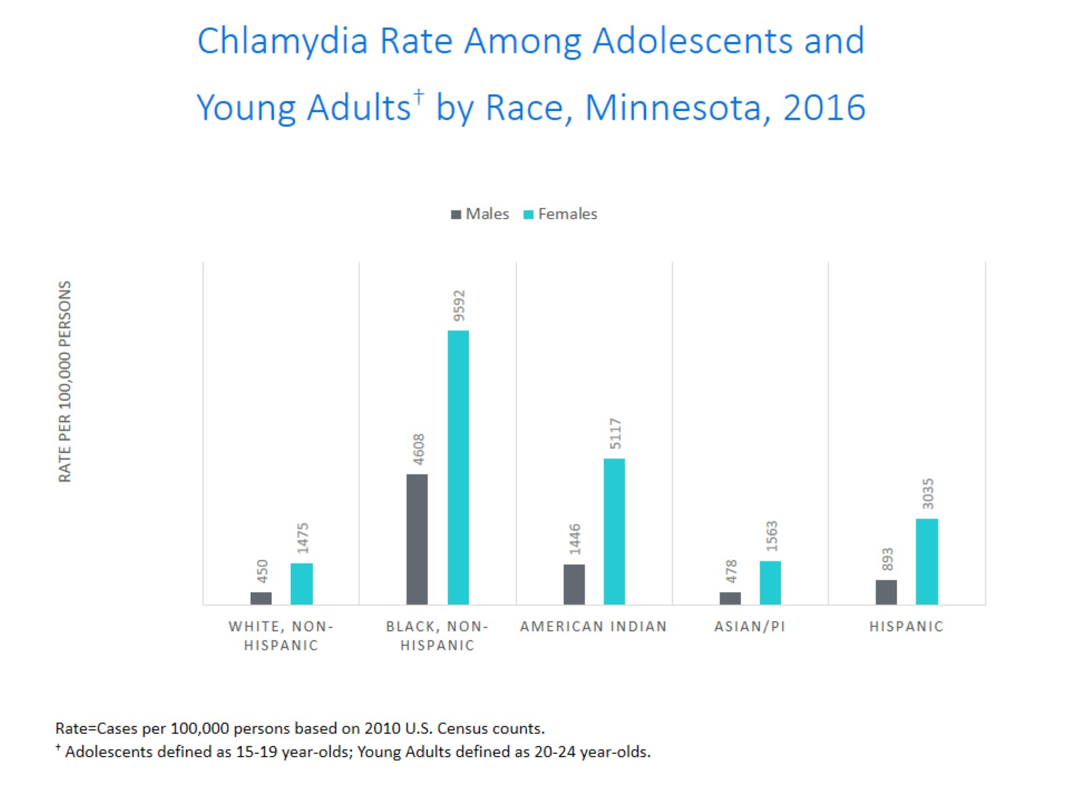
Chlamydia Rate Among Adolescents and
Young Adults† by Race, Minnesota, 2016
Notes:
The highest rates among adolescents and young adults are among females in the Black, Non-Hispanic community. Their rate is 9952 per 100,000 population.
Black, Non-Hispanic males also have the highest rates among adolescent and young adult males at 4608 per 100,000 population.

Slide 46
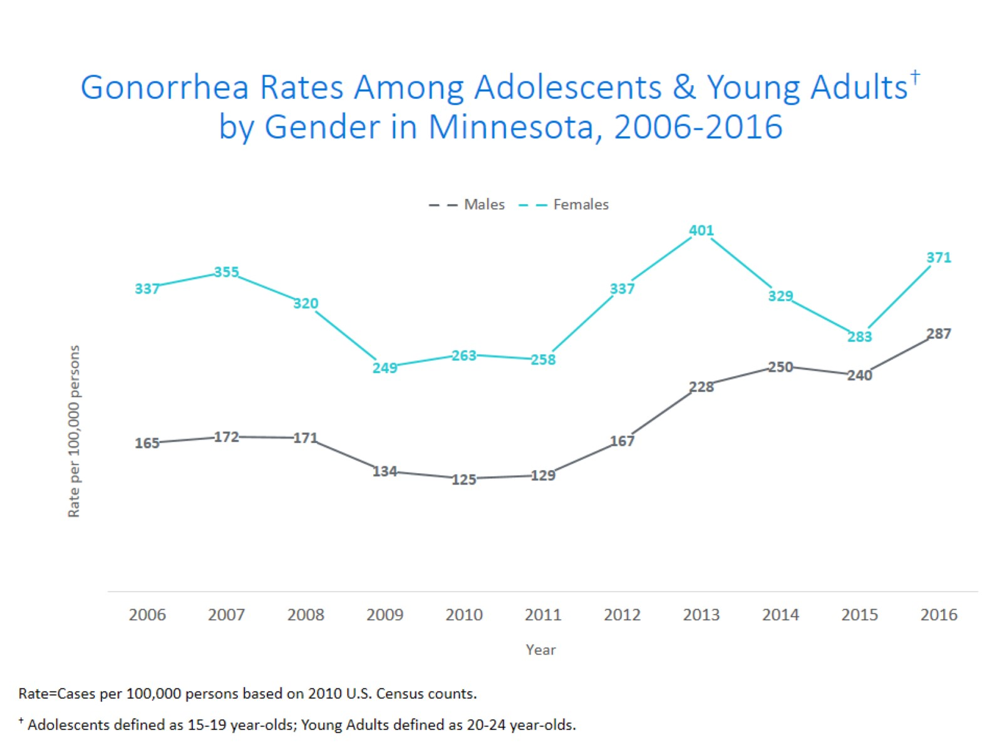
Notes:
The rates of gonorrhea in adolescent and young adults increased in both males and females.
The rate in adolescent and young adult females increase more than males and is now at 371 per 100,000 population.

Slide 47
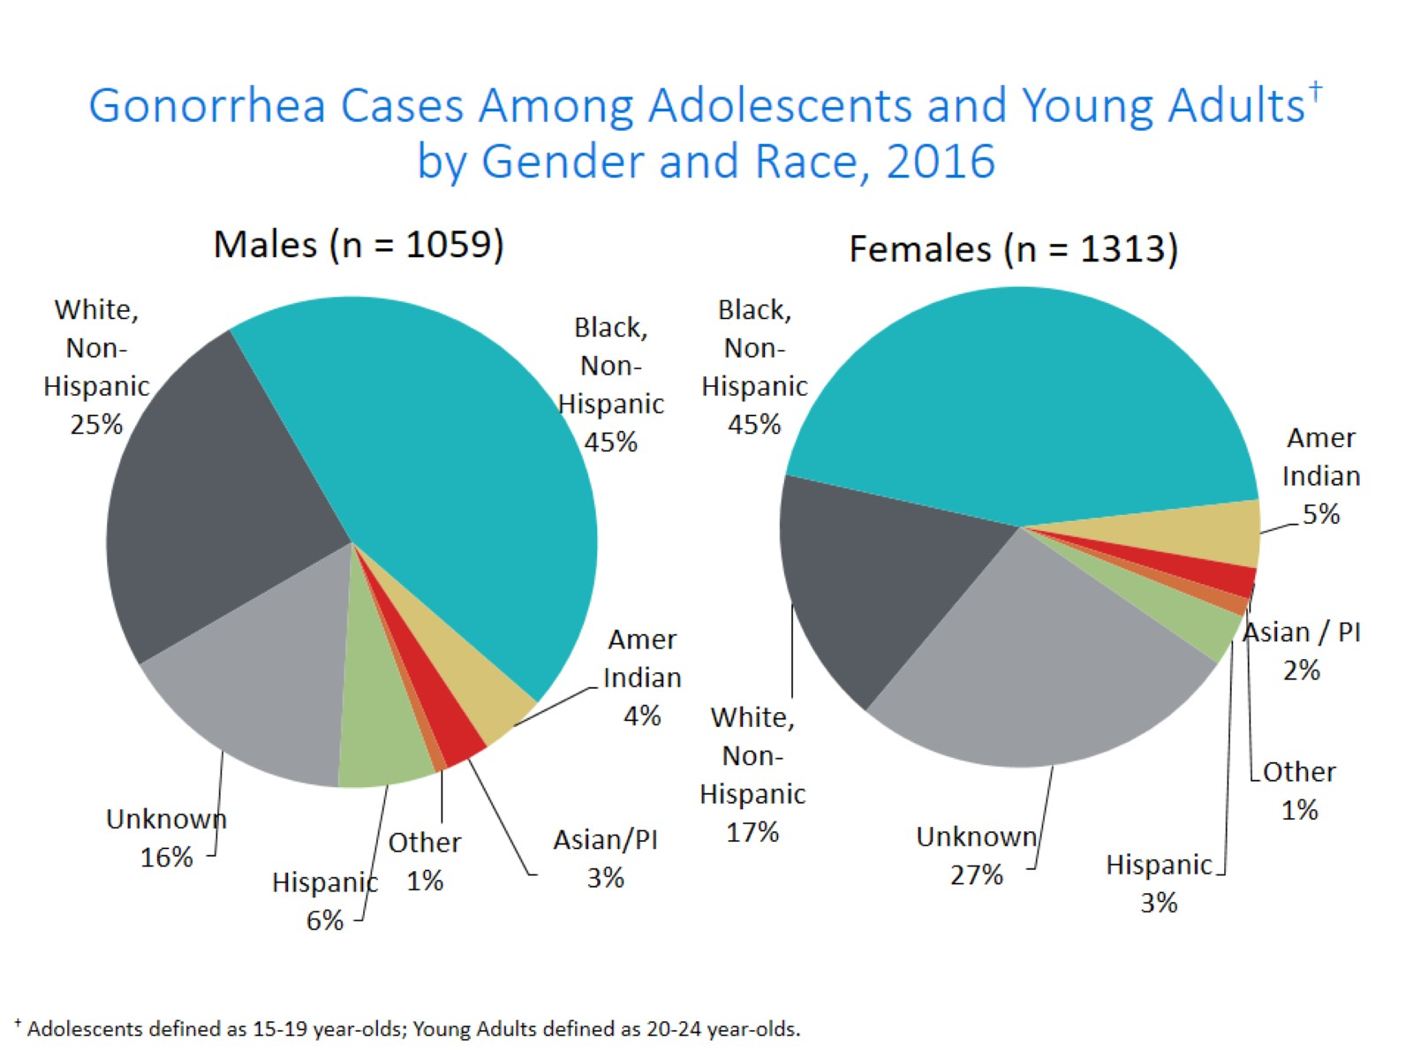
Notes:
Black, Non-Hispanic males make up 45% of gonorrhea cases in male adolescent and young adults.
Black, Non-Hispanic females also make up 45% of gonorrhea cases in female adolescent and young adults

Slide 48
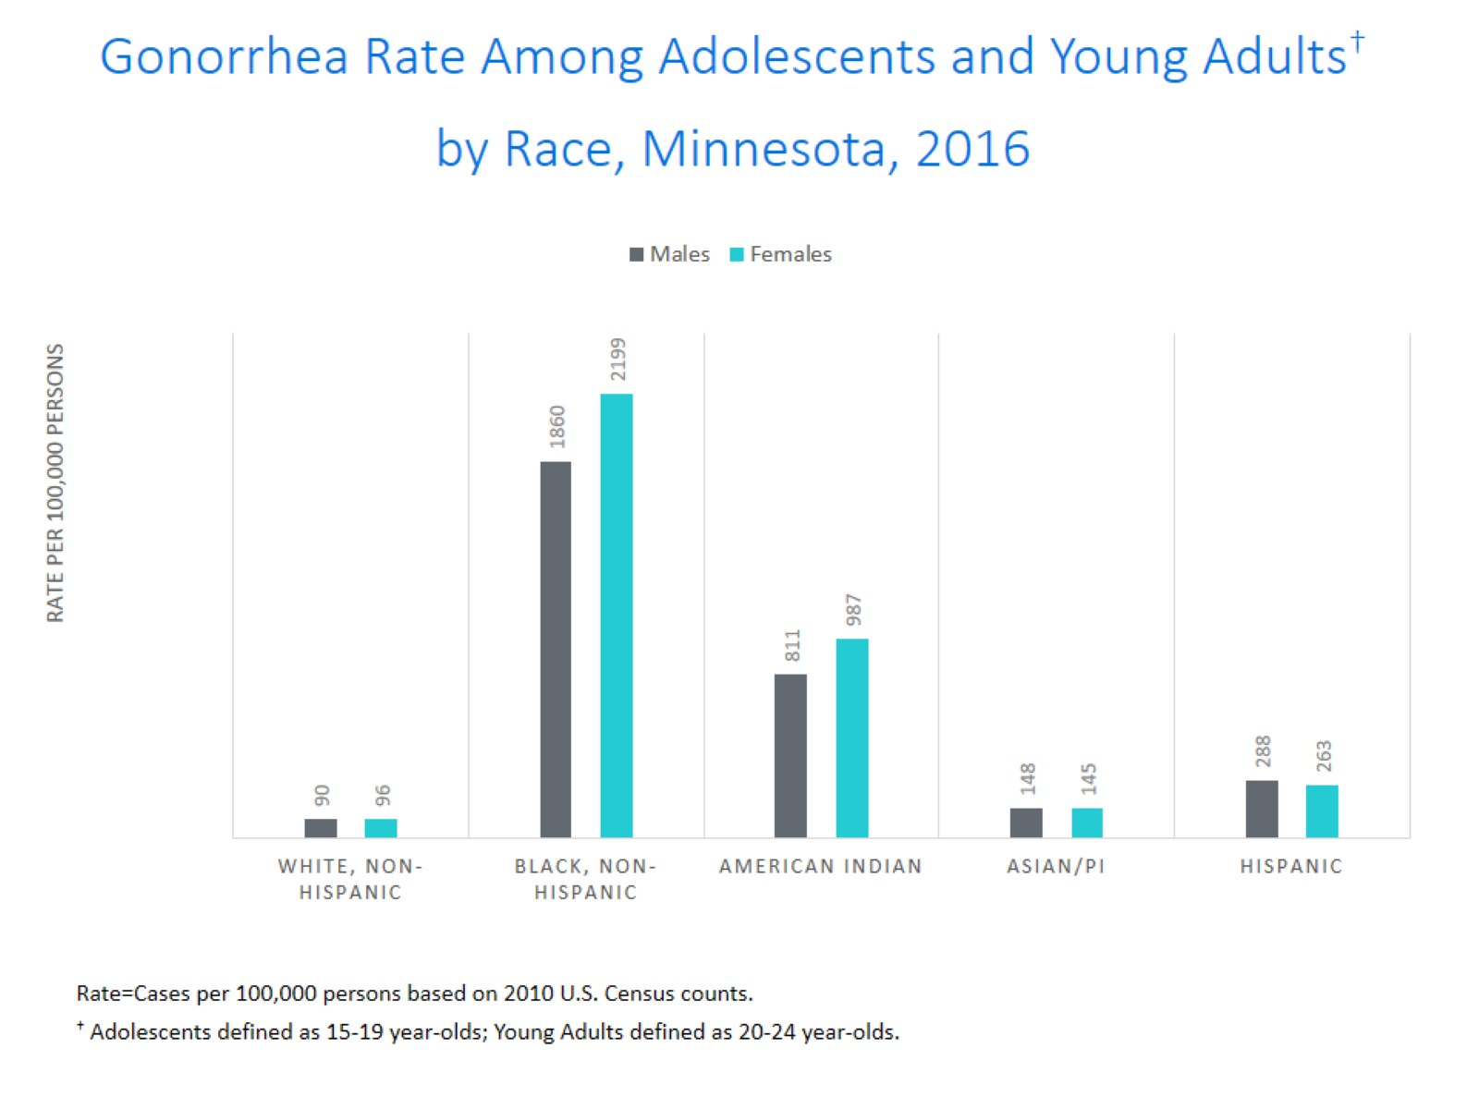
Gonorrhea Rate Among Adolescents and Young Adults† by Race, Minnesota, 2016
Notes:
Black, Non-Hispanic and American Indian males and females adolescents and young adults are disproportionately affected by gonorrhea.

Slide 49
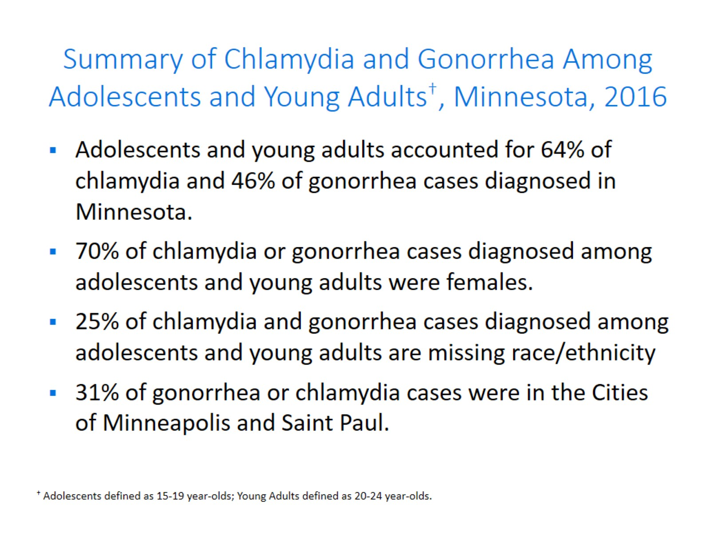
Summary of Chlamydia and Gonorrhea Among Adolescents and Young Adults†, Minnesota, 2016

Slide 50
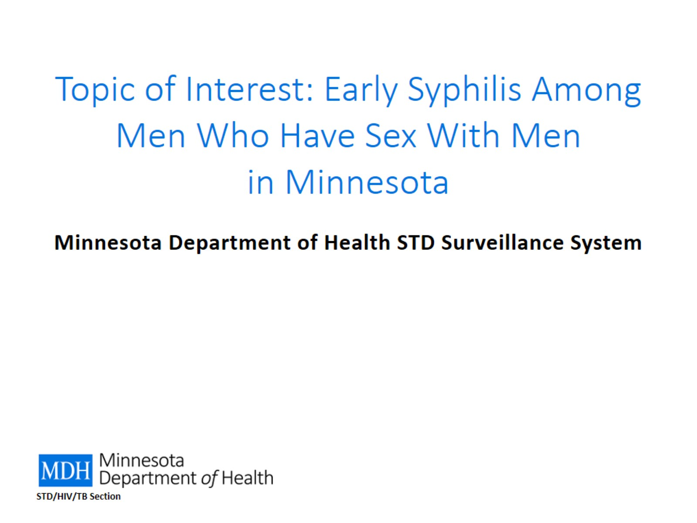
Topic of Interest: Early Syphilis Among
Men Who Have Sex With Men in Minnesota

Slide 51
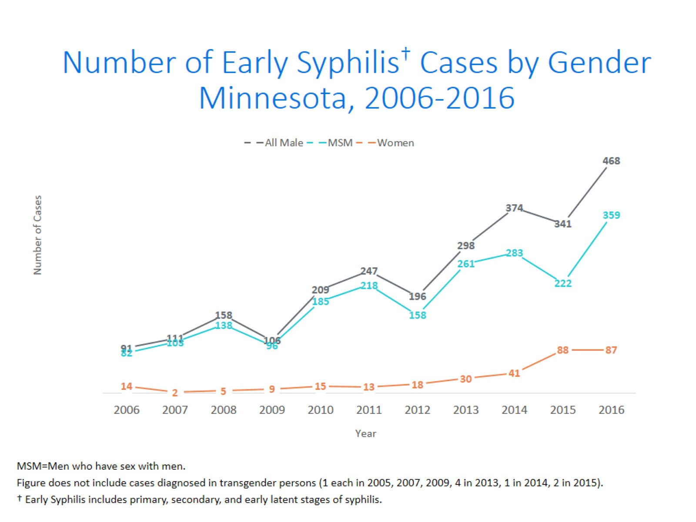
Notes:
Men who have sex with men (MSM) make up the majority of early syphilis cases.

Slide 52

Notes:
There were 557 early syphilis cases reported in 2016.
251 of the cases were staged as early latent, followed by 164 secondary, and 142 primary.

Slide 53

Early Syphilis† by Gender and Sexual Behavior Minnesota, 2006-2016

Slide 54

Early Syphilis† Cases Among MSM by Age Minnesota, 2016 (n=359)
Notes:
The average age of MSM with early syphilis 36 years of age.
Ages ranged from 16 – 72 years of age
The 25-29 year old age group had the highest number of cases at 66.

Slide 55

Early Syphilis† (ES) Cases
Co-infected with HIV, 2006-2016
Notes:
Thirty percent of all early syphilis cases were co-infected with HIV.
Forty-four percent of all MSM early syphilis cases were co-infected with HIV.

Slide 56

Characteristics of Early Syphilis† Cases
Among MSM, Minnesota, 2016

Slide 57

Topic of Interest: Syphilis Among
Females and Congenital Syphilis in Minnesota

Slide 58

Female Early Syphilis cases

Slide 59

Notes:
Thirty-eight percent of female early syphilis cases were residents of the City of Minneapolis
Twenty-five percent of female early syphilis cases were residents of the Suburbs of the seven-county metro area
Nineteen percent were City of St. Paul residents, and 18% were Greater MN residents.

Slide 60

Notes:
There are large disparities in women with syphilis. Thirty-nine percent of all early syphilis cases in females are found in the Black/African American population and 15% in the American Indian population.

Slide 61

What’s Being Done in Minnesota?

Slide 62

STD Surveillance Summary

Slide 63

Summary of STD Trends in Minnesota

Slide 64

Future Updates to STD Reporting and Current Follow-Up

