Slide 1

2021 Marks the 40th Anniversary of AIDS Discovery

Slide 2
Sexually Transmitted Disease (STD) Surveillance Report, 2020
Minnesota Department of Health STD Surveillance System
Notes:
Welcome to MDH's annual data release! We will start with a presentation about the 2020 STD data, and next move to the presentation about the 2020 HIV data.

Slide 3
STDs in Minnesota:
Number of Cases Reported in 2020
Total of 33,252 STD cases reported to MDH in 2020:
  21,942 Chlamydia cases
  10,217 Gonorrhea cases
  1,093 Syphilis cases (all stages)
  0 Chancroid cases
Notes:
In the year 2020, a total of 33,252 STD cases were reported to the Minnesota Department of Health:
21,942 Chlamydia cases
10,217 Gonorrhea cases
1093 Syphilis cases (all stages)
0 Chancroid cases

Slide 4
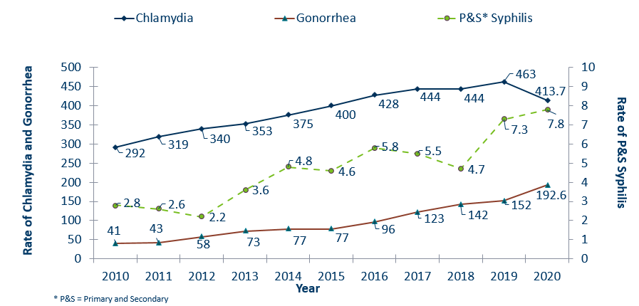
STDs in Minnesota:
Rate per 100,000 by Year of Diagnosis, 2010-2020
Notes:
Now, we will discuss the STD rates in Minnesota.
The rate of chlamydia in MN decreased by 11% to 413.7 per 100,000 from 463 per 100,000 in 2019.
The rate of gonorrhea in MN increased 27% to 192.6 per 100,000 compared to 152 per 100,000 in 2019.
The rate of primary and secondary syphilis increased by 7% from 7.3 in 2019 to 7.8 per 100,000 in 2020.

Slide 5
Interpreting STD Surveillance Data
Factors that impact the completeness and accuracy of STD data include:
  Level of STD screening by healthcare providers
  Individual test-seeking behavior
  Sensitivity of diagnostic tests
  Compliance with case reporting
  Completeness of case reporting
  Timeliness of case reporting
Increases and decreases in STD rates can be due to actual changes in disease occurrence and/or changes in one or more of the above factors.
COVID-19 lockdowns likely played a role in the number of cases reported/diagnosed this past year.
Notes:
Factors that impact the completeness and accuracy of STD data include:
Level of STD screening by healthcare providers, individual test-seeking behavior, sensitivity of diagnostic tests, compliance with case reporting, completeness of case reporting, timeliness of case reporting.
Increases and decreases in STD rates can be due to actual changes in disease occurrence and/or changes in one or more of the above factors.
Important to note that COVID-19 lockdowns likely played a role in the number of cases reported or diagnosed this past year.

Slide 6
Syphilis
Notes:
Let's start by discussing syphilis.

Slide 7
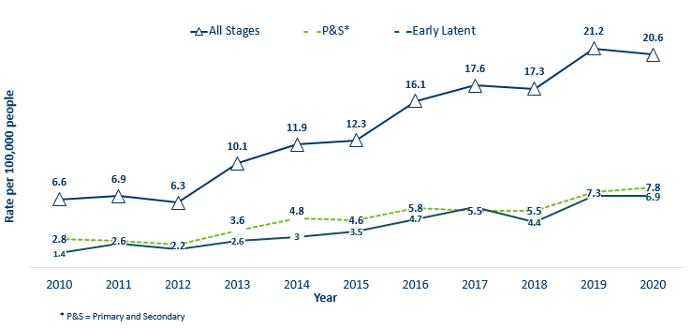
Syphilis Rates by Stage of Diagnosis
Minnesota, 2010-2020
Notes:
This graph shows syphilis rates by stage of diagnosis.
The overall syphilis rate is 20.6 per 100,000. A slight decrease from 2019, but a 212% increase from a decade ago.
Of concern is the rate of primary and secondary syphilis which is 7.8 per 100,000, a slight increase from 2019.

Slide 8
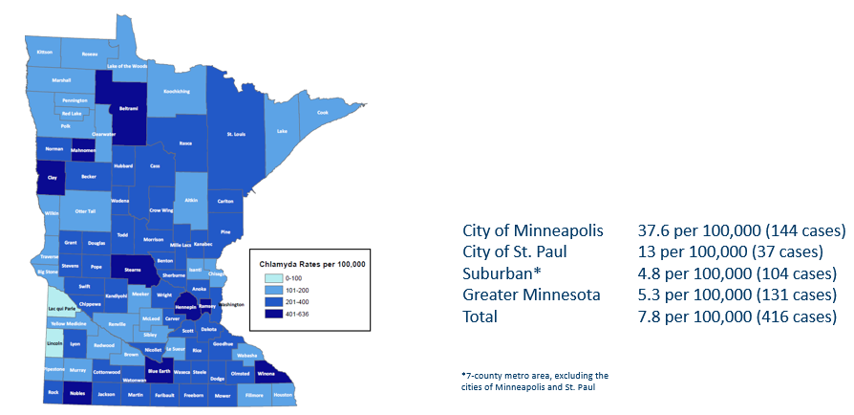
2020 Minnesota Primary & Secondary Syphilis Rates by County
Notes:
The statewide rate of primary and secondary syphilis is 5.5 cases per 100,000
Within the metro, the highest rate of primary and secondary syphilis remains in the City of Minneapolis at 37.6 cases per 100,000 population.
The City of St. Paul has the second highest rate in the metro at 13 per 100,000.

Slide 9
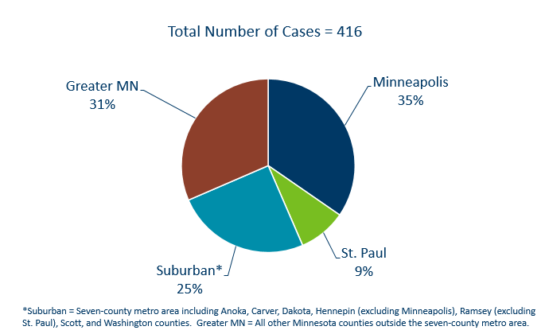
Primary & Secondary Syphilis Infections by Residence at Diagnosis
Minnesota, 2020
Notes:
This slide shows primary and secondary syphilis infections by residence at diagnosis.
The City of Minneapolis had the largest percent of all reported primary and secondary cases with 35%, second to Greater Minnesota with 31% of the cases.
The suburban area had 25% and St. Paul had 9%.

Slide 10
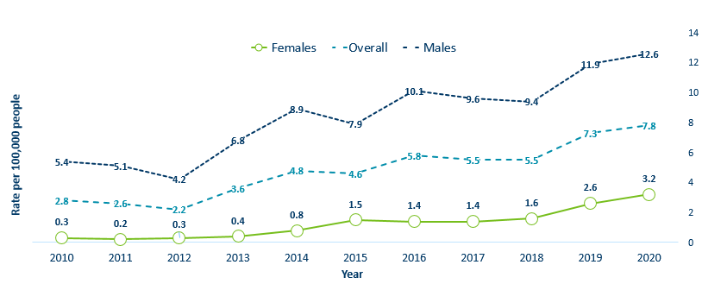
Primary & Secondary Syphilis Rates by Gender
Minnesota, 2010-2020
Notes:
People assigned male at birth have the highest rates of primary and secondary syphilis at 12.6 cases per 100,0000 population
The rate of primary and secondary syphilis in females is 3.2 per 100,000 per population.

Slide 11
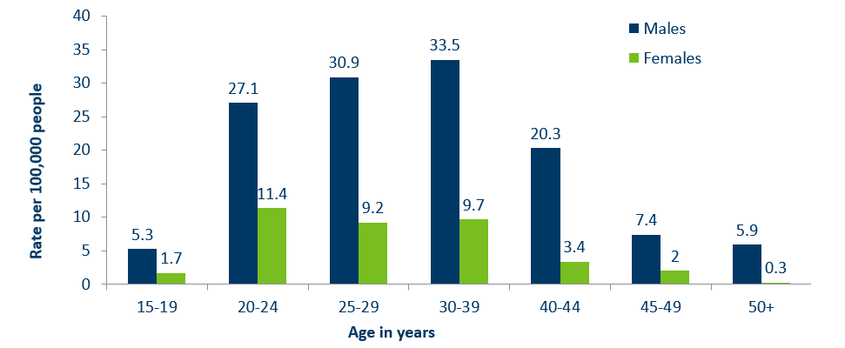
Age-Specific Primary & Secondary Syphilis Rates by Gender, Minnesota, 2020
Notes:
People assigned male at birth have higher rates of primary and secondary syphilis than people assigned female at birth in all age groups. The rate in people assigned male at birth is 4 times higher than people assigned female at birth.
30-39 year old people assigned male at birth had the highest rate at 33.5 per 100,000
20-24 year old people assigned female at birth had the highest rate of the female population at 11.4 per 100,000.

Slide 12
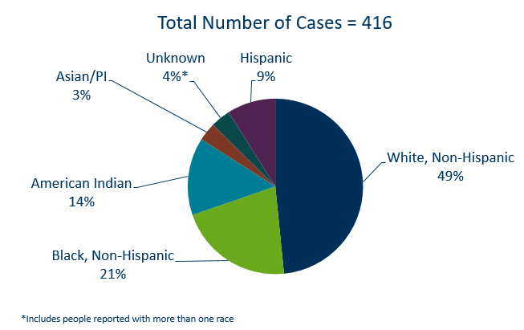
Primary & Secondary Syphilis Cases by Race
Minnesota, 2020
Notes:
49% percent of all primary and secondary syphilis cases are White, non-Hispanic.
Black, non-Hispanic cases made up 21% of all Primary and Secondary Syphilis cases followed by, American Indian cases at 14%, Hispanic cases at 9%, and Asian/Pacific Islander cases at 3%.

Slide 13
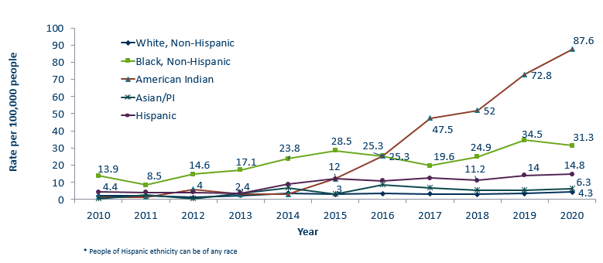
Primary & Secondary Syphilis Rates by Race/Ethnicity
Minnesota, 2010-2020
Notes:
Large disparities continue to exist in the rates of syphilis compared to the white, non-Hispanic population.
The rates of primary and secondary syphilis are 20.3 times higher in the American Indian populations than that of the White, non-Hispanic population.
The rates of primary and secondary syphilis are 7.2 times higher in the Black/African American, non-Hispanic than that of the White, non-Hispanic population.
The rates of primary and secondary syphilis in the American Indian population are 87.6 per 100,000 compared to 4.3 per 100,000 in the White, non-Hispanic population.
The rates of primary and secondary syphilis in the Black/African American, non-Hispanic population are 31.3 per 100,000 .
The rates in the Hispanic/Latino population are 16.0 per 100,000 which is 3.4 times higher than the White, non-Hispanic population.
The rates in the Asian/Pacific Islander population are 6.3 per 100,000 which is 1.5 times higher than the White, non-Hispanic population.

Slide 14
Topic of Interest: Syphilis Among
Females and Congenital Syphilis in Minnesota
Notes:
Next we will discuss a topic of interest: syphilis among people assigned female at birth and congenital syphilis in Minnesota

Slide 15
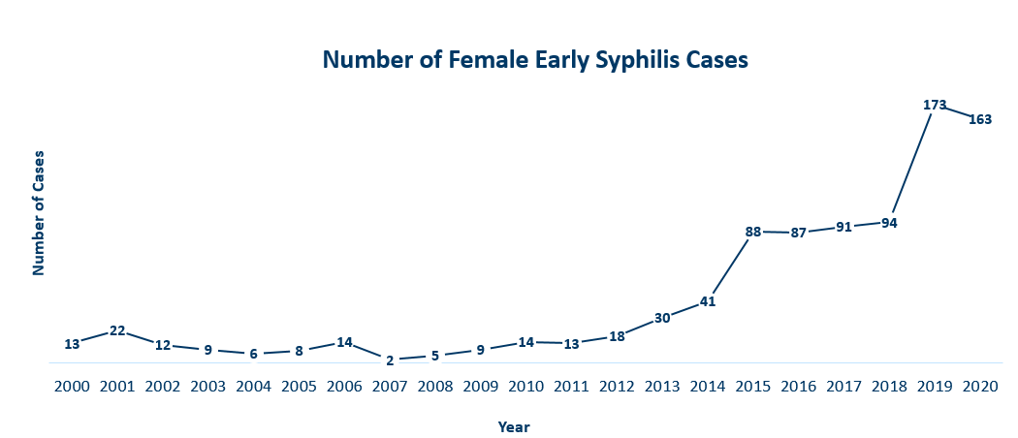
Female Early Syphilis Cases
Minnesota, 2020
Notes:
The number of female early syphilis cases has increased dramatically over the last 10 years from 14 cases in 2010 to 163 in 2020.

Slide 16
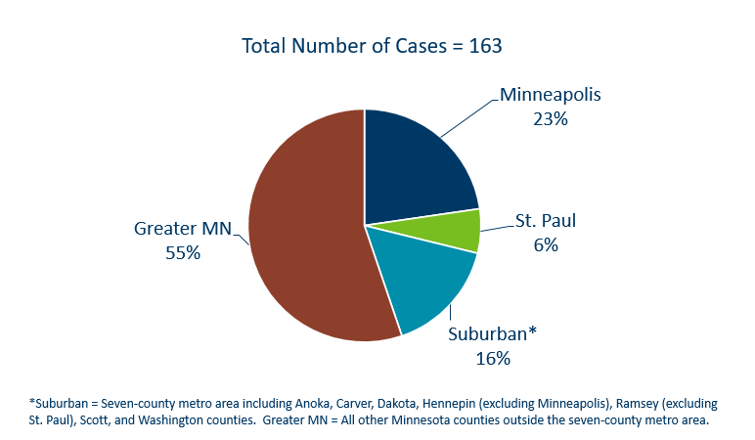
Early Syphilis Infections in Women by Residence at Diagnosis
Minnesota, 2020
Notes:
Now, we will talk about early syphilis infections in people assigned female at birth by residence at diagnosis.
55 percent of female early syphilis cases were residents of Greater Minnesota
16 percent of female early syphilis cases were residents of the Suburbs of the seven-county metro area
23 percent were City of Minneapolis residents, and 6 percent were St. Paul residents.

Slide 17
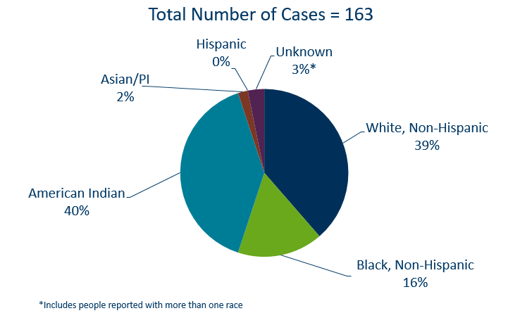
Early Syphilis Cases in Females by Race/Ethnicity
Minnesota, 2020
Notes:
There are large disparities in people assigned female at birth with syphilis. 40% of all early syphilis cases in females are found in the American Indian population and 16% in the Black, African American population.

Slide 18
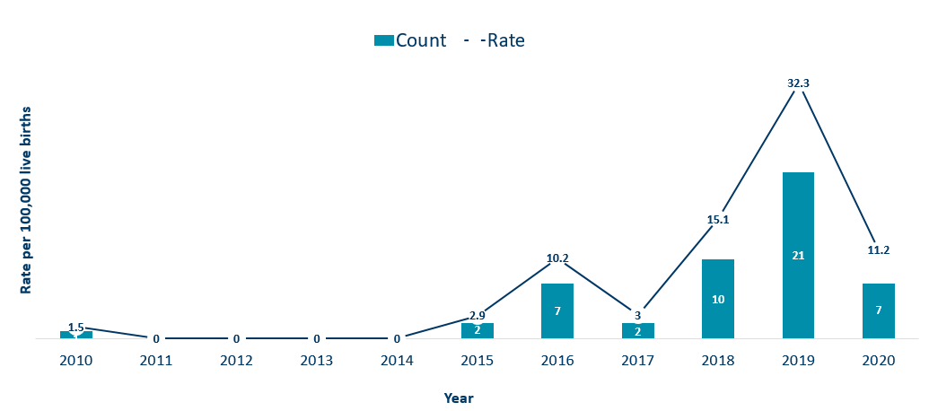
Congenital Syphilis Rates among infants
Minnesota, 2010-2020
Notes:
In Minnesota, the number and rate of congenital syphilis cases among infants has decreased in 2020 from a high of 21 in 2019 to 7 in 2020. Overall, the rate has increased over the past five years from a rate of 0 per 100,000 live births in 2014 to 11.2 per 100,000 live births in 2020.
Syphilis may be passed from a pregnant person to the unborn baby through the placenta. The infection can cause miscarriages and stillbirths, and infants born with congenital syphilis can suffer a variety of serious health problems, including deformities, seizures, anemia and jaundice.
The Centers for Disease Control and Prevention reported this fall that the number of infants born with syphilis has more than doubled in the past four years and last year reached a 20-year high.

Slide 19
Topic of Interest: Early Syphilis Among
Men Who Have Sex With Men in Minnesota
Notes:
For the next topic of interest, we will discuss early syphilis among men who have sex With Men in Minnesota.
Men who have sex with men (MSM) make up the majority of early syphilis cases.

Slide 20
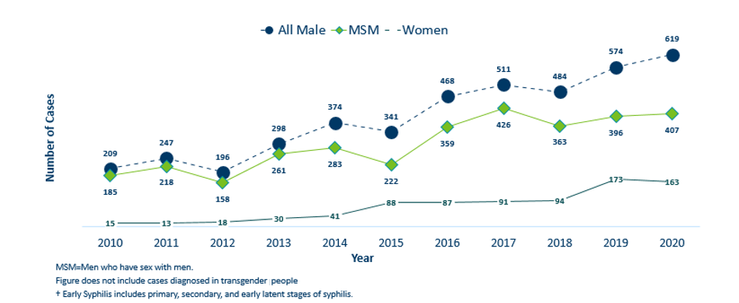
Number of Early Syphilis† Cases by Gender and MSM
Minnesota, 2010-2020
Notes:
Early syphilis, includes not only primary and secondary syphilis, but all new syphilis acquired in the past year.
Of all early syphilis cases, 79 percent were among people whose current gender was reported as male.
Men who have sex with men (MSM) account for 66% of all early syphilis cases among people assigned male at birth.

Slide 21
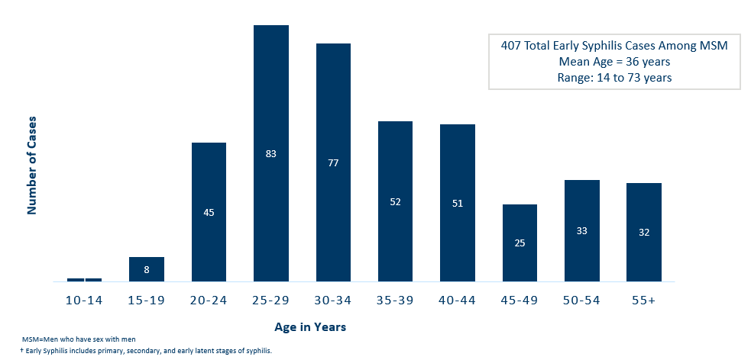
Early Syphilis† Cases Among MSM by Age
Minnesota, 2020
Notes:
The average age of MSM with early syphilis is 36 years of age.
Ages ranged from 14–73 years of age
The 25-29 year old age group had the highest number of cases at 83.
39% of early syphilis cases are among MSM are in the 25-34 age groups.

Slide 22
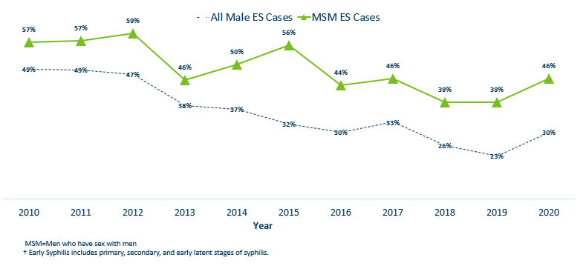
Early Syphilis† (ES) Cases
Co-infected with HIV, 2010-2020
Notes:
30% percent of all early syphilis cases were co-infected with HIV.
46% percent of all MSM early syphilis cases were co-infected with HIV.

Slide 23
Gonorrhea
Notes:
Next, we will discuss gonorrhea. Cases of reported gonorrhea saw the greatest increase among STDs with a 27 percent increase. 10,217 in 2020 compared to 8,063 in 2019.

Slide 24
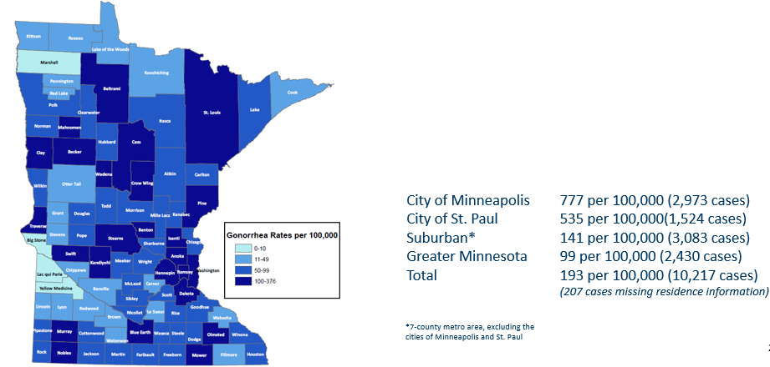
2020 Minnesota Gonorrhea Rates by County
Notes:
The rate of gonorrhea in MN reached an all time high at 193 per 100,000. This is a rate increase of 27% from 2019.
The city of Minneapolis continues to have the highest rates of gonorrhea at 777 per 100,000, followed by the city of St. Paul at 535 per 100,000, the suburban area (7-county metro excluding Minneapolis & St. Paul) at 141 per 100,000 and Greater Minnesota at 99 per 100,000.
The rates of gonorrhea increased in all areas across Minnesota.
The seven-county metro Suburban area had the highest increase at 37%, followed by the City of St Paul with 29%.
Greater Minnesota increased by 26% and the City of Minneapolis had the smallest increase of 13%.

Slide 25
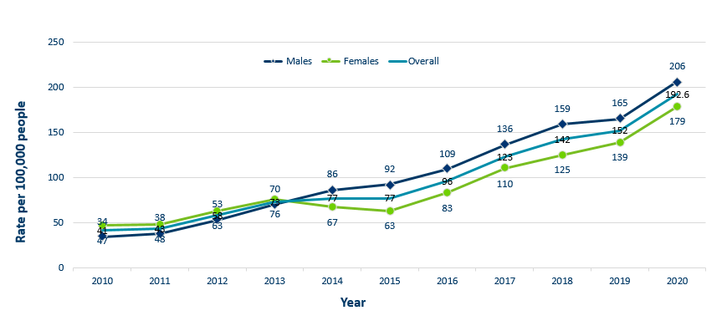
Gonorrhea Rates by Gender
Minnesota, 2010-2020
Notes:
The rates of gonorrhea went up in both people assigned male and female at birth in 2020. Males continue to have higher rates of gonorrhea than females, but the rate in females is increasing.
Males had a rate of 206 per 100,000 which is an increase of 25% over the 2019 rate of 165 per 100,000.
Females had a rate of 179 per 100,000 which is an increase of 29% over the 2019 rate of 139 per 100,000.

Slide 26
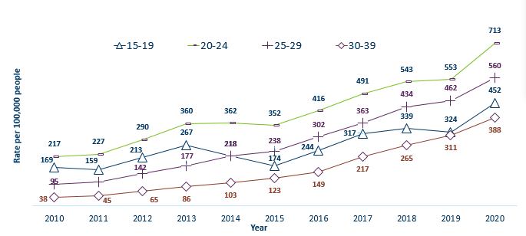
Gonorrhea Rates by Age
Minnesota, 2010-2020
Notes:
All age groups saw an increase in gonorrhea rates.
The highest rate remains in the 20–24-year-old age group at 713 per 100,000.
The 15–19-year-old age group had the largest rate increase from 324 in 2019 to 452 in 2020 a 40% increase.

Slide 27
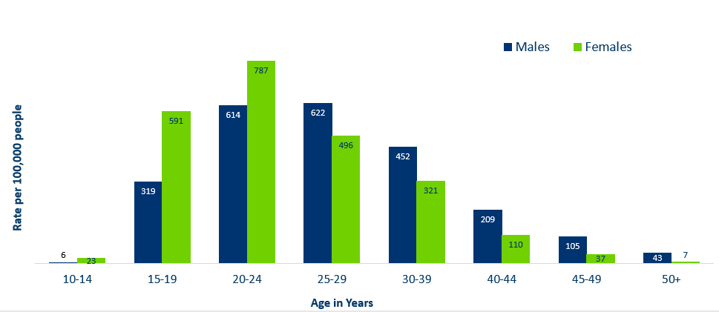
Age-Specific Gonorrhea Rates by Gender
Minnesota, 2020
Notes:
The rates of gonorrhea went up in both people assigned male and female at birth for all age groups in 2020 compared to 2019.
Females under the age of 25 years of age, continue to have higher rates of gonorrhea than males.
Males record the highest rate among age groups older than 25 years.
The highest rates of gonorrhea are in females 20-24 at 787 per 100,000.

Slide 28
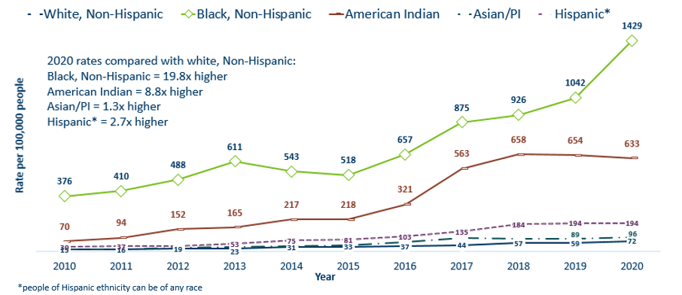
Gonorrhea Rates by Race/Ethnicity
Minnesota, 2010-2020
Notes:
There continues to be large disparities in the rates of gonorrhea.
The Black/African American, non-Hispanic population rates are 19.8 times higher than that of whites. The rate in the Black/African American population was 1429 per 100,000 compared to the rate in the White, Non-Hispanic population at 72 per 100,000.
The American Indian population had a rate that was 8.8 times higher at 633 per 100,000
The Asian/Pacific Islander population had a rate that was 1.3 times higher at 96 per 100,000
The Hispanic/Latino population, which can be of any race, had a rate that was 2.7 times higher at 194 per 100,000

Slide 29
Chlamydia
Notes:
Finally, we will discuss chlamydia. Chlamydia decreased for the first time since 2009. This could be the result of a true decrease in the number of cases, but it could also reflect the COVID-19 pandemic and reduced preventative visits. Chlamydia is more likely to be asymptomatic than gonorrhea and syphilis, especially in people assigned female at birth.

Slide 30
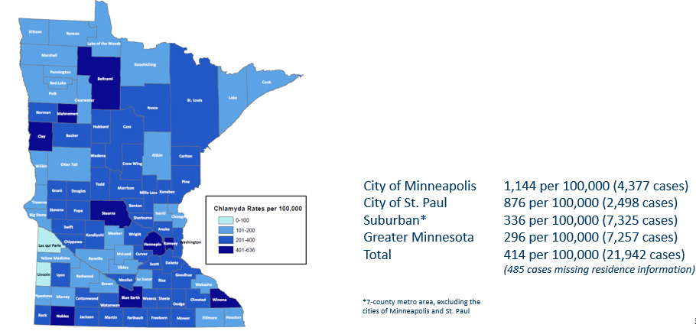
2020 Minnesota Chlamydia Rates by County
Notes:
Despite the decrease, all counties in Minnesota were affected by chlamydia. There were at least 4 cases in all counties in 2020.
The city of Minneapolis continues to have the highest rates of chlamydia at 1,144 per 100,000, followed by the city of St. Paul at 876 per 100,000, the suburban area (7-county metro excluding Minneapolis & St. Paul) at 336 per 100,000 and Greater Minnesota at 296 per 100,000.
All geographic areas saw a decrease in the rate of chlamydia reported in 2020 from 2019.

Slide 31
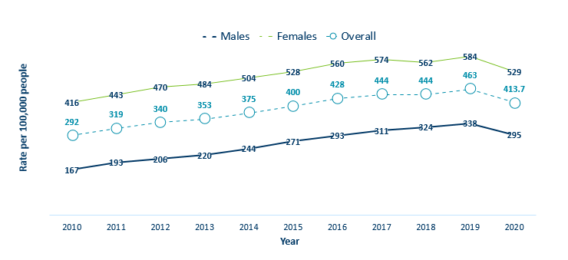
Chlamydia Rates by Gender
Minnesota, 2010-2020
Notes:
The rates of chlamydia decreased for both people assigned male and female at birth in 2020.
Females continue to have higher rates of chlamydia than males. Males had a rate of 295 per 100,000 which is a decrease of 13% over the 2019 rate of 338 per 100,000.
Females had a rate of 529 per 100,000 which is a decrease of 9% from 2019 rate of 584 per 100,000.

Slide 32
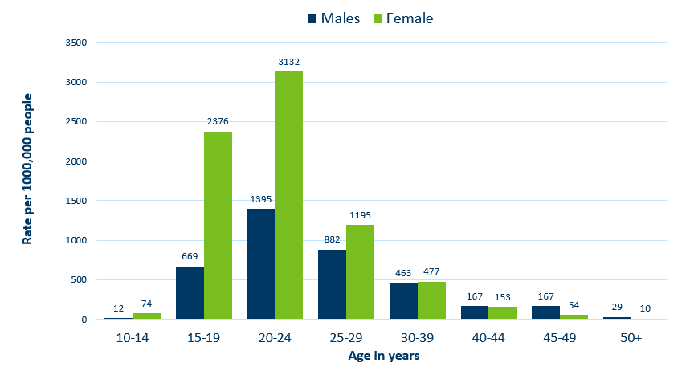
Age-Specific Chlamydia Rates by Gender
Minnesota, 2020
Notes:
The rates of chlamydia are highest among people assigned female at birth.
Females, 20-24 years of age continue to have the highest rate at 3132 per 100,000.
Females aged 40-44 were the only group that increased from 2019, by 4%.

Slide 33
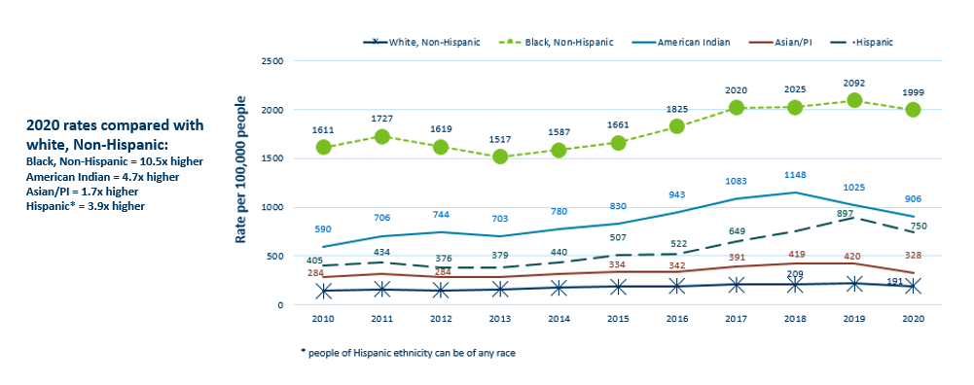
Chlamydia Rates by Race/Ethnicity
Minnesota, 2010-2020
Notes:
There continues to be great disparities in rates of chlamydia.
The Black/African American, non-Hispanic population has rates that are 10.5 times higher than that of white proplr.
The rate in the Black/African American, non-Hispanic population was 1,999 per 100,000 compared to the rate in the White, non-Hispanic population at 191 per 100,000.
The American Indian population had a rate that was 4.7 times higher at 906 per 100,000
The Asian/Pacific Islander population had a rate that was 1.7 times higher at 328 per 100,000
The Hispanic/Latino population, which can be of any race, had a rate that was 3.9 times higher at 750 per 100,000

Slide 34
Chlamydia and Gonorrhea Among Adolescents and Young Adults
(15-24 years of age)
Notes:
Next, we will discuss Chlamydia and Gonorrhea among Adolescents and Young Adults (15-24 years of age)

Slide 35
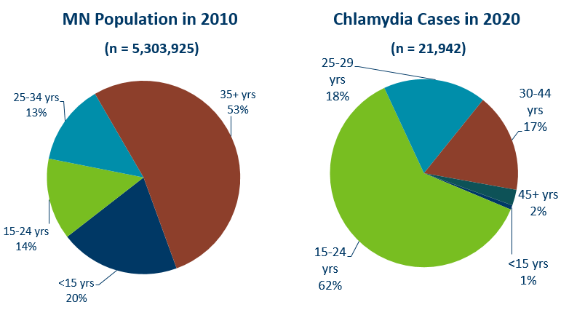
Chlamydia Disproportionately Impacts Youth and Young Adults
Notes:
Chlamydia continues to disproportionately impact youth and young adults.
15–24-year-olds make up only 14% of the population, but account for 62% of all chlamydia cases reported.

Slide 36
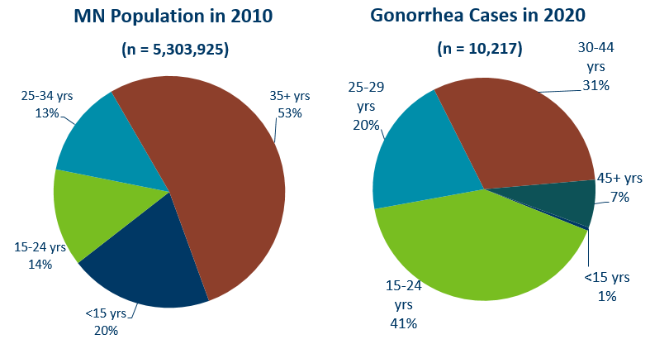
Gonorrhea Disproportionately Impacts Youth and Young Adults
Notes:
Gonorrhea also disproportionately impacts youth and young adults.
Again 15–24-year-olds make up only 14% of the population, but account for 41% of all gonorrhea cases reported.

Slide 37
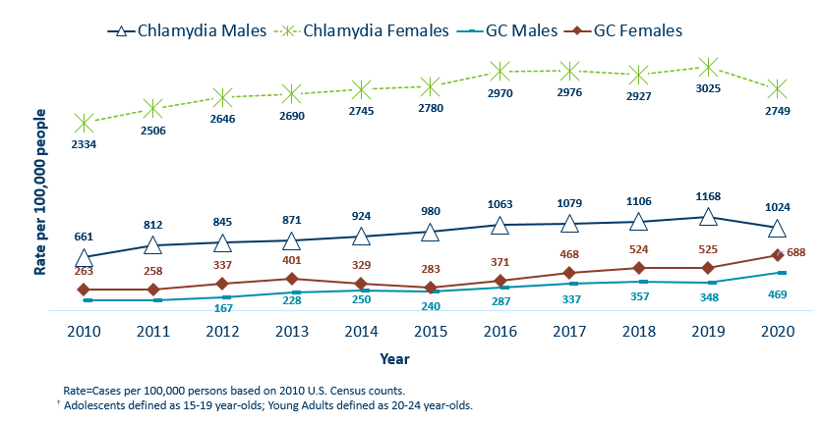
Chlamydia and Gonorrhea Rates Among Adolescents & Young Adults† by Gender in Minnesota, 2010-2020
Notes:
The rates of chlamydia and gonorrhea are higher in people assigned females at birth compared to males in the 15–24-year-old age group.
The rates for chlamydia in females are 2749 per 100,000 population compared to males at 1024 per 100,000 population.
The rates of gonorrhea in females is 688 per 100,000 compared to 469 per 100,000 in males.

Slide 38
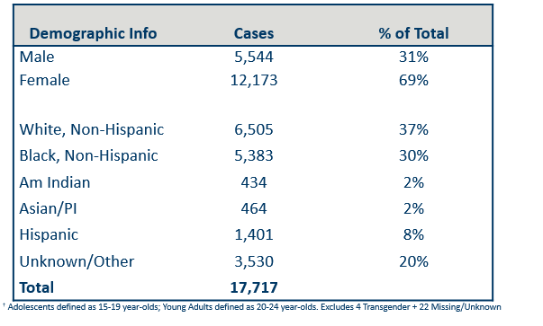
Summary Characteristics of Adolescents & Young Adults†
Diagnosed With Chlamydia or Gonorrhea in 2020
Notes:
In adolescents and young adults, the majority of chlamydia and gonorrhea cases are among people assigned female at birth (69%) .
A little over one-third (37%) are white, non-Hispanic followed by about one-third (30%) that are black, non-Hispanic. 20% were unknown or more than one race.
Adolescents and young adults accounted for 62% of chlamydia and 41% of gonorrhea cases diagnosed in Minnesota.

Slide 39
Summary of STD Trends in Minnesota
From 2010-2020, the chlamydia rate increased by 42%. The rate of gonorrhea increased by 370% and syphilis has increased by 212%.
Adolescent and young females aged 15-24 years old continue to make up the majority of all chlamydia or gonorrhea cases at 69%.
Minnesota has seen a resurgence of syphilis over the past decade, with men who have sex with men and those co-infected with HIV being especially impacted. However, the number of females impacted is near the record high for the last decade.
People of color continue to be disproportionately affected by all STDs in Minnesota and nationwide. Disparities in the rates of STDs are not explained by differences in sexual behavior, but are due to differences in health insurance coverage, employment status and access to healthcare with preventative, screening and treatment services.
Notes:
From 2010-2020, the chlamydia rate increased by 42%. The rate of gonorrhea increased by 370% syphilis has increased by 212%.
Adolescent and young people assigned female at birth aged 15-24 years old continue to make up the majority of all chlamydia or gonorrhea cases at 69%.
Minnesota has seen a resurgence of syphilis over the past decade, with men who have sex with men and those co-infected with HIV being especially impacted. However, the number of females impacted is near the record high for the last decade.
People of color continue to be disproportionately affected by all STDs in Minnesota and nationwide. Disparities in the rates of STDs are not explained by differences in sexual behavior, but are due to differences in health insurance coverage, employment status and access to healthcare with preventative, screening and treatment services.

Slide 40
New Treatment Guidelines for Uncomplicated Gonorrhea Infection
New CDC Treatment Guidelines for Uncomplicated Gonorrhea Infection were published in the MMWR in December 2020 “Update to CDC’s Treatment Guidelines for Gonococcal Infection, 2020.”
New treatment guidelines were prompted by an increased finding of gonorrhea's resistant to Azithromycin through the CDC’s Gonococcal Isolate Surveillance Project (GISP).
Regimen for uncomplicated gonococcal infections of the cervix, urethra, or rectum:
  Ceftriaxone 500 mg IM as a single dose for people weighing <150 kg (300 lb)
  OR
  Ceftriaxone 1g of IM for people weighing ≥150 kg (300 lb)
  If chlamydial infection has not been excluded, providers should treat for chlamydia with doxycycline 100 mg orally twice daily for 7 days. During pregnancy, azithromycin 1 g as a single dose is recommended to treat chlamydia.
  For alternative treatment options and a full guidelines refer to CDC STD Treatment Guidelines.
Notes:
New CDC Treatment Guidelines for Uncomplicated Gonorrhea Infection were published in the MMWR in December 2020.
New treatment guidelines were prompted by an increased finding of gonorrhea's resistant to Azithromycin through the CDC’s Gonococcal Isolate Surveillance Project (GISP).
The biggest change for uncomplicated gonococcal infections of the cervix, urethra, or rectum is only Ceftriaxone 500 mg IM as a single dose for people weighing <150 kg (300 lb) OR ceftriaxone 1g for people weighing ≥150 kg (300 lb),
If chlamydial infection has not been excluded, providers should treat for chlamydia with doxycycline 100 mg orally twice daily for 7 days. During pregnancy, azithromycin 1 g as a single dose is recommended to treat chlamydia.
For alternative treatment options and a full guidelines refer to CDC STD Treatment Guidelines.

Slide 41
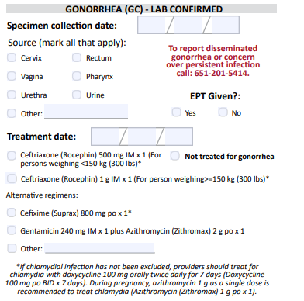
Updates to STD Reporting and Current Follow-Up
A new Chlamydia and Gonorrhea Case Report Form is available on the MDH website, to accommodate changes in treatment guidelines and highlight DGI reporting.
The case report form can be filled out and mailed or faxed to MDH at 651-201-4040.
More information may be requested on gonorrhea cases for Enhanced Gonorrhea Surveillance as part of the CDC PCHD grant.
All cases co-infected with early syphilis will continue to be assigned to MDH Partner Services for follow-up.
All STD cases continue to have the potential for being contacted by MDH for additional follow-up.
Notes:
A new Chlamydia and Gonorrhea case report form is available on the MDH website, to accommodate changes in treatment guidelines and highlight DGI reporting.
The case report form can be filled out and mailed or faxed to MDH at 651-201-4040.
More information may be requested on gonorrhea cases for Enhanced Gonorrhea Surveillance as part of the CDC PCHD grant.
All cases co-infected with Early Syphilis will continue to be assigned to MDH Partner Services for follow-up.
All STD cases continue to have the potential for being contacted by MDH for additional follow-up.

