Slide 1
Sexually Transmitted Disease (STD) Surveillance Report, 2021
Minnesota Department of Health STD Surveillance System

Slide 2
Introduction 1/2
Under Minnesota law, physicians and laboratories are required to report all laboratory-confirmed cases of chlamydia, gonorrhea, syphilis, and chancroid to the Minnesota Department of Health (MDH) within one working day.
The MDH does not maintain statistics for other, non-reportable STDs (ex: herpes, HPV/genital warts).
This slide set describes trends in reportable STDs in Minnesota by person, place, and time.
Analyses exclude cases reported from federal and private prisons.

Slide 3
Introduction 2/2
STD surveillance is the systematic collection of data from cases for the purpose of monitoring the frequency and distribution of STDs in a given population.
STD surveillance data are used to detect problems, prioritize resources, develop and target interventions, and evaluate the effectiveness of interventions.

Slide 4
Interpreting STD Surveillance Data (1/2)
Factors that impact the completeness and accuracy of STD data include:
  Level of STD screening by healthcare providers
  Individual test-seeking behavior
  Sensitivity of diagnostic tests
  Compliance with case reporting
  Completeness of case reporting
  Timeliness of case reporting
Increases and decreases in STD rates can be due to actual changes in disease occurrence and/or changes in one or more of the above factors.
COVID-19 lockdowns likely played a role in the number of cases reported/diagnosed this past year.
Notes:
Factors that impact the completeness and accuracy of STD data include:
Level of STD screening by healthcare providers, individual test-seeking behavior, sensitivity of diagnostic tests, compliance with case reporting, completeness of case reporting, timeliness of case reporting.
Increases and decreases in STD rates can be due to actual changes in disease occurrence and/or changes in one or more of the above factors.
Important to note that COVID-19 lockdowns likely played a role in the number of cases reported or diagnosed this past year.

Slide 5
Interpreting STD Surveillance Data (2/2)
The surveillance system only includes cases with a positive laboratory test. Cases diagnosed solely on symptoms are not counted.
Since 2012 we have included cases that had only a lab report and no corresponding case report form. This has increased the number of unknowns in some variables.
In 2020, the COVID-19 response accelerated the use of laboratory reporting by facilities, again increasing the number of unknown variables.
In 2018, in order to be consistent with CDC, we categorized all white, Hispanic and Black, Hispanic cases as Hispanic. That means the race categories now reflect only white, Non-Hispanic and Black, Non-Hispanic cases.
Surveillance data represent cases of infection, not individuals. A person with multiple infections in a given year will be counted more than once.
Caution is warranted when interpreting changes in STD numbers that can seem disproportionately large when the number of cases is small.

Slide 6
National Context

Slide 7
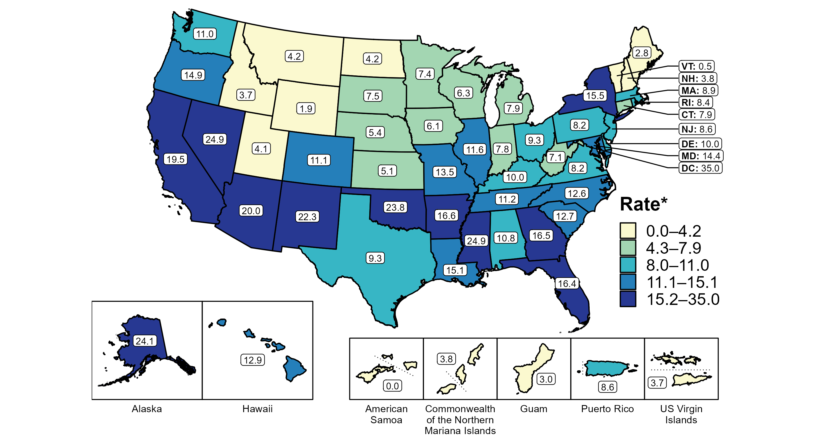
Primary and Secondary Syphilis — Rates of Reported Cases by State, United States and Territories, 2020
* Per 100,000
Notes:
Minnesota’s primary and secondary syphilis rate in 2020 was 7.8 per 100,000
This was lower than the national rate of 12.7 per 100,000

Slide 8
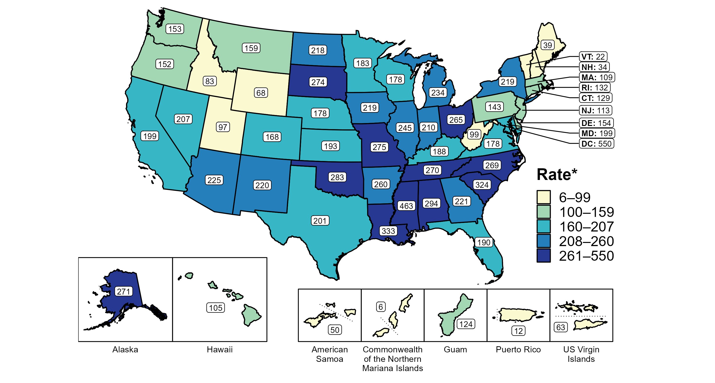
Gonorrhea — Rates of Reported Cases by State, United States and Territories, 2020
* Per 100,000
Notes:
Minnesota’s gonorrhea rate in 2010 was 192.6 per 100,000
This was lower than the national rate of 206.5 per 100,000

Slide 9
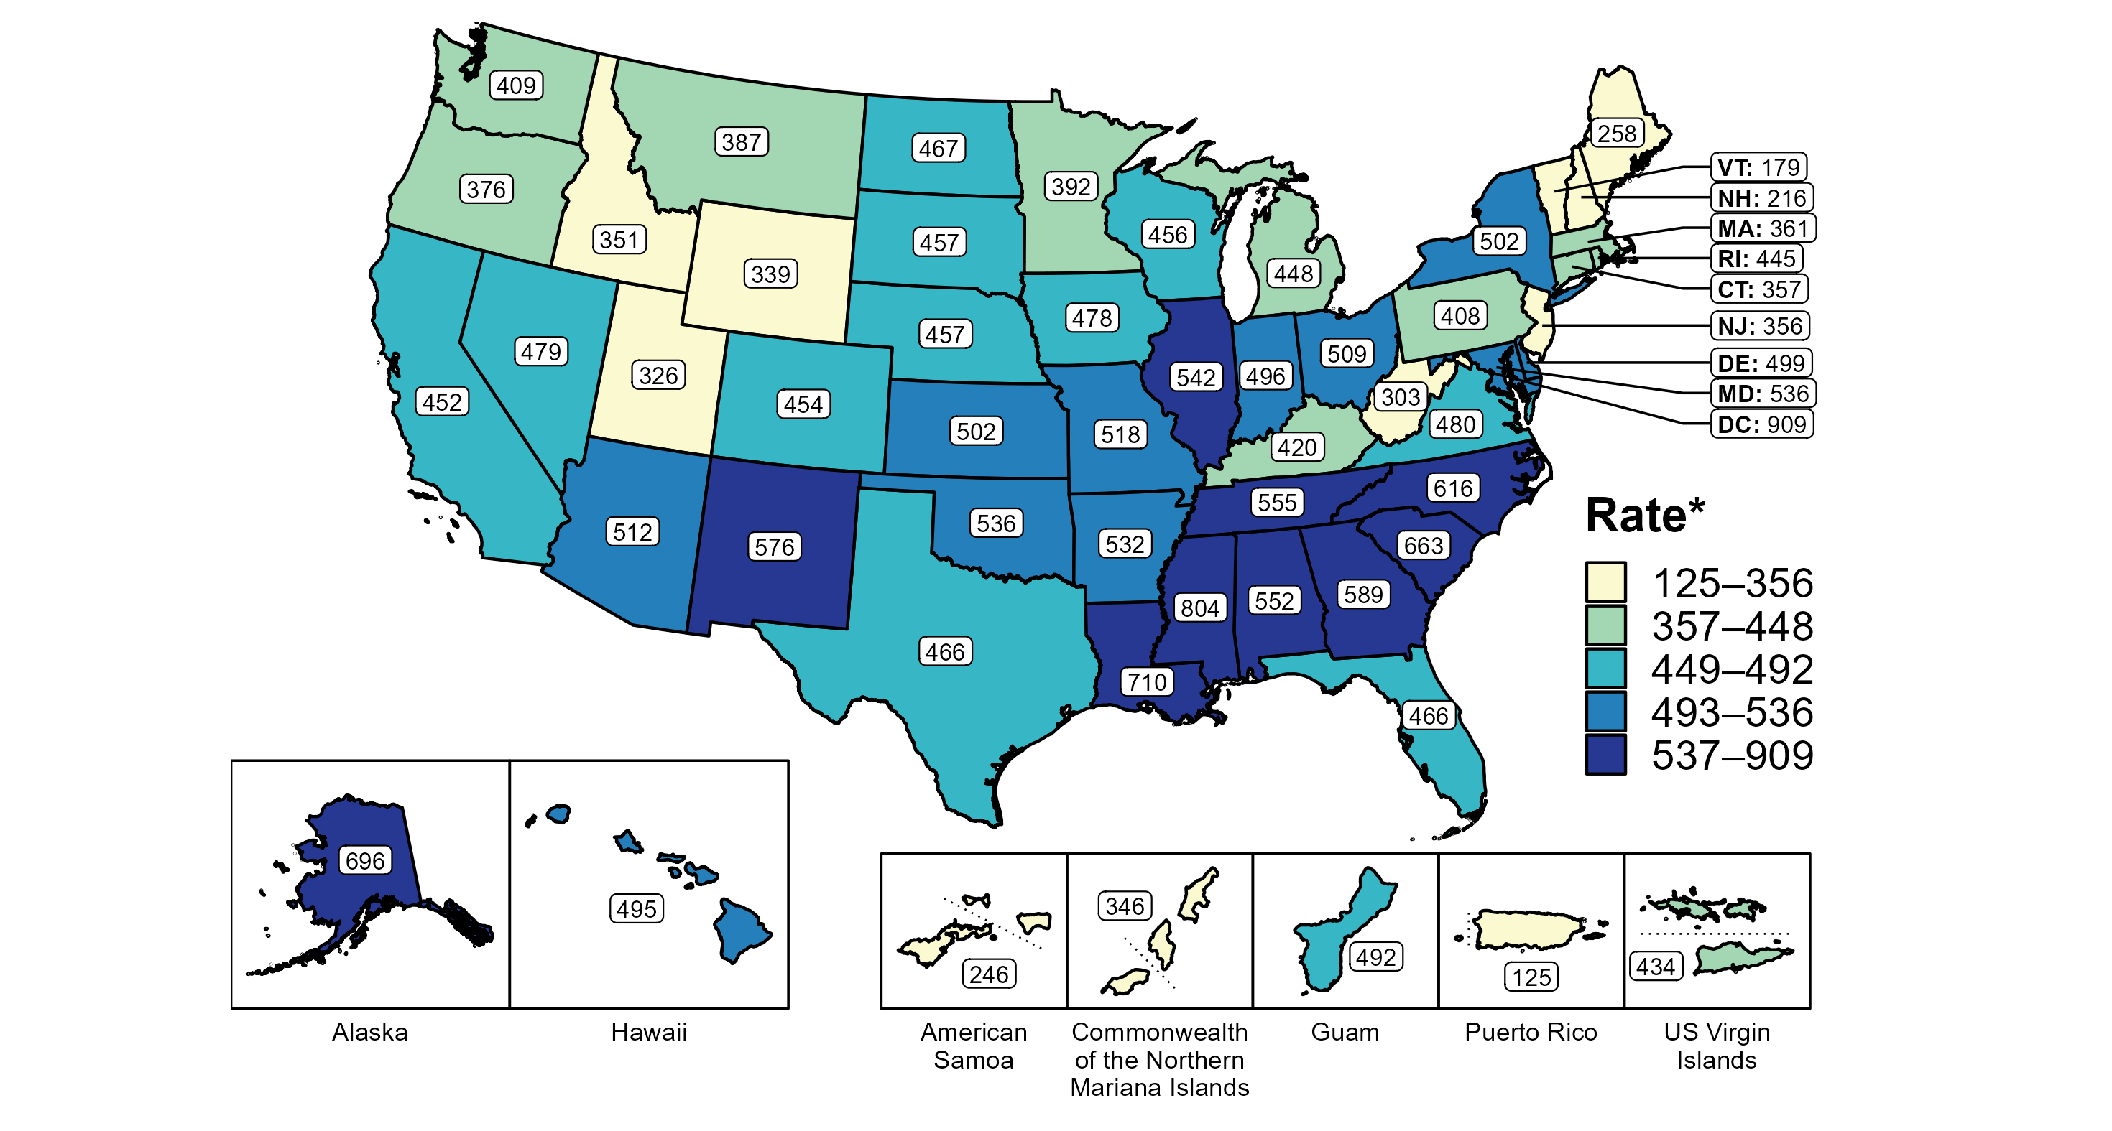
Chlamydia — Rates of Reported Cases by State, United States and Territories, 2020
* Per 100,000
Notes:
Minnesota’s chlamydia rate in 2020 was 413.7 per 100,000
This was lower than the national rate of 481.3 per 100,000
Nationally CT declined 12.6% nationally.
MN declined 11 in 2020.
The COVID-19 pandemic has introduced uncertainty and difficulty in interpreting 2020 case data.

Slide 10
Overview of STDs in Minnesota
Minnesota Department of Health STD Surveillance System

Slide 11
STDs in Minnesota:
Number of Cases Reported in 2021
Total of 33,706 STD cases reported to MDH in 2021:
  22,578 Chlamydia cases
  9,671 Gonorrhea cases
  1457 Syphilis cases (all stages)
  0 Chancroid cases
Notes:
In the year 2021, a total of 33,245 STD cases were reported to the Minnesota Department of Health:
22,578 Chlamydia cases
9,671 Gonorrhea cases
1457 Syphilis cases (all stages)
0 Chancroid cases

Slide 12
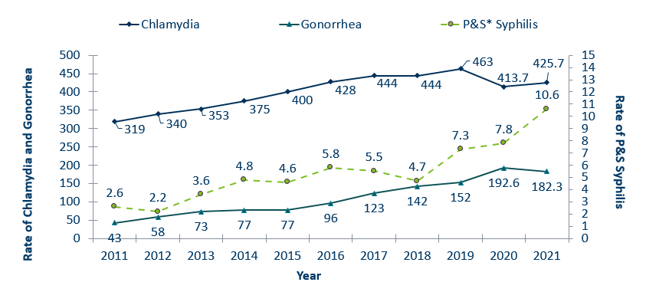
STDs in Minnesota:
Rate per 100,000 by Year of Diagnosis, 2011-2021
* P&S = Primary and Secondary
Notes:
The rate of chlamydia in MN increased by 3% to 425.7 per 100,000 compared to 413.7 per 100,000 in 2021.
The rate of gonorrhea in MN decreased 5% to 182.3 per 100,000 compared to 192.6 per 100,000 in 2021.
The rate of primary and secondary syphilis increased by 36% from 7.8 in 2020 to 10.6 per 100,000 in 2021.

Slide 13
Syphilis
Minnesota Department of Health STD Surveillance System

Slide 14
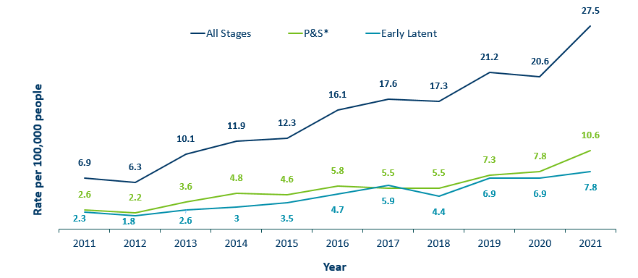
Syphilis Rates by Stage of Diagnosis, Minnesota, 2011-2021
* P&S = Primary and Secondary
Notes:
The overall syphilis rate is 27.5 per 100,000. A increase from 2020, and a 300% increase from a decade ago.
Of concern is the rate of primary and secondary syphilis which is 10.6 per 100,000, a 36% increase from 2020.

Slide 15
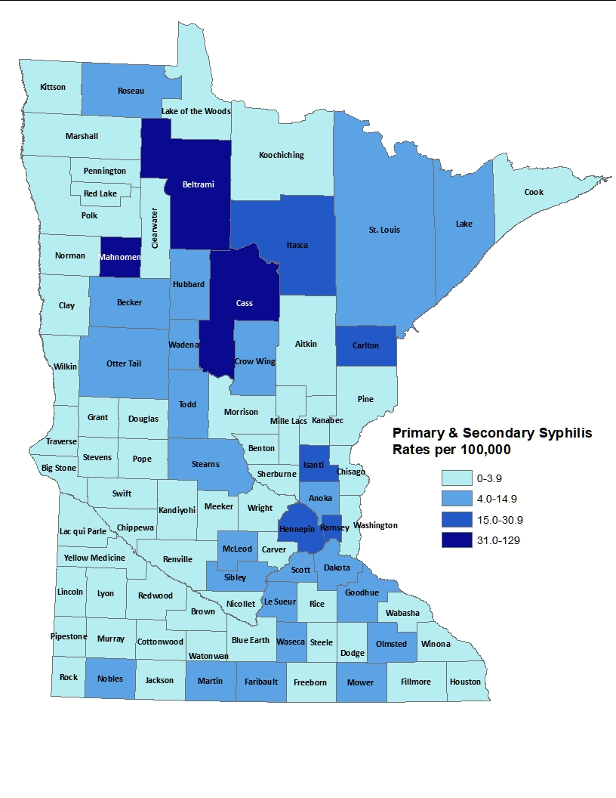
2021 Minnesota Primary & Secondary Syphilis Rates by County
City of Minneapolis
City of St. Paul
Suburban*
Greater Minnesota
Total
49.7 per 100,000 (144 cases)
28.4 per 100,000 (37 cases)
6.7 per 100,000 (104 cases)
5.9 per 100,000 (131 cases)
10.6 per 100,000 (416 cases)
*7-county metro area, excluding the cities of Minneapolis and St. Paul
Notes:
The statewide rate of primary and secondary syphilis increased to 10.6 cases per 100,000 from 7.8.
Within the metro, the highest rate of primary and secondary syphilis remains in the City of Minneapolis at 49.7 cases per 100,000 population.
The City of St. Paul has the second highest rate in the metro at 28.4 per 100,000.

Slide 16
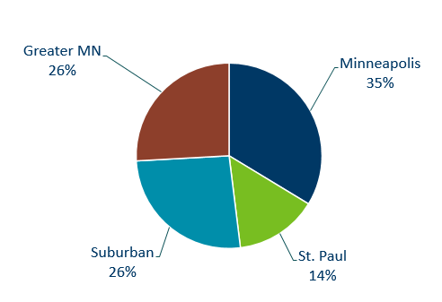
Primary & Secondary Syphilis Infections by Residence at Diagnosis
Minnesota, 2021
Total Number of Cases = 564
Suburban = Seven-county metro area including Anoka, Carver, Dakota, Hennepin (excluding Minneapolis), Ramsey (excluding St. Paul), Scott, and Washington counties. Greater MN = All other Minnesota counties outside the seven-county metro area.
Notes:
The City of Minneapolis had the largest percent of all reported primary and secondary cases with 35%, second to Greater Minnesota with 26% of the cases.
The suburban area had 26% and St. Paul had 14%.

Slide 17
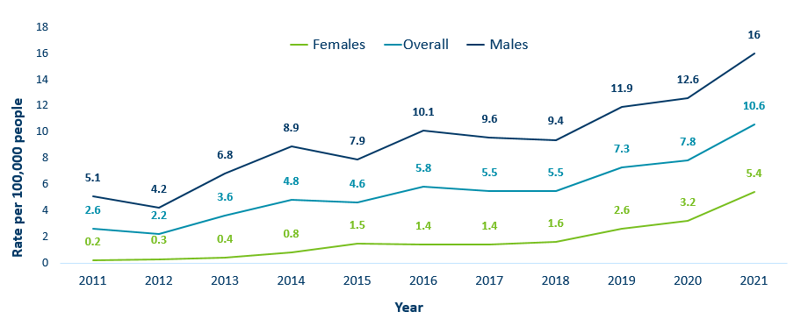
Primary & Secondary Syphilis Rates by Gender, Minnesota, 2011-2021
Notes:
Males have the highest rates of primary and secondary syphilis at 16 cases per 100,0000 population
The rate of primary and secondary syphilis in females is 5.4 per 100,000 per population.

Slide 18
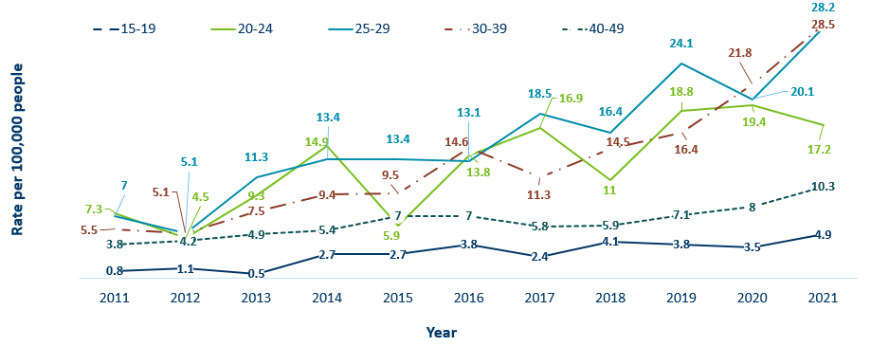
Primary & Secondary Syphilis Rates by Age
Minnesota, 2011-2021
Notes:
The highest rates of primary and secondary syphilis were in the 30-39 year old age group at 28.5 cases per 100,000 population, a 31% increase from 2020.
25-29 year olds and 20-24 had the next highest rate at 28.2 and 17.2 per 100,000, respectively.

Slide 19
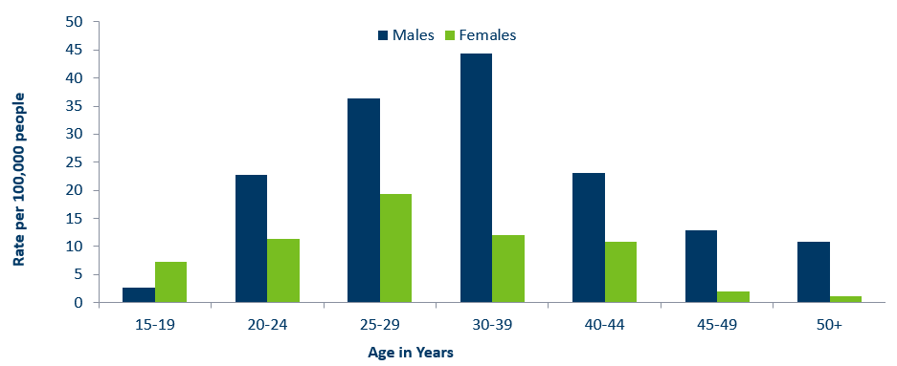
Age-Specific Primary & Secondary Syphilis Rates by Gender, Minnesota, 2021
Notes:
Males have higher rates of primary and secondary syphilis than females in all age groups. The rate in males is 3 times higher than females.
30-39 year old males had the highest rate at 44.4 per 100,000
25-29 year old females had the highest rate of the female population at 19.4 per 100,000.

Slide 20
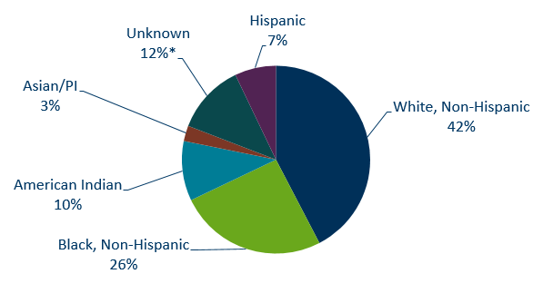
Primary & Secondary Syphilis Cases by Race
Minnesota, 2021
Total Number of Cases = 564
*Includes people reported with more than one race
Notes:
42% percent of all primary and secondary syphilis cases are White, non-Hispanic.
Black, non-Hispanic cases made up 26% of all Primary and Secondary Syphilis cases followed by, American Indian cases at 10%, Hispanic cases at 7%, and Asian/Pacific Islander cases at 3%.

Slide 21
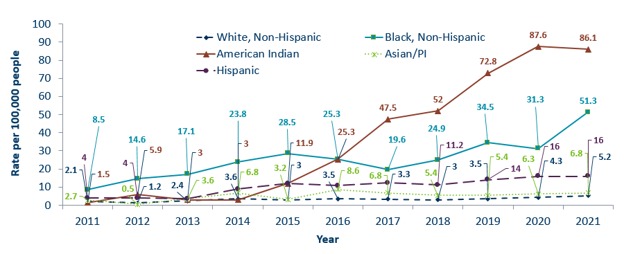
Primary & Secondary Syphilis Rates by Race/Ethnicity
Minnesota, 2011-2021
* people of Hispanic ethnicity can be of any race.
Notes:
Large disparities continue to exist in the rates of syphilis compared to the White, non-Hispanic population.
The rates of primary and secondary syphilis are 16.7 times higher in the American Indian populations than that of the White, non-Hispanic population.
The rates of primary and secondary syphilis are 9.9 times higher in the Black/African American, non-Hispanic than that of the White, non-Hispanic population.
The rates of primary and secondary syphilis in the American Indian population are 95.1 per 100,000 compared to 5.7 per 100,000 in the White, non-Hispanic population.
The rates of primary and secondary syphilis in the Black/African American, non-Hispanic population are 57.7 per 100,000 .
The rates in the Hispanic population are 16.0 per 100,000 which is 3.1 times higher than the White, non-Hispanic population.
The rates in the Asian/Pacific Islander population are 6.8 per 100,000 which is 1.3 times higher than the White, non-Hispanic population.

Slide 22
Topic of Interest: Syphilis Among
Females and Congenital Syphilis in Minnesota
Minnesota Department of Health STD Surveillance System
Notes:
Topic of Interest: Syphilis Among
Females and Congenital Syphilis in Minnesota

Slide 23
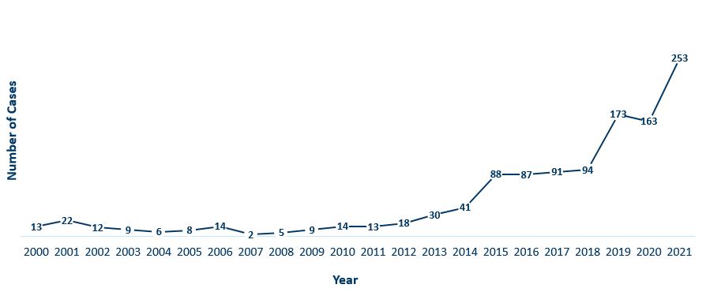
Female Early Syphilis Cases
Minnesota, 2021
Notes:
The number of female early syphilis cases has increased dramatically over the last 10 years from 13 cases in 2011 to 253 in 2021.

Slide 24
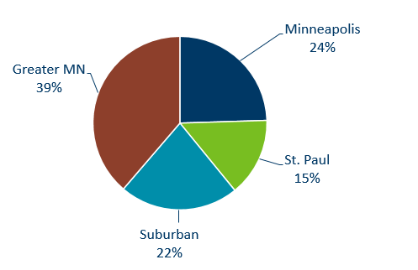
Early Syphilis Infections in Females by Residence at Diagnosis
Minnesota, 2021
Total Number of Cases = 253
Suburban = Seven-county metro area including Anoka, Carver, Dakota, Hennepin (excluding Minneapolis), Ramsey (excluding St. Paul), Scott, and Washington counties. Greater MN = All other Minnesota counties outside the seven-county metro area.
Notes:
39 percent of female early syphilis cases were residents of Greater Minnesota
22 percent of female early syphilis cases were residents of the Suburbs of the seven-county metro area
24 percent were City of Minneapolis residents, and 15 percent were St. Paul residents.

Slide 25
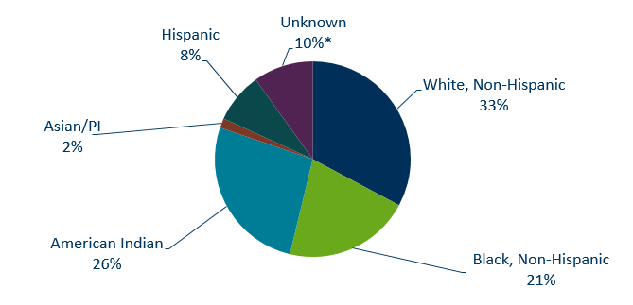
Early Syphilis Cases in Females by Race/Ethnicity
Minnesota, 2021
Total Number of Cases = 253
*Includes people reported with more than one race
Notes:
There are large disparities in women with syphilis. 26 percent of all early syphilis cases in females are found in the American Indian population and 21% in the Black, African American population.

Slide 26
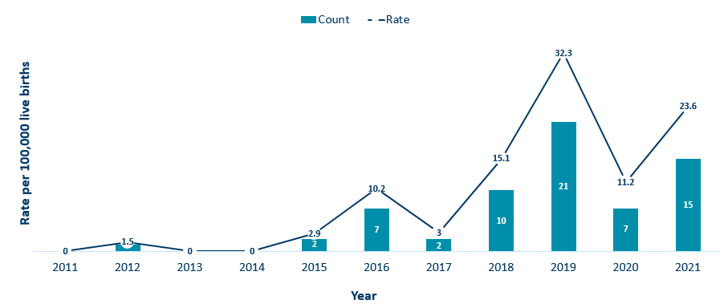
Congenital Syphilis Rates Among Infants
Minnesota, 2011-2021
Notes:
In Minnesota, the number and rate of congenital syphilis cases among infants has increased in 2021 compared to 2020. Overall, the rate has increased over the past five years from a rate of 3 per 100,000 live births in 2017 to 23.6 per 100,000 live births in 2021.
Syphilis may be passed from a pregnant person to the unborn baby through the placenta. The infection can cause miscarriages and stillbirths, and infants born with congenital syphilis can suffer a variety of serious health problems, including deformities, seizures, anemia and jaundice.
The Centers for Disease Control and Prevention reported this fall that the number of infants born with syphilis has more than 200% in the past four years and last year reached a 20-year high.

Slide 27
Topic of Interest: Early Syphilis Among
Men Who Have Sex With Men in Minnesota
Minnesota Department of Health STD Surveillance System
Notes:
Topic of Interest: Early Syphilis Among Men Who Have Sex With Men in Minnesota.
Men who have sex with men (MSM) make up the majority of early syphilis cases.

Slide 28
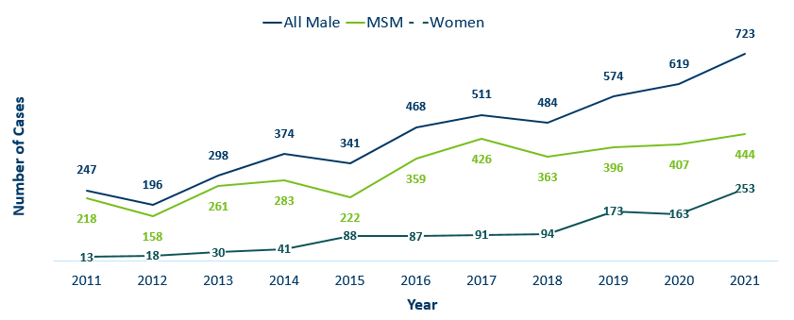
Number of Early Syphilis† Cases by Gender and MSM
Minnesota, 2011-2021
MSM=Men who have sex with men.
Figure does not include cases diagnosed in transgender people
† Early Syphilis includes primary, secondary, and early latent stages of syphilis.
Notes:
Early syphilis, includes not only primary and secondary syphilis, but all new syphilis acquired in the past year.
Of all early syphilis cases, 73 percent were among people whose current gender was reported as male.
Men who have sex with men (MSM) account for 61% of all early syphilis cases among men.

Slide 29
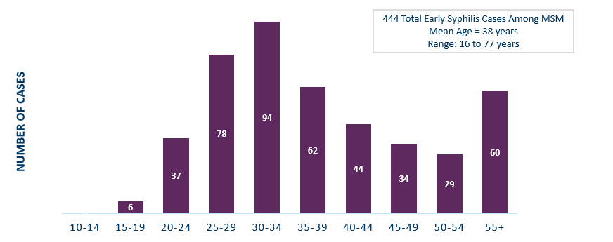
Early Syphilis† Cases Among MSM by Age
Minnesota, 2021
MSM=Men who have sex with men
† Early Syphilis includes primary, secondary, and early latent stages of syphilis.
Notes:
The average age of MSM with early syphilis is 38 years of age.
Ages ranged from 16–77 years of age
The 25-29 year old age group had the highest number of cases at 94.
39% of early syphilis cases are among MSM are in the 25-34 age groups.

Slide 30
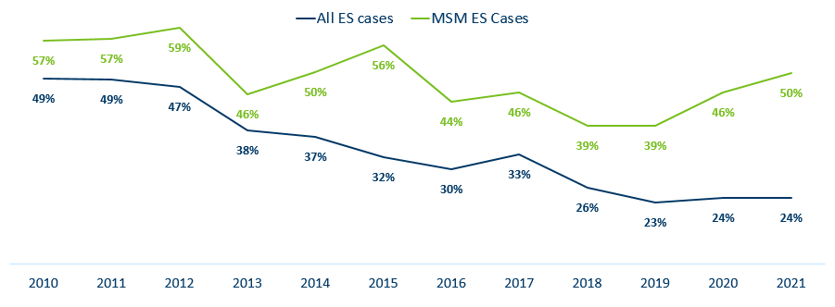
Early Syphilis† (ES) Cases
Co-infected with HIV, 2011-2021
MSM=Men who have sex with men
† Early Syphilis includes primary, secondary, and early latent stages of syphilis.
Notes:
24% percent of all early syphilis cases were co-infected with HIV.
50% percent of all MSM early syphilis cases were co-infected with HIV.

Slide 31
Gonorrhea
Minnesota Department of Health STD Surveillance System
Notes:
Cases of reported gonorrhea saw the greatest decrease of 5 percent. 10,217 in 2020 compared to 9671 in 2021.

Slide 32
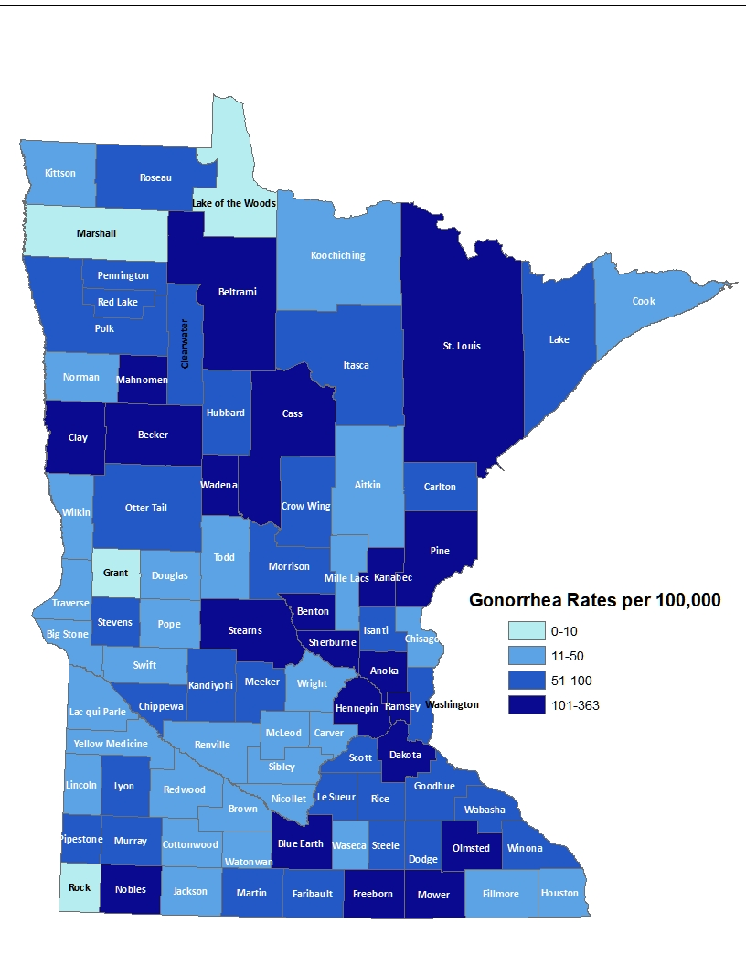
2021 Minnesota Gonorrhea Rates by County
City of Minneapolis
City of St. Paul
Suburban*
Greater Minnesota
Total
764 per 100,000 (2,973 cases)
514 per 100,000(1,524 cases)
126 per 100,000 (3,083 cases)
97 per 100,000 (2,430 cases)
182.3 per 100,000 (9,671 cases)
(150 cases missing residence information)
*7-county metro area, excluding the cities of Minneapolis and St. Paul
Notes:
The rate of gonorrhea in MN reached an all time high at 182.3 per 100,000. This is a rate decrease of 5% from 2020.
The city of Minneapolis continues to have the highest rates of gonorrhea at 764 per 100,000, followed by the city of St. Paul at 514 per 100,000, the suburban area (7-county metro excluding Minneapolis & St. Paul) at 126 per 100,000 and Greater Minnesota at 97 per 100,000.
The rates of gonorrhea increased in all areas across Minnesota.
The seven-county metro Suburban area had the highest increase at 37%, followed by the City of St Paul with 29%.

Slide 33
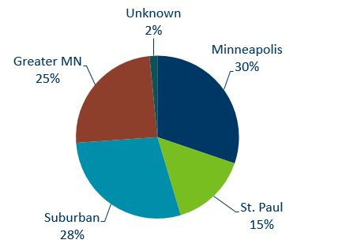
Gonorrhea Infections in Minnesota by Residence at Diagnosis, 2021
Suburban = Seven-county metro area including Anoka, Carver, Dakota, Hennepin (excluding Minneapolis), Ramsey (excluding St. Paul), Scott, and Washington counties. Greater MN = All other Minnesota counties outside the seven-county metro area.
Notes:
All parts of Minnesota are affected by gonorrhea. The cities of Minneapolis and St. Paul reported 45% of the cases; followed by 28% in the Suburban area surrounding the cities, and 25% in Greater Minnesota.

Slide 34
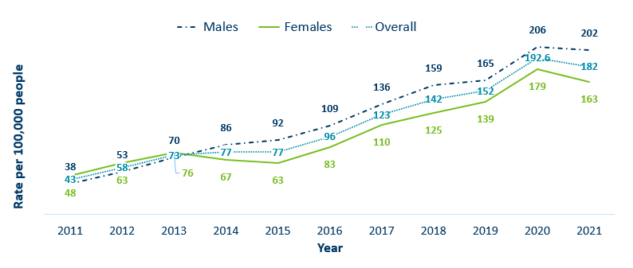
Gonorrhea Rates by Gender
Minnesota, 2011-2021
Notes:
The rates of gonorrhea went down in both males and females in 2021. Males continue to have higher rates of gonorrhea than females, but the rate in females is increasing.
Males had a rate of 202 per 100,000 which is a decrease of 2% over the 2020 rate of 206 per 100,000.
Females had a rate of 163 per 100,000 which is a decrease of 9% over the 2020 rate of 179 per 100,000.

Slide 35
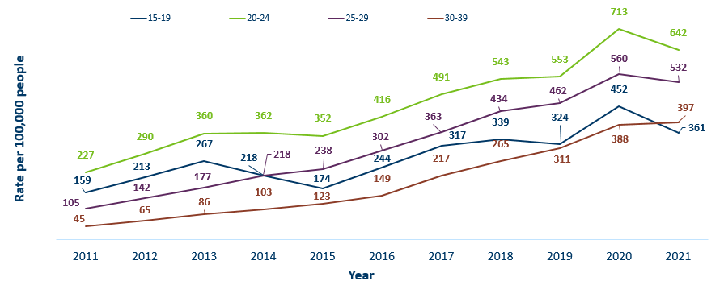
Gonorrhea Rates by Age
Minnesota, 2011-2021
Notes:
Most age groups saw a decrease in gonorrhea rates.
The highest rate remains in the 20–24-year-old age group at 642 per 100,000.
The 15–19-year-old age group had the largest rate increase from 388 in 2020 to 397 in 2021 a 2% increase.

Slide 36
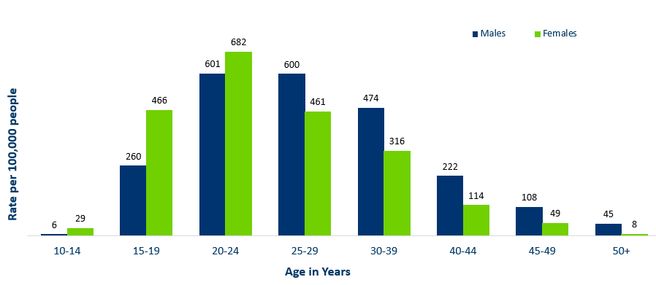
Age-Specific Gonorrhea Rates by Gender
Minnesota, 2021
Notes:
Females under the age of 25 years of age, continue to have higher rates of gonorrhea than males.
Males record the highest rate among age groups older than 25 years.
The highest rates of gonorrhea are in females 20-24 at 682 per 100,000.

Slide 37
Gonorrhea Rates by Race/Ethnicity
Minnesota, 2011-2021
2021 rates compared with white rates:
Black, Non-Hispanic = 20.6x higher
American Indian = 9.2x higher
Asian/PI = 1.5x higher
Hispanic* = 3.7x higher
Notes:
There continues to be large disparities in the rates of gonorrhea.
The Black/African American, non-Hispanic population rates are 20.6 times higher than white rates. The rate in the Black/African American population was 1370 per 100,000 compared to the rate in the White, Non-Hispanic population at 67 per 100,000.
The American Indian population had a rate that was 9.2 times higher at 609 per 100,000
The Asian/Pacific Islander population had a rate that was 1.5 times higher at 98 per 100,000
The Hispanic/Latino population, which can be of any race, had a rate that was 3.7 times higher at 249 per 100,000

Slide 38
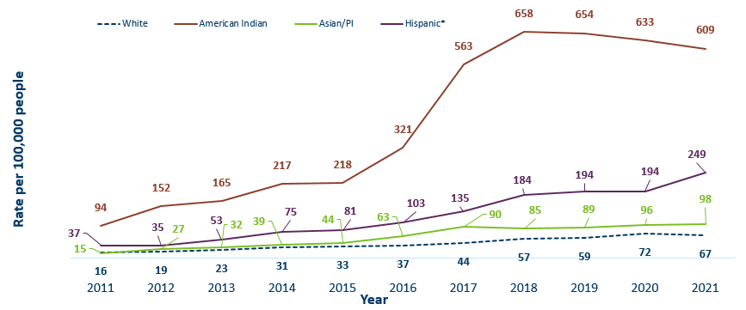
Gonorrhea Rates by Race/Ethnicity
Minnesota, 2010-2020
* people of Hispanic ethnicity can be of any race.
Notes:
This is a clearer view of the rates of Gonorrhea by Race/Ethnicity from the previous slide, after removing the Black/African American, Non-Hispanic data.

Slide 39
Chlamydia
Minnesota Department of Health STD Surveillance System
Notes:
Chlamydia increased 3% in 2021 compared to 2020 which recorded the first decline in over a decade. This could be the result of a true decrease in the number of cases, but it could also reflect the COVID-19 pandemic and reduced preventative visits. Chlamydia is more likely to be asymptomatic than gonorrhea and syphilis, especially in females.

Slide 40
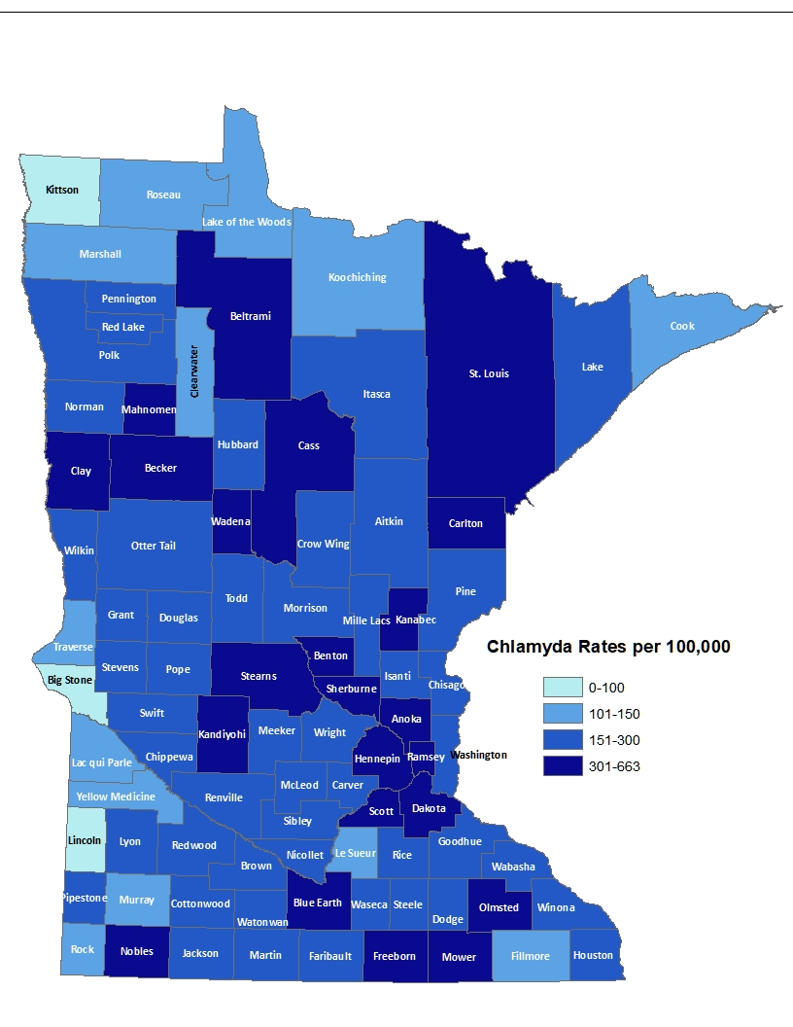
2021 Minnesota Chlamydia Rates by County
City of Minneapolis
City of St. Paul
Suburban*
Greater Minnesota
Total
1,206 per 100,000 (4,613 cases)
894 per 100,000 (2,548 cases)
348 per 100,000 (7,585 cases)
306 per 100,000 (7,519 cases)
425.7 per 100,000 (22,578 cases)
(315 cases missing residence information)
*7-county metro area, excluding the cities of Minneapolis and St. Paul
Notes:
Despite the decrease, all counties in Minnesota were affected by chlamydia. There were at least 2 cases in all counties in 2021.
The city of Minneapolis continues to have the highest rates of chlamydia at 1,206 per 100,000, followed by the city of St. Paul at 894 per 100,000, the suburban area (7-county metro excluding Minneapolis & St. Paul) at 348 per 100,000 and Greater Minnesota at 306 per 100,000.

Slide 41
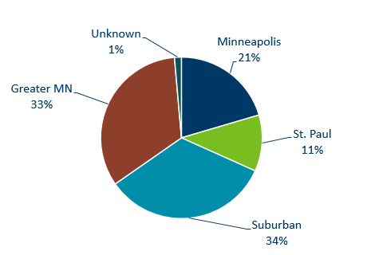
Chlamydia Infections by Residence at Diagnosis
Minnesota, 2021
Total Number of Cases = 22,578
Suburban = Seven-county metro area including Anoka, Carver, Dakota, Hennepin (excluding Minneapolis), Ramsey (excluding St. Paul), Scott, and Washington counties. Greater MN = All other Minnesota counties outside the seven-county metro area.
Notes:
All areas of Minnesota are affected by chlamydia. About a third of the cases occurred in the cities of Minneapolis and St. Paul, a third in the Suburban area surround the cities, and a third in Greater Minnesota.

Slide 42
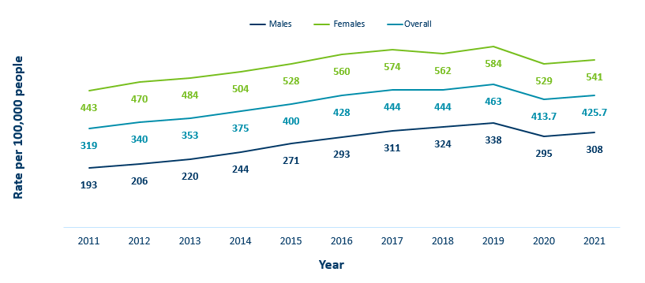
Chlamydia Rates by Gender
Minnesota, 2010-2020
Notes:
The rates of chlamydia increased for both males and females in 2021.
Females continue to have higher rates of chlamydia than males. Males had a rate of 308 per 100,000 which is a increase of 2% over the 2020 rate of 295 per 100,000.
Females had a rate of 541 per 100,000 which is a increase of 2% from 2020 rate of 529 per 100,000.

Slide 43
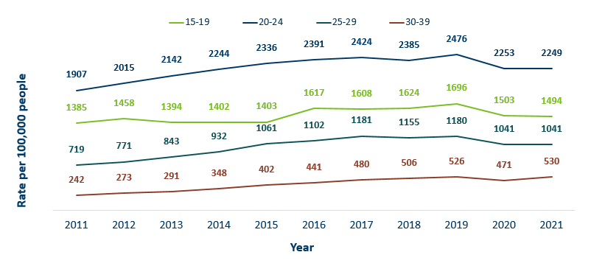
Chlamydia Rates by Age
Minnesota, 2011-2021
Notes:
The highest rate remains in the 20-24 year old age group at 2,249 per 100,000.
The next highest rate remains in the 15-19 year old age group at 1,494 per 100,000.

Slide 44
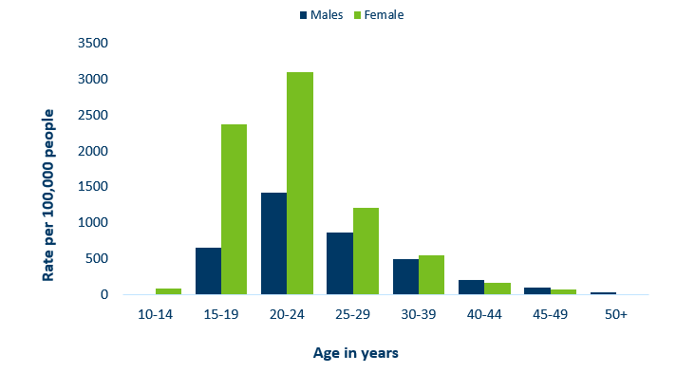
Age-Specific Chlamydia Rates by Gender,
Minnesota, 2021
Notes:
The rates of Chlamydia are highest among females.
Females, 20-24 years of age continue to have the highest rate at 3101 per 100,000.
Males aged 50+ reported the largest increase of over 50% when compared to 2020.

Slide 45
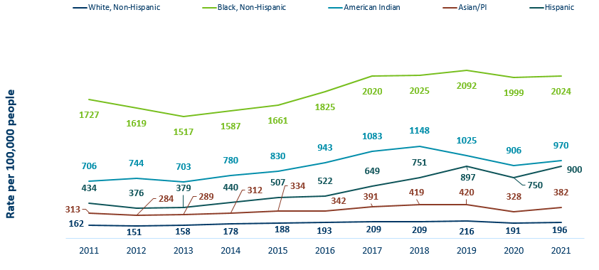
Chlamydia Rates by Race/Ethnicity Minnesota, 2011-2021 (1/2)
2021 rates compared with white rates:
Black, Non-Hispanic = 10.3x higher
American Indian = 4.9x higher
Asian/PI = 1.9x higher
Hispanic* = 4.6x higher
Notes:
There continues to be great disparities in rates of chlamydia.
The Black/African American, non-Hispanic population has rates that are 10.3 times higher than that of white rates.
The rate in the Black/African American, non-Hispanic population was 2024 per 100,000 compared to the rate in the White, non-Hispanic population at 196 per 100,000.
The American Indian population had a rate that was 4.9 times higher at 970 per 100,000
The Asian/Pacific Islander population had a rate that was 1.9 times higher at 382 per 100,000
The Hispanic/Latino population, which can be of any race, had a rate that was 4.6 times higher at 900 per 100,000

Slide 46
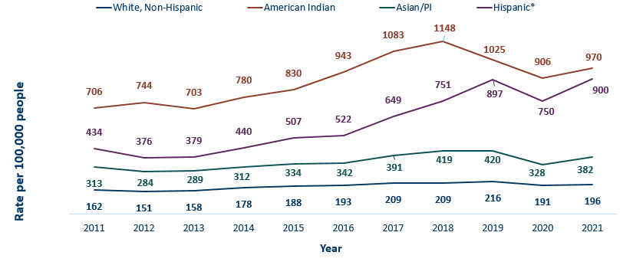
Chlamydia Rates by Race/Ethnicity, Minnesota, 2011-2021 (2/2)
Notes:
This is a clearer view of the rates from the previous slide, removing the Black/African American, non-Hispanic data.

Slide 47
Chlamydia and Gonorrhea Among Adolescents and Young Adults
(15-24 years of age)
Minnesota Department of Health STD Surveillance System

Slide 48
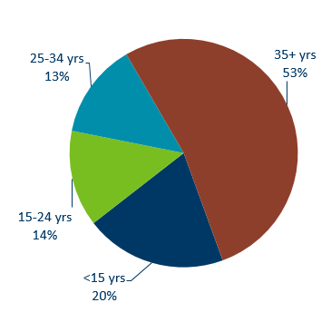
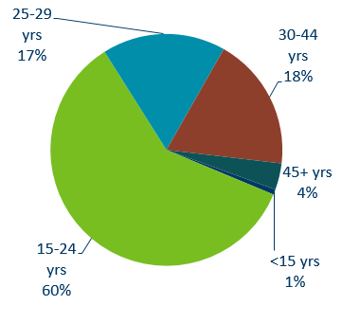
Chlamydia Disproportionately Impacts Youth and Young Adults
MN Population
(n = 5,303,925)
Chlamydia Cases in 2021
(n = 22,578)
Notes:
Chlamydia continues to disproportionately impact youth and young adults.
15–24-year-olds make up only 14% of the population, but account for 60% of all chlamydia cases reported.

Slide 49
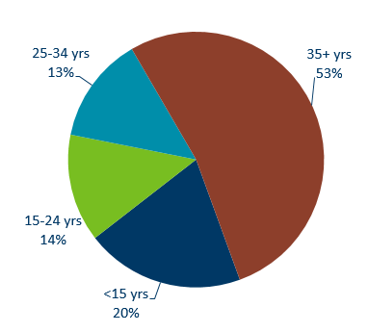
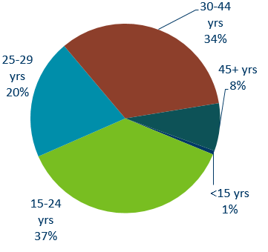
Gonorrhea Disproportionately Impacts Youth and Young Adults
MN Population
(n = 5,303,925)
Gonorrhea Cases in 2021
(n = 9,671)
Notes:
Gonorrhea also disproportionately impacts youth and young adults.
Again 15–24-year-olds make up only 14% of the population, but account for 37% of all gonorrhea cases reported.

Slide 50
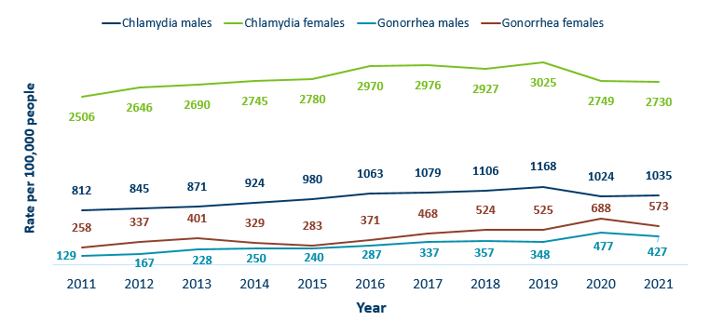
Chlamydia and Gonorrhea Rates Among Adolescents & Young Adults† by Gender in Minnesota, 2011-2021
Rate = Cases per 100,000 people based on 2010 U.S. Census counts.
† Adolescents defined as 15-19 year-olds; Young Adults defined as 20-24 year-olds.
Notes:
The rates of chlamydia and gonorrhea are higher in females compared to males in the 15–24-year-old age group.
The rates for chlamydia in females are 2730 per 100,000 population compared to males at 1035 per 100,000 population.
The rates of gonorrhea in females is 573 per 100,000 compared to 427 per 100,000 in males.

Slide 51
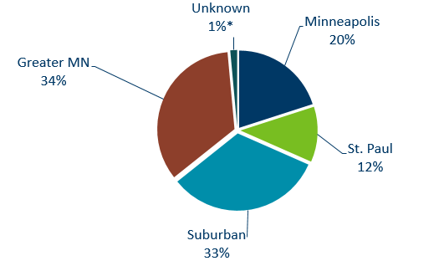
Geographic Characteristics of Adolescents and Young Adults † Diagnosed with Chlamydia or Gonorrhea, Minnesota 2021
Total Number of Cases = 17,101
Suburban = Seven-county metro area including Anoka, Carver, Dakota, Hennepin (excluding Minneapolis), Ramsey (excluding St. Paul), Scott, and Washington counties. Greater MN = All other Minnesota counties outside the seven-county metro area.
† Adolescents defined as 15-19 year-olds; Young Adults defined as 20-24 year-olds.
Notes:
In adolescents and young adults diagnosed with chlamydia or gonorrhea in 2021, about one-third (32%) reside in Minneapolis or St. Paul, one-third (34%) in Greater MN and one-third (33%) in the seven-county metro region.

Slide 52
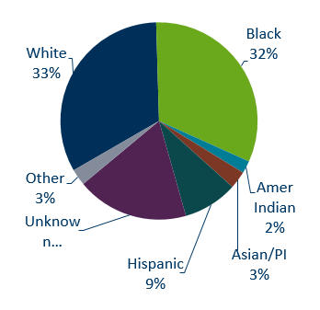
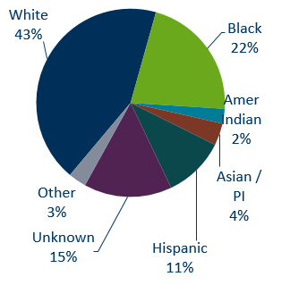
Chlamydia Cases Among Adolescents and Young Adults† by Gender and Race, Minnesota, 2021
Males (n = 3,821)
Females (n = 9,667)
† Adolescents defined as 15-19 year-olds; Young Adults defined as 20-24 year-olds * Other is more than one race. Excludes 4 transgender & 19 missing/other
Notes:
There is a large number of chlamydia cases among adolescents and young adults that are missing race/ethnicity when reported.
The use of electronic lab reporting has increased missing variables.

Slide 53
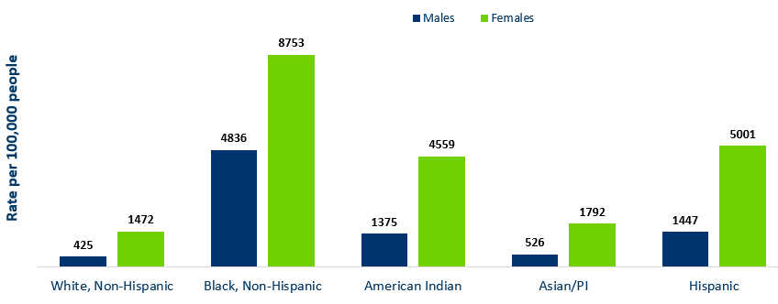
Chlamydia Rates Among Adolescents and
Young Adults† by Race, Minnesota, 2021
Rate=Cases per 100,000 people based on 2010 U.S. Census counts.
† Adolescents defined as 15-19 year-olds; Young Adults defined as 20-24 year-olds.
Notes:
The highest rates among adolescents and young adults are among females in the Black, non-Hispanic community. Their rate is 8,753 per 100,000 compared to 1472 in white, non-Hispanic youth and young adults.
Black, non-Hispanic males also have the highest rates among adolescent and young adult males at 4,836 per 100,000 population, compared to 425 in the white, non-Hispanic population.
Young females have the highest rates of chlamydia in all races.

Slide 54
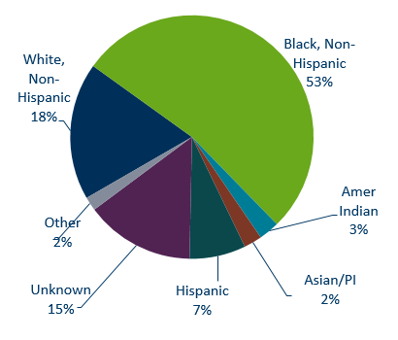
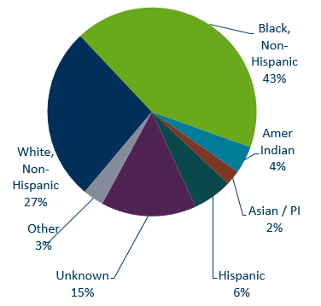
Gonorrhea Cases Among Adolescents and Young Adults† by Gender and Race, 2021
Males (n = 1,578)
Females (n = 2,028)
† Adolescents defined as 15-19 year-olds; Young adults defined as 20-24 year-olds. Excludes unknown/transgender/missing
Notes:
Black, Non-Hispanic males make up 53% of gonorrhea cases in male adolescent and young adults and 43% of gonorrhea cases in Black, Non-Hispanic females.

Slide 55
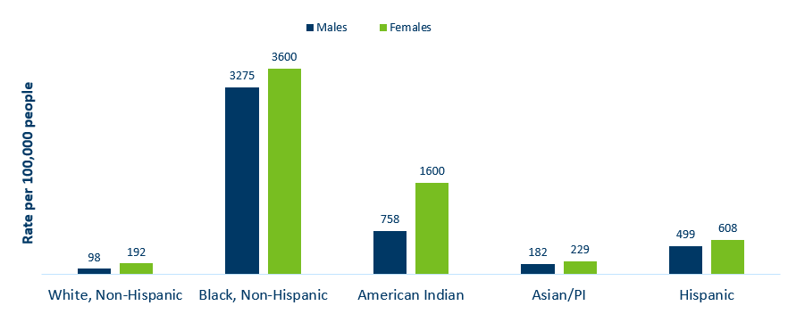
Gonorrhea Rate Among Adolescents and Young Adults† by Race, Minnesota, 2021
† Adolescents defined as 15-19 year-olds; Young Adults defined as 20-24 year-olds.
Rate = Cases per 100,000 people based on 2010 U.S. Census counts.
Notes:
Black, non-Hispanic and American Indian males and female adolescents and young adults are disproportionately affected by gonorrhea.

Slide 56
Burden of STDs on Young Females and Communities of Color
Females and particularly females of color disproportionately bear the long-term consequences of STDs.
  68% of chlamydia or gonorrhea cases diagnosed among adolescents and young adults were females.
  29% of all chlamydia or gonorrhea cases diagnosed among adolescents and young adults were in the Black, non-Hispanic females.
People with vulvas are biologically more prone to contracting an STD, but less likely to have symptoms. Untreated STDs can have serious consequences on their health and future reproductive ability.
  Untreated STDs in people with vulvas can lead to pelvic inflammatory disease, infertility and ectopic pregnancy.
  Pregnant people are at risk of passing a STDs to their newborn, causing premature delivery, infant pneumonia and blindness.
  Importance of annual preventive and prenatal screening
Notes:
Women and particularly women of color disproportionately bear the long-term consequences of STDs.
68% of chlamydia or gonorrhea cases diagnosed among adolescents and young adults were females.
29% of all chlamydia or gonorrhea cases diagnosed among adolescents and young adults were in the Black, non-Hispanic females.
Women are biologically more prone to contracting a STD, but less likely to have symptoms. Untreated STDs can have serious consequences on their health and future reproductive ability.
Untreated STDs in women can lead to pelvic inflammatory disease, infertility and ectopic pregnancy.
Women are at risk of passing a STDs to their newborn, causing premature delivery, infant pneumonia and blindness.
This highlights the importance of annual preventive and prenatal screening.

Slide 57
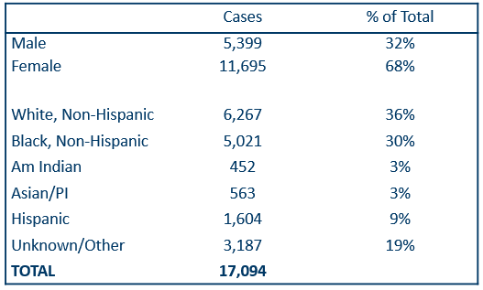
Summary Characteristics of Adolescents & Young Adults†
Diagnosed With Chlamydia or Gonorrhea in 2021
† Adolescents defined as 15-19 year-olds; young adults defined as 20-24 year-olds, excludes 4 transgender + 22 missing/unknown
Notes:
In adolescents and young adults, the majority of chlamydia and gonorrhea cases are females (68%) .
A little over one-third (36%) are white, non-Hispanic followed by about one-third (30%) that are black, non-Hispanic. 19% were unknown or more than one race.
Adolescents and young adults accounted for 60% of chlamydia and 37% of gonorrhea cases diagnosed in Minnesota.

Slide 58
What’s Being Done in Minnesota?
The MDH Partner Services Program continues to follow up on early syphilis cases and their sex partners and all pregnant syphilis cases.
All HIV/syphilis co-infected cases are assigned to Partner Services for follow-up.
Physicians are encouraged to screen men who have sex with men at least annually and to ask about sex partners.
All pregnant females should be screened for syphilis at first prenatal visit, 28 weeks’ gestation (at minimum 28-36 weeks), and at delivery.

Slide 59
Summary of STD Trends in Minnesota
From 2011-2021, the chlamydia rate increased by 34%. The rate of gonorrhea increased by 324%, syphilis has increased by 305%.
Adolescent and young females aged 15-24 years old continue to make up the majority of all chlamydia or gonorrhea cases at 53%.
Syphilis has resurged in MN over the past decade, with MSM and those co-infected with HIV being especially impacted. However, the number of females impacted is near the record high for the last decade.
People of color continue to be disproportionately affected by all STDs in Minnesota. Disparities in the rates of STDs are not explained by differences in sexual behavior, but are due to differences in health insurance coverage, employment status and access to healthcare with preventative, screening, and treatment services.
Notes:
From 2011-2021, the chlamydia rate increased by 34%. The rate of gonorrhea increased by 324% syphilis has increased by 305%.
Adolescent and young females aged 15-24 years old continue to make up the majority of all chlamydia or gonorrhea cases at 69%.
Minnesota has seen a resurgence of syphilis over the past decade, with men who have sex with men and those co-infected with HIV being especially impacted. However, the number of females impacted is near the record high for the last decade.
people of color continue to be disproportionately affected by all STDs in Minnesota and nationwide. Disparities in the rates of STDs are not explained by differences in sexual behavior, but are due to differences in health insurance coverage, employment status and access to healthcare with preventative, screening and treatment services.

Slide 60
Health Watch: Disseminated Gonococcal Infection (DGI) (1/2)
3 cases of disseminated gonococcal infections (DGI) diagnosed in MN in 2021.
DGI occurs when a gonorrhea infection moves into the bloodstream and spreads to distant sites in the body, which can lead to clinical findings: septic arthritis, polyarthralgia, tenosynovitis, petechial/pustular lesions, bacteremia, or rarely: endocarditis or meningitis.
DGI is uncommon and occurs in 0.5-3% of untreated cases.
If there is clinical suspicion for DGI, nucleic acid amplification test (NAAT) & culture specimens from urogenital and extra-genital (e.g., pharyngeal and rectal) mucosal site(s), as applicable, should be collected and processed, in addition to culture specimens from disseminated sites of infection (e.g., skin, synovial, blood, CSF).
Source: Health Alert Template for Disseminated Gonococcal Infection (DGI) (https://www.cdc.gov/std/program/outbreakresources/HANtemplate-dgi.htm)
Notes:
3 cases of disseminated gonococcal infections (DGI) were diagnosed in Minnesota in 2021.
DGI occurs when a gonorrhea infection moves into the bloodstream and spreads to distant sites in the body, which can lead to clinical findings, such as septic arthritis, polyarthralgia, tenosynovitis, petechial/pustular lesions, bacteremia, or on rare occasions endocarditis or meningitis.
DGI is uncommon and occurs in 0.5-3% of untreated cases.
Report all laboratory confirmed cases of DGI or concern over persistent infection to MDH within 24 hours of identification. Also please call MDH when these cases are identified at 651-201-5414.
Management of DGI cases should be guided by the CDC STD Treatment Guidelines.

Slide 61
Health Watch: Disseminated Gonococcal Infection (DGI) (2/2)
Report all laboratory confirmed cases of DGI or concern over persistent infection to MDH within 24 hours of identification at 651-201-5414.
All DGI cases should be cultured and tested for antimicrobial susceptibility. Please contact MDH for guidance on sending samples to the MDH Lab for additional testing.
Management of DGI cases should be guided by the STI Treatment Guidelines (https://www.cdc.gov/std/treatment-guidelines/default.htm)
Source: Health Alert Template for Disseminated Gonococcal Infection (DGI) (https://www.cdc.gov/std/program/outbreakresources/HANtemplate-dgi.htm)
Notes:
8 cases of disseminated gonococcal infections (DGI) were diagnosed in Minnesota in 2021.
DGI occurs when a gonorrhea infection moves into the bloodstream and spreads to distant sites in the body, which can lead to clinical findings, such as septic arthritis, polyarthralgia, tenosynovitis, petechial/pustular lesions, bacteremia, or on rare occasions endocarditis or meningitis.
DGI is uncommon and occurs in 0.5-3% of untreated cases.
Report all laboratory confirmed cases of DGI or concern over persistent infection to MDH within 24 hours of identification. Also please call MDH when these cases are identified at 651-201-5414.
Management of DGI cases should be guided by the CDC STD Treatment Guidelines.

Slide 62
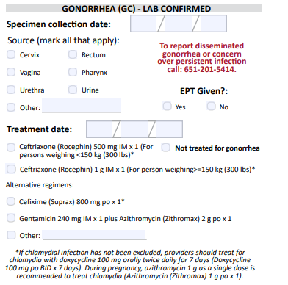
Updates to STD Reporting and Current Follow-Up
A new chlamydia and gonorrhea case report form is available on the MDH website, to accommodate changes in treatment guidelines and highlight DGI reporting.
The case report form can be filled out and mailed or faxed to MDH at 1-800-298-3775.
More information may be requested on gonorrhea cases for Enhanced Gonorrhea Surveillance as part of the CDC PCHD grant.
All cases co-infected with early syphilis will continue to be assigned to MDH Partner Services for follow-up.
All STD cases continue to have the potential for being contacted by MDH for additional follow-up.
Notes:
A new Chlamydia and Gonorrhea case report form is available on the MDH website, to accommodate changes in treatment guidelines and highlight DGI reporting.
The case report form can be filled out and mailed or faxed to MDH at 1-800-298-3775.
More information may be requested on gonorrhea cases for Enhanced Gonorrhea Surveillance as part of the CDC PCHD grant.
All cases co-infected with Early Syphilis will continue to be assigned to MDH Partner Services for follow-up.
All STD cases continue to have the potential for being contacted by MDH for additional follow-up.

