Slide 1
Sexually Transmitted Disease (STD) Surveillance Report, 2021
Minnesota Department of Health STD Surveillance System

Slide 2
STDs in Minnesota:
Number of Cases Reported in 2021
Total of 33,706 STD cases reported to MDH in 2021:
  22,578 Chlamydia cases
  9,671 Gonorrhea cases
  1457 Syphilis cases (all stages)
  0 Chancroid cases
Notes:
In the year 2021, a total of 33,706 STD cases were reported to the Minnesota Department of Health:
22,578 Chlamydia cases
9,671 Gonorrhea cases
1457 Syphilis cases (all stages)
0 Chancroid cases

Slide 3
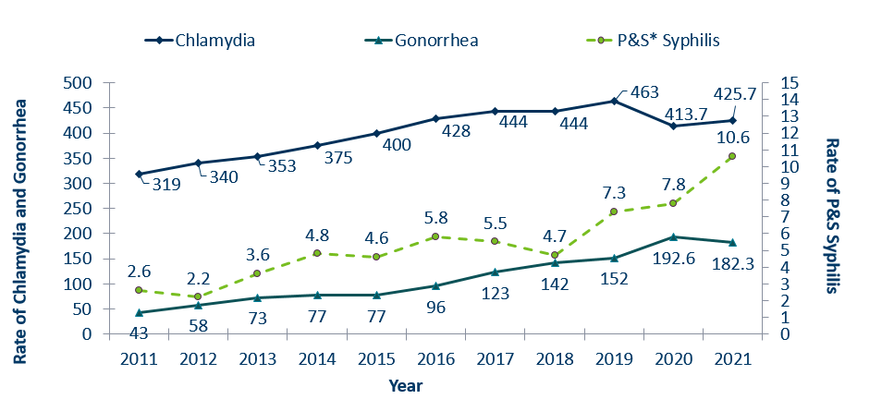
STDs in Minnesota:
Rate per 100,000 by Year of Diagnosis, 2011-2021
* P&S = Primary and Secondary
Notes:
The rate of chlamydia in MN increased by 3% to 425.7 per 100,000 compared to 413.7 per 100,000 in 2021.
The rate of gonorrhea in MN decreased 5% to 182.3 per 100,000 compared to 192.6 per 100,000 in 2021.
The rate of primary and secondary syphilis increased by 36% from 7.8 in 2020 to 10.6 per 100,000 in 2021.

Slide 4
Interpreting STD Surveillance Data
Factors that impact the completeness and accuracy of STD data include:
  Level of STD screening by healthcare providers
  Individual test-seeking behavior
  Sensitivity of diagnostic tests
  Compliance with case reporting
  Completeness of case reporting
  Timeliness of case reporting
Increases and decreases in STD rates can be due to actual changes in disease occurrence and/or changes in one or more of the above factors.
COVID-19 lockdowns likely played a role in the number of cases reported/diagnosed this past year.
Notes:
Factors that impact the completeness and accuracy of STD data include:
Level of STD screening by healthcare providers, individual test-seeking behavior, sensitivity of diagnostic tests, compliance with case reporting, completeness of case reporting, timeliness of case reporting.
Increases and decreases in STD rates can be due to actual changes in disease occurrence and/or changes in one or more of the above factors.
Important to note that COVID-19 lockdowns likely played a role in the number of cases reported or diagnosed this past year.

Slide 5
Syphilis
Minnesota Department of Health STD Surveillance System

Slide 6
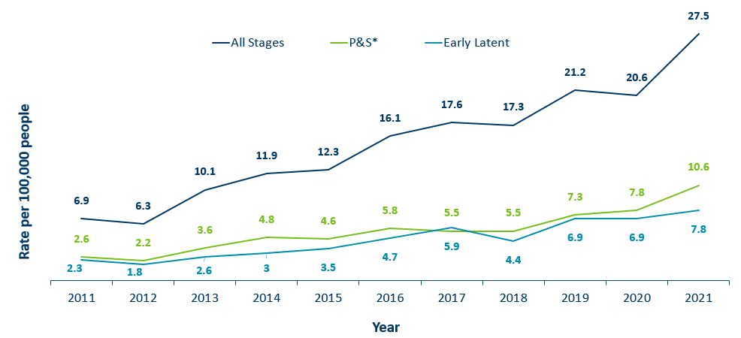
Syphilis Rates by Stage of Diagnosis, Minnesota, 2011-2021
* P&S = Primary and Secondary
Notes:
The overall syphilis rate is 27.5 per 100,000. An increase from 2020, and a 300% increase from a decade ago.
Of concern is the rate of primary and secondary syphilis which is 10.6 per 100,000, a 36% increase from 2020.

Slide 7
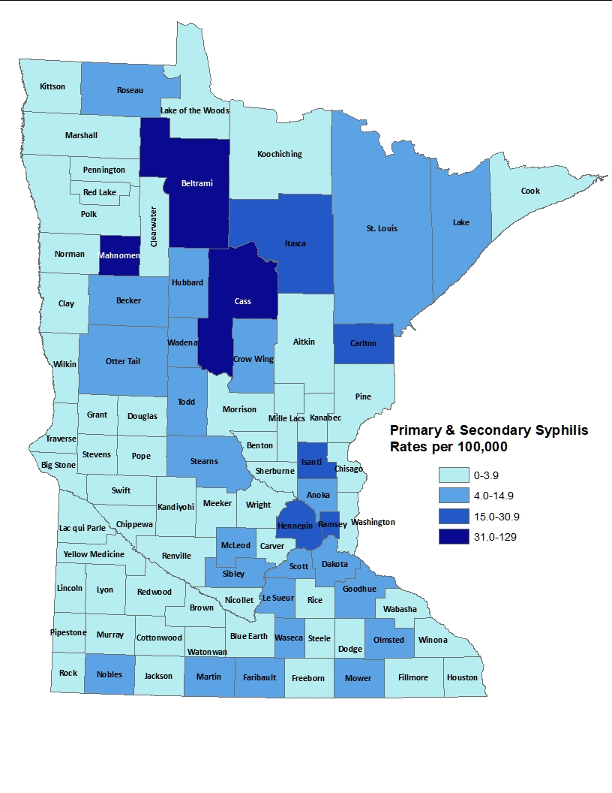
2021 Minnesota Primary & Secondary Syphilis Rates by County
City of Minneapolis
City of St. Paul
Suburban*
Greater Minnesota
Total
49.7 per 100,000 (144 cases)
28.4 per 100,000 (37 cases)
6.7 per 100,000 (104 cases)
5.9 per 100,000 (131 cases)
10.6 per 100,000 (416 cases)
*7-county metro area, excluding the cities of Minneapolis and St. Paul
Notes:
The statewide rate of primary and secondary syphilis increased to 10.6 cases per 100,000 from 7.8.
Within the metro, the highest rate of primary and secondary syphilis remains in the City of Minneapolis at 49.7 cases per 100,000 population.
The City of St. Paul has the second highest rate in the metro at 28.4 per 100,000.

Slide 8
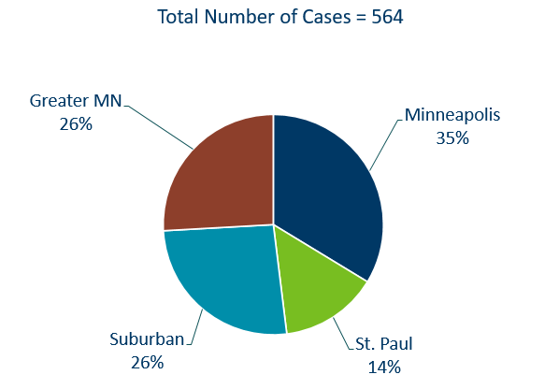
Primary & Secondary Syphilis Infections by Residence at Diagnosis
Minnesota, 2021
Suburban = Seven-county metro area including Anoka, Carver, Dakota, Hennepin (excluding Minneapolis), Ramsey (excluding St. Paul), Scott, and Washington counties. Greater MN = All other Minnesota counties outside the seven-county metro area.
Notes:
The City of Minneapolis had the largest percent of all reported primary and secondary cases with 35%, second to Greater Minnesota with 26% of the cases.
The suburban area had 26% and St. Paul had 14%.

Slide 9
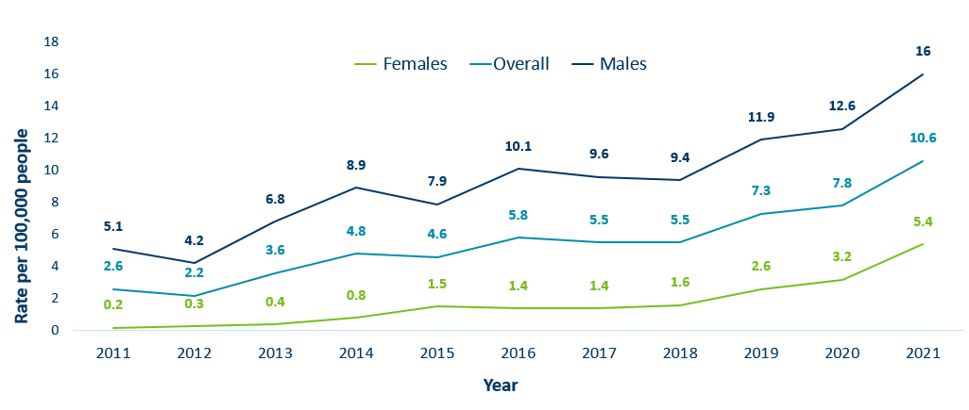
Primary & Secondary Syphilis Rates by Gender, Minnesota, 2011-2021
Notes:
Males have the highest rates of primary and secondary syphilis at 16 cases per 100,0000 population
The rate of primary and secondary syphilis in females is 5.4 per 100,000 per population.

Slide 10
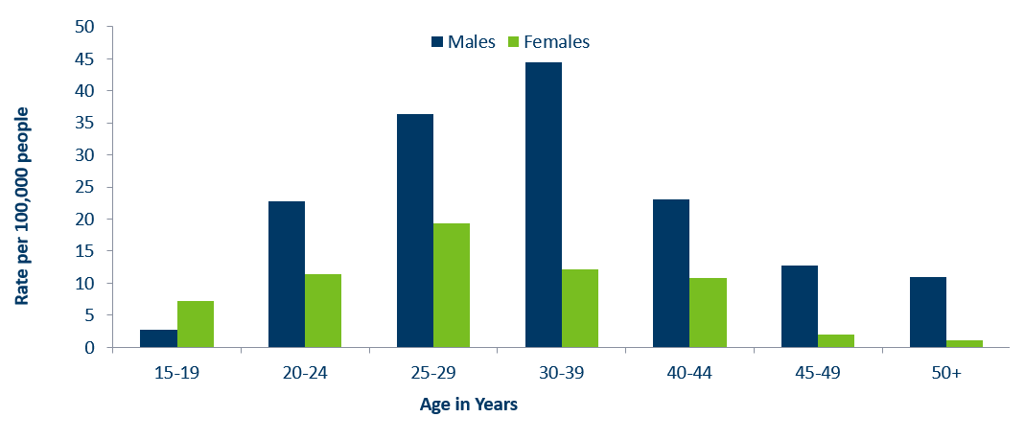
Age-Specific Primary & Secondary Syphilis Rates by Gender, Minnesota, 2021
Notes:
Males have higher rates of primary and secondary syphilis than females in all age groups. The rate in males is 3 times higher than females.
30-39 year old males had the highest rate at 44.4 per 100,000
25-29 year old females had the highest rate of the female population at 19.4 per 100,000.

Slide 11
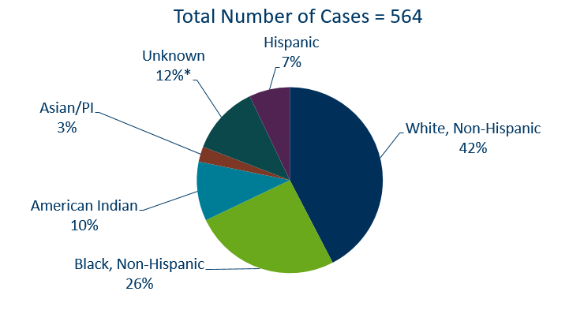
Primary & Secondary Syphilis Cases by Race
Minnesota, 2021
*Includes people reported with more than one race
Notes:
42% percent of all primary and secondary syphilis cases are White, non-Hispanic.
Black, non-Hispanic cases made up 26% of all Primary and Secondary Syphilis cases followed by, American Indian cases at 10%, Hispanic cases at 7%, and Asian/Pacific Islander cases at 3%.

Slide 12
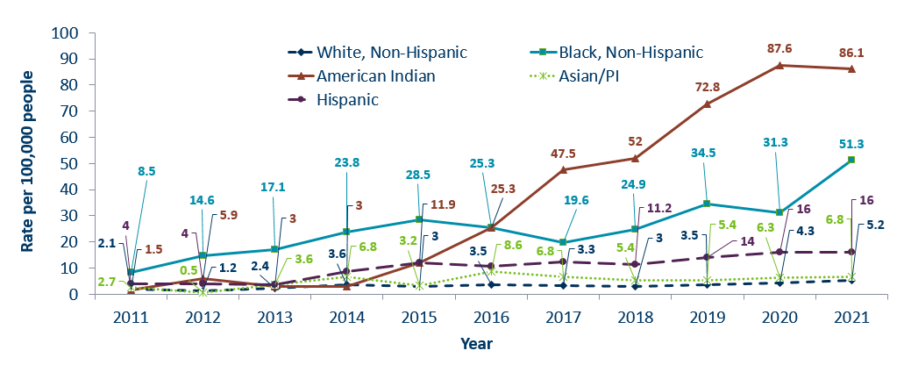
Primary & Secondary Syphilis Rates by Race/Ethnicity
Minnesota, 2011-2021
* people of Hispanic ethnicity can be of any race.
Notes:
Large disparities continue to exist in the rates of syphilis compared to the White, non-Hispanic population.
The rates of primary and secondary syphilis are 16.7 times higher in the American Indian populations than that of the White, non-Hispanic population.
The rates of primary and secondary syphilis are 9.9 times higher in the Black/African American, non-Hispanic than that of the White, non-Hispanic population.
The rates of primary and secondary syphilis in the American Indian population are 95.1 per 100,000 compared to 5.7 per 100,000 in the White, non-Hispanic population.
The rates of primary and secondary syphilis in the Black/African American, non-Hispanic population are 57.7 per 100,000 .
The rates in the Hispanic population are 16.0 per 100,000 which is 3.1 times higher than the White, non-Hispanic population.
The rates in the Asian/Pacific Islander population are 6.8 per 100,000 which is 1.3 times higher than the White, non-Hispanic population.

Slide 13
Topic of Interest: Syphilis Among
Females and Congenital Syphilis in Minnesota
Minnesota Department of Health STD Surveillance System
Notes:
Topic of Interest: Syphilis Among
Females and Congenital Syphilis in Minnesota

Slide 14
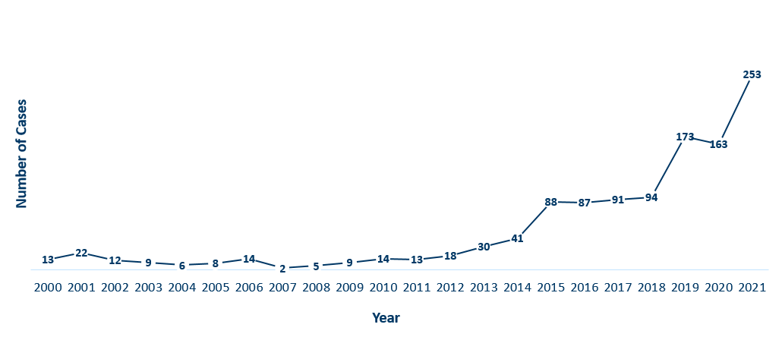
Female Early Syphilis Cases
Minnesota, 2021
Notes:
The number of female early syphilis cases has increased dramatically over the last 10 years from 13 cases in 2011 to 253 in 2021.

Slide 15
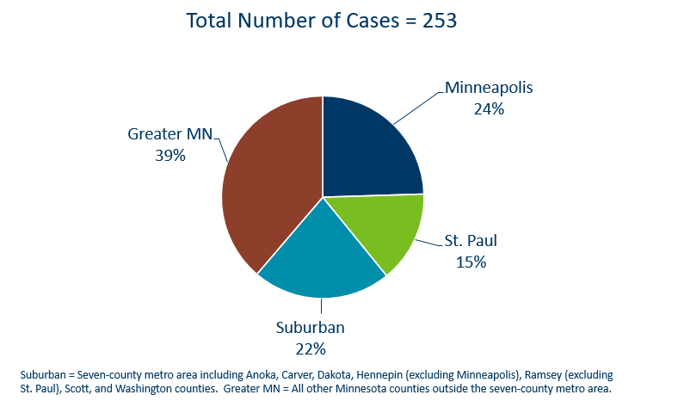
Early Syphilis Infections in Females by Residence at Diagnosis
Minnesota, 2021
Notes:
39 percent of female early syphilis cases were residents of Greater Minnesota
22 percent of female early syphilis cases were residents of the Suburbs of the seven-county metro area
24 percent were City of Minneapolis residents, and 15 percent were St. Paul residents.

Slide 16
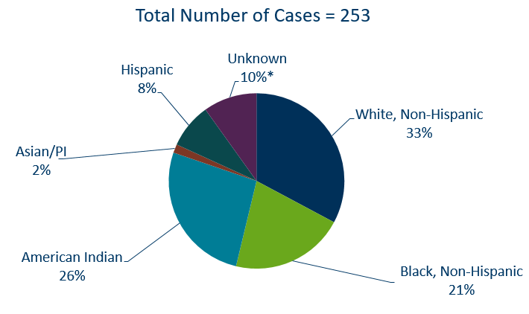
Early Syphilis Cases in Females by Race/Ethnicity
Minnesota, 2021
*Includes people reported with more than one race
Notes:
There are large disparities in women with syphilis. 26 percent of all early syphilis cases in females are found in the American Indian population and 21% in the Black, African American population.

Slide 17
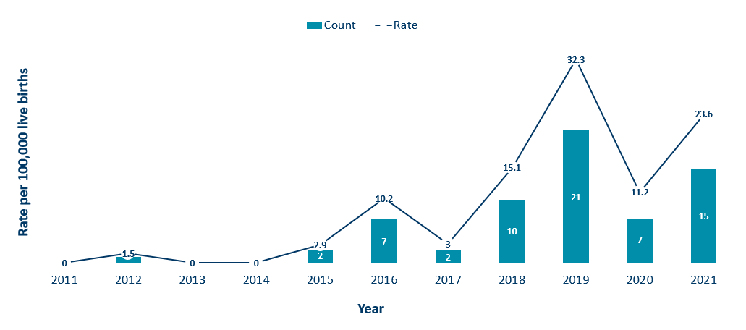
Congenital Syphilis Rates Among Infants
Minnesota, 2011-2021
Notes:
In Minnesota, the number and rate of congenital syphilis cases among infants has increased in 2021 compared to 2020. Overall, the rate has increased over the past five years from a rate of 3 per 100,000 live births in 2017 to 23.6 per 100,000 live births in 2021.
Syphilis may be passed from a pregnant person to the unborn baby through the placenta. The infection can cause miscarriages and stillbirths, and infants born with congenital syphilis can suffer a variety of serious health problems, including deformities, seizures, anemia and jaundice.
The Centers for Disease Control and Prevention reported this fall that the number of infants born with syphilis has more than 200% in the past four years and last year reached a 20-year high.

Slide 18
Topic of Interest: Early Syphilis Among
Men Who Have Sex With Men in Minnesota
Minnesota Department of Health STD Surveillance System
Notes:
Topic of Interest: Early Syphilis Among Men Who Have Sex With Men in Minnesota.
Men who have sex with men (MSM) make up the majority of early syphilis cases.

Slide 19
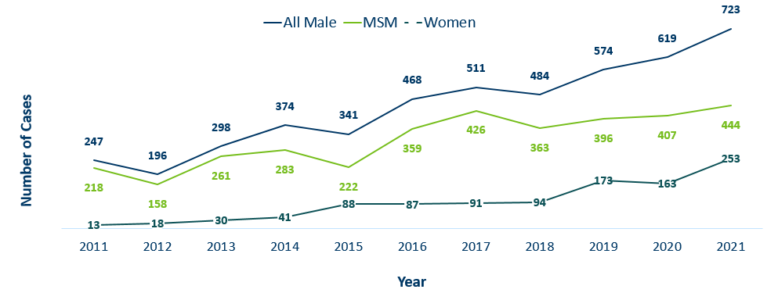
Number of Early Syphilis† Cases by Gender and MSM
Minnesota, 2011-2021
MSM=Men who have sex with men.
Figure does not include cases diagnosed in transgender people
† Early Syphilis includes primary, secondary, and early latent stages of syphilis.
Notes:
Early syphilis, includes not only primary and secondary syphilis, but all new syphilis acquired in the past year.
Of all early syphilis cases, 73 percent were among people whose current gender was reported as male.
Men who have sex with men (MSM) account for 61% of all early syphilis cases among men.

Slide 20
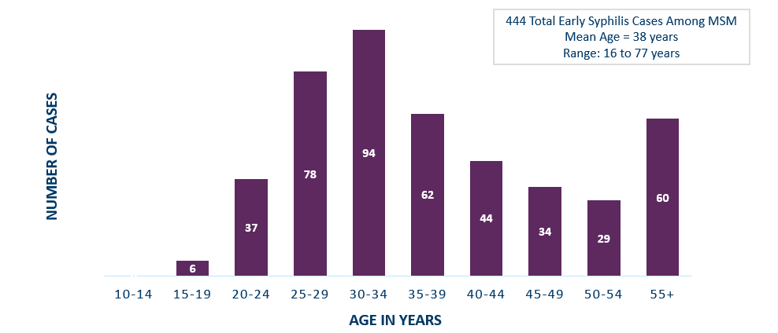
Early Syphilis† Cases Among MSM by Age
Minnesota, 2021
MSM=Men who have sex with men
† Early Syphilis includes primary, secondary, and early latent stages of syphilis.
Notes:
The average age of MSM with early syphilis is 38 years of age.
Ages ranged from 16–77 years of age
The 30-34 year old age group had the highest number of cases at 94.
39% of early syphilis cases are among MSM are in the 25-34 age groups.

Slide 21
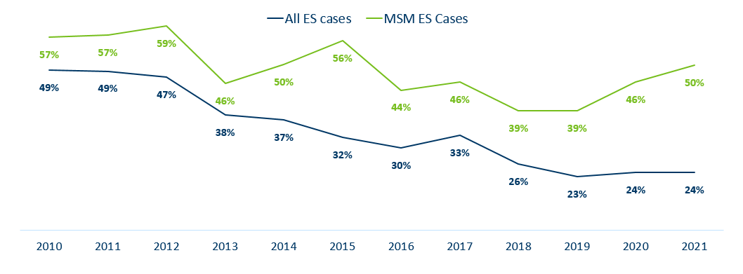
Early Syphilis† (ES) Cases
Co-infected with HIV, 2011-2021
MSM=Men who have sex with men
† Early Syphilis includes primary, secondary, and early latent stages of syphilis.
Notes:
24% percent of all early syphilis cases were co-infected with HIV.
50% percent of all MSM early syphilis cases were co-infected with HIV.

Slide 22
Gonorrhea
Minnesota Department of Health STD Surveillance System
Notes:
Cases of reported gonorrhea saw the greatest decrease of 5 percent. 10,217 in 2020 compared to 9671 in 2021.

Slide 23
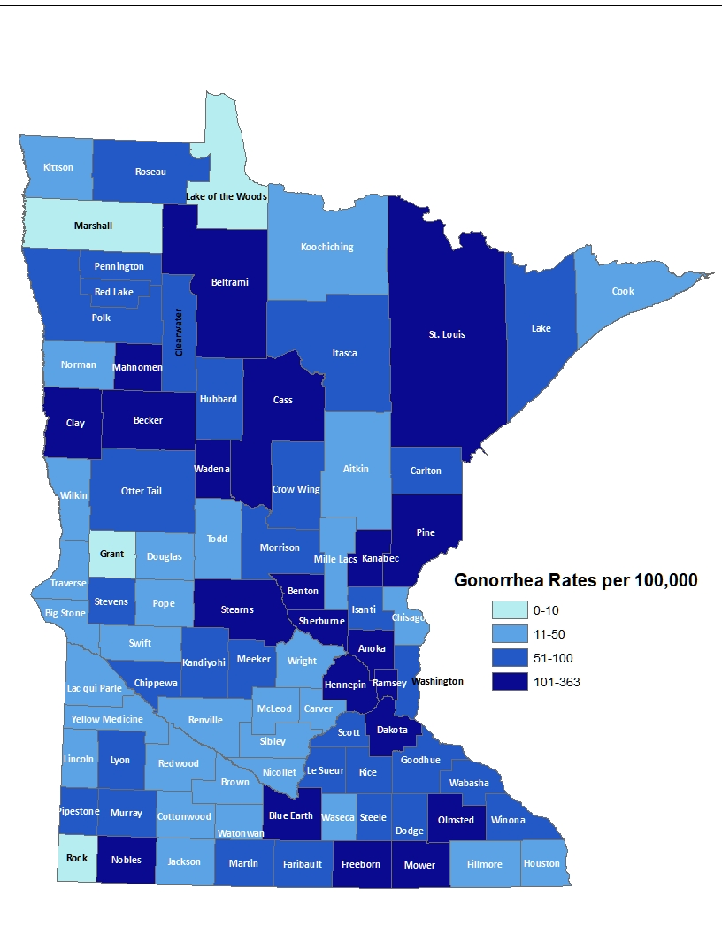
2021 Minnesota Gonorrhea Rates by County
City of Minneapolis
City of St. Paul
Suburban*
Greater Minnesota
Total
764 per 100,000 (2,973 cases)
514 per 100,000(1,524 cases)
126 per 100,000 (3,083 cases)
97 per 100,000 (2,430 cases)
182.3 per 100,000 (9,671 cases)
(150 cases missing residence information)
*7-county metro area, excluding the cities of Minneapolis and St. Paul
Notes:
The rate of gonorrhea in MN reached an all time high at 182.3 per 100,000. This is a rate decrease of 5% from 2020.
The city of Minneapolis continues to have the highest rates of gonorrhea at 764 per 100,000, followed by the city of St. Paul at 514 per 100,000, the suburban area (7-county metro excluding Minneapolis & St. Paul) at 126 per 100,000 and Greater Minnesota at 97 per 100,000.
The rates of gonorrhea increased in all areas across Minnesota.
The seven-county metro Suburban area had the highest increase at 37%, followed by the City of St Paul with 29%.

Slide 24
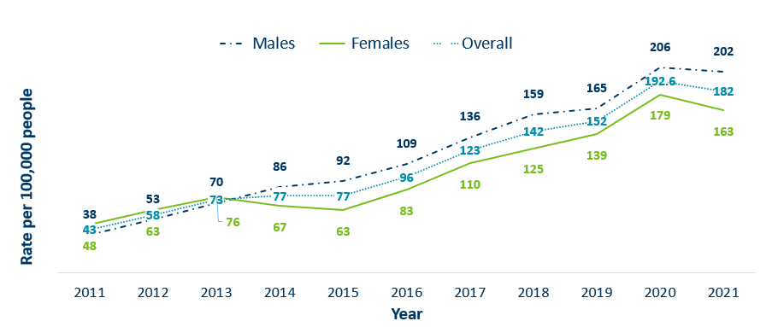
Gonorrhea Rates by Gender
Minnesota, 2011-2021
Notes:
The rates of gonorrhea went down in both males and females in 2021. Males continue to have higher rates of gonorrhea than females, but the rate in females is increasing.
Males had a rate of 202 per 100,000 which is a decrease of 2% over the 2020 rate of 206 per 100,000.
Females had a rate of 163 per 100,000 which is a decrease of 9% over the 2020 rate of 179 per 100,000.

Slide 25
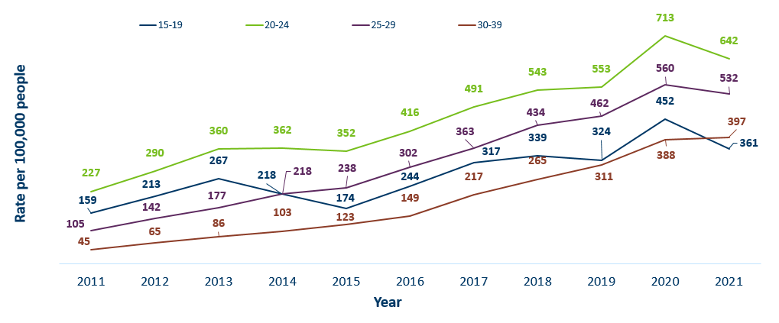
Gonorrhea Rates by Age
Minnesota, 2011-2021
Notes:
Most age groups saw a decrease in gonorrhea rates.
The highest rate remains in the 20–24-year-old age group at 642 per 100,000.
The 15–19-year-old age group had the largest rate increase from 388 in 2020 to 397 in 2021 a 2% increase.

Slide 26
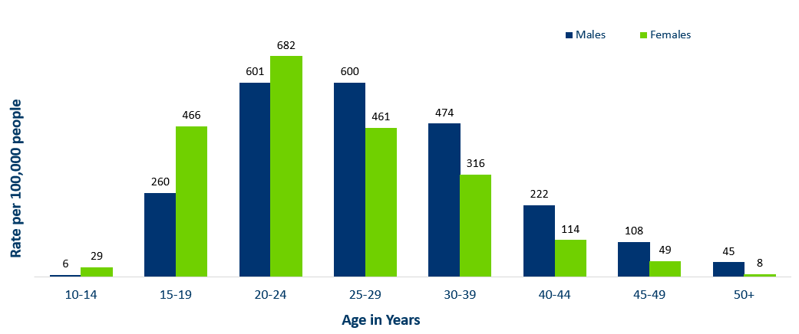
Age-Specific Gonorrhea Rates by Gender
Minnesota, 2021
Notes:
Females under the age of 25 years of age, continue to have higher rates of gonorrhea than males.
Males record the highest rate among age groups older than 25 years.
The highest rates of gonorrhea are in females 20-24 at 682 per 100,000.

Slide 27
Gonorrhea Rates by Race/Ethnicity
Minnesota, 2011-2021
Notes:
There continues to be large disparities in the rates of gonorrhea.
The Black/African American, non-Hispanic population rates are 20.6 times higher than white rates. The rate in the Black/African American population was 1370 per 100,000 compared to the rate in the White, Non-Hispanic population at 67 per 100,000.
The American Indian population had a rate that was 9.2 times higher at 609 per 100,000
The Asian/Pacific Islander population had a rate that was 1.5 times higher at 98 per 100,000
The Hispanic/Latino population, which can be of any race, had a rate that was 3.7 times higher at 249 per 100,000

Slide 28
Chlamydia
Minnesota Department of Health STD Surveillance System
Notes:
Chlamydia increased 3% in 2021 compared to 2020 which recorded the first decline in over a decade. This could be the result of a true decrease in the number of cases, but it could also reflect the COVID-19 pandemic and reduced preventative visits. Chlamydia is more likely to be asymptomatic than gonorrhea and syphilis, especially in females.

Slide 29
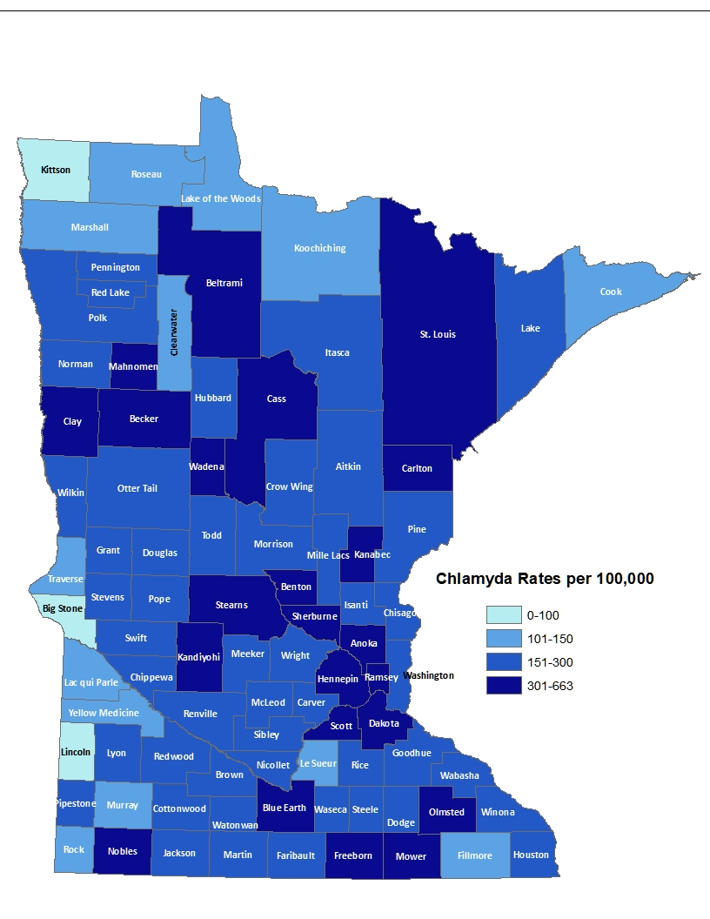
2021 Minnesota Chlamydia Rates by County
City of Minneapolis
City of St. Paul
Suburban*
Greater Minnesota
Total
1,206 per 100,000 (4,613 cases)
894 per 100,000 (2,548 cases)
348 per 100,000 (7,585 cases)
306 per 100,000 (7,519 cases)
425.7 per 100,000 (22,578 cases)
(315 cases missing residence information)
*7-county metro area, excluding the cities of Minneapolis and St. Paul
Notes:
All counties in Minnesota were affected by chlamydia. There were at least 2 cases in all counties in 2021.
The city of Minneapolis continues to have the highest rates of chlamydia at 1,206 per 100,000, followed by the city of St. Paul at 894 per 100,000, the suburban area (7-county metro excluding Minneapolis & St. Paul) at 348 per 100,000 and Greater Minnesota at 306 per 100,000.

Slide 30
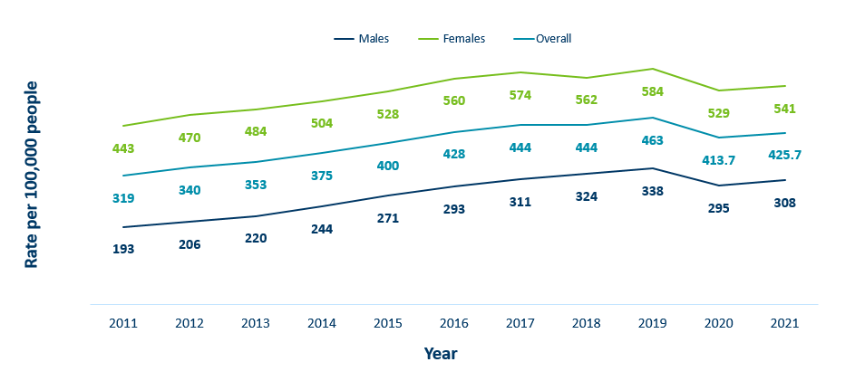
Chlamydia Rates by Gender
Minnesota, 2010-2020
Notes:
The rates of chlamydia increased for both males and females in 2021.
Females continue to have higher rates of chlamydia than males. Males had a rate of 308 per 100,000 which is an increase of 2% over the 2020 rate of 295 per 100,000.
Females had a rate of 541 per 100,000 which is an increase of 2% from 2020 rate of 529 per 100,000.

Slide 31
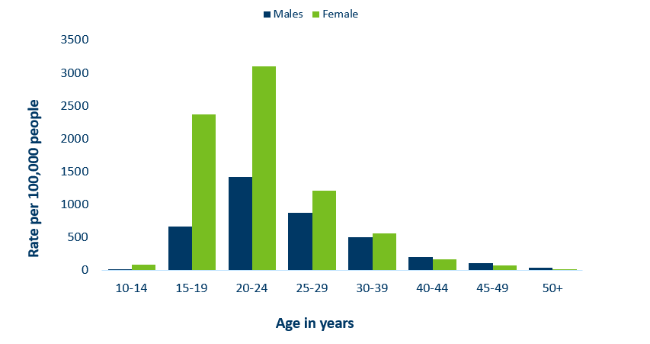
Age-Specific Chlamydia Rates by Gender,
Minnesota, 2021
Notes:
The rates of Chlamydia are highest among females.
Females, 20-24 years of age continue to have the highest rate at 3101 per 100,000.
Males aged 50+ reported the largest increase of over 50% when compared to 2020.

Slide 32
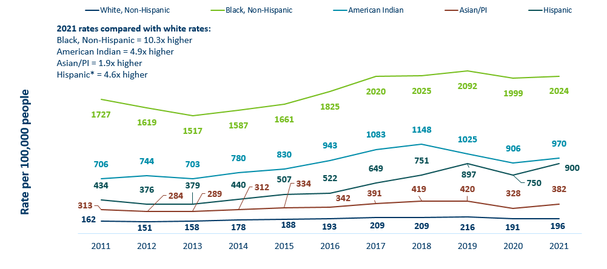
Chlamydia Rates by Race/Ethnicity Minnesota, 2011-2021 (1/2)
Notes:
There continues to be great disparities in rates of chlamydia.
The Black/African American, non-Hispanic population has rates that are 10.3 times higher than that of white rates.
The rate in the Black/African American, non-Hispanic population was 2024 per 100,000 compared to the rate in the White, non-Hispanic population at 196 per 100,000.
The American Indian population had a rate that was 4.9 times higher at 970 per 100,000
The Asian/Pacific Islander population had a rate that was 1.9 times higher at 382 per 100,000
The Hispanic/Latino population, which can be of any race, had a rate that was 4.6 times higher at 900 per 100,000

Slide 33
Chlamydia and Gonorrhea Among Adolescents and Young Adults
(15-24 years of age)
Minnesota Department of Health STD Surveillance System

Slide 34
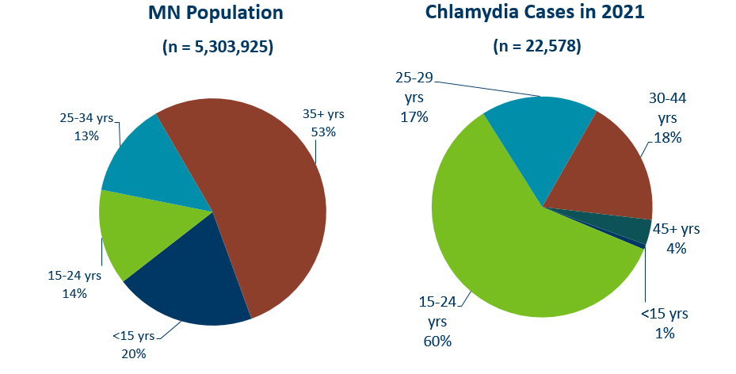
Chlamydia Disproportionately Impacts Youth and Young Adults
Notes:
Chlamydia continues to disproportionately impact youth and young adults.
15–24-year-olds make up only 14% of the population, but account for 60% of all chlamydia cases reported.

Slide 35
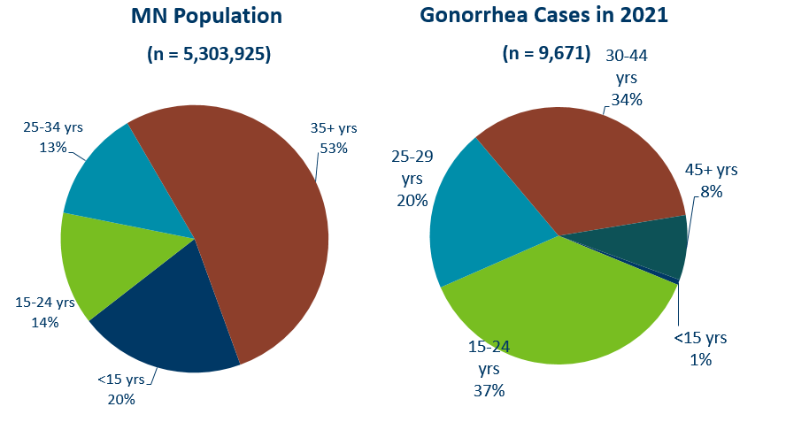
Gonorrhea Disproportionately Impacts Youth and Young Adults
Notes:
Gonorrhea also disproportionately impacts youth and young adults.
Again 15–24-year-olds make up only 14% of the population, but account for 37% of all gonorrhea cases reported.

Slide 36
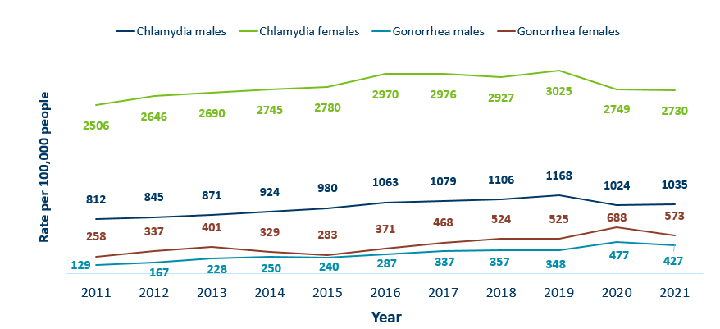
Chlamydia and Gonorrhea Rates Among Adolescents & Young Adults† by Gender in Minnesota, 2011-2021
Rate = Cases per 100,000 people based on 2010 U.S. Census counts.
† Adolescents defined as 15-19 year-olds; Young Adults defined as 20-24 year-olds.
Notes:
The rates of chlamydia and gonorrhea are higher in females compared to males in the 15–24-year-old age group.
The rates for chlamydia in females are 2730 per 100,000 population compared to males at 1035 per 100,000 population.
The rates of gonorrhea in females is 573 per 100,000 compared to 427 per 100,000 in males.

Slide 37
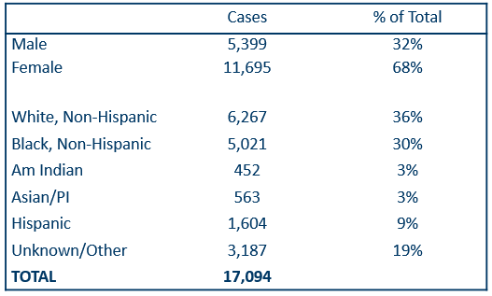
Summary Characteristics of Adolescents & Young Adults†
Diagnosed With Chlamydia or Gonorrhea in 2021
† Adolescents defined as 15-19 year-olds; young adults defined as 20-24 year-olds, excludes 4 transgender + 22 missing/unknown
Notes:
In adolescents and young adults, the majority of chlamydia and gonorrhea cases are females (68%) .
A little over one-third (36%) are white, non-Hispanic followed by about one-third (30%) that are black, non-Hispanic. 19% were unknown or more than one race.
Adolescents and young adults accounted for 60% of chlamydia and 37% of gonorrhea cases diagnosed in Minnesota.

Slide 38
Summary of STD Trends in Minnesota
From 2011-2021, the chlamydia rate increased by 34%. The rate of gonorrhea increased by 324%, syphilis has increased by 305%.
Syphilis has resurged in MN over the past decade, with MSM and those co-infected with HIV being especially impacted. However, the number of females impacted is near the record high for the last decade.
People of color continue to be disproportionately affected by all STDs in Minnesota. Disparities in the rates of STDs are not explained by differences in sexual behavior, but are due to differences in health insurance coverage, employment status and access to healthcare with preventative, screening, and treatment services.
Notes:
From 2011-2021, the chlamydia rate increased by 34%. The rate of gonorrhea increased by 324% syphilis has increased by 305%.
Minnesota has seen a resurgence of syphilis over the past decade, with men who have sex with men and those co-infected with HIV being especially impacted. However, the number of females impacted is near the record high for the last decade.
People of color continue to be disproportionately affected by all STDs in Minnesota and nationwide. Disparities in the rates of STDs are not explained by differences in sexual behavior, but are due to differences in health insurance coverage, employment status and access to healthcare with preventative, screening and treatment services.

Slide 39
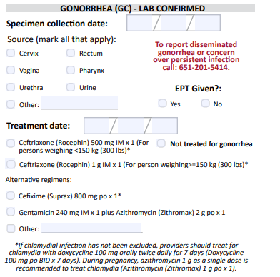
Updates to STD Reporting and Current Follow-Up
A new chlamydia and gonorrhea case report form is available on the MDH website, to accommodate changes in treatment guidelines and highlight DGI reporting.
The case report form can be filled out and mailed or faxed to MDH at 651-201-4040.
More information may be requested on gonorrhea cases for Enhanced Gonorrhea Surveillance as part of the CDC PCHD grant.
All cases co-infected with early syphilis will continue to be assigned to MDH Partner Services for follow-up.
All STD cases continue to have the potential for being contacted by MDH for additional follow-up.
Notes:
A new chlamydia and gonorrhea case report form is available on the MDH website, to accommodate changes in treatment guidelines and highlight DGI reporting.
The case report form can be filled out and mailed or faxed to MDH at 651-201-4040.
More information may be requested on gonorrhea cases for Enhanced Gonorrhea Surveillance as part of the CDC PCHD grant.
All cases co-infected with early syphilis will continue to be assigned to MDH Partner Services for follow-up.
All STD cases continue to have the potential for being contacted by MDH for additional follow-up.

