Slide 1
Ticks & Tickborne Diseases of Minnesota
Vectorborne Diseases Unit
Last Updated March 2024
Notes:
Welcome! We are pleased to present you with information about ticks and tickborne diseases found in Minnesota.
This slide presentation and script are part of the ongoing public education efforts of the Minnesota Department of Health’s Vectorborne Diseases Unit.
The photos used in this presentation are property of the Centers for Disease Control and Prevention’s (CDC) public image library or property of the Minnesota Department of Health (MDH). Explicit permission was granted and credited for use of images not property of CDC or MDH.

Slide 2
What is a tickborne disease and why should you care about it?
People can get a tickborne disease when they are bitten by a tick that is infected with a disease agent
The number of people getting tickborne diseases is increasing throughout the United States, including Minnesota
Personal protection methods can help keep you safe from tick bites and tickborne diseases while enjoying healthy outdoor activities
Notes:
The purpose of this slideshow is to educate people who live, work, and travel to Minnesota about the importance of being aware of ticks and tickborne diseases.
People can get a tickborne disease when they are bitten by a tick that is infected with a disease agent. Tickborne diseases are a growing concern throughout the United States, including Minnesota, because the number of people getting tickborne diseases is increasing. In order to keep you safe from tick bites and tickborne diseases while enjoying the great outdoors, you should be aware of and follow some simple personal protection methods.

Slide 3
Goals of Presentation
Be able to recognize ticks of public health concern in MN
Be aware of tickborne diseases
Recognize basic signs and symptoms
Seek early diagnosis and treatment
Know when and where tickborne disease risk is highest
Practice prevention methods
Know who to contact for more information
Notes:
By the end of this presentation, you will:
Be able to recognize ticks of public health concern in Minnesota,
Be aware of tickborne diseases in Minnesota,
Recognize basic signs and symptoms,
Seek early diagnosis and treatment,
Know if you live, work or play in an area that has blacklegged ticks,
Know when and where tickborne disease risk is highest,
Practice prevention methods, and
Know who to contact for more information.

Slide 4
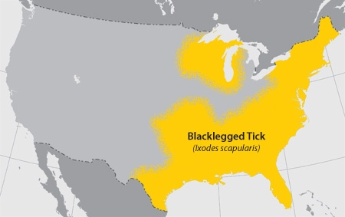
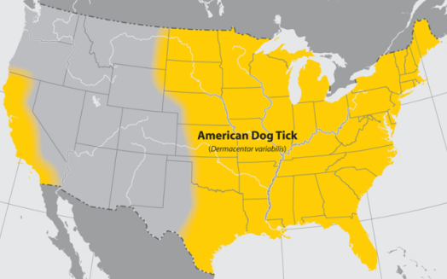
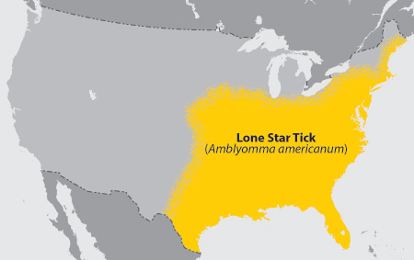
Ticks of Public Health Concern in Minnesota
Blacklegged (Deer) Tick
Lyme disease
Anaplasmosis
Babesiosis
Ehrlichiosis
Powassan virus
Relapsing fever
American Dog (Wood) Tick
Spotted Fever Group bacteria
Tularemia
Lone Star Tick
Ehrlichiosis
Tularemia
Notes:
In order to understand the tickborne diseases that we have present in Minnesota and how to protect yourself from them, it is important to start with the tick itself. In Minnesota, there are roughly 12 species of hard ticks found here. However, not all of them spread disease and only a few of these tick species are a primary public health concern: the blacklegged tick (also known as the deer tick), the American dog tick (also known as the wood tick), and the lone star tick. Soft ticks are a whole different subject and usually don’t come into contact with people in Minnesota so the rest of this presentation will focus on hard ticks, primarily the blacklegged tick.
The blacklegged tick causes by far the most tickborne diseases in Minnesota. It can transmit diseases such as Lyme disease, anaplasmosis, babesiosis, ehrlichiosis (a certain strain called Ehrlichia muris eauclairensis), and Powassan virus. American dog ticks are very common in our state but they rarely spread diseases. American dog ticks may spread diseases such as Rocky Mountain spotted fever and tularemia. Lone star ticks are rarely found in Minnesota, but can spread diseases such as ehrlichiosis, tularemia, Heartland virus disease, and Southern Tick-Associated Rash Illness (STARI).
Pictured in the middle of the slide are adult female ticks from each of those three species. Pictured on the left of the slide are maps of where you are most likely to find these ticks in the United States. You can see that the American dog tick can be found throughout Minnesota while the blacklegged tick is primarily found in the eastern, central, and north-central areas of Minnesota. The lone star tick is not currently established in Minnesota but sporadic reports from persons around the state indicate that you can rarely find it here.

Slide 5
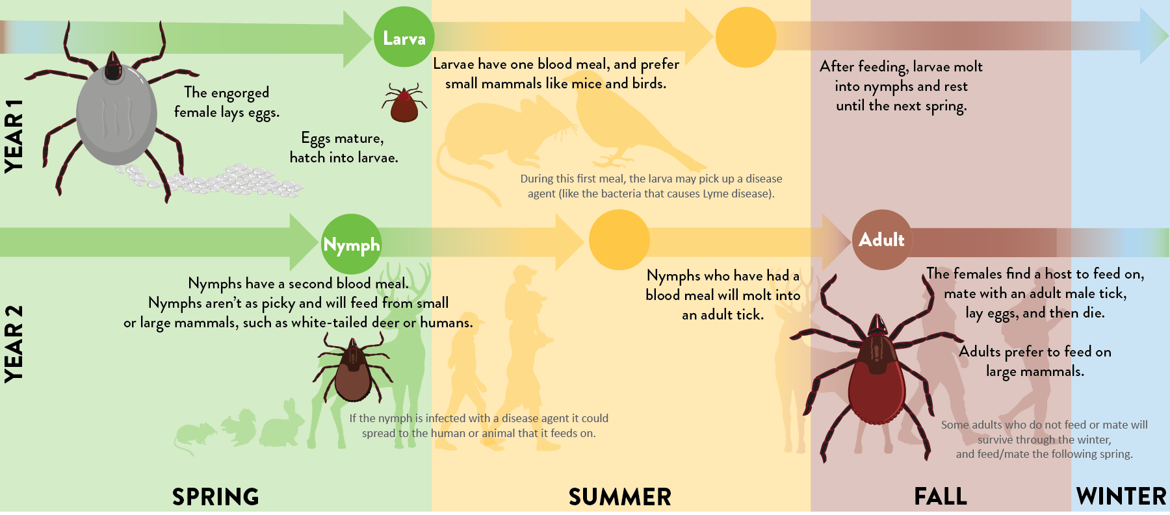
Blacklegged Tick Life Cycle
Notes:
Blacklegged ticks live for about two to three years. Most of their life is spent out in the environment rather than on a host or in a host’s nest. During their entire lifetime, they will only have up to three blood meals. The life cycle begins when the female lays eggs. As the egg matures, it develops into a larva, then a nymph and finally, an adult male or female.
In the spring of their first year, eggs hatch into larvae. Larvae prefer to feed on blood from small mammals, like mice and birds. Larvae have one feeding then molt into nymphs and rest until the next spring. During this first meal, the larva may pick up a disease agent (like the bacteria that causes Lyme disease) while feeding on a small mammal, such as a white-footed mouse.
Late in the spring of their second year, nymphs take their second feeding. Nymphs aren’t as picky with their choice of host and will feed on blood from small or large mammals, such as white-tailed deer or humans. At this time, if the nymph is infected with a disease agent then it could spread the disease agent to a human or animal that it feeds on.
In the fall of their second year, nymphs who have had a blood meal will molt into an adult male or female tick. Adults prefer to feed on large mammals, such as white-tailed deer or humans. The females find a host to feed, mate with an adult male tick, lay hundreds of eggs, and then die. The males attach to a host to find a female mate and then die. Some adults who do not feed or mate in the fall will survive through the winter and then come out to feed and/or mate the following spring. If there is little to no snow cover and temperatures rise above freezing, it is possible to find an active adult tick searching for a host on a warm winter day.
In Minnesota, adult ticks will usually emerge right after the snow melts and reach peak spring-time activity during the month of May. The adult ticks will typically stay active throughout June. Adults will also become active again in the fall, usually by the end of September and through October, until temperatures drop below freezing or snow covers the ground. Blacklegged tick nymphs start to become active in mid-May and reach peak activity at the end of May through the month of June. Nymph activity tapers off slowly, and they are much less active by the end of July. Larvae are typically most active in June.

Slide 6
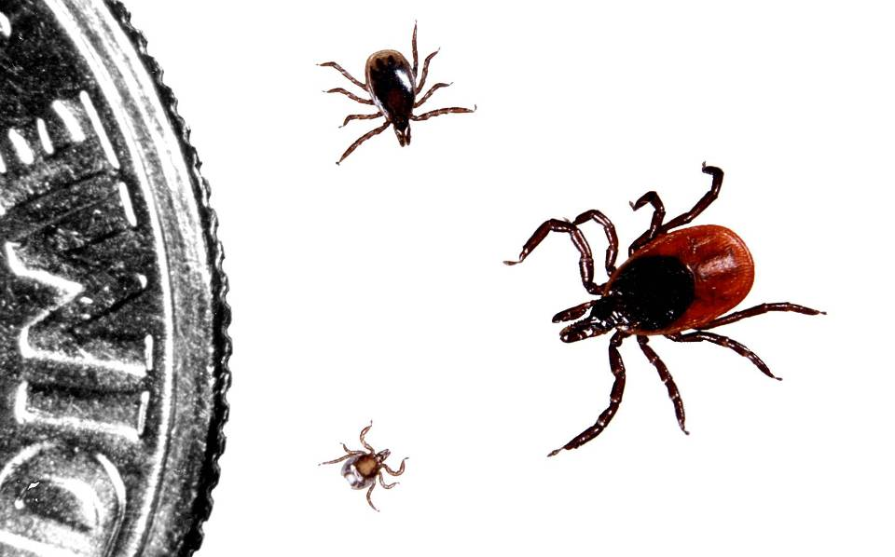
Blacklegged Tick Life Stages
Nymph
Adult (female)
Larva
Notes:
Hard ticks have four life stages. These life stages include the egg (not pictured here), larva, nymph, and adult. All ticks take a blood meal at the larval and nymph stages but only females will take a blood meal at the adult stage. Adult male ticks will attach to hosts like adult females do, but adult males do not take a blood meal so they are unable to spread diseases such as Lyme disease.
The tick that spreads Lyme disease is called the blacklegged tick. It is also commonly known as the deer tick. You may also hear it called the bear tick. They are all the same tick. The scientific name is Ixodes scapularis.
The blacklegged tick is much smaller than the lone star tick and the American dog tick. Adult females can be identified by their reddish-orange back while adult males, nymphs, and larvae are brownish-black in color.
Larvae are very, very small and prefer small mammals, like mice, so they uncommonly bite people. Notice that larvae only have six legs; they will have eight legs after they feed and molt into a nymph. Nymphs are the life stage that you really want to watch out for because they are very small, about the size of a poppy seed. Because they are so small and not as noticeable as adults, they have a better chance of staying attached to you longer and spreading disease. It is also important to keep an eye open for adult ticks since they are small too, about the size of a sesame seed.

Slide 7
Engorged Adult Female Blacklegged Tick
Notes:
Blacklegged ticks are slow feeders. Once a tick attaches to a host, the entire feeding process will take several days with an average of 3 to 5 days. It will then fall off to complete its life cycle in the environment. During the feeding process, the body of the tick slowly enlarges with blood and becomes engorged. This picture shows an adult female who has been feeding for at least a few days. She is about the size of a watermelon seed. Engorged ticks may be difficult to identify without a trained eye or microscope.
In order to spread disease to a human or animal, a tick needs to be attached for a certain amount of time. For instance, blacklegged ticks must be attached for at least 24 hours for Lyme disease to develop. Less common tickborne diseases, such as anaplasmosis, may take less time. In addition, the tick needs to be infected with a disease agent and not all ticks are infected. After collecting blacklegged ticks from various sites in Minnesota and testing them in our laboratory for disease agents, we have found on average about 1 in 3 adult ticks and 1 in 5 nymphs is infected with the bacteria that causes Lyme disease. With less common tickborne diseases (such as anaplasmosis, babesiosis, and Powassan virus) ticks are infected at much lower levels.

Slide 8
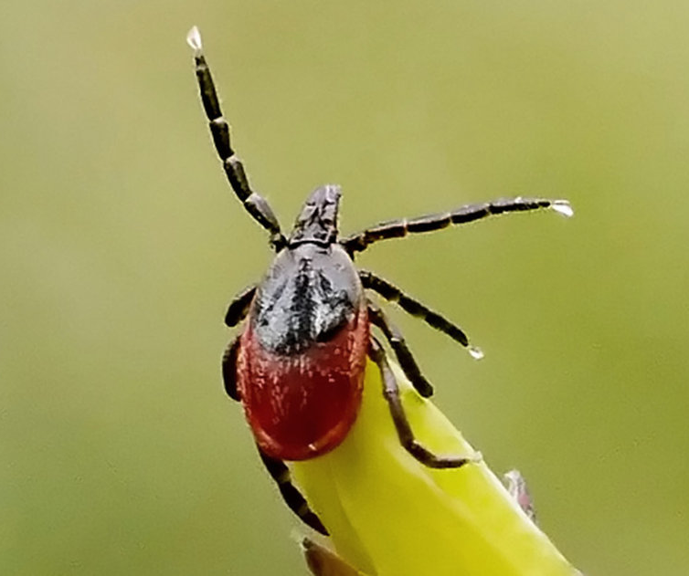
Blacklegged Tick Questing
Searches for a host from the tips of low-lying vegetation
Sense body chemicals and other cues from potential hosts, like heat, moisture, and vibrations
Climbs onto a person or animal near ground level and then finds a place to attach
Notes:
Blacklegged ticks search for a host from the tips of grasses and shrubs, not from trees. They do not jump or fly, but crawl. When they sense a potential host, they grab onto people or animals who brush against vegetation they are sitting on and crawl upward.
Generally, ticks climb onto a person or animal near ground level.
Ticks find their hosts by detecting animals´ breath and body odors, or by sensing body heat, moisture, and vibrations. Some species can even recognize a shadow. In addition, ticks pick a place to wait by identifying well-used paths. Then they wait for a host, resting on the tips of grasses and shrubs. Ticks can't fly or jump, but many tick species wait in a position known as "questing".
While questing, ticks hold onto leaves and grass by their third and fourth pair of legs. They hold the first pair of legs outstretched, waiting to climb on to the host. When a host brushes the spot where a tick is waiting, it quickly climbs aboard. Some ticks will attach quickly and others will wander, looking for places like the ear, or other areas where the skin is thinner.
Depending on the tick species and its stage of life, preparing to feed can take from 10 minutes to 2 hours. When the tick finds a feeding spot, it grasps the skin and cuts into the surface.

Slide 9
Blacklegged Ticks Do NOT…
Jump
Fly or glide through the air
Fall from treetops or high branches
See
Notes:
Blacklegged ticks spend most of their time on the forest floor underneath the leaf litter. When looking for a host, they will perform a behavior called questing. This is when ticks emerge from the leaf litter and crawl to the tips of grass, leaves, branches. They use their back sets of legs to hold onto the tip of the vegetation and reach their front legs out to grab onto a host that may pass by. Ticks do not see, but sense these hosts through biological cues such as body heat, CO2, or vibrations. When a tick senses a host passing by, they grab on. From there they do not jump, but crawl. Some ticks will attach by biting a host relatively quickly, while others crawl around for awhile finding areas such as the ears of base of the scalp. Because many people find ticks along the scalp or higher up on their body, it’s commonly thought that ticks jump, fly, or fall from trees, but ticks do not do any of these behaviors. They have simply crawled without us noticing.

Slide 10
Blacklegged Tick Habitat
Notes:
This picture provides a great example of ideal blacklegged tick habitat. While American dog ticks may be found in grassy, more open habitat and woods, blacklegged ticks are more sensitive creatures and will dry out if they don’t have enough protection. They live at ground level in areas where there is canopy cover, low-growing vegetation, and leaf litter. Since most people are not walking through the heart of these wooded areas, exposure to blacklegged ticks may be greatest along trails and also the fringe area between the woods and borders of yards, parks, and other open areas. Blacklegged ticks can also rarely be found in more open areas (such as yards) that are near wooded habitat so it is important to be on the lookout for ticks when in or near wooded areas.
Some people associate white-tailed deer with blacklegged ticks. White-tailed deer are an important and common host for ticks to feed on and they can move ticks into new areas. However, even though white-tailed deer live throughout Minnesota, blacklegged ticks are not found everywhere that deer live. Therefore, it is important to know when you are in a county where blacklegged ticks have been found.

Slide 11
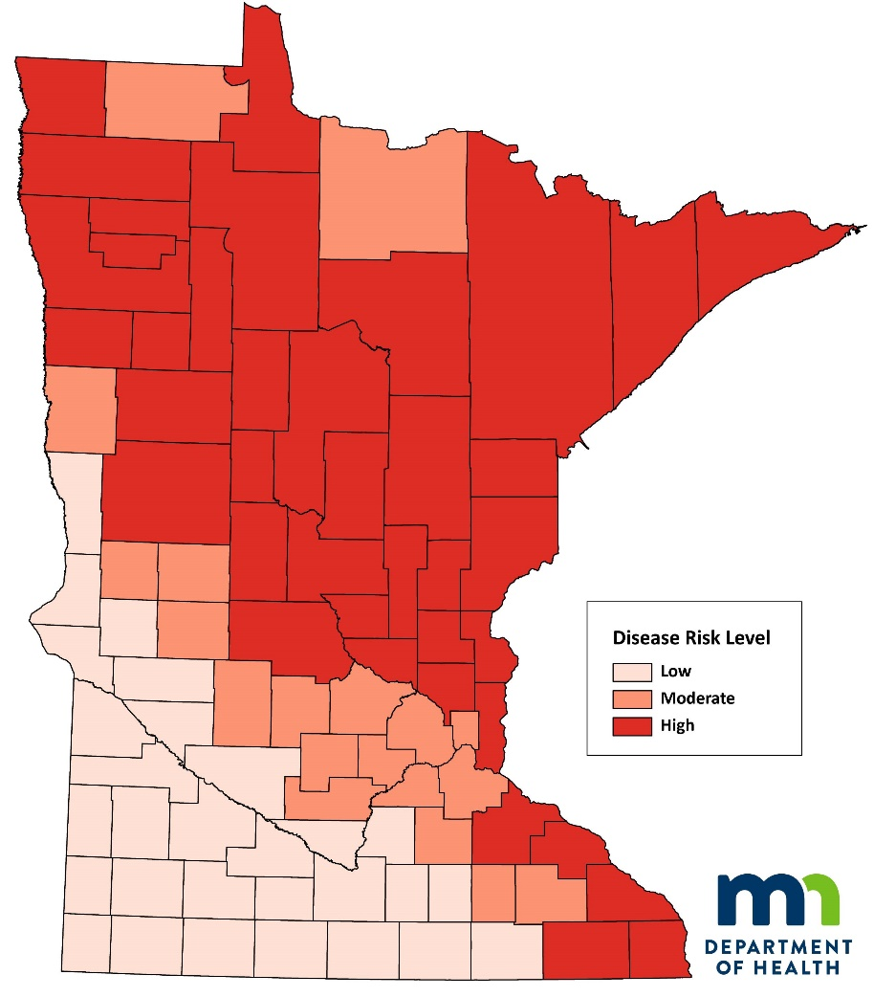
Tickborne Disease Risk in Minnesota
County | Tickborne Disease Risk Level
Aitkin | High
Anoka | High
Becker | High
Beltrami | High
Benton | High
Big Stone | Low
Blue Earth | Low
Brown | Low
Carlton | High
Carver | Moderate
Cass | High
Chippewa | Low
Chisago | High
Clay | Moderate
Clearwater | High
Cook | High
Cottonwood | Low
Crow Wing | High
Dakota | Moderate
Dodge | Moderate
Douglas | Moderate
Faribault | Low
Fillmore | High
Freeborn | Low
Goodhue | High
Grant | Moderate
Hennepin | Moderate
Houston | High
Hubbard | High
Isanti | High
Itasca | High
Jackson | Low
Kanabec | High
Kandiyohi | Moderate
Kittson | High
Koochiching | Moderate
Lac qui Parle | Low
Lake | High
Lake of the Woods | High
Le Sueur | Low
Lincoln | Low
Lyon | Low
Mahnomen | High
Marshall | High
Martin | Low
McLeod | Moderate
Meeker | Moderate
Mille Lacs | High
Morrison | High
Mower | Low
Murray | Low
Nicollet | Low
Nobles | Low
Norman | High
Olmsted | Moderate
Otter Tail | High
Pennington | High
Pine | High
Pipestone | Low
Polk | High
Pope | Moderate
Ramsey | Moderate
Red Lake | High
Redwood | Low
Renville | Low
Rice | Moderate
Rock | Low
Roseau | Moderate
Scott | Moderate
Sherburne | High
Sibley | Moderate
St. Louis | High
Stearns | High
Steele | Low
Stevens | Low
Swift | Low
Todd | High
Traverse | Low
Wabasha | High
Wadena | High
Waseca | Low
Washington | High
Watonwan | Low
Wilkin | Low
Winona | High
Wright | Moderate
Yellow Medicine | Low
Source: Ecological Sections of Minnesota,
Minnesota Department of Natural Resources (DNR)
Notes:
To better understand tickborne disease risk in Minnesota, it helps to understand our unique land biomes in the state. Blacklegged ticks live in wooded habitats, or biomes of deciduous, coniferous, and mixed forests. These biomes make up a large portion of the state and you can see that tickborne disease risk is highest in areas of the state that are largely wooded habitat. Tickborne disease risk in the southwestern corner of the state is considered low. This part of the state is dominated by agriculture or is a natural prairie grassland, neither of which provide a habitat that favors blacklegged tick survival. However, the MDH Vectorborne Diseases Unit is closely monitoring these areas along the border of our state’s known blacklegged tick habitat range because of its continuing emergence into new areas.
Footnote:
Data source - MDH Vectorborne Disease Program surveillance data. This tickborne disease risk map is based on reported human cases of tickborne disease. More specifically, the risk levels are based on average incidence (cases/100,000 population) of Lyme disease, anaplasmosis, and babesiosis in Minnesota from 2007 through 2022. The low risk level demonstrates an average incidence <10 cases/100,000 population while the moderate risk level demonstrates an average incidence of 10-24 cases/100,000 population and the high risk level demonstrates an average incidence ≥24 cases/100,000 population. It should also be noted that cases of tickborne disease in Minnesota are reported to the state by county of residence. County of residence for a case does not always reflect where the case was actually exposed to a blacklegged tick, especially considering the large part of our metropolitan population that travels north for recreational activities.

Slide 12
Distribution of Blacklegged Tick Populations by County in Minnesota
County | Blacklegged Tick Establishment Status
Aitkin | Established
Anoka | Established
Becker | Established
Beltrami | Established
Benton | Established
Big Stone | Established
Blue Earth | Established
Brown | Established
Carlton | Established
Carver | Established
Cass | Established
Chippewa | Established
Chisago | Established
Clay | Established
Clearwater | Established
Cook | Established
Cottonwood | No Reports
Crow Wing | Established
Dakota | Established
Dodge | No Reports
Douglas | Established
Faribault | Reported
Fillmore | Established
Freeborn | No Reports
Goodhue | Established
Grant | Established
Hennepin | Established
Houston | Established
Hubbard | Established
Isanti | Established
Itasca | Established
Jackson | No Reports
Kanabec | Established
Kandiyohi | Established
Kittson | Established
Koochiching | Established
Lac qui Parle | Established
Lake | Established
Le Sueur | Established
Lincoln | No Reports
Lake of the Woods | Established
Lyon | Established
Mahnomen | Established
Marshall | Established
Martin | No Reports
McLeod | Established
Meeker | Established
Mille Lacs | Established
Morrison | Established
Mower | No Reports
Murray | No Reports
Nicollet | Established
Nobles | No Reports
Norman | Established
Olmsted | Established
Otter Tail | Established
Pennington | Established
Pine | Established
Pipestone | No Reports
Polk | Established
Pope | Established
Ramsey | Established
Red Lake | Established
Redwood | Established
Renville | Established
Rice | Established
Rock | Reported
Roseau | Established
Scott | Established
Sherburne | Established
Sibley | Established
Stearns | Established
Steele | Reported
Stevens | Established
St. Louis | Established
Swift | No Reports
Todd | Established
Traverse | No Reports
Wabasha | Established
Waseca | No Reports
Washington | Established
Watonwan | No Reports
Wilkin | No Reports
Winona | Established
Wright | Established
Wadena | Established
Yellow Medicine | Established
Notes:
While American dog ticks may be found in all counties of the state, blacklegged ticks have only been documented in the following shaded counties of this map. Over the last 30 years, blacklegged ticks have become more common in some areas and continue to emerge into new areas of the state. It is important to keep in mind that the numbers of ticks found in any location varies greatly between counties and even sites within a county. Counties shown in white may have blacklegged ticks present although they have not been detected or reported to date. People are encouraged to contact the Minnesota Department of Health if they find a blacklegged tick in any of the undocumented counties by using our tick submission form: https://www.health.state.mn.us/diseases/tickborne/ticksubform.pdf.
Footnote:
Data source - MDH Vectorborne Disease Program tick surveillance data as of December 2023. Map is based on criteria set by the Centers for Disease Control and Prevention. Counties classified as established had at least six ticks or two life stages recorded within a single calendar year. Counties with fewer ticks of a single life stage are classified as reported. Counties shown in white indicate no documented records.

Slide 13
Reported Tickborne Disease Cases in Minnesota, 1996-2022
Year Number of Lyme Disease Cases Number of Anaplasmosis Cases Number of Babesiosis Cases
1996 252 18 3
1997 256 14 0
1998 261 30 0
1999 283 36 2
2000 465 79 2
2001 463 93 5
2002 866 149 7
2003 475 76 1
2004 1023 139 9
2005 917 186 10
2006 913 176 18
2007 1239 322 24
2008 1273 278 29
2009 1546 317 31
2010 1960 720 56
2011 2156 788 72
2012 1516 507 41
2013 2340 627 64
2014 1416 448 49
2015 1806 613 45
2016 2126 733 50
2017 2318 638 59
2018 1541 496 49
2019 1527 407 55
2020 n/a n/a n/a
2021 1902 603 63
2022 2685 540 61
Notes:
This graph shows reported cases of the top three tickborne diseases that we have here in Minnesota: Lyme disease, anaplasmosis, and babesiosis. Since 1996, the incidence of tickborne diseases in Minnesota has increased in endemic counties as well as emerging counties. Factors such as increasing physician awareness and expanding blacklegged tick distribution may have contributed to this trend.

Slide 14
What are the symptoms of a tickborne disease?
Many tickborne diseases have similar symptoms
Initial symptoms usually show up within 2-4 weeks of being bitten by an infected tick
Watch for symptoms like:
Rash
Fever
Headache
Fatigue
Muscle or joint aches
Notes:
Many tickborne diseases cause similar symptoms. Initial symptoms usually show up within 2-4 weeks of being bitten by an infected blacklegged tick. Watch for symptoms like:
Rash
Fever
Headache
Fatigue
Muscle or joint aches

Slide 15
How are tickborne diseases diagnosed?
If you think that you may have a tickborne disease, contact your health care provider as soon as possible
Your health care provider can determine if you have a tickborne disease based on your:
History of being around wooded or brushy areas (where ticks may live)
Physical examination
Laboratory tests
Notes:
If you think that you could have a tickborne disease, you should contact your health care provider as soon as possible. Your health care provider can determine if you have a tickborne disease based on your history of being around wooded or brushy areas, a physical exam, and possibly blood tests.

Slide 16
Are tickborne diseases treatable?
Most tickborne diseases are treatable
For most people, the prognosis is good and symptoms go away after treatment
Talk with your health care provider about managing symptoms that have not resolved after treatment
Notes:
Lyme disease, anaplasmosis, and ehrlichiosis are treated with antibiotics. Babesiosis is treated with both an antibiotic and an antiparasitic. There is no specific medication available for Powassan virus. Instead, the symptoms of Powassan virus are treated with supportive care. For most people, the prognosis is good and symptoms go away after treatment. For others who may have lingering symptoms after treatment, speak with your health care provider about managing those symptoms and any other concerns you may have.

Slide 17
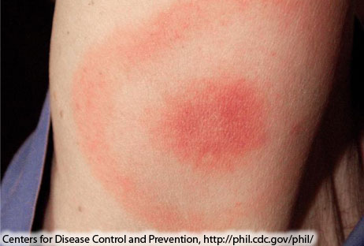
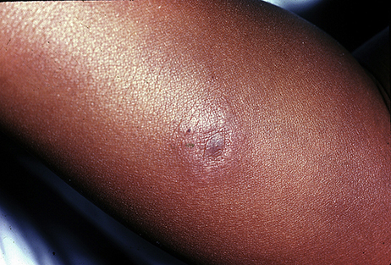
Lyme Disease
Borrelia burgdorferi
Symptoms
Characteristic Rash (erythema migrans)
Fever
Muscle or joint pain
Fatigue
Diagnosis
History of exposure to ticks or wooded areas
Physical examination
Laboratory testing
Treatment
Antibiotics
Bhate C, Schwartz RA.
Notes:
Now that we have provided a general overview of tickborne disease symptoms, diagnosis, and treatment we will now cover some of Minnesota’s specific tickborne diseases in more detail.
Lyme Disease is the most common tickborne disease in the United States, including Minnesota. It is caused by the bacteria Borrelia burgdorferi. Symptoms of Lyme disease will usually show up within 3 to 30 days following a bite from an infected blacklegged tick. Symptoms may include a rash, fever, muscle or joint pains, and fatigue. Lyme disease often causes a characteristic rash called erythema migrans that may not be painful or itchy. The rash may look like a bulls-eye (see top picture), a red blotch, or several red blotches. The rash should be distinguished from the common skin reaction that people experience after a tick bite. Irritation of the skin that occurs after a tick bite is small in size and gets smaller over time whereas the erythema migrans rash is characterized by redness that increases in size over time, often larger than two inches in diameter.
If infections progress undiagnosed and untreated (as may happen if a person doesn’t get a rash or doesn’t notice the rash), pain and swelling may develop in large joints, such as the knee or facial paralysis on one side of the face, known as Bell’s palsy. Diagnosis of Lyme disease depends on a recent history of exposure to ticks or wooded areas, compatible symptoms, as well as positive laboratory tests. For people who experience the characteristic rash, health care providers may make a diagnosis of Lyme disease based on symptoms alone since laboratory tests may not be positive this early in the course of illness. For people who have been sick for at least a month, blood tests should be performed to confirm the diagnosis of Lyme disease.
Lyme disease is treated with antibiotics. Treatment works best early in the disease, but is still treatable if the disease isn’t detected until later. Those treated later in the disease may experience a slower resolution of symptoms, but antibiotics have been shown to be effective in killing the bacteria. Most people make a full recovery following treatment. A small proportion of people who have been appropriately treated for Lyme disease may continue to experience symptoms such as fatigue or muscle aches. Contact your health care provider if you think you may have “Post-treatment Lyme Disease Syndrome”. Your health care provider can discuss ways to manage your symptoms or search for other causes of your symptoms. Long-term antibiotic treatment for Lyme disease is not recommended because it has not been proven to be effective and has been associated with serious complications.

Slide 18
Anaplasmosis
Anaplasma phagocytophilum
Symptoms
Fever
Severe headache
Muscle or joint pain
Severe complications and death possible
Diagnosis
History of exposure to ticks or wooded areas
Physical examination
Laboratory testing
Treatment
Antibiotics
Notes:
Anaplasmosis is the second most common tickborne disease we have here in Minnesota. It is caused by the bacteria, Anaplasma phagocytophilum, that infects white blood cells in the body (see picture). Many people with anaplasmosis never develop any symptoms at all. Those who do develop symptoms are more likely to be middle-aged to elderly or have other underlying illnesses. Symptoms will usually develop anywhere from a few days up to a few weeks following a bite from an infected blacklegged tick. Symptoms may include fever, severe headache, and muscle or joint aches. Severe complications or death are possible but not common. Health care providers will need to take a blood sample and perform laboratory tests in order to diagnose this disease (see picture of blood smear with Anaplasma morulae inside a white blood cell). Treatment with antibiotics results in a full recovery for most people.

Slide 19
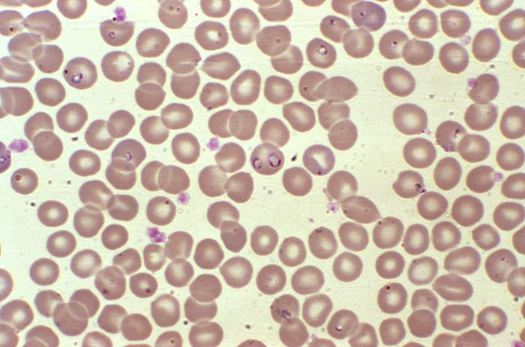
Babesiosis
Babesia microti
Symptoms
Fever
Headache
Fatigue
Severe complications and death possible
Diagnosis
History of exposure to ticks or wooded areas
Physical examination
Laboratory testing
Treatment
Patients without symptoms may not require treatment
Combination of anti-protozoal and antibiotic
Notes:
Babesiosis is the third most common tickborne disease in Minnesota. It is caused by the parasite Babesia microti. Many people who become infected with this parasite never develop symptoms. For people who do become ill, symptoms usually develop within 2 months after a bite of a blacklegged tick but may take even longer. Symptoms may include fever, headache, fatigue, muscle or joint aches, weakness, loss of appetite, and nausea. Severe complications and death are rare but possible and are much more likely to occur in the elderly or those who have other underlying illnesses. Health care providers will need to take a blood sample and perform laboratory tests in order to diagnose this disease (see picture of blood smear with Babesia piroplasms inside a red blood cell). Treatment for babesiosis involves a combination of an anti-protozoal medication and antibiotics, which results in full resolution of symptoms for most people. Persons without symptoms may not require treatment.

Slide 20
Other Emerging Pathogens?
Powassan virus
Ehrlichia muris eauclairensis
Borrelia mayonii
Borrelia miyamotoi
Rickettsia rickettsii
Francisella tularensis
Notes:
In addition to the three tickborne diseases previously covered, several other tickborne diseases have been found in ticks and human patients throughout our state of Minnesota. The blacklegged tick is believed to be responsible for spreading rare diseases such as Powassan virus, a particular strain of ehrlichiosis (Ehrlichia muris eauclairensis), Borrelia mayonii (a newly described form of Lyme disease), and Borrelia miyamotoi (a recently discovered type of relapsing fever). Also included on this slide are two diseases that are spread by the American dog tick (Rocky Mountain spotted fever and tularemia), both of which are rarely reported diseases in Minnesota. We will now briefly describe each of these diseases in more detail.
Powassan virus disease is caused by a virus closely related to West Nile Virus, however it is caused by the bite of an infected blacklegged tick rather than a mosquito. The full spectrum of clinical illness is not fully understood at this point, but it is believed that many infections don’t result in any symptoms at all. Those who do show symptoms may develop a mild illness with fever and headache while some severe infections may cause nervous system disease (swelling of the brain and surrounding tissues). In some severe cases, nerve damage and death are possible. Powassan virus disease is confirmed by laboratory testing using blood or spinal fluid. There is no specific anti-viral medication available to treat this disease, only supportive care for severe cases.
Ehrlichia muris eauclairensis is a bacteria that was discovered in 2009 and is closely related to the agent that causes anaplasmosis. From what is known about this rare illness so far, it’s clinical spectrum and treatment regimen are similar to anaplasmosis. However, human cases identified to date have only had exposures to ticks in Minnesota or Wisconsin, suggesting that this disease agent may be limited to the upper Midwest.
Borrelia mayonii is a bacteria that was discovered in 2013 and is closely related to the agent that causes Lyme disease. Among the 12 patients that have been described to date, all had tick exposures in Minnesota or Wisconsin and all had an illness similar to Lyme disease.
Borrelia miyamotoi is a relapsing fever type of bacteria that was first discovered in a human patient in 2011. As with other tickborne diseases, symptoms may include fever, headache, muscle or joint aches, and fatigue. Treatment is similar for patients with Lyme disease.
Rocky mountain spotted fever (RMSF) is a disease caused by the bacteria Rickettsia rickettsii and is spread by the American dog tick, also commonly known as the wood tick here in Minnesota. Although American dog ticks are very common in Minnesota, it is very rare for a person to get this disease here. Most reported cases of RMSF in the state are in residents who have traveled and contracted the disease out of state (particularly to the southeastern region of the United States). However, there have been a few isolated cases in Minnesota residents with no reported travel. Symptoms of this disease will usually occur 2-14 days following a bite from an infected tick and may include a sudden onset of fever, a characteristic spotty rash, headache, muscle aches, nausea, vomiting, diarrhea and abdominal pain. Death is possible if not treated promptly. Diagnosis is made by laboratory testing. RMSF is treatable with antibiotics, but it is important to note that treatment should not be delayed when RMSF is suspected. The disease can progress quickly if not treated.
Tularemia is a potentially serious illness caused by the bacteria Francisella tularensis, and can be spread by lone star ticks and American dog ticks (wood ticks). Although American dog ticks are very common in Minnesota, it is very rare for a person to get this disease here. Symptoms of tularemia depend on how you’re exposed to it since there are several ways to get tularemia other than a tick bite. Typically, symptoms of infection will develop 3-5 days following exposure, but can take up to 2 weeks. Symptoms may include fever, ulcerated skin wound, enlarged lymph nodes, cough, vomiting, diarrhea, and abdominal pain. Laboratory tests are necessary to confirm the diagnosis. Tularemia can be treated with antibiotics but it is important to note that treatment should not be delayed when tularemia is suspected. Disease can be fatal if not treated appropriately. Following treatment, symptoms may persist for a short period of time but the prognosis is generally good and most people experience full resolution of symptoms.
The MDH Vectorborne Disease Unit is continuing to collaborate with federal, state, and private partners to learn more about these rare tickborne diseases. Over time, we aim to collect more information regarding the frequency, clinical spectrum, and efficacy of treatment in order to provide guidance to patients and health care providers.

Slide 21
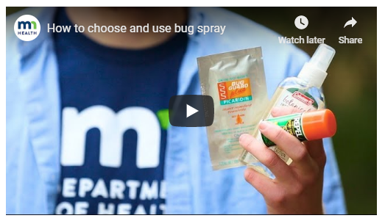
Protect Yourself from Tickborne Diseases
1) Know when and where you’re at risk
Primarily mid-May through mid-July
Wooded and brushy areas – Blacklegged tick
Grassy or wooded areas – American dog tick
2) Wear EPA-registered bug spray
DEET 20-30% on skin or clothing
Permethrin 0.5% on clothing
3) Check yourself for ticks
Undress and shower after being outdoors
Check at least once a day
Remove ticks ASAP!
Notes:
Now that you know how you may come into contact with ticks and what symptoms to watch out for, we will now discuss ways to keep yourself healthy and avoid tickborne diseases.
To protect yourself from tickborne diseases, it is first important to know when and where ticks may be living. While you may come across a tick during any of the warm months of the year, nymphs are most active in Minnesota from mid-May through mid-July. Blacklegged ticks live in wooded or brushy areas while American dog ticks live in grassy or wooded areas. Ticks live close to ground-level and will crawl to the tips of low-growing vegetation when seeking a blood meal. So be sure to look down and remove any crawling or attached tick as soon as possible when you are in or near wooded or brushy areas in the state.
Use of repellents is a great way to protect yourself from tick bites. Repellents containing 20-30% DEET are effective at deterring ticks from biting your skin. DEET is safe to apply directly on exposed skin or clothing. Products containing 0.5% permethrin is also recommended for people who spend a lot of time in the woods and can actually kill ticks upon contact. Permethrin is NOT safe to use directly on the skin, but is safe to treat clothing or gear and will last through multiple washes. Other effective ingredients are available but be sure to only use products that are registered by the Environmental Protection Agency (EPA). You should look for an EPA-reg. number on the label, typically close to the barcode. Always follow label instructions when using any repellent or pesticide products. Wash yourself after coming in from the outdoors to remove any product remaining on your skin. The picture shown here is linked to a short video on the MDH website that shows you how to safely apply insect repellents such as DEET and permethrin. View this video by clicking on the picture or by visiting https://www.youtube.com/watch?time_continue=2&v=X9bYUiH1Wfw.
The best thing you can do to prevent tick bites and tickborne diseases is to check yourself carefully for ticks after being in or near wooded areas. After coming inside, you should remove all of your clothing (to avoid any ticks that are on your clothes to crawl onto you), shower (to wash away any ticks that aren’t attached yet and dirt so that it’s easier to look for ticks), and closely inspect every single part of your body. Ticks will crawl around on your body until they find a nice, hidden spot to attach so use a mirror (or a parent or very close friend) to look closely behind your knees, around your groin area, in your belly button, under your arms, behind your ears, and in your hair. Ticks may look like a freckle or speck of dirt on your skin so get to know your body well and take a close look at any new “spots” you find!
Remove crawling and attached ticks as soon as possible to reduce your risk of getting a tickborne disease! For more information on how to remove ticks, see the next slide.

Slide 22
How to Remove a Tick
Notes:
If you find an attached tick, it is important to remove it as soon as possible. Ticks can be removed with a pair of tweezers or even with your own fingers. Don’t get too worried about the proper technique of removing a tick. It is much better to simply remove the tick as quickly as possible.
Remove the tick as soon as possible. Use your fingers or tweezers.
If the tick is attached, grab its head and pull slowly and steadily.
Clean the area with rubbing alcohol or soap and water.
We do not recommend using folk remedies to remove ticks, such as Vaseline®, nail polish remover or burning matches. These are not a safe or effective way to remove ticks.
We also have a short video demonstration of proper tick removal. View this video by clicking on the picture or by visiting https://www.youtube.com/watch?v=GGRSy0u_fPU.

Slide 23
Tick Bite Prevention: Integrate tick control methods around you too
Tumble dry clothing on high for ≥ 6 (dry) - 60 (wet) minutes
Keep lawn and trails mowed short
Remove leaf litter and brush
Create a barrier between your yard and woods
Talk with your vet about tick preventatives for your pets
Notes:
Other tick prevention methods are available to help you further reduce your risk of tick bites and tickborne diseases. For instance, when you come inside after being outdoors remove your clothing and gear. If it’s safe for the material, you can put them straight into the dryer on high heat for at least six minutes to kill any blacklegged ticks that may be on them. If you prefer to wash the clothing first then you’ll need to dry the clothing on high heat for longer, for at least 60 minutes in order to kill blacklegged ticks. Ticks can survive a cycle in the washing machine so don’t rely simply on water to kill them, a hot and dry environment is much more effective at doing that.
You can also modify your landscape to make the environment less friendly for ticks. Keep yards and trails mowed short and clear of leaf litter and brush as ticks cannot survive long on short, mowed, “clean” grass. If your yard is bordered by woods or brush, create a barrier of at least 3 feet of rocks or woodchips between the edge of your yard and the wooded areas (see picture). This barrier will help ensure that you are a safe distance away from tick habitat when outside and also act as a reminder that when you cross the barrier you are entering tick habitat. Applying pesticides to high traffic or high risk areas of your yard can also be an effective way to reduce tick populations.
Lastly, many people are exposed to ticks through their pets who are outside in wooded or brushy areas. Talk with your veterinarian about safe and effective tick preventatives to protect yourself and your pet.

Slide 24
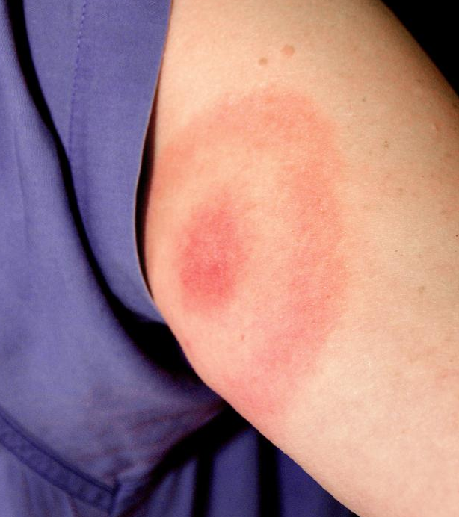
Be Aware of Tickborne Disease Symptoms
Contact your doctor if you notice:
Rash
Fever
Headache
Fatigue
Muscle or joint aches
Notes:
Even after practicing all of the previous prevention methods, watch yourself for symptoms of tickborne disease, especially within a month of being in or near wooded or brushy areas.
Contact your health care provider if you notice symptoms such as rash, fever, headache, fatigue, muscle or joint aches.
The sooner you can get diagnosed and treated for a tickborne disease, the quicker you’ll be on the road to recovery and enjoying time in the great outdoors again.

Slide 25
Thank You! Vectorborne Diseases Unit 651-201-5414 health.bugbites@state.mn.us www.health.state.mn.us/ticks
Notes:
Thank you very much for your attention today! We hope you found this information useful. Contact the MDH Vectorborne Diseases Unit if you have any questions.
You may also visit the MDH Vectorborne Disease and CDC Ticks websites for additional information:
http://www.health.state.mn.us/ticks
https://www.cdc.gov/ticks/index.html

