Slide 1
Presenter Notes:
Put the Slide Show into “Presenter Mode”
  Slide Show > From Beginning
Navigate using the hyperlinked “hot spots” and purple buttons
  Hover over and click on a “hot spot” to advance to that problem’s slide
  On each problem slide:
    Click again to show text box
    Click the “Next” button to return to the main picture slide
  Click the “Finish” button to advance to the reflection slide
Please do not make any edits to this presentation

Slide 2
What’s Wrong with this Picture:
Nurses Station
Table Talk with MDH Project Firstline
Interactive Resources

Slide 3
Agenda
Welcome
Welcome and Introductions
What’s Wrong with this Picture: Nurses Station
Conclusion

Slide 4
What’s Wrong with this Picture: Nurses Station

Slide 5
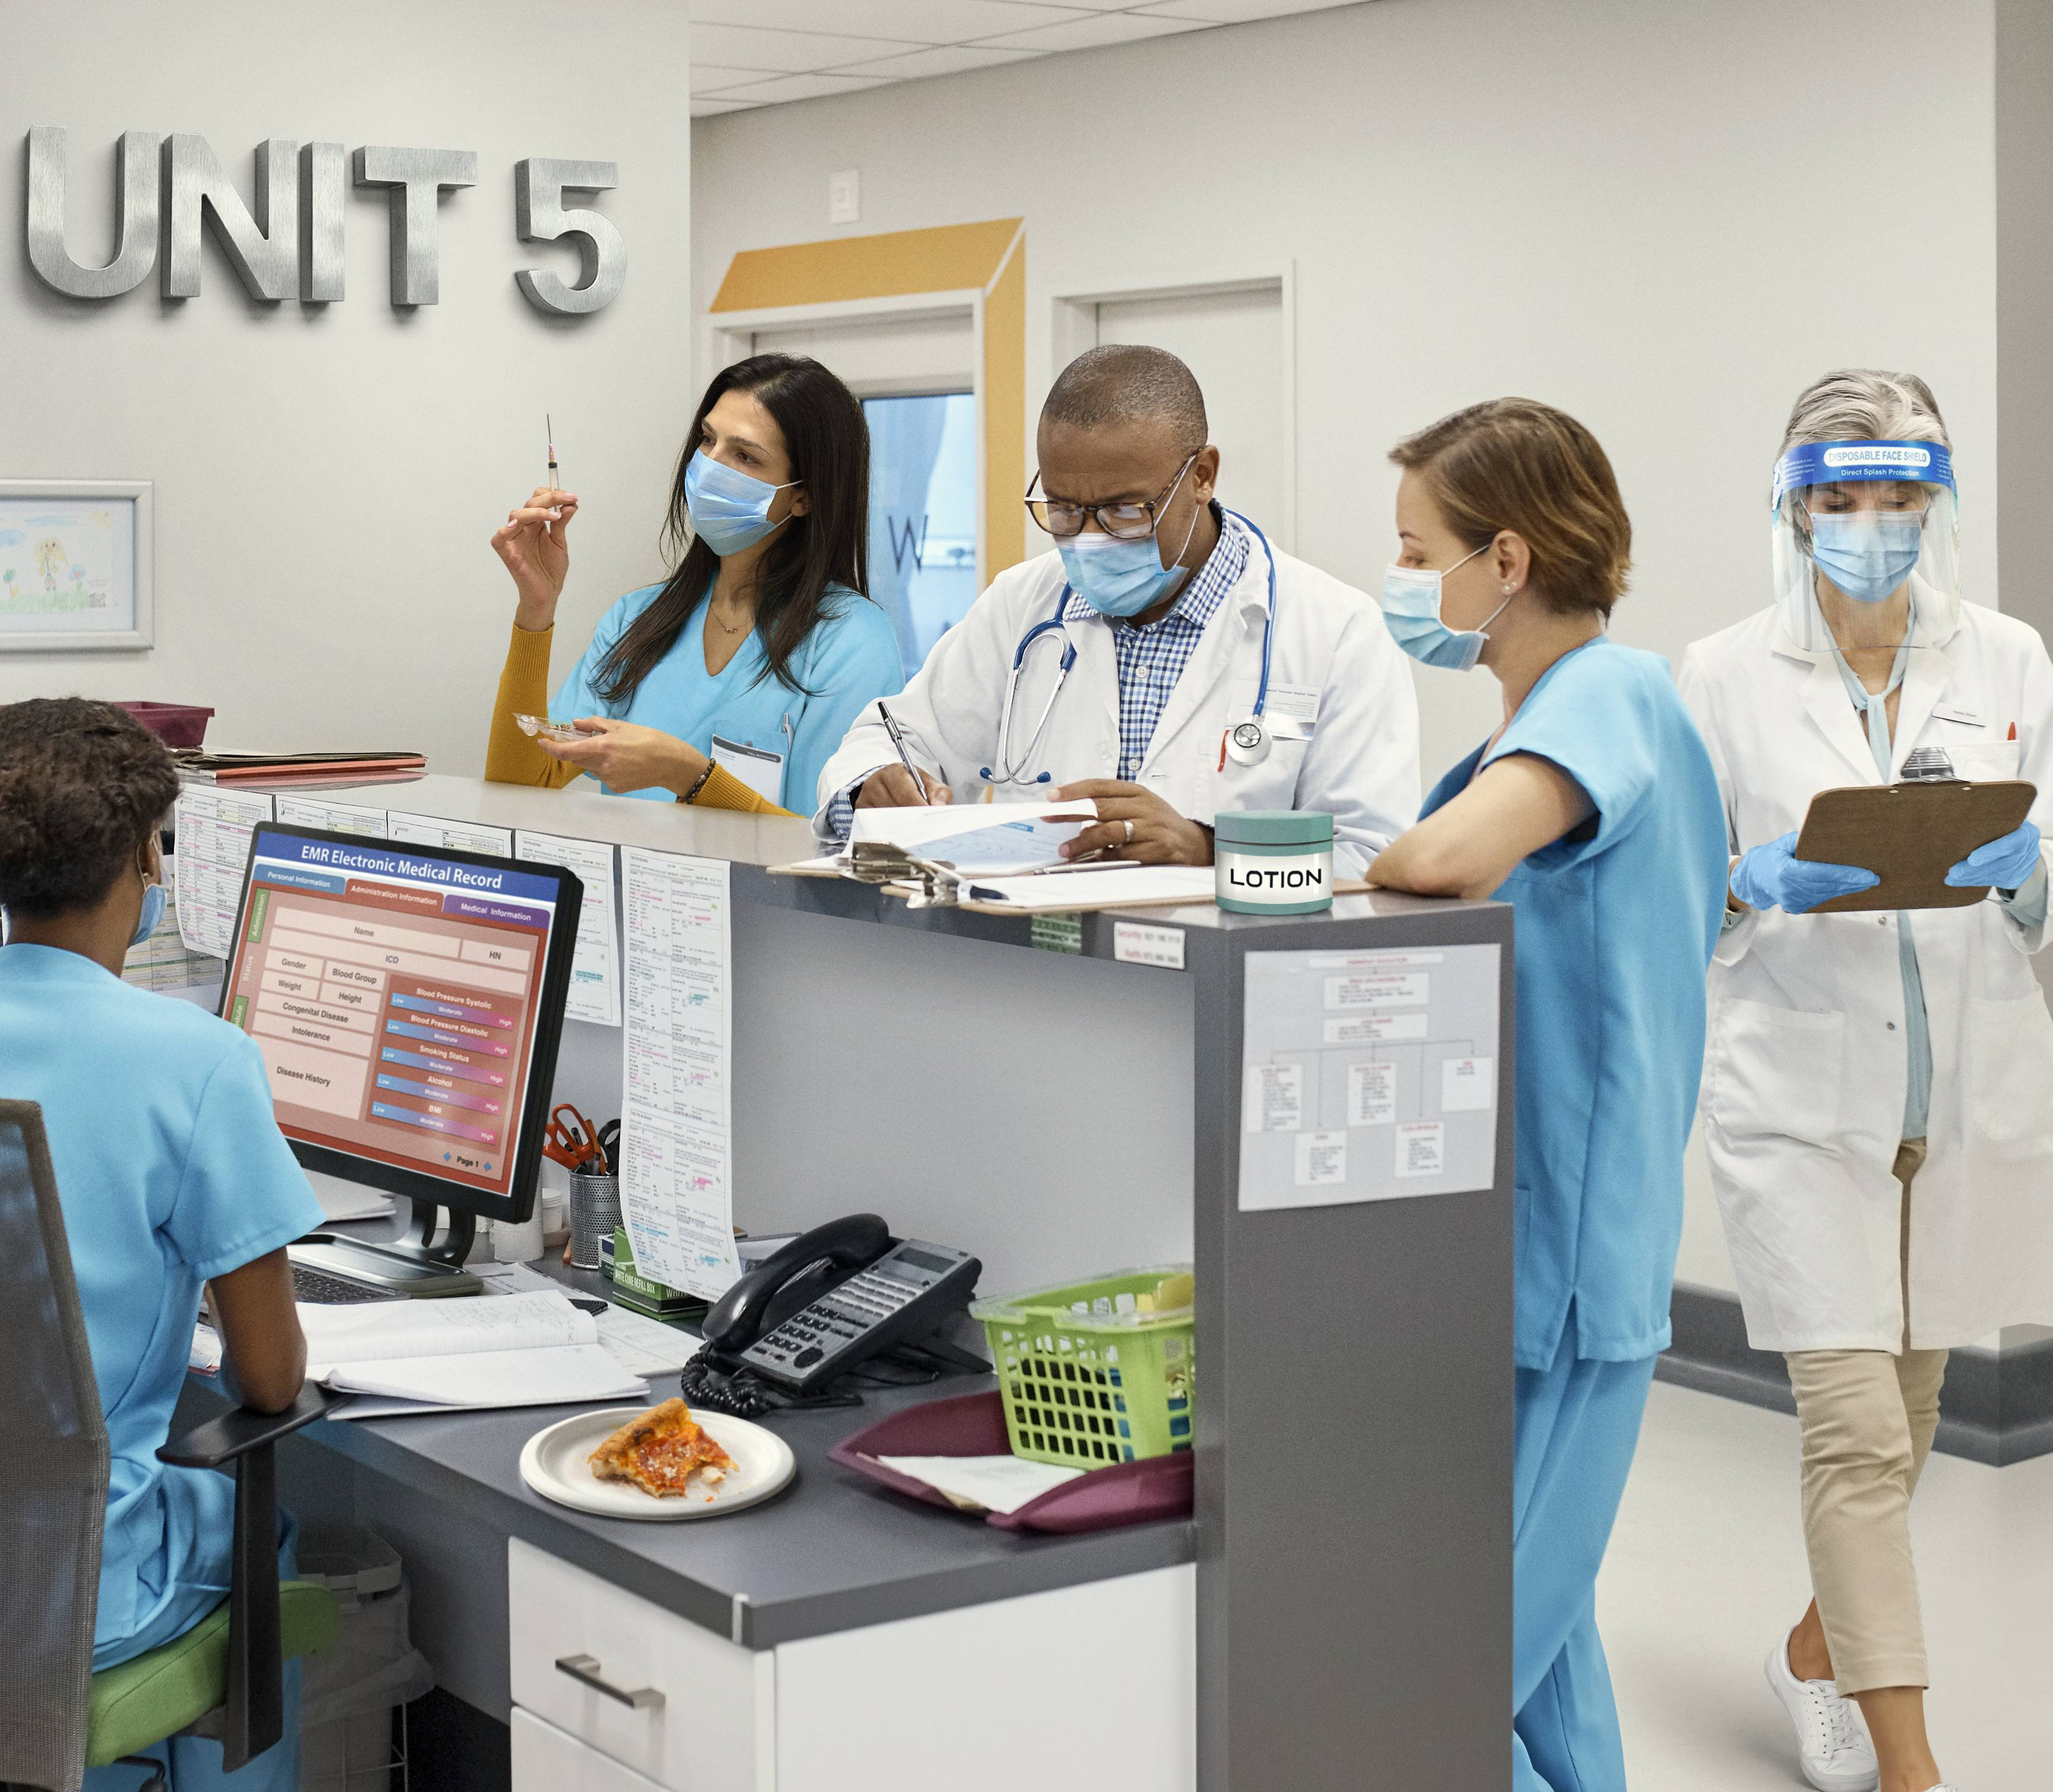
What’s wrong with this picture?
Health care workers need to be extra aware of where germs are found and how they can be spread to surfaces and people.
We can help stop infections when we recognize the risk for germs to spread!
In this image of a nurses station, select four problems that need to be fixed to reduce the spread of germs.
Finish

Slide 6



Using a Shared Tub of Lotion
Next
Tubs of lotion can pick up bacteria from hands. Those bacteria can then grow and multiply in the wet lotion and spread to others' hands every time the lotion is used.

Slide 7

Having Food in the Nurses’ Station
Next
Food in the nurses station can get blood or body fluids on it. Also, food spilled on dry surfaces can become a place for germs to grow.

Slide 8


Wearing Gloves Between Patients or Tasks
Next
Gloves can spread germs to people and things just like dirty hands can. The same pair of gloves should not be worn for more than one patient or task, and they should be removed and thrown away after they are used.

Slide 9

Health Care Working Handling a Syringe
Next
To reduce the risk of germ spread, certain tasks should not be conducted in public spaces such as hallways and nurses stations. Medications and vaccines should be prepared in clean, designated spaces - not at the nurses station.

Slide 10
Reflection
You did it! Thanks for exploring this common health care setting and identifying infection control problems.
Have you ever encountered them in your workplace?
If so, why do you think they are so common? What could we do to stop them?

Slide 11
Conclusion

Slide 12
Resources
MDH Project Firstline wwww.health.mn.gov/projectfirstline
CDC PFL Interactive Resources
CDC Interactive Resources: What’s Wrong with This Picture? Nurses Station
CDC Project Firstline (cdc.gov) | Facebook | Twitter
Subscribe to CDC Project Firstline e-mails
Subscribe to MDH Project Firstline Mailing List
Minnesota Department of Health (@mnhealth)| Facebook
Minnesota Department of Health (@mnhealth)| Twitter
Minnesota Department of Health (@mnhealth) | LinkedIn
Minnesota Department of Health (@mnhealth)| Instagram

Slide 13

Questions

