Slide 1
Presenter Notes:
Put the Slide Show into “Presenter Mode”
  Slide Show > From Beginning
Navigate using the hyperlinked “hot spots” and purple buttons
  Hover over and click on a “hot spot” to advance to that problem’s slide
  On each problem slide:
    Click again to show text box
    Click the “Next” button to return to the main picture slide
  Click the “Finish” button to advance to the reflection slide
Please do not make any edits to this presentation

Slide 2
What’s Wrong with this Picture:
Outpatient Exam Room
Table Talk with MDH Project Firstline
Interactive Resources

Slide 3
Agenda
Welcome
Welcome and Introductions
What’s Wrong with this Picture: Outpatient Exam Room
Conclusion

Slide 4
What’s Wrong with this Picture: Outpatient Exam Room

Slide 5
What’s wrong with this picture?
Health care workers need to be extra aware of where germs are found and how they can be spread to surfaces and people.
We can help stop infections when we recognize the risk for germs to spread!
In this outpatient room, select four problems that need to be fixed to reduce the spread of germs.
Finish

Slide 6
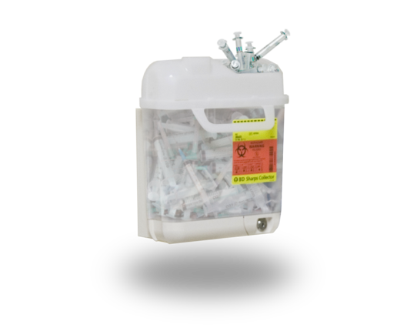


Overflowing Sharps Container
Next
When sharps containers are overfilled, there is greater risk of accidentally getting poked with a dirty needle or sharp instrument. Remove or replace frequently-used sharps containers often, and before they become too full.

Slide 7
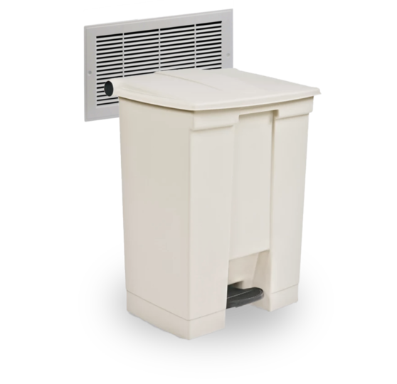
Blocking a Vent
Next
A blocked vent can decrease the air handling system's ability to replace the air in a room with new, clean air.
If you see an air vent blocked by something mobile, like a chair or a trashcan, move the item to improve ventilation. If a vent is blocked by something else, like cabinets, notify a supervisor or the person in charge of the area.

Slide 8
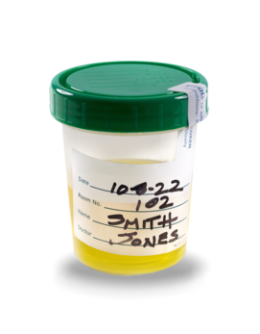
Urine Specimen Without a Biohazard Bag
Next
When a sample from a patient is collected, body fluids and germs can easily get on the outside of the container and spread. These samples should be placed in a biohazard bag to prevent the spread of germs.

Slide 9
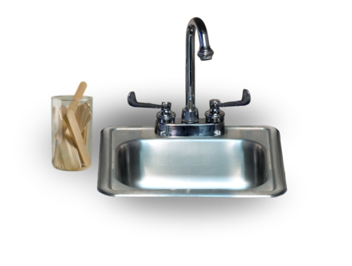
Placing Supplies Close to the Sink
Next
Tap water is clean, but it is not sterile. Places that are frequently wet with tap water or sprayed by tap water, like sinks and the counters around sinks, can be a risk for germs in water to spread. That's why it's important to keep health care supplies away from water.

Slide 10
Reflection
You did it! Thanks for exploring this common health care setting and identifying infection control problems.
Have you ever encountered them in your workplace?
If so, why do you think they are so common? What could we do to stop them?

Slide 11
Conclusion

Slide 12
Resources
MDH Project Firstline www.health.mn.gov/projectfirstline
CDC PFL Interactive Resources
CDC Interactive Resources: What’s Wrong with This Picture? Outpatient Exam Room
CDC Project Firstline (cdc.gov) | Facebook | Twitter
Subscribe to CDC Project Firstline e-mails
Subscribe to MDH Project Firstline Mailing List
Minnesota Department of Health (@mnhealth)| Facebook
Minnesota Department of Health (@mnhealth)| Twitter
Minnesota Department of Health (@mnhealth) | LinkedIn
Minnesota Department of Health (@mnhealth)| Instagram

Slide 13

Questions

