Slide 1
AGRICULTURE AND FOOD SECURITY
2017
HEALTH AND CLIMATE CHANGE TRAINING MODULE SERIES
Minnesota Climate & Health Program | Environmental Impacts Analysis Unit
Notes:
This Agriculture & Food Security climate change training module is one of six one-hour introductions to the health effects of climate changes in Minnesota. The other training modules are:
Climate Change & Health 101
Agriculture & Food Security
Air Quality & Health
Extreme Heat Events & Health
Well-being & Health
These modules have been designed for public health professionals, as well as others concerned about climate change, to provide a basic level of information about the observed climate changes in Minnesota and their health impacts.
The training modules generally focus on climate adaptation (preparing for and adjusting to new conditions to reduce harm or risk of negative health outcomes), and includes some references to climate mitigation (reducing harmful greenhouse gas emissions) as well.

Slide 2
NOTICE
The Minnesota Department of Health (MDH) developed this presentation based on scientific research published in peer-reviewed journals. References for information can be found in the relevant slides and/or at the end of the presentation.
Notes:
The Minnesota Department of Health (MDH) developed this presentation based on scientific research published in peer-reviewed journals. References for information can be found in the relevant slides and/or at the end of the presentation.

Slide 3
OUTLINE
Climate changes in Minnesota
Minnesota agriculture
Food security
Crop production
Livestock production
Key concerns
Strategies: Public health professionals and individuals
Notes:
This training module will review the following topic areas:
Climate Changes in Minnesota
Minnesota Agriculture
Food Security
Crop Production
Livestock Production
Key Concerns
Strategies: Public Health Professionals and Individuals
The first section describes Climate Changes in Minnesota.

Slide 4
WEATHER VERSUS CLIMATE
Weather: conditions of the atmosphere over a short period of time
Climate: conditions of the atmosphere over long periods of time
Notes:
Although related, the terms weather and climate are defined differently. Weather generally refers to conditions of the atmosphere over a short period of time (days or weeks), while climate refers to conditions of the atmosphere over long periods of time (30-year standard averaging period) (NASA, 2005).
Therefore, climate change refers to any significant change in the measures of climate lasting for an extended period of several decades (US EPA, 2016a).
Weather has always fascinated Minnesotans, perhaps because we have all kinds of it, but recently climate change has also become a leading topic of concern.
Source: NASA, 2005; US EPA, 2016a
Image source: Lightning bolt and sun – Microsoft Clip Art

Slide 5
DEFINITIONS
CLIMATE ADAPTATION: efforts to anticipate and prepare for the effects of climate change, and thereby to reduce the associated health burden
CLIMATE MITIGATION: efforts to slow, stabilize, or reverse climate change by reducing greenhouse gas emissions
Notes:
Actions to prevent the adverse health effects of climate change can be described as ‘adaptation efforts’ or ‘mitigation efforts.’
Adapting to climate change means anticipating and preparing for the effects of climate change and reducing the associated health burden.
Mitigating climate change means taking on or supporting efforts that slow, stabilize or reverse climate change by reducing greenhouse gas emissions.
Image: Microsoft Clip Art

Slide 6
CLIMATE AND HEALTH ARE LINKED
Notes:
MDH’s MN Climate & Health Program is dedicated to understanding the links between climate changes and adverse health impacts and identifying opportunities for implementing adaptation measures in Minnesota communities.
Recent climate change is resulting in warmer temperatures and changing precipitation. Most climate scientists attribute these changes to burning of fossil fuels, like coal and oil, to produce energy for everyday use. This burning adds heat-trapping gases, such as carbon dioxide, into the air. These gases are called greenhouse gases (NASA, 2016).
As this graphic shows, the rise in greenhouse gases is leading to increases in temperature and changes in precipitation. These changes are causing changes in air quality, weather patterns, water quality and quantity, and ecosystems which, in turn, are leading to more air pollution, extreme heat, floods & drought, and ecosystem threats.
Source: EQB, 2015; MDH, 2015; NASA, 2016

Slide 7
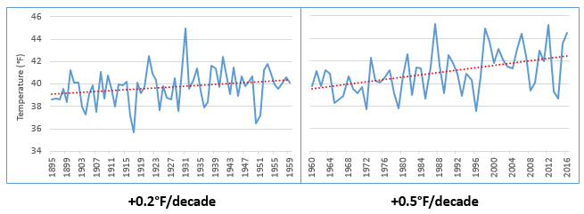
RISING TEMPERATURES
Minnesota Average Annual Temperature, 1895 -2016
Source: NOAA, 2017
Notes:
Minnesota has gotten noticeably warmer, especially over the last few decades. Since the beginning of the data record (1895) through 1959, Minnesota’s annual average temperature increased by nearly 0.2°F per decade, which is equivalent to over 2°F per century. This is shown in the graph to the left. This warming effect has accelerated over the last 50+ years. Data from 1960-2016 show that the recent rate of warming for Minnesota has sped up substantially to over 0.5°F per decade, which is equivalent to 5.0°F per century. This is shown in the graph to the right.
Source: National Oceanic and Atmospheric Administration (NOAA). 2017a. NOAA National Centers for Environmental information, Climate at a Glance: U.S. Time Series, Average Temperature, published February 2017, retrieved on February 9, 2017 from http://www.ncdc.noaa.gov/cag/

Slide 8
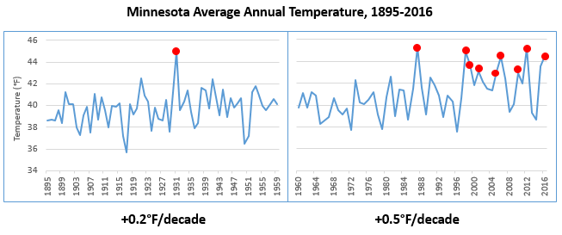
RISING TEMPERATURES
Minnesota Average Annual Temperature, 1895 -2016
Source: NOAA, 2017
Notes:
The increase in temperature trend is driving changes in the environment, affecting ice cover, soil moisture, bird migrations, insect behavior, and forest and plant growth. Some of these changes will impact the health of Minnesotans. For example, finding ways to cope with recent summer heat waves has made climate change less of an abstract concept for many residents, especially those who struggle to acclimate or adjust to these events, and the challenge will likely increase. Based on more than a century of data, 9 of the top 10 warmest years for Minnesota, shown in the slide as the peaks with red points, have occurred just within the last three decades.
Source: National Oceanic and Atmospheric Administration (NOAA). 2017a. NOAA National Centers for Environmental information, Climate at a Glance: U.S. Time Series, Average Temperature, published February 2017, retrieved on February 9, 2017 from http://www.ncdc.noaa.gov/cag/

Slide 9
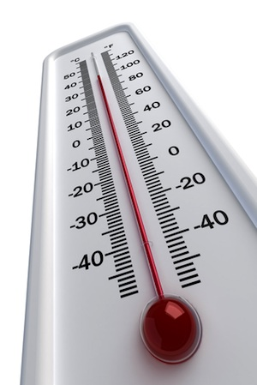
RISING TEMPERATURES
WINTER TEMPREATURES ARE RISING ABOUT TWICE AS FAST AS ANNUAL AVERAGE TEMPERATURES
MINIMUM OR ‘OVERNIGHT LOW’ TEMPERATURES ARE RISING FASTER THAN MAXIMUM OR ‘DAYTIME HIGH’ TEMPERATURES
NORTHERN MINNESOTA IS WARMING FASTER THAN SOUTHERN MINNESOTA
Notes:
Within this overall annual warming pattern, there have been three significant observations in Minnesota.
First, winter temperatures are rising twice as fast as the annual average temperatures. We are now experiencing more warmer winter temps, less snow and more winter rain, and changes in the amount of ice.
Secondly, minimum temperatures, which are the overnight lows, have been rising faster than maximum temperatures, which are the daytime highs. In just the last 30 years, average annual overnight lows have been rising at a rate of 6 degrees Fahrenheit per 100-year period.
And lastly, the northern part of the state is warming faster than the southern part of the state. Over the last 50 years, there has been a distinct spread of warmer overnight lows into the northern part of Minnesota. This is consistent with patterns seen across the Northern Hemisphere, where climate changes are occurring more rapidly at these higher latitudes.
Source: Zandlo, 2008; NOAA, 2017a
Image: Clip Art Images

Slide 10
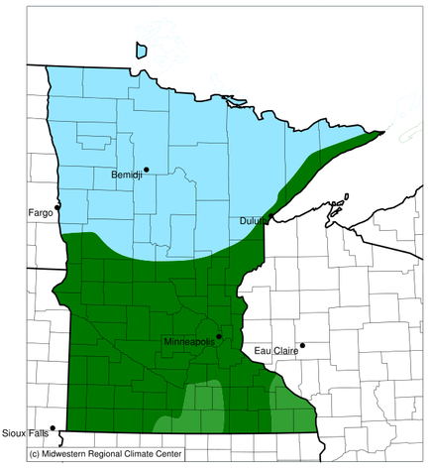
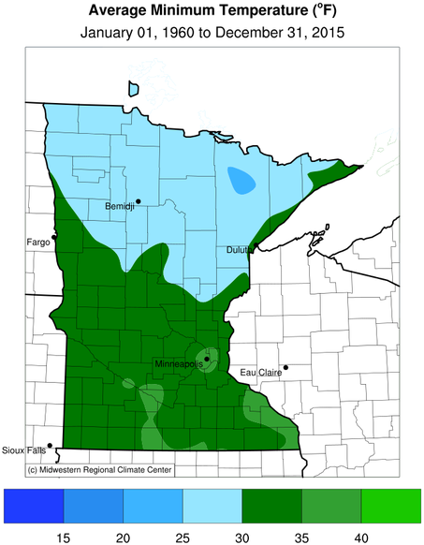
TEMPERATURE INCREASING
Annual Average Minimum Temperature for Minnesota
1900-1959
Source: MDH, 2015
1960-2015
Notes:
In Minnesota, there are distinct daily, seasonal, and regional trends in temperature.
Across the state winter season temperatures have been warming nearly twice as fast as annual average temperatures. The change in Minnesota’s winter daily low temperatures drives the statewide trend in all-season annual temperatures.
Minimum temperatures across all seasons, often referred to as “overnight lows”, have increased at a faster rate than average daily temperatures taken as a whole. Since 1985, average annual overnight lows have been rising at a rate of 6.0°F per century. There is no straightforward answer as to why nighttime lows are warming faster than daytime highs, but one likely factor is an increase in cloudiness that insulates land surface at night combined with reduced snow cover.
Over the last half century there has been a distinct spread of warmer lows into the northern part of Minnesota. Warming rates generally have been higher in northern areas of the state compared to southern areas, which is consistent with patterns seen across the Northern Hemisphere, where climate changes are occurring more rapidly at higher latitudes. However, the Twin Cities area located in the southeastern part of the state is a notable exception. The highest calculated warming trend of recent years is associated with the Twin Cities Metropolitan Area (TCMA). The high rate of warming associated with the TCMA may be a result of the urban heat island effect.
Source: MDH, 2015; Zandlo, 2008
Image source: Annual average minimum temperatures for Minnesota – MDH, 2015

Slide 11
ENVIRONMENTAL CHANGES
Changing Plant Hardiness Zones
After USDA Plant Hardiness Zone Map, USDA Miscellaneous Publication No. 1475, Issued January 1990.
Arbor Day Foundation Plant Hardness Zone Map published in 2015.
Notes:
The change in temperature is already causing substantial shifts in the environment. Maps of USDA plant hardiness zones show what types of plants will survive well and where. This is the standard by which gardeners and growers determine the plants that are most likely to thrive at a location. Zones are based on the average annual minimum winter temperature over a 30-year period and each zone represents a 10-degree Fahrenheit increment of minimum temperatures (USDA Agricultural Research Service, 2012).
This image from the National Arbor Day Foundation compares two points in recent times. In 1990, Minnesota was predominantly zone 3 in the northern half of the state and zone 4 in the southern half of the state. In 2015, Minnesota was predominantly zone 4 across the majority of the state, with a smaller area of zone 3 in the far northern part of the state and zone 5 emerging in the far southern part of the state.
These shifts may stress native plant species and may make it easier for non-native plants, and the insects and pathogens that rely on them, to move into areas where they previously couldn’t survive.
Source: USDA Agricultural Research Service, 2012
Image source: Plant Hardiness Zones – Arbor Day Foundation, 2015

Slide 12
PRECIPITATION INCREASES
Minnesota Average Annual Precipitation, 1895-2016
-0.2”/decade
+0.5”/decade
Notes:
With a warming atmosphere, more evaporation occurs. Warmer air can also hold more water vapor than cool air. The water holding capacity of air increases by about 7% per 1°C warming.
The chart on this slide shows Minnesota's average annual precipitation from 1895 to 2016. The graph on the left highlights the trend for the early part of the last century, 1895-1959, while the graph on the right highlights the trend for the most recent half century, 1960-2016. For most of the first half of the 20th century, the trend in precipitation was slightly downward, at a loss of 0.2 inches per decade or the equivalent of -2 inches per century. This downward trend was influenced by the Dust Bowl years of the 1930s. However, the rate of precipitation across the state has increased by nearly 0.5 inches per decade or the equivalent of 5 inches per century over the last 50+ years.
Source: Trenberth, 2011; National Oceanic and Atmospheric Administration (NOAA). 2017. NOAA National Centers for Environmental information, Climate at a Glance: U.S. Time Series, Precipitation, published February 2017, retrieved on February 9, 2017 from http://www.ncdc.noaa.gov/cag

Slide 13
PRECIPITATION – MORE EXTREME EVENTS
1860s
1870s
1880s
1900s
1910s
1920s
1930s
1940s
1950s
1960s
1970s
1980s
1990s
2000s
2010s
2020s
1890s
1
1
1
2
3
3
4
7 OF THE 15
MINNESOTA MEGA-RAIN EVENTS HAVE
OCCURRED SINCE 2002
Notes:
Overall our average annual precipitation is slightly increasing and this increase is being driven by heavy precipitation events. This timeline captures the historic mega-rain events in Minnesota that have occurred since 1858. These events constitute a six-inch rainfall that covers more than 1,000 square miles, with the core of the event topping eight inches. 15 mega-rain events have been identified in Minnesota since 1858 and 7 of these events have occurred since 2002.
A recent study of precipitation in Minnesota found that storms with 3+ inches of rainfall has increased 104% in last 50 years.
[Reference] These seven mega-rain events since 2002 include:
June 2002 – where rainfall topped 12 inches over 48 hours in Roseau and Lake of the Woods Counties of Northern MN
September 2004 – with more than 10 inches of rain in a 36-hour period in Faribault and Freeborn Counties of Southern MN
August 2007 – in South East Minnesota, after 15.1 inches of rain fell in 24 hours
September 2010 – in South Central Minnesota, after 9.5 inches of rain fell in one day
June 2012 – in North East Minnesota, after over 10 inches of rain fell over 2 days, causing severe flash flooding and river flooding; the St. Louis River crested at over 16 feet after rising 10 feet in 24 hours
July 2016 – in Central Minnesota, especially Pine County, with a two-day total of 9.3 inches
August 2016 – in Central and South East Minnesota, with rainfall rates of two-three inches per hour.
Source: MDNR, 2016

Slide 14
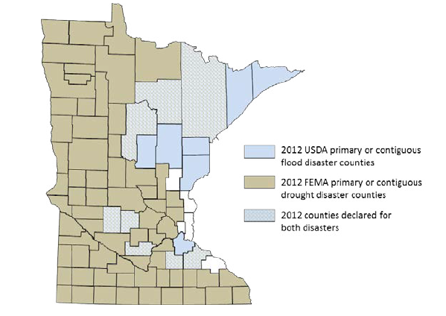
PRECIPITATION CHANGES
Blue counties were declared disaster areas due to flooding.
Brown counties were declared disaster areas due to drought.
Light blue, cross-hatched counties received both designations.
Notes:
However, more moisture in the atmosphere doesn’t necessarily mean a consistent rise in rain and snow. The character of precipitation in Minnesota is changing, increasing the potential for both extreme wet and dry spells. Minnesota is starting to experience increases in localized, heavy precipitation events. Observed trends have the potential to cause both increased flooding and drought, based on the localized nature of storms and their intensity, leaving some areas of the state drenched and other areas without any precipitation. For example, in 2012, 75 counties were declared primary or contiguous disaster areas for drought. However, in that same year 15 counties and three tribal reservations were declared disaster areas for flooding, with eight counties receiving disaster designation for both, underscoring the intensification of precipitation extremes in both directions.
Source: MDH, 2015

Slide 15
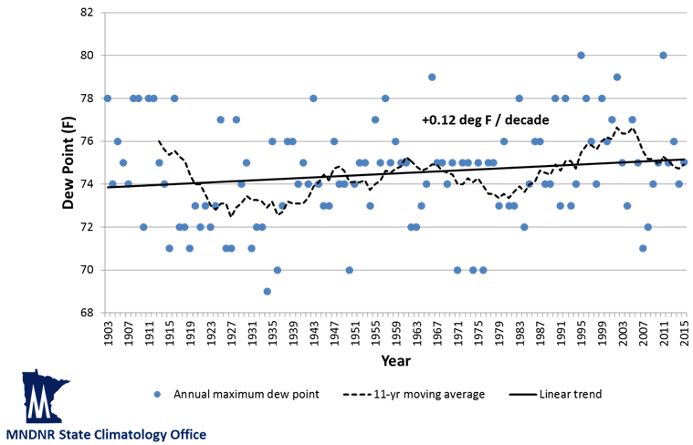
HUMIDITY CHANGES
Highest annual dew points at 6 p.m. CST
Minneapolis – St. Paul, 1903-2015
Notes:
Humidity levels are a function of both temperature and water levels in the atmosphere. Health professionals are particularly interested in humidity, since this affects the skin’s ability to evaporate moisture and cool the body. Dew point is a measure of water vapor in the air. Specifically, the dew point temperature is the temperature to which air must be cooled at constant pressure for it to become fully saturated with water. The higher the dew point is, the more uncomfortable and physically stressed a person feels. This is because people cool themselves by sweating, and if the dew point is high, it becomes more difficult for sweat to evaporate off the skin.
While many measures of dew point and humidity in Minnesota do not yet show evidence of increasing, the most extreme dew point values are becoming more frequent and more extreme over time. Based on historical data, annual maximum dew point temperatures (measured at 6pm CST) are increasing in Minnesota. This trend is modest but significant, about 0.12 degrees per decade. We are also experiencing an increase in the frequency of dew point readings at or above 75°F, a level that is extremely uncomfortable and oppressive. In fact, the frequency of these extreme dew point temperatures is 51% more common in the second half of Minnesota’s weather record (1960-2015) than in the first half (1903-1959).
Source: Trenberth, K.E., 2011; personal communication with Kenny Blumenfeld, Minnesota DNR State Climatology Office on August 9, 2016

Slide 16
OUTLINE
Climate changes in Minnesota
Minnesota agriculture
Food security
Crop production
Livestock production
Key concerns
Strategies: Public health professionals and individuals
Notes:
The next section describes Minnesota Agriculture.

Slide 17
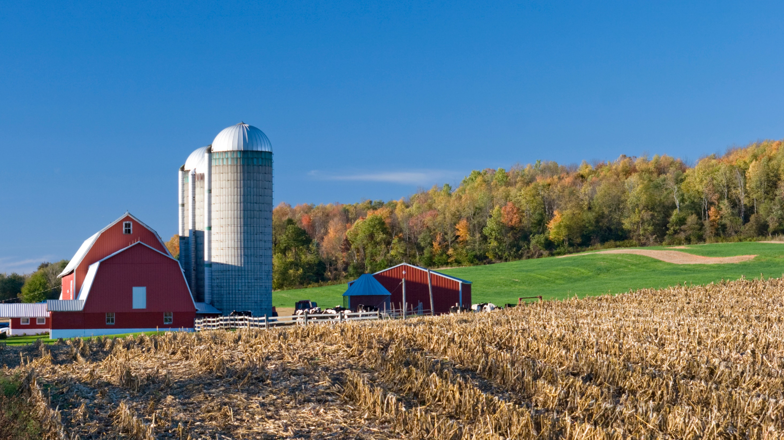
26 million acres of farm land in Minnesota
74,542 farms in Minnesota
349 acres average farm size
MINNESOTA AGRICULTURE
Notes:
Of the 5.4 million people living in Minnesota, 23% live in rural areas of the state.
Agricultural land makes up 51% of the total land acres in Minnesota for a total of 26 million acres of farm land.
The number of farms in the state is 74,542.
The average farm size is 349 acres.
Source: MDA, 2015

Slide 18
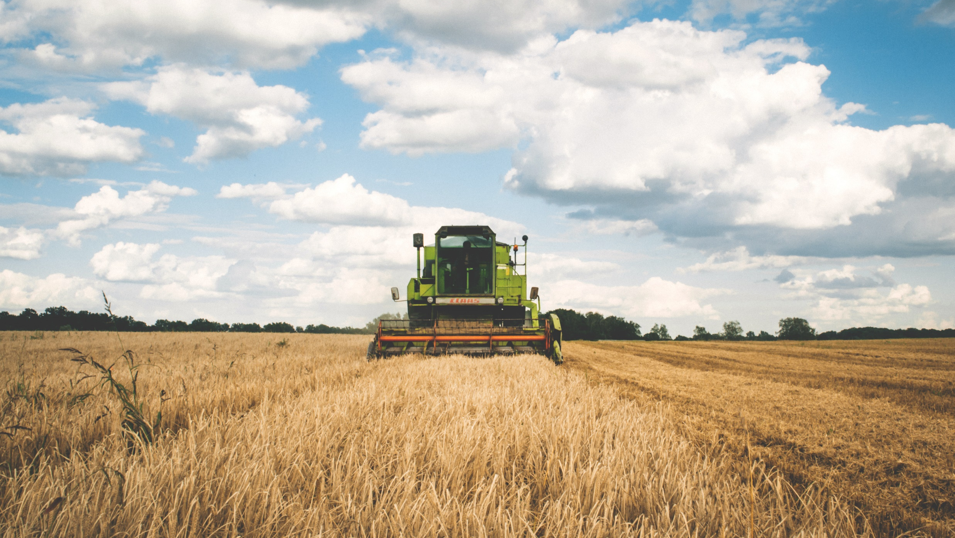
$90 billion per year in agricultural production and processing
340,000 jobs
4th largest agricultural exporting state in the U.S.
ECONOMIC CONTRIBUTIONS
Notes:
Minnesota is fortunate to be rich in food and agricultural activity.
Agricultural production and processing generates approximately $90 billion per year for the state’s economy (Ye, 2016).
Total employment directly and indirectly supported by Minnesota agriculture is responsible for approximately 340,000 jobs (Ye, 2016).
Minnesota ranks as the 4th largest agricultural exporting state in the country. The 2014 agricultural exports totaled $7.35 billion and accounted for over one-third of the state’s total merchandise exports (MDA, 2015).
Agricultural production is a key contributor to Minnesota’s economy.
Source: Ye, 2016; MDA, 2015
Photo source: Green Tractor, Pexels, https://www.pexels.com/photo/green-tractor-175389/

Slide 19
AGRICULTURAL PRODUCTION
MINNESOTA CROPS
#1 in sugar beets, processed sweet corn, and green peas
#2 in wild rice
#3 in dry beans and oats
#4 in corn, soybeans, and flaxseed
#5 in rye
#6 in canola
MINNESOTA LIVESTOCK
#1 in turkeys
#2 in hogs
#3 in meat animals
#6 in cheese and honey
#8 in milk
Notes:
Of the total Minnesota agricultural production, 53% is from crop production and 47% is from livestock production (MDA, 2015).
Minnesota ranks 5th in U.S. states for total crop sales. The state is the #1 crop producer in sugar beets, processed sweet corn and green peas; #2 in wild rice; #3 in dry beans and oats; #4 in corn, soybeans and flaxseed; #5 in rye; and #6 in canola (MDA, 2015).
Minnesota ranks 8th in U.S. states for total livestock sales. The state is the #1 livestock producer in turkeys, #2 in hogs, #3 in meat animals, #6 in cheese and honey, and #8 in milk (MDA, 2015).
Minnesota’s agricultural production is not only important for local food security. It is also important for national and global food security because Minnesota exports many of its agricultural products across the U.S. and the world.
Source: MDA, 2015

Slide 20
IMPACTS ON MINNESOTA AGRICULTURE
Climate disruptions are projected to continue to increase.
Impacts will be increasingly negative.
Notes:
Climate disruptions to agricultural production have increased in the past 40 years and are projected to increase over the next 25 years. Climate change has the potential to both positively and negatively affect the location, timing, and productivity of crop, livestock, and fishery systems at local, national and global scales. By 2050 and beyond, these impacts will be increasingly negative on most crops and livestock (Hatfield et al, 2014).
With agricultural production being a key contributor to Minnesota’s economy and with many of Minnesota agricultural products being exported across the country and the world, disruptions to Minnesota agricultural production would have a significant impact on the state’s economy as well as the availability and accessibility of food for many people.
Adaptation strategies can help delay and reduce some of these impacts, which will be described later.
Source: Hatfield et al, 2014
Image: Man Planting, Pexels, https://www.pexels.com/photo/man-planting-plant-169523/

Slide 21
OUTLINE
Climate changes in Minnesota
Minnesota agriculture
Food security
Crop production
Livestock production
Key concerns
Strategies: Public health professionals and individuals
Notes:
The next section describes Food Security.

Slide 22
FOOD SECURITY DEFINITIONS
Food safety
Amount of food
Notes:
There are generally two ways to think about food security. Many environmental health specialists and sanitarians think about food security as food safety. They focus on ensuring food is not contaminated with a disease or pathogen in order to prevent people from becoming sick. The focus of this training module is on food security: referring to the availability and accessibility of food; although food safety is discussed later in the training module.
Image source: Tomatoes, Carrots, Radish – Pexels - https://www.pexels.com/photo/tomatoes-carrots-and-radish-on-the-top-of-the-table-196643/

Slide 23
“People have the ability and adequate access at all times to sufficient, safe, nutritious food to maintain a healthy and active life.”
- World Food Programme, 2016
Notes:
The World Food Programme of the United Nations defines food security as when “people have the availability and adequate access at all times to sufficient, safe, nutritious food to maintain a healthy and active life.” Commonly, the concept of food security is defined as including both physical and economic access to food that meets people's dietary needs as well as their food preferences.
Source: World Food Programme, 2016

Slide 24
COMPONENTS OF FOOD SECURITY
Availability
Access
Utilization
Stability
Notes:
There are four components of food security:
Availability is the existence of food in a particular place at a particular time.
Access is the ability of a person or group to obtain food.
Utilization is the ability to use and obtain nourishment from food. This includes a food’s nutritional value and how the body assimilates its nutrients.
Stability is the absence of significant fluctuations in the three previous components of availability, access and utilization.
For food security to be achieved, all four components must be attained and maintained simultaneously.
Each component is sensitive to climate change.
Source: Brown et al, 2015
Image source: Kebab, Pexels, https://www.pexels.com/photo/food-vegetables-summer-eat-111131/

Slide 25
FOOD SECURITY & CLIMATE CHANGE
The food system is complex
Food security is multifaceted
Climate change may amplify risks
Notes:
Food security, food systems, and climate change are complex and multifaceted topics. Many factors aside from climate change influence food systems and food security. The most relevant include technological and structural changes in food production, processing, distribution, and markets; increasing population, demographic changes, and urbanization; changes in wealth; changes in eating habits and food preferences; disasters and disaster response; and changes in energy availability and use. Some of these are amplified by the effects of climate change and increase the risks to food security (e.g., population growth), while others appear likely to diminish risk and to help offset damaging climate-change impacts (e.g., increasing levels of wealth) (Brown et al, 2015).
Climate change could affect food security in Minnesota in a number of ways. It may affect the total amount of food the state can produce. The ability to transport and distribute food may be affected. It may affect the variety and nutritional value of the food produced. Changes in total quantity and quality of foods may affect the price of food as well. Overall, climate change may affect our ability to meet our nutrition needs.
It is also important to note that much of our food comes from outside of Minnesota and even outside of the country. Climate change in other parts of the country or world could affect our food security within Minnesota.
Source: Brown et al, 2015

Slide 26
OUTLINE
Climate changes in Minnesota
Minnesota agriculture
Food security
Crop production
Livestock production
Key concerns
Strategies: Public health professionals and individuals
Notes:
The next section describes the potential impacts of climate change on Crop Production.

Slide 27
PHOTOSYNTHESIS
INPUTS
Sunlight
Carbon dioxide
Precipitation
OUTPUTS
Oxygen
Food
Notes:
To understand the climate change impacts on crop production, let’s start with a review of photosynthesis. Photosynthesis is the process used by plants to convert solar radiation into chemical energy. It is the process in which carbon dioxide, water, and light energy are utilized to synthesize carbohydrates and produce oxygen as a by-product (Biology Online, 2017). Crop production inputs are sunlight, atmospheric carbon dioxide and precipitation. Outputs are oxygen and plant materials used as food for humans and animals.
Source: Biology Online, 2017
Image source: Photosynthesis – http://www.hourlybook.com/wp-content/uploads/2015/08/Photosynthesis-in-Plants.jpg

Slide 28
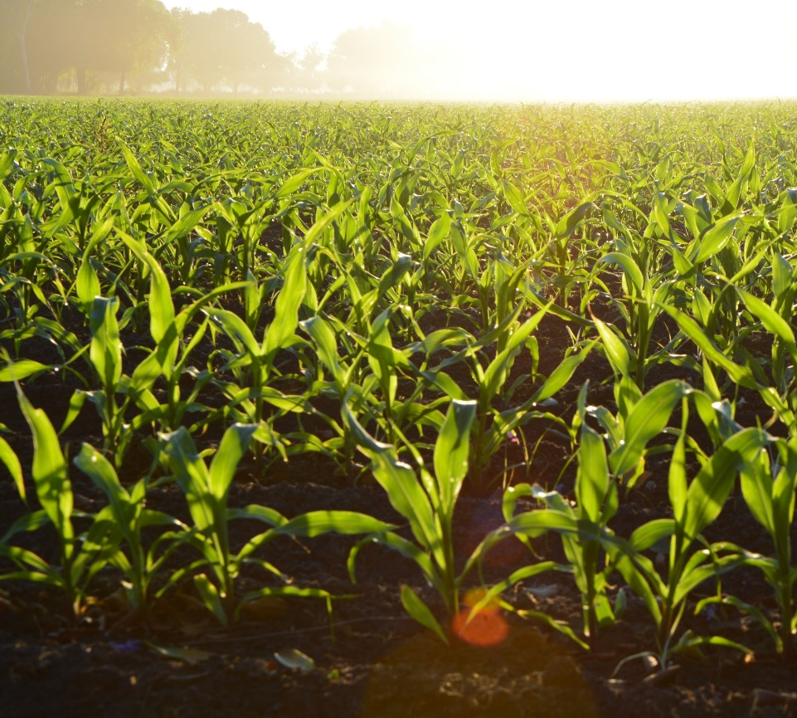
IMPACTS ON CROP PRODUCTION
CLIMATE CHANGE IMPACTS
Crop yields
Crop losses
Annual variations
Soil and water quality and quantity
Solar radiation
Notes:
Several key impacts of changing climatic conditions on crop production include the following concerns:
Crop yields can be impacted by changes in temperature and precipitation trends as well as extremes. There may be a positive, negative or no effect on crop yields. For example, corn yields decline as temperatures warm because of a shortening of the reproductive development period. By mid-century, crop yields are expected to decline due to these changes.
Crop yields may increase with increased atmospheric carbon dioxide that benefits some plant growth rates. For example, soybeans yields may increase early in the 21st Century because of the elevated carbon dioxide. However, added stress due to increasing temperature is expected to offset this benefit later in the century.
Crop losses may increase due to both direct and indirect impact from weeds, insects, and diseases that accompany changes in both average weather trends and extreme weather events.
Annual variations in crop production are expected to increase due to climate change effects on weather patterns and increases in extreme weather events.
Declines in soil and water quality and quantity are expected due to increasing extremes in precipitation.
Reductions in solar radiation due to increased clouds and humidity in the last 60 years are projected to continue. Depending on the crop, this may affect the rates of plant growth.
Source: Hatfield et al, 2014
Image source: Corn Field – Pexels - https://www.pexels.com/photo/corn-96715/

Slide 29
ENVIRONMENTAL CHANGES
Changing Plant Hardiness Zones
After USDA Plant Hardiness Zone Map, USDA Miscellaneous Publication No. 1475, Issued January 1990.
Arbor Day Foundation Plant Hardness Zone Map published in 2015.
Notes:
The change in temperature is already causing substantial shifts in the environment.
Maps of USDA plant hardiness zones show what types of plants will survive well and where. This is the standard by which gardeners and growers determine the plants that are most likely to thrive at a location. Zones are based on the average annual minimum winter temperature over a 30-year period and each zone represents a 10-degree Fahrenheit increment of minimum temperatures (USDA Agricultural Research Service, 2012).
This image from the National Arbor Day Foundation compares two points in recent times. In 1990, Minnesota was predominantly zone 3 in the northern half of the state and zone 4 in the southern half of the state. In 2015, Minnesota was predominantly zone 4 across the majority of the state, with a smaller area of zone 3 in the far northern part of the state and zone 5 emerging in the far southern part of the state.
These shifts may stress native plant species and may make it easier for non-native plants, and the insects and pathogens that rely on them, to move into areas where they previously couldn’t survive.
Source: USDA Agricultural Research Service, 2012
Image source: Plant Hardiness Zones – Arbor Day Foundation, 2015

Slide 30
WARMER WINTERS
Earlier spring planting
Reduced “winter chill” hours
Earlier crop buds or blooms
Notes:
Warmer winters have created a longer growing season. The Midwest growing season has lengthened by almost two weeks since 1950. This is due in part to earlier timing of the last spring freeze. This trend is expected to continue (Pryor et al, 2014).
The earlier last spring freeze could allow for earlier spring planting. This longer growing season could have a positive effect on crop production with an increased number of crops per season and larger harvests.
Warmer winters could also have a negative effect due to increased risk of low yields or frost damage. For example:
Perennial specialty crops have a winter chilling requirement with a minimum number of hours exposed to chilling temperatures to keep plants dormant for a time before flowering and fruiting. Yields decline if the chilling requirement is not completely satisfied (Hatfield et al, 2014).
Warmer winters can lead to early bud burst or bloom of some perennial plants, which could result in frost damage when cold conditions occur in late spring (Hatfield et al, 2014). From an example from 2012, Minnesota experienced an unusually warm March followed by a hard frost in April. This damaged the buds of the state’s apple crop. A few months later, the apples that were left on trees were damaged from summertime hail storms and drought, dropping production by as much as 40 percent below normal (Baier, 2012).
Source: Pryor et al, 2014; Hatfield et al, 2014; Baier, 2012
Image source: Branches – Pexels - https://www.pexels.com/photo/white-flower-plant-199754/

Slide 31
WARMER NIGHTS AND HOTTER DAYS
Warmer nights and higher daytime minimum temperatures may affect crop yields:
Disturb pollination stage
Disturb grain-filling process
Notes:
One of the temperature trends of climate change is warmer nighttime temperatures. This trend has been occurring in Minnesota and throughout the U.S. and is expected to increase. Two examples of how the lack of nighttime cooling may affect crop yields are:
Disturbance in the pollination stage – Pollen release is related to development of fruit, grain, or fiber. Exposure to high temperatures during this period can greatly reduce crop yields and increase the risk of total crop failure. Plants exposed to high nighttime temperatures during the grain, fiber, or fruit production period experience lower productivity and reduced quality. These effects have already begun to occur; corn yields were affected by high nighttime temperatures in 2010 and 2012 across the U.S. Corn Belt. The number of nights with hot temperatures are projected to increase as much as 30%. Yield reductions will become more prevalent.
Disturbances in the rate of grain-filling process – The grain-filling process begins with pollination and initiation of kernel development, and ends when the kernels reach physiological maturity. Exposure to higher temperatures, both at night and during the day, affect the development of grain by increasing the rate of grain-filling and decreasing the length of the grain-filling period. This results in reduced yields in grain crops.
Source: Hatfield et al, 2014
Image source: Starry Sky – Pexels - https://www.pexels.com/photo/blue-and-black-starry-sky-51021/

Slide 32
PRECIPITATION EXTREMES
Fewer workable field days
Increased soil erosion
Drowning of crops
Drought-induced losses
Notes:
The changing climate affects the amount, distribution, and intensity of precipitation. Precipitation, along with temperature, affect the potential amount of available water for crop production. The actual amount of available water also depends on soil type, soil water holding capacity, and the rate at which water filters through the soil (Hatfield et al, 2014).
There has been a trend toward fewer workable field days because of shifting precipitation amounts to more spring (April-May) occurrences. Timeliness of planting is an important part of the crop production cycle (Hatfield et al, 2014).
Soil erosion occurs when the rate of precipitation exceeds the ability of the soil to maintain an adequate infiltration rate. When this occurs, runoff from fields moves water and soil from the fields into nearby water bodies. Water and soil that are lost from the field are no longer available to support crop growth. Projected increases in rainfall intensity that include more extreme events will increase soil erosion in the absence of conservation practices (Hatfield et al, 2014).
Periods of drought may cause crop losses due to reduced groundwater, surface water, and soil moisture as well as a potential concentration of pollutants or threat of wild fires. By the end of the 21st Century, the occurrence of very hot nights and the duration of periods lacking agriculturally significant rainfall are projected to increase. Recent studies suggest that increased average temperatures and drier conditions will amplify future drought severity and temperature extremes (Hatfield et al, 2014).
Source: Hatfield et al, 2014
Image source: Drowning crops – John Luke – The Times, http://bloximages.chicago2.vip.townnews.com/nwitimes.com/content/tncms/assets/v3/editorial/a/9d/a9deec2f-24f1-55d1-be4c-133b400789d6/5593dbe49c5f5.image.jpg?resize=1200%2C661

Slide 33
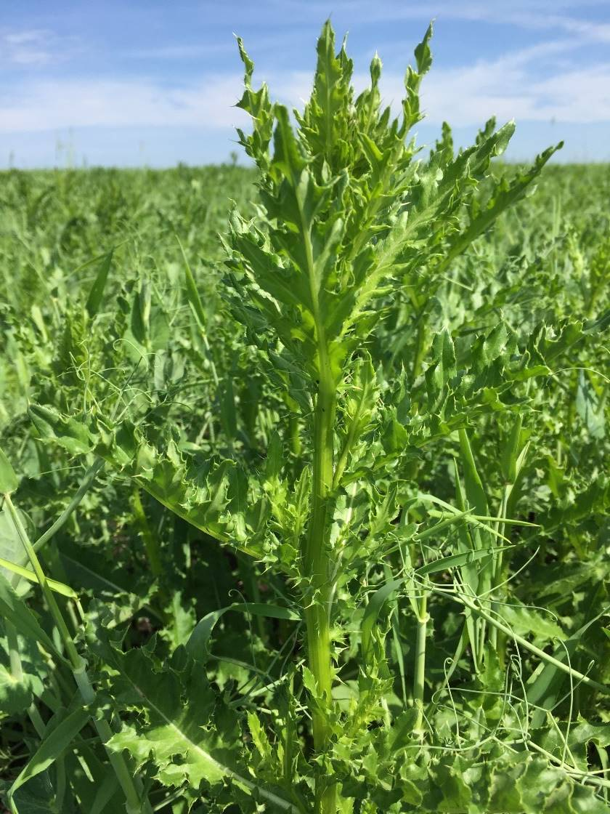
WEEDS, INSECTS, AND DISEASES
CONCERNS
Increased pest susceptibility
Invasive weeds, insects, and pathogens
Disease interactions, survival, and proliferation
Insect populations and reproductive rates
Increased use and cost of pesticides
Notes:
Many weeds, insects, and diseases (“plant pests” in general) already have large negative impacts on agricultural production. Climate change has the potential to increase these impacts. Further increases in temperature and carbon dioxide levels along with changes in dew points and precipitation patterns will induce new conditions. These new conditions affect the plants, their pests, and their interactions. This applies to both native and invasive species of pests. One example is that several weed species benefit more than crop species from higher temperatures and higher carbon dioxide levels. Another example is the change in insect populations and incidence of pathogens may increase under conditions of higher temperatures and higher humidity levels. Conversely, some pathogens may increase with higher temperatures combined with drought conditions (like aflatoxin which is a cancer-causing toxin produced by certain molds that grow on crops like wheat, corn, beans, and rice). Many plants that are stressed by these new conditions will be much more susceptible to the “usual” pests, but these plants may also become susceptible to opportunistic weeds, insects, and diseases – those that don’t usually damage healthy plants.
General concerns include:
Increased susceptibility of plants to pests because of stress caused by climate changes
Northern spread of invasive weeds
Increased survival and proliferation of disease-causing agents and parasites
Increased insect populations due to overwinter survival
Increased insect reproductive rates due to warmer summer temperatures
Increased use and costs of pesticides due to increased pests and loss of pesticide efficacy (decline in efficacy can reflect carbon dioxide-induced increases in herbicide tolerance of certain weeds as well as climate-induced changes that enhance pesticide degradation or affect coverage)
Source: Hatfield et al, 2014
Image source: Canada thistle – MDH, 2016

Slide 34
NUTRITIONAL VALUE
Nutritional value of some foods may change:
Higher carbohydrate levels
Lower protein levels
Lower mineral content
Notes:
The nutritional value of some crops is projected to decline due to rising levels of atmospheric carbon dioxide. This carbon dioxide “fertilization” effect stimulates plant growth and carbohydrate production, which in turn, dilutes nitrogen and other nutrient content.
Lower nitrogen concentrations result in reduced protein in many crops (Ziska et al, 2016). Crops of note in Minnesota that may have declining protein levels include soybeans, wheat, barley, and wild rice. In contrast, protein content is not anticipated to decline significantly for corn or sorghum. In either case, reduced protein levels may not be a considerable threat in the United States where dietary protein deficiencies are uncommon.
Rising carbon dioxide concentration is very likely to lower the concentrations of minerals essential to human health such as iron, zinc, calcium, magnesium, copper, sulfur, and phosphorous in most plants. High carbon dioxide concentrations also reduce plant demands for water, resulting in fewer nutrients being drawn into plant roots (Ziska et al, 2016).
The nutrient content of crops is also projected to decline if soil nitrogen levels are suboptimal due to extreme rain events causing water runoff that takes nitrogen and other soil nutrients with it.
Source: Ziska et al, 2016; Luber et al, 2014
Image source: Strawberries – Pexels - https://www.pexels.com/photo/strawberry-fruit-berry-food-106251/

Slide 35
ADAPTATIONS FOR CROP PRODUCTION
Strategies:
Changing crop selection
Timing of field operations
Diversifying crop rotations
Improving soil quality
Reducing soil erosion
Notes:
Adaptation is not new to the agricultural field. Over the course of history, agriculture has continually adapted to natural changes in climate. Adaptation strategies will vary by location because the effects of climate change will be different by geography (wetter in some areas, drier in others) and seasonal and annual variability. Adaptation must also take into consideration differences in crops, soils, and topography in various parts of the state.
Adaptation strategies for crop production currently used to cope with extreme weather and climate changes are generally described as sustainable agricultural practices and/or conservation practices. Some examples include:
Changing crop selection due to changing plant hardiness zones and competition from weeds and other pests
Timing of field operations to optimize growing season and crop competition with weeds while minimizing losses from diseases and insects
Diversifying crop rotations with different tolerances to temperature, precipitation, weeds, insects, and diseases
Improving soil quality
Reducing soil erosion and off-farm flows of nutrients and pesticides
Although agriculture has a long history of successful adaptation to climate variability, the accelerating pace of climate change and the intensity of projected climate change represent new and unprecedented challenges to the sustainability of U.S. agriculture. Increased innovation will be needed to ensure the rate of adaptation keeps pace with climate change over the next 25 years. In the longer term, adaptation will be more difficult because the physiological limits of plants will be exceeded more frequently and crop productivity will become more volatile.
Source: Hatfield et al, 2014
Image source: Wheat kernels – Pexels - https://www.pexels.com/photo/wheat-kernels-54084/

Slide 36
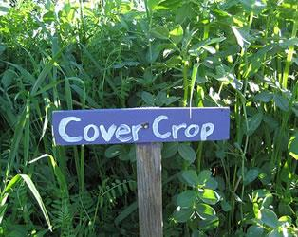
REDUCING SOIL EROSION
STRATEGIES Strategies may also enhance water management during drought.
Conservation tillage
Crop residue management
Perennial crops and cover crops
Water management
Notes:
An adaptation strategy of note is reducing soil erosion. Erosion is managed through a number of strategies that encompass maintenance of cover on the soil surface to reduce the effects of rainfall intensity. Studies have shown that a reduction in projected crop biomass (and hence the amount of crop residue that remains on the surface over the winter) will increase soil loss. Soil conservation practices will therefore be an important element of agricultural adaptation to climate change (Hatfield et al, 2014).
Although large-scale agriculture in the Midwest historically led to decreased carbon in soils, higher crop residue inputs and adoption of different soil management techniques have reversed this trend. Other techniques, such as planting cover crops and no-till soil management, can further increase carbon dioxide uptake and reduce energy use. The use of cover crops to hold carbon in the soil improves soil quality, soil water holding capacity, water quality, air quality, and crop productivity (Pryor et al, 2014).
Water management strategies are also important for reducing soil erosion. Examples include grassed waterways and buffers management, contour farming, and wetlands management.
Source: Hatfield et al, 2014; Pryor et al, 2014
Image source: Cover crop – Farmer D Blog, Steven Bell, November 14, 2011

Slide 37
OUTLINE
Climate changes in Minnesota
Minnesota agriculture
Food security
Crop production
Livestock production
Key concerns
Strategies: Public health professionals and individuals
Notes:
The next section will discuss the potential impacts of climate change on Livestock Production. Livestock include cattle, dairy animals, swine and poultry.

Slide 38
IMPACTS ON LIVESTOCK PRODUCTION
Heat and humidity
Precipitation
Extreme events
Weather variability
Notes:
Climate impacts on animal agriculture are not well defined and vary by species, geographic location, and individual farm vulnerabilities.
Some examples of how climate and weather changes impact livestock are:
Heat and humidity
Precipitation
Extreme events
Weather variability
These examples are covered in more detail in the next slides.
Source: Schmidt, Whitefield and Smith, 2014
Image source: Cows – Pexels - https://www.pexels.com/photo/animals-cattle-cow-farm-207044/

Slide 39
HEAT AND HUMIDITY
Feed efficiency
Milk production
Animal health
Forage and grain production
Pests and disease
Death loss in extreme cases
Worker health
Notes:
Depending on the timing and duration, heat and humidity impact livestock production in a variety of ways including reproduction, feed efficiency, milk production, animal illness, grain and forage production, increase in pests or timing of pest impacts, animal death, changes in nutrient value of crops, worker health, etc. Temperature Humidity Indexes (THI) are used to help assess animal stress for the different combinations of heat (temperature) and humidity as each animal species and stage of production are impacted differently. Even small changes, such as warmer nighttime temperatures, can have a significant impact in animal production. On a larger scale, national or global, this can impact the price of feed supplies or price of farm products.
For example, extreme heat resulted in 1,000 cattle deaths across the state in 2011, according to Feedlot Educator Grant Crawford from the University of Minnesota Extension. The majority of the losses occurred in south central and southwestern Minnesota.
http://articles.aberdeennews.com/2011-07-29/farmforum/29831844_1_livestock-indemnity-program-livestock-losses-turkey-producers
Source: Schmidt, Whitefield and Smith, 2014
Photo source: Pig – Pexels - https://www.pexels.com/photo/farm-farmer-pink-ears-110820/

Slide 40
PRECIPITATION
Crop and forage loss
Soil erosion
Manure storage
Muddy pastures
Access to roads and bridges
Notes:
Wetter conditions, dryer conditions, intensity of rainfall, or timing of rainfall all impact animal production. Drought can lead to crop and forage losses, and soil loss through wind erosion. Soil loss also occurs with large or intense rainfall events. Soil loss can have a long-term impact on farmland productivity. Manure storage and manure application can be challenging with large precipitation events. Muddy pastures, feedlots, and roads also create production and health challenges.
Source: Schmidt, Whitefield and Smith, 2014
Image source: Muddy field – Pexels - https://www.pexels.com/photo/nature-sunset-field-sunrise-702/

Slide 41
EXTREME EVENTS
Losses due to flooding, drought, blizzards, or tornadoes
Challenges with transporting feed and product
Challenges for farm operations from power outages, wind damage or snow loads
Notes:
Extreme weather such as widespread flooding, drought, blizzards, or tornadoes all can lead to catastrophic losses on the farm. Flooding can impact local bridges or roads causing logistic challenges for transporting feed and supplies to the farm or for exporting farm products. In addition, flooding may impact employees’ ability to get to work. Power outages, wind damage, snow loads, etc. create additional challenges to farm operations.
Source: Schmidt, Whitefield and Smith, 2014
Image – Blizzard, Pexels, https://www.pexels.com/photo/snow-nature-sky-trees-65911/

Slide 42
WEATHER VARIABILITY
Animal acclimation
Timing of rainfall for manure application or planting
Environmental controls caught off guard
Notes:
Within physiological limits, animals can adapt to and cope with gradual weather changes. However, rapidly changing or extreme weather events often result in catastrophic livestock deaths and lost productivity in surviving animals if they have not had prior conditioning or acclimation to the rapid weather variability (Hatfield et al, 2014).
It is often not the event itself that causes the problem but the timing or circumstances that cannot always be quantified by climate data. Early season high or low temperatures may not be outside the normal ranges of temperatures but can be devastating to animals (Schmidt, 2016).
Source: Hatfield et al, 2014; Schmidt, 2016
Image source: Rooster – Pexels - https://www.pexels.com/photo/agriculture-animal-avian-barn-346483/

Slide 43
ADAPTIONS FOR HEAT
Proper design, installation, and management of ventilation and cooling systems
Diet changes
Adequate water availability
Notes:
Farmers are well aware of heat stress with animals. The key is being prepared for more days of heat stress or for heat stress earlier or later in the season. Proper design of the building ventilation system is important as is the good operation and maintenance of these systems. Sprinkler systems, used to cool animals, can be very effective at reducing heat stress but also need to be properly designed, operated and maintained. Hot weather diets also aid in reducing heat stress. In addition, farmers must make sure there is adequate cool water for the animals to drink.
Source: Schmidt, 2016
Image source: Countryside – Pexels - https://www.pexels.com/photo/agriculture-clouds-countryside-cropland-410756/

Slide 44
ADAPTIONS FOR PRECIPITATION
Alternative feed sources
Manure management options
Backup power supply
Emergency response plan
Notes:
Impacts from changes in precipitation timing or amount can be reduced with proper planning. This planning is also important to reduce the impact of extreme events such as flooding, drought, or blizzards. Planning includes reserving enough feed and having alternative sources of feed. Building in some flexibility in manure management with extra storage or managing for more freeboard in the manure storage. (Freeboard is the empty vertical space above the top of the liquid or semi-sold manure level and below the top of the manure storage facility.) Backup power supplies are currently essential to all farms and should be well maintained and tested. A comprehensive Emergency Response Plan is useful with these extreme events.
See the resource, Animal Agriculture in a Changing Climate: Adapting to a Changing Climate: A Planning Guide (July 2016) for more information on developing a climate adaptation plan or emergency response plan; available online: http://animalagclimatechange.org/wp-content/uploads/2016-Planning-Guide-FINAL-web.pdf
Source: Schmidt, 2016
Image source: Drops of water – Pexels - https://www.pexels.com/photo/car-drops-of-water-glass-rain-1553/

Slide 45
OUTLINE
Climate changes in Minnesota
Minnesota agriculture
Food security
Crop production
Livestock production
Key concerns
Strategies: Public health professionals and individuals
Notes:
It is not possible to identify all the agricultural and food security challenges that are or will be created by climate change. The next section will highlight a number of key concerns that have been identified in Minnesota.

Slide 46
FOOD SAFETY
Climate changes…
Higher air temperatures
Higher water body temperatures
Can lead to…
Increased food spoilage
Increased crop contamination
High or low precipitation
Increased damage to stored food
Notes:
As climate change drives changes in environmental variables, increases in foodborne illnesses are expected. Climate already influences food safety within an agricultural system – prior to, during, and after the harvest, and during transport, storage, preparation, and consumption. Changes in climate factors, such as temperature, precipitation, and extreme weather (particularly flooding and drought) are key drivers of pathogen introduction, food contamination, and foodborne disease, as well as changes in the level of exposure to specific contaminants and chemical residues for crops and livestock.
The impact of climate on food safety occurs through multiple pathways. Changes in air and water temperatures, weather-related changes, and extreme events can shift the seasonal and geographic occurrences of bacteria, viruses, insects, parasites, fungi, and chemical contaminants. For example:
Higher temperatures can increase the kinds and numbers of pathogens already present on produce
Bacterial populations that increase during food storage can increase food spoilage rates depending on timing and temperature
Extreme weather events like dust storms or flooding can introduce toxins to crops during development
The risk for food spoilage and contamination in storage facilities, supermarkets, and homes is likely to increase due to the impacts of extreme weather events, particularly those that result in power outages that may expose food to temperatures inadequate for safe storage. Power outages are often linked to an increase in diarrheal illness resulting from consumption of spoiled foods due to lost refrigeration capabilities.
Source: Ziska et al, 2016

Slide 47
FOOD DISTRIBUTION
Disruptions in transportation and infrastructure
Water levels in shipping routes
Mississippi River
Lake Superior
Notes:
A reliable and resilient food distribution system is essential for access to a safe and nutritious food supply. Access to food is characterized by transportation and availability, which are defined by infrastructure, trade management, storage requirements, government regulation, and other socioeconomic factors.
The shift in recent decades to a more global food market has resulted in a greater dependency on food transport and distribution, particularly for expanding urban areas. Consequently, any climate-related disturbances to food distribution and transport may have significant impacts not only on safety and quality, but also on food access. The effects of climate change on each of these interfaces will differ based on geographic, social, and economic factors. Ultimately, the outcome of climate-related disruptions and damages to the food transportation system will be strongly influenced by the resilience of the system, as well as the adaptive capacity of individuals, populations, and institutions.
Projected increases in the frequency or severity of some extreme events will interrupt food delivery, particularly for vulnerable transport routes. The degree of disruption is related to three factors: a) popularity of the transport pathway, b) availability of alternate routes, and c) timing or seasonality of the extreme event. As an example, the food transportation system in the U.S. frequently ships large volumes of grain by barges via major rivers and the Great Lakes. In the case of an extreme weather event affecting a waterway, there are few, if any, alternate pathways for transport. This presents an especially relevant risk to food access if an extreme event, like flooding or drought, coincides with times of agricultural distribution, such as the fall harvest.
Source: Ziska et al, 2016
Image source: Boat – Pexels - https://www.pexels.com/photo/sea-clouds-boat-ship-16513/

Slide 48
FOOD PRICES
Food prices may rise if
Production declines
Prices of inputs increase
Food insecurity increases with rising food prices
Notes:
Globally, climate change is expected to threaten food production and certain aspects of food quality, as well as food prices and distribution systems. Prices are expected to rise in response to declining food production and associated trends in the cost of inputs such as increasingly expensive petroleum used for agricultural inputs such as pesticides and fertilizers.
Food insecurity increases with rising food prices. In such situations, people cope by turning to cheaper nutrient-poor but calorie-rich foods, and/or they endure hunger, with consequences ranging from micronutrient malnutrition to obesity.
Source: Luber et al, 2014
Image source: Money – Pexels - https://www.pexels.com/photo/u-s-dollar-bills-pin-down-on-the-ground-164474/

Slide 49
TRADITIONAL FOODS
Impacts on traditional foods for American Indians:
Availability
Access
Health of plant and animal resources
Notes:
American Indian communities face an array of climate change impacts and vulnerabilities. The consequences of observed and projected climate change have and will undermine indigenous ways of life that have persisted for thousands of years. Key vulnerabilities include the loss of traditional knowledge in the face of rapidly changing ecological conditions, increased food insecurity due to reduced availability of traditional foods, and changing water quality and availability.
American Indians have historically depended on the gathering and preparation of a wide variety of local plant and animal species for food, frequently referred to as traditional foods. These foods common to American Indians in Minnesota include fish, bear, moose, deer, corn, beans, squash, wild rice, and a multitude of herbal plants. A changing climate affects the availability of, access to, and health of these foods. This in turn threatens tribal customs, cultures, and identity.
Medicinal and food plants are becoming increasingly difficult to find or are no longer found in historical ranges. An example from the Great Lakes region is that wild rice is unable to grow in its traditional range due to warming winters and changing water levels, thus affecting the Anishinaabe (Chippewa, Ojibwe) peoples’ culture, health, and well-being. The next slide covers more details on wild rice.
Subsequent shifts from traditional lifestyles and diet, compounded by persistent poverty, the cost of non-traditional foods, and poor housing conditions, have led to increasing health problems in communities. All of these issues increase the risk to food security. Climate change is likely to amplify other indirect effects to traditional foods by limiting access to gathering places and hunting grounds.
Source: Bennett et al, 2014
Image source: Wild Rice – Chowtastic - https://www.chowstatic.com/assets/recipe_photos/29465_basic_steamed_wild_rice.jpg

Slide 50
WILD RICE
Climate changes…
Hot and dry conditions
Warm and humid conditions
Can lead to…
Pollination disruptions
Increased plant disease
Warmer winters
Reduced winter dormancy
Crop devastation from floods and drought
Severe weather
Notes:
Minnesota is ranked #2 in wild rice production of all U.S. states (MDA, 2015). It is an important part of the state’s ecosystem with approximately 1,300 Minnesota lakes and streams identified as wild rice waters (MPCA, 2016). Wild rice is an excellent source of complex carbohydrates, vitamins (particularly riboflavin), minerals (particularly potassium and zinc), fiber, and protein (MDNR, 2008).
Wild rice is a culturally, ecologically, and economically important crop for American Indians in Minnesota. Natural wild rice has been hand-harvested as a source of food in the Great Lakes region for thousands of years. Wild rice accompanies ceremonies, celebrations, mourning, initiations, and feasts as both a food and a spiritual presence.
Climate change affects natural wild rice in a number of ways.
Hot, dry conditions can negatively impact the pollination of wild rice and thereby reduce its seed production (MDNR, 2008).
The required cold temperature (35 °F or less) dormancy of 3-4 months for wild rice seeds could be reduced with warmer Minnesota winters (MDNR, 2008).
Warm, humid conditions support diseases of wild rice such as brown spot and other pathogens. For example, high humidity and sustained warm overnight temperatures in August 2007 promoted the development of brown spot in many natural wild rice stands in Minnesota. Estimated crop losses in some stands were 70 to 90% (MDNR, 2008).
Flooding and abrupt changes in lake levels due to individual weather events during the growing season may increase damage to natural wild rice. For example, the June 2012 mega-rain event in Northeastern Minnesota – the area with highest rice lakes and harvests – devastated the wild rice crop for 2012 (Myers, 2012).
Source: MDA, 2015; MPCA, 2016; MDNR, 2008; Myers, 2012

Slide 51
FISH
Climate changes…
Warmer waters
Rainfall intensity
Can lead to…
Fewer cold water fish
Invasive species
Lower water levels
Toxic algae
Notes:
There have been recently recorded higher water temperatures and less ice cover in Lake Superior (and all of the Great Lakes) as well as other Minnesota water bodies as a result of changes in the regional climate. Warmer water can harm fish populations and biological activity of cold aquatic ecosystems in general (Pryor et al, 2014).
Warming waters are expected to reduce the abundance of many coldwater species, including brook trout, lake trout, and whitefish. Coolwater species, such as muskie, smallmouth bass, and bluegill are expected to increase. The habitat of many fish species may also be degraded by harmful algal blooms, flooding, and pollution runoff (Hatfield et al, 2014).
Climate change may also lower water levels. Lower water levels may result in a concentration of contaminants due to reduced dilution. Contaminants in the water, especially toxic chemicals like mercury, may accumulate in fish and affect both the quality and quantity of fish for ecological balance and consumption (CDC, U.S. EPA, NOAA and AWWA, 2010).
Higher temperatures, along with increases in precipitation and lengthened growing seasons, favor production of blue-green and toxic algae. This can harm fish, water quality, and habitats as well as heighten the impact of invasive species already present (Pryor et al, 2014).
Source: Pryor et al, 2014; Hatfield et al, 2014; CDC, U.S. EPA, NOAA and AWWA, 2010
Image source: Walleye, Star Tribune, April 15, 2013

Slide 52
FARM WORKERS
Climate changes…
Extreme heat and humidity
Extreme weather events
Can lead to…
Exposure to farm chemicals
Injuries
Illnesses
Death
Notes:
As stated earlier, Minnesota agriculture supports approximately 340,000 jobs of which a number are farm workers (MDA, 2015). The climate change effects of extreme heat, humidity, and weather events can increase the risk of injury and illness for people who work outdoors. Farm workers may have job tasks requiring great physical exertion. They may also need to wear protective clothing that may trap heat and prevent cooling, in addition to making tasks harder. They may operate equipment that radiates heat. Additionally, they may not have easy and quick access to water and shade (NIHHIS, 2016).
Exposure to extreme heat and humidity makes physical labor inefficient and then impossible as heat and humidity increase. Acclimating to heat can take 10-14 days. Lack of acclimatization of new workers or during heat waves can put workers at higher risk of heat-related injuries, illness or even death. Of the 23 heat stroke deaths investigated by OSHA in 2011, 17 deaths were within the first three days of employment for these workers (Casa, 2016).
Farm workers have an increased risk of injury or death due to working outdoors and potentially not having sufficient time to seek cover from extreme weather events such as flash flooding or tornadoes.
Farmers are expected to use more herbicides and pesticides due to increased pests and growth of weeds as well as decreased effectiveness and duration of some of these chemicals (Luber et al, 2014). Farm workers, especially pesticide applicators, may experience increased exposure as pesticide applications increase with rising pest loads. This could also lead to higher pesticide levels in the children of these farm workers (Ziska et al, 2016).
Source: NIHHIS, 2016; Casa, 2016; Luber et al, 2014; Ziska et al, 2016

Slide 53
THE FOOD SYSTEM
Notes:
The food system involves a complex set of activities. These activities include growing and producing raw food materials, producing the raw materials into produce, marketing and distributing the products to buyers or consumers, preparing and consuming the food, and disposing of any remaining food waste. This pathway is can be affected in multiple ways at multiple points. For example, we’ve outlined how extreme weather events can significantly impact food production and transportation of food.
Source: Brown et al, 2015
Image source: The Food System – Minnesota Food Charter, 2014 http://mnfoodcharter.com/demo/wp-content/uploads/2014/10/food_system.png

Slide 54
OUTLINE
Climate changes in Minnesota
Minnesota agriculture
Food security
Crop production
Livestock production
Key concerns
Strategies: Public health professionals and individuals
Notes:
The next section will highlight a number of strategies that can be implemented by public health professionals and individuals to address climate change in Minnesota.

Slide 55
STRATEGIES: PUBLIC HEALTH PROFESSIONALS
FOCUS ON PREVENTION
Increase awareness
Identify vulnerable populations
Monitor health status
Reduce exposures
Notes:
Public health strategies, especially preparedness and prevention, can do much to protect people from some of the impacts of climate change. Early action provides the largest health benefits. As threats increase, our ability to adapt to future changes may be limited (Luber et al, 2014).
Public health professionals can play a number of roles in addressing the health impacts of climate change that affect Minnesota’s agriculture and food security. Examples of public health strategies include:
Increasing the awareness of how climate change impacts agriculture and food security
Identifying which populations are most likely to be impacted by climate change that affects their food security; for example, identifying those who may have limited financial resources, which may impact their food security if food prices increase due to changing climate conditions
Monitoring population health status by tracking diseases and health conditions that are impacted when food security is at risk
Working with partners to reduce exposure to harmful agents such as toxic chemicals found in the water and food supply
Source: Luber et al, 2014
Image source: “Peppers” – Pexels - https://www.pexels.com/photo/orange-bell-pepper-near-yellow-bell-pepper-109014/

Slide 56
STRATEGIES: PUBLIC HEALTH PROFESSIONALS
FOCUS ON FOOD SAFETY AND DISTRIBUTION
Foodborne illnesses
Emergency preparedness (power outages, disruptions in transportation routes)
Notes:
Although the U.S. has one of the safest food supplies in the world, food safety remains an important public health issue (Ziska et al, 2016).
Public health professionals can improve food safety by addressing risks of foodborne illnesses that may increase as a result of changes in temperature, precipitation and extreme weather events driven by climate change. Many local public health departments include licensing and inspections for establishments that produce or sell food. Local public health professionals also may help educate the public on proper handling of food, such as washing fresh fruits and vegetables to remove possible pesticide residue, or proper cooking and storage practices to keep food safe for consumers.
Public health professionals are also involved in emergency preparedness efforts to prepare communities to respond when power outages occur or when food distribution systems are at risk due to disruptions in transportation routes or impacts to distribution facilities.
Source: Ziska et al, 2016
Image source: “Berries” – Pexels - https://www.pexels.com/photo/food-forest-blueberries-raspberries-87818/

Slide 57
STRATEGIES: PUBLIC HEALTH PROFESSIONALS
FOCUS ON FOOD ACCESS AND AVAILABILITY
Promote a diverse food supply
Promote local food initiatives (Minnesota Grown, farmers markets, school gardens)
Notes:
Addressing food access and availability is a key role public health professionals can play.
Promoting a diverse food supply, including biodiversity and geographic diversity, can help insulate Minnesota from crop losses due to climate change and extreme weather events. Part of the equation is having a strong, diverse local food economy in case losses occur in other parts of the country or world where we access our foods. In addition, transporting foods grown in one part of the country or world to other locations contributes to more greenhouse gas emissions than foods grown locally and consumed locally.
Promoting local food initiatives can contribute to the food security within Minnesota.
The Minnesota Grown Program is a statewide partnership between the Minnesota Department of Agriculture and Minnesota producers of specialty crops and livestock. It was created over 20 years ago by specialty crop growers to differentiate their produce from competitors’ produce from thousands of miles away.
Promoting farmers markets, Farm-to-School programs, community-based agriculture, school gardens, and other local food initiatives are other ways for public health professionals to address food security. Many of these initiatives are being promoted and/or supported through the Statewide Health Improvement Partnership (SHIP) grants being implemented across the state.
A number of these local initiatives may include educational components that help educate the public about how food is grown and produced, and what food security issues may arise with changes in the climate.
Image source: “Farmer’s Market” – Pexels - https://www.pexels.com/photo/apple-business-fruit-local-95425/

Slide 58
STRATEGIES: PUBLIC HEALTH PROFESSIONALS
FOCUS ON HEALTH EQUITY
Vulnerable populations
Those with limited incomes
Hunters and gatherers
Farm workers
Notes:
Climate change, combined with other social, economic, and political conditions, may increase the vulnerability of many different populations to food insecurity.
Not all populations are equally vulnerable. Infants and young children, pregnant women, the elderly, low-income populations, agricultural workers, and those with weakened immune systems or who have underlying medical conditions are more susceptible to the effects of climate change on food security (Ziska et al, 2016). Implementing strategies from the Minnesota Food Charter Health Equity Guide would assist to advance health equity (Minnesota Food Charter Health Equity Guide, 2015).
Food prices are projected to increase with more negative impacts from climate change. Promoting and supporting programs that accept SNAP (Supplemental Nutrition Assistance Program, formerly known as Food Stamps) and WIC (Women, Infants and Children) payments at local food retailers and vendors will assist to address food security for those with limited financial resources. Partnering with emergency food banks is another action to support those who would benefit from temporary or emergency access to food.
Climate change has broad, sweeping impacts on ecosystems that impact fish, game, and wild plants used for food and may have a particularly negative impact on rural, American Indian, and other population groups relying more heavily on subsistence hunting and gathering. An example of a public health strategy is to address water quality issues that protect wild rice waters that support a key traditional food for American Indians. Another example is to distribute fish consumption guidance on Minnesota lakes and rivers where fish have been tested for contaminants to assist in protecting the health of people who fish for food.
Promoting and supporting worksite policies and practices that protect outdoor workers from extreme heat, humidity, and weather events could support farm workers’ health.
Source: Ziska et al, 2016; Minnesota Food Charter Health Equity Guide, 2015
Image source: Farmer – Pexels - https://www.pexels.com/photo/man-field-rice-colombia-50715/

Slide 59
What can individuals do to address climate change?
Notes:
We as individuals can play many roles in mitigating and adapting to climate change. The next slides list actions each of us can take to make a difference.

Slide 60
Energy
1
Notes:
Energy production is one of the big three contributors to our changing climate because burning oil, coal, and natural gas to generate electric power puts a lot of GHGs into the air.

Slide 61
Energy
INDIVIDUAL ACTIONS
Use less energy to heat or cool homes
Use energy-efficient appliances and lightbulbs
Reduce, reuse, recycle what we buy and use on a daily basis
COLLECTIVE ACTIONS
Use more renewable energy (solar, wind, and biofuels)
Use less fossil fuel energy (oil, coal, natural gas)
Support policy change for renewable energy
Notes:
As individuals, we can each reduce the amount of GHG emissions we cause in a number of ways, like using less energy to heat or cool our homes; using energy-efficient appliances and light bulbs; and reducing, reusing, and/or recycling what we buy and what we use on a daily basis.
However, what is really going to make a difference is having all of us rely more on renewable energy sources like solar, wind, and biofuels, and less on fossil fuel energy sources like oil, coal, and natural gas. As individuals, we can support public and private sector policies that lead to more renewable energy production. A policy example is Minnesota’s Next Generation Energy Act of 2007, which has achievable GHG reduction targets for the Year 2025 and beyond.

Slide 62
Transportation
2
Notes:
Transportation is the second big contributor to our changing climate because burning fuel to power vehicles emits a lot of GHGs into the air.

Slide 63
Transportation
INDIVIDUAL ACTIONS
Burn less gasoline or diesel fuel
Walk, bike, use transit, carpool, and telecommute when possible
Drive an electric vehicle (powered by wind or solar energy)
COLLECTIVE ACTIONS
Support public and private sector policies
To increase gas and diesel mileage standards
Incentivize the production of electric vehicles
Build more transit options
Notes:
We each can reduce the amount of GHG emissions we cause by using transportation options that burn less gasoline or diesel fuel like walking, biking, using transit, and carpooling or telecommuting when possible. Another option would be to drive an electric car powered by wind or solar energy.
But, what would really have an impact is if we all have more transportation options that either burn less or don’t use any gasoline or diesel fuel. This can be done by supporting public and private sector policies like increasing fuel efficiency standards, incentivizing the production and purchase of electric vehicles, building more transit options where sufficient population density exists, and adopting policies that support telecommuting.

Slide 64
Agriculture
3
Notes:
Agriculture is the third big contributor to GHG emissions because it takes a lot of energy to produce, process, and transport food.

Slide 65
Agriculture
INDIVIDUAL ACTIONS
Buy more locally grown foods
Eat fewer processed foods and less meat
Grow some of our own food
COLLECTIVE ACTIONS
Support policies that incentivize:
Foods produced with fewer chemicals
Food that are less processed
Food that are transported shorter distances
Notes:
As individuals, we can each reduce the amount of GHG emissions we cause by buying more locally grown foods, eating fewer processed foods and less meat, and even growing some of our own food.
However, what is really going to make a difference is if we all have access to foods that are produced, processed, and transported using less energy. As individuals, we can support public and private sector policies that incentivize foods produced with fewer chemicals, foods that are less processed and closer to their natural state, and foods that are transported shorter distances.

Slide 66
SUMMARY
Our climate is changing and impacting agriculture and food security.
Agricultural strategies and public health actions can help people adapt to climate change impacts.
Notes:
In summary, our health depends on a reliable, nutritious, adequate supply of food and the resources to procure our food.
Changes in climate may lead to variability in agricultural production. Production variability may affect food safety, food distribution, food availability, and other concerns.
Farmers can implement strategies in crop and livestock production to adapt to the impacts of climate change. These strategies would support food security.
Public health professionals and individuals can take actions to increase food security as well.

Slide 67
ACKNOWLEDGEMENTS
This work was supported by cooperative agreement 5UE1EH000738 from the Centers for Disease Control and Prevention
Special thanks to the following people for their contributions to the creation of this training module:
Mark Abrahamson, Minnesota Department of Agriculture
Mark Dittrich, Minnesota Department of Agriculture
Kevin Hennessy, Minnesota Department of Agriculture
Kevin Janni, University of Minnesota
Kathy Kromroy, Minnesota Department of Agriculture
Bob Patton, Minnesota Department of Agriculture
Ann Pierce, Minnesota Department of Natural Resources
David Schmidt, University of Minnesota
Joe Storlien, College of St. Benedict and St. John’s University
Curt Zimmerman, Minnesota Department of Agriculture

Slide 68
Questions?
Contact Minnesota Climate and Health Program
health.climatechange@state.mn.us
651-201-4898

Slide 69
REFERENCES: 1 of 5
Arbor Day Foundation. 2015. Hardiness Zones – Changes from 1990-2015. Available online: https://www.arborday.org/media/map_change.cfm
Arbor Day Foundation. 2017. Everyone Can Plant a Tree & Help Fight Climate Change. Available online: www.arborday.org/trees/climatechange/plantatree.cfm
Baier E. 2012. Tough harvest this year for Minnesota apple growers. MPR News. September 26, 2012. Available online: http://minnesota.publicradio.org/display/web/2012/09/26/business/apple-harvest
Bennett, T. M. B., N. G. Maynard, P. Cochran, R. Gough, K. Lynn, J. Maldonado, G. Voggesser, S. Wotkyns, and K. Cozzetto, 2014: Chapter 12: Indigenous Peoples, Lands, and Resources. Climate Change Impacts in the United States: The Third National Climate Assessment, J. M. Melillo, Terese (T.C.) Richmond, and G. W. Yohe, Eds., U.S. Global Change Research Program, 297-317. doi:10.7930/J09G5JR1. Available online: http://nca2014.globalchange.gov/report/sectors/indigenous-peoples
Biology Online, 2017. Definition of photosynthesis. Available online: http://www.biology-online.org/dictionary/Photosynthesis
Blumenfeld, K. 2016. Minnesota Department of Natural Resources, State Climatology Office; personal communication on August 9, 2016
Brown, M.E., J.M. Antle, P. Backlund, E.R. Carr, W.E. Easterling, M.K. Walsh, C. Ammann, W. Attavanich, C.B. Barrett, M.F. Bellemare, V. Dancheck, C. Funk, K. Grace, J.S.I. Ingram, H. Jiang, H. Maletta, T. Mata, A. Murray, M. Ngugi, D. Ojima, B. O’Neill, and C. Tebaldi. 2015. Climate Change, Global Food Security, and the U.S. Food System. Available online: http://www.usda.gov/oce/climate_change/FoodSecurity2015Assessment/FullAssessment.pdf
Casa, D., 2016. Building Community Preparedness to Extreme Heat: A White House Webinar. May 26, 2016. National Security County and the Office of Science and Technology Policy. Available online: http://cpo.noaa.gov/AboutCPO/AllNews/TabId/315/ArtMID/668/ArticleID/520711/White-House-Webinar-Building-Community-Preparedness-to-Extreme-Heat.aspx

Slide 70
REFERENCES: 2 of 5
Centers for Disease Control and Prevention, U.S. Environmental Protection Agency, National Oceanic and Atmospheric Agency, and American Water Works Association (CDC, U.S. EPA, NOAA and AWWAY). 2010. When every drop counts: protecting public health during drought conditions – a guide for public health professionals. Atlanta: U.S. Department of Health and Human Services
Do It Green Minnesota. 2017a. Eating Low: Back to Basics. Available online: https://doitgreen.org/topics/food/eating-low-back-basics
Do It Green Minnesota. 2017b. The Connection Between Recycling and Global Warming. Available online: https://doitgreen.org/topics/climate-change/connection-between-recycling-and-global-warming
Do It Green Minnesota, 2017c. Save the Rainwater! Available online: https://doitgreen.org/topics/gardening/save-rainwater
Do It Green Minnesota. 2017d. Achieving a Sustainable Lawn. Available online: https://doitgreen.org/topics/gardening/achieving-sustainable-lawn
Environmental Quality Board. 2015. Minnesota and climate change: our tomorrow starts today. Available online: https://www.eqb.state.mn.us/content/climate-change
Hatfield, J., G. Takle, R. Grotjahn, P. Holden, R. C. Izaurralde, T. Mader, E. Marshall, and D. Liverman, 2014: Chapter 6: Agri­culture. Climate Change Impacts in the United States: The Third National Climate Assessment, J. M. Melillo, Terese (T.C.) Richmond, and G. W. Yohe, Eds., U.S. Global Change Research Program, 150-174. doi:10.7930/J02Z13FR. Available online: http://nca2014.globalchange.gov/report/sectors/agriculture
Luber, G., K. Knowlton, J. Balbus, H. Frumkin, M. Hayden, J. Hess, M. McGeehin, N. Sheats, L. Backer, C. B. Beard, K. L. Ebi, E. Maibach, R. S. Ostfeld, C. Wiedinmyer, E. Zielinski-Gutiérrez, and L. Ziska, 2014: Chapter 9: Human Health. Climate Change Impacts in the United States: The Third National Climate Assessment, J. M. Melillo, Terese (T.C.) Richmond, and G. W. Yohe, Eds., U.S. Global Change Research Program, 220-256. doi:10.7930/J0PN93H5. Available online: http://nca2014.globalchange.gov/report/sectors/human-health
Minnesota Department of Agriculture (MDA). 2015. Minnesota Agricultural Profile. Available online: http://www.mda.state.mn.us/about/divisions/~/media/Files/agprofile.ashx

Slide 71
REFERENCES: 3 of 5
Minnesota Department of Health (MDH). 2015. Minnesota Climate and Health Profile Report. Available online: http://www.health.state.mn.us/divs/climatechange/docs/mnprofile2015.pdf
Minnesota Department of Natural Resources (MDNR), 2008. Natural Wild Rice in Minnesota. Available online: http://files.dnr.state.mn.us/fish_wildlife/wildlife/shallowlakes/natural-wild-rice-in-minnesota.pdf
Minnesota Department of Natural Resources (MDNR), 2016a. Historic Mega-Rain Events in Minnesota. Available online: http://www.dnr.state.mn.us/climate/summaries_and_publications/mega_rain_events.html
Minnesota Department of Natural Resources (MDNR), 2016b. Central Minnesota Flood: July 11-12, 2016. Available online: http://www.dnr.state.mn.us/climate/journal/160711_12_flood.html
Minnesota Food Charter Health Equity Guide, 2015. Center for Prevention at Blue Cross and Blue Shield of Minnesota, Minnesota Department of Health. Available online: http://mnfoodcharter.com/wp-content/uploads/2014/10/MinnesotaFoodCharterHealthEquityGuide.pdf
Minnesota Pollution Control Agency, 2016. Protecting wild rice waters. Available online: https://www.pca.state.mn.us/water/protecting-wild-rice-waters
Minnesota Public Radio (MPR) News. 2012. Is cooling the house heating up the planet? August 27, 2012. Available online: www.mprnews.org/story/2012/08/25/regional/air-conditioning-global-warming
Myers, J., 2012. Minnesota Wild Rice Harvest Hurt by June Flooding. Pioneer Press. August 25, 2012. Available online: http://www.twincities.com/localnews/ci_21399725/minnesota-wild-rice-harvest-hurt-by-june-flooding
National Aeronautics and Space Administration (NASA). 2005. What’s the Difference Between Weather and Climate? Available online: https://www.nasa.gov/mission_pages/noaa-n/climate/climate_weather.html

Slide 72
REFERENCES: 4 of 5
National Aeronautics and Space Administration (NASA). 2016. Global Climate Change: Vital Signs of the Planet. Available online: http://climate.nasa.gov/causes
National Integrated Heat Health Information System (NIHHIS), 2016. United States Climate Resilience Toolkit. Available online: https://toolkit.climate.gov/topics/human-health/extreme-heat%E2%80%94nihhis/nihhis-quick-start-guide#outdoor
National Oceanic and Atmospheric Administration (NOAA). 2017a. NOAA National Centers for Environmental information, Climate at a Glance: U.S. Time Series, Average Temperature, published February 2017, retrieved on February 9, 2017 from http://www.ncdc.noaa.gov/cag/
National Oceanic and Atmospheric Administration (NOAA). 2017b. NOAA National Centers for Environmental information, Climate at a Glance: U.S. Time Series, Precipitation, published February 2017, retrieved on February 9, 2017 from http://www.ncdc.noaa.gov/cag/
National Oceanic and Atmospheric Administration/National Climate Data Center (NOAA/NCDC). 2016. National Centers for Environmental Information, Climate at a Glance: U.S. Time Series, July 2016. Available online: http://www.ncdc.noaa.gov/cag
Pryor, S. C., D. Scavia, C. Downer, M. Gaden, L. Iverson, R. Nordstrom, J. Patz, and G. P. Robertson, 2014: Chapter 18: Mid­west. Climate Change Impacts in the United States: The Third National Climate Assessment, J. M. Melillo, Terese (T.C.) Rich­mond, and G. W. Yohe, Eds., U.S. Global Change Research Program, 418-440. doi:10.7930/J0J1012N. Available online: http://nca2014.globalchange.gov/report/regions/midwest)
Schmidt, D., Whitefield, E., and Smith, D. 2014. Adapting to a Changing Climate: A Planning Guide, U.S. Department of Agriculture National Institute of Food and Agriculture. Available online: www.animalagclimatechange.org
Schmidt, D. 2016. College of Food, Agriculture and Natural Resource Sciences; University of Minnesota. Email communication on July 7, 2016.

Slide 73
REFERENCES: 5 of 5
Trenberth, K.E. 2011. Changes in precipitation with climate change. Available online: http://www.int-res.com/articles/cr_oa/c047p123.pdf
United States Department of Agriculture (USDA) Agricultural Research Service, 2012. USDA Plant Hardiness Zone Map. Available online: http://planthardiness.ars.usda.gov
United States Environmental Protection Agency (U.S. EPA). 2016a. Climate Change: Basic Information. Available online: https://www3.epa.gov/climatechange/basics
United States Environmental Protection Agency (U.S. EPA) 2016b. Climate Change, What You Can Do: At Home. Available online: www.epa.gov/climatechange/what-you-can-do-home
United States Geological Survey (USGS). 2016. National Climate Change Viewer. Available online: https://www2.usgs.gov/climate_landuse/clu_rd/nccv/viewer.asp
What’s Your Impact. 2017. Available online: http://whatsyourimpact.org/fight-climate-change/drive-less
Wikipedia, 2016. Photosynthesis. Available online: https://en.wikipedia.org/wiki/Photosynthesis
World Food Programme, United Nations. What is food security? Available online: https://www.wfp.org/node/359289
Xcel Energy. 2017. Renewable Energy Options – Residential. Available online: www.xcelenergy.com/programs_and_rebates/residential_programs_and_rebates/renewable_energy_options_residential
Ye, S. 2016. Minnesota Department of Agriculture. Email communication on July 18, 2016.
Zandlo, Jim. 2008. Observing the climate. Minnesota State Climatology Office. Available online: http://climate.umn.edu/climateChange/climateChangeObservedNu.htm
Ziska, L., A. Crimmins, A. Auclair, S. DeGrasse, J.F. Garofalo, A.S. Khan, I. Loladze, A.A. Pérez de León, A. Showler, J. Thurston, and I. Walls, 2016: Ch. 7: Food Safety, Nutrition, and Distribution. The Impacts of Climate Change on Human Health in the United States: A Scientific Assessment. U.S. Global Change Research Program, Washington, DC, 189–216. http://dx.doi.org/10.7930/J0ZP4417. Available online: https:/health2016.globalchange.gov/

Slide 74
PHOTO AND IMAGE CREDITS
Slide 4 Lightning bolt and sun – Microsoft Clip Art
Slide 5 Leaves – Microsoft Clip Art
Slide 6 Climate and health graphic – MDH
Slide 7 Annual average annual temperature – NOAA, 2017
Slide 8 Annual average annual temperature – NOAA, 2017
Slide 9 Annual average minimum temperatures for Minnesota – MDH, 2015
Slide 10 Annual average precipitation – NOAA
Slide 11 Mega-rain event graphic – MDH
Slide 12 Drought and flood disaster map – MDH
Slide 13 Dew points graph – MNDNR
Slide 16 Tractor – Pexels. Available online at: https://www.pexels.com/photo/green-tractor-175389/
Slide 18 Person planting in dirt – Pexels. Available online at: https://www.pexels.com/photo/man-planting-plant-169523/
Slide 20 Vegetables – Pexels. Available online at: https://www.pexels.com/photo/tomatoes-carrots-and-radish-on-the-top-of-the-table-196643/
Slide 22 Kebabs on grill – Pexels. Available online at: https://www.pexels.com/photo/food-vegetables-summer-eat-111131/
Slide 23 The Food System – Minnesota Food Charter, 2014. Center for Prevention at Blue Cross and Blue Shield of Minnesota, Minnesota Department of Agriculture, Minnesota Department of Health, and University of Minnesota Extension Health and Nutrition. Available online: www.mnfoodcharter.com
Slide 24 Apple – Pexels. Available online at: https://www.pexels.com/photo/healthy-red-love-apple-89434/
Slide 26 Photosynthesis – Available online at: http://www.hourlybook.com/wp-content/uploads/2015/08/Photosynthesis-in-Plants.jpg
Slide 27 Corn field – Pexels. Available online at: https://www.pexels.com/photo/corn-96715/
Slide 28 Plant Hardiness Zones – Arbor Day Foundation, 2015
Slide 29 Branches – Pexels. Available online at: https://www.pexels.com/photo/white-flower-plant-199754/
Slide 30 Starry night – Pexels. Available online at: https://www.pexels.com/photo/blue-and-black-starry-sky-51021/

Slide 75
PHOTO AND IMAGE CREDITS
Slide 31 Wet crops – Pexels. Available online at: http://bloximages.chicago2.vip.townnews.com/nwitimes.com/content/tncms/assets/v3/editorial/a/9d/a9deec2f-24f1-55d1-be4c- 133b400789d6/5593dbe49c5f5.image.jpg?resize=1200%2C661
Slide 32 Canada thistle – MDH, 2016
Slide 33 Strawberries – Pexels. Available online at: https://www.pexels.com/photo/strawberry-fruit-berry-food-106251/
Slide 34 Wheat kernels – Pexels. Available online at: https://www.pexels.com/photo/wheat-kernels-54084/
Slide 35 Cover crops – Steven Bell, Farmer D Blog, 2011
Slide 37 Cows – Pexels. Available online at: https://www.pexels.com/photo/animals-cattle-cow-farm-207044/
Slide 38 Pigs – Pexels. Available online at: https://www.pexels.com/photo/farm-farmer-pink-ears-110820/
Slide 39 Muddy field – Pexels. Available online at: https://www.pexels.com/photo/nature-sunset-field-sunrise-702/
Slide 40 Blizzard – Pexels. Available online at: https://www.pexels.com/photo/snow-nature-sky-trees-65911/
Slide 41 Rooster – Pexels: Available online at: https://www.pexels.com/photo/agriculture-animal-avian-barn-346483/
Slide 42 Countryside – Pexels. Available online at: https://www.pexels.com/photo/agriculture-clouds-countryside-cropland-410756/
Slide 43 Drops of water – Pexels. Available online at: https://www.pexels.com/photo/car-drops-of-water-glass-rain-1553/
Slide 46 Boat – Pexels. Available online at: https://www.pexels.com/photo/sea-clouds-boat-ship-16513/
Slide 47 Money in dirt – Pexels. Available online at: https://www.pexels.com/photo/u-s-dollar-bills-pin-down-on-the-ground-164474/
Slide 48 Wild rice – Chowstatic. Available online at: https://www.chowstatic.com/assets/recipe_photos/29465_basic_steamed_wild_rice.jpg
Slide 53 Peppers – Pexels. Available online at: https://www.pexels.com/photo/orange-bell-pepper-near-yellow-bell-pepper-109014/
Slide 54 Berries – Pexels. Available online at: https://www.pexels.com/photo/food-forest-blueberries-raspberries-87818/
Slide 55 Farmers market – Pexels. Available online at: https://www.pexels.com/photo/apple-business-fruit-local-95425/
Slide 56 Farmer – Pexels. Available online at: https://www.pexels.com/photo/man-field-rice-colombia-50715/

Slide 76
PHOTO AND IMAGE CREDITS
Slide 58 Bike – Pexels: Available online at: https://www.pexels.com/photo/person-wearing-black-and-gray-sleeveless-dress-riding-a-step-through-bicycle- 112588/
Slide 59 Light bulbs – Pexels: Available online at: https://www.pexels.com/photo/shallow-focus-photography-of-yellow-string-light-185699/
Slide 60 Food – Pexels. Available online at: https://www.pexels.com/photo/lemon-orange-red-berries-ginger-peanut-on-wooden-table-103649/
Slide 61 Plant and dirt – Pexels. Available online at: https://www.pexels.com/photo/agriculture-ball-shaped-ecology-environment-82728/
Slide 62 Windmill – Pexels. Available online at: https://www.pexels.com/photo/road-street-desert-industry-932/
Slide 64 Rain on window – Pexels. Available online at: www.pexels.com/photo/rainy-rain-raindrops-window-110874

